Slide 1
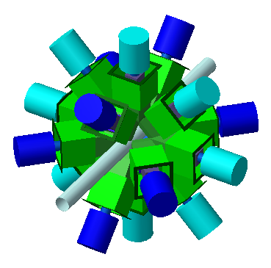
Highlights of the CAGRA CAMPAIGNS at RCNP
NUSTAR Workshop 2019
drhgfdjhngngfmhgmghmghjmghfmf
Michael p carpenter
Physics Division
Argonne National Laboratory
June 25, 2019

Slide 2
OUTLINE of Talk
Who and what is CAGRA
Highlights from 1st campaign
Highlights from 2nd Campaign
Future
Summary

Slide 3
What Does CAGRA stand for?
KCAGRA
Compton Array Gamma-ray spectrometer at RCNP/RIBF for Advanced studies - CAGRA
This name relates to the Japanese word "KAGURA"
which is a form of music and dance dedicated to Shinto gods.

Slide 4
CAGRA project
Create a pool of Compton Suppressed Ge Clover detectors from laboratories in Japan and the U.S. + China which can be assembled at RCNP/RIBF to be utilized in gamma-ray spectroscopy.
Physics experiments at RCNP using EN-beam line and Grand Raiden
At RIBF it has been discussed to use array for both energy degraded (OIEDA) and stopped beams of exotic nuclei (original plan)
Mechanical Infrastructures to be built
Self contained, trigger-less acquisition system using Gretina Digitizers
Liquid Nitrogen filling system
Support structure

Slide 5
DOE Funding
Project funded through FOA at ~$720,000

Slide 6
CAGRA: Brief History
Dec. 2008, workshop at ANL to discuss physics opportunities at RIBF using Clover Array.
Dec. 2008, proposal submitted to DOE to fund infrastructure of Array.
Apr. 2010, notified that proposal is accepted and will receive funding.
Nov. 2010, DOE funding begins.
Dec. 2012, workshop to discuss physics opportunities at RCNP and RIBF held at RCNP - recommendation was to explore siting CAGRA at RCNP first.
December 2013, workshop to discuss physics opportunities at RCNP & RIBF with CAGRA with the emphasis on RCNP
EN beam line - in flight RIB production capability
Grand Raiden beam line to couple CAGRA with the large spectrometer.
April 2014 - proposal submitted to RCNP P-PAC and received recommendation to run a campaign of CAGRA experiments in 2015 and 2016.
Mar – May 2015, 1st campaign of 6 experiments run at EN Beam Line.
Oct – Jan 2017, 2nd campaign run on Grand Raiden Beam line.
Dec 2018, 3rd campaign at EN Beam Line

Slide 7
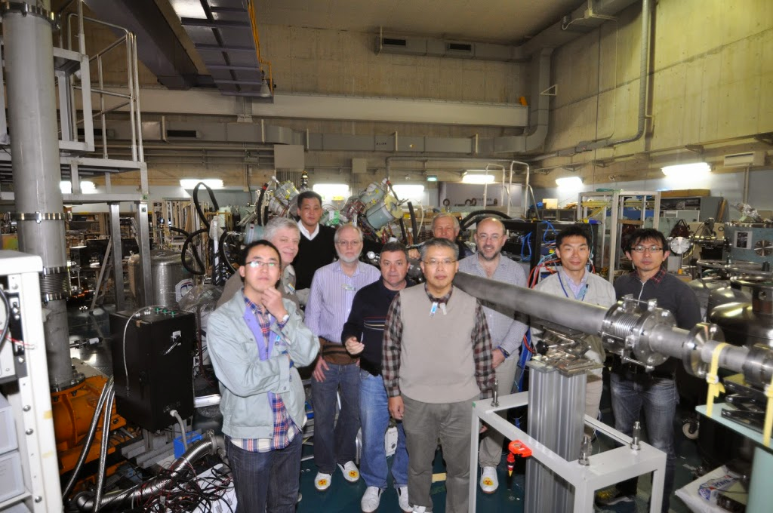
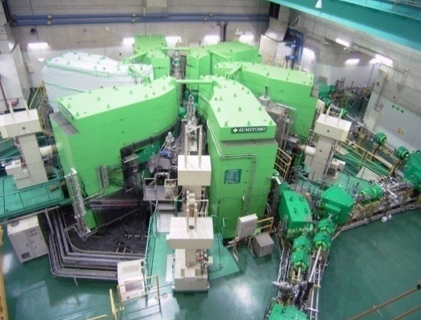
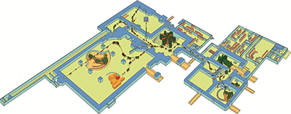
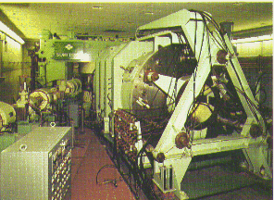
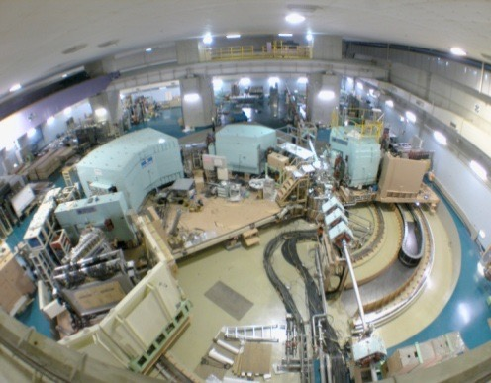
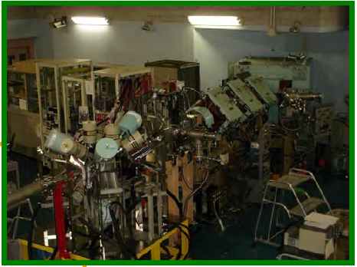
CAGRA: RCNP Campaigns
RCNP
p: 400MeV HI:100MeV/u
Group shot from E436
K140 AVF cyclotron
p ~ Xe
Pol. p & d
Double arm spectrometer
(Grand Raiden & LAS)
EN beam line for RI beam

Slide 8
CAGRA Board
CAGRA board members
CARPENTER Michael (Chair, ANL)
IDEGUCHI Eiji (vice chair, RCNP) ***
KOIKE Takeshi (Tohoku University)
FALLON Paul (LBNL)
WERNER Volker (TU Darmstadt)
AOI Nori (RCNP)
BRACCO Angela (Milano)
GARG Umesh (University of Notre Dame)
von NEUMANN-COSEL Peter (TU Darmstadt)
SAKURAI Hiroyoshi (RIKEN/Tokyo)
SHIMOURA Susumu (CNS)
TAMII Atsushi (RCNP) ***
ZEGERS Remco G. T. (NSCL)
CARROLL, Jeff (Army Research Lab)
Due to the expansion in scope of the Physics program that resulted from the 2013 workshop, it was decided to appoint a board to examine issues when needed.

Slide 9
CAGRA COMPONENTS

Slide 10
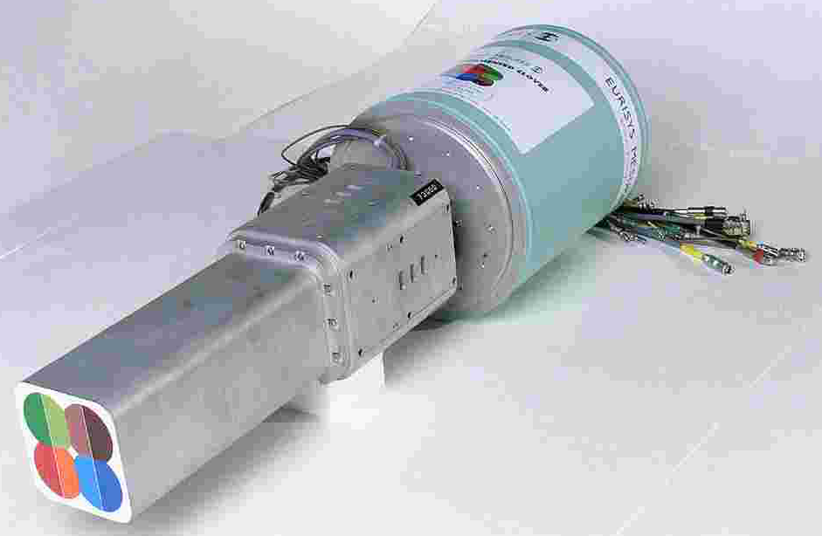
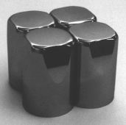
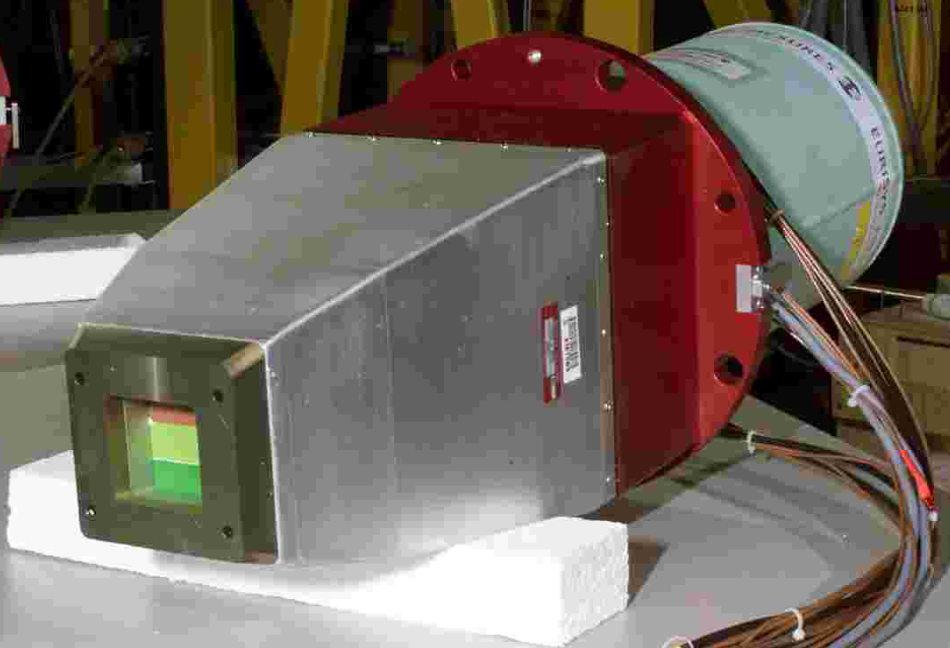
Detector Availiability
6 Clovers + Compton Suppression Shields from Tohuku University. Inventory from Hyper-Nuclei program at JPARC (T. Koike)
10 Clovers + Compton Suppression Shields come from CloverShare in USA.
(M.P. Carpenter, P. Fallon)
2 Clover Detectors from Army Research Laboratory USA - can be used in Compton Suppression Shields (Jeff Carroll)
3 Clover Detectors from IMP China – larger and do not have Compton Shields.
Other collaborators with Clover detectors are welcome!

Slide 11
U.S. Clover Share Collaboration
Steering Committee:
J. Burke (LLNL), M. P. Carpenter (ANL), P. Fallon (LBNL), S. Liddick (MSU, chair)
Steering committee is responsible for prioritizing requests for the Yale Compton-Suprressed Clover detectors based on scientific merit and institutional scheduling constraints.
Experimental Campaigns:
NSCL: Mar–May 2014 (Beta Decay Studies) – 9 Clovers
RCNP: Feb-May 2015 (In-Beam) – 10 Clovers + Shields
Texas A&M: Aug-Oct 2015 (In-Beam) – 7 Clovers + Shields.
Notre Dame: Mar. 2016 – Jun 2016 (In-Beam) - 7 Clovers + Shields
RCNP: Oct-Dec. 2016 – Coupled to Grand Raiden Spectrometer.
Texas A&M: Nov-Dec 2017
RCNP: Dec 2018 (In Beam)
NSCL: Oct 2019 – Mar 2020 (Beta Decay Studies)
TUNL: April 2020 – Sep 2020 (Studies @ HiγS)
…
FRIB: First Day Measurements (Part of Decay Station Project)

Slide 12
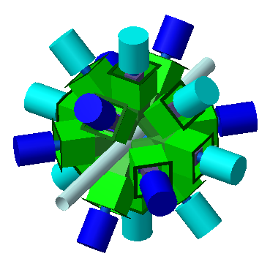
Simulation of CAGRA Efficiency
16 Compton suppressed Clover Ge detectors
4 detectors at 45°
8 detectors at 90°
4 detectors at 135°
Target－Ge：16cm
ε_{ph}(1MeV)〜6%
1770
1405
Beam

Slide 13
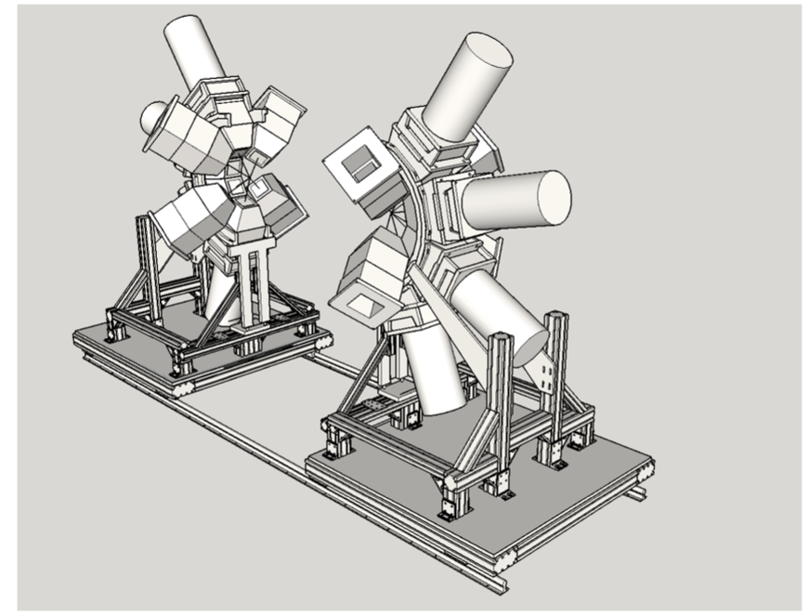
CAGRA Support Structure

Slide 14
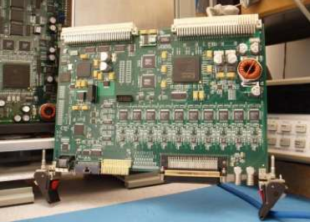
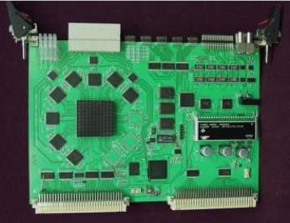
CAGRA DAQ
Digitizer Module (LBNL)
10 Channel
14 Bit, 100 MHz
Energy
Leading Edge Timing
Constant Fraction Timing
Pulse Shape
Trigger Timing and Control Module (ANL)
1 Master, 1 Router/8 Digitizers
Sync All Clocks
Fast Multiplicty Triggers ~ 500ns
Slow triggers ~ 2μsec
Multiplicty
Energy
Firmware developed by John Anderson utilizing hardware developed for GRETINA.
DAQ consists of up to 200 channels (20 digitizers)

Slide 15
1st CAGRA CAMPAIGN

Slide 16
EN Beam Line
RCNP secondary beam line using Heavy Ion Beams
F１
D1
SX1
SX2
Q4
D2
Q2
Q3
Q5
Q1
Q6
F0
Q7
SX3
F3
Q8
Q9
F２
T. Shimoda et al., NIM B70 (1992) 320.
S. Mitsuoka et al., NIM A372 (1996) 489.
Maximum rigidity 3.2 Tm
Energy acceptance ΔE/E = 16 %
Angular acceptance Δθ = 40 mrad
Δφ = 28 mrad
Path length 16.8 m
RI beam with beam energy
from low (~ MeV/u)
to high (~several tens MeV/u )
can be delivered.

Slide 17
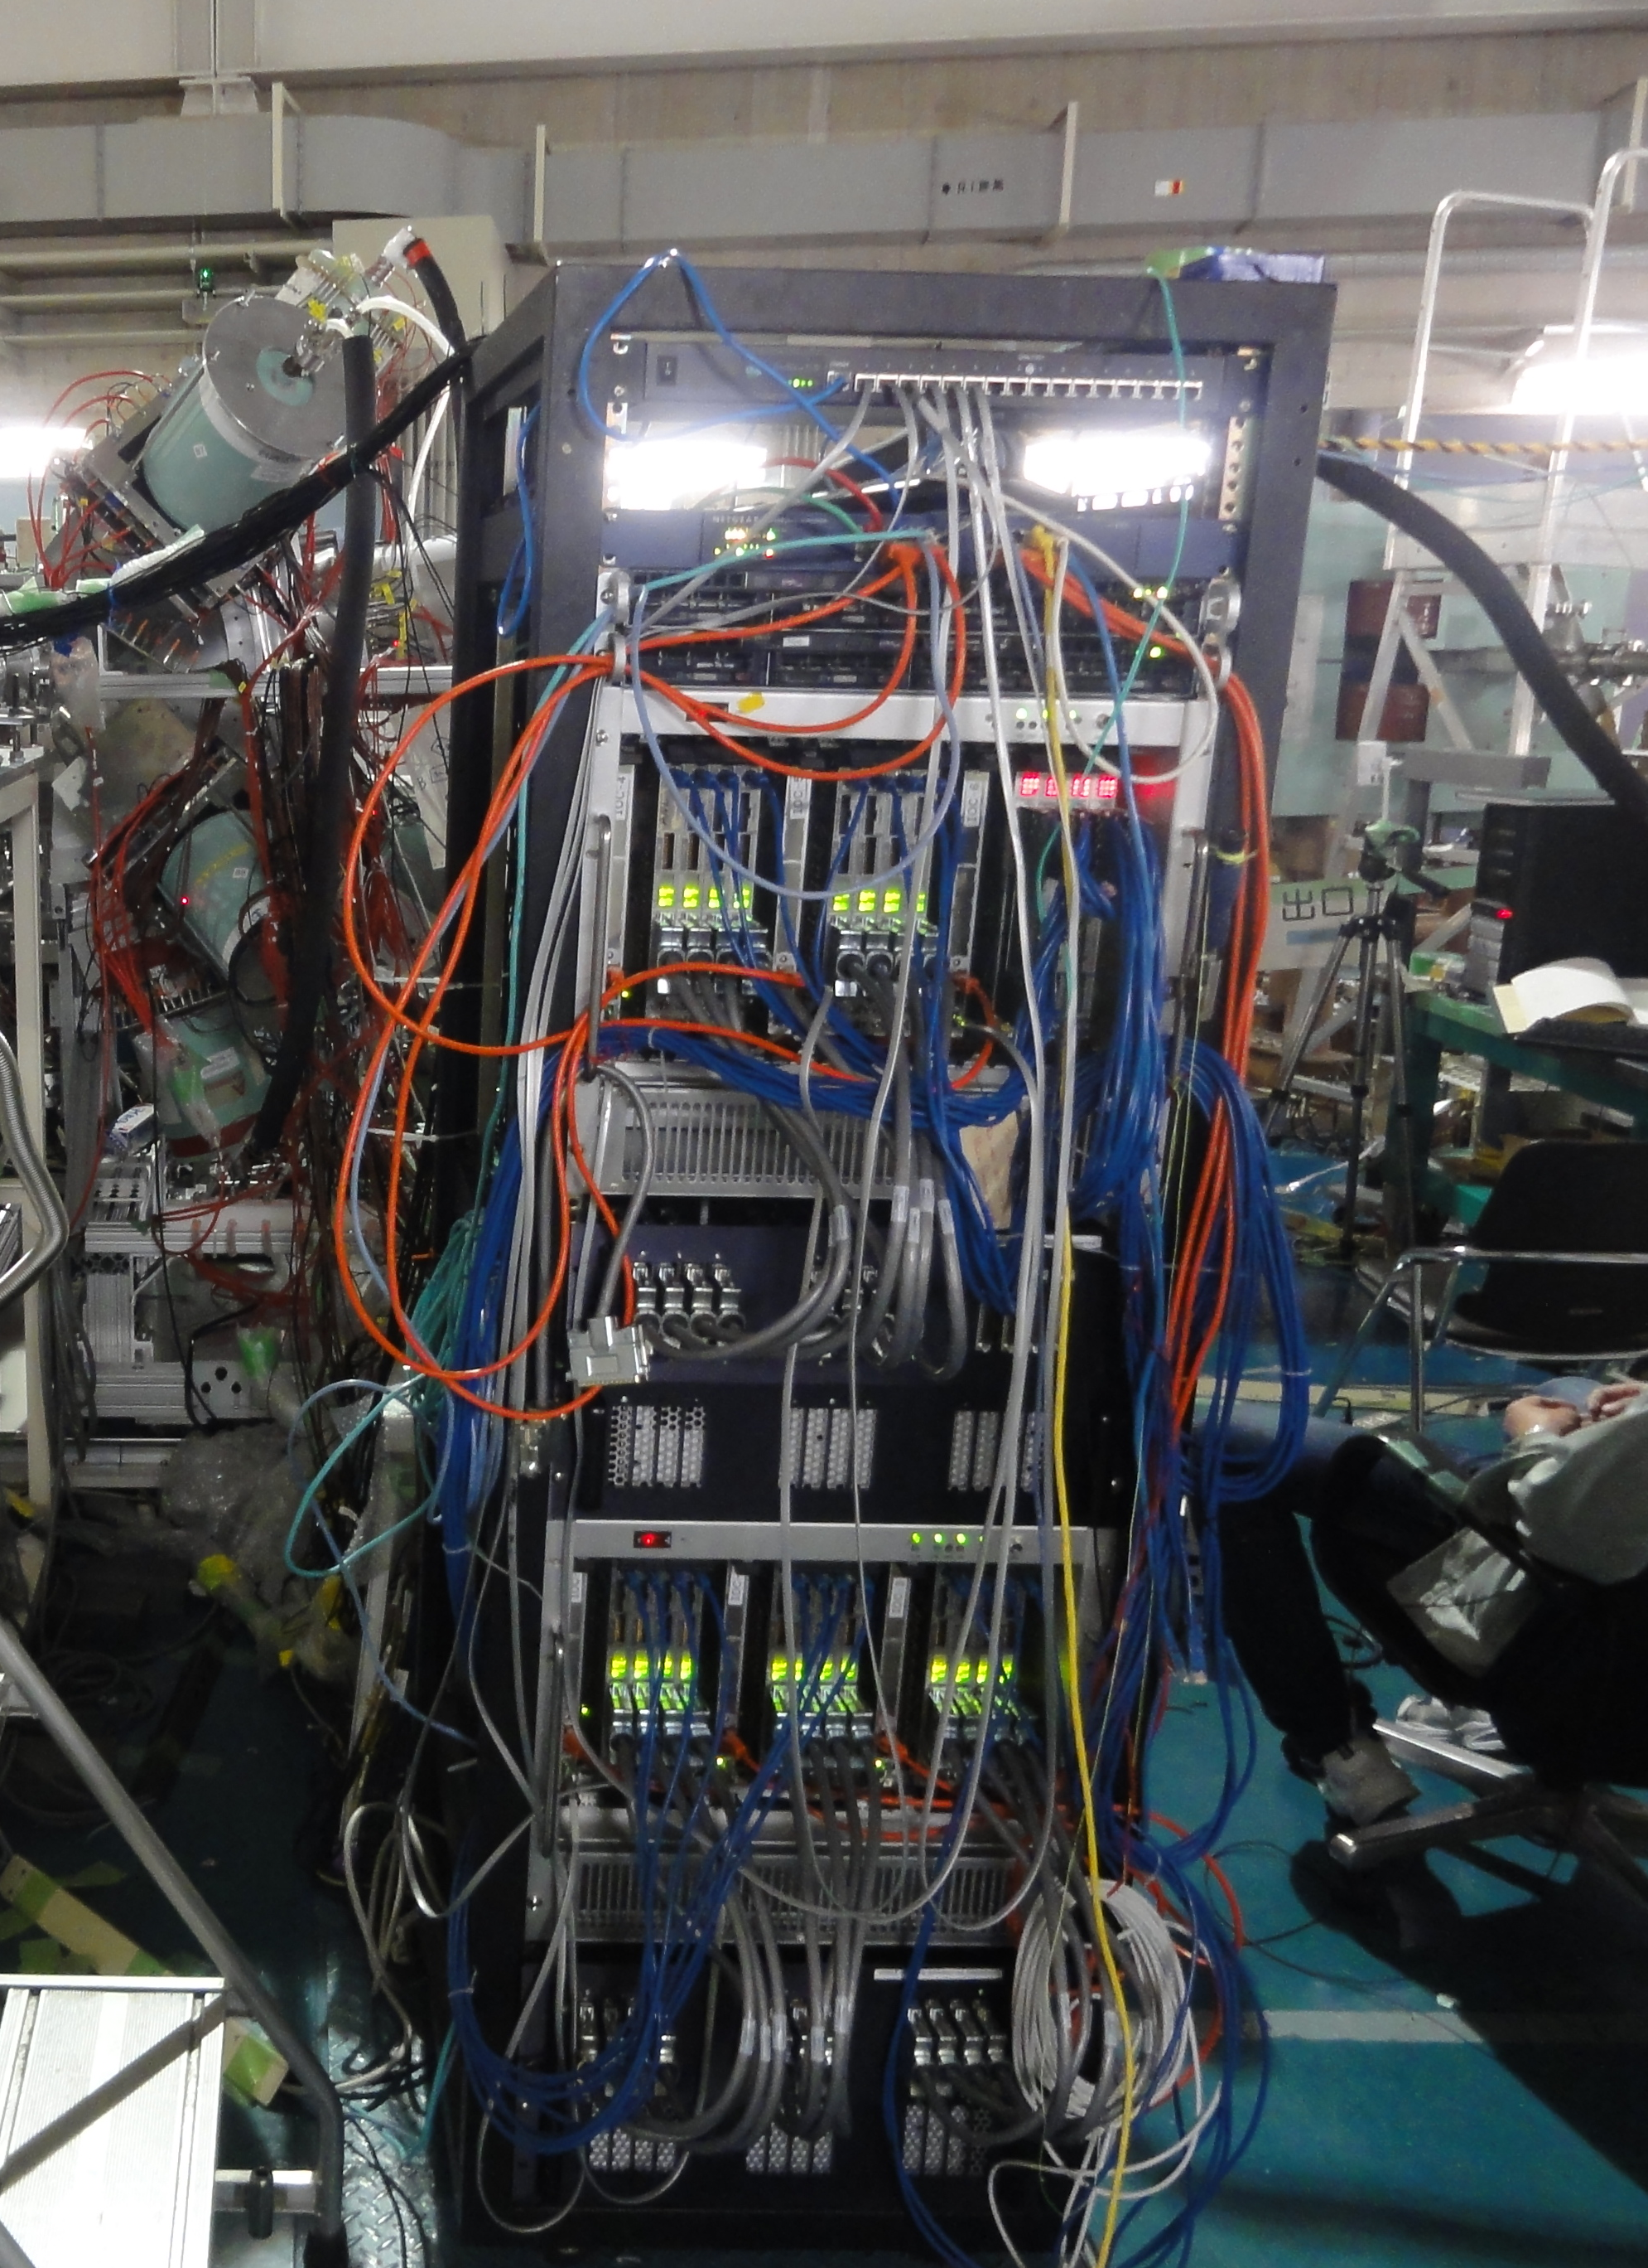
High-rate capability using
fast digital DAQ system
stands for 10 times stronger
beam intensity: 2pnA → 20pnA
CAGRA Array

Slide 18
Experiments of First CAGRA Campaign
Experiments using stable beam
Study of superdeformed structure in ⁴⁴Ti, ⁴⁵Sc (E. Ideguchi, RCNP-Osaka)
Structure of excited states above the long-lived (T_{1/2}〜1.5×10⁵y), K^{π} = 8⁺ isomer in ¹⁸⁶Re (F.G. Kondev, ANL)
Experiments using unstable beam
Probing High-Spin States in ^{61,62}Fe Using the ⁴⁸Ca(¹⁷N,pxn) Reaction (M.P. Carpenter, ANL)
Study of High-Spin States by RI Beam Induced Fusion Reaction (A. Odahara, Osaka)
Study of shell evolution at N=20 in neutron-rich region through nucleon transfer reaction (T. Yamamoto, RCNP-Osaka)
Spectroscopy of ¹⁵B: A search for unexpected bound states (C.R. Hoffman, ANL)

Slide 19
In-beam γ-ray spectroscopy of the odd-odd nucleus ¹⁸⁶Re
D. A. Matters et al., Phys. Rev. C 96, 014318 (2017)

Slide 20
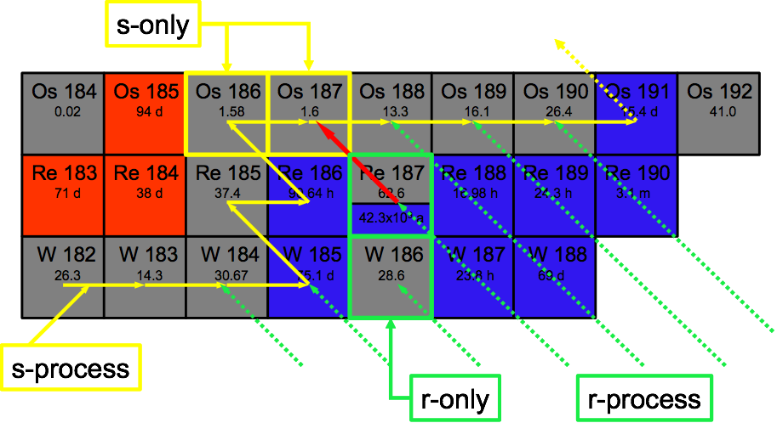
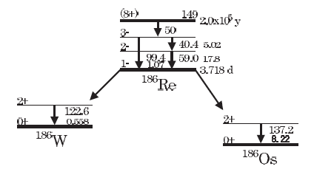
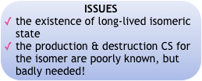
Motivation
D.D. Clayton, Ap.J. 139 (1964) 637.
What is needed – detailed knowledge of the ¹⁸⁶Re levels above the isomer!
T. Hayakawa et al., Ap.J. 628 (2005) 533.

Slide 21
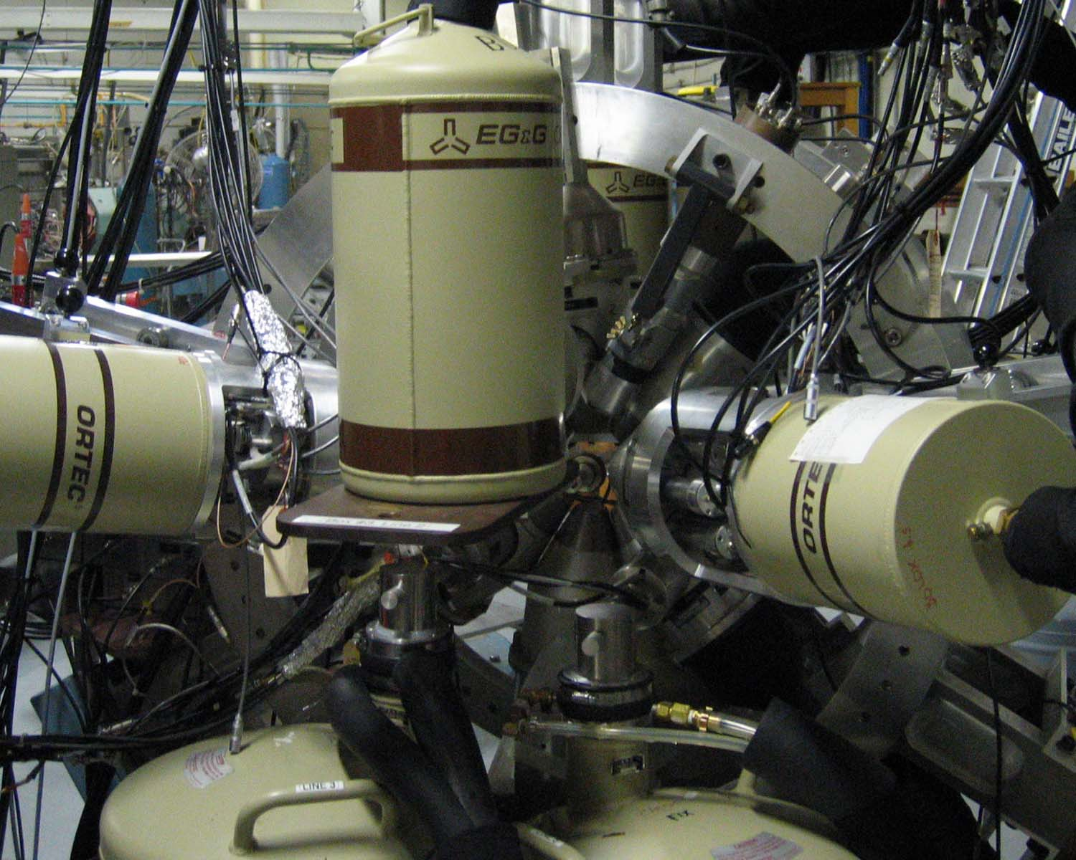
Two different experiments using ¹⁸⁶W(d,2n)

Slide 22
New structures above the isomer
gate

Slide 23
Configuration assignments
^{π 5/2+ [402] ⊗ ν 3/2− [512]}
^{π5/2+[402] ⊗ ν11/2+[615]}
^{π 9/2− [514] ⊗}
^{ν 1/2− [510]}

Slide 24
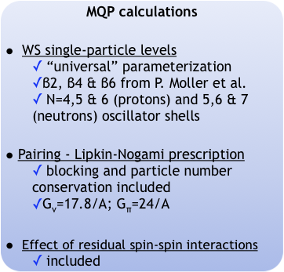
Deformed shell model predictions

Slide 25
2nd CAGRA CAMPAIGN
coupled to Grand Raiden

Slide 26
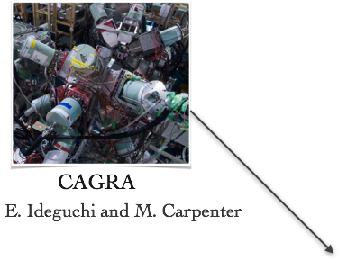
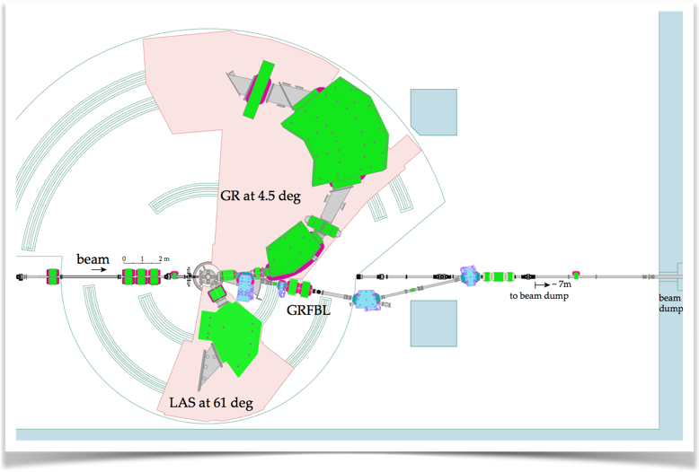
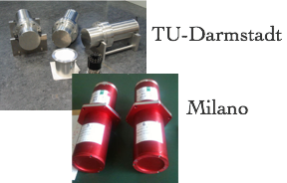
CAGRA-Grand Raiden Campaign at RCNP (A.Tamii)
Purpose: To perform high-resolution coincident measurements between reacting light-ions (Grand Raiden) and de-excitation γ-rays (CAGRA).
RCNP, Tohoku, ANL, LBNL, Milano, TU-Darmstadt, GSI, Köln, KVI, IFJ-PAN, IMP, York, ARL, NSCL …

Slide 27
2ND CAGRA CAMPAIGN Oct-Dec 2016
E441: The (⁶Li,⁶Li’[3:56MeV]) reaction as a novel probe for studying the inelastic neutrino-nucleus response in astrophysical scenarios
5.0 days
(⁶Li, ⁶Li*) on ¹²C etc
E450: Study of the Structure of the Pygmy Dipole Resonance States via the the (p,p’γ) and (α,α’γ) Reactions
25.0 days
E454: Study of the Structure of the Pygmy Dipole Resonance States in ⁶⁴Ni via the (p,p’γ) and (α,α’γ) Reactions
6.0 days
(α,α’γ) and (p,p’γ) on ⁶⁴Ni, ^{90,94}Zr, ^{120,124}Sn, ^{206,208}Pb
E470: Search for superdeformed states in ²⁸Si via γ-particle coincidence measurements
6.0 days
(α,α’γ) on ²⁸Si
3.0 days
E471: Study of high-spin state population by light-ion reactions
(⁶Li, ⁶Li) on ⁴⁰Ca
In total 45 days of beam time
ALSO E455: Search for Evidence of Triaxality in A~190 Region

Slide 28
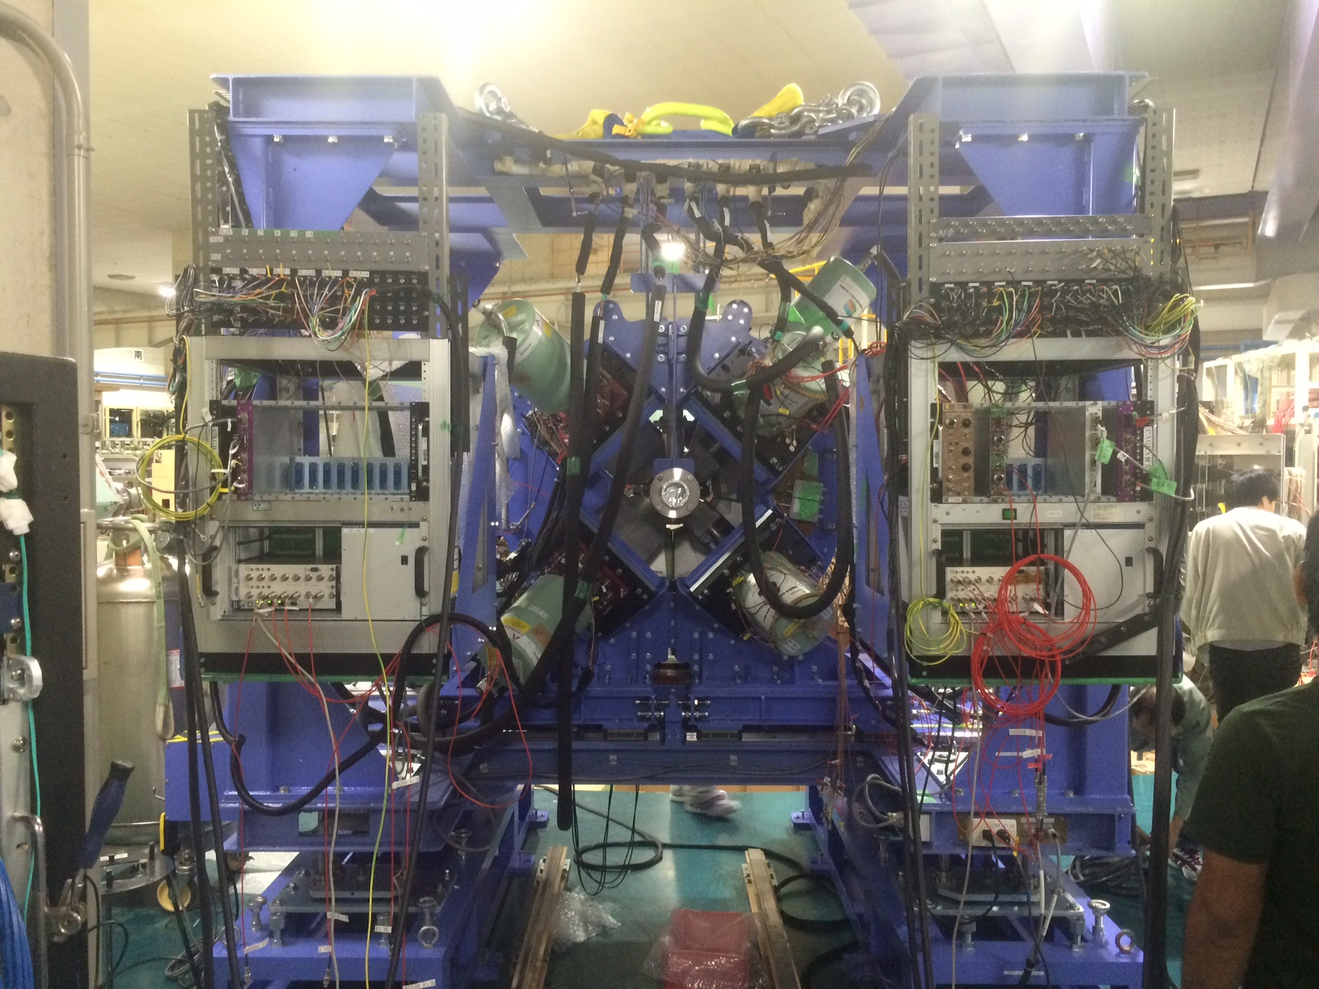
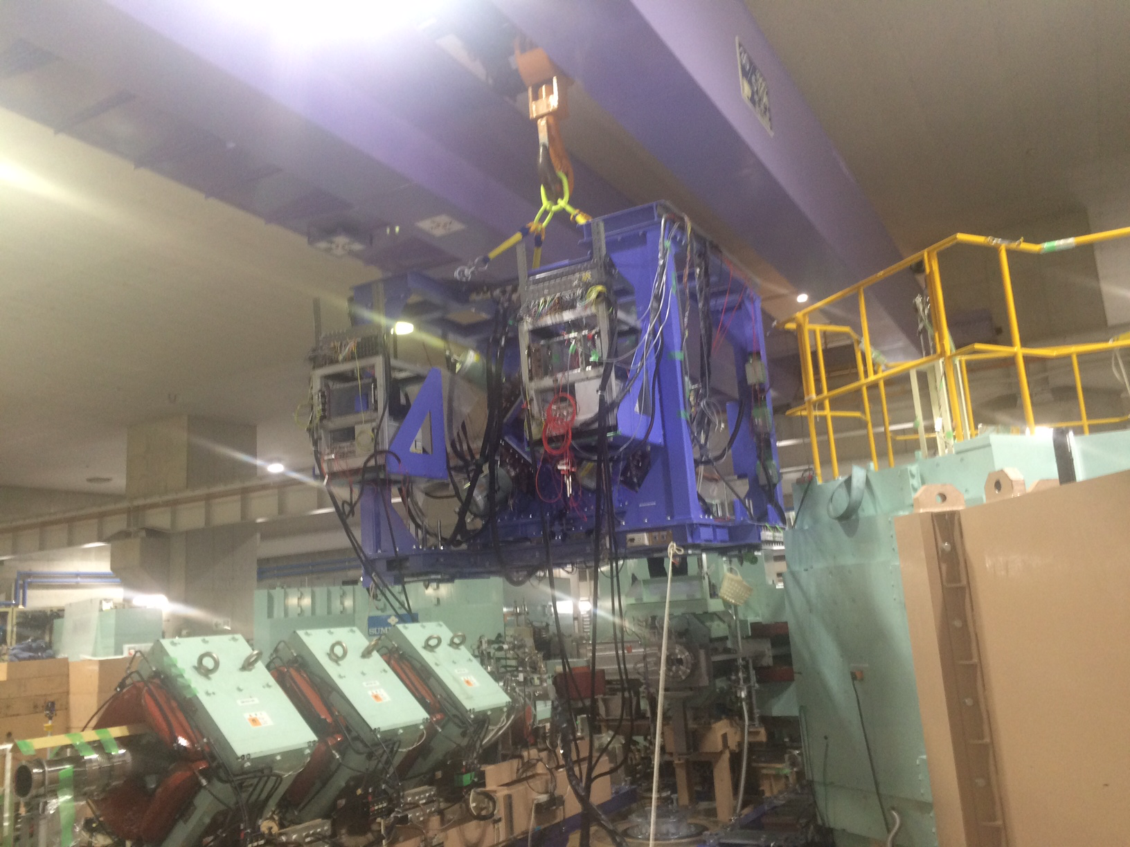
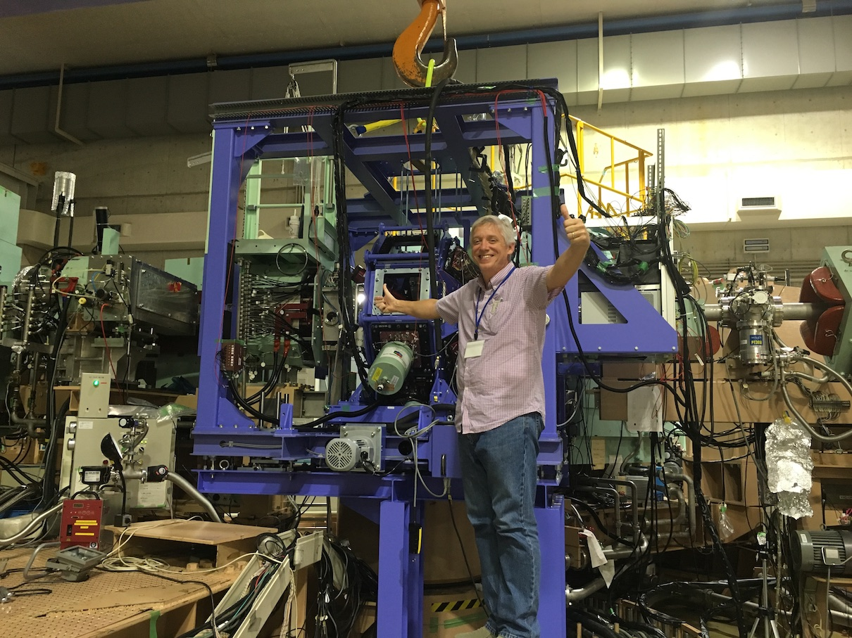
CAGRA at Grand Raiden
Due to harsh conditions at target position during beam tuning, Ge detectors must not be present.
This is accomplished by moving entire frame.
Worked flawlessly!
CAGRA Array consisted of 12 Clovers from Clover Share, ARL, IMP, Tohuko, and 4 LaBr from Milano

Slide 29
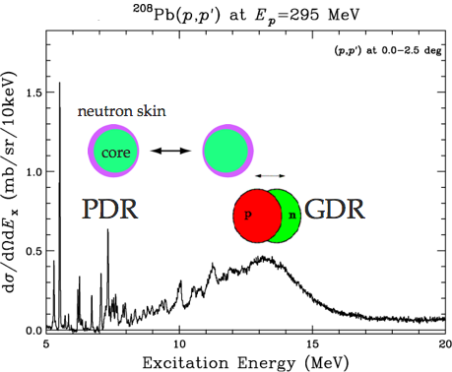
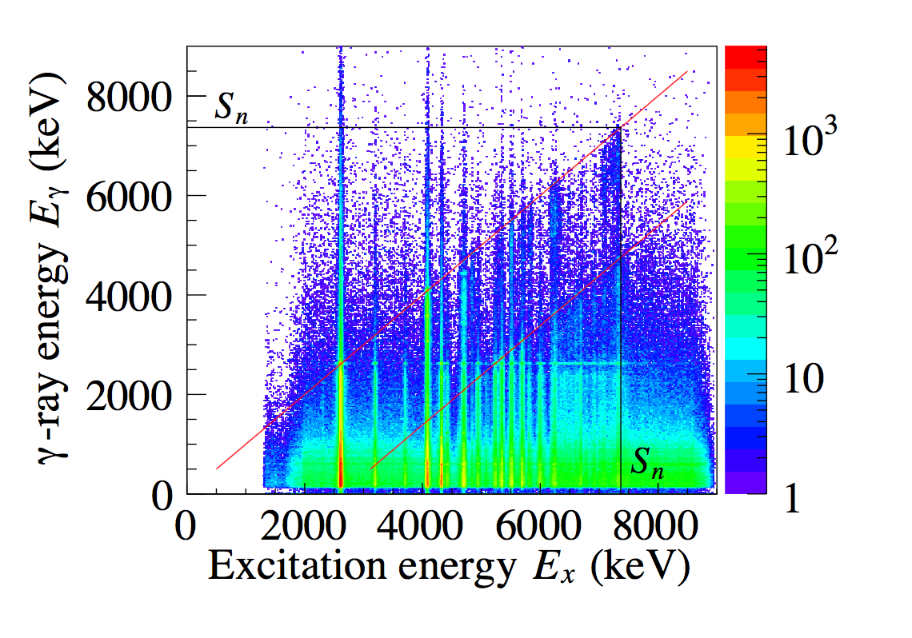
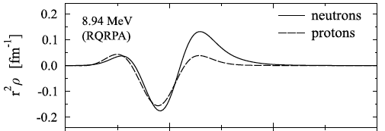
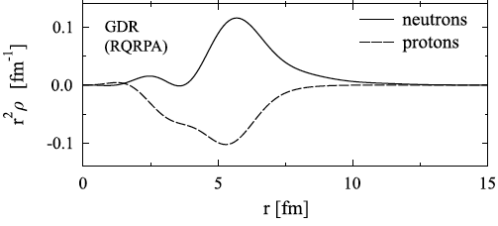
Study of PDR by (p, p’γ) and (α,α’γ)
Total of 36 days for all measurements
PDR structure transition density, isospin-structure, angular dependence
PDR
GDR
A. Bracco, F. Crespi, V. Derya, M.N. Harakeh, T. Hashimoto, C. Iwamoto, A. Maj, P. von Neumann-Cosel, N. Pietralla, D. Savran, A. Tamii, V. Werner, and A. Zilges et al.

Slide 30
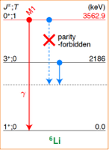
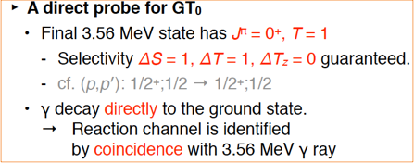
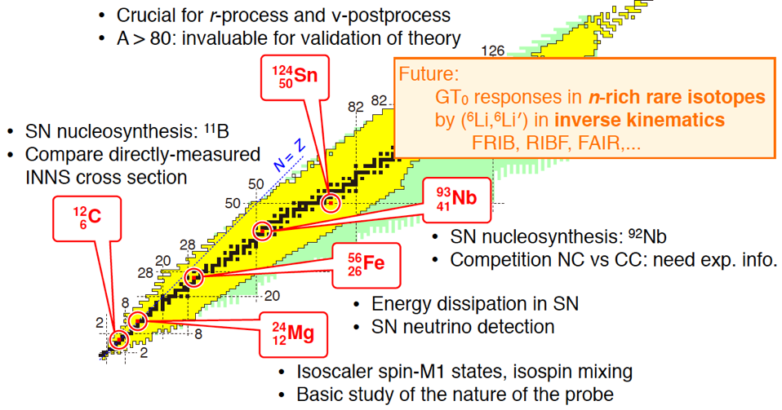
(⁶Li, ⁶Li’+γ): a probe of GT strengths in the inelastic channel
C. Sullivan et al., Phys. Rev. C 98, 15804 (2018)

Slide 31
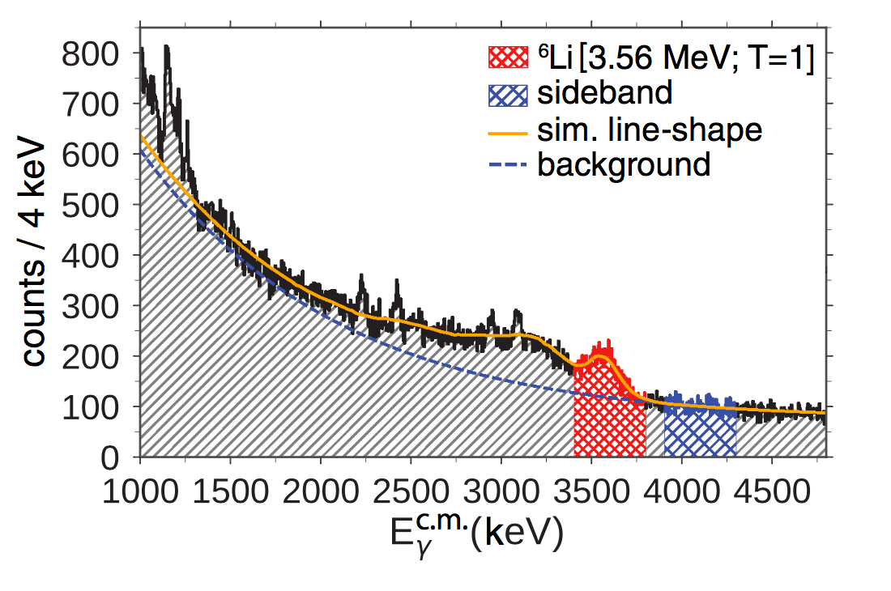
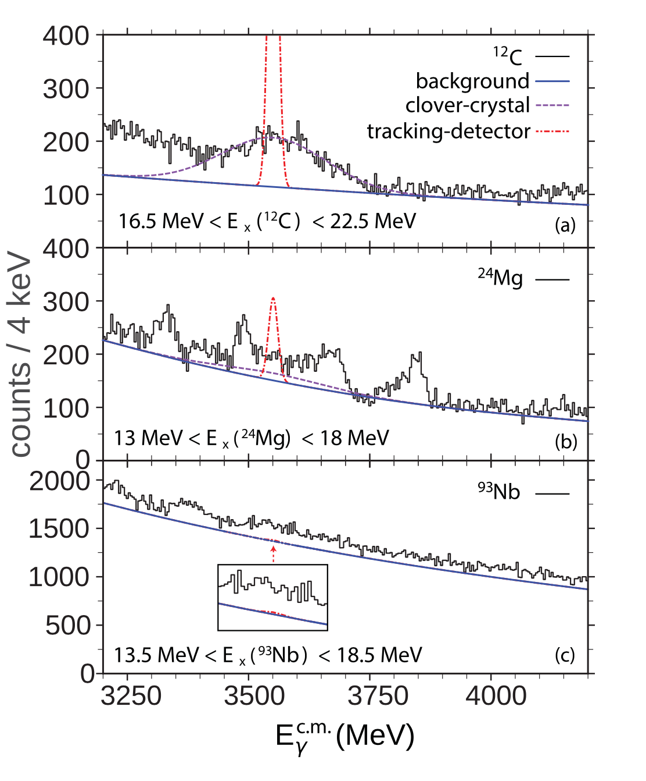
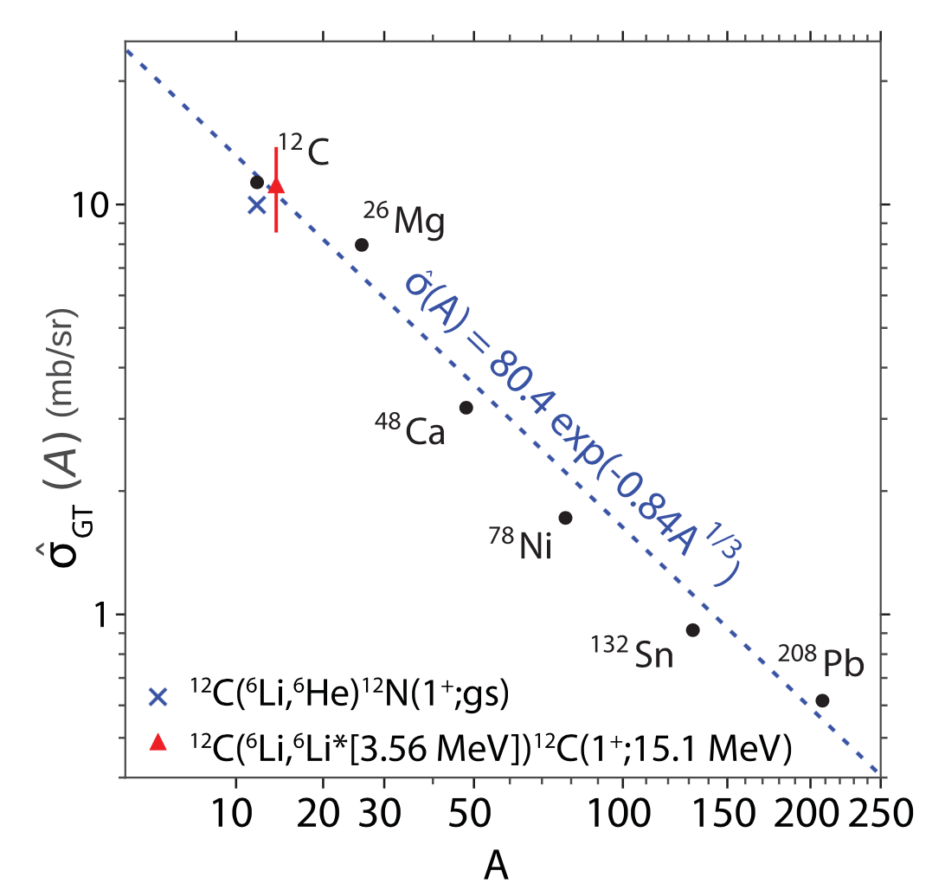
SUMMARY OF RESULTS
Comparison of all 3 targets
¹²C
Extracted GT cross section
Possible to measure cross-section with this method using tracking array up A~25.
C. Sullivan et al., Phys. Rev. C 98, 15804 (2018)

Slide 32
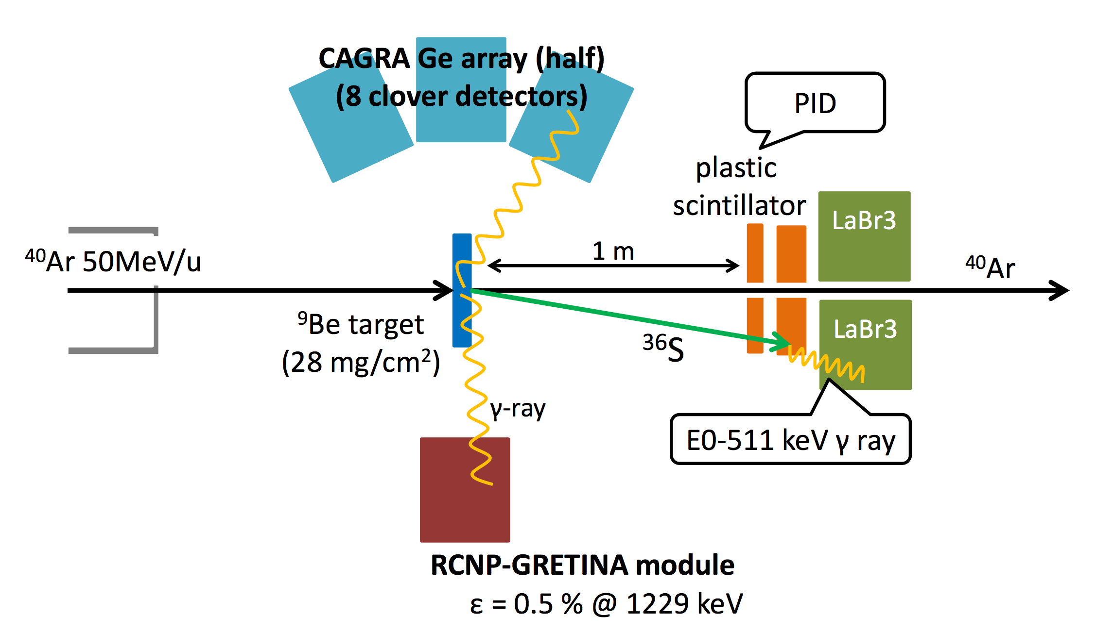
Search for low lying deformed states in ³⁶S (N=20)
Experiment is scheduled for Dec. 2018 – thesis: Y. Yamamoto
Also E506 on EN Beamline: PI – K. Mukhi

Slide 33
Future CAGRA CAMPAIGNs

Slide 34
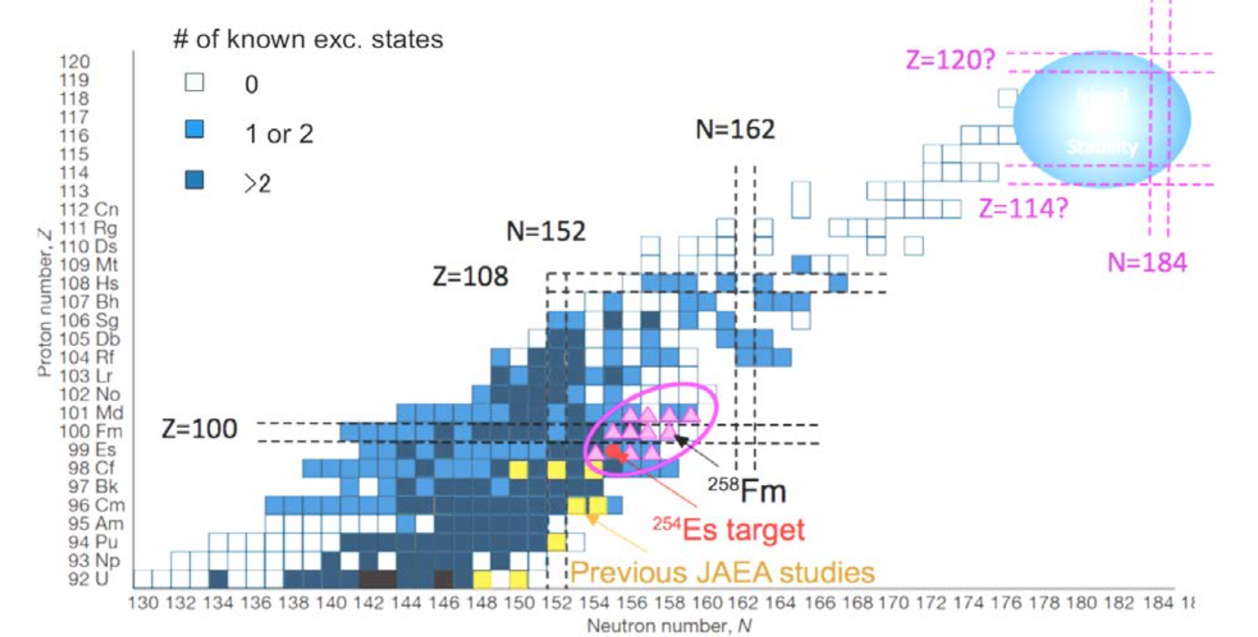
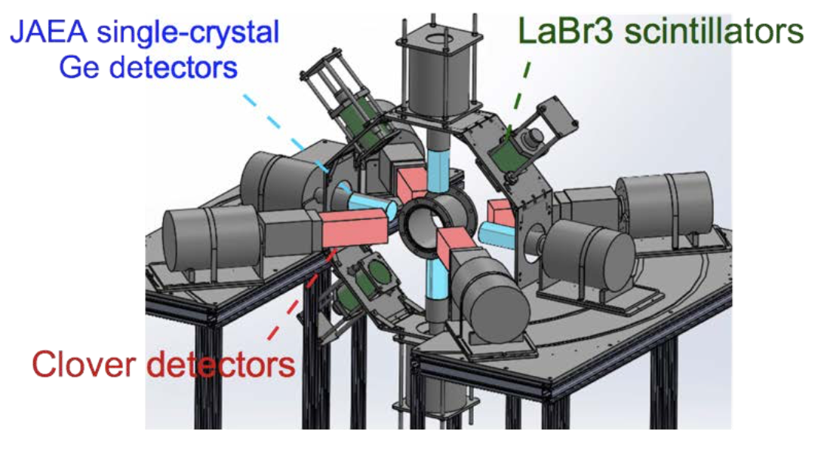
Near Future: Probing Excited States in vicinity of ²⁵⁴Es
Measurements to be performed at JAEA-Tokai Tandem Accelerator facility using a ²⁵⁴Es (ORNL) target.
²⁵⁴Es Coulomb Excitation – DB:9
¹⁸O + ²⁵⁴Es transfer to study excited states in neighboring systems. DB:8

Slide 35
FINAL THOUGHTS
Thanks to DOE-NP for supporting the Project through the FOA
Three campaigns have a run and thus we can say the goals of the project have been met.
Large number of people have worked on this project but in particular, I want to thank - E. Ideguchi, A. Tamii, N. Aoi, A. Odahara, S. Noji, N. Kobyashi, Y. Fang, K. Mukhi, J. Isaak, C. Sullivan and S. Zhu
CAGRA DAQ will be used in the high-resolution array discussed by K. Wimmer in her presentation yesterday.

Slide 36
Thanks for you attention

