Slide 1



Gamma-ray spectroscopy
at a neutron beam :
the latest news from ILL
Caterina Michelagnoli
Institut Laue-Langevin

Slide 2
Outline
Introduction: Nuclear Physics using slow neutrons
The FIPPS (FIPPS+IFIN-HH) instrument
The (n,γ) experiments:
          Overview
          Nuclear deformation, shape coexistence phenomena
New setup for n-induced fission experiments
"Homeworks": possible experiments, collaborations

Slide 3
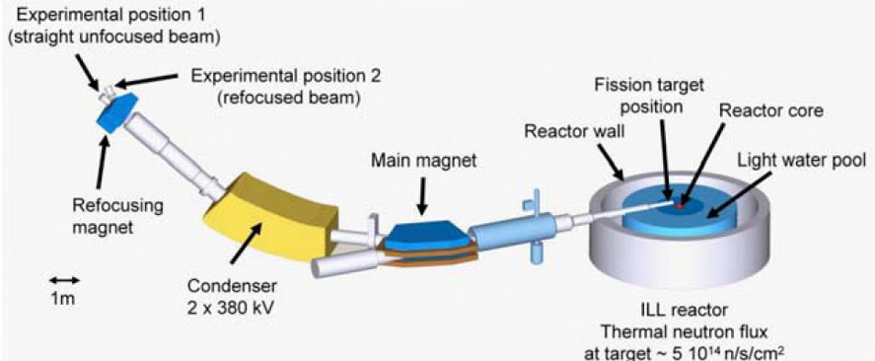
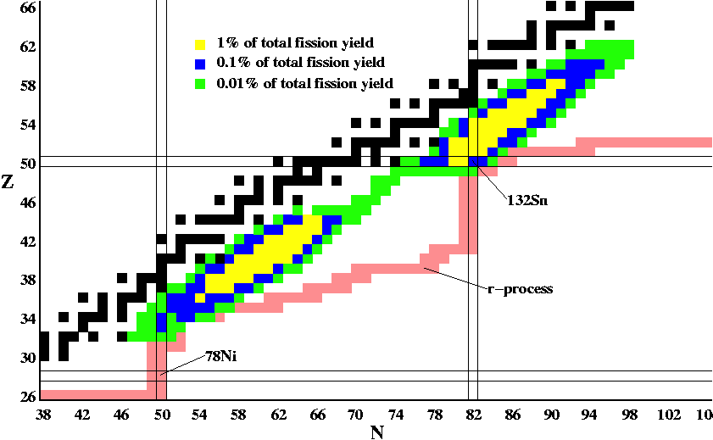
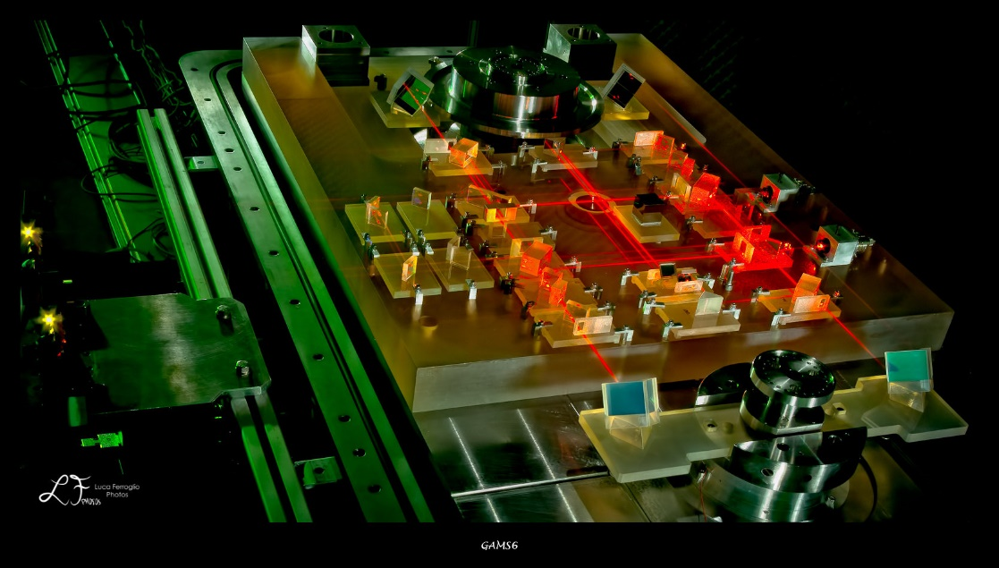
Slow neutron induced reactions
n-induced fission on actinides
structure of n-rich nuclei
(far from stability)
fission yields and dynamics
The Lohengrin fission fragment separator
(n,γ) on stable (rare)/radioactive targets
➔ close to stability
structure at low spin
(below n-separation energy)
➔ cross-sections (applications)
The GAMS spectrometer

Slide 4
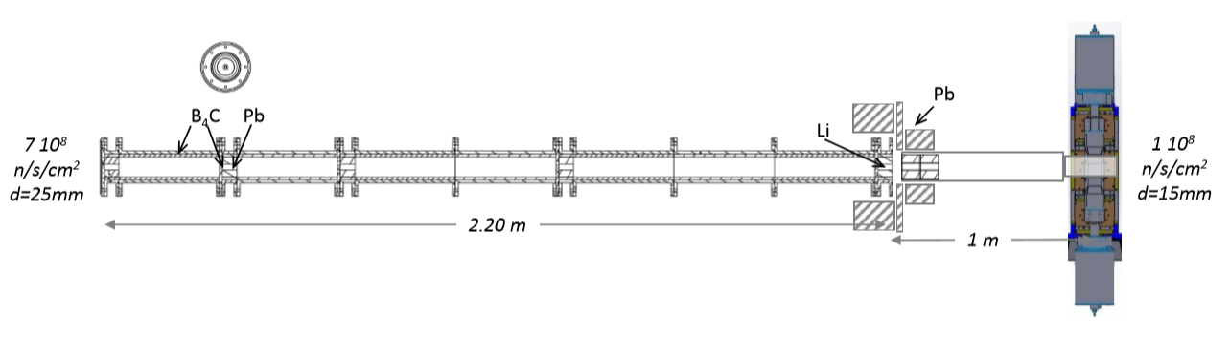
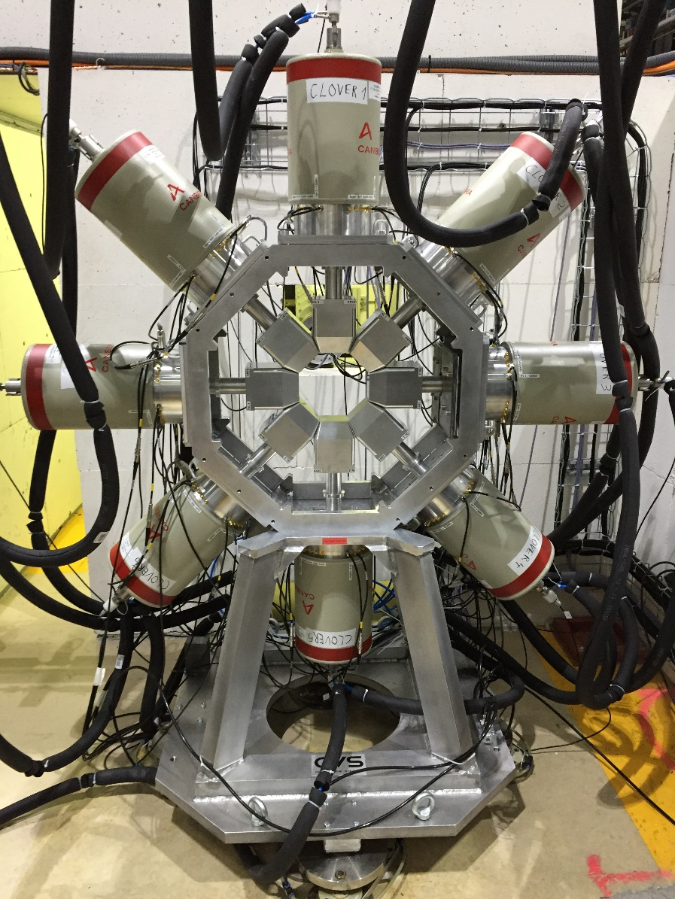

FIssion Product Prompt γ-ray Spectrometer (FIPPS)
–since end 2016
"pencil-like" neutron beam + HPGe array
From the experience of EXILL (campaign, 2012-13 –M. Jentschel et al. JINST 12 (2017) P11003)
thermal neutron beam: 10⁸ n/s/cm² , d=15mm
High resolution HPGe clovers (2keV @ 1.4 MeV)
symmetry around target position
ancillary detectors (LaBr₃, Si, …)
digital electronics, list-mode (~10kHz/crystal, triggerless)
tight casemate for handling of radioactive targets
C. Michelagnoli et al., EPJ 193 (2018) 04009

Slide 5

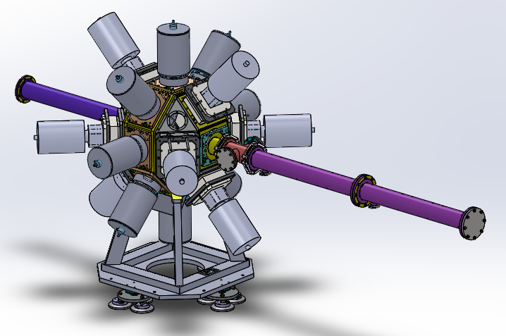
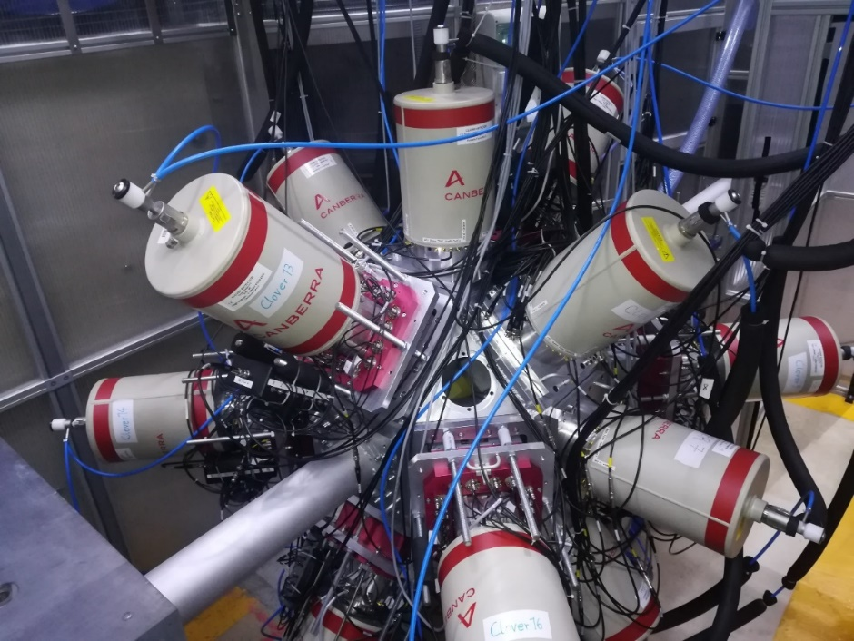

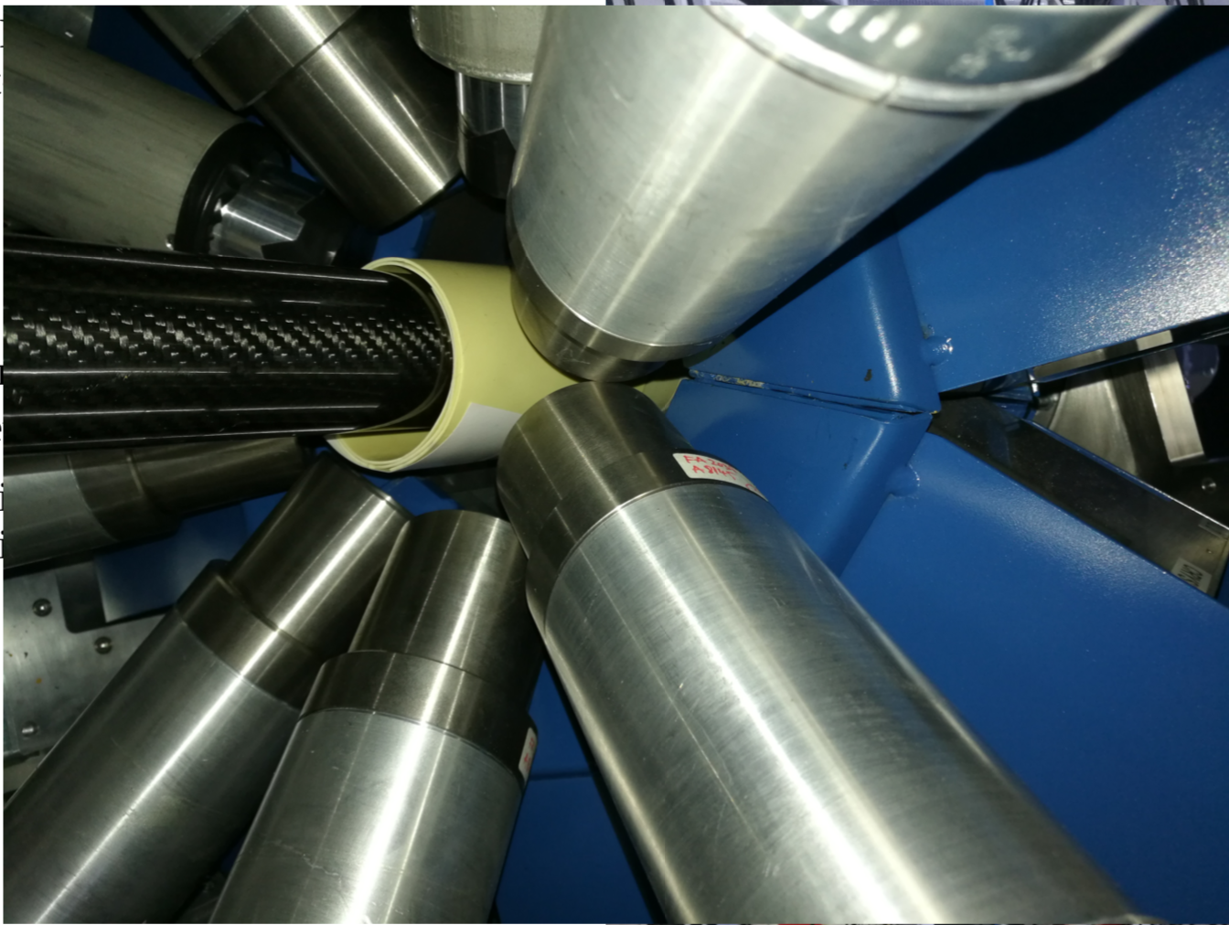
High sensitivity γ-ray setup @ n beam
n beam
May – November 2018
March-April 2018
FIPPS (8 clovers)
+ LaBr₃ fast timing detectors
(IFIN-HH, IKP Cologne)
picosecond lifetime
measurements
FIPPS (8 clovers)
+ 8 IFIN-HH clovers+antiCompton
3.4x higher efficiency
in γ−γ−γ spectroscopy

Slide 6
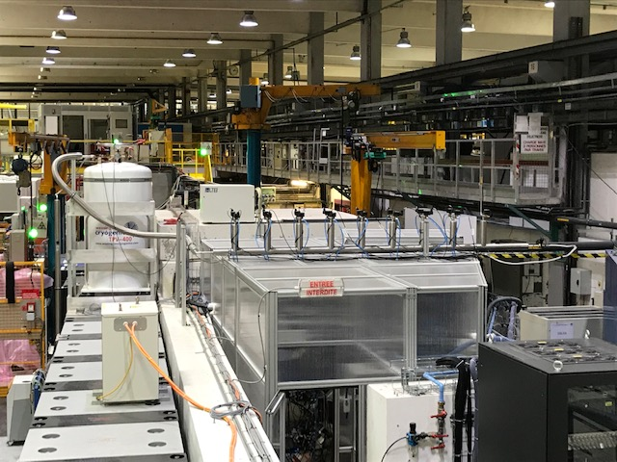
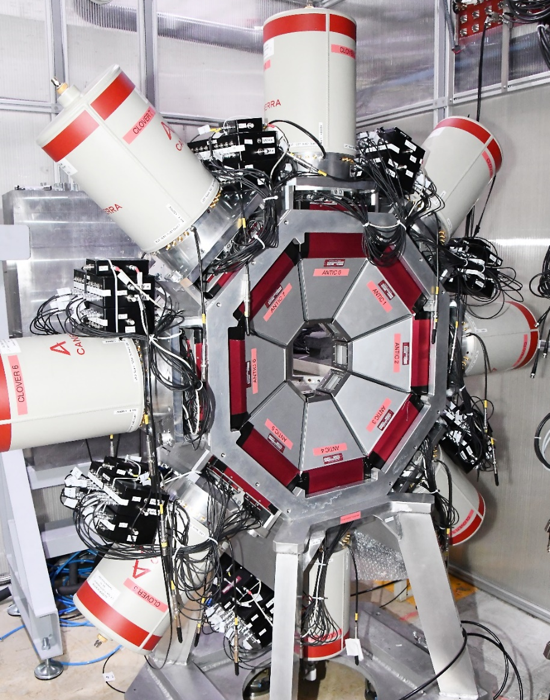
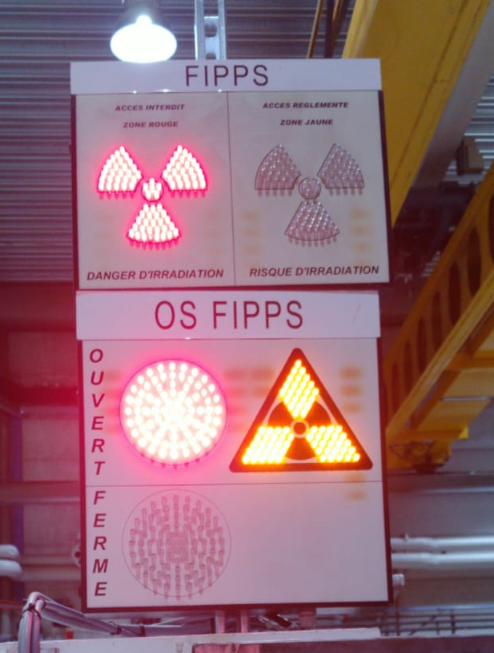
FIPPS today
8 FIPPS ACs in addition
to the FIPPS+IFIN-HH setup
Segmented
veto detectors (Scionix).
~30% improvement in P/T observed
(M. Barani, ILL internship)
tight polycarbonate casemate to handle radioactive (actinide) targets
running n+²³³U at the moment !

Slide 7

There’s not a nuclear model that explains everything!
Need to collect good data to benchmark different regions of the nuclear chart

Slide 8
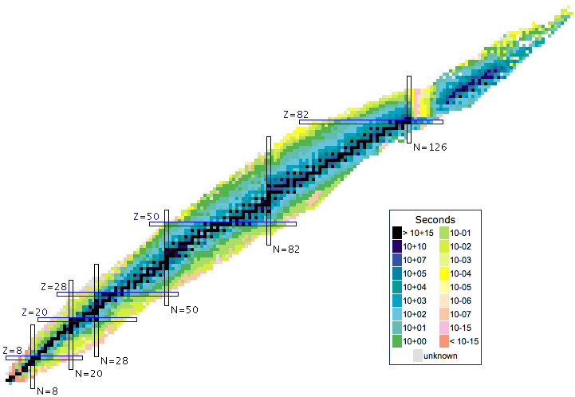
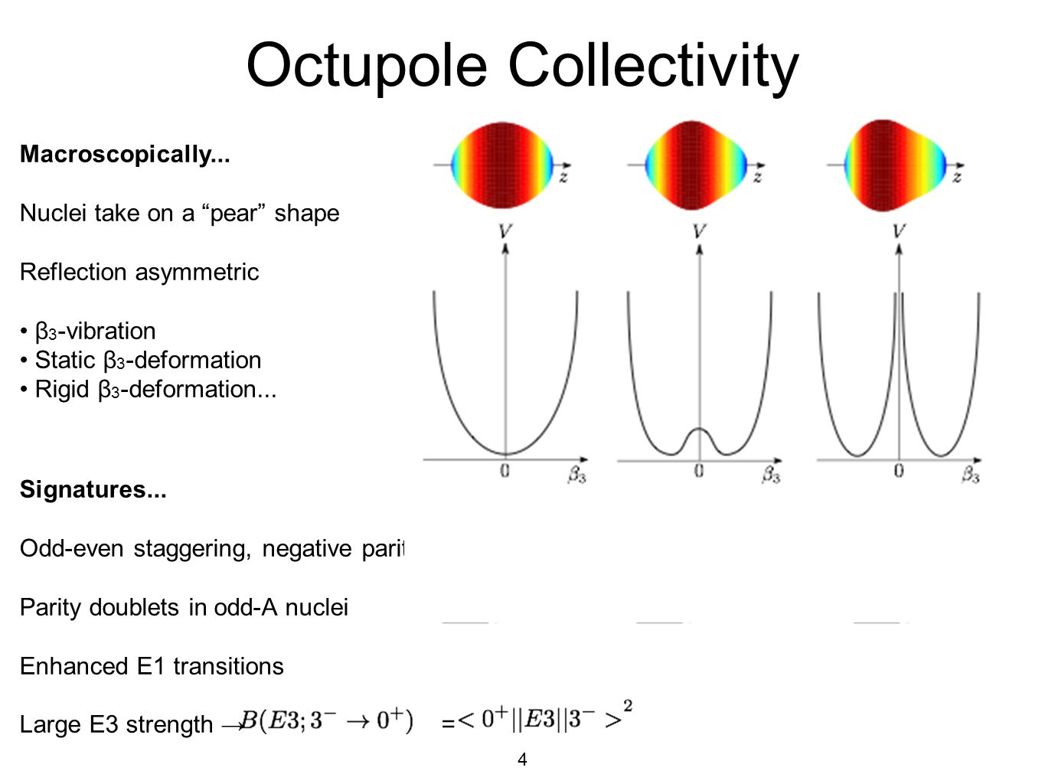
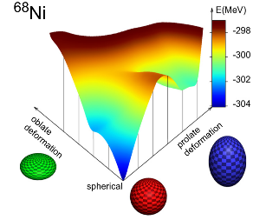
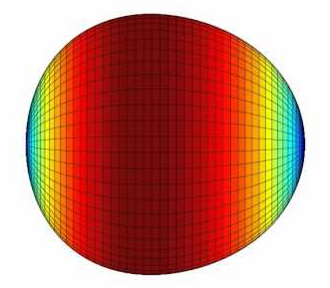

(n,γ) on stable (rare) and radioactive targets
¹⁷⁵Lu
IKP Cologne
IKP Cologne
¹⁶⁷Er
¹⁷⁶Lu
CEA B. le Chatel
ILL
¹⁶⁰Gd
²⁰⁵Tl
^{205,206}Pb
Milan, Krakow
Milan, IFIN-HH
^{61,63,64}Ni
¹⁴⁹Sm
IFIN-HH
¹⁴⁶Nd
Manchester
¹⁴⁵Nd
TU-Darmstadt
¹³C
# protons
^{115,117,119}Sn
^{96,97,98}Mo
Warsaw
CSNSM, Univ. Guelph
⁹⁹Ru, ^{123,125}Te
^{41,44}Ca
Milan
¹¹¹Cd
# neutrons
lifetime measurement technique (gas target)
Milan, ILL

Slide 9
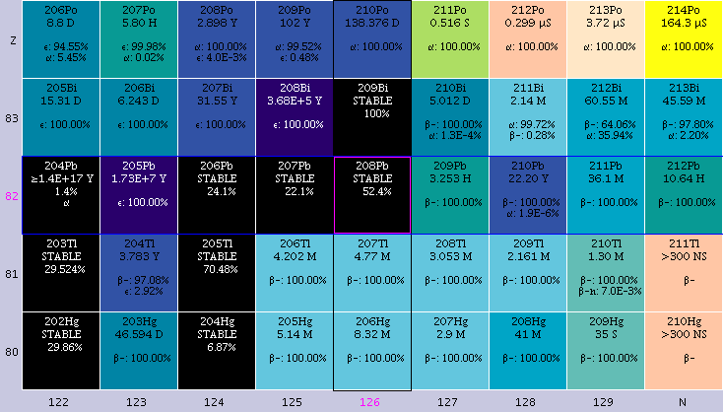
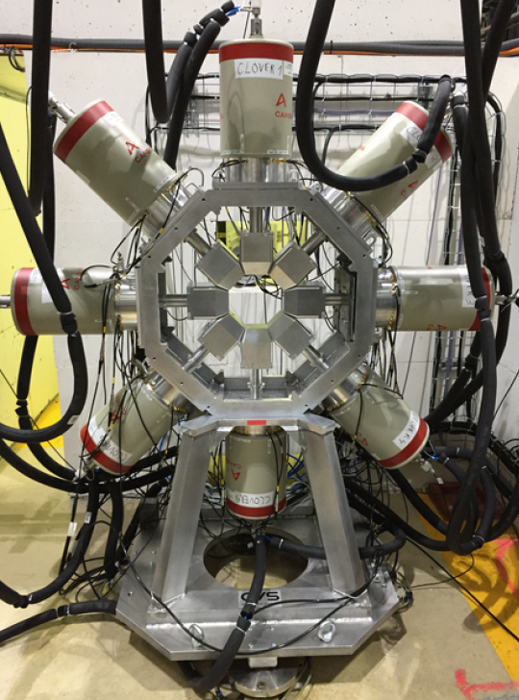
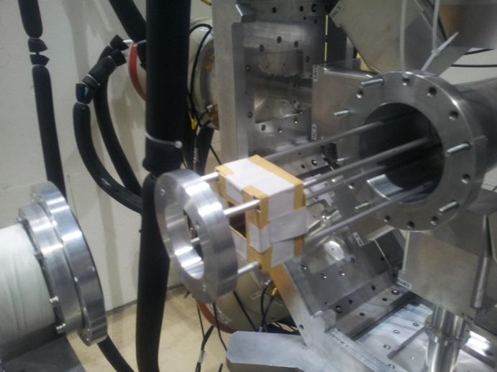
Nuclear structure around ²⁰⁸Pb
²⁰⁸Pb
²⁰⁵Tl(n,g)²⁰⁶Tl reactions
neutron flux 10⁸n/(s ⋅ cm²)
1.9-g target of ²⁰⁵Tl (99.9% enriched)
221 hours of measurements
²⁰⁶Tl
Capture state
at neutron binding energy
1/2+
0
(0+,1+)
6.5 MeV
²⁰⁵Tl
We expect to populate
the states with spins values
from 0 to 3
0–
0
8 HPGe clovers of FIPPS array (32 crystals) – coincidence measurements of gamma rays
N. Cieplicka et al.
²⁰⁶Tl

Slide 10
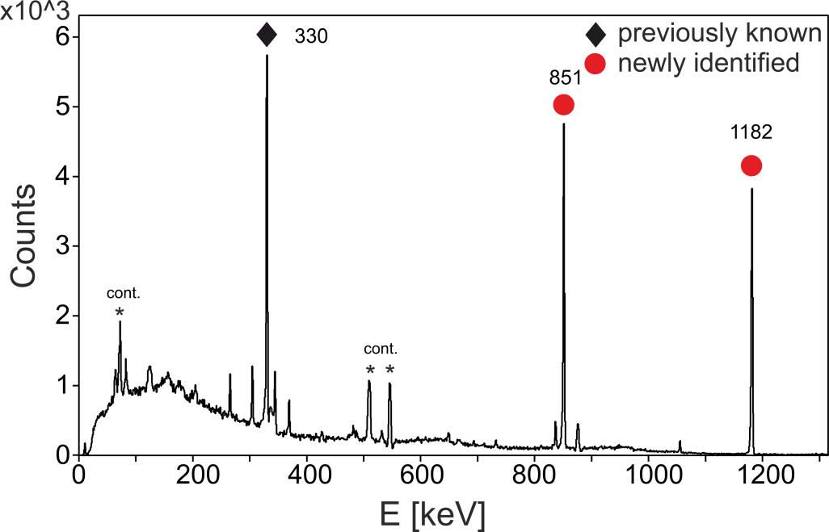
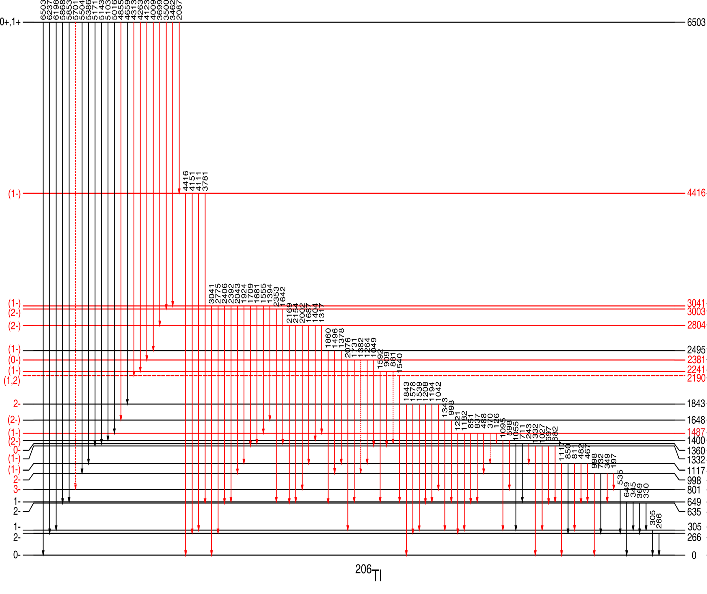
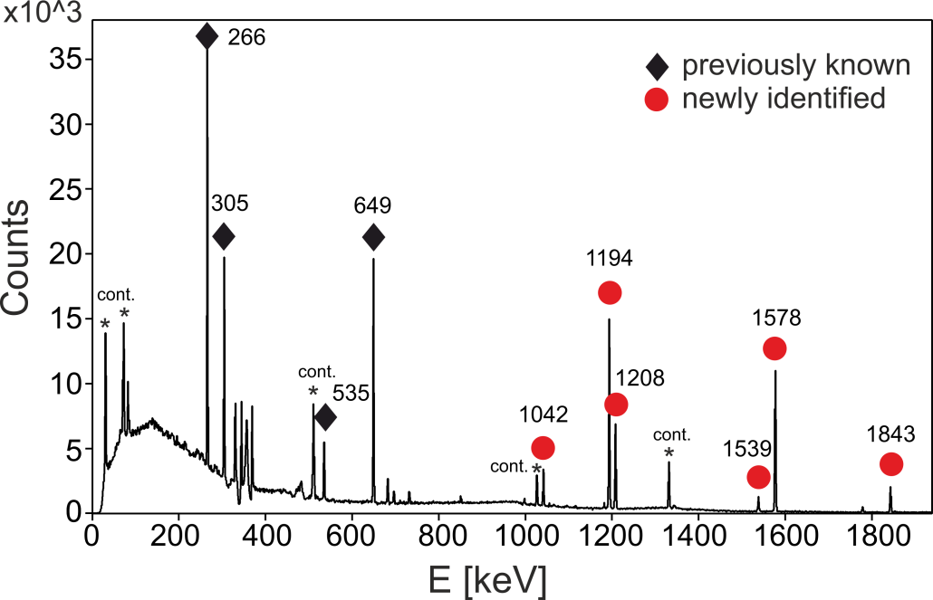
γ-coincidence analysis
γγγ coincidences: gate 5016-305 keV
330
851
22 primary transitions (10 new)
1182
5016
21 excited states (8 new)
γγ coincidences: gate 4659 keV
1487
1182
851
330
635
305
²⁰⁶Tl
N. Cieplicka et al.

Slide 11
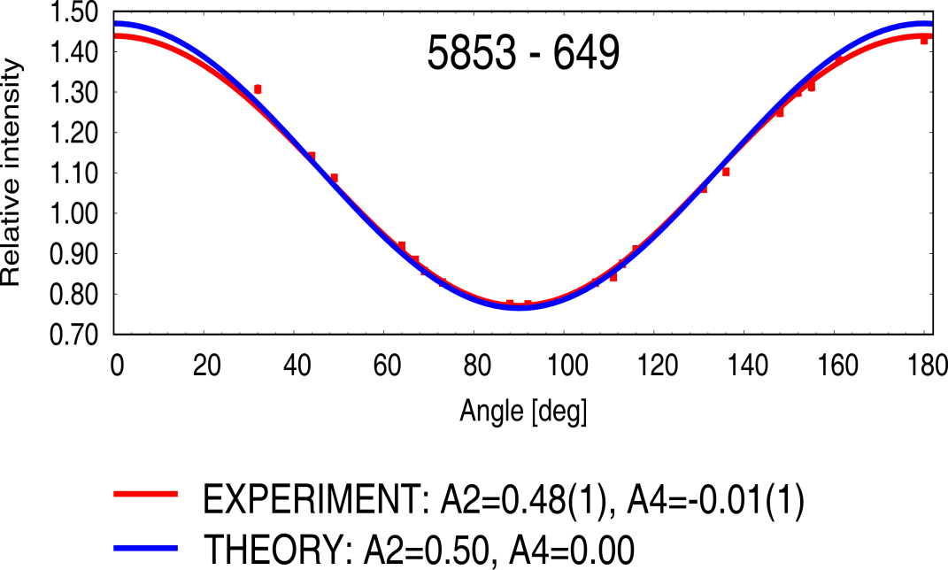
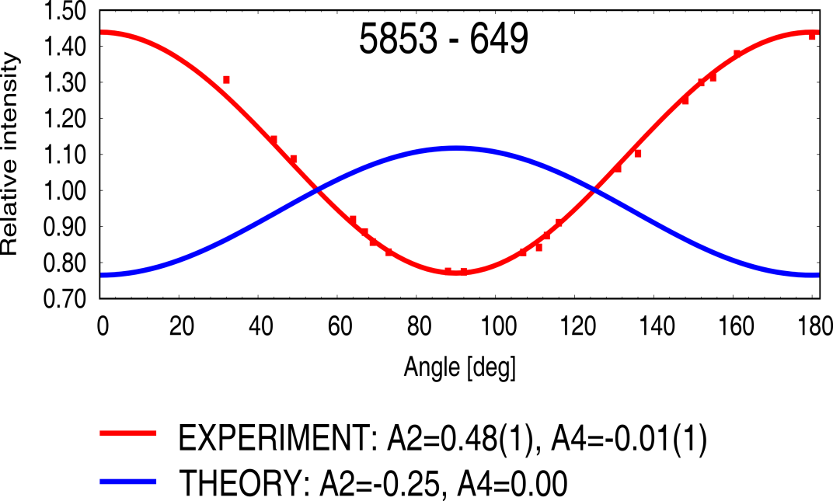
Angular correlations of γ rays
0+,1+
E1 0+  1–
E1
?
5853
1 –
649
M1
649
0 –
E1 1+  1–
²⁰⁶Tl
N. Cieplicka et al.

Slide 12
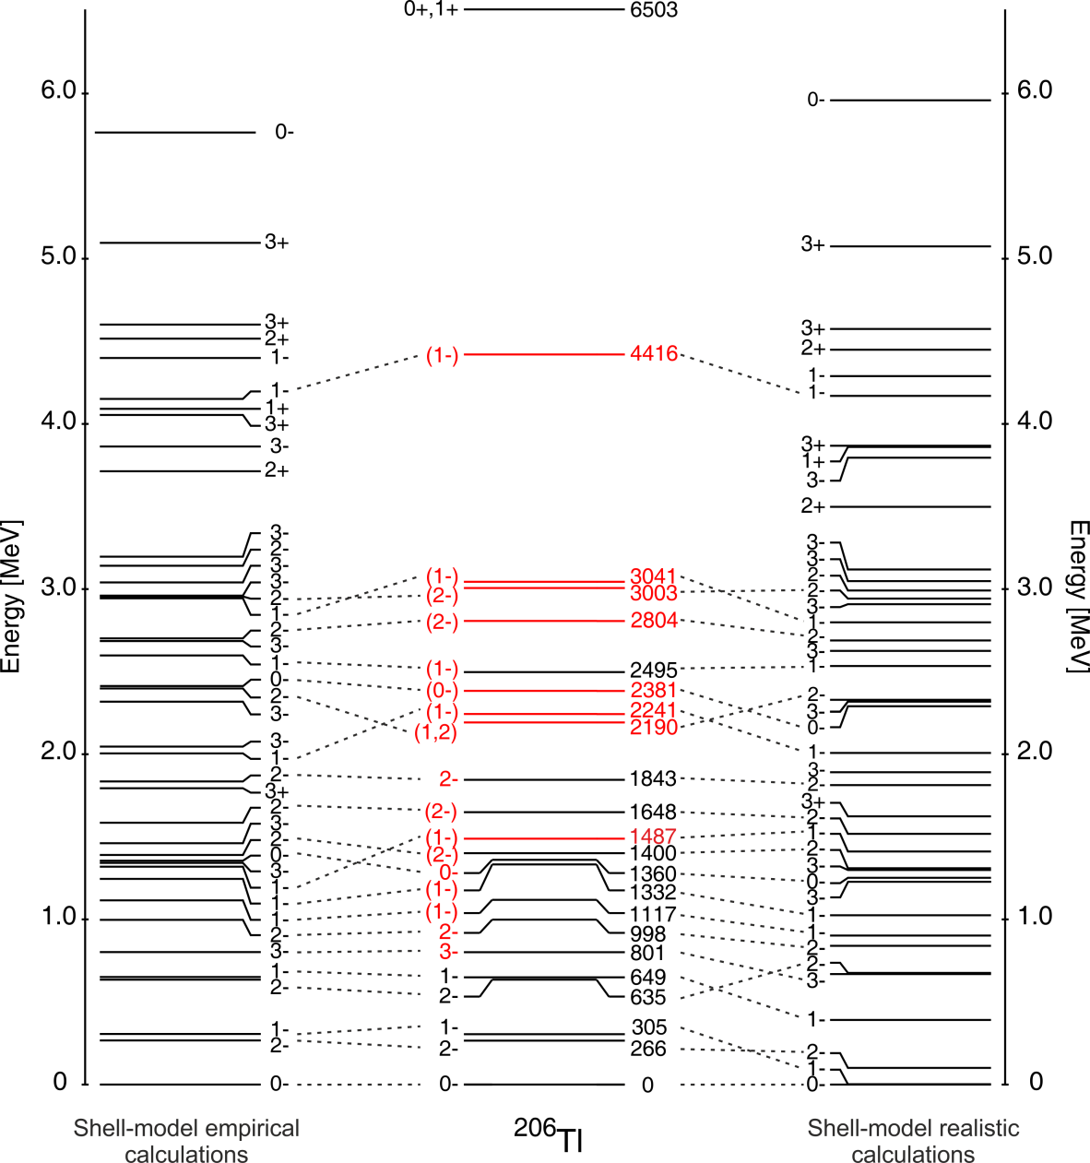
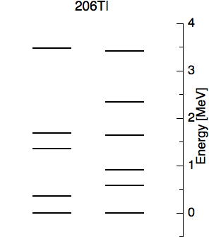
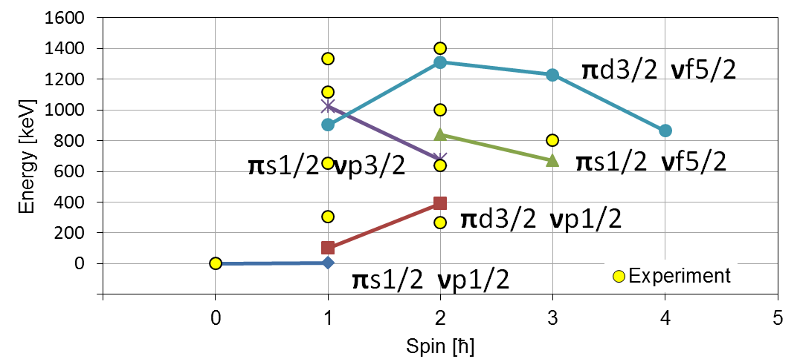
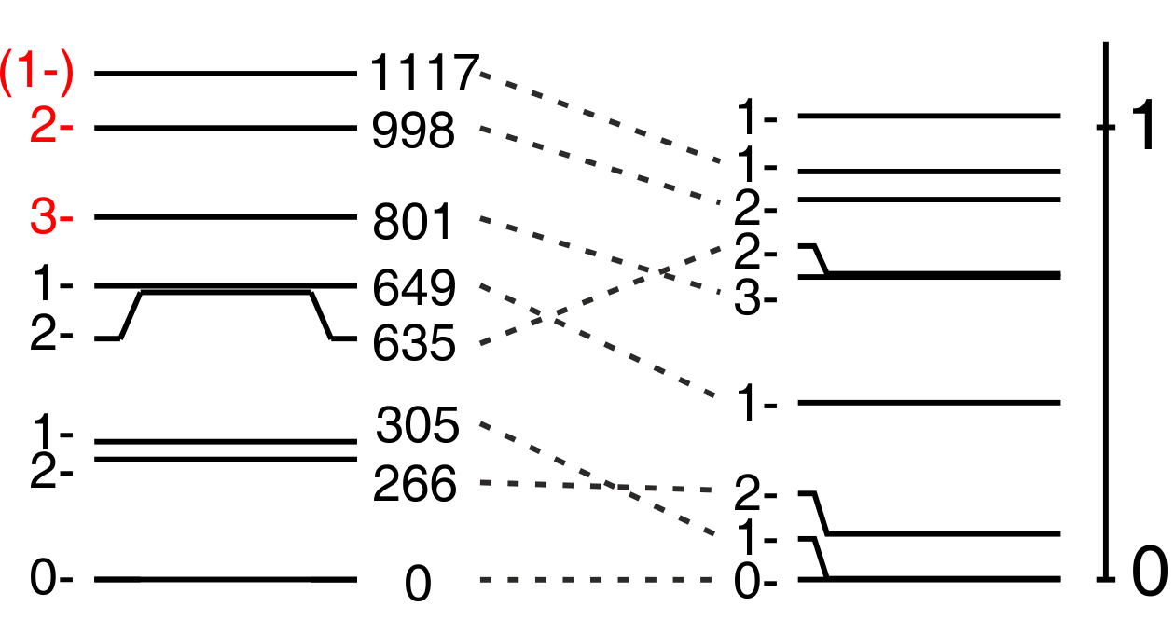
Shell-model realistic calculations for ²⁰⁶Tl (A. Gargano)
²⁰⁶Tl MULTIPLETS
N. Cieplicka et al.
g_{7/2}
h_{9/2}
Realistic interactions derived from the nucleon-nucleon potential, making use of the V_{low-k} approach, were used.
(thanks to prof. Angela Gargano, INFN Napoli)
f_{7/2}
d_{5/2}
i_{11/2}
h_{11/2}
p_{3/2}
d_{3/2}
f_{5/2}
s_{1/2}
p_{1/2}
protons
neutrons
208Pb
3s 1/2
3p 1/2
2f 5/2
2d 3/2
3p 3/2
1h 11/2
1i 13/2
2d 5/2
2f 7/2
1h 9/2
1g 7/2
132Sn
protons
neutrons
²⁰⁶Tl
THEORY

Slide 13
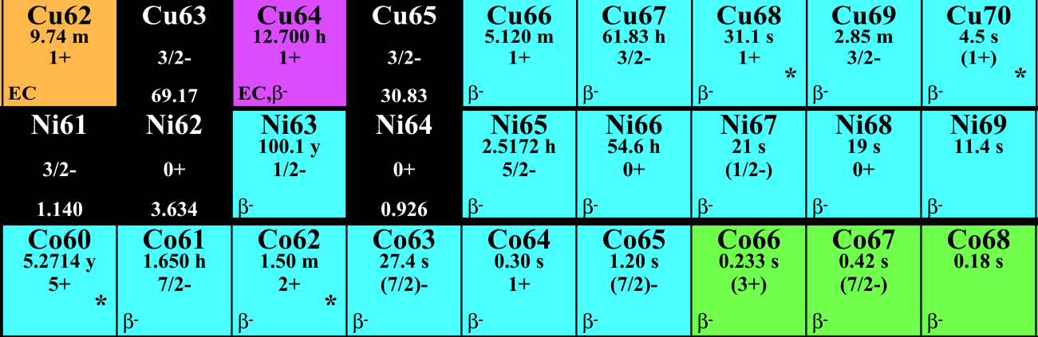
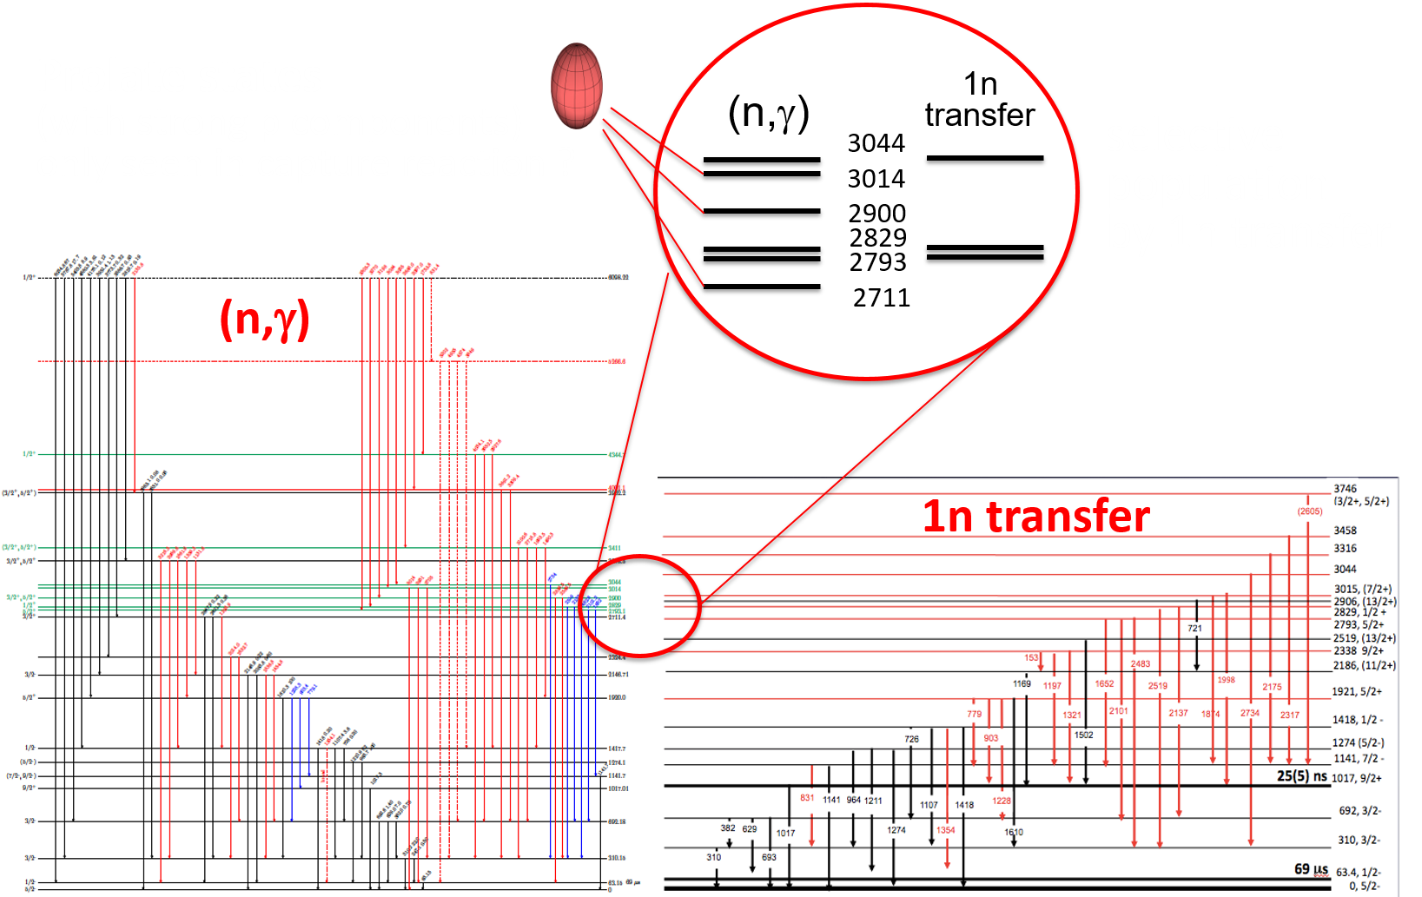
Nuclear shape coexistence
Follow the evolution of shape coexistence and shape isomerism in the nickel isotopes:
joint IFIN-HH and ILL experimental program
Prolate states only seen in capture ?
FIPPS data
(March 2018)
⁶⁴Ni(n,γ)⁶⁵Ni (enriched target)
M.Sferrazza et al., C. Porzio master thesis
IFIN-HH data
⁶³Ni(n,γ)⁶⁴Ni (radioactive target)
N. Marginean et al., to be scheduled 2019
⁶¹Ni(n,γ)⁶²Ni (enriched target)
C. Mihai et al., to be scheduled 2019
⁶⁶Ni: S. Leoni et al., PRL118 (2017) 162502
Monte Carlo Shell Model calculations (MCSM)
T. Otsuka et al., JPG43 (2016) 024009
Preliminary, courtesy of S. Leoni

Slide 14
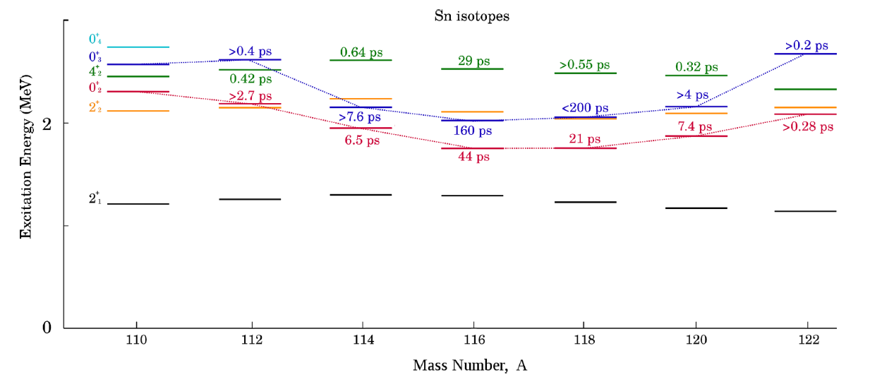
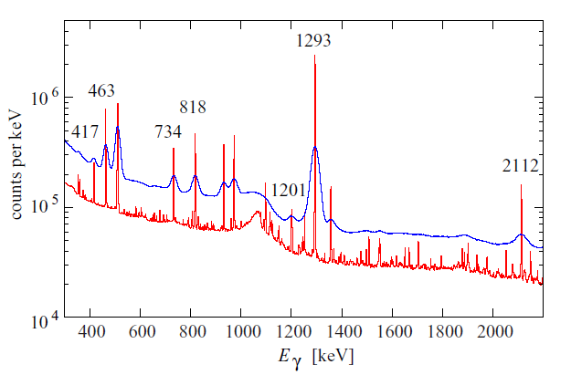
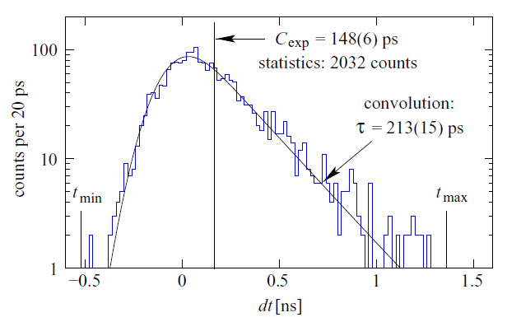
Collectivity of the 2p-2n intruder band in ¹¹⁶Sn
Lifetime of the 4⁺₂ state measured with fast-timing technique at FIPPS
HPGe vs LaBr₃ spectra
0₃⁺ state lifetime
Systematics of Sn first excited states, evidence for deformed band built on intruder states. Comparison with IBA2 calculations.
C. Petrache et al., Phys. Rev. C 99 (2019) 024303

Slide 15
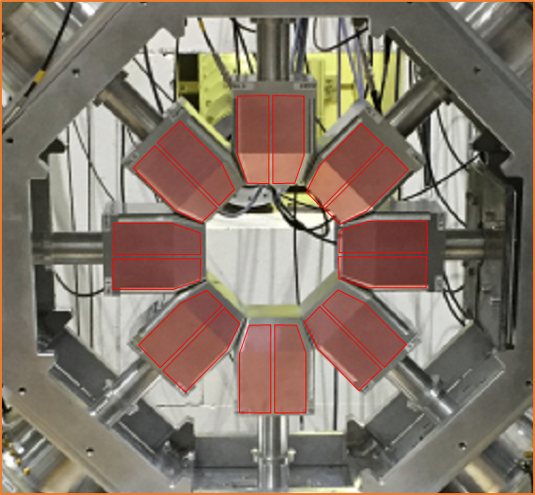
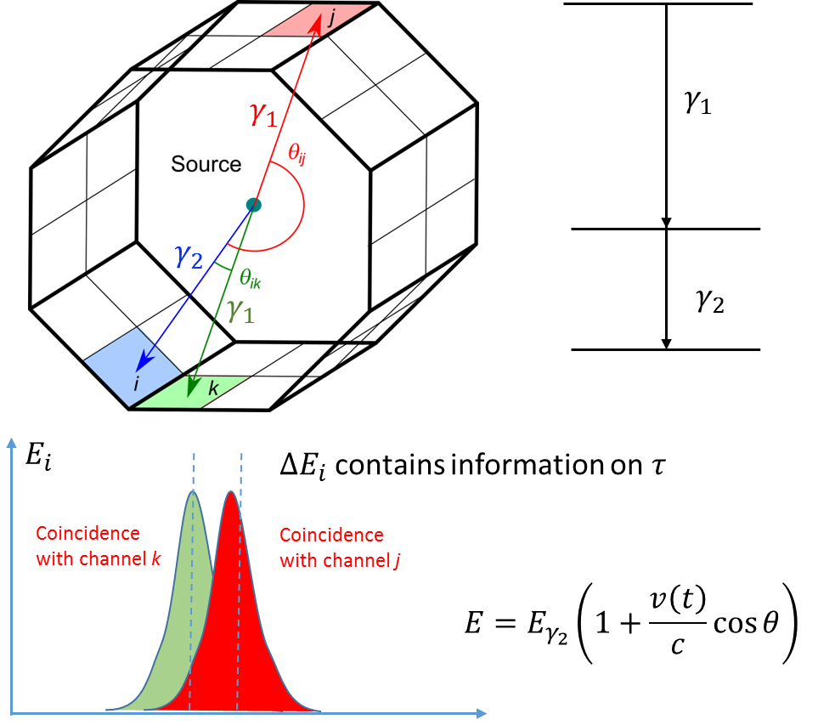
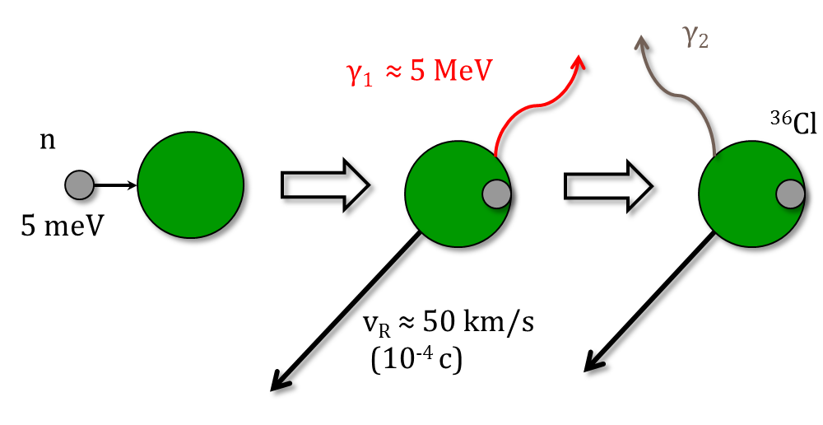
The GRIDSA Technique
The Gamma Ray Induced Doppler Shift Attenuation (GRIDSA) technique
  Measurement of very short lifetime in the range of a few up to a few hudreds of femtosecond by means of an array of HPGe detectors
  Samples in the milligram range
  Coincidences eliminate uncertainty from feeding
  Two step cascade after thermal neutron capture measured in coincidence
*See e.g.: V. T. Kupryashkin et al., AN SSSR, Ser. Fiz. Vol 53 (1989) 2
T. Khan, et al. Nucl. Instr. Meth. A 385 (1997) 100-107
F. Crespi et al.

Slide 16
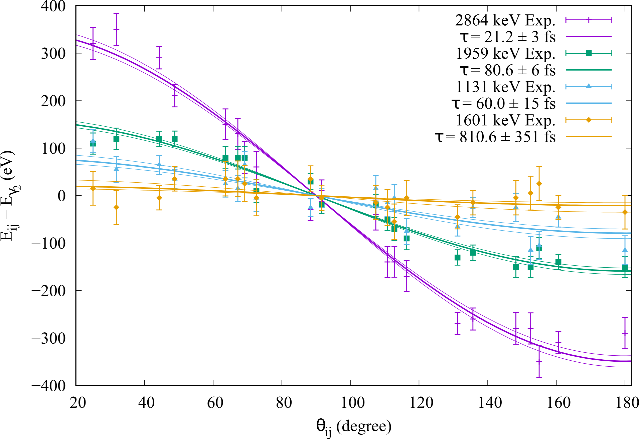
Extraction of the Lifetimes from the Experimental Data
Experimentally determined values of E_{i,j}(θ) for the 4 analyzed γ transitions
The data were fitted using the analytical expression based on the exponential slowing down model
The slowing down times were determined from MD-simulations with the KrC potential
The thin lines indicate the variation within the error bar
F. Crespi et al.

Slide 17
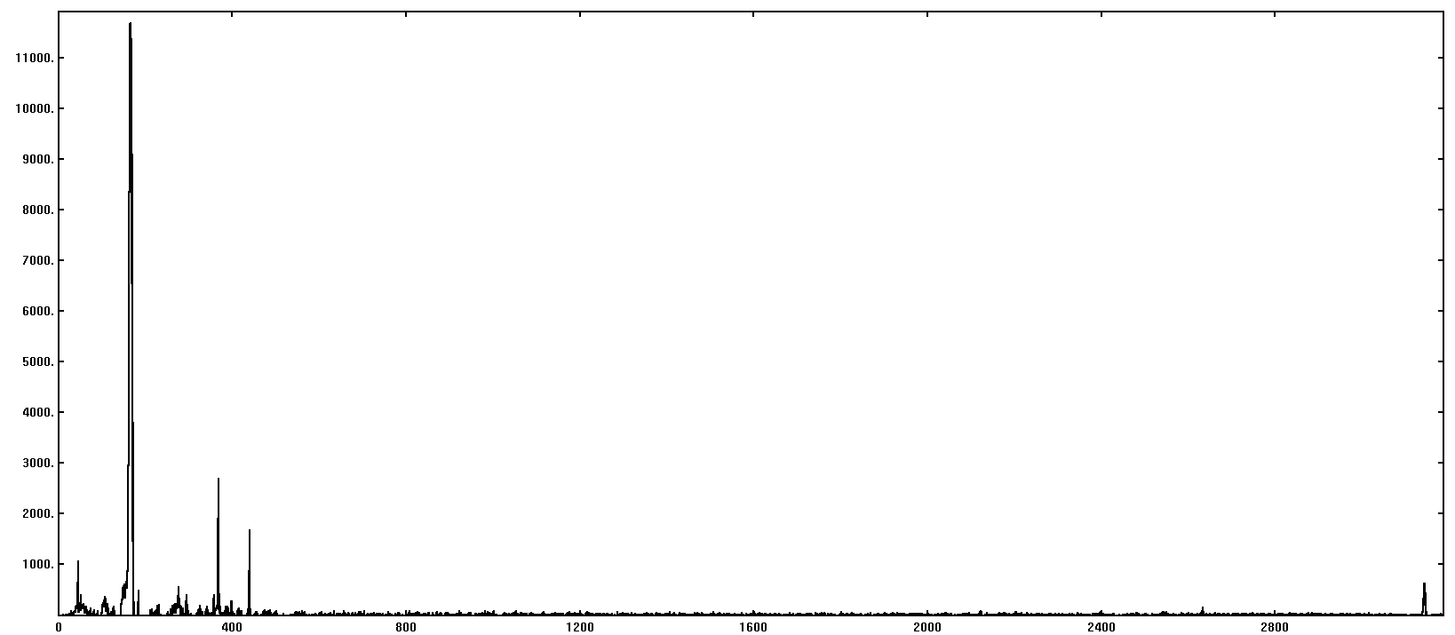
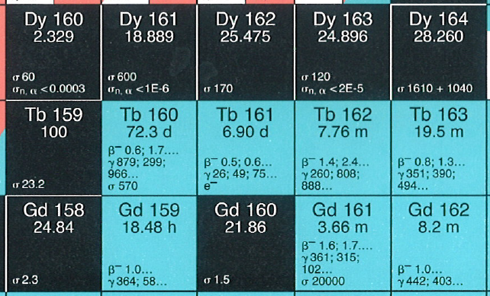

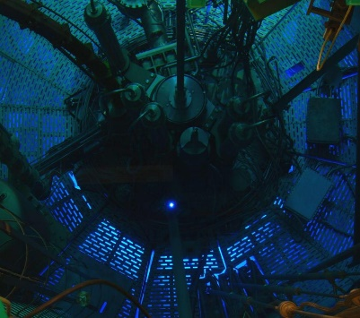
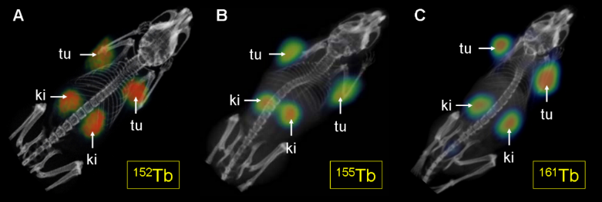
¹⁶¹Gd spectroscopy @ FIPPS
Common interest for fundamental research and radioisotope production
S_{n}=5635 keV
164 keV
¹⁶¹Gd (N=97)
nuclear structure:
deformed Nilsson orbitals around N=96
and search for scissor modes
¹⁶⁰Gd(n,γ)¹⁶¹Gd, 50mg target, 30 min data
neutrons
Gate on 2057 keV
protons
new
¹⁶¹Tb is ideal for targeted radionuclide therapies
¹⁶⁰Gd(n,γ)¹⁶¹Gd
H. Uusijärvi et al., J. Nucl. Med. 47 (2006) 807
¹⁶⁰Gd(n,γ)¹⁶¹Gd cross section measurement and ¹⁶¹Gd gamma-ray spectroscopy at FIPPS
PET SPECT SPECT
CM et al., performed experiment

Slide 18
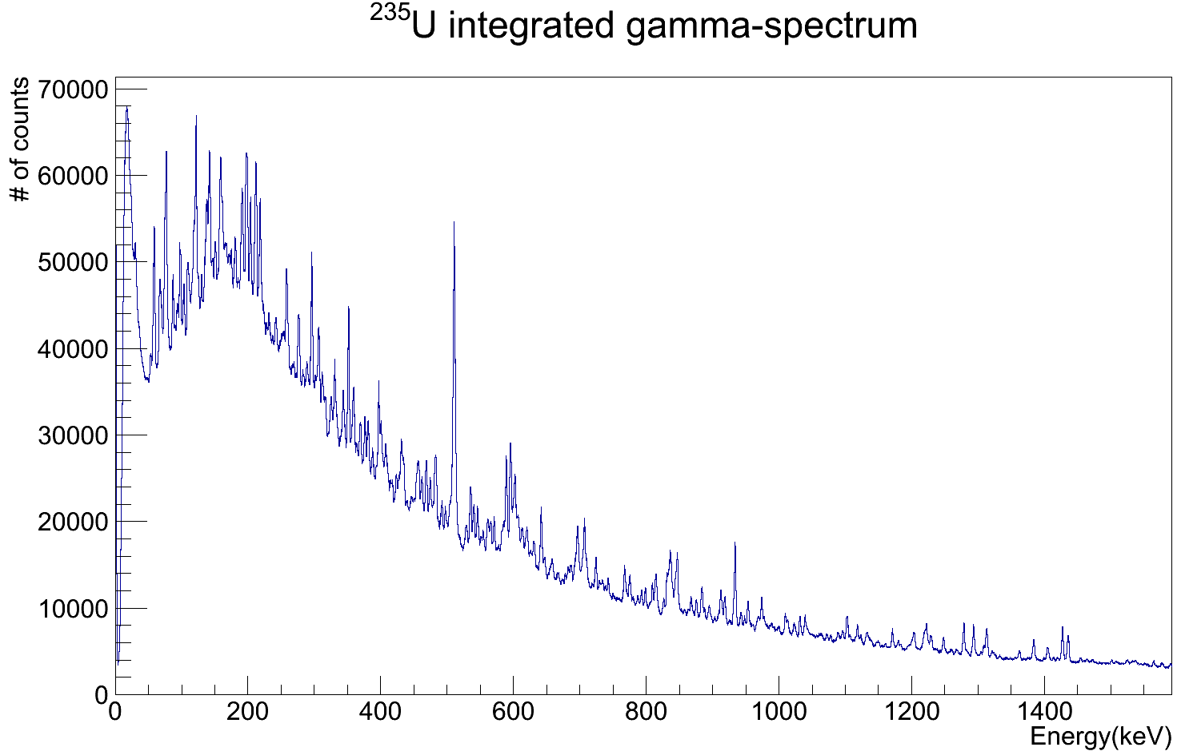

Spectroscopy of fission fragments: a challenge!
More than 150 nuclei emitting γ rays at the same time (excited fission fragments and β-decay products)
First ²³⁵U(n,f) campaign at FIPPS+IFIN-HH
(Sept-Oct 2018):
J. Dudouet et al. : Particle-core excitations at N=50
N. Redon et al. : Structure of n-rich Br isotopes
W. Urban et al. : Deformation at N=59
F. Crespi et al. : Octupole vibrations in ¹³²Sn
T. Materna et al. : Influence of fission partner in gamma ray cascades from fission fragments
Fission populates exotic nuclei with
an « excess » of neutrons important for:
understanding of nuclear structure far from stability
modeling of the fission mechanism
nuclear properties along r-process path
L. Iskra et al. : Structure of ^{92,94}Y

Slide 19
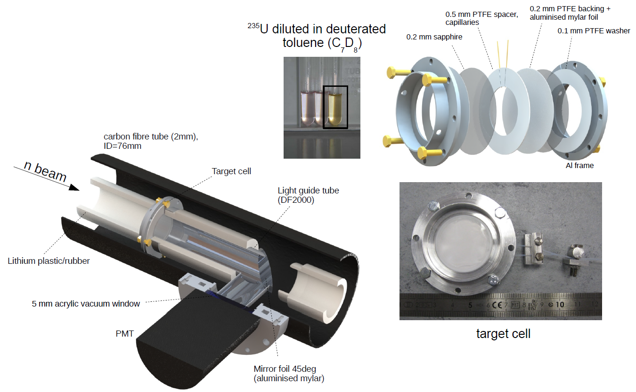
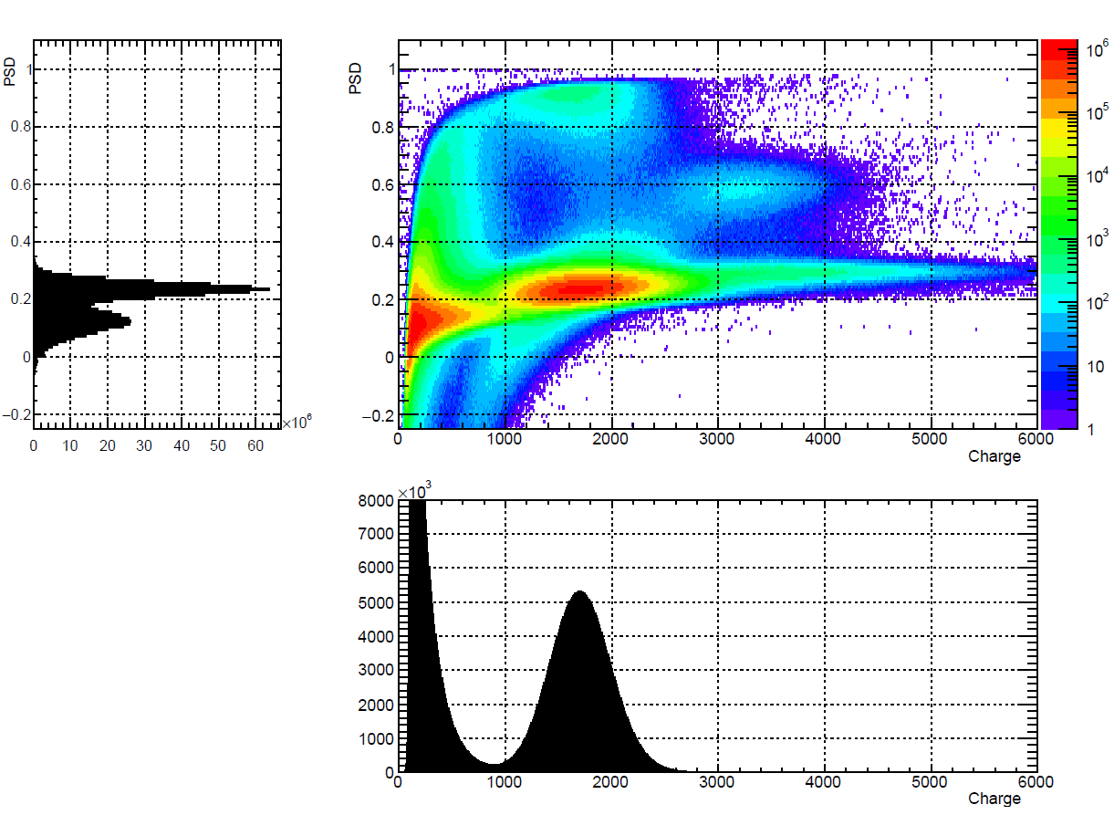
Active fission target @ FIPPS+IFIN-HH
FILL2030 postdoc project
PSD (Pulse-Shape-Discrimination)
²³⁵U diluted in
liquid scintillator
(Q_{long} –Q_{long})/Q_{long}
β, α
fission
Q_{long}
F. Kandzia, G. Bélier, et al.

Slide 20
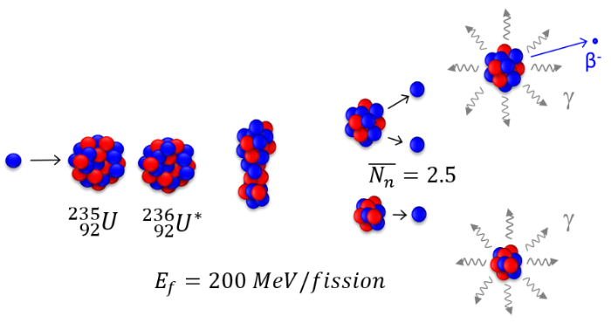
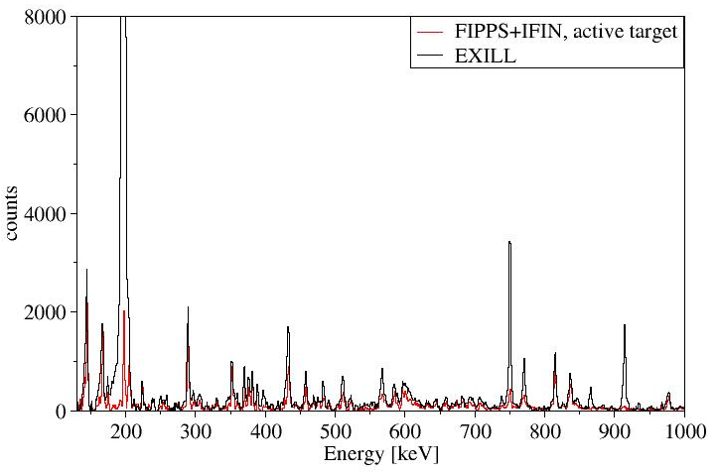

Examples of β-induced background suppression
¹³⁶Xe
Coincidences with 2⁺→0⁺ (1313 keV) and 4⁺→2⁺ (381 keV) transitions in ¹³⁶Xe.
(30 days)
(35 days)
$$2.4$$
⁹⁷⁻⁹⁹Sr
¹³⁶Xe
¹³⁶I (β-)→¹³⁶Xe
⁹⁸Sr
?
⁹⁹Sr
September-October 2018

Slide 21
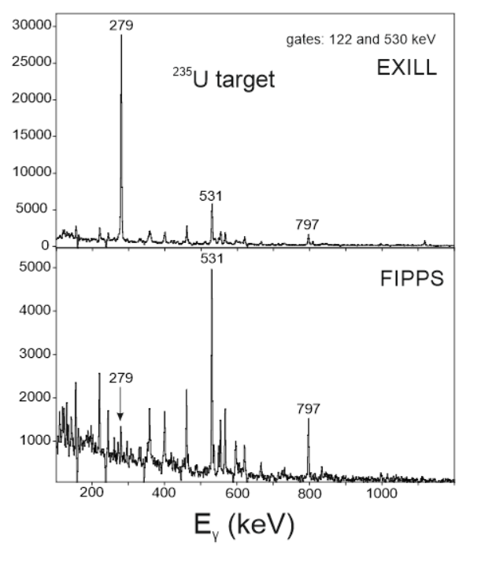
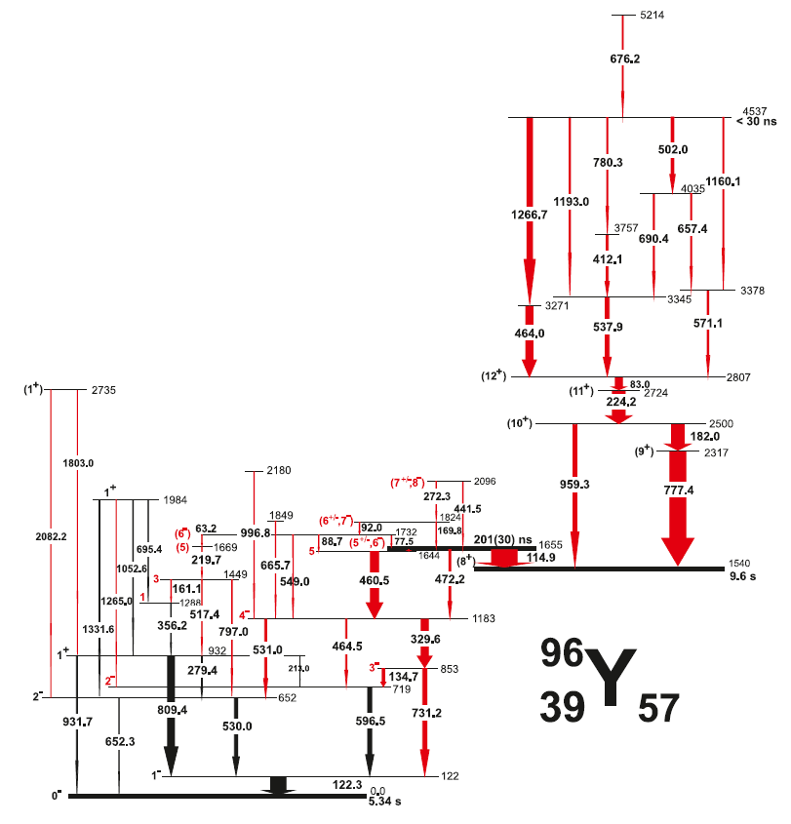
EXILL vs FIPPS
L. Iskra et al.

Slide 22
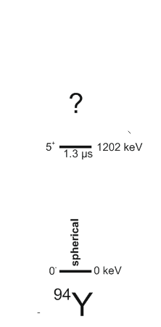
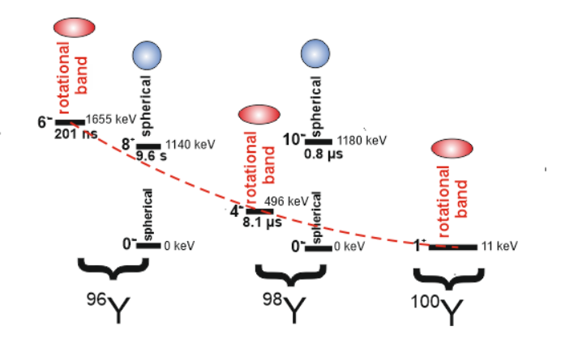
Shape evolution in the Y isotopic chain
No sudden onset of deformation at N = 60 but gradually decrease in energy !?
L. Iskra et al.

Slide 23
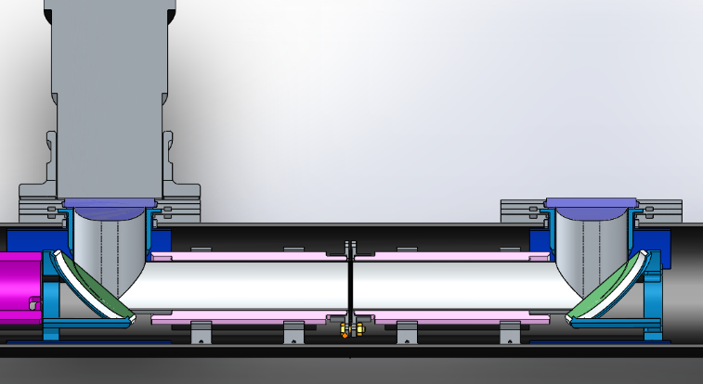


Now running ²³³U(n,f)
Double target cell (downstream + upstream)
2 optically separated volumes
=> increasing fission rate w/o increasing pile-up
Adapted for manipulation in glove box
U-235 test run (2019 June 17-23)
U-233 run (2019 June 24-ongoing)
F. Kandzia, R. Pommier

Slide 24

First ~20h statistics
Check ¹⁴²Ba – ⁹⁰Kr coincidences (yesterday at 18h ☺ -- ACs to be added in this analysis)
counts
Selection on fission tag
Gate on ¹⁴²Ba 2⁺ → 0⁺ (359 keV)
Mass ~100 favoured in 233U(n,f) vs 235U(n,f)
Complementary data
Fission tag necessary for the analysis of the data of interest for fission models
¹⁴²Ba
⁹⁰Kr
Energy [keV]
M. Barani, J. Dudouet, J. Wisniewsky, …

Slide 25





Nuclear Fission: how does it work?
Fission dynamics and generation of excitation energy and angular momentum
geometry
fission fragment, E_{x}
P(8)
10
8⁺
P(6)
n emission
6⁺
wriggling
B_{n}
P(4)
Energy [MeV]
γ decay
5
4⁺
"neck mechanisms"
P(2)
bending
2⁺
P(0)
0⁺
0
0
2
4
6
8
10
Spin and excitation energy distributions from prompt γ rays
Angular momentum (J) [hbar]
friction
superfluidity
microscopic
A. Chebboubi et al., PLB 775 (2017) 190 (LOHENGRIN)
A. Bulgac et al., PRL 116 (2016) 122504

Slide 26



FIPPS phase 2: HPGe array+GFM
Gain of order of magnitudes in sensitivity for fission studies and spectroscopy of n-rich nuclei using a Gas-Filled-Magnet (GFM) separator
1/R field (B(1.2m)=1T, Bmax <1.7T, dB/B~1%)
Y focusing → large acceptance (~60 msr)
same B for all trajectories
→ good dispersion (2.1 cm/%)
"complex pole shape" (Thales circles)
→ horizontal focusing independent
from trajectory
ionization chamber at focal position
for Ekin measurement
just received feasibility studies from companies
(HTS technology)
Thales of Miletus, 600 bc
H. Faust, Y-H. Kim, …

Slide 27
Concluding remarks
Rich Nuclear Physics program at ILL using FIPPS/FIPPS+IFIN-HH (shape coexistence, intruder structures, … ) using slow-neutron induced reactions
²³⁵U(n,f) and ²³³U(n,f) with fission tag: new spectroscopic info on n-rich fission fragments is now available trough multiple gamma-ray coincidences analysis (data are open for LoI)
→ bridge for the science program at FIPPS phase 2
(HPGe detectors+GFM fragment separator)
Next ILL proposal submission deadline: September 2019
→ “all targets can be used at FIPPS” (or, at least, many… ask myself or Ulli K.)
→ interest already expressed for transuranium target (²⁴⁵Cm)
The physics program and detector developments at FIPPS depend on your input! Hope to see you all soon at ILL!

Slide 28



A new chamber for a ²⁴⁵Cm target
²⁴⁵Cm target :
  $\left.\begin{matrix}→\text{2 }\text{confinement} \text{barriers} \\ →\text{closed} \text{target} \end{matrix}\right\}$ a single wall vacuum chamber is sufficient
Environment | Consequence | Constraints for the chamber
Vacuum chamber | / | Vacuum resistance
To be a confinement barrier | / | Tightness Resistance to a 1 m fall
Beam neutron | low $σ(n,γ)$ | $σ\left(n,γ\right)<1barn$
γ spectrometer | Low γ attenuation | Z<30
α particles emission from ²⁴⁵Cm decay | Presence of 5.5 MeV energy α particles | Stops 7 MeV energy α particles
(C. Duthoit,
ILL internship)
Final choice : Magnesium cylinder chamber of 44 mm diameter and 2mm wall-thickness, closed by Zirconium foils of 44mm and 0.2mm thickness

Slide 29
Many thanks to all the collaborators:
F. Kandzia, U. Köster, YH. Kim, H. Faust, M. Thomas,
E. Ruiz-Martinez, P. Mutti, M. Barani, C. Duthoit,
D. Reygadas, M. Jentschel
ILL
N. Marginean, C. Mihai, R. Lica, S. Pascu, A. Turturica, …
IFIN-HH
J. Dudouet, …
IPNL Lyon
S. Leoni, F. Crespi, L. Iskra, …
Univ. and INFN Milano
T. Materna
CEA Saclay
G. Bélier, J. Aupiais
CEA B. le Chatel
G. Kessedjian, …
LPSC Grenoble
…
Caterina Michelagnoli, mailto: cmichela@ill.fr

Slide 30

¹⁶⁰Gd(n,γ)¹⁶¹Gd
Single detector, 15min
(transitions verified in coincidence data; from which one sees that the one in 161Gd is a doublet belonging to 161Gd, I fitted as double gaussian )
163.7 keV, 161Gd
181.9 keV, 158Gd
From this spectrum I get:
3270 (311) 161Gd
3581 (277) 158Gd
Energy [keV]

Slide 31


Target mounted in Li-plastic support

Slide 32

Examples of β-induced background suppression
¹³²Te
Coincidences with 2⁺→0⁺ (974 keV) and 4⁺→2⁺ (697 keV) transitions in ¹³²Te.
(30 days)
(35 days)
$$2.4$$
¹³²Te
¹⁰¹⁻¹⁰³Zr
¹³²Sb (β-)→¹³²Te
¹⁰²Zr
¹⁰¹Zr
?
September-October 2018

Slide 33


Fission Tag – Options
Thin film scintillators
  Scintillator foils O(10) μm
  Fission fragment (FF) identification by dE/dx (when crossing foils)
  or energy threshold (when stopping in foils)
Diamond detectors
  Solid state ionization chamber
  Radiation hard, fast response
  Under development (LPSC Grenoble)
Liquid scintillator (LS)
  Actinide directly dissolved in LS
  => selected for first realization
[USAppliedDiamond.com/products/detectors/]

Slide 34



Liquid Scintillator Target
actinide in homogeneous solution
=> homogeneous stopping of fission fragments
LS developed at CEA Bruyères-le-Châtel
(Bélier et al.)
Pulse Shape Discrimination for strongly ionizing particles
Principle verified in spontaneous fission studies:
[G. Belier et al., NIM A 664, 341],
[G. Belier et al., PRC 98, 034612]
[G. Knoll, Radiation Detection and Measurement, Wiley & Sons]
[G. Belier]
[G. Belier et al. PRC 98, 034612]

Slide 35


Design of the Liquid Scintillator Target
Constraints for FIPPS:
  minimal γ-ray background
    small neutron scattering and absorption cross sections
    minimal material content
  chemical compatibility with LS
  minimal γ-ray attenuation
  efficient scintillation light readout
  radiological safety requirements
    safe handling
    tightness
    protective vacuum
1- alu frame, 2&5- sapphire windows (0.2 mm), 3- PTFE spacer (0.5 mm) w/ capillaries, 4- PTFE backing w/ reflective foil, 6- PTFE washer
26 mm

Slide 36


Light Guide and Vacuum System
n
Light guiding system:
Specular reflective tubes
  DF2000 from 3M
  metal free polymer foils
  ~99% reflectivity
Mirror foil
  intersecting beam under 45°
  aluminised mylar
Active target
Mirror foil
Li-tubes
Reflective tubes
PMT
Vacuum chamber
Vacuum chamber
carbon fiber
layer thickness: 2 mm
PMT viewport

Slide 37



Fission - Beta-decay Discrimination
fission rate 12 kHz
coincidences PMT- γ – γ: 10 kHz
total: 1.5E11 fission tagged γ – γ coinc.
(36 days, Sep-Oct 2018)
good separation in energy
moderate separation in
PSD = Qtail/Qtot
Fission detection efficiency: prel.: 85%(?)
Fission mis-identification: 0.3%
β-mis-identification: ~0.4%
Limitation: pile-up on PMT
Background
Fission
I – fission events
II – β-decay events
III – pile-up fiss.-fiss.
IV – pile-up β- β
V – pile-up fiss.- β
VI – pile-up β -fiss.
VII – incorrect event reconstr.
VIII – tail w/ fiss. characteristics

Slide 38



Time Stability
Drift of PMT signal:
  PMT deterioration
  => compensation via HV adjustment
  Aging of scintillator
Evolution of fission- β separation:
FoM = (μ_{fiss} – Min)/σ_{fiss}: 2.84 -> 2.79
21/9 28/9 5/10 12/10 19/10
Date [DD/MM]
μ_{fiss}
Min
21/9 28/9 5/10 12/10 19/10
Date [DD/MM]

Slide 39


Active Target Gamma Spectra
Fig.: γ -spectrum, total projection, multiplicity ≥2
Bgd dominated by Al:
  sapphire windows (Al₂O₃)
  scattered neutrons in frame
strong bgd suppression by fission tag
already in total projection
Al-28 – β⁻
Al-27(n,g)
*1/20
Te-134 – 1279 keV

Slide 40



Nuclear fission: how does it work?
Different mass and charge distributions for different fissioning systems
liquid
drop
model
single
particle
effects
Fission is a lazy process…
A. Andreyev et al., Rep. Prog. Phys. 2017

Slide 41



Nuclear shape coexistence
The nickel isotopes: Z=28 (magicity) ➔ spherical in the g.s. Still different shapes are predicted at low excitation energies
Monte Carlo Shell Model calculations (MCSM)
p-n interaction due to tensor force ➔ nuclear deformation in a spherical nucleus
T. Otsuka et al., JPG43 (2016) 024009

Slide 42


Slide 43



Comparison of the branching ratios in ²⁰⁶Tl with shell-model calculations
Interaction Matrix
Strong configuration mixing:
Non-diagonal matrix elements
come into play
N. Cieplicka et al.

Slide 44



Comparison of the branching ratios in ²¹⁰Bi with shell-model calculations
MULTIPLET
N. Cieplicka et al.

Slide 45

Hole-hole and particle-particle interactions around ²⁰⁸Pb
g_{7/2}
h_{9/2}
Interaction Matrix
p_{1/2}
p_{3/2}
f_{5/2}
d_{3/2}
f_{7/2}
g_{7/2}
s_{1/2}
d_{5/2}
i_{11/2}
d_{5/2}
h_{11/2}
i_{13/2}
j_{15/2}
p_{3/2}
f_{7/2}
h_{11/2}
d_{3/2}
f_{5/2}
s_{1/2}
p_{1/2}
h_{9/2}
g_{9/2}
protons
neutrons
protons
neutrons
N. Cieplicka et al.
²⁰⁶Tl MULTIPLETS
²¹⁰Bi MULTIPLETS

Slide 46




Angular correlations of γ rays
0+, 1+
(1 –)
(1 –)
(2 –)
(2 –)
(1 –)
(1 –)
(0–)
2 –
(1,2 )
(1 –)
(2 –)
(2 –)
1487
0 –
(1 –)
1360
(1 –)
2–
3 –
801
1 –
²⁰⁶Tl
N. Cieplicka et al.

Slide 47

γ-coincidence analysis
γγ coincidences: gate 305 keV
305
²⁰⁶Tl
N. Cieplicka et al.

Slide 48
γ-coincidence analysis
γγ coincidences: gate 305 keV
4659
γγ coincidences: gate 4659 keV
266
649
1843
305
1194
1578
1208
1042
1844
305
649
266
²⁰⁶Tl
N. Cieplicka et al.

Slide 49





Some Preliminary Results (FIPPS data)
Experiment performed at ILL with FIPPS: “Test of the Gamma Ray Emission Induced Doppler Shift technique to measure fs lifetimes after (n,g) reactions” (From : 29/01/17 To : 06/02/17) (F. Crespi, M. Jentschel)
Peak Centroid (keV)
1 keV
Relative Angle between Ge Crystals (deg)
Short lifetime → →→→→→→→→→→→→→→→→→→→→→ Long Lifetime
F. Crespi et al.

Slide 50



Are the any examples of quadrupole spherical vibrators?
The text-book cases have been recently revised thanks to recent measurements
Deformed structures that co-exist with the vibrational one, based on 2p-2h intruder configurations close to N=50
Difficult assessment due to the lack of observation of the linking transitions
P. Garrett (Univ. Guelph) et al. performed and accepted experiments at FIPPS

Slide 51

First evidence of deformed structures based on intruder states in the Te isotopes
preliminary, courtesy of P. Garrett

Slide 52



Nuclear shape coexistence
First evidence of shape isomerism in a light system.
Lifetime measurements of excited 0+ states after 2-n transfer reactions at IFIN-HH
Monte Carlo Shell Model
calculations (MCSM)
T. Otsuka et al., JPG43 (2016) 024009
S. Leoni et al., PRL118 (2017) 162502

Slide 53

Gate on 2+ →0+ in ¹³⁴Te
FIPPS+IFIN
FIPPS
¹³⁴Te
counts
¹³⁴Te
¹⁰⁰Zr
¹⁰⁰Zr
¹⁰⁰Zr
Energy [keV]

