Slide 1




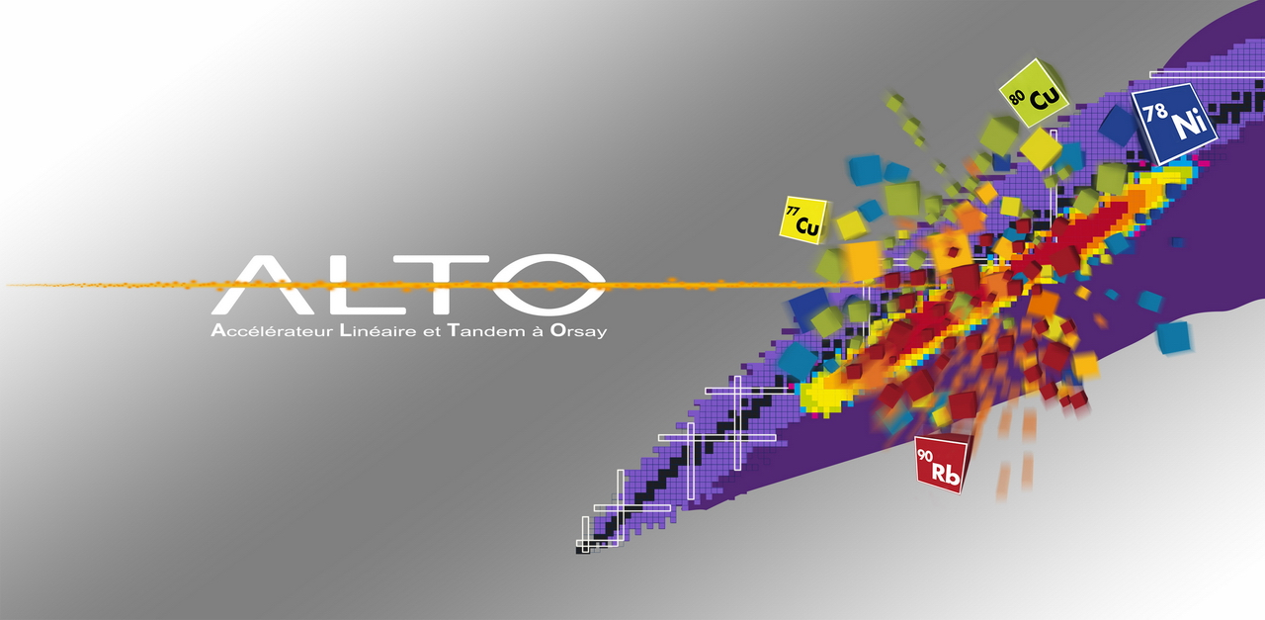
The ν-ball project at ALTO
Jonathan Wilson, Matthieu Lebois,
Nikola Jovancevic, Liqiang Qi, Damien Thisse
IPN Orsay

Slide 2
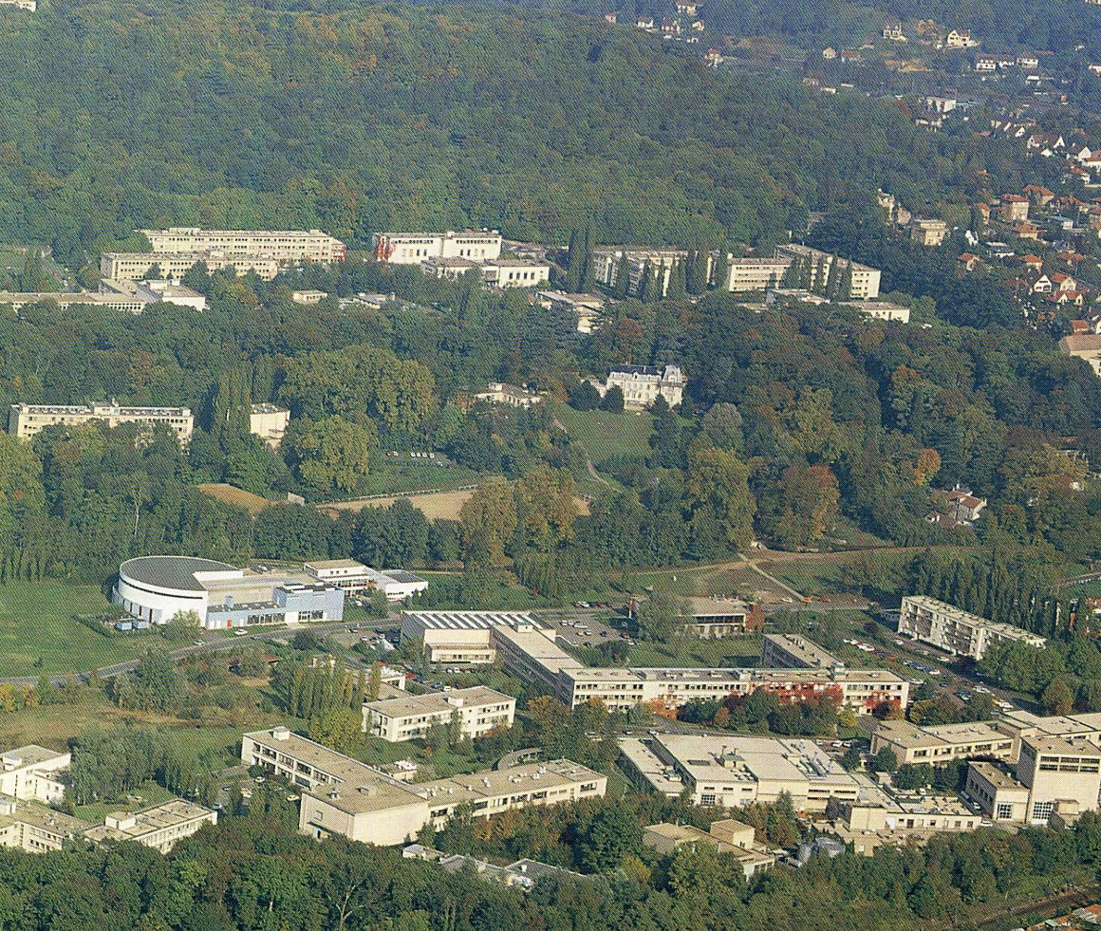
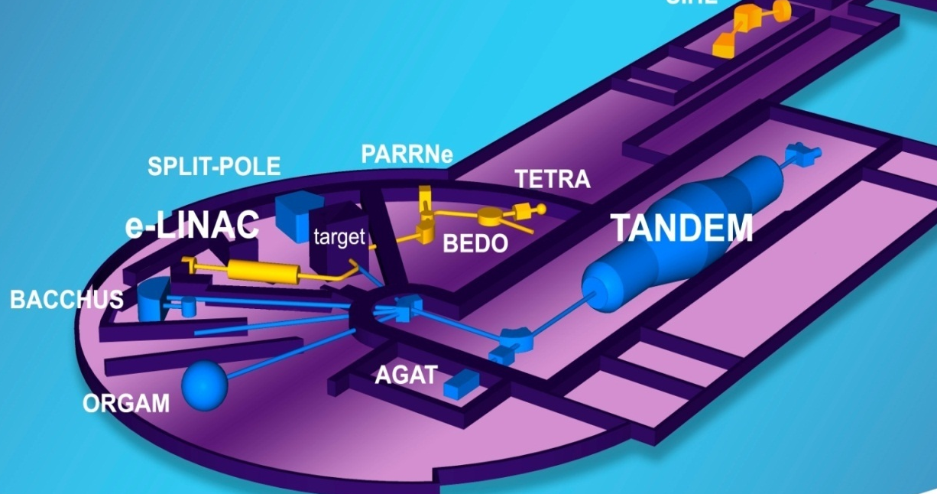


The ALTO facility
15 MV
ALTO typically delivers ~3000 hours of beam time per year
Trans National Access Facility
(ENSAR2, ARIEL)
ALTO international PAC

Slide 3

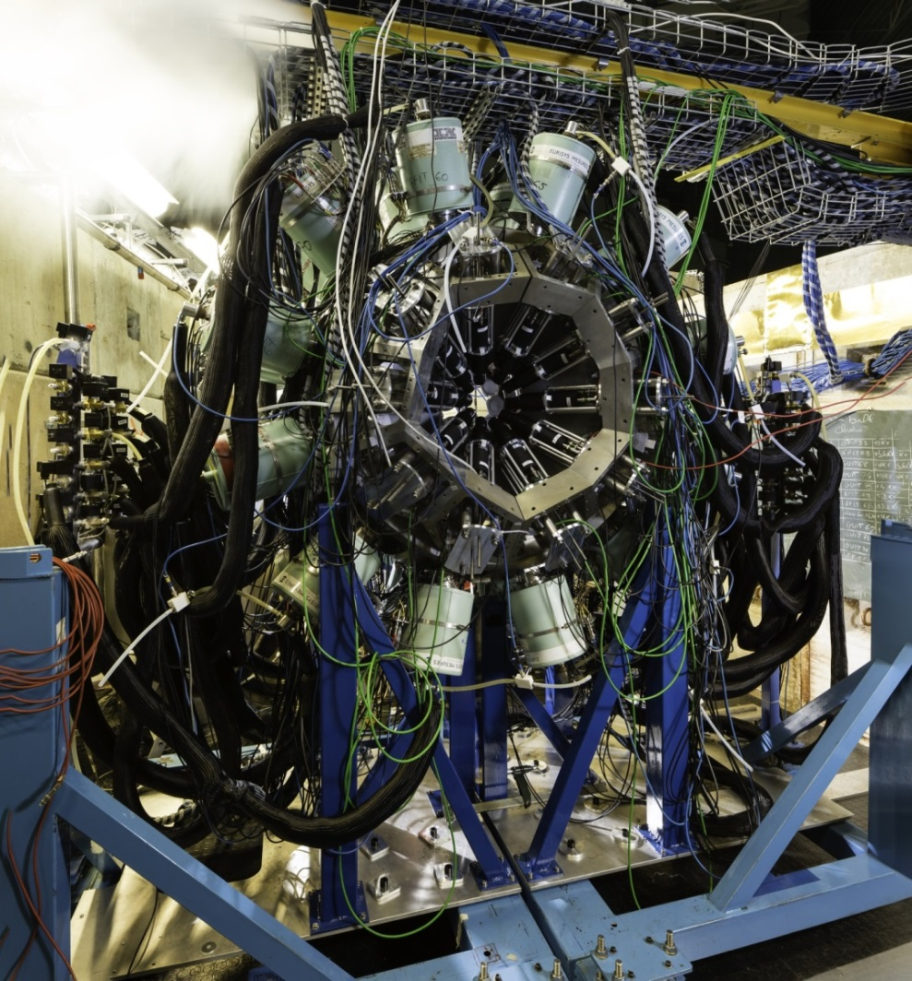
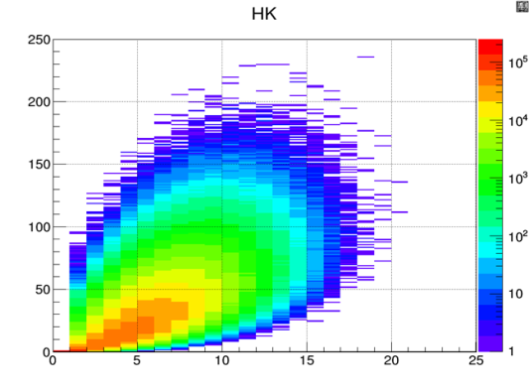
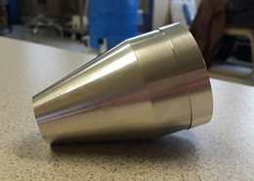
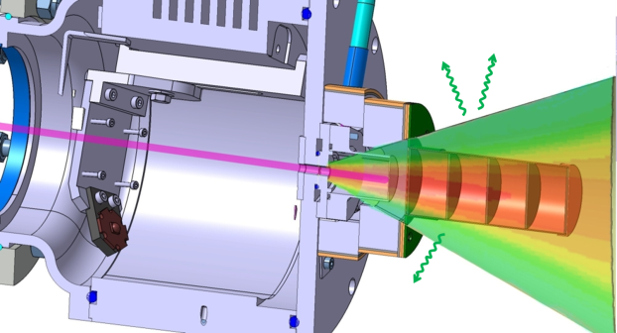
The ν-ball spectrometer @ ALTO
v-ball international collaboration
153 researchers from 16 countries and 37 institutes, including 80 Ph.D students
ν-ball experimental campaign
Nov. 2017-June 2018. 10 experiments 3200 hours of beam time
Innovations
Hybrid Spectrometer (Ge/BGO/LaBr3)
high resolution, high efficiency
Coupling with the LICORNE directional neutron source
Calorimetry for reaction studies/selection
Fully digital, 200 channels, including BGO
Modes Triggered or Triggerlesss
24 Clover Ge + BGO
10 Coaxial Ge + BGO
20 LaBr3
or 36 PARIS phoswich

Slide 4
What physics questions does ν-ball address?
To understand the detailed nuclear structure of very neutron-rich isotopes far from nuclear stability
To study precisely fast-neutron-induced nuclear fission using new techniques to extract new observables and new correlations
To further develop state-of-the art fast timing techniques to measure sub nanosecond lifetimes, study nuclear isomerism, extract nuclear moments
To facilitate diverse spectroscopy experiments proposed by the national and international users of the ALTO facility

Slide 5
















153 researchers from 16 different countries, 37 instutitues, including ~80 thesis students
The ν-ball International Collaboration
France(44)
IPN Orsay (16)
CSNSM Orsay (6)
CEA DAM/CEA Saclay (5)
Subatech, Nantes (3)
CENBG Bordeaux (6)
IPHC Strasbourg (3)
GANIL (2)
LPC Caen (2)
ILL (1)
UK(29)
University of Surrey (13)
National Physical Laboratory (5)
University of Brighton (2)
University of West Scotland (4)
University of Manchester (3)
University of York (2)
Germany(16)
TU Darmstadt (7)
IFK- Koln (9)
Poland(14)
IFJ-PAN Krakow (8)
University of Warsaw (6)
Italy(8)
University of Milano(6)
University of Padova(1)
Legnaro(1)
Finland(2)
Jyvaskyla(2)
Spain(6)
Madrid (4)
IFIC Valencia (2)
Belgium(4)
JRC-Geel (3)
Leuven (1)
Bulgaria(8)
University of Sofia (8)
Romania(7)
IFIN-HH, Bucharest (1)
ELI-NP, Bucharest (6)
Norway(6)
University of Oslo (6)
India(1)
Tata Institute (1)
Canada(4)
University of Guelph (4)
Serbia(2)
University of Novi Sad (1)
University of Belgrade (1)
South Africa(1)
iThemba (1)
Japan(1)
Riken(1)

Slide 6
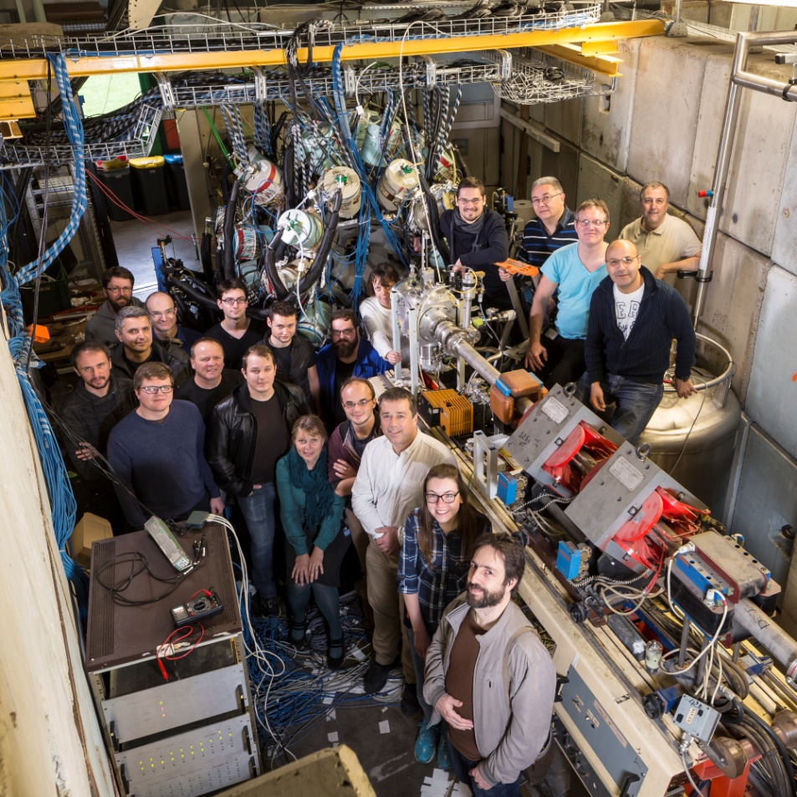
The ν-ball core team and local support

Slide 7
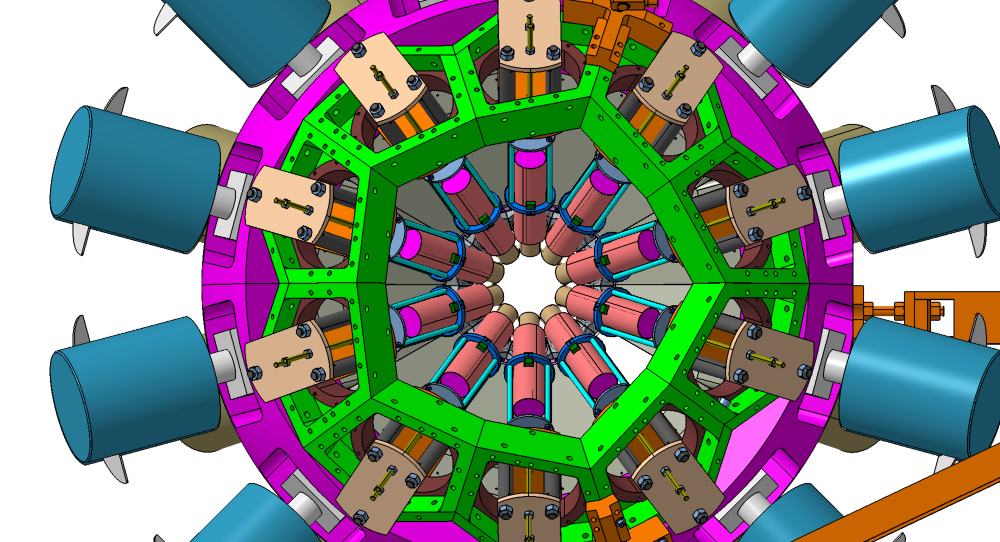
ν-ball experimental campaign (Nov. 2017-June 2018)
3200 hours of beam time delivered
Heavy Ion Reaction γ spectroscopy:
Half-life measurement and isomer spectroscopy in the neutron-rich deformed nucleus ¹⁶⁶Dy (1 week)
Electromagnetic transition rates in the nucleus ¹³⁶Ce (1 week)
Pinning down the structure of ⁶⁶Ni by 2n- and 2p-Heavy-Ion transfer reactions and g-factor measurement (2 weeks)
A study on the transition between seniority-type and collectivity excitations in the YRAST 4⁺ state of ²⁰⁶Po (1 week)
Measurement of the super-allowed branching ratio of ¹⁰C (2 weeks)
Feeding of low-energy structures of different deformations by the GDR decay: the nuBall array coupled to PARIS (1 week)
Neutron induced reaction γ spectroscopy:
Spectroscopy of the neutron-rich fission fragments produced in the ²³⁸U(n,f) and ²³²Th(n,f) reactions (5 weeks)
Spectroscopy above the shape isomer in ²³⁸U (2 weeks)

Slide 8
The ν-ball experimental campgain highlights
Fission studies
Detailed structure of neutron rich nuclei
Sub nanosecond timing
GDR studies: ν-ball coupled to PARIS

Slide 9
Fission Studies with LICORNE/v-ball

Slide 10
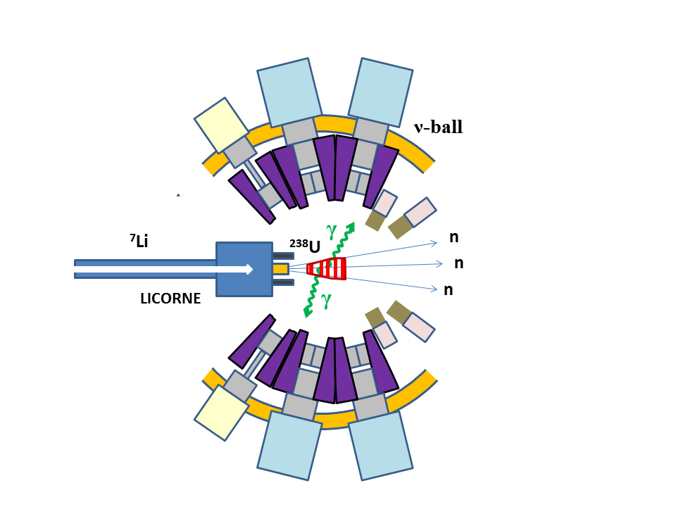
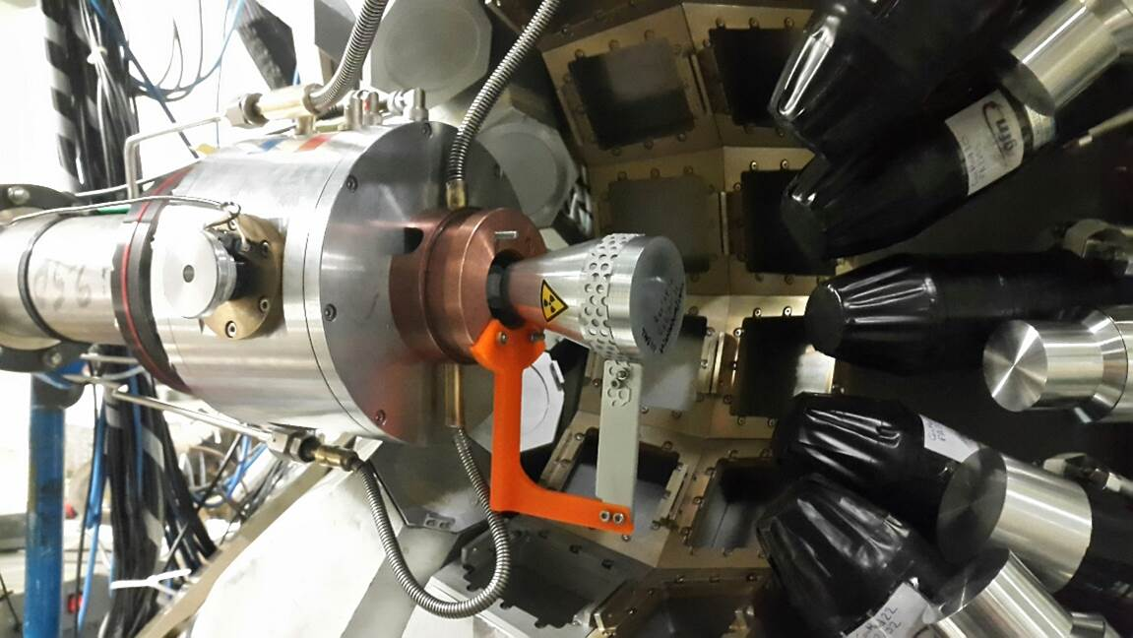
LICORNE/ν-ball coupling principle

Slide 11
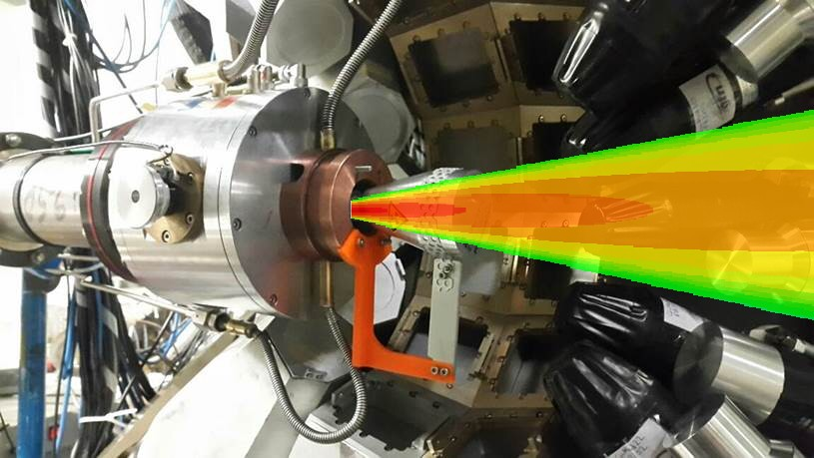
LICORNE/ν-ball coupling principle
Primary beam
2 x 10¹¹ /s
Target
Secondary beam
2 x 10⁷ /s
Sample
10⁵ fissions/s
⁷Li (16 MeV)
H₂
1.5 MeV neutrons
²³⁸U
²³²Th
3 x 10²⁰ atoms/cm²
~100 g

Slide 12
Summary of ν-ball/LICORNE fission experiments:
Expt. | Target mass | ⁷Li Current | E_{n} | Fission Rate | Time | Data | Total Fissions
²⁵²Cf(SF) | - | - | - | 3 kHz | 2 days | 50 Gb | 5.2×10⁸
²³⁸U(n,f) | 81 g | 10 nA | 1.7 MeV | 8 kHz | 9 days | 11 Tb | 6.0×10⁹
²³²Th(n,f) | 129 g | 80 nA | 1.7 MeV | 26 kHz | 19 days | 80 Tb | 4.0×10¹⁰
²³⁸U(n,f) | 81 g | 100 nA | 3.4 MeV | 28 kHz | 7 days | 25 Tb | 1.7×10¹⁰

Slide 13
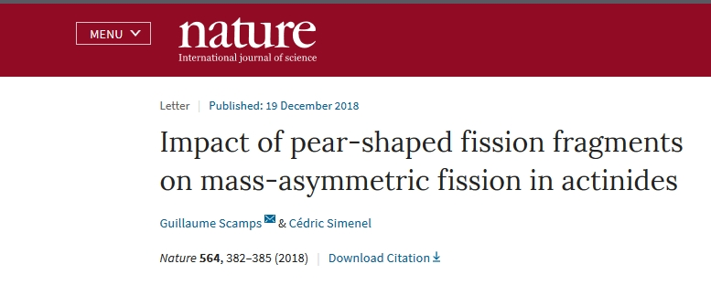
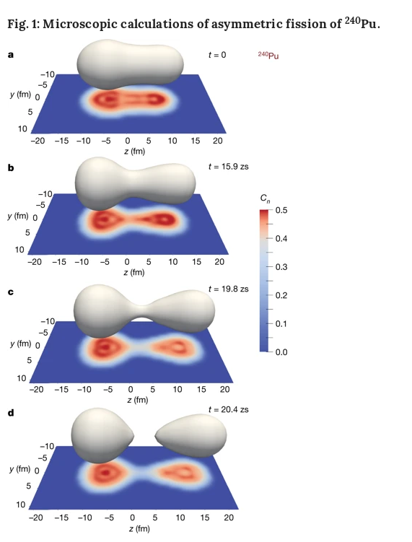
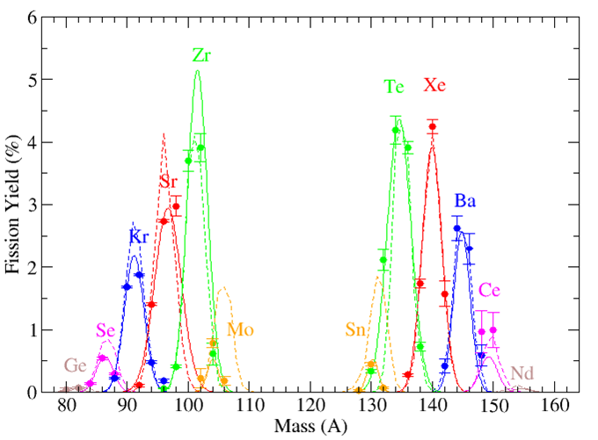
Anomalies in the charge yields of fission fragments from the ²³⁸U(n,f) reaction
J.N. Wilson, M. Lebois, L. Qi et al.,
Phys. Rev. Lett. 118, 222501 (2017)

Slide 14
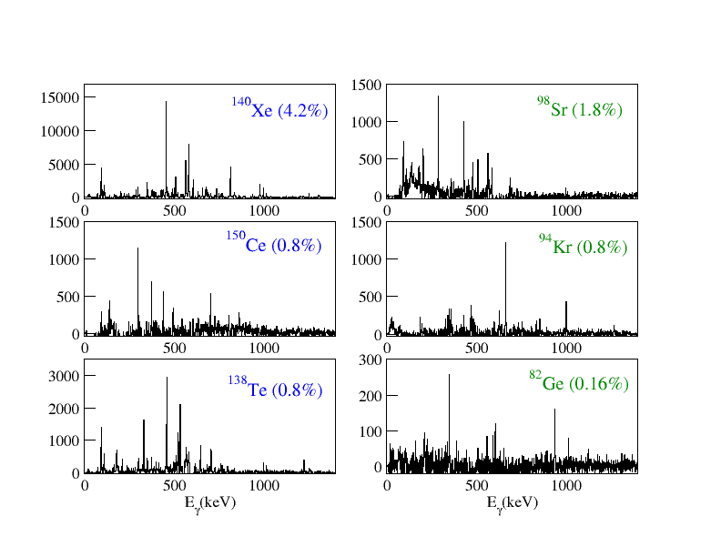
²³⁸U(n,f) Fission Fragment Selection

Slide 15
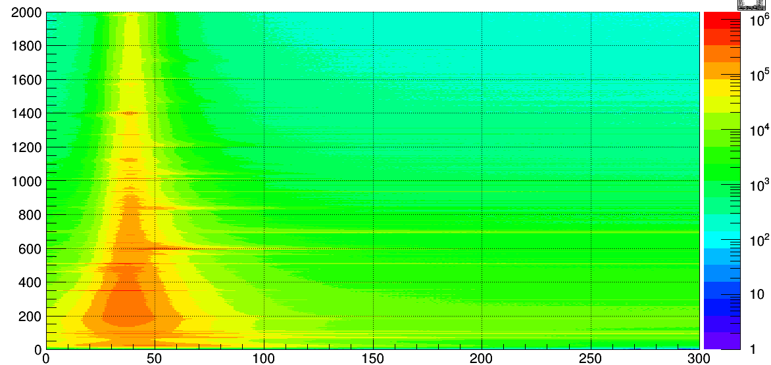
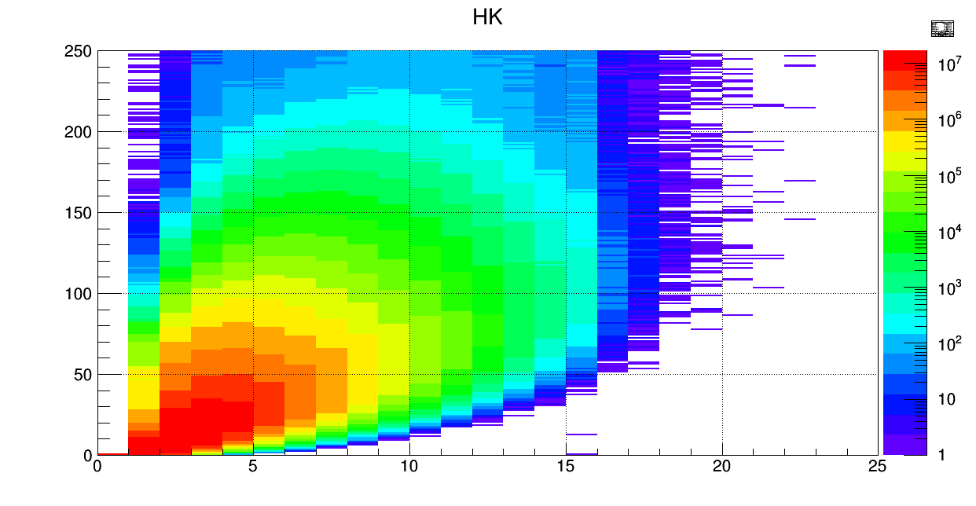
Ge Energy (keV)
ν-ball timing
and calorimetry
Ge Time (ns)
Sum Energy (MeVx10)
Gamma Multiplicity

Slide 16
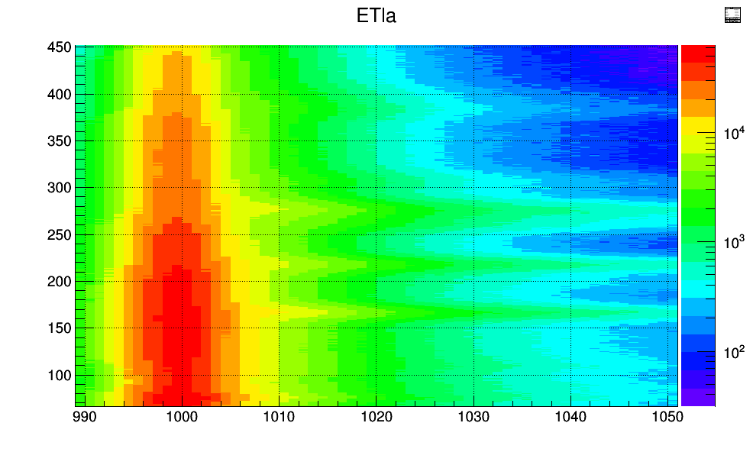
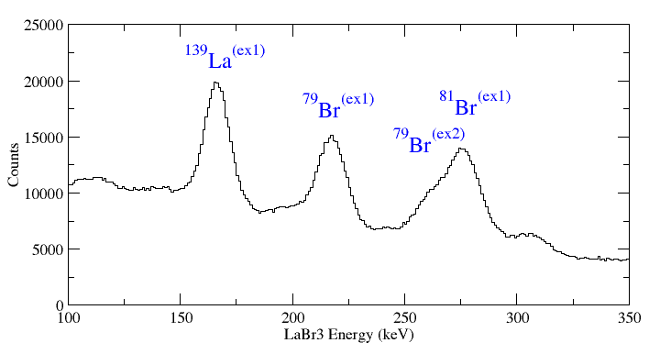
New Fission Observables and Correlations
Gamma multiplicity distribution
Gamma sum energy distribution
Average gamma multiplicity
Average total gamma energy
High energy gamma spectrum
Average neutron multiplicity
Correlated with detected fragment (and partners)
²⁵²Cf, ²³⁸U(n,f) and ²³²Th(n,f)
Prompt neutrons: (n,n’γ) events
LaBr3 Energy (keV)
LaBr3 Time

Slide 17
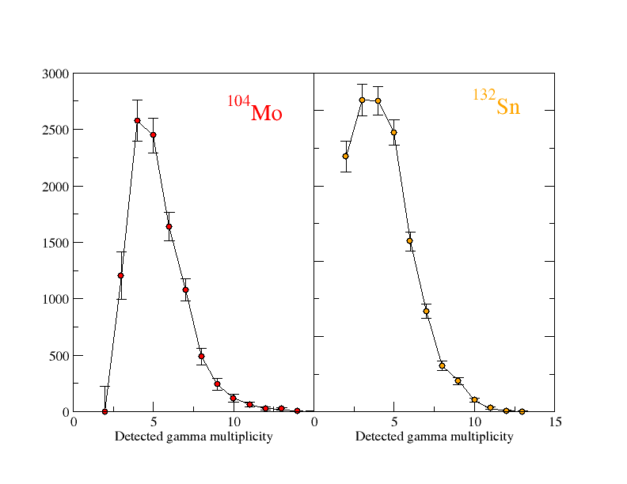
²³⁸U(n,f) Gamma Multiplicity Distributions correlated with A/Z

Slide 18
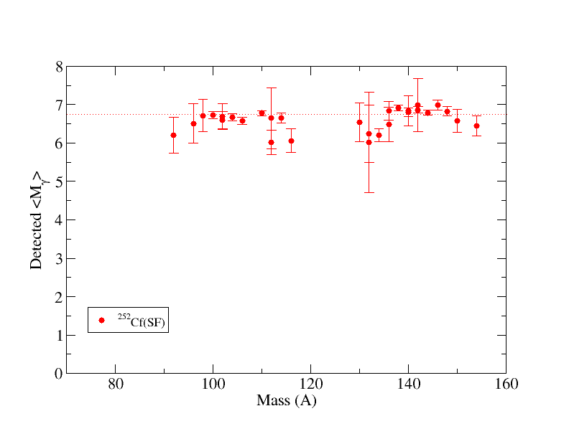
Average gamma multiplicities

Slide 19
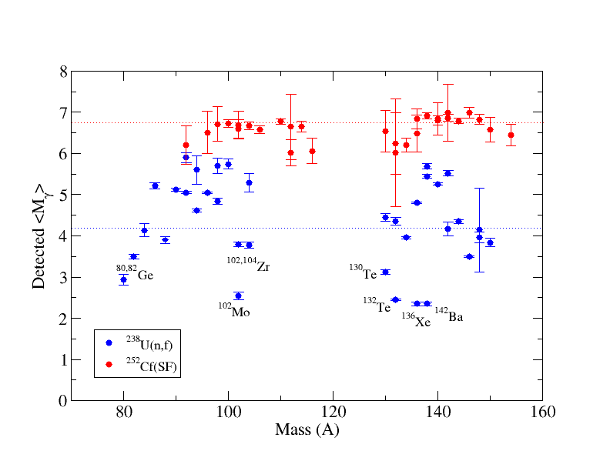
Average gamma multiplicities

Slide 20
Detailed nuclear structure of neutron-rich nuclei

Slide 21
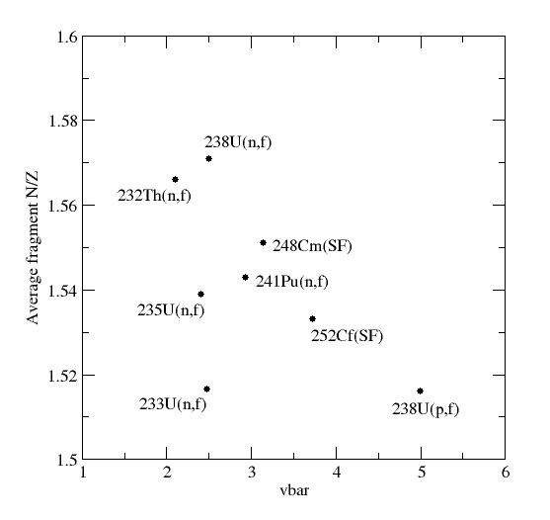
Exotic Nuclei Production/Study from Fission Reactions
Spontaneous Fission
²⁵²Cf(SF), ²⁴⁸Cm(SF)
(Gammasphere, Euroball)
Exoticity
Fission induced by thermal neutrons
²³⁵U(n_{th},f) ²⁴¹Pu(n_{th},f) (EXILL Exogam@ILL)
Too hot!
Fission induced by fast ~2 MeV neutrons
²³⁸U(n,f), ²³²Th(n,f)
(LICORNE @ IPN Orsay)

Slide 22
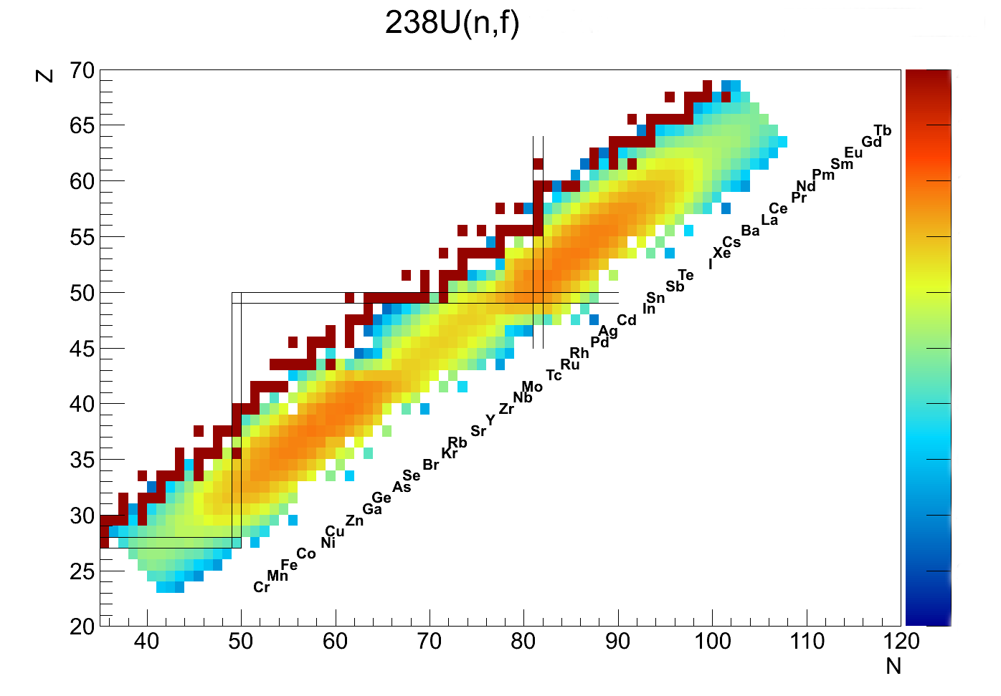
Onset of deformation
T. Kroll (Xe)
G. Benzoni (Ba,Ce,Nd)
Neutron-rich nuclei around ¹³²Sn
S. Leoni (Sn,Sb)
L. Fraile (Sn,Sb,Te)
R. Lozeva (Sb,Te,I)
Shape coexistence around N=60
Blahzev (Kr)
G. Georgiev (Rb)
D. Ralet (Sr)
L. Iskra (Y)
S. Bottoni (Sr,Zr)
P. Regan (Zr)
Spectroscopy above ⁷⁸Ni
M. Lebois (Zn, Ge, Ga)
B. Fornal (Ge,Ga)
A. Korgul (Ge,Se)
C. Schmitt (All)
M. Fallot (Many)
C. Schmitt and J.N. Wilson (All isotopes)

Slide 23
Production and study of neutron-rich nuclei above ⁷⁸Ni with LICORNE/nu-ball
²³²Th(n,f) reaction products
⁹⁵Kr
2
⁹⁶Kr
⁹⁴Kr
2
5
3
⁹³Kr
⁸⁹Br
0
⁹⁰Br
0
⁹¹Br
0
⁹²Br
8
⁸⁶Se
3
⁸⁷Se
0
⁸⁹Se
0
⁹⁰Se
0
⁹¹Se
⁸⁸Se
0
1
Yield
⁸⁵As
0
⁸⁸As
⁸⁴As
0
6
⁸⁶As
0
⁸⁷As
0
> 1%
⁸⁴Ge
3
⁸⁵Ge
1
⁸⁶Ge
⁸²Ge
0
5
⁸³Ge
5
0.1 – 1 %
⁸⁰Ga
13
⁸¹Ga
4
⁸²Ga
1
0.01% - 0.1%
Number of known excited states
1
⁷⁸Ni
2
“⁷⁸Ni revealed as a doubly magic stronghold against nuclear deformation”
R. Taniuchi, et al. Nature, volume 569, pages 53–58 (2019)

Slide 24
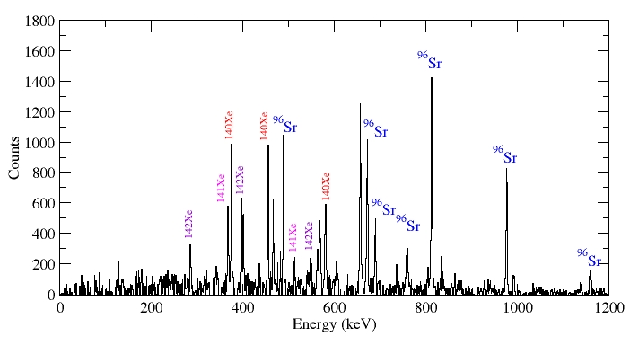

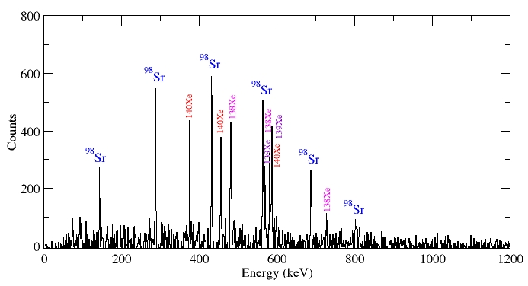
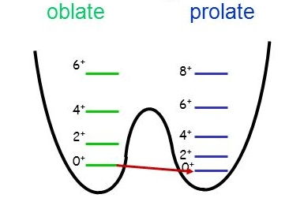
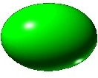
N= 60
⁹⁶Sr
⁹⁶Sr
⁹⁷Sr
⁹⁸Sr
⁹⁵Rb
⁹⁶Rb
⁹⁷Rr
⁹⁴Kr
⁹⁵Kr
⁹⁶Kr
⁹⁸Sr
~132
⁹⁶Kr Low-Z boundary of the Island of Deformation at N=60
J. Dudouet et al.
PRL 118, 162501 (2017)

Slide 25
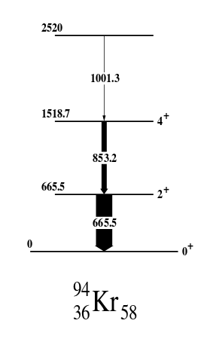
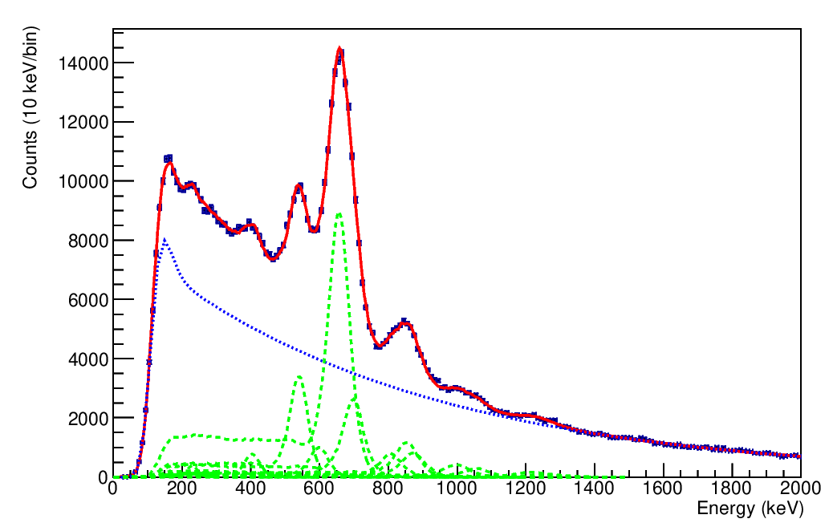
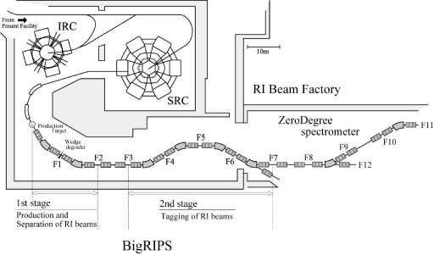
⁹⁴Kr recent RIKEN Big RIPS data
666
v/c = 0.6
854
1001
Previous results confirmed
(courtesy of R-B. Gerst)
T. Rzaca-Urban et al.
Eur. Phys. J. A9, 165–169 (2000)
²⁴⁸Cm(SF)
²³⁸U + Pb @ 350 MeV/A

Slide 26
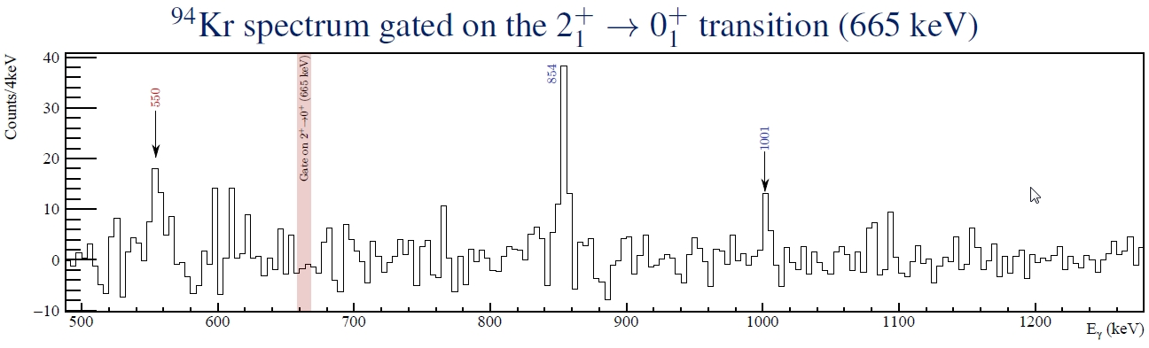
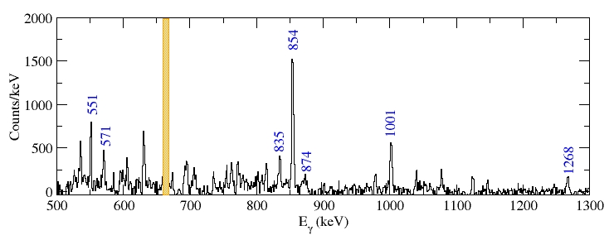
AGATA/VAMOS@GANIL
⁹Be(²³⁸U,f)
(courtesy of J. Dudouet)
v/c = 0.1
ν-ball/LICORNE@ALTO
²³⁸U(n,f)

Slide 27
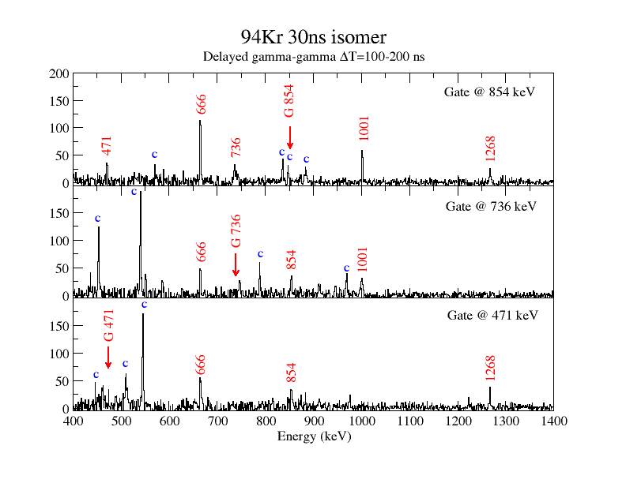
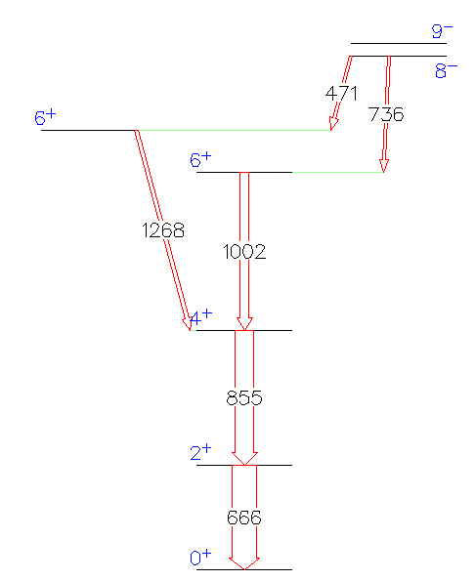

Slide 28
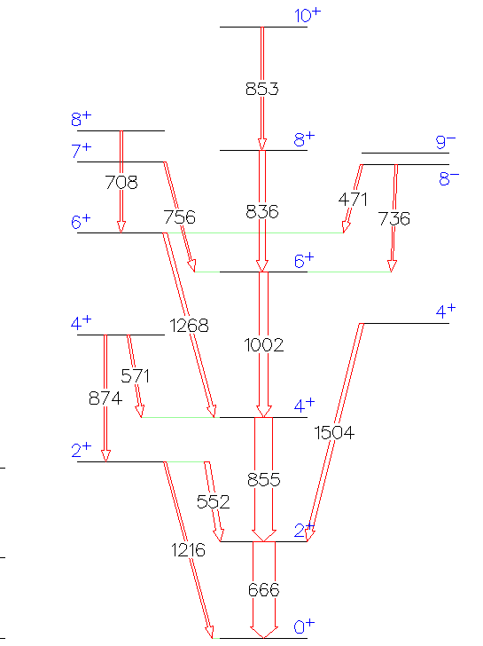
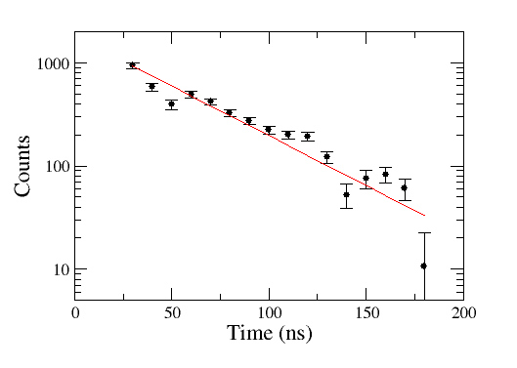
ν-ball/LICORNE ²³⁸U(n,f) data
T_{1/2} = 31 (3) ns
Kπ = 9− = n11/2- [505] ⊗ 7/2+ [404]
Kπ = 7− = n11/2- [505] ⊗ 3/2+ [411]
⁹⁴Kr
(preliminary)

Slide 29
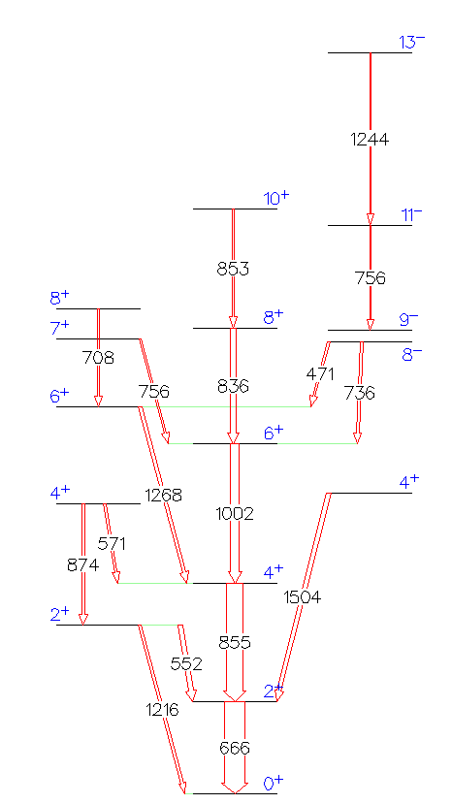
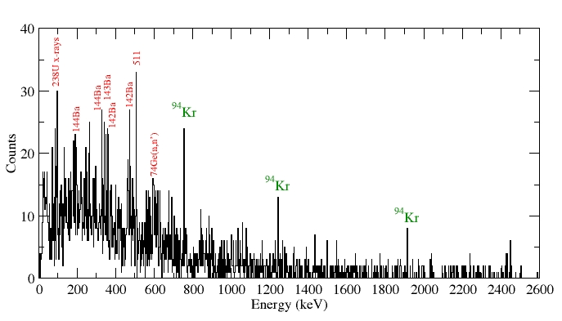
Above the isomer in ⁹⁴Kr

Slide 30
Sub nanosecond timing

Slide 31
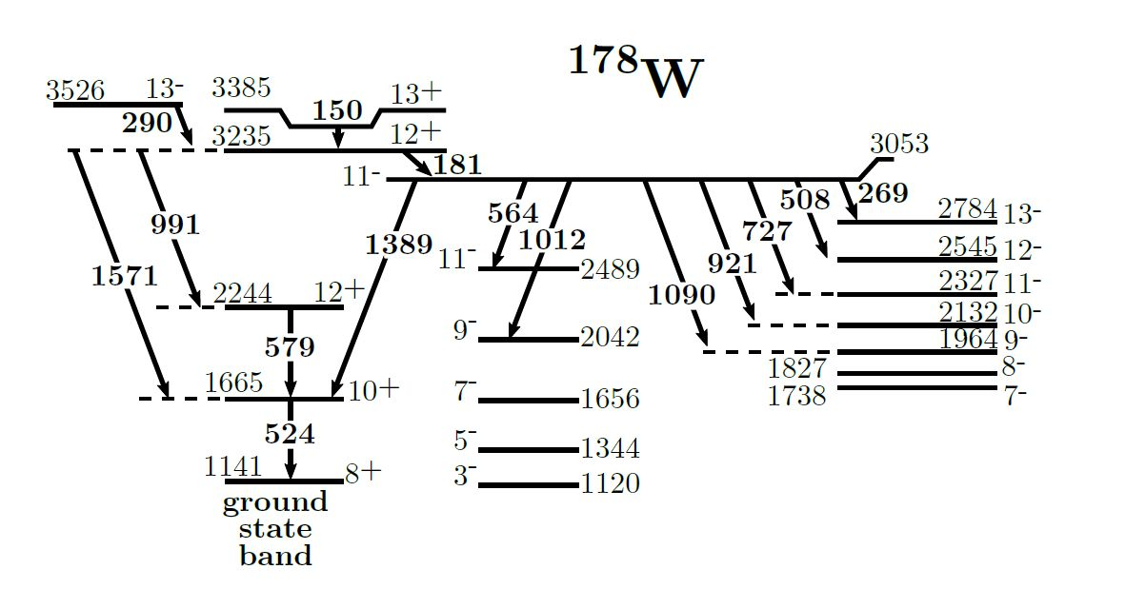
Multi-quasiparticle sub-nanosecond isomers in ¹⁷⁸W
M. Rudigier, P. Walker et al., University of Surrey
Submitted to Physics Letters B.
¹⁸O + ¹⁶⁴Dy -> ¹⁷⁸W + 2n
@ 72, 76 and 80 MeV
275(65)ps
476(44)ps

Slide 32
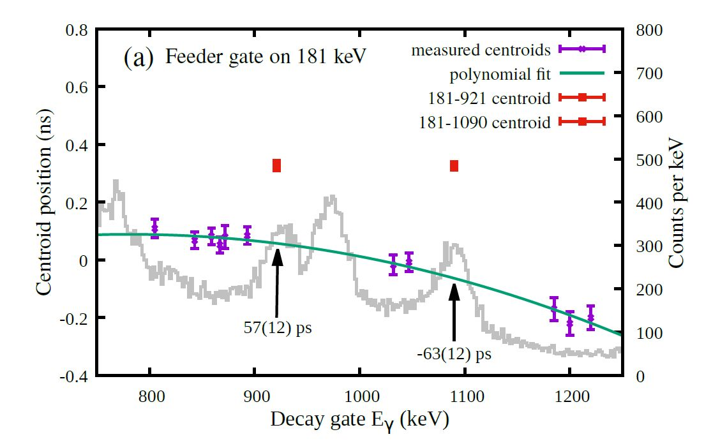
Lifetime of the 11- state

Slide 33
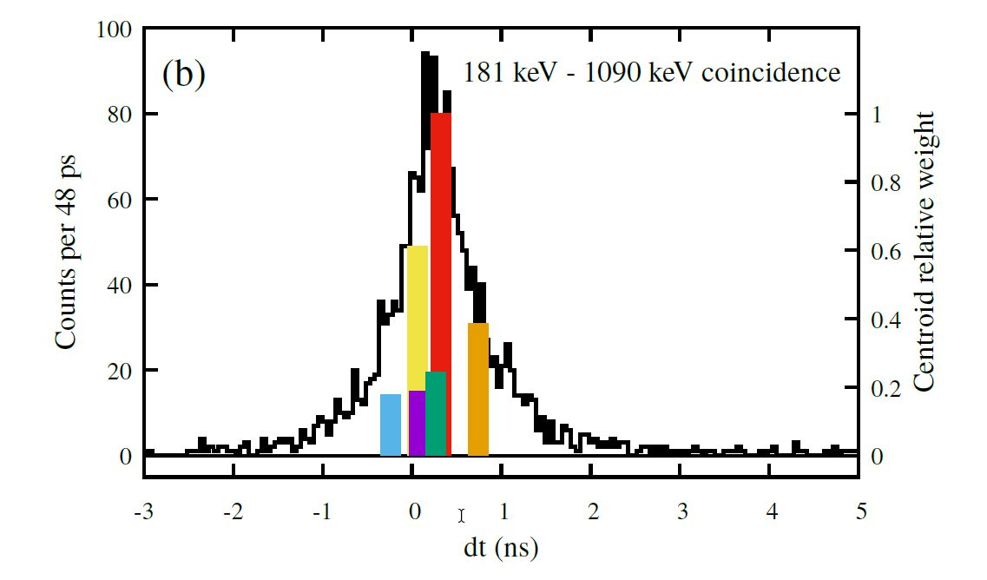

Slide 34
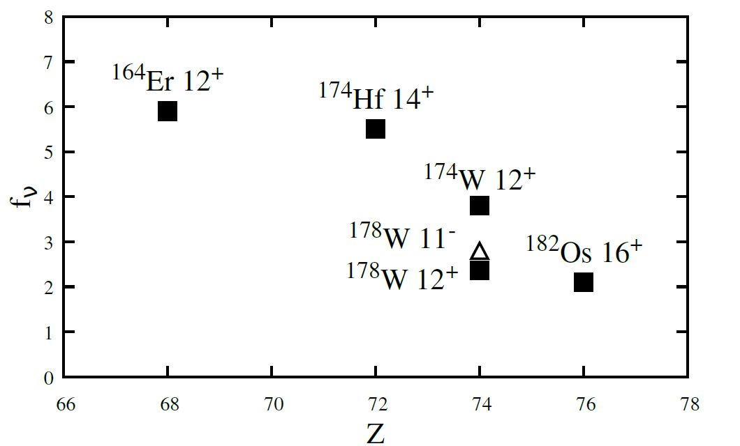
Hinderance factors in context

Slide 35
GDR studies: ν-ball coupled to PARIS

Slide 36
Feeding of low-energy structures by GDR decay using coupled ν-ball and PARIS detectors
M. Kmiecik, M. Ciemała, A. Maj, B. Fornal, P. Bednarczyk, N. Cieplicka-Oryńczak, Ł. Iskra, K. Mazurek, M. Matejska-Minda, B. Wasilewska, et al. IFJ PAN Kraków, Poland;
F.C.L. Crespi, A. Bracco, F. Camera, S. Leoni, S. Ceruti et al. INFN Milano and Milano University, Italy;
J. Wilson, M. Lebois, I. Matea, D. Thisse et al., IPN Orsay, France;
P. Napiorkowski, M. Kicińska-Habior et al., Warsaw University, Poland;
O. Dorvaux, Ch. Schmitt, J. Dudek et al., IPHC Strasbourg, France;
I. Mazumdar, V. Nanal et al, TIFR Mumbai, India;
And the PARIS Collaboration

Slide 37
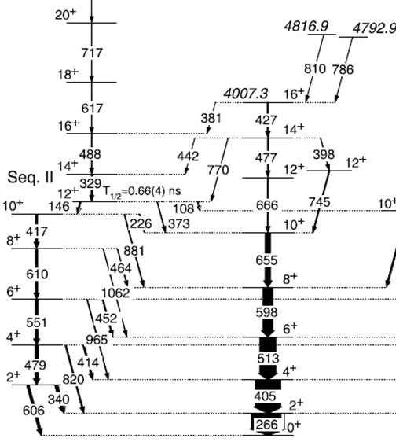
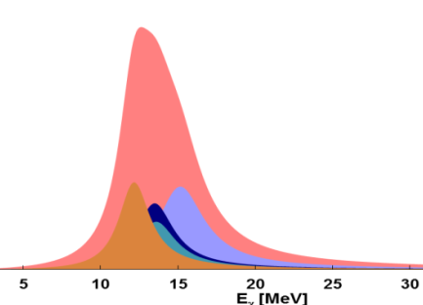
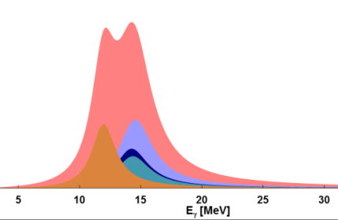
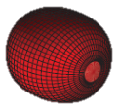

The idea
High-energy γ rays from ¹⁹²Pt* CN decay in 4n channel in coincidence with low-energy transitions in ¹⁸⁸Pt
How the deformation changes along the decay path?
Gate on transitions
GDR strength functions for CN decaying to particular states of ¹⁸⁸Pt
β=0.16 and γ=−40°
triaxial
β =0.18and γ=−6°
near prolate
S. Mukhopadhyay et al., Phys. Lett. B 739, 462 (2014)

Slide 38
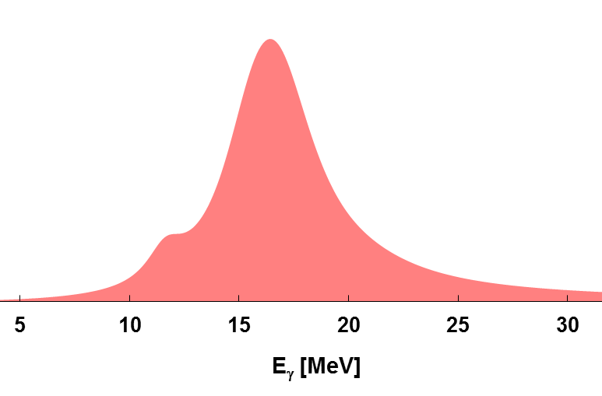
The idea
High-energy γ rays from ¹⁹²Pt* CN decay in 4n channel in coincidence with low-energy transitions in ¹⁸⁸Pt
How the GDR feeds low energy structures?
Gate on energy subregions in GDR
transitions yield as a function
of GDR energy
S. Mukhopadhyay et al., Phys. Lett. B 739, 462 (2014)

Slide 39
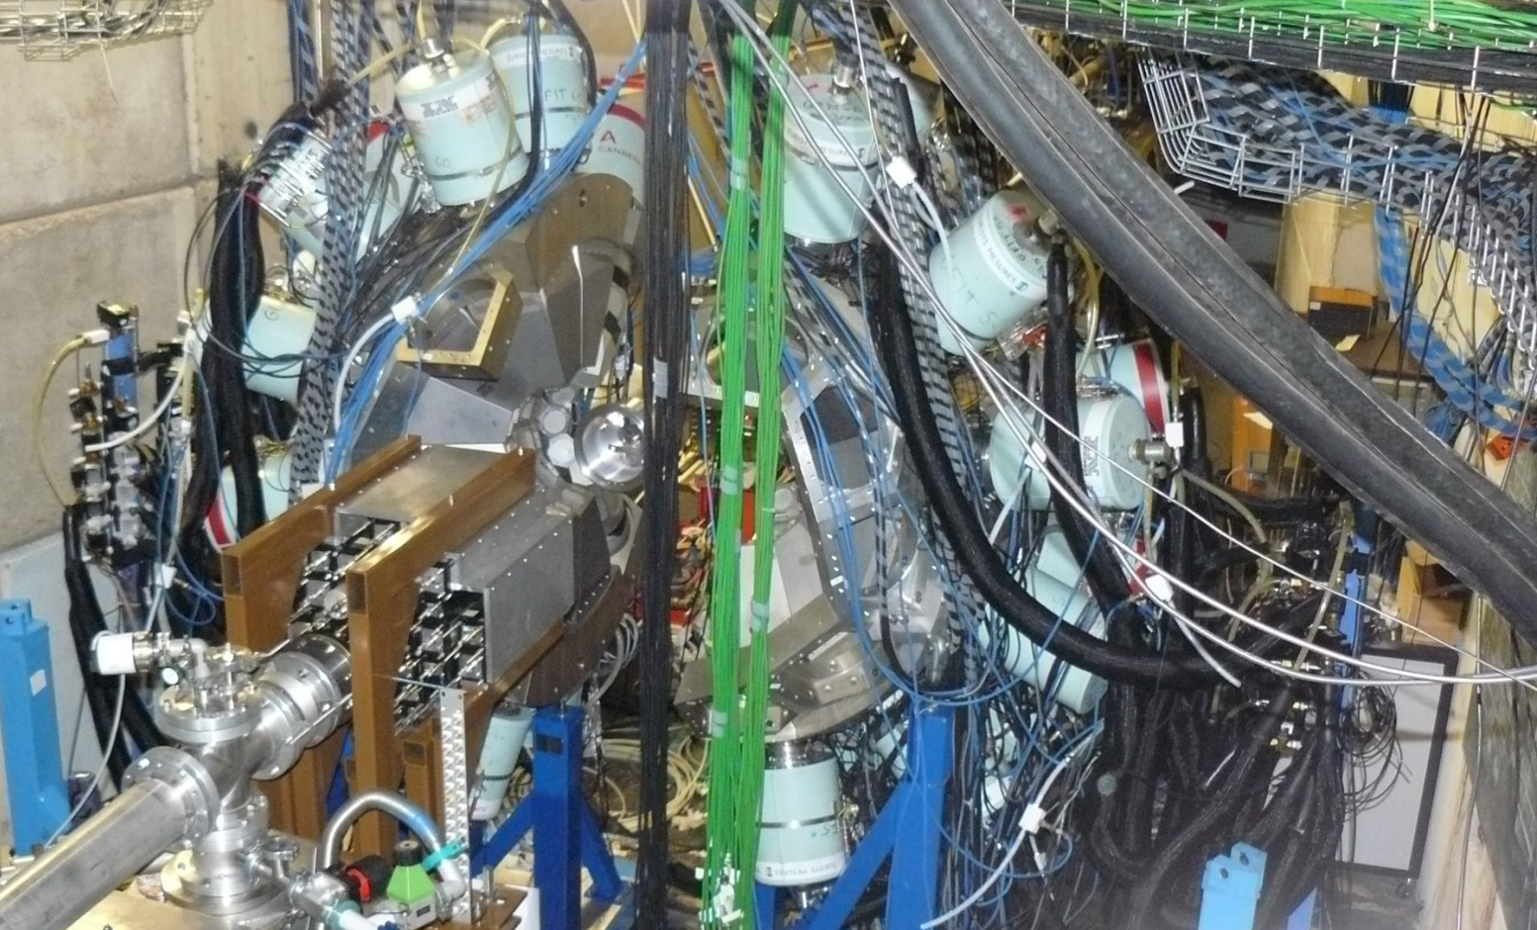
Set-up
ν-ball array: 33 Clovers +10 Coaxial HPGe
coupled to 33 PARIS detectors:
11 CeBr:NaI phoswiches,
22 LaBr3:NaI phoswiches.
Triggerless DAQ by FASTER digitizer
ν-ball
PARIS

Slide 40
Reaction
GEMINI++ calculations
Yields of residual nuclei
Name | Percent | Cross-section (mb)
¹⁸⁶Pt | 5.2% | 36.98
¹⁸⁸Pt | 14.8% | 104.78
¹⁸⁷Pt | 79.0% | 558.84
¹⁸⁷Ir | 0.3% | 2.05
¹⁸⁴Os | 0.7% | 5.14
¹⁸O + ¹⁷⁴Yb → ¹⁹²Pt
Beam energy: 90 MeV
E* = 59 MeV
L_{max} = 38 ħ
Target thickness: 1.5 mg/cm²
Yields of residual nuclei with condition Eγ > 10 MeV
Name | Percent
¹⁸⁹Pt | 15%
¹⁸⁸Pt | 75%
¹⁸⁷Pt | 10%
coincidence
with GDR

Slide 41

γ-γ matrix
~20% of the data
266 keV

Slide 42

Gate on high-energy γ rays
[Preliminary]
Gating on high-energy γ rays in PARIS – more 4n decay events selected

Slide 43


ν-ball2 campaign forseen 2021 - 2022
New Configurations
ν-ball/PARIS
GDR studies. High energy gamma detection for light nuclei (ALTO high intensity ^{6,7}Li, ¹⁴C beams)
ν-ball/OUPS plunger and/or charged particle detector
RDM lifetimes
ν-ball/Fast Timing
24 clovers coupled with 40 FATIMA for best hybrid array performance. Lifetime measurements 10-ps 10ns range for weakly populated states
ν-ball/LICORNE
Improve fission technique: Reduce gamma backgrounds from
the source and intrinsic target activity. More primary beam.
Low density targets for DPM lifetime measurements. ²⁵²Cf IC

Slide 44

The ν-ball2 International Workshop
JRC-Geel, European Commission, Belgium, November 2018
ν-ball2 campaign in 2021 and 2022 will be defended as an official in2p3 project before the scientific council of the in2p3 (26/06/19)

Slide 45
Thank you to all the Collaborators
Core Team: M. Lebois, D. Thisse, N. Jovancevic, D. Etasse, J.N. Wilson,
M. Rudigier, R. Canavan, R-B. Gerst
P. Regan, Z. Podloyak, M. Rudigier, S. Jazwari (University of Surrey)
M. Bunce, A. Boso, (National Physical Laboratory, UK)
T. Kröll , M. Treskow, C. Henrich, J. Wiederhold, I. Homm (TU Darmstadt)
A. Blazhev, N. Warr, C. Surder (University of Köln)
L. Fraile, V. Vedia, J. Benito, V. Sanchez (University of Madrid)
S. Oberstedt (JRC Geel, European Comission)
A. Maj, M. Kmiecik, M. Ciemala, B. Fornal, B. Wasiewska (IFJ PAN, Krakow)
S. Leoni, L. Iskra, G. Benzoni, S. Bottoni, C. Porzio, S. Zilliani (University of Milano)
A. Korgul, K. Miernik, M. Piersa, E. Adamska (Warsaw)
R. Lozeva, Guilaume Häfner, A. Lopez-Martens, R. Chakma (CSNSM Orsay)
S. Siem, W. Paulson, D. Gjestvang, F. Zeiser (University of Oslo)
B. Blank, J. Giovinazzo, S. Grevy, P. Ascher, T. Kurtukian (CENBG Bordeaux)
M. Fallot, L. Lemur (Subatech)
P. Davies (University of Manchester)
C. Schmitt, S. Courtin, M. Heine (IPHC Strasbourg)
A. Algora (Valencia)
and the PARIS and FATIMA collaborations

Slide 47

ν-ball Ge detector maintenance
Operations
11 detectors were repaired during the campaign. 25 FET’s replaced.
Components are expensive
HV Filter - 860 euros
FET - 180 euros
Preamplifier - 1600 euros
Failure diagnostic
Pumping
Annealing (80°C)
FET replacement (Clean room required)
HV Filter replacement
Charge preamplifier test and replacement
Replace ORTEC’s obsolete preamplifier by Canberra material
Timeline was very tight
New technique developed in
2018 to replace Preamplifier
components rather than whole board

Slide 48


First preliminary results: ²⁵²Cf ionisation chamber + ν-ball
ν-ball calorimetry
¹⁵²Eu beta decay events
²⁵²Cf fission events
Sum Energy
γ multiplicity
γ multiplicity

Slide 49

First preliminary results: ν-ball calorimetry

Slide 50



First preliminary results:
²⁵²Cf ionisation chamber + ν-ball
RIKEN
ν-ball
Isomer in ¹⁶⁴Gd discovered at BIGRIPS focal plane in 2017
¹⁶⁴Gd isomer identified after only 48 hours of data
< 0.01% of the total yield
Decays from states above the isomer observed for the first time
Prompt decays impossible to observe

Slide 51

The search for neutron radioactivity
V
Proton
radioactivity
Neutron
radioactivity
(?)
Coulomb barrier
Centrifugal barrier
distance
distance
protons
neutrons

Slide 52
Neutron radioactivity
n
high-spin isomer
neutron-emission
threshold
^{A-1}X
γ decay
g.s.
^{A}X

Slide 53


MeV
MeV
8
neutron separation
energy
8
6
neutron separation
energy
6
126
4
4
terra incognita
82
2
50
2
0
0

Slide 54
A.K. Jain, B. Maheshwari, S. Garg, M. Patial, and B. Singh
ATLAS OF NUCLEAR ISOMERS
Nuclear Data Sheets 128 (2015) 1–130
Occurrence of microsecond isomers
in the known nuclei
²⁰⁸Pb
Proton number
¹³²Sn
Potential existence of isomers
lying above neutron-separation energy
⁷⁸Ni
Neutron number

Slide 55



Yields of products
from the fast-neutron
induced fission of ²³²Th
²³²Th
Thermal neutron induced fission
of ²³⁵U
Spontaneous fission of ²⁴⁸Cm

