Slide 1
Status and Perspectives of AGATA
    AGATA status and achievements
    Memorandum of Understanding
    Physics case – White book
    Future host laboratories
    Project definition
Peter Reiter
Institute of Nuclear Physics, University of Cologne
AGATA collaboration meeting
Orsay 27.6. – 28.6.2019

Slide 2
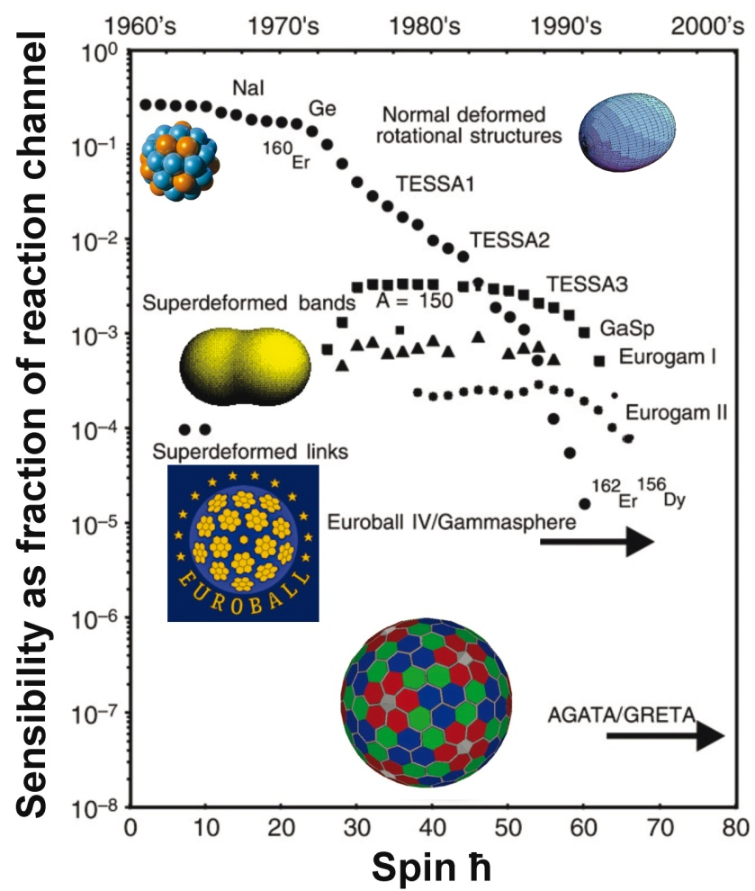
The AGATA 4π promise
Unprecedented detection sensitivity
Improved conditions for in-beam γ-ray spectroscopy
  energy resolution
  → Doppler effects
  detection efficiency at high energies
  line shape
  → escape line suppression
  1st interaction point
  → angular distributions
  2nd interaction point
  → polarization sensitivity
  lifetime measurements
  → continuous DSAM
  → 2d line shape fit
  γ-ray imaging
  → back ground suppression

Slide 3
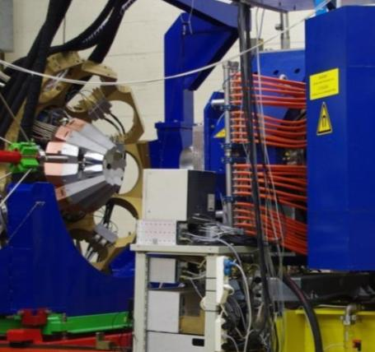
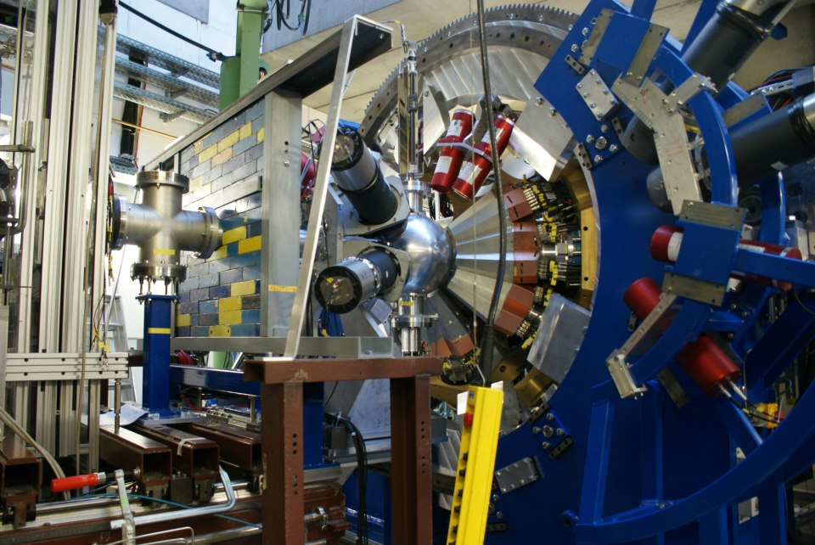
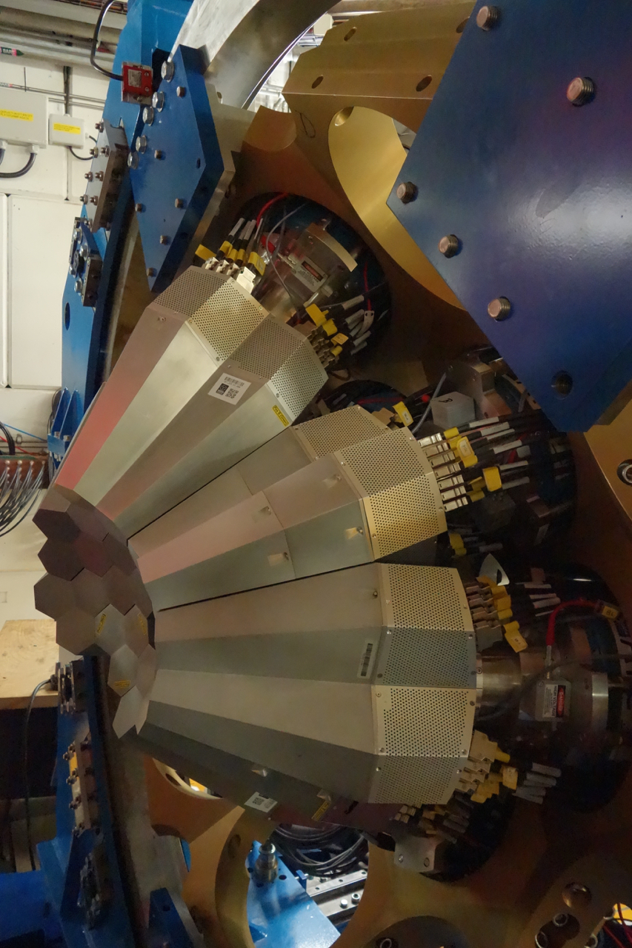
From the Demonstrator to AGATA 1π
LNL: 2009-2011
15 crystals (5TC)
Total Eff. ~6%
GSI: 2012-2014
24 crystals (3DC+6TC)
Total Eff.~9%
GANIL: 2014-2021
45 crystals (15 TC)
Total Eff. ~15%
Demonstrator + PRISMA
AGATA + FRS
AGATA @ G1
>45 crystals in ATCs available in June 2019

Slide 4
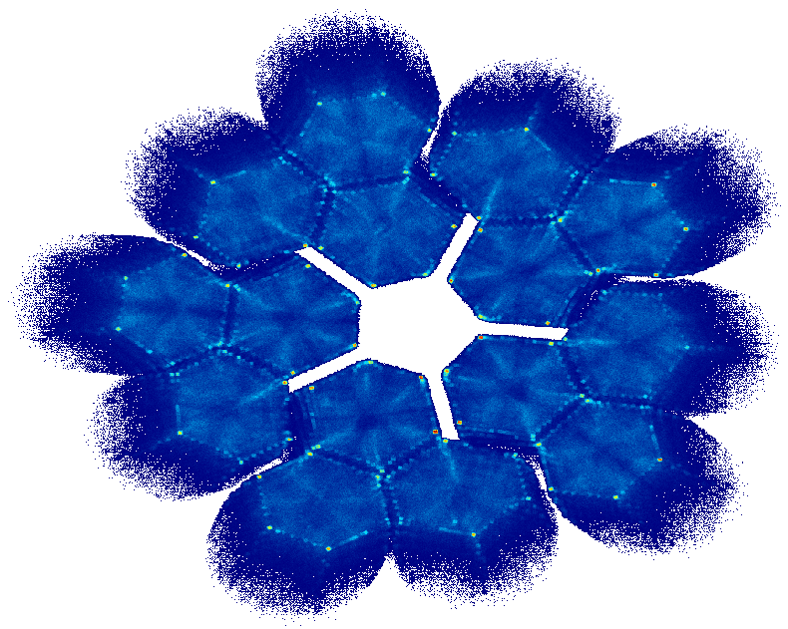
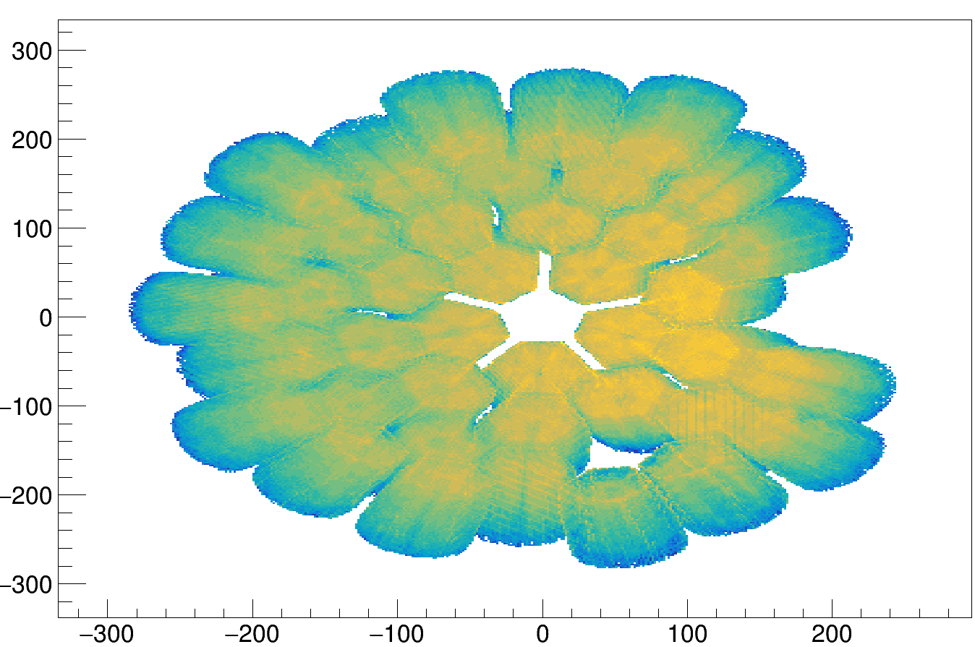
AGATA γ-ray tracking
Reconstructed initial gamma rays with: - gamma ray energy
- 1st interaction position → Doppler correction
- 2nd interaction position → Polarization
B. Alikhani, NIM A, 675(0):144 (2012)
P.G. Bizzeti et al., Eur. Phys. J. A (2015) 51: 49
.

Slide 5
AGATA scientific results: technical publications
89 publications
https://www.agata.org/

Slide 6
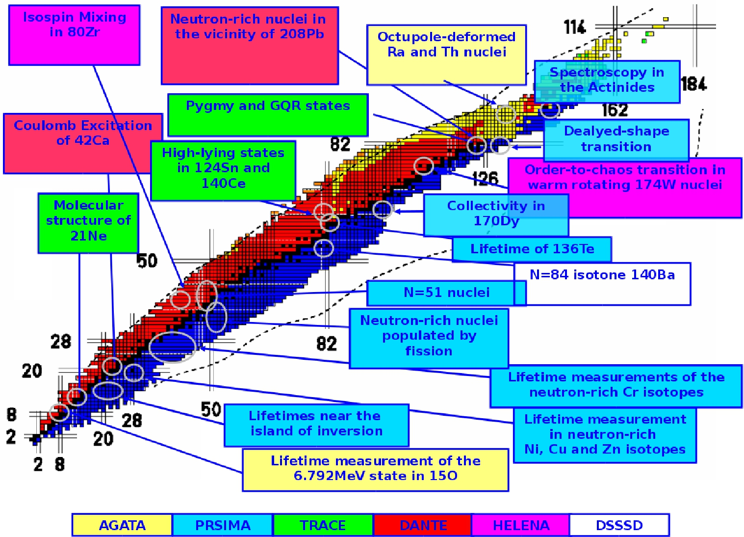
LNL EXPERIMENTS: 20 exps, 148 days, 3500 hs
PRISMA
Notes:
6
Over all 20 exps have been run, ranging from n- to p- rich nuclei from the light
15O and 21Ne up the spectroscopy of heavy Actinides. A variety of ancillary
detectors have been also employed, mostly PRISMA on the n-rich side for quasi-elastic,
MNT, deep inelastic induced fission and other ancillary detectors for Feand Coulomb
Excitation with stable or p-rich nuclei. These were TRACE, HELENA, HECTOR, DANTE..
6

Slide 7
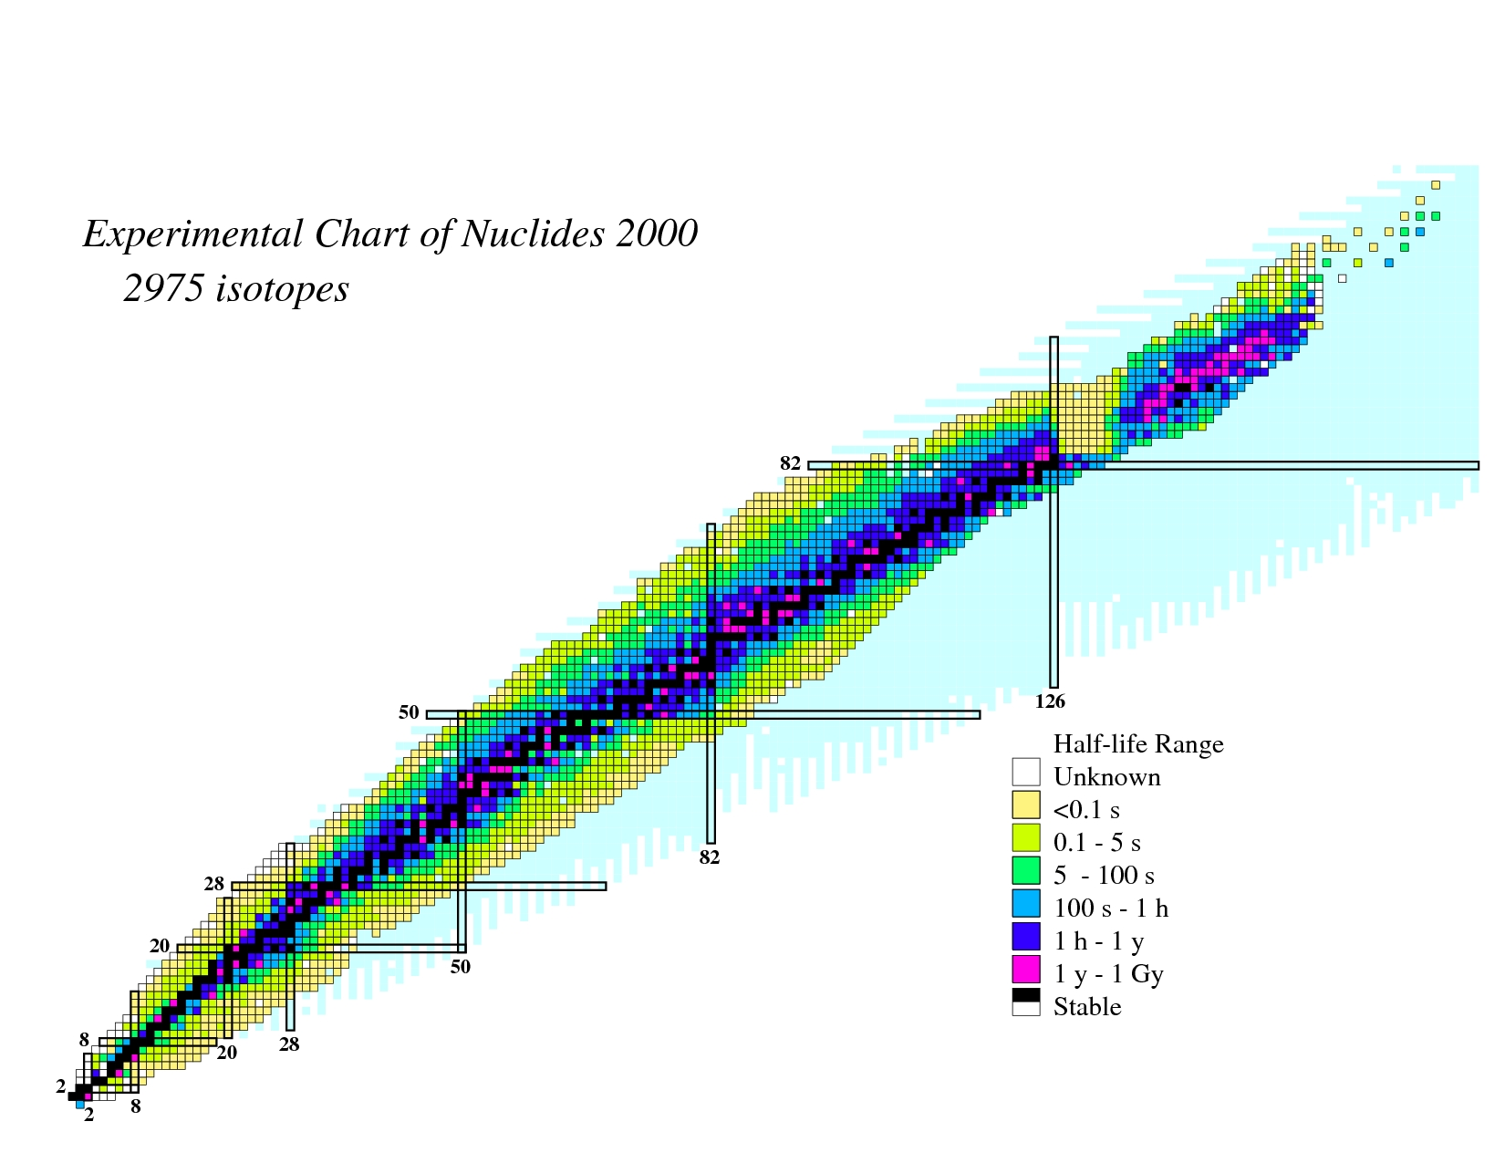
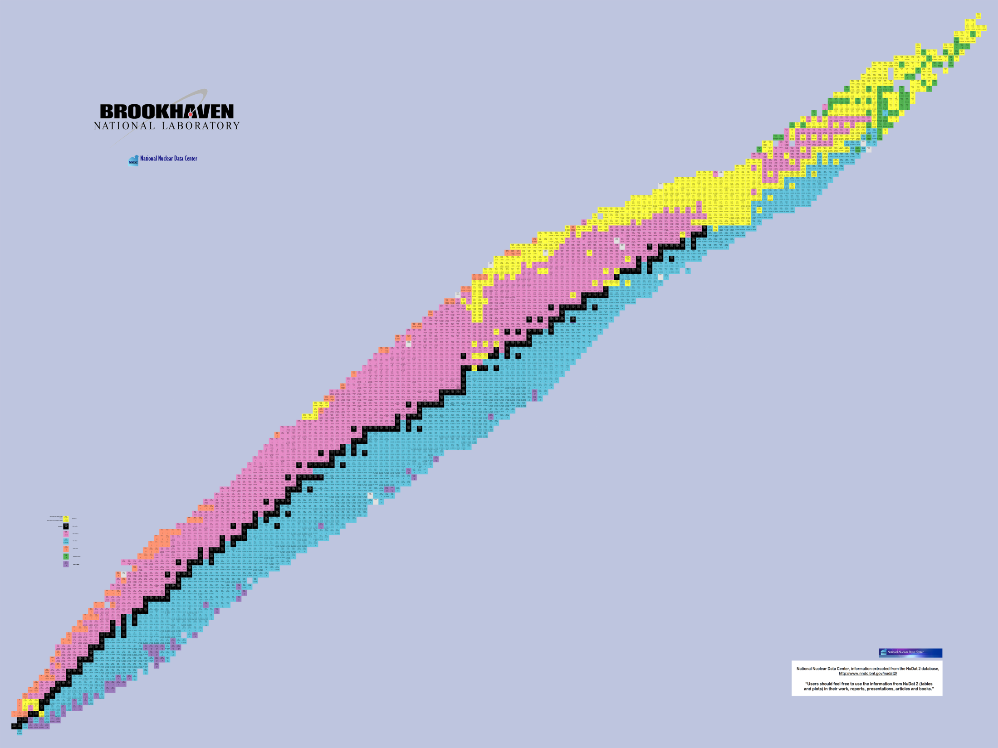

AGATA Experiments at GANIL in 2015-2018
Search for Double Gamma decay in ¹³⁷Cs source
Reaction mechanism : Fission of Light Hg
Octupole – Quadrupole correlation in ¹¹²Xe
²⁰⁸Pb
Studies of excited states in ^{102,103}Sn
Octupole correlation in ²⁰⁷Pb
Evolution of collectivity around N=50: lifetime measurements ^{104,106}Sn
Exploration of alpha-cluster: the unique case of ²¹²Po (²⁰⁸Pb + α)
Evolution of collectivity around N=50: lifetime measurements ⁹⁴Ru
Shape transition in the neutron-rich W isotopes
Search for isoscalar pairing in the N=Z nucleus ⁸⁸Ru
Transition Quadrupole Moments in ^{166,168}Dy.
¹⁰⁰Sn
i_{13/2} single particle state in ¹³³Sn and high spin in ¹⁰⁸Zr
Isospin Symmetry Breaking in the A=63,71 mirror nuclei
¹³²Sn
Shape evolution in neutron rich fission fragments in the mass A~100 region
⁶⁸Ni
⁷⁸Ni
Shell evolution around N=50: ⁸¹Ga spectroscopy
Evolution of collectivity around N=52: lifetime measurements in ^{83,84}Ge
Evolution of collectivity around N=40: lifetime measurements in ^{73,75}Ga
⁴⁸Ca
Evolution of collectivity around N=40: lifetime measurements in ⁶⁴Fe
Evolution of the shell structure in the region of neutron-rich Ti isotopes
21 experiments
Lifetime measurements of excited states in neutron-rich C and O isotopes
The lifetime of the 7.786 MeV state in ²³Mg as a probe for classical novae models

Slide 8
AGATA performance [2015-2018]
Cumulative [TB]
Without Traces…
2017 r3
2017
2016
2015
2014

Slide 9
Scientific results: physics papers from LNL, GSI, GANIL
Pseudospin Symmetry and Microscopic Origin of Shape Coexistence in the ⁷⁸Ni Region:
a Hint from Lifetime Measurements
C. Delafosse, et al.;
Phys. Rev. Lett. 121, 192502 (2018)
⁹⁶Kr₆₀–Low-Z boundary of the island of deformation at N=60
J. Dudouet, et al.;
Phys. Rev. Lett. 118, 162501 (2017)
Role of the Δ Resonance in the Population of a Four-Nucleon State in the ⁵⁶Fe → ⁵⁴Fe Reaction at Relativistic Energies
Zs. Podolyák, et al.;
Phys. Rev. Lett. 117, 222302 (2016)
Superdeformed and Triaxial States in ⁴²Ca
K. Hadyńska, et al.,
Phys. Rev. Lett.117, 062501 (2016)
Isospin mixing in ⁸⁰Zr: from finite to zero temperature
S. Ceruti, et al.;
Phys. Rev. Lett. 115, 222502 (2015)
Isospin character of low-lying pygmy dipole states in ²⁰⁸Pb via inelastic scattering of ¹⁷O ions
F.C.L. Crespi, et al.;
Phys. Rev. Lett. 113, 012501 (2014)
Pygmy Dipole Resonance in ¹²⁴Sn populated by inelastic scattering of ¹⁷O
L. Pellegri, et al.;
Phys. Lett. B 738 (2014) 519
AGATA publications from experiments
Period 2011 - 2019
> 45 publications in peer reviewed journals (no proceedings)
https://www.agata.org/

Slide 10
Scientific results: latest papers
Effects of one valence proton on seniority and angular momentum
of neutrons in neutron-rich 122–131Sb isotopes
S. Biswas, et al.;
Phys. Rev. C 99, 064302 (2019)
Identification of high-spin proton configurations in 136Ba and 137Ba
L. Kaya, et al.;
Phys. Rev. C 99, 014301 (2019)
Pseudospin Symmetry and Microscopic Origin of Shape Coexistence in the 78Ni Region:
a Hint from Lifetime Measurements
C. Delafosse, et al.;
Phys. Rev. Lett. 121, 192502 (2018)
Millisecond 23/2+ isomers in the N = 79 isotones 133Xe and 135Ba
L. Kaya, et al.;
Phys. Rev. C 98, 054312 (2018)
High-spin structure in the transitional nucleus 131Xe: Competitive neutron and proton alignment
in the vicinity of the N = 82 shell closure
L. Kaya, et al.;
Phys. Rev. C 98, 014309 (2018)
Transition probabilities in neutron-rich 80,82Se and the role of the ng9/2 orbital
J. Litzinger, et al.;
Phys. Rev. C 97, 044323 (2018)
Study of Isomeric States in 198,200,202,206Pb and 206Hg Populated in Fragmentation Reactions
N. Lalovic, et al.;
J. Phys. G: Nucl. Part. Phys. 45 035105 (2018)
Quadrupole collectivity in 42Ca from low-energy Coulomb excitation with AGATA
K. Hadynska-Klek, et al.;
Phys. Rev. C 97, 024326 (2018)
AGATA publications from experiments
Period 2018-19

Slide 11
Scientific results: submitted papers
Isospin properties of nuclear pair correlations from the level structure of the self-conjugate nucleus ⁸⁸Ru
B. Cederwall, et al.;
Phys. Rev. Lett. submitted
Lifetime measurements of the second 2+ state in neutron-rich ¹⁶C and ²⁰O as a test of
ab initio nuclear structure
M. Ciemala, et al.;
Phys. Rev. Lett. submitted
Isomer spectroscopy in ¹³³Ba and high-spin structure of ¹³⁴Ba
L. Kaya, et al.;
Phys. Rev. C submitted
Isospin dependence of electromagnetic transition strengths among an isobaric triplet
A. Boso, et al.;
Phys. Lett. B submitted
Evidence of octupole-phonons in ²⁰⁷Pb
D. Ralet, et al.;
Phys. Lett. B submitted
First lifetime measurements of low-lying states in the neutron-deffcient ^{106,108}Sn isotopes and
the pairing-quadrupole interplay in ¹⁰²⁻¹¹⁴Sn
M. Siciliano, et al.:
Phys. Rev. Lett. submitted

Slide 12

NuPECC Long Range Plan 2017
SUMMARY AND RECOMMENDATIONS
….
  Support to the completion of AGATA in full geometry
AGATA represents the state-of-the-art in γ-ray
spectroscopy and is an essential precision tool
underpinning a broad programme of studies in
nuclear structure, nuclear astrophysics and nuclear
reactions. AGATA will be exploited at all of the
large-scale radioactive and stable beam facilities
and in the long-term must be fully completed in
full 60 detector unit geometry in order to realise
the envisaged scientific programme. AGATA will be
realised in phases with the goal of completing the
first phase with 20 units by 2020.
….

Slide 13


AGATA physics case
MoU for AGATA 4π configuration has to be based on a strong, convincing physics case!
Five working groups are established to work on White Book
Chair of ACC W. Korten: coordination, major contributions
  AGATA@FAIR A. Jungclaus
  AGATA@GANIL Ch. Theisen
  AGATA@HIE-ISOLDE M. Zielinska
  AGATA@LNL/SPES S. Leoni
  AGATA@JYFL D. Jenkins
Close to final version circulates since spring 2019!
Status and discussion of the AGATA White Book tomorrow

Slide 14
AGATA physics case
The Nuclear Shell Structure
and its Evolution
Light Exotic Nuclei and
Clusterisation Phenomena
Shape coexistence

Slide 15
AGATA physics case
Higher-order nuclear deformation
Isospin Symmetry Studies

Slide 16
AGATA physics case
High-Spin States,
Extreme Deformation and
Giant Collective Modes
Pygmy Resonance Excitations

Slide 17
AGATA physics case
Very Heavy and Superheavy Elements
Spectroscopic Studies for
Nuclear Astrophysics

Slide 18
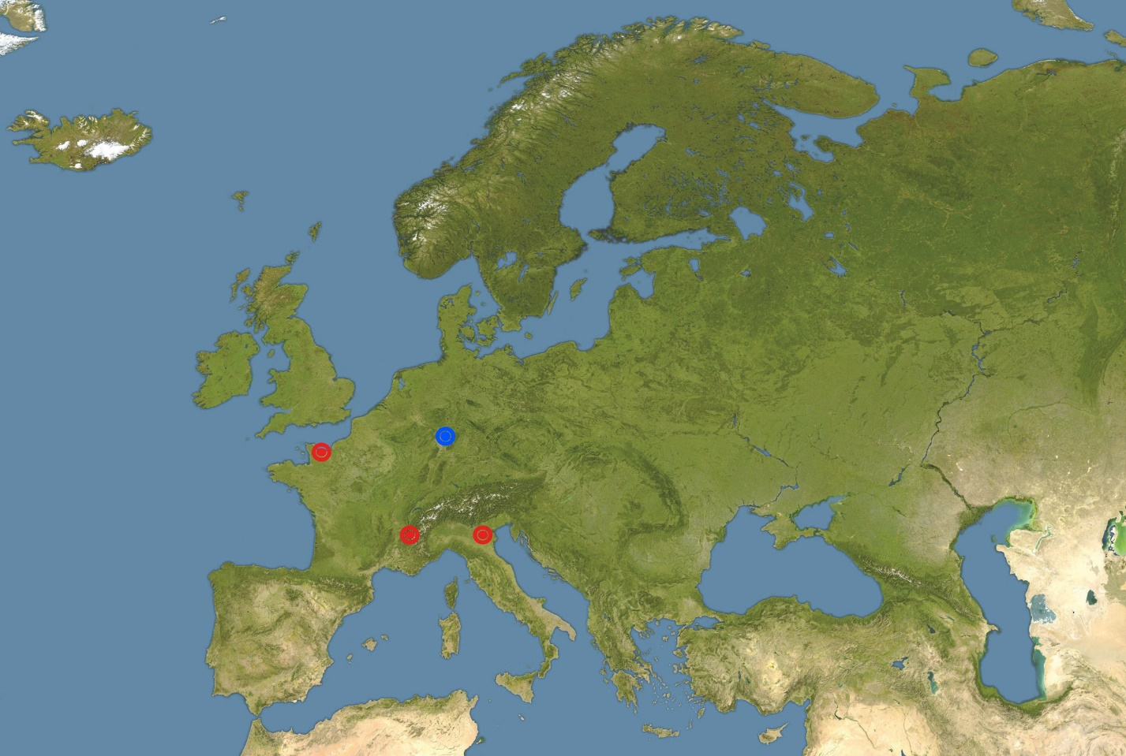
Future host labs beyond 2020
JYFL
High-Intensity
Stable-Beam Facility
SPIRAL/GANIL
FAIR
HIE-ISOLDE
SPES/LNL
ISOL Facilities
In-Flight Facility
High-Intensity
Stable-Beam Facility
Reaccelerated RIBs:
Coulomb Excitation,
Direct Reactions, MNT, Deep Inelastic, CN
Direct and inverse kinematics β ~ 10%
In-flight RIBs:
Relativistic Coulomb Excitation, Knock-out, Fragmentation …
Inverse kinematics β ~ 50%

Slide 19
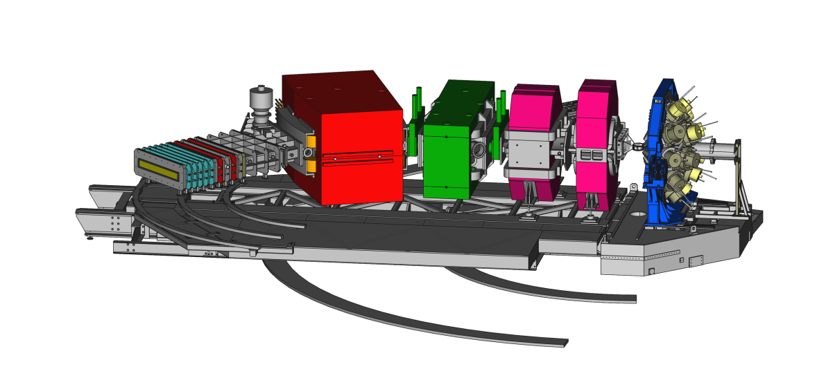
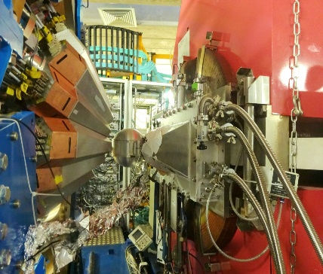
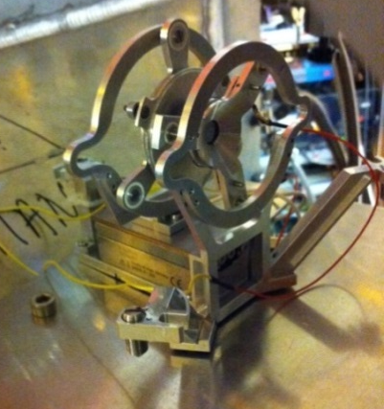
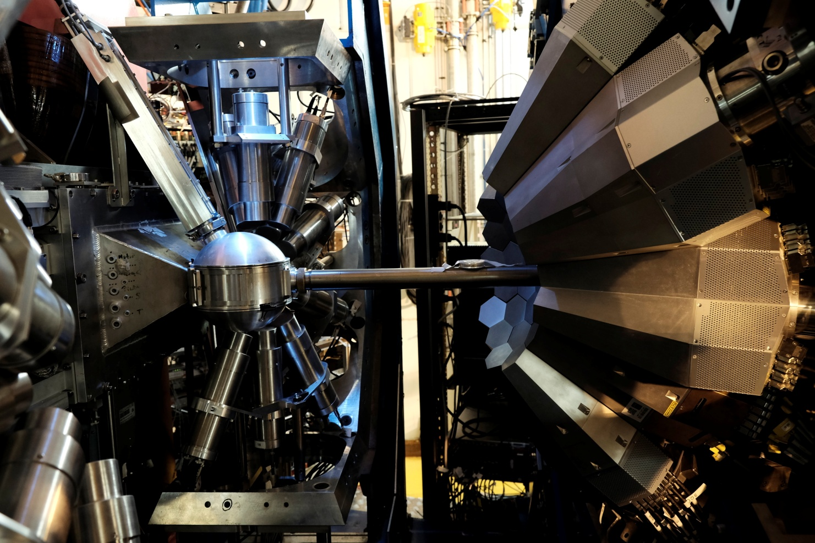
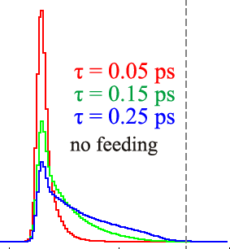
GANIL the actual host lab
Variety of setups
✓VAMOS
✓Plunger
✓Delayed γ-ray spectroscopy
✓Fast-timing
✓PARIS, DSSD, FATIMA
✓2nd VAMOS arm
✓NEDA
✓MUGAST
FATIMA-PARIS detectors coupled to AGATA in 2017

Slide 20
SPES a future host lab beyond 2020
SPES experiments with reaccelerated beams from ALPI projected for 2021
Stable beams are available before provided by LNL accelerator facility

Slide 21
FAIR a future host lab beyond 2025

Slide 22
Future AGATA campaigns
AGATA MoU
For the duration of this MoU the AGATA system is expected to be sited for at least 25% of its total operation time each at GANIL/SPIRAL2 (Caen, France), GSI/FAIR (Darmstadt, Germany), LNL/SPES (Legnaro, Italy).
The host collaborating institutions GANIL, GSI and LNL (hereinafter “Host” or “AGATA Host”) have agreed to host AGATA. AGATA will be an essential instrument for the future facilities FAIR, SPES and SPIRAL2.
Campaigns at any other host laboratory, in particular outside of the Collaborating Institutions, are subject to negotiations within the AGATA Steering Committee.

Slide 23
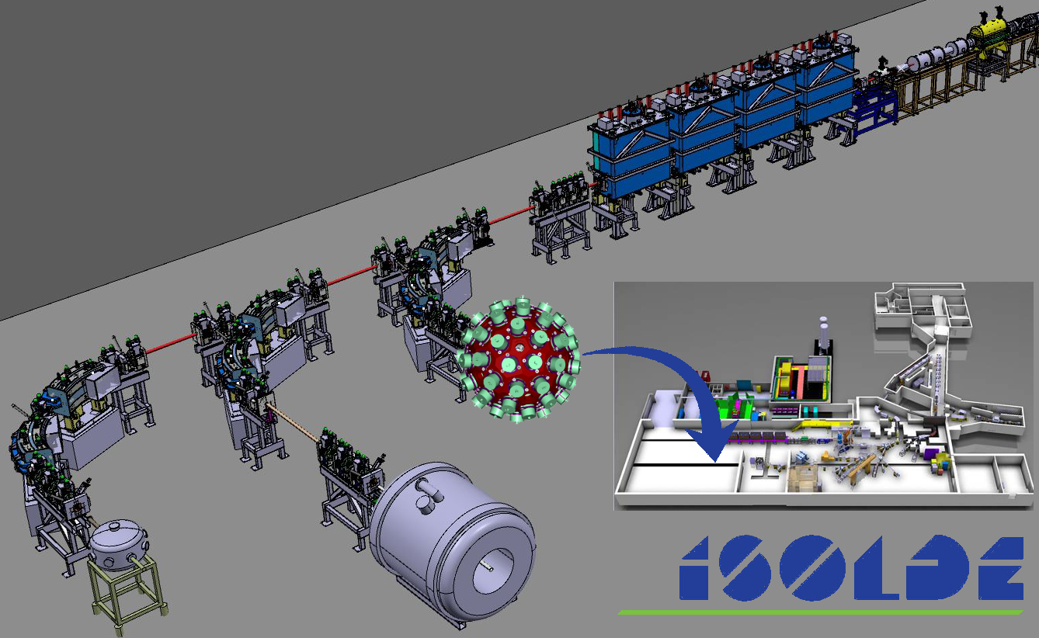
HIE-ISOLDE a future host lab beyond 2020

Slide 24
JYFL Accelerator Laboratory
Pelletron
Commercial applications
Medical
Reactions
ECR
MARA
*RADEF
Space
Microfilters
CLinac
RITU
K=30 MeV
K=130 MeV
IGISOL4
Medical
*RADiation Effects Facility

Slide 25

Future host labs beyond 2020
AGATA steering committee inquired interest of various laboratories to host AGATA beyond. Letters from directors, (ISOLDE group leader, ISCC head) were received with following dates:
  GANIL now – 2020
  GANIL period 2021-2025
  LNL period 2023-2025
  JYFL period 2024-2026/27
  ISOLDE period 2 (May 2026 - November 2028) after LS3
  FAIR NUSTAR period after 2026/27
ASC discussed the various host labs in September 2018 .
ASC endorsed the idea to move from GANIL to LNL prior completion of SPES.
AGATA physics workshop in March 2019 to discuss physics with stable beams

Slide 26
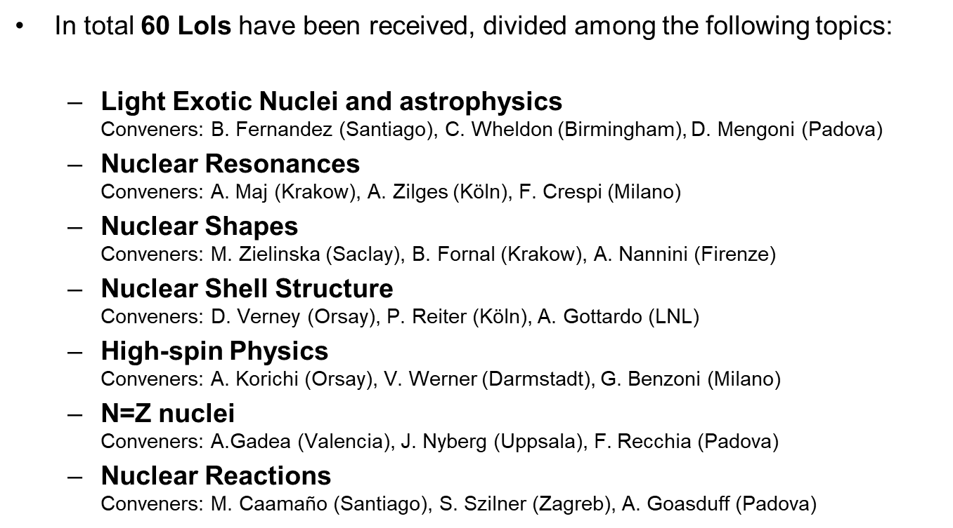
AGATA@LNL for stable beams

Slide 27
AGATA@LNL

Slide 28
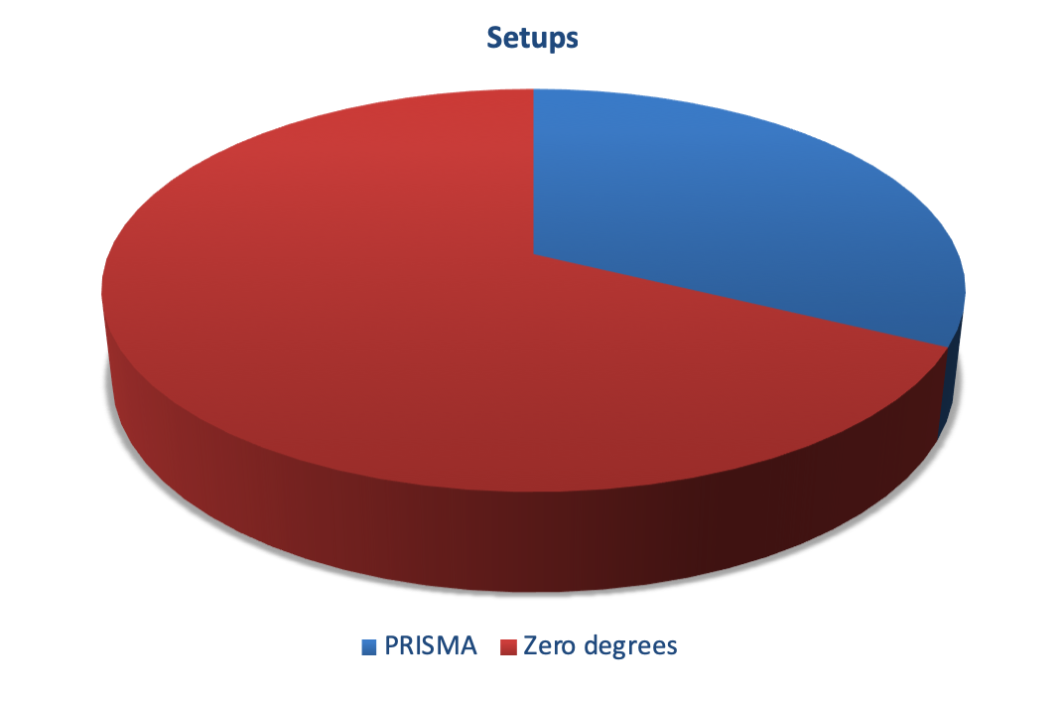
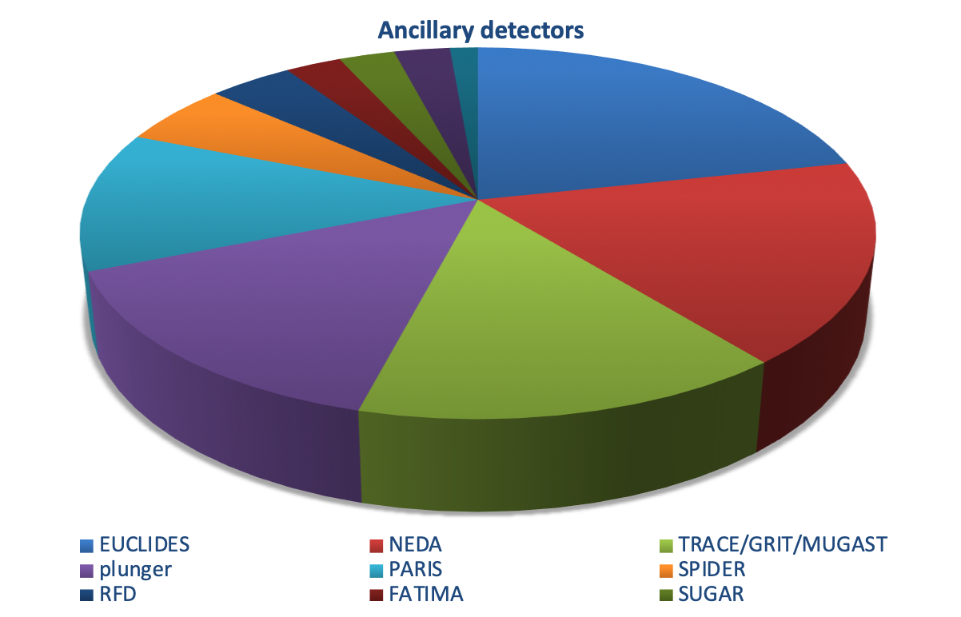
AGATA@LNL

Slide 29
Future AGATA campaigns
Letter to
Dear Dr. Navin Alahari and Prof. Diego Bettoni,
During its last meeting held on 27th March 2019, the AGATA Steering Committee (ASC) discussed the operation of AGATA from 2020-2023 and decided on the schedule for operation at GANIL and LNL during this period. …
Considering the availability of the 60 detector systems of AGATA the ASC agreed to move the AGATA spectrometer from GANIL to LNL in 2021 after the beam period ending in June 2021. This allows advanced independent preparation of the mechanics and infrastructure at LNL and thus a minimal downtime of AGATA during the transfer and reconfiguration of the spectrometer.
The ASC therefore formally approves the extension of operation of AGATA at GANIL to the end of June 2021 and the commencement of operation of the spectrometer at LNL in 2022. ….

Slide 30
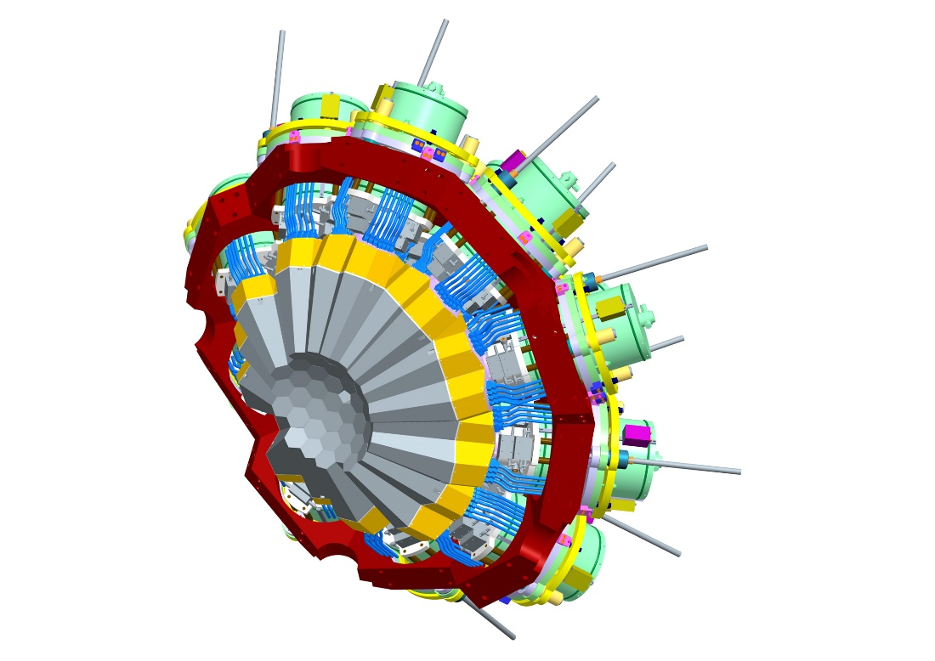
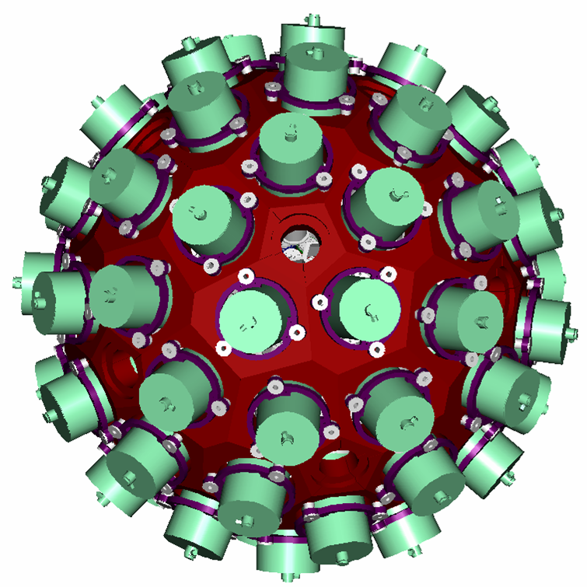
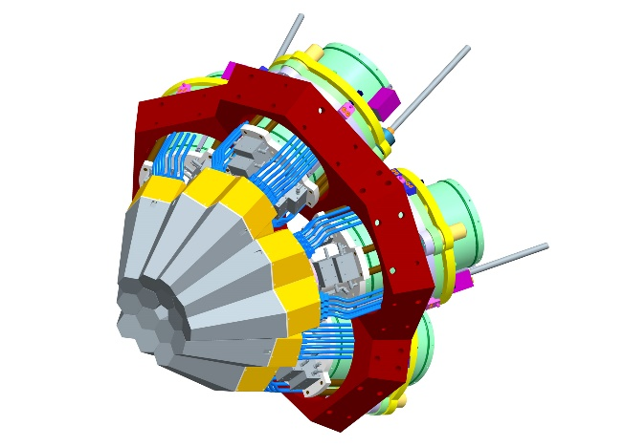
Memorandum of Understanding
I MoU
AGATA 15
Demonstrator
II MoU
AGATA 60
III MoU
AGATA 180 = 4π

Slide 31













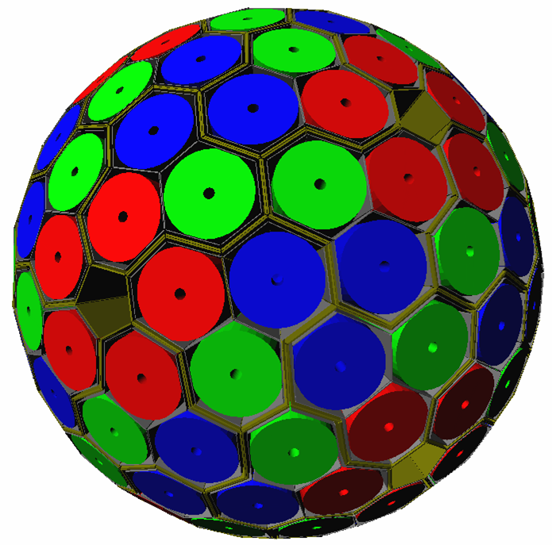
Advanced GAmma Tracking Array
180 hexagonal crystals 3 shapes
60 triple-clusters all equal
Inner radius (Ge) 23.5 cm
Amount of germanium 362 kg
Solid angle coverage 82 %
36-fold segmentation 6480 segments
Singles rate ~50 kHz
Efficiency: 43% (M_{γ}=1) 28% (M_{γ}=30)
Peak/Total: 58% (M_{γ}=1) 49% (M_{γ}=30)
Position resolution
Energy resolution
High energy efficiency
Polarization sensitivity
Resolving power
Count rate capability

Slide 32

AGATA 4π
(Advanced GAmma Tracking Array)
Sustainable growth of the AGATA subsystems from a configuration of 60 to 180 detectors.
Improving mobility and compatibility for the Hosting labs: FAIR/NUSTAR, GANIL/SPIRAL, LNL/SPES, HIE-ISOLDE, JYFL.
Full tracking performance and optimizing the position sensitivity.
Improving performance and compatibility of subsystems:
Detectors, FEBEE, DAQ, Infrastructure.
Upgrade of the already existing subsystems for the 60 detectors Phase 1.
Parts belong to the early AGATA Demonstrator Phase, more than 12 years old.

Slide 33

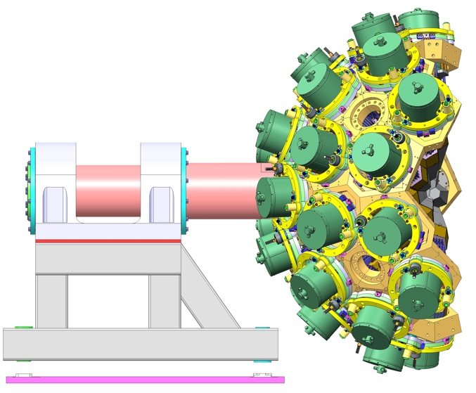
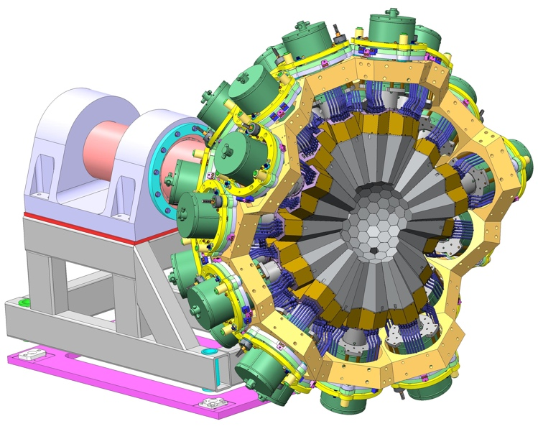
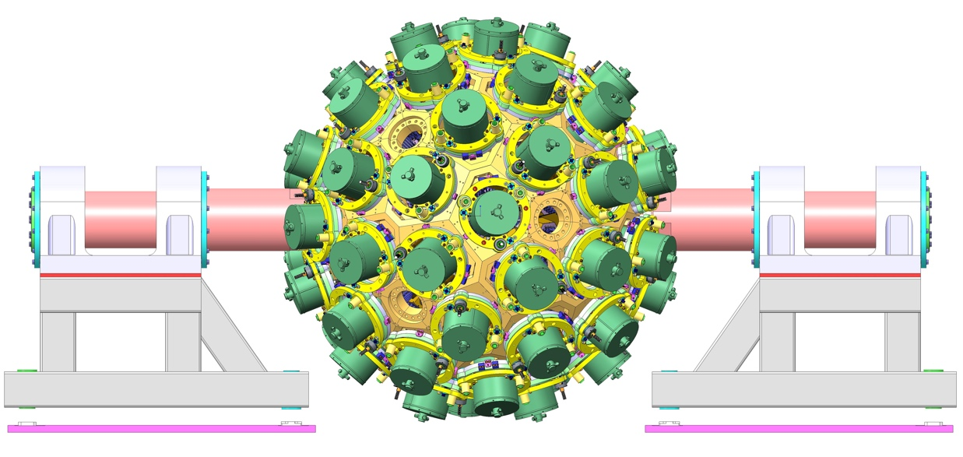
Mechanical Infrastructures
STFC-Daresbury, GANIL, INFN-Milano, INFN-Padova

Slide 34
Summary
Status AGATA:
  highly segmented HPGe detectors
  digitizer & front-end electronics
  pulse shape analysis & γ-ray tracking
  position sensitive γ-ray detection
  highly improved conditions for γ-ray spectroscopy
Increased productivity of AGATA collaboration (funding applications, white book, technical and ‘physics’ papers, conference contributions, new developments)
Next MoU: 4π γ-ray tracking for future RIB facilities
White book with convincing physics case
Next host lab: AGATA will move to LNL in 2021
Project definition

Slide 35
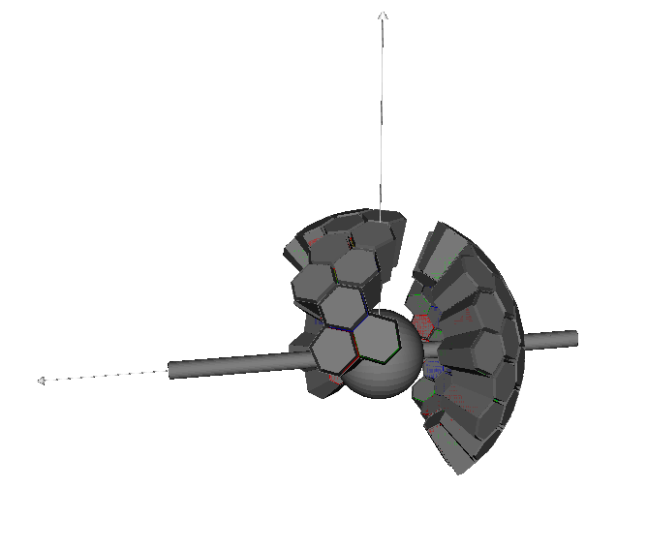
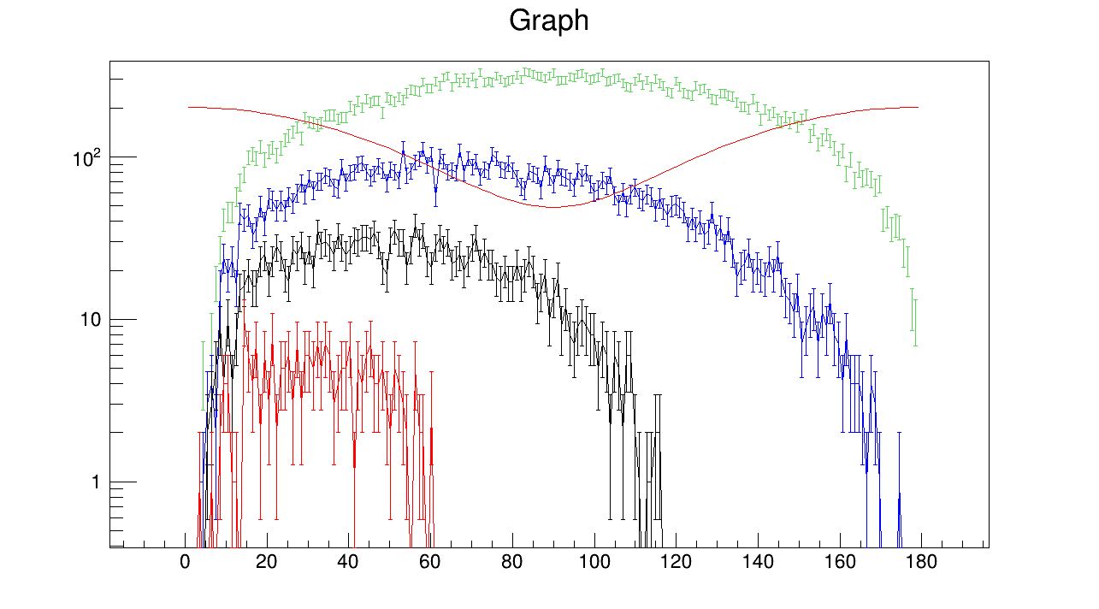
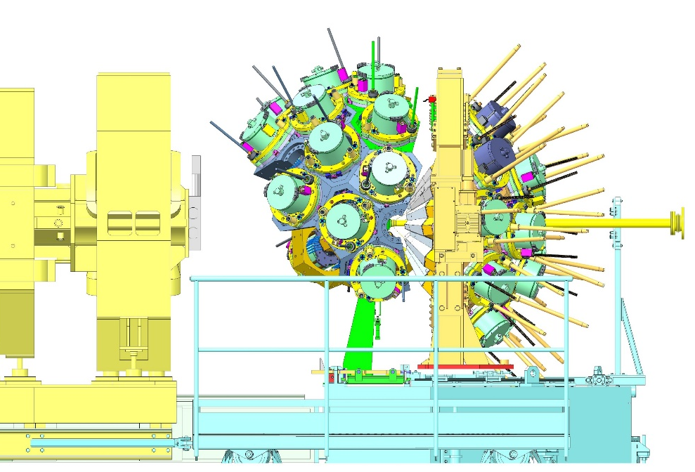
Beyond the 1π in G1 (2020-
From Lifetime to Angular correlations
10⁶ Random γγ cascades
Next 8 triple beyond 1π could be placed on the top positions.
Angular correlation in Nominal position
⁶⁰Co correlation
3π
2π
π
AD
Relative angle
Next detectors at 90° for angular and polarization measurement

Slide 36
GANIL a future host lab beyond 2020
Perspectives of AGATA
- VAMOS & MUGAST 2019-2020
- SPIRAL1 beams (Coulex)
- VAMOS (Fission and MNT) 2021?
- VAMOS (SF of 250Cm) 2021?
- VAMOS (VAMOS-Gas-Filled)
- PARIS
- NEDA & DIAMANT

Slide 37
SPES a future host lab beyond 2020
SPES Selective Production of Isotopes
AGATA will be a major instrument of SPES-β

Slide 38
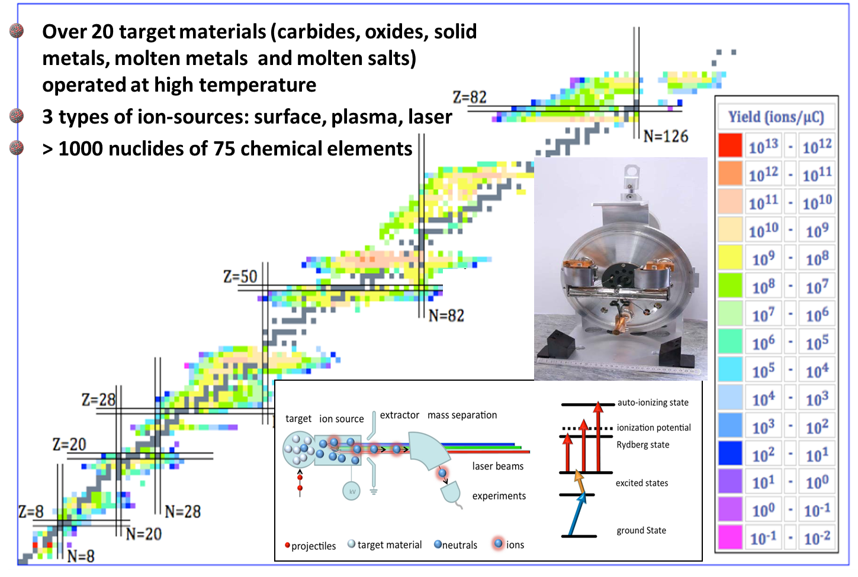
HIE-ISOLDE a future host lab beyond 2020

Slide 39
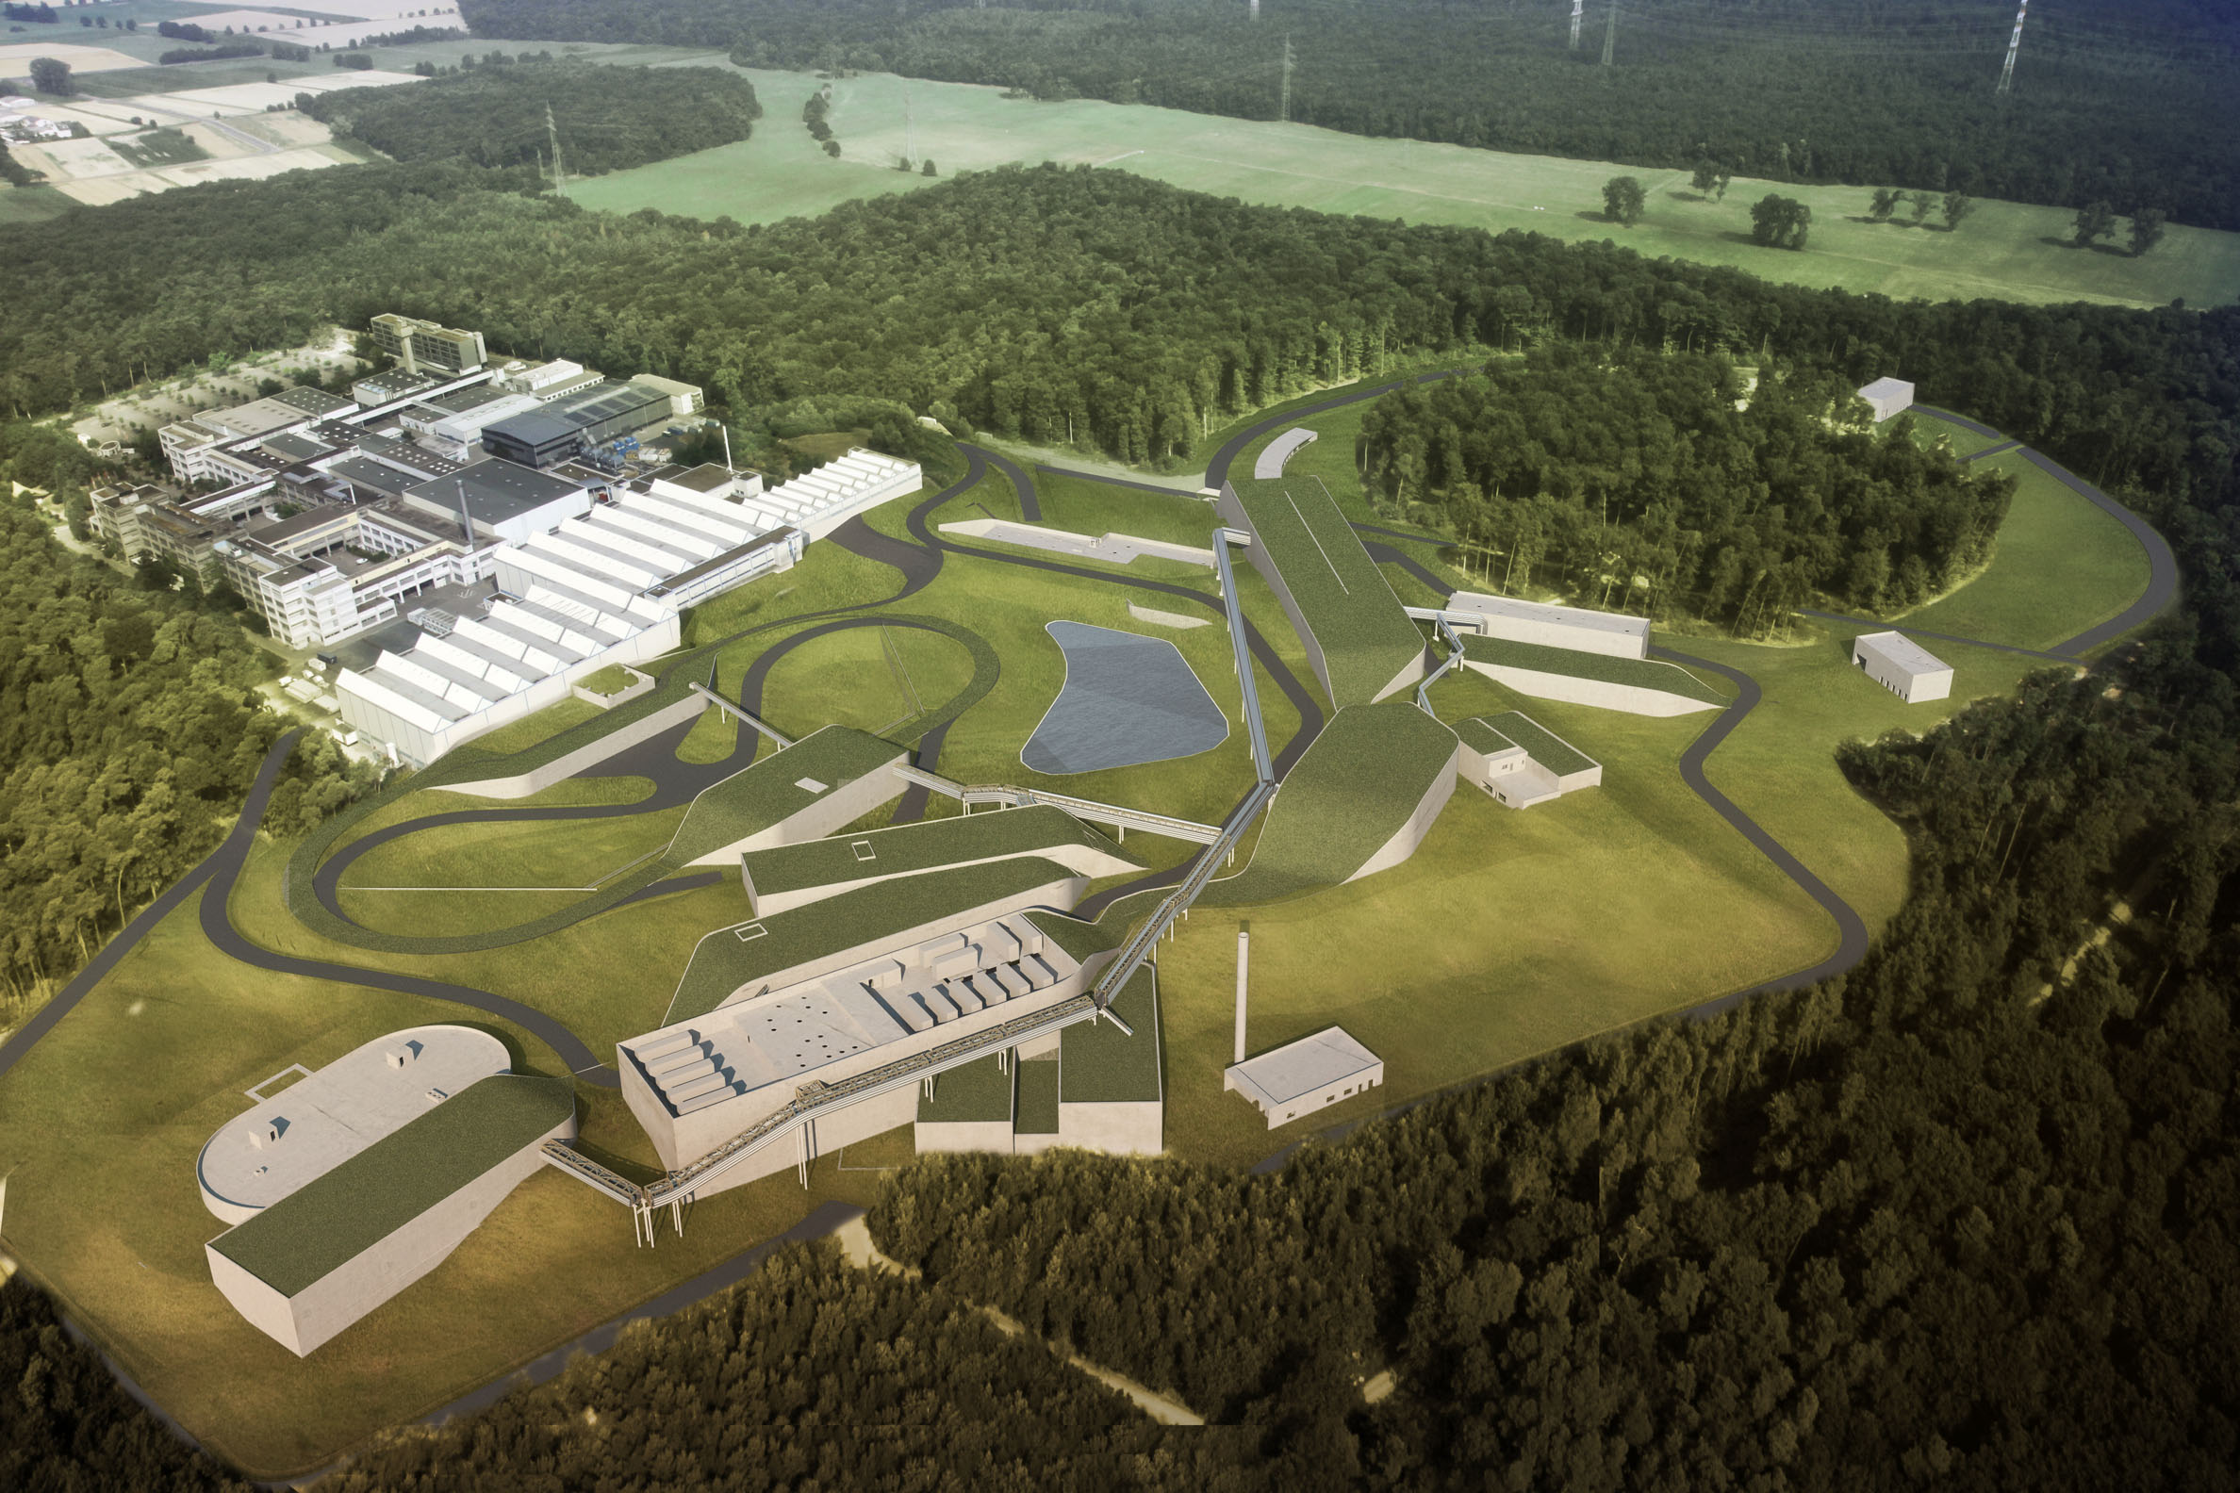
FAIR
a future AGATA
host lab beyond 2020

Slide 40
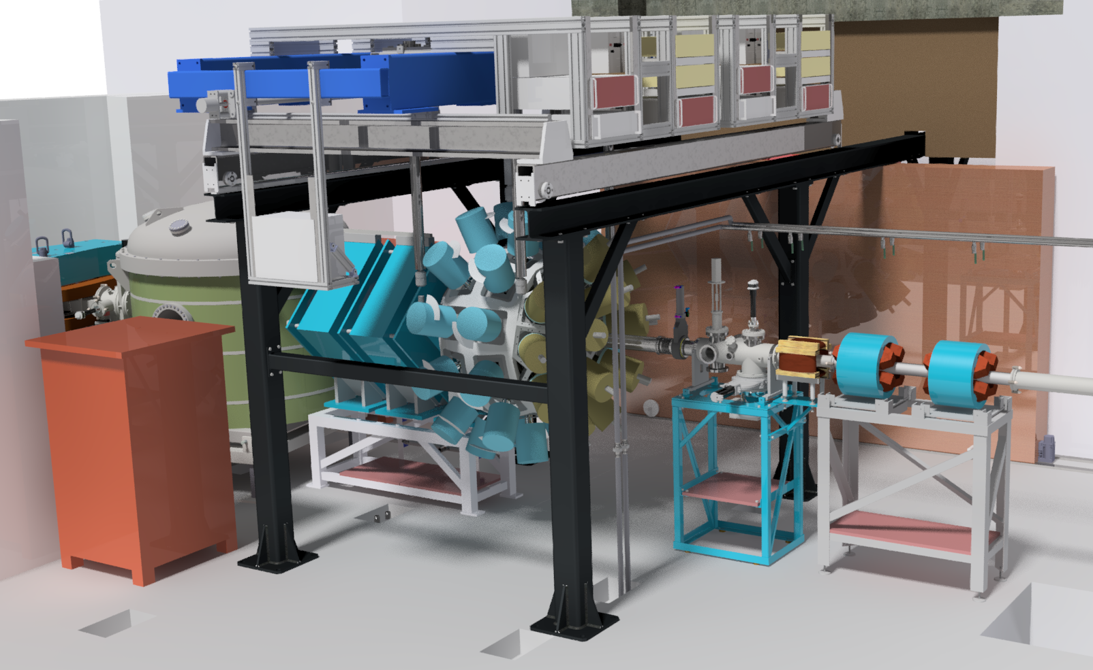
JUROGAM3 at MARA

Slide 41
In-beam spectroscopy at JYFL
Two recoil separators: gas-filled RITU and vacuum-mode mass spectrometer MARA
Heavy ion beams from p to Au with intensities up to 100-200 pnA
Wide range of possibilities to study proton-drip line and heavy nuclei
Excellent track record in in-beam spectroscopy and maintenance of large arrays
Wide range of ancillary devices
Expertise in conversion electron spectroscopy
Typically 100 days of beam time per year dedicated to in-beam spectroscopy
Relatively large and dedicated in-house team

Slide 42
Back up slides

Slide 43
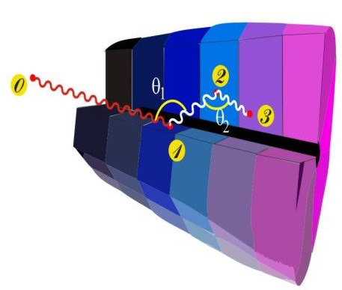
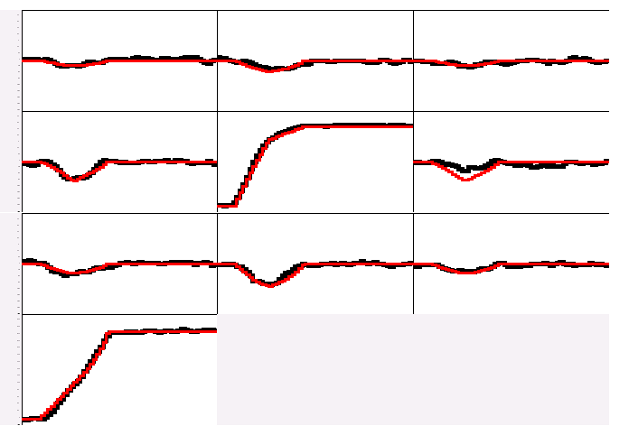
Ingredients of Gamma–Ray Tracking
1
4
Identified
interaction points
Highly segmented
HPGe detectors
Reconstruction of tracks
evaluating permutations
of interaction points
(x,y,z,E,t)_{i}
Pulse Shape Analysis
to decompose
recorded waves
·
·
3
2
Digital electronics
to record and
process segment signals
A3
A4
A5
B3
B4
B5
Reconstructed
γ-rays
C3
C4
C5
measured
calculated
CORE

Slide 44
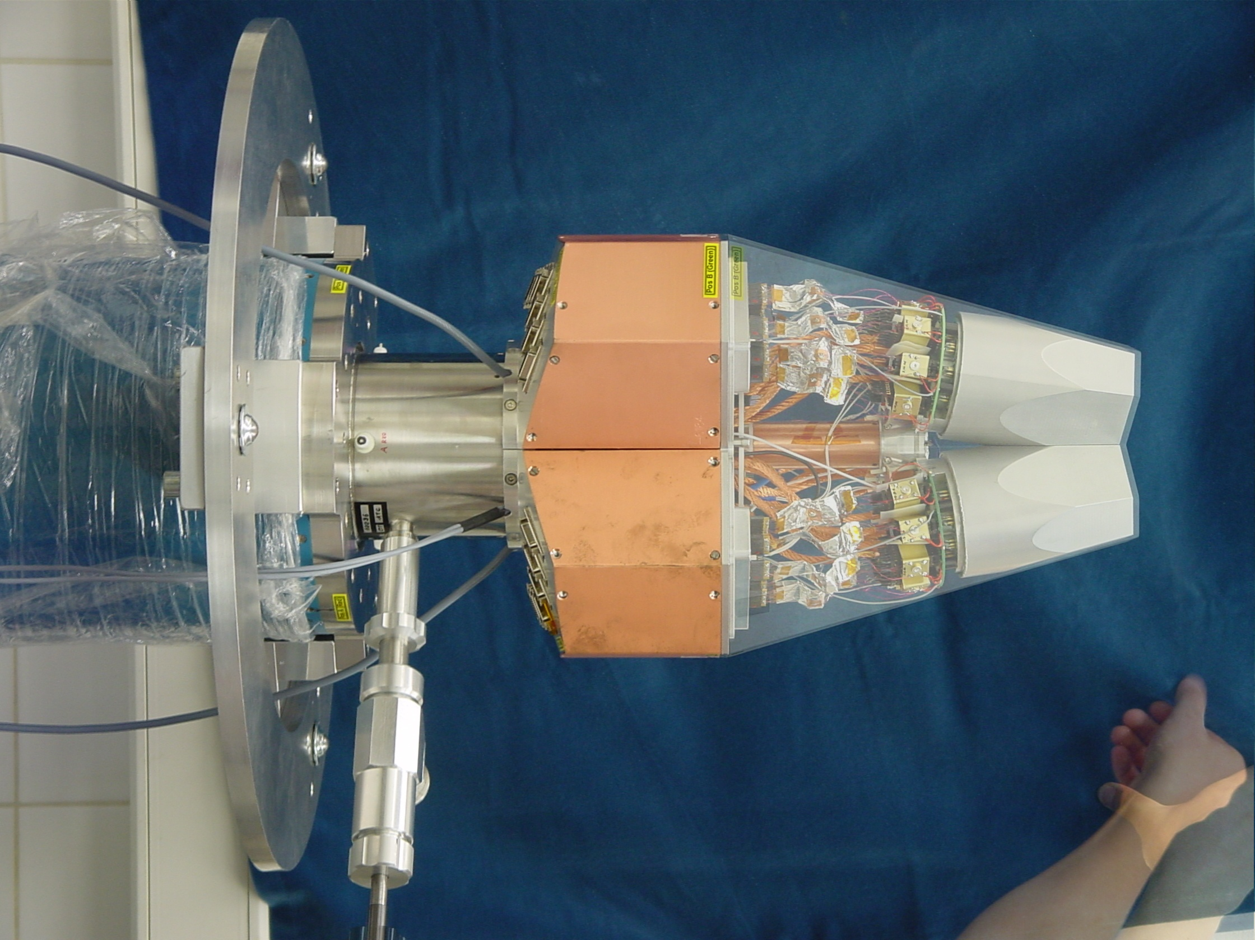
AGATA Triple Cryostat
- integration of 111 high resolution spectroscopy channels
- cold FET technology for all signals

Slide 45
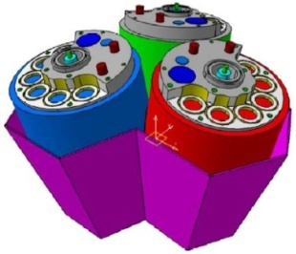
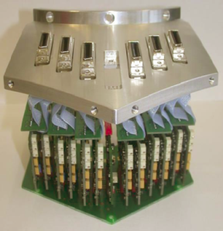
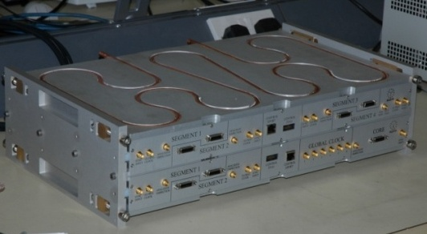
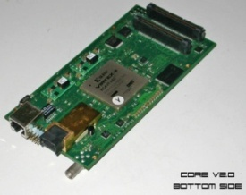
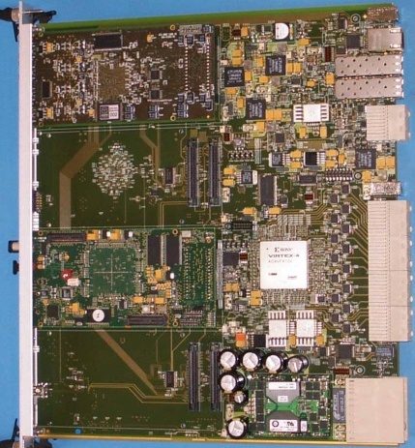
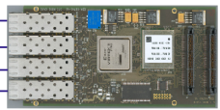

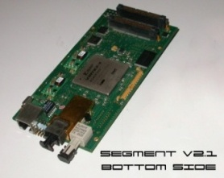
Digital electronics and DAQ
PREAMPL.
DIGITIZER
Fast 1st Level Trigger
Other Detectors
GL Trigger
Diff. Fast-reset-TOT
75.5db SNR 12.2 ENOB
Clock
100 MHz
T-Stamp
INFN-MI/GANIL/KÖLN
IPHC/Liverpool/ STFC
200MB/s/ segment
Detector Level
ATCA Carrier
Other detectors
GTS
GTS
PSA FARM
Core +
36 seg.
INFN-Pd
100MB/s/
detector
HIGH THROUGHTPUT PRE-PROCESSING
CARRIER / MEZZANINES
IPNO/CSNSM/INFN-Pd
Global Level
DAQ-NARVAL
RUN- & SLOW-Control
EVENT BUILDER
Control,
Storage…
TRACKING
Other detectors
IPNO/CSNSM/
LNL/GANIL/IFJ-PAN
interface to GTS, merge time-stamped data into event builder, prompt local trigger from digitisers

Slide 46

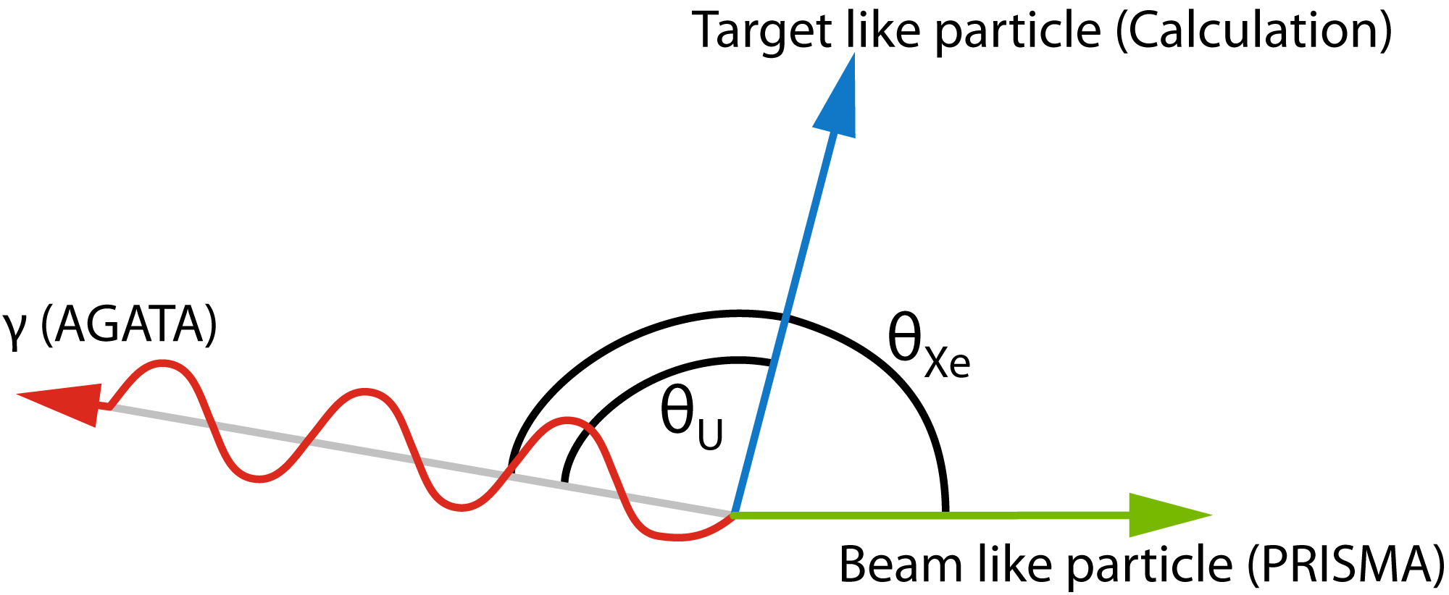

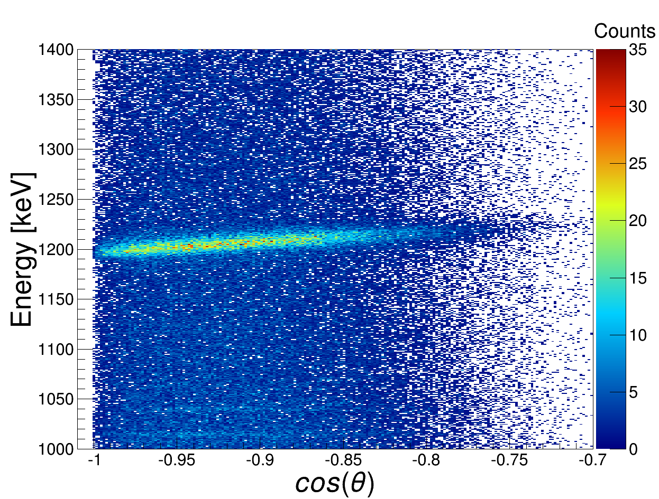
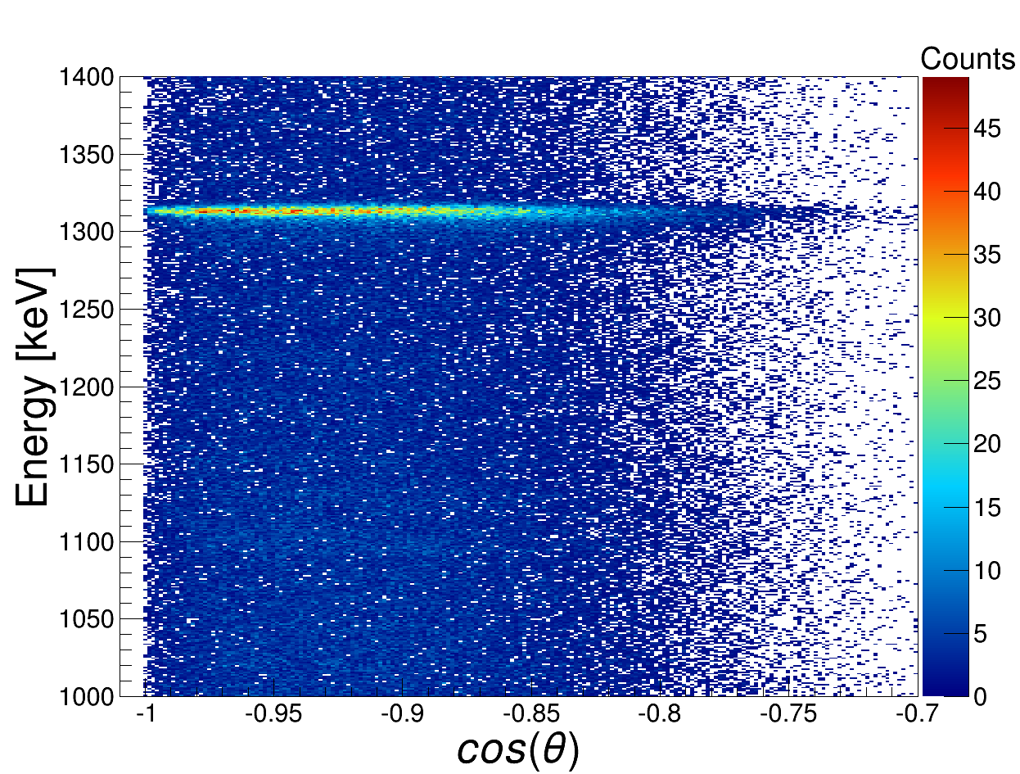
Position resolution & Doppler effects
Doppler correction needed for beam
and target like nuclei
Example: ¹³⁶Xe: 2⁺ → 0⁺ 1313 keV
No Doppler correction
Doppler correction for beam like Xe
Notes:
The characterization procedure I developed were tested on a 12-fold segmented MINIBALL detector.
To characterize such crystal, one needs to know first of all how much mirror charge is induced in each of these
Electrodes when a unit of charge is placed at a specific point in the detector.
This information is provided by the Weighting potentials.
The weigting potential for “this” segment is show here for a true coaxial detector.
These potentials can be calculated as solution of the Laplace equation,
With the boundary conditions that they have to be 1 at “this” electrode and 0 at all the other electrodes.
How to calculate the Weighting potentials is well described in litterature, so I will not disscuss this further.

Slide 47
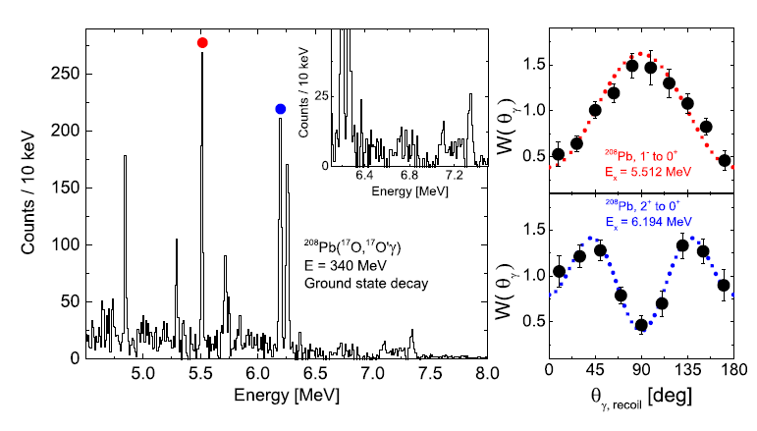
Line shape high γ-ray energy
Escape lines are identified and
discriminated by γ-ray tracking
First interaction points yield angular distributions:
E1 transition from the 1⁻ state at 5.512 MeV
E2 transition from the 2⁺ state at 6.194 MeV
F. Crespi, A. Bracco et al., Phys. Rev. Lett. 113,012501 (2014)
Notes:
Centre: By gating on the scattered 17O and the TKEL -> peaks
in the region of GDR are pronounced. When the yields is extracted and
compared with gg’ and pp’, it is evident that different states respectively
in the isoscalar and isovector part of the GDR are selectively populated.

Slide 48
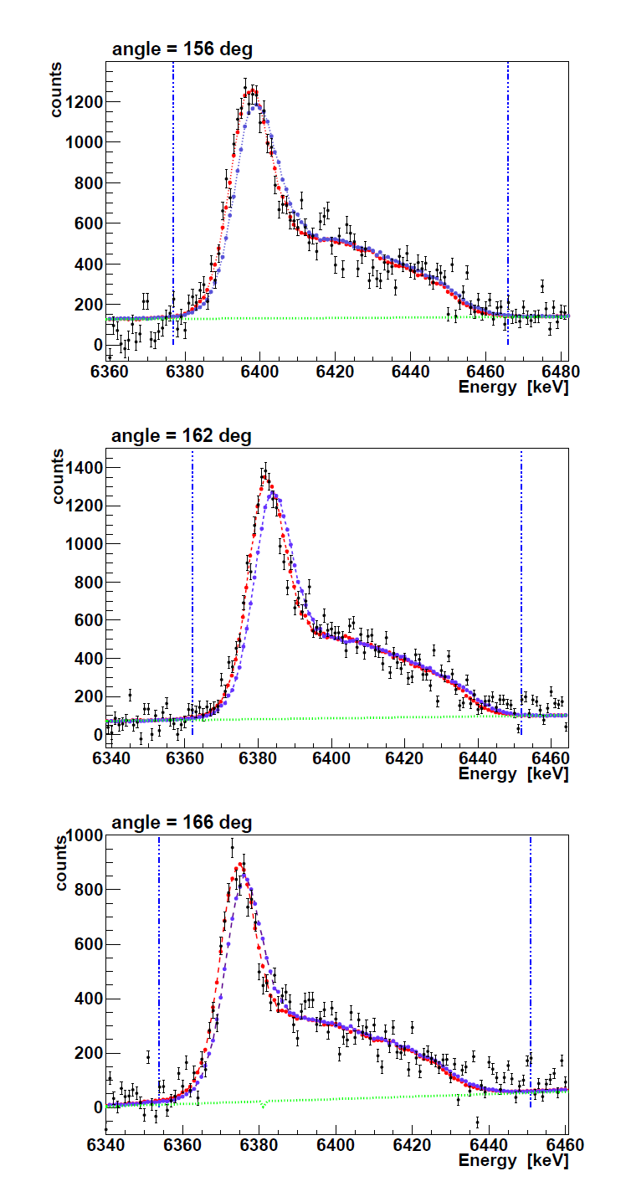
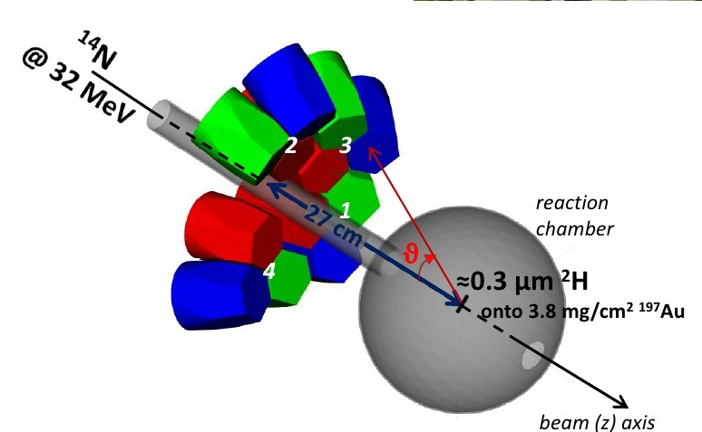
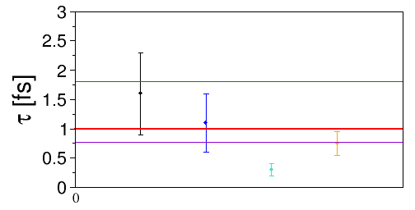
Lifetime of the 6.79 MeV state in ¹⁵O
¹⁴N(²H,n)¹⁵O and ¹⁴N(²H,p)¹⁵N reactions
inverse kinematics
Continuous DSAM lifetime measurement
0.1 fs
3.0 fs
0.1 fs
3.0 fs
New upper limit of < 0.5 fs on the lifetime of the 6.79 MeV state in ¹⁵O
Lower limit of the width of the state
Γ > 1.07 eV
C. Michelagnoli, et al.,
Notes:
48
NB: L’ energia dei calcoli non e`la «nostra», DWBA e CC calc in progress...
Vita media messa nella simul = 1fs
a voce di che stimiamo che con questa cinematica ecc. la nostra sensibilita`e`di circa 4 fs (preliminare)
The g-ray energy emitted from a slowyng down nucleus changes accordingly
with the velocity. To fully exploit theDSAM method the nucleus
must appreciably slow down within a time interval comparable
with the intended lifetime. In the case of AGATA the energy data
can be sorted as a function
of a CONTINUOS theta angle shows up the quality of collected data.
48

Slide 49
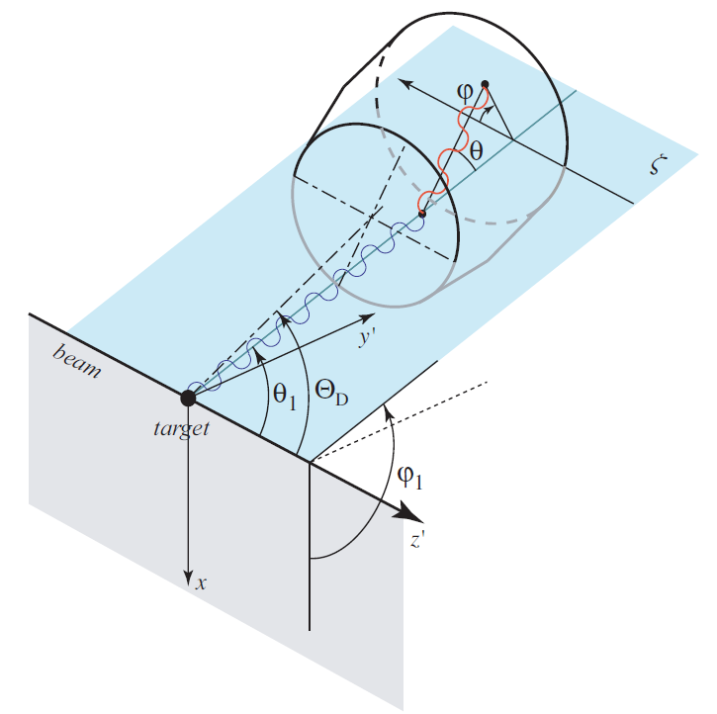


Analyzing power for γ-ray linear polarization
AGATA modules as Compton Polarimeters
Partially-polarized 555.8-keV and 433.9-keV lines in ¹⁰⁴Pd and ¹⁰⁸Pd after Coulomb excitation.
GOSIA
Analyzing power: A = 0.48
P.G. Bizzeti et al., Eur. Phys. J. A (2015) 51: 49
Notes:
We have investigated the ability of a cluster of three segmented Ge crystals (AGATA
module) to measure the linear polarization of gamma rays, exploiting the dependence of the Comp-
ton scattering differential cross section on the azimuthal angle.
To this aim, partially polarized emitted at about 90
degrees with respect to the beam direction have been
produced by Coulomb excitation of the first excited state of 104Pd and 108Pd
The analyzing power extracted, after some selection of the data was performed,
resulted in a really nice value, 0.48, in agreement with simulation

Slide 50



The GANIL Campaign [2015-2020]
Courtesy J. Dudouet
2017-2018 : 35 detectors on-line
Efficiencies @ 1.408 MeV
Core 3.4(1)% (GEANT4 = 3.6%)
AddBack 4.8(1)% (5.1%)
Coupled to VAMOS spectrometer
multi-nucleon transfer
fusion-fission
transfer-fission
E. Clément et al.; NIM A 855, 1-12 (2017)
J. Dudouet, et al.; Phys. Rev. Lett. 118, 162501 (2017)

Slide 51



The GANIL Campaign [2018]
NEDA & DIAMANT & AGATA & plunger
three full digital systems
NUMEXO2 & AGATA GTS
×20 increase in (nγ²) event rate compared to NWALL-DIAMANT-EXOGAM system VME-VXI.
PSA
p
α
Energy
Time of flight
γ
n
54 NEDA detectors at forward angles
14 NWALL detectors at 90 deg + plunger
~9% γ-efficiency at 1.4 MeV after tracking
>20% efficiency for 1 neutron
>35% efficiency for 1 proton
PSA – Neural network

Slide 52


NEDA & AGATA: the 2n selectivity
Simulation
T. Huyuk and the NEDA collaboration,
Eur. Phys. J. A (2016) 52: 55
ON-LINE
⁵⁸Ni(⁵⁰Cr,2p2n)¹⁰⁴Sn
¹⁰⁴Sn

Slide 53
RISING @ GSI
Coulomb Excitation of ¹⁰⁴Sn and the Strength of the ¹⁰⁰Sn Shell Closure".
G. Guastalla, et al.; Phys. Rev. Lett.110 (2013), 172501.
ON-LINE
¹⁰⁴Sn

Slide 54




NEDA & AGATA & plunger
Lifetime measurement ⁵⁸Ni+⁵⁸Ni at 250 MeV
1n2p
ON-LINE
2⁺
2n2p
7⁻
9⁻
4⁺
2n2p 2⁺ gated
6⁺
8⁺
5⁻
σ~100 μb
e⁺e⁻
3⁻ ?
D. Ralet, M. L. Jurado, E. Clement et al,
OUPS Plunger in degrader mode
J. Ljungvall et al, NIM A 679 (2012) 61.

Slide 55
Summary & Outlook
Status AGATA:
  highly segmented HPGe detectors
  digitizer & front-end electronics
  pulse shape analysis & γ-ray tracking
  position sensitive γ-ray detection
  highly improved conditions for γ-ray spectroscopy
Physics campaigns at LNL, GSI, GANIL
White book, physics case
Project definition
Next MoU: 4π γ-ray tracking array
Physics campaign at RIB facility

Slide 56


Acknowledgements

Slide 57
Back up slides

Slide 58
Available AGATA Detectors
year

Slide 59
Detectors
175
150
2055
100
2045
13 Detector deliveries 10.12.14-27.3.18
3.9 detectors/year
2π configuration in 11 years 2029
4π configuration in 34 years 2052
2035

Slide 60




JYFL Accelerator Facilties
K130
Accelerating p to Au
E = Q²/A 130 MeV
Annual use: 6000-7500 h/year
Ion sources:
6.4 GHz ECRIS, 14 GHz ECRIS,
18 GHz ECRIS
Multicusp (H⁻, D⁻)
Electron linac (Varian)
Electrons: 6,9,12,16 or 20 MeV
Brehmstrahlung X-rays 6 or 15 MeV
MCC30/15
H⁻ 18-30 MeV
d⁻ 9-15 MeV
Beam current 200/62 μA
New RF ion source
Users: IGISOL
Radioisotope prod.
Pelletron
H, He, Cl, Cu, Br, I, + other heavy ion beams;
0.2 – 20 MeV; 4 beam lines available

Slide 61


Performance: Energy resolution
@ 60 keV
@ 1333 keV
Averages of the segment resolutions
@ 60 keV :
A001: 1011 +/- 53 eV B002: 1039 +/- 70 eV C002: 965 +/- 63 eV
Averages of the segment resolutions
Measured in Cologne and Legnaro
@ 1333 keV :
IKP / Legnaro
A001: 2,19 keV / 2,00 keV
B002: 2,09 keV / 1,98 keV
C002: 2,1 keV / 1,94 keV
Segment labeling

Slide 62

Energy resolution & Cross talk
A. Wiens, et al.; Eur. Phys. J. A (2013) 49: 67 B. Bruyneel, et al.; Eur. Phys. J. A (2013) 49: 61

Slide 63





Pulse shape analysis two examples
Eγ = 1172 keV net-charge in A1
x10
1 A 6 1 B 6 1 C 6 1 D 6 1 E 6 1 F 6 CC
Eγ = 1332 keV net-charge in C4, E1, E3
x10
Tomography of interactions in the crystal: non uniformities due to PSA

Slide 64
Pulse Shape Analysis concept
A3
A4
A5
Result of
Grid Search
Algorithm
B3
B4
B5
(10,25,46)
C3
C4
C5
y
CORE
C4
B4
measured
calculated
D4
A4
x
791 keV deposited in segment B4
E4
F4
z = 46 mm

Slide 65



AGATA position resolution
⁴²Ca@170MeV + ²⁰⁸Pb
Kinematical coincidences
Position sensitive MCP
- Line shape without BGO
- energy resolution ΔE = 4.9 KeV corresponds to Δx < 4 mm
1524,7 keV
2⁺ - 0⁺
Uncorrected
Doppler-corrected (Ca)
Doppler-corrected (Pb)
AGATA position resolution
Δx FWHM Method
5.2 mm Doppler corr. meas. F. Recchia et al. NIM A (2009)
4.0 mm Doppler corr. meas P.-A. Söderström et al. NIM A (2011)
3.5 mm 511keV source meas. S. Klupp, M.Schlarb, R. Gernhäuser

Slide 66

Line shape higher multiplicity events
Andreas Vogt, et al.; EPJA submitted

Slide 67


Lifetime of the 6.792MeV state in ¹⁵O
¹⁴N(²H,n)¹⁵O and ¹⁴N(²H,p)¹⁵N reactions, inverse kinematics
θ [deg]
151
157
163
169
175
¹⁵O
AGATA DSAM line shape
¹⁵N
¹⁵O
¹⁵N
source
5600
6000
6400
6800
7200
7600
E
nucleon-transfer
¹⁴N
¹⁵O
¹⁴N
¹⁶O
¹⁵O
²H
n
²H
n
fusion-evaporation

Slide 68

PreSPEC-AGATA Setup @ GSI
Gamma-ray detection
AGATA with up to 23 crystals
pulse shape analysis and γ-ray tracking
BaF&LaBr scintillators (HECTOR+)
FRS
particle selection: Bρ-ΔE-Bρ
Particle identification:
TPC tracking detectors
ToF measurement
Energy-loss measurement
LYCCA
Outgoing particle tracking and identification:
Z identification via E-ΔE
Mass identification via E-ToF
Picture from C. Domingo-Pardo et al., NIM A 694 297-312 (2012)

Slide 69


Coulomb Excitation of ⁸⁰Kr
Reminder: Doppler effect
⁸⁰Kr
FWHM 2%
large Coulex cross section
no decay inside the target
Michael Reese, AG Pietralla IKP, TU Darmstadt

Slide 70


Location of Gamma Emission
⁷⁸Kr
projectile
⁷⁸Kr
⁸⁰Kr
tof
dsssd
target
Michael Reese, AG Pietralla IKP, TU Darmstadt

Slide 71




Improved lifetime measurements
¹³⁶Xe 2⁺₁ → 0⁺₁
LNL-data, 546 MeV run
Fit-Function
Fit to Doppler-broadened line shape as function of gamma-ray energy and detection angle for a relativistic emitter, i.e. an excited exotic ion from the FRS
Coulex and lifetime measurement of
excited state simultaneously!

Slide 72
Acknowledgements

Slide 73







PRISMA: Tracking Magnetic Spectrometer
MCP Start Det.: X,Y & T_{I}
MWPPAC X,Y & T_{F}
6m TOF
Large acceptance Ω = 80 msr
Charge ΔZ/Z ≈ 1/60
Mass ΔA/A ≈ 1/230
Max. Bρ = 1.2 Tm
Ionisation Chamber ΔE - E
Notes:
The host site position was chosen to face the magnetic spectrometer PRISMA,
which, by a series of entrance and focal plane detector, is able
to fully discriminate in A,Z the incoming ion.

Slide 74


Stellar burning rates and the ¹⁴N(p,γ)¹⁵O reaction
¹⁴N(p,γ)¹⁵O reaction is slowest, determines the overall rate
threshold
(C. Broggini et al., Annu. Rev. Nucl. Part. Sci. 2010. 60:53–73)
cross section (astrophysical S-factor) in Gamow peak region relies on sub-threshold resonances
corresponding to bound states in ¹⁵O
first excited 3/2+ state at 6.792 MeV in ¹⁵O plays dominant role
width of the resonance lifetime of the excited nuclear level

Slide 75
Lifetime of the 6.792MeV state in ¹⁵O
θ [deg]
151
157
163
169
175
¹⁵O
AGATA DSAM line shape
¹⁵N
¹⁵O
¹⁵N
source
5600
6000
6400
6800
7200
7600
E
nucleon-transfer
¹⁴N
¹⁵O
¹⁴N
¹⁶O
¹⁵O
²H
n
²H
n
fusion-evaporation

Slide 76
LIFETIME MEASUREMENT of 6.79 MeV in ¹⁵O
¹⁴N(²H,n)¹⁵O and ¹⁴N(²H,p)¹⁵N reactions @ 32 MeV
Direct lifetime measurement with 4 ATCs at backward
angles (close to the beam-line)
C. Michelagnoli et al., EPJ WoC, INPC 2013
Notes:
76
NB: L’ energia dei calcoli non e`la «nostra», DWBA e CC calc in progress...
Vita media messa nella simul = 1fs
a voce di che stimiamo che con questa cinematica ecc. la nostra sensibilita`e`di circa 4 fs (preliminare)
The g-ray energy emitted from a slowyng down nucleus changes accordingly
with the velocity. To fully exploit theDSAM method the nucleus
must appreciably slow down within a time interval comparable
with the intended lifetime. In the case of AGATA the energy data
can be sorted as a function
of a CONTINUOS theta angle shows up the quality of collected data.
76

Slide 77


Slide 79


Slide 80





Low lying E1 strength & Pygmy dipole resonace
High E.
Nuclear Structure information from low energy part of the electric dipole response
Pygmy Dipole Resonance
Giant Dipole Resonance
LOW ENERGY
HIGH ENERGY
Inelastic scattering of ¹⁷O @ 20 MeV/u on different targets + γ-rays in coincidence
HECTOR+
TWO EXPERIMENTS PERFORMED:
Studied Nuclei: 208Pb 90Zr
R. Nicolini (Università di Milano /INFN)
D.Mengoni (Università di Padova/INFN)
Studied nuclei: 208Pb, 124Sn,140Ce
M. Kmiecik (IFJ PAN Kraków) ,
F. Crespi (Univ. di Milano/INFN)
Notes:
One important open problem for pygmy states is the cross section sensitivity to transition densities containing the nuclear structure information. To explore this one needs high-resolution measurements and comparison of data obtained with different probes. In particular, nuclei with sizable neutron skin, such as the doubly magic 208Pb, are very interesting.
The γ decay from the pygmy states was measured in 208Pb using the inelastic scattering of 17O at 340 MeV. The emitted γ rays were detected with high resolution with the AGATA demonstrator array and the scattered ions were detected in two segmented ΔE-E silicon telescopes.
80

Slide 81





Pygmy dipole states in ²⁰⁸Pb
²⁰⁸Pb(γ, γ’ )
A. Tamii et al., PRL 107, 062502 (2011)
²⁰⁸Pb(p, p’)
High resolution measurement
This expoeriment
²⁰⁸Pb(¹⁷O,¹⁷O’γ)
Different states are selectively populated in the isoscalar and isovector part of the GDR
Notes:
Centre: By gating on the scattered 17O and the TKEL -> peaks
in the region of GDR are pronounced. When the yields is extracted and
compared with gg’ and pp’, it is evident that different states respectively
in the isoscalar and isovector part of the GDR are selectively populated.

Slide 82


Pygmy dipole states in ²⁰⁸Pb
²⁰⁸Pb
Differential cross sections for excitation of the 1⁻ @ 4.842 MeV and @ 5.512 MeV
DWBA calculations with microscopic form factor for isoscalar E1 excitation
F. Crespi, A. Bracco et al., Phys. Rev. Lett. 113,012501 (2014)
see also AGATA results on ¹²⁴Sn
L. Pellegri, A. Bracco et al. Phys. Lett. B 738 (2014) 519-523
Theory: E. Lanza et al., Phys.Rev. C 84 (2011) 064602
Notes:
The multipolarity of the observed gamma transitions was determined with remarkable sensitivity thanks to angular distribution measurements.
Cross sections and angular distributions of the ã rays and of the scattered particles were measured.
The data analysis with the distorted wave Born approximation approach gives a good description of the elastic scattering and of the inelastic excitation of the 2+ and 3− states.
A similar measurement was performed on 124Sn and the results were analysed using the DWBA approach.
For the 1− states a DWBA analysis based on a microscopically calculated form factor was performed and showed a sensitivity to the surface part of the transition density. Being the transition density dominated on the surface by the neutron component one can deduce that the pygmy states 124Sn are associated with the excitation of surface neutrons, mainly those in the neutron skin

