Slide 1
Nuclear Energy Density Functionals focused on spin-isospin excitations and the nuclear equation of state
Gianluca Colò
Collaborators:
X. Roca-Maza, S. Shen (Univ. of Milano and INFN, Italy)
Y. Niu (Lanzhou University, China)
H. Sagawa (University of Aizu and RIKEN, Japan)

Slide 2
(Nuclear) Density Functional Theory
The exact functional has a minimum at the exact ground-state density, where it assumes the exact E as a value. Oscillations around this point can be studied.
Energy density =
E is a functional called EDF
Existence guaranteed by the Hohenberg-Kohn theorem (1964). Universality: valid for any system of fermions.
Mechanism for saturation.
Flexibility to account for the rich nuclear phenomenology.
Suitable for extensive computational efforts.
“DFT is an exactification of Hartree-Fock” (W. Kohn).
From M. Pössel

Slide 3
A realization: the Kohn-Sham scheme
We assume that the density can be expressed in terms of single-particle orbitals, and that the kinetic energy has the simple form:
We have said that the energy must be minimized, but we add a constraint associated with the fact that we want orbitals that form an orthonormal set (Lagrange multiplier)
The variation of this quantity, 𝛿(…) = 0 produces a Schrödinger-like equation:

Slide 4
Status (in a nutshell)
Error on masses of the order of 1 MeV.
Predictions of drip lines and super heavy nuclei.
Trends of charge radii and deformations fairly well reproduced.
Advanced techniques based on symmetry restoration.
Giant resonances, charge-exchange states and β-decay: here!
Current interest in large amplitude motion, reactions etc.
Progress in the study of theoretical errors and of correlations among EDF parameters.
Merging with ab initio.
n
⁹Li
n
Skyrme: local functionals
Gogny: non local f.
Covariant (relativistic) f.
SEDF, GEDF, CEDF

Slide 5
Charge-exchange transitions and β-decay
They are induced by reactions, like (p,n) or (³He,t).
Some transitions may be inside the allowed β-decay window.
(p,n)
(n,p)
Z+1,N-1
Z,N
Z-1,N+1
Isobaric Analog State:
n changed into p
Gamow-Teller Resonance:
also spin-flip
Z
N
Z
N

Slide 6
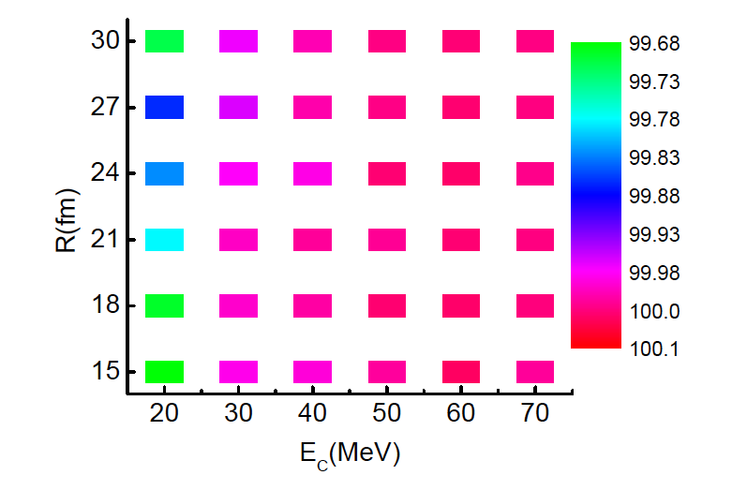
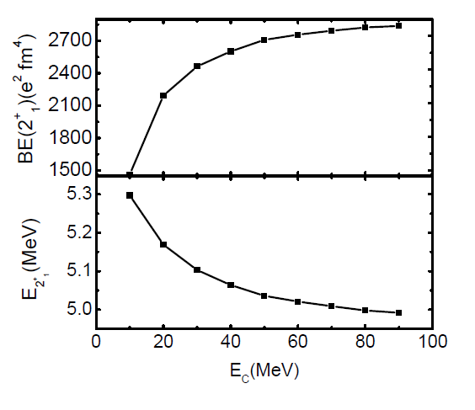
Our self-consistent RPA implementation
RPA = linear response theory. No more parameters than in
Non charge-exchange states: G.C. et al., Computer Physics Commun. 184, 142 (2013).
We also have self-consistent codes for the charge-exchange states.
Symmetry restoration.
Harmonic potential theorem [PRL 73, 16 (1994)].
²⁰⁸Pb - SGII
m₁(RPA)/m₁(DC) [%]

Slide 7
Equation of state of (a)symmetric matter
J: 29-32.7 MeV, 30.7-32.5 MeV, 28.5-34.5 MeV [1-3].
L: 40-75, 30-90 MeV [1-3]. Well established correlation:
L vs. neutron skin thickness ΔR [4].
Symmetry energy S
Symmetric matter EOS
Nuclear matter EOS
[1] J.M. Lattimer, Y. Lim, Astr. J. 771, 51 (2013) [2] B.A. Li and X. Han, PLBB 727, 276 (2013)
[3] M. Oertel et al., RMP. 89, 015007 (2017) [4] B.A. Brown and S. Typel, PRC 64, 027302 (2001)
ρ₀= 0.16 fm⁻³ SATURATION POINT of SNM
β=1
β=0

Slide 8
Dedution/impact of the symmetry energy
Properties of n-rich nuclei
Heavy-ion collisions
Properties of neutron stars
Proton drip line
Neutron drip line
From: B. Tsang
“Isospin diffusion”: stiff symmetry energy causes small diffusion (too much energy cost).

Slide 9
EDFs from our group
We have been motivated by the fact that many Skyrme functionals on the market do not have realistic features in the spin and spin-isospin channel.
G₀’ should be positive!
Artificial correlation!
Interaction in the spin (G₀) and spin-isospin (G₀’) channels

Slide 10
Isobaric Analog State and the neutron skin
Why is the IAS energy so well correlated with the neutron skin ?
Why all results from EDFs are inconsistent with a “realistic” value of the skin ?
²⁰⁸Pb
PREx
Elastic p-scattering
Dipole polarizability
Results from RPA
Acting with T₋ on a g.s. with uniform neutron and proton distributions:

Slide 11
Except the last one, these effects are basically model-independent.
There exist CSB/CIB effects of strong origin. We call them ISB, generically.
np mass difference
ρ⁰-ω mixing
π⁰-η mixing
Main sources are the meson mass differences. There are more complicated effects.
There exist few microscopic calculations and some phenomenological forms.

Slide 12
In-medium calculations
One should try to fit effective interactions starting from ab initio results, whenever possible.
Dots: calculations of the CSB/CIB (or ISB) contribution to the energy per particle in symmetric nuclear matter.
Brueckner-Hartree-Fock calculation using Argonne-v18
We have adopted a simple strategy: we have chosen a simple two-parameter CSB/CIB effective force.
We have tried to fit it to the BHF results.
SAMi-ISB

Slide 13
SAMi-ISB predicts a correct value for the E(IAS) with a reasonable value for the skin.
It also improves the reproduction of E(IAS) for the Sn isotopes.
X. Roca-Maza, GC, and H. Sagawa
Phys. Rev. Lett 120, 202501 (2018)

Slide 14
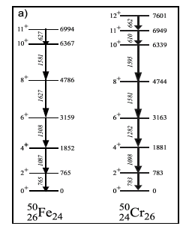
Different views of CSB/CIB
M. Bentley and S. Lenzi, Prog. Part. Nucl. Phys. 59, 497 (2007)
P. Bączyk et al., PLB 184, 178 (2018)

Slide 15
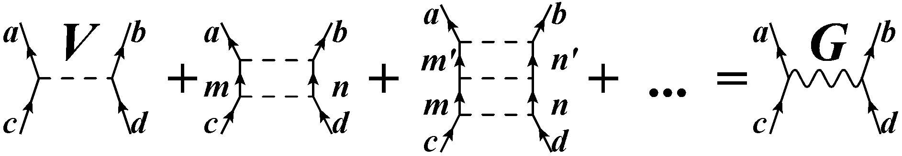
Neutron drops from ab initio methods
Neutrons confined in a HO potential are simple systems that can be studied using ab initio approaches.
Good to pin down information on spin-orbit splitting and constrain the EDFs accordingly.
B.S. Pudliner et al., PRL 76, 2416 (1996)
We have used Relativistic-Brückner-Hartree-Fock (RBHF) as a guideline for our fits:
Quantum Monte Carlo (QMC) calculations with AV8’+different 3-body forces are available.
T
S. Shen et al., PLB 778, 344 (2018)
S. Gandolfi et al., PRL 106, 012501 (2011)

Slide 16
New functional SAMi-T
Fit of:
Binding energies and charge radii (⁴⁰Ca, ⁴⁸Ca, ⁹⁰Zr, ¹³²Sn, ²⁰⁸Pb).
Spin-orbit splitting of proton 1d (⁴⁰C), 1g (⁹⁰Zr) and 2f (²⁰⁸Pb) orbits.
Trends of spin-orbit splittings in neutron drops
Total energy of neutron drops
We also keep control of
G₀’ > G₀ > 0
Symmetric matter
Neutron matter
S. Shen, GC, X. Roca-Maza, PRC 99, 034322 (2019)

Slide 17
Gamow-Teller and spin-dipole resonances
Spin-dipole resonance (SD)
Z
N

Slide 18
Spin polarized neutron matter
Plot of

Slide 19
Merging of neutron star AND the nuclear EoS
2015: first observation of Gravitational Waves (GW), awarded with Nobel prize in 2017.
17/8/2017 ”multi-messenger” observation of NS merging (GW, GRB, X-rays...).
B.P. Abbott et al., Astrophysical J. Lett. 848:L12 (2017)
In simulations tidal effects are relevant. A more compact star is harder to distort. But this depends on S!
Nuclear experiments on isovector observables are relevant for the physics of GWs

Slide 20
Tidal polarizability
Mass vs. radius
(neutron star)
Masses and radii of neutron stars can be derived by integrating the TOV (Tolman-Oppenheimer-Volkoff) equation
Tidal polarizabilities Ʌ₁ and Ʌ₂ associated with the high-mass and low-mass components of the binary system GW170817.
J. Piekarewicz, arXiv:1812.04438 [nucl-th]

Slide 21
Conclusions and open problems
Energy Density Functionals (EDFs) are becoming increasingly sophisticated and capable of dealing with different phenomenology.
Too “specialized” functionals? One should have a broad view, including spin and isospin channels.
In fact, there are strong connections between various properties (IAS and symmetry energy, spin excitations and polarized matter viz. neutron stars).
The proliferation of parameter sets is an issue. More constraints from ab initio.
Neutron stars: what is the highest density at which we can extrapolate EDFs?

Slide 22
Thank you!

Slide 23
Backup slides

Slide 24
Masses and radii of atomic nuclei
Masses: typical errors ≈ MeV. “Arches” show up.
X. Roca-Maza and N.Paar, PPNP 101, 96 (2018)
For radii the pictures is more blurred. In some cases, signatures of the limits of the model appear.
From M. Bender

Slide 25
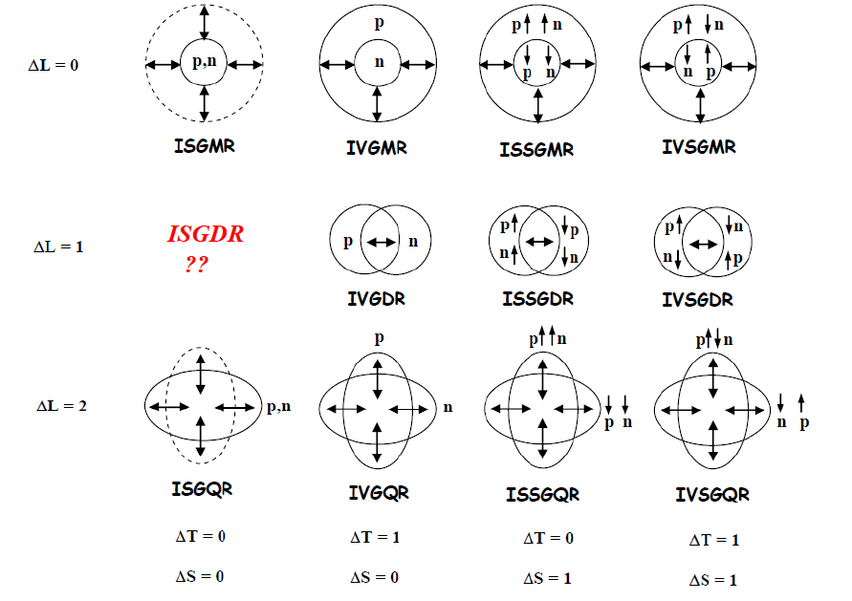
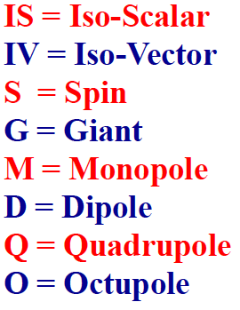
Nuclear collective vibrations
Figure by M. Harakeh
One motivation to study these states is to get access to general properties like the Equation of State of nuclear matter.

Slide 26
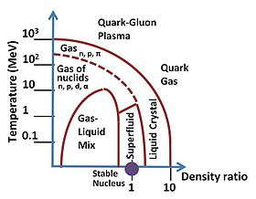
The equation of state of nuclear matter
Nuclear matter is an idealized UNIFORM system of neutrons and protons having constant density. (The Coulomb interaction among protons must be taken out).
It is analogous to the uniform electron gas for condensed matter physicists.
WE STICK TO
T = 0 !
We call E/A the “equation of state” of nuclear matter.

Slide 27
Isovector collective vibrations
Neutrons and protons oscillate in opposition of phase.
Promising observables to extract the properties of the symmetry energy – as well as the neutron skin.
Problems:
the nucleus is not a homogeneous system, it has a shell structure, and there is isoscalar/isovector mixing.
𝝆
r

Slide 28
MEASURABLE QUANTITY A
PDR PRC 81, 041301(R) (2010)
J = 32.3 ± 1.3; L = 64.8 ± 15.7
ΔR = 0.194 ± 0.024
Dipole polarizability PRC 88, 024316 (2013)
J = 31 ± 2; L = 43 ± 16
ΔR = 0.16 ± 0.03
IVGQR PRC 87, 034301 (2013)
J = 32 ± 1; L = 37 ± 18
ΔR = 0.14 ± 0.03
Anti-analog dipole PRC 94, 044313 (2016) ?
Isobaric Analog State PRL 120, 202501 (2018)
EoS PARAMETER B
“Points” correspond to the results of calculations with Energy Density Functionals (EDFs) like Skyrme, or RMF.
J, L in MeV
ΔR is the value of the neutron skin thickness of ²⁰⁸Pb in fm

Slide 29
Neutron stars
Postulated by Landau after the neutron was discovered
http://www.ift.uni.wroc.pl/%7Ekarp44/talks/yakovlev.pdf
Discovered many years later by J. Bell and A. Hewish (Nobel prize 1974 only to A. Hewish)
Masses known much more precisely than radii
Characterised by huge magnetic fields
F. Özel and P. Freire, ARAA 54, 401 (2016)

