Slide 1




Evidence for far-beyond-neutron-threshold structure effects in the ⁷⁸Ni region from β decay
David Verney, IPN Orsay
• from ALTO data, N=50 region, nearby ⁷⁸Ni:
- β-delayed neutron-emission probability (P_{n}) measurements
with the TETRA ³He long counter………………PRC 95, 054320 (2017)
- β-delayed γ-spectroscopy
with the BEDO decay station……………….PLB 772, 359 (2017)
• Perspectives: PARIS, MONSTER and TAS campaigns at BEDO@ALTO

Slide 2
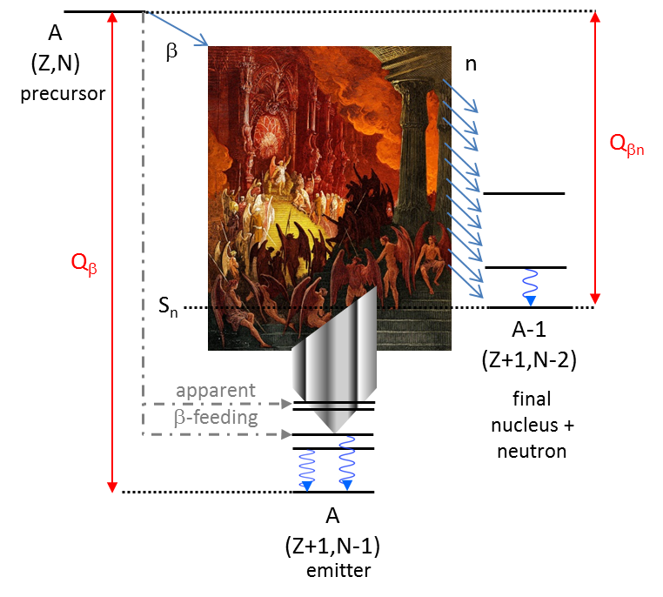
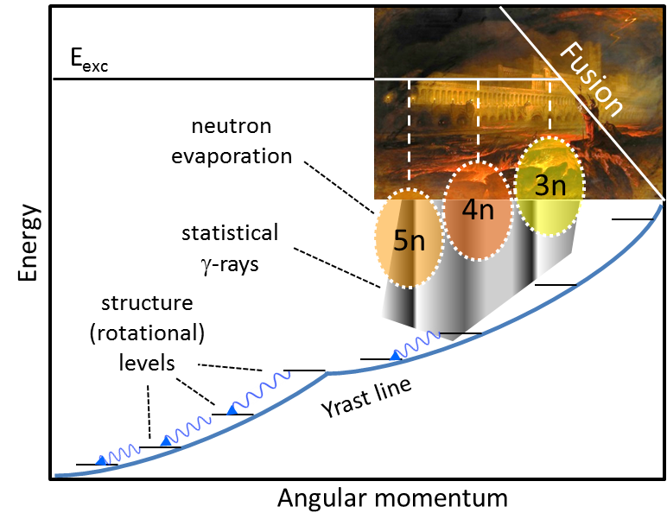
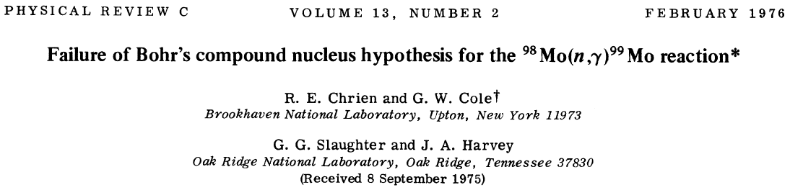
Pandemonium* vs structure in β-decay properties
*concept introduced by Hardy PLB 71, 307 (1977)
the terrifying specter of the so-called
“Pandemonium effect”
has since then haunted all β-decay (experimental) studies
TAS techniques introduced as an answer
“hot” unstructured system
Bohr’s compound nucleus
[Nature 137, 344 (1936)]
“cool” structured system

Slide 3
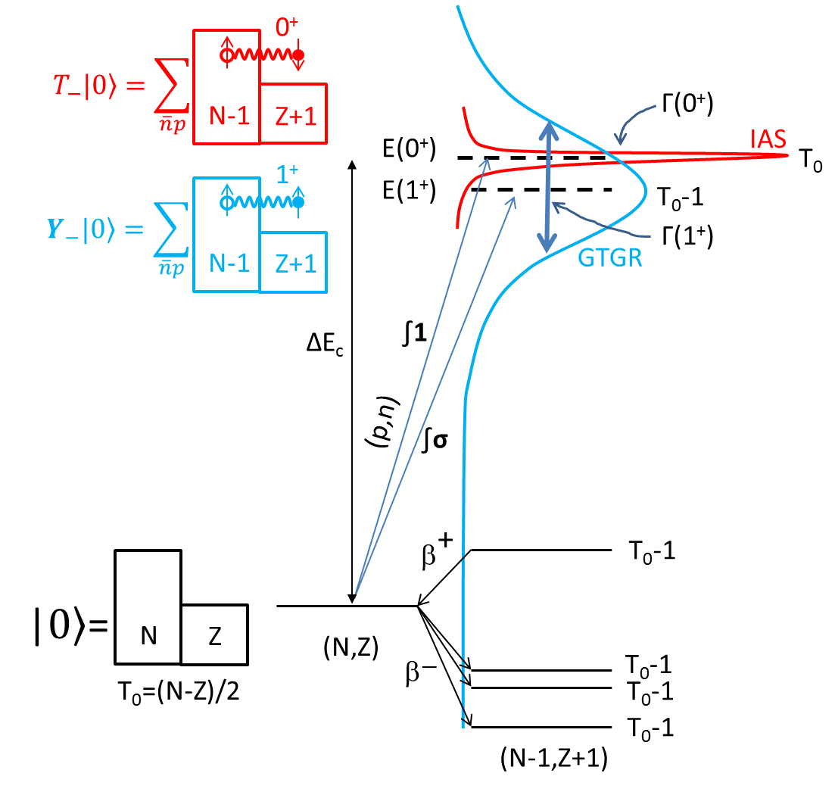
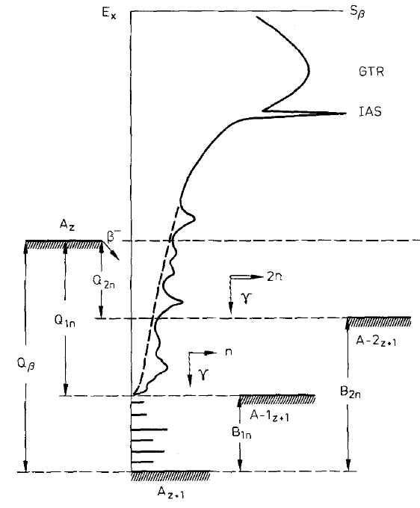
between the “hot” and the “cool” : β-strength function

Slide 4
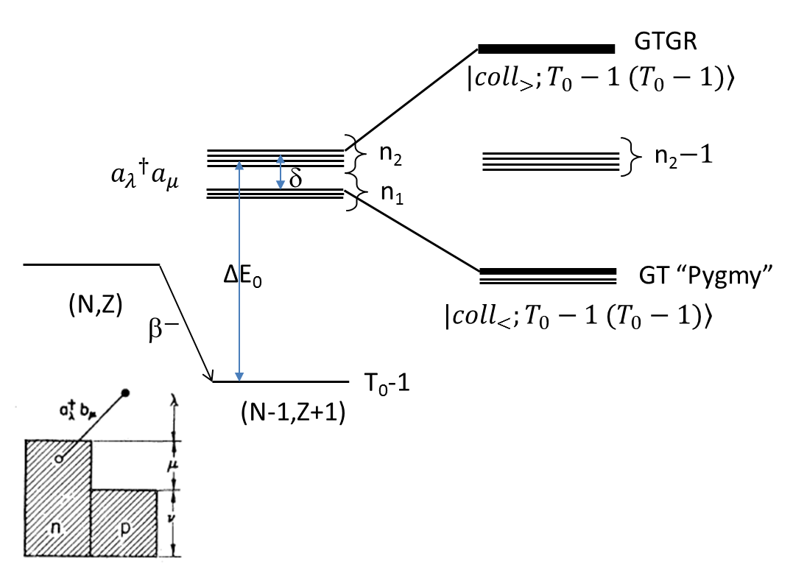
Structured β-strength function
V_{pn}
Ejiri, Ikeda, Fujita Phys Rev C 176 (1968)
isovector part of the nuclear interaction

Slide 5

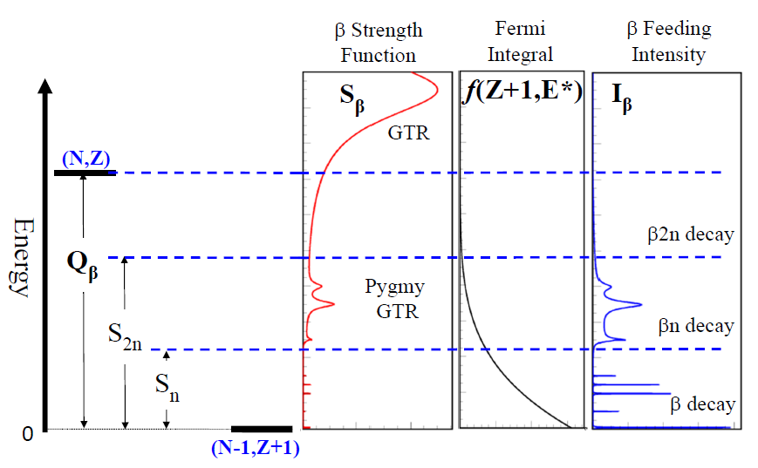
Structured β-strength function : experimental evidence ?
A
(Z,N)
β
n
precursor
β-decay products
to be detected
S_{n}
Q_{β}
A-1
(Z+1,N-2)
What can be measured
final nucleus + neutron
γ
A
(Z+1,N-1)
emitter

Slide 6
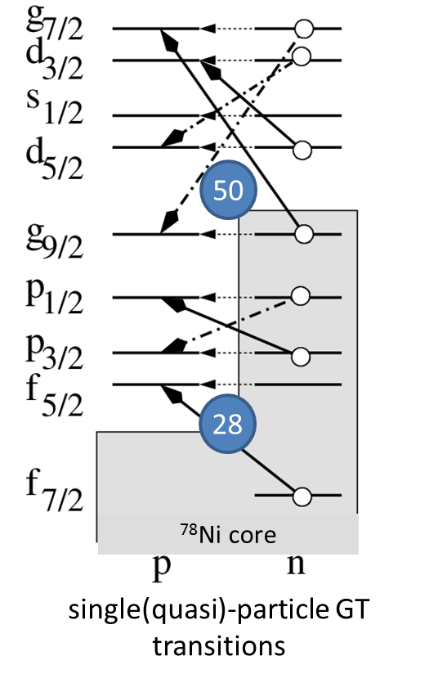
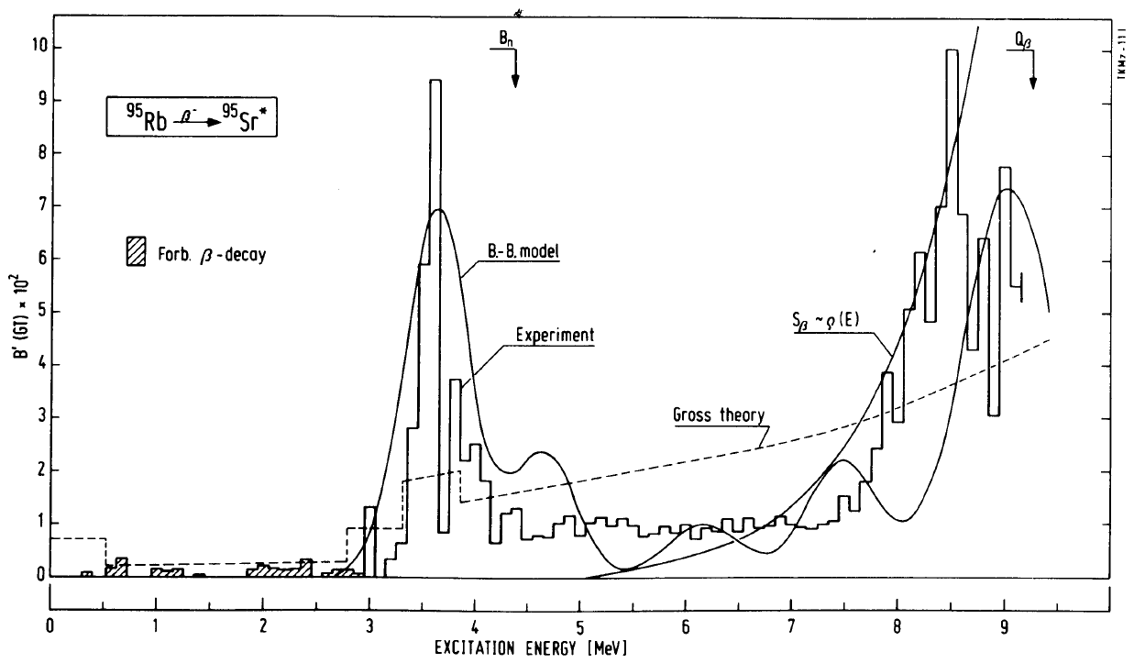
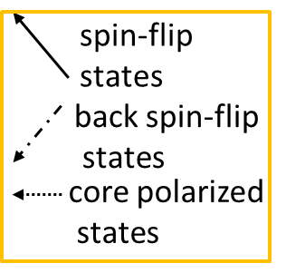
Structured β-strength function : experimental evidence ?
Example : ⁹⁵Rb → ⁹⁵Sr in the ⁷⁸Ni valence space
nuclear structure strongly influences β-decay properties !
0.06% of β-feeding !
“Pygmy” resonance built from accumulation of CP and SF transitions
~64% of β-feeding
strong νg_{7/2}→πg_{9/2} BSF
SF
BSF
K.-L. Kratz et al.
Proceedings of the Fourth International Conference on Nuclei far from Stability,
(CERN Yellow Report 81-09, Geneva, 1981), pp. 317–326.
CP

Slide 7
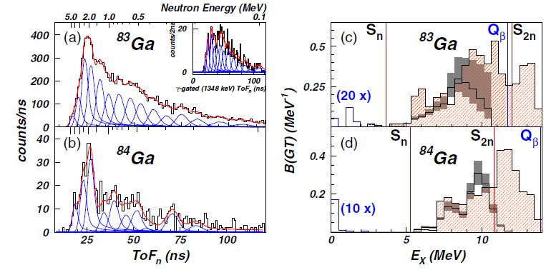
Structured β-strength function : experimental evidence ?
More recent example : ^{83,84}Ga → ^{83,84}Ge in the ⁷⁸Ni valence space
Madurga et al. PRL 117, 092502 (2016)
β-delayed neutron TOF spectroscopy with VANDELE
SF
BSF
CP

Slide 8
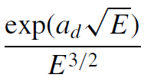
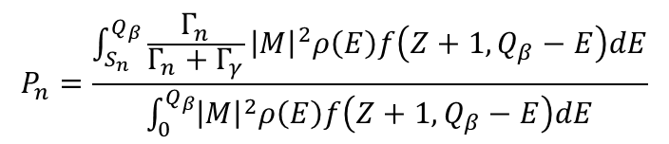

Integrated β-strength function : P_{(x)n}
P_{2n}
P_{1n}
cste
the “Kratz-Herrmann formula”
[Z. Phys. 263, 435 (1973)]
transition (GT, ff etc)
matrix element
level density
$$ρ\left(E\right)=$$
Miernik
[PRC 88 041301(R) (2013)]
S_{β}
Fermi function
$$P_{n}=\frac{\int_{S_{n}}^{Q_{β}}{\frac{Γ_{n}}{Γ_{n}+Γ_{γ}}{\left|M\right|}^{2}ρ\left(E\right)f\left(Z+1,Q_{β}−E\right)dE}}{\int_{0}^{Q_{β}}{{\left|M\right|}^{2}ρ\left(E\right)f\left(Z+1,Q_{β}−E\right)dE}}$$
structureless (“Pandemonium-like”)

Slide 9
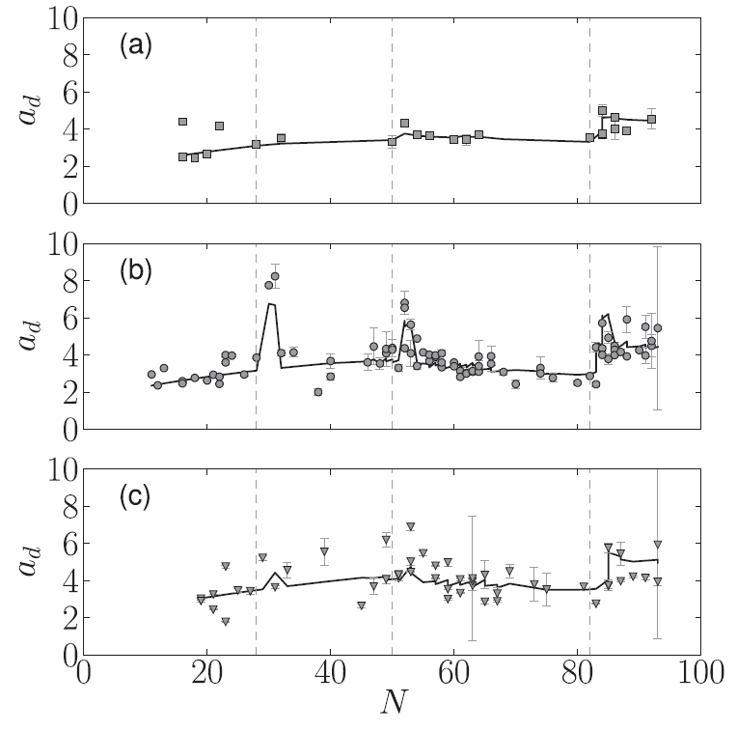
Integrated β-strength function : P_{(x)n}
Spin-orbit magic numbers
Miernik level density parameterization
[PRC 88 041301(R) (2013)]
N=28
N=50
N=82
even-even
odd-mass
odd-odd

Slide 10
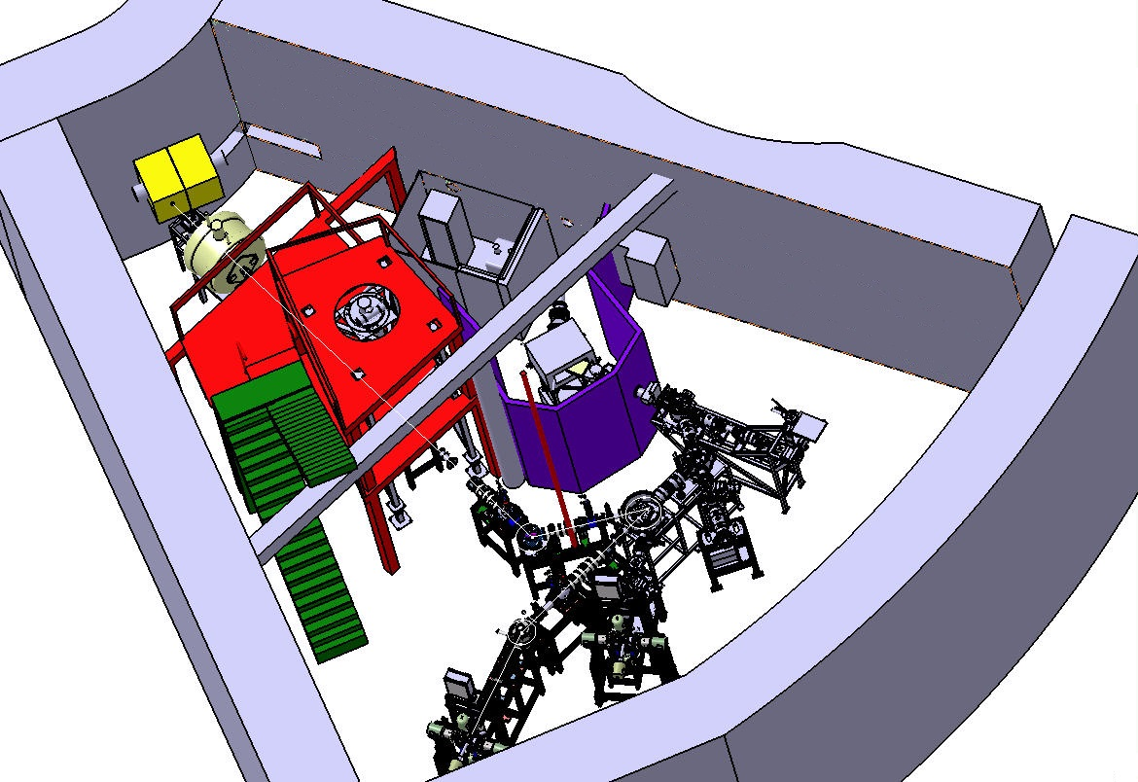
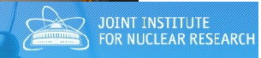
BEDO: the BEta Decay program in Orsay
ALTO : the photo-fission ISOL facility in Orsay
a set of 3 complementary movable-tape-based detection arrays at the ALTO on-line mass separator
Hall 110
PARRNe
mass separator
MLLTRAP
mass spectrometry
POLAREX
identification station
CE spectroscopy
LTNO
TETRA
2019-2021
neutron detection
LINO
BEDO
gamma spectroscopy
and fast-timing
collinear laser spectroscopy and laser pumping

Slide 11
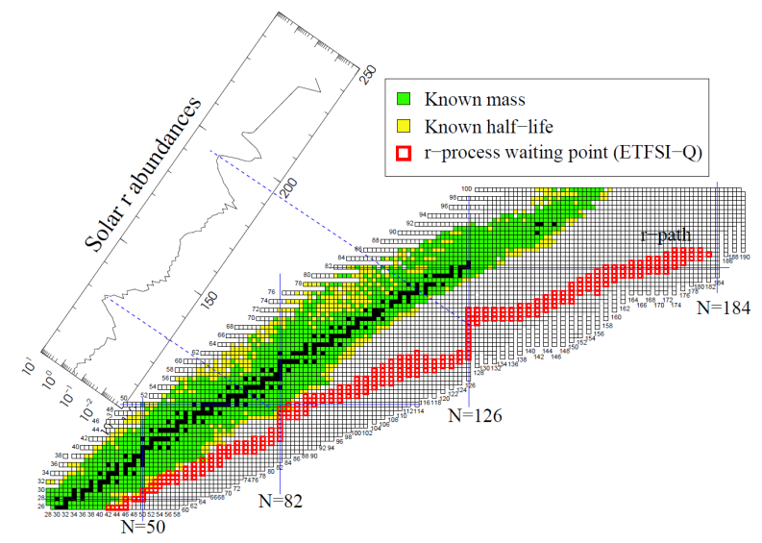
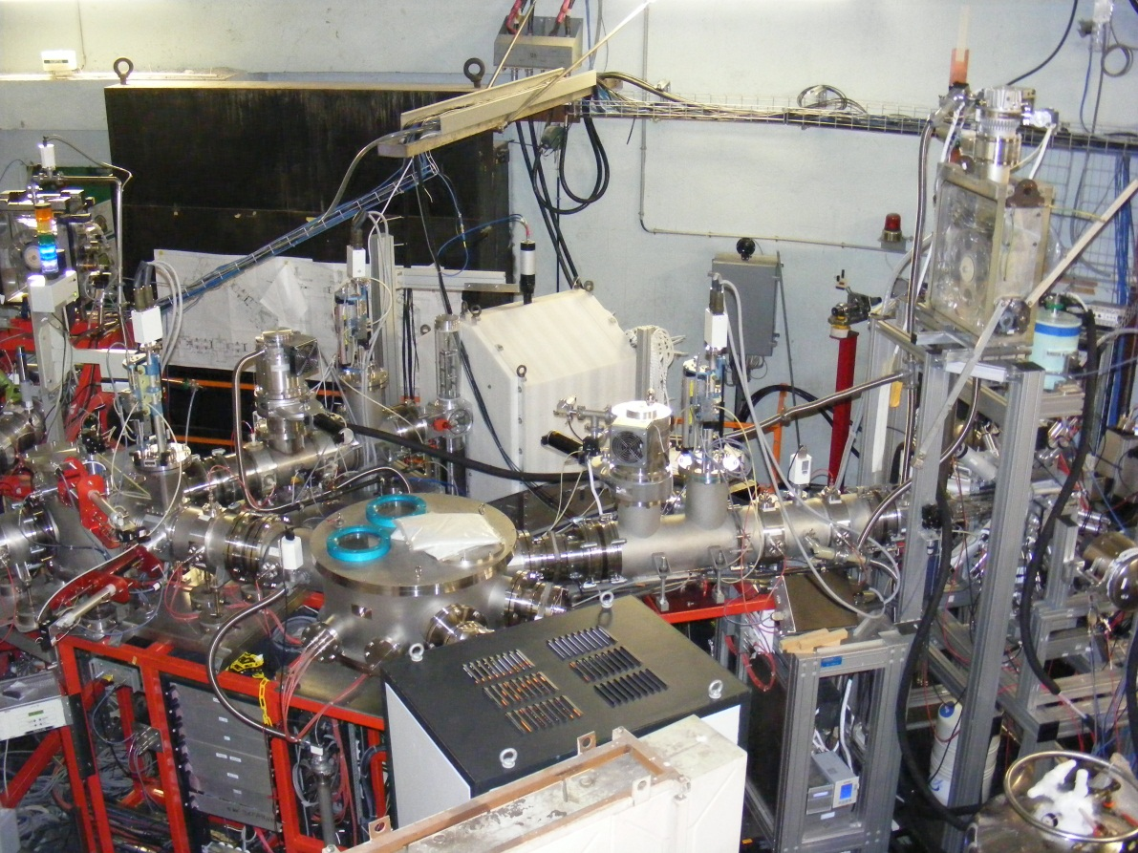
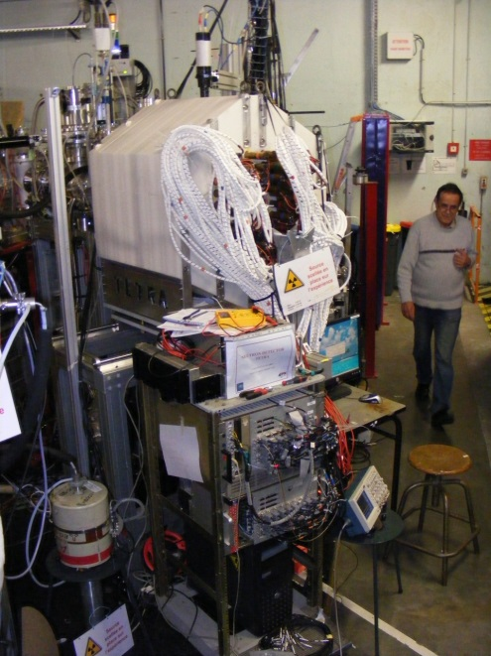
TETRA and BEDO experiments at ALTO
TETRA
BEDO
at ALTO
(photo)fission of actinides
The ³He long counter TETRA at ALTO
collaboration with JINR Dubna

Slide 12
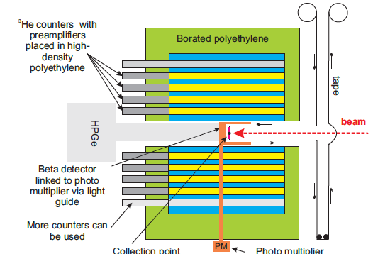
TETRA experiment at ALTO
mass separated low-energy (30 keV) beam
100% pure Ga beams
masse selection at A=82,83,84
(three measurements during a same run)

Slide 13
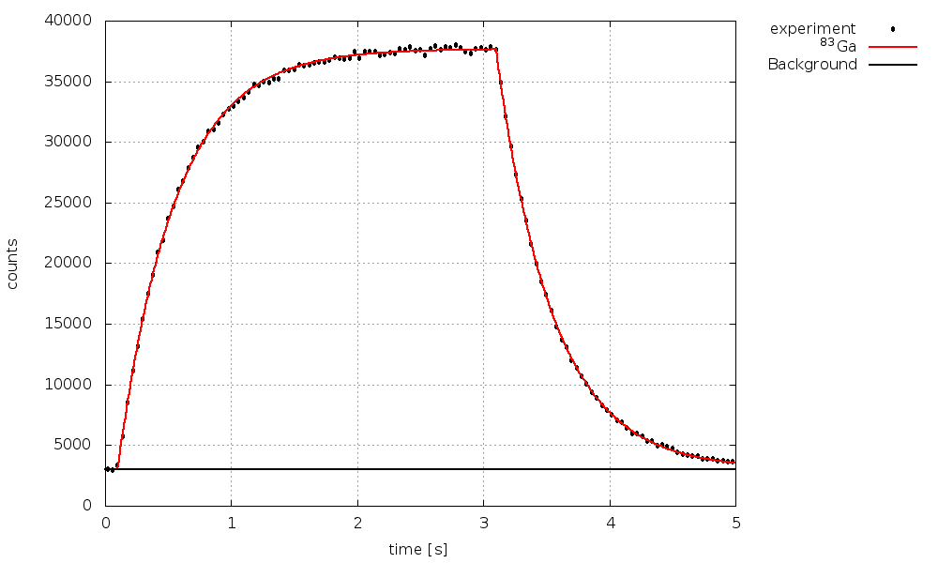
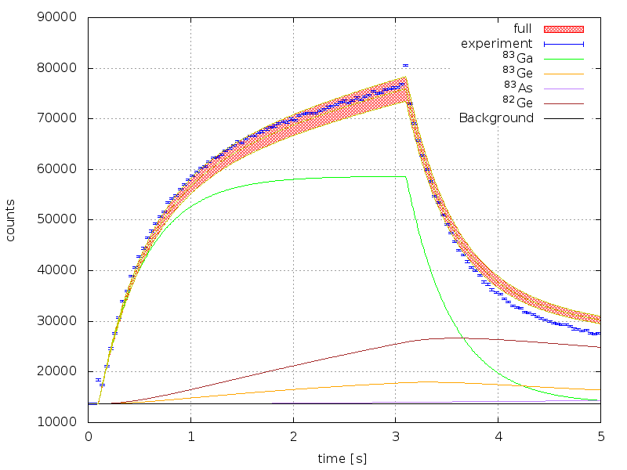
⁸³Ga βn decay
n,β,γ activities recorded simultaneously
β-n, β-γ, β-γ-n coinc data
⇒ ε_{β}, ε_{n}
cumulated β-delayed neutron activity curve
T_{1/2} = 0.312(1) s
The key quantities to be determined from the comparison of the neutron and β activity curves:
φ: the number of incident ions per second
P_{n}: the β-delayed neutron emission probability
time (s)
beam collection
on tape
cumulated β activity curve
time (s)

Slide 14
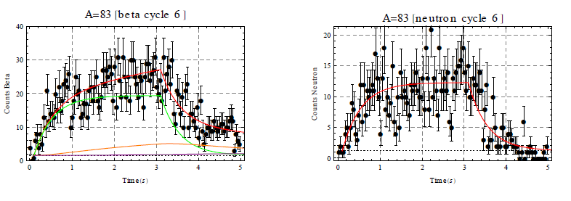
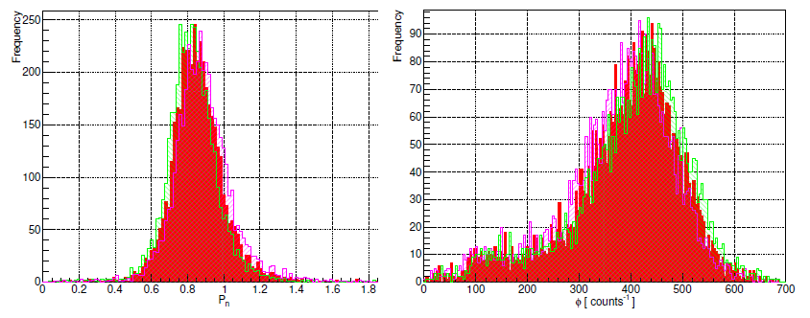
cycle-per-cycle analysis
(strategy introduced by D. Testov)
4405 cycles analyzed
P_{n}
φ (pps)
0.824(2) ≤ Pn≤ 0.878(2)
4405 tape cycles

Slide 15

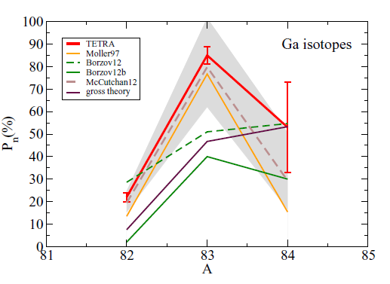
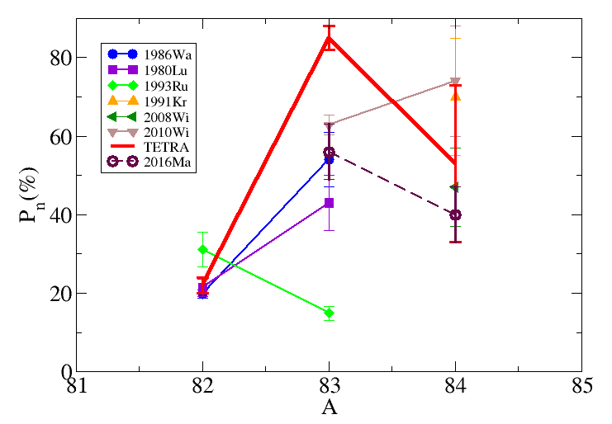
TETRA experiment at ALTO : results
The case of Ga (Z=31) precursors:
⁸²Ga (N_{m}+1) → P_{n}= 22(2)% (test case- Testov et al. NIM A 815 (2016) 96)
⁸³Ga (N_{m}+2) → P_{n}= 85(4)%
⁸⁴Ga (N_{m}+3) → P_{n}= 53(20)%
uncertainties on the results of the McCutchan-et-al. empirical formula : parameters + mass
TETRA
Verney et al., PRC 95, 054320 (2017)
1986Wa: Reeder, Warner et al Rad Eff 94 (1986)
1980Lu: Lund et al Z Phys A 294 (1980)
1993Ru: Rudstam et al Atom. Nat. Nucl. Dat. Tab. 340 (1991)
1991Kr: Kratz et al Z Phys A 340 (1991)
2008Wi: Winger et al Sanibel Conf Proc (2008)
2010Wi: Winger et al. PRC 81 (2010)
2016Ma: Madurga et al. PRL 117 (2016)
Moller97: Möller et al At. Data Nucl. Data Tables 66, 131 (1997)
Borzov12: Borzov, EPJ Web Conf. 38, 12002 (2012)
McCutchan12: derived from McCutchan-et-al. formula
gross theory: [http://wwwndc.jaea.go.jp/nucldata/]

Slide 16
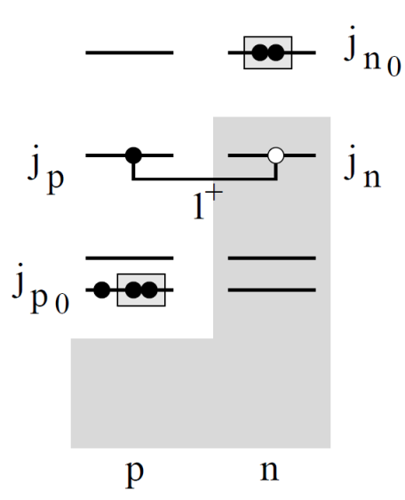
Towards a structure interpretation of the strong Pn oscillation
A phenomenological approach
typical “doorway” configuration
energy location of the main doorway configuration from spectroscopic data
pairing effects : BCS
using gaps from experimental data
$V_{0i}=V_{τ}\left(r_{0i}\right) {\vec{τ}}_{0}∙{\vec{τ}}_{i}+$ $V_{στ}\left(r_{0i}\right)\left({\vec{σ}}_{0}∙{\vec{σ}}_{i}\right)\left({\vec{τ}}_{0}∙{\vec{τ}}_{i}\right)$
strength of the residual interaction from spectroscopy of odd-odd nuclei around N=50
[Etilé, Verney, Severyukhin et al PRC 91, 064317 (2015)]
SF
BSF
CP
however: no configuration mixing; no phonon-coupling
(only QRPA can do, see later)

Slide 17
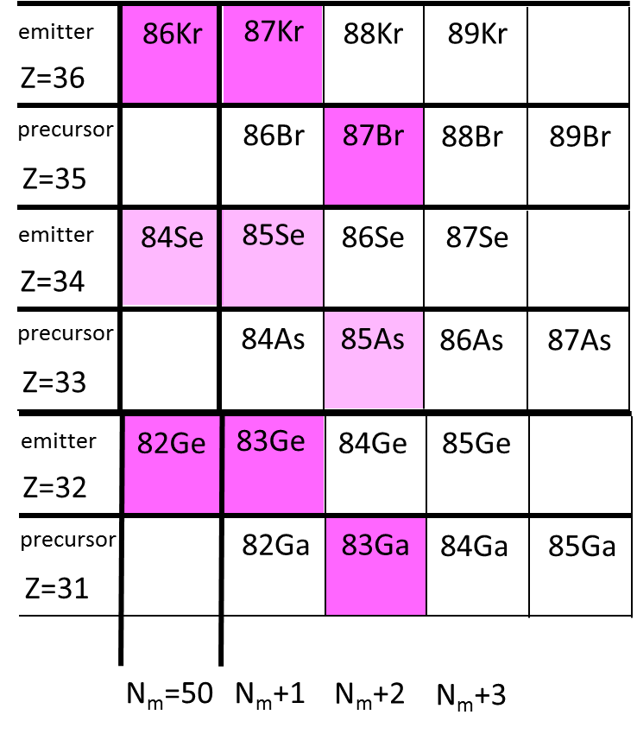
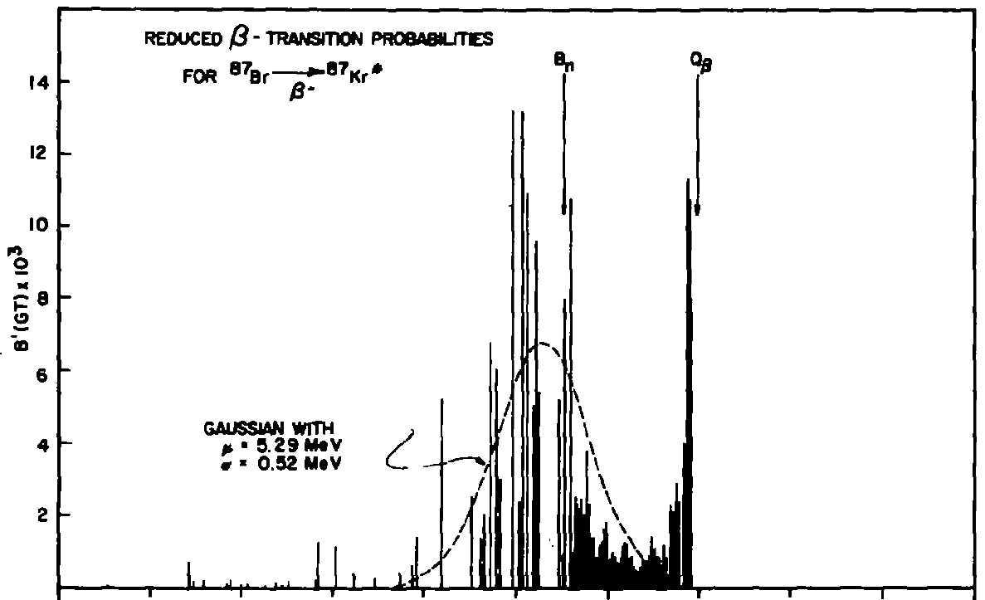
Towards a structure interpretation of the strong Pn oscillation
Test case : the analogous N_{m}(50)+2 well-established case ⁸⁷Br→⁸⁷Kr
Nuh et al. NPA 293 (1977)
Prussin Oliveira Kratz NPA 317 (1979)
clear evidence of a resonance-like structure in the β-strength function at ~5.3 MeV

Slide 18
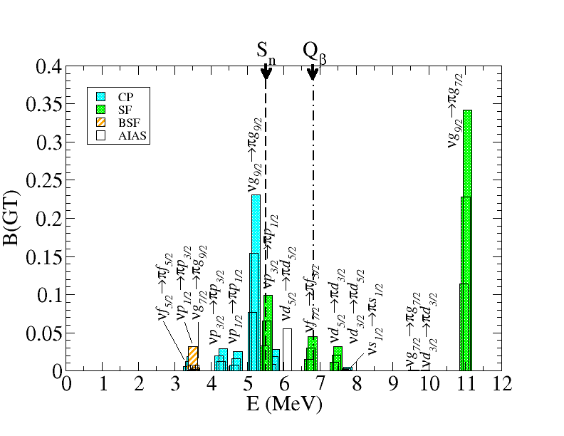
Towards a structure interpretation of the strong Pn oscillation
Test case : the analogous N_{m}(50)+2 well-established case ⁸⁷Br→⁸⁷Kr
⁸⁷Br→⁸⁷Kr

Slide 19
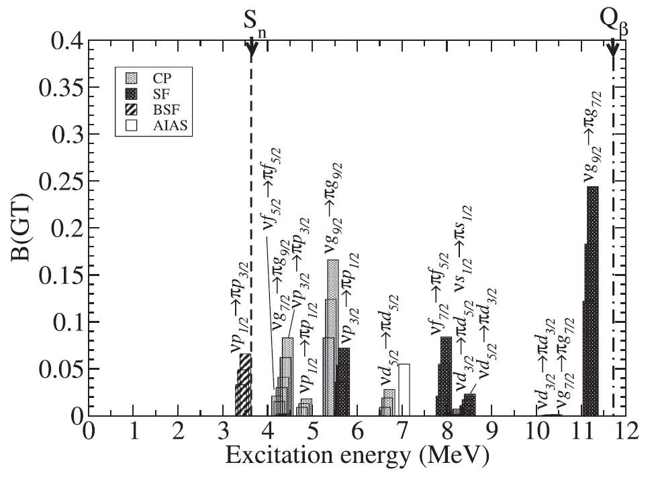
Towards a structure interpretation of the strong Pn oscillation
Calculated β-strength function for the case ⁸³Ga→⁸³Ge
S_{n}(84)
SF
BSF
if this “beautiful story” is correct :
γ-decay from high-lying states in ⁸⁴Ga→⁸⁴Ge should be observed.
Unfortunately no large-statics data on this decay have been obtained so far…
CP

Slide 20
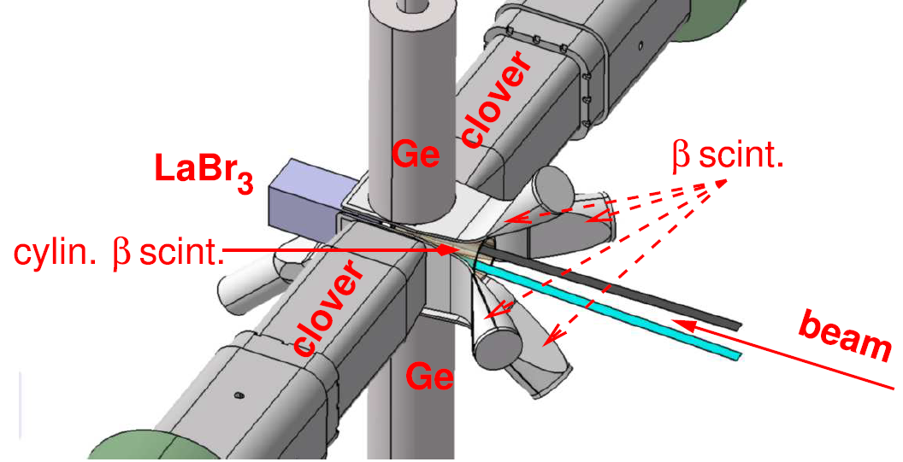
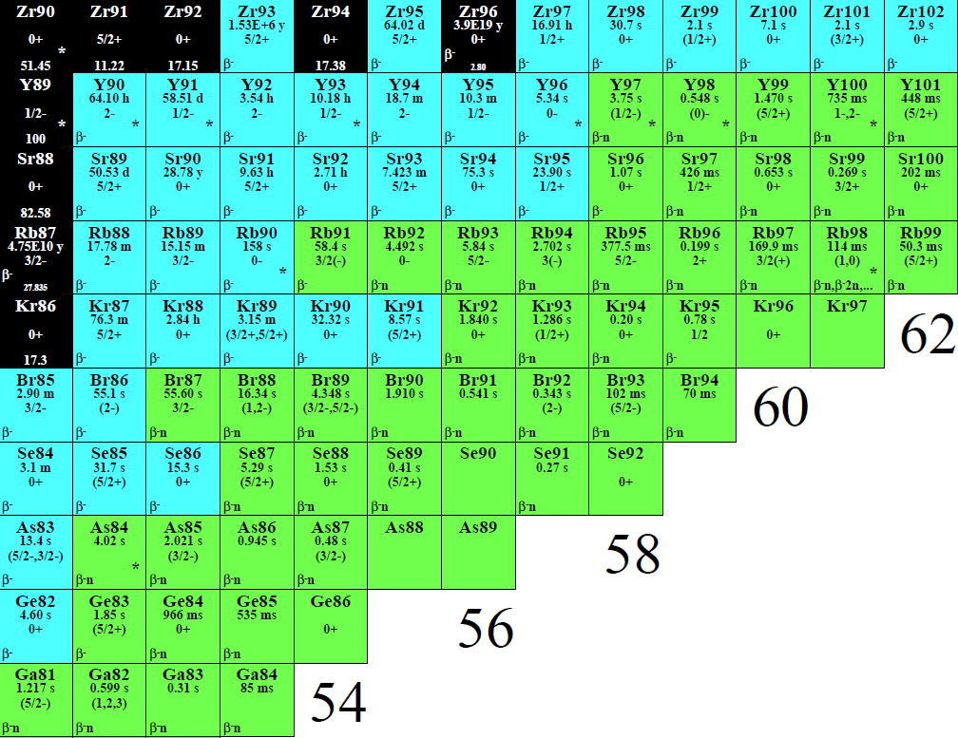
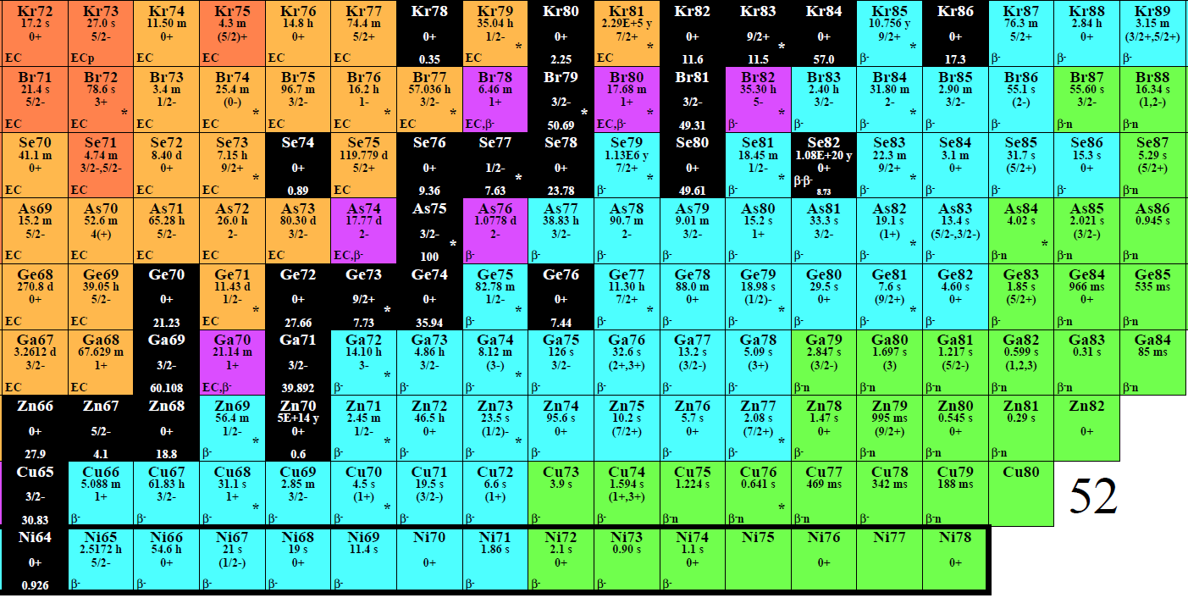
Involuntarily (but seriously) slipping into Pandemonium troubles
2×2×4’’ LaBr3
36
34
32
30
⁸³Ge (Z=32, N=51)
⁸⁰Ge (Z=32, N=48)
28

Slide 21
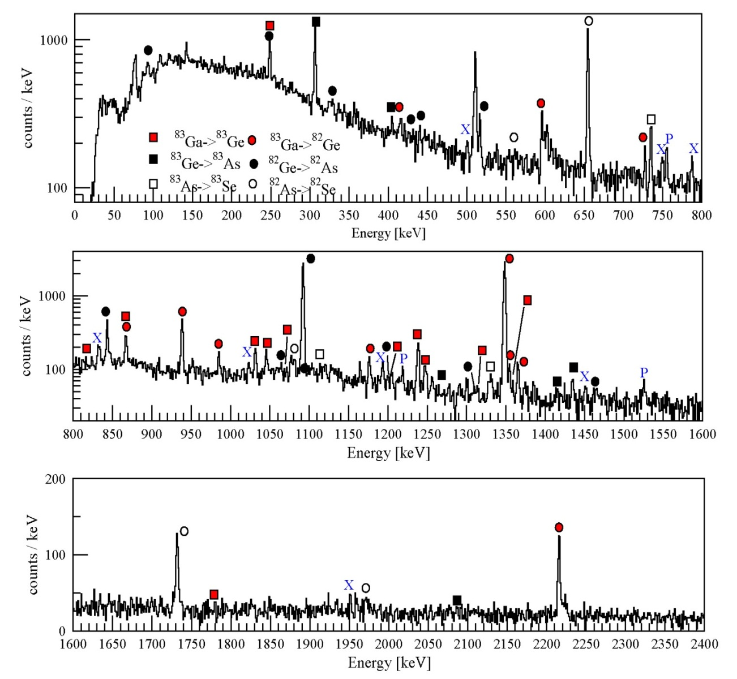
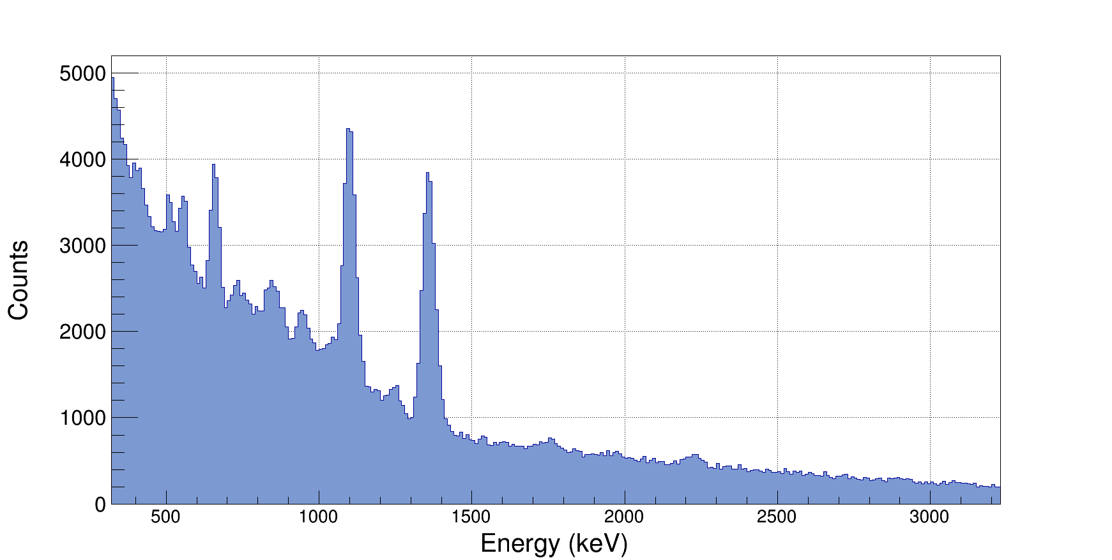
At the beginning everything looked normal
⁸³Ge
β-gated HP-Ge γ-spectrum
β-gated LaBr₃
low-energy γ-spectrum
1092 keV
655 keV
1348 keV
1238 keV
data collected within the PhD program of C. Delafosse
(β-decay at ALTO, as a non-Yrast supplement to the AGATA+plunger+VAMOS data)

Slide 22

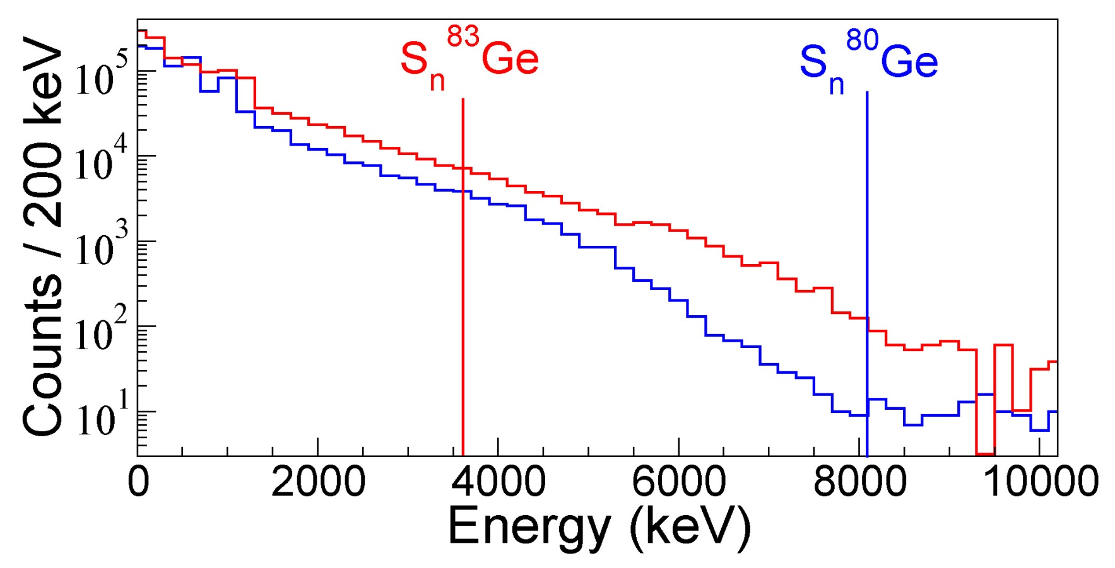
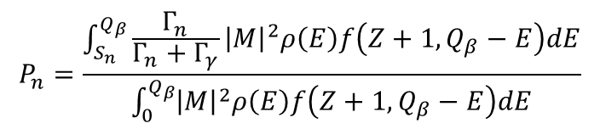
A true serendipity
generally taken as ≈1 !
S_{β}
Fermi function
$$P_{n}=\frac{\int_{S_{n}}^{Q_{β}}{\frac{Γ_{n}}{Γ_{n}+Γ_{γ}}{\left|M\right|}^{2}ρ\left(E\right)f\left(Z+1,Q_{β}−E\right)dE}}{\int_{0}^{Q_{β}}{{\left|M\right|}^{2}ρ\left(E\right)f\left(Z+1,Q_{β}−E\right)dE}}$$
comparison of ⁸⁰Ge vs ⁸³Ge spectra (below vs above N=50) up to ≈Q_{β}
one order of magnitude !

Slide 23
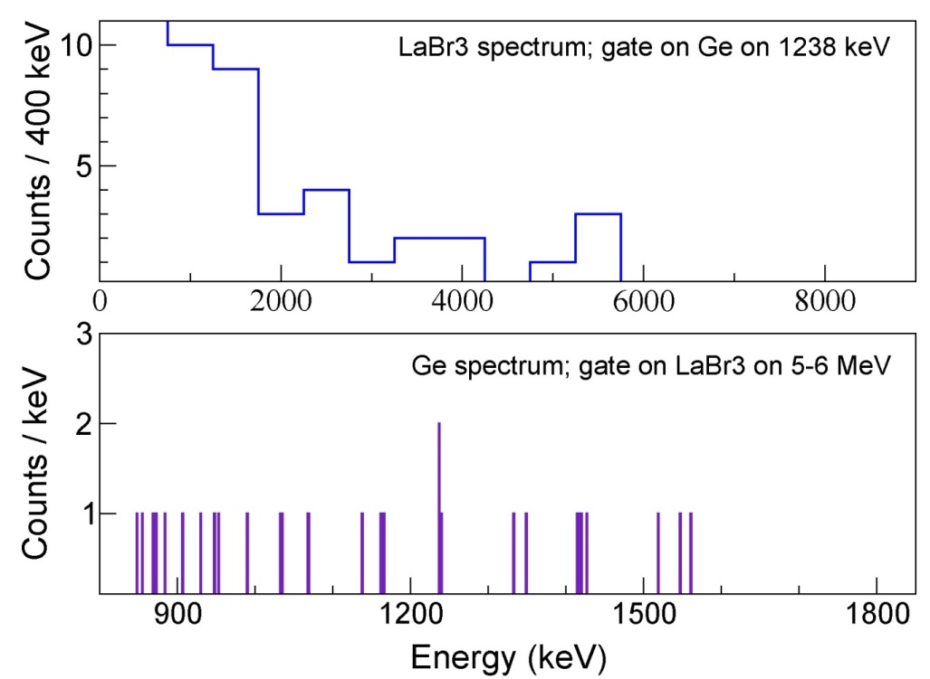
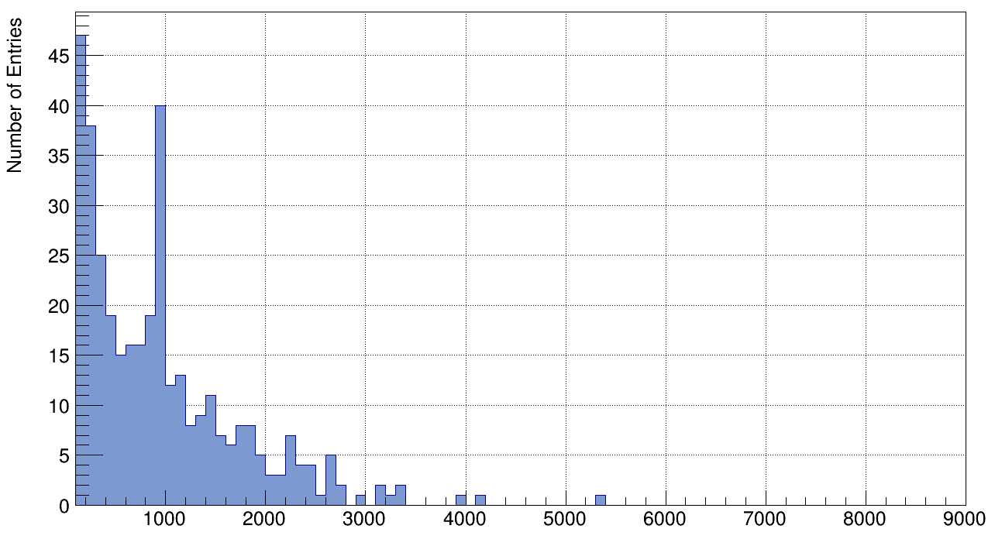
Pandemonium uncovered
γ rays between 4.5 – 6 MeV in coincidence with ⁸³Ge 1238 keV line
!!
LaBr3 spectrum
γ rays in coincidence with ⁸²Ge 1348 keV line (2⁺→0⁺)
Conclusion:
Low-energy states in ⁸³Ge are fed by β decay
via the GT population of high-energy (5-7 MeV) states
→ descrete ?

Slide 24
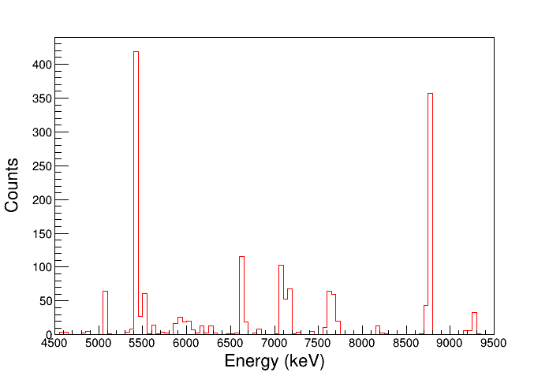
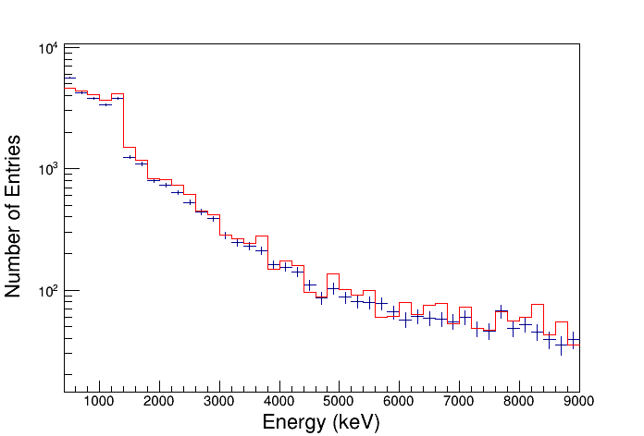
Pandemonium unveiled
Response function + energy linearity of LaBr3 detector fully characterized up to 11 MeV using ²⁷Al(p,γ)²⁸Si reaction at the ARAMIS accelerator (CSNSM in Orsay)
LaBr₃ de-convoluted γ-spectrum
(intensity spectrum)
LaBr₃ re-convoluted spectrum
experimental γ-spectrum
structures appear above the neutron threshold
16(4) % of the β decay strength above n-threshold and followed by γ-emission
β-n branching measured with TETRA= 85(4)%

Slide 25
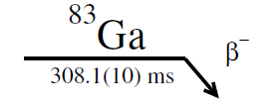

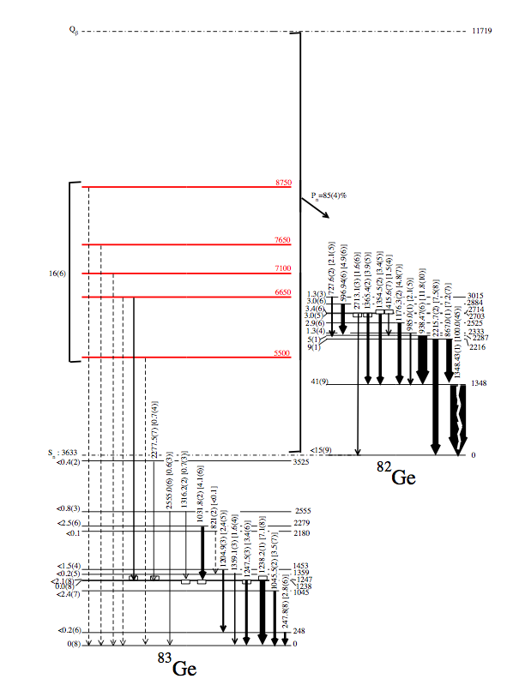
The first “quasi-Pandemonium-free” β-delayed γ-spectroscopy of ⁸³Ge
16(4)% followed by γ
85(4)% followed by n
S_{n}=3633
→ a very puzzling situation: as if,
contrary to what has been believed so far,
FF transitions play ≈ no role !!
ΣIβ~100%

Slide 26
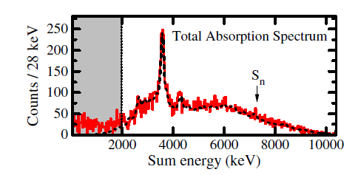
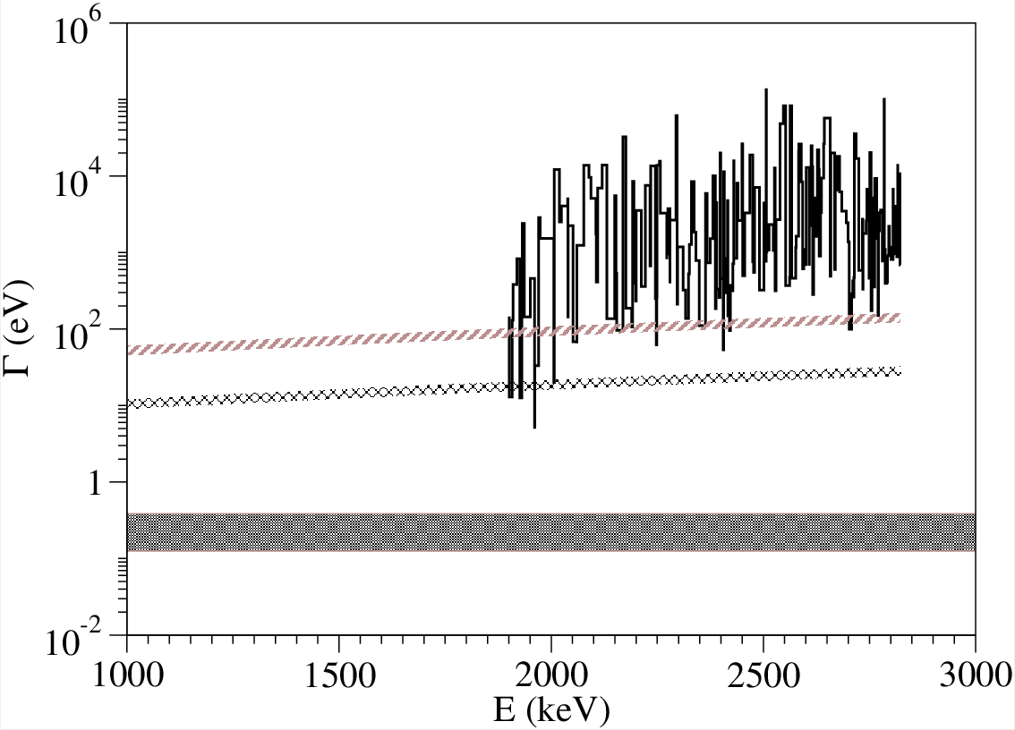
Possible competing n/γ-decay from high lying sates
from β population:
the record was held by ⁷⁰Co→⁷⁰Ni
A. Spyrou et al. PRL 117, 142701 (2016)
⁸⁶Kr+n experimental neutron widths rescaled for ⁸²Ge+n
B(E1)=0.5 e²fm²
B(E1)=0.1 e²fm²
observed average radiative width in ⁸⁷Kr
energy above threshold

Slide 27

Towards a microscopic explanation
valence topology considerations
entrance (GT) doorway state
exit channel
p_{1/2}
n
p_{1/2}
n
p_{3/2}
p_{3/2}
-
-
h_{11/2}
h_{11/2}
g_{7/2}
g_{7/2}
d_{3/2}
d_{3/2}
s_{1/2}
+
s_{1/2}
d_{5/2}
d_{5/2}
+
1+
g_{9/2}
g_{9/2}
2+
p_{1/2}
2+
p_{1/2}
p_{3/2}
p_{3/2}
f_{5/2}
f_{5/2}
-
-
f_{7/2}
f_{7/2}

Slide 28
Towards a microscopic explanation
valence topology considerations

Slide 29

Towards a microscopic explanation
valence topology considerations
entrance (GT) doorway state
exit channel
p_{1/2}
n
p_{1/2}
n
p_{3/2}
p_{3/2}
-
-
h_{11/2}
parity forbidden
h_{11/2}
g_{7/2}
g_{7/2}
d_{3/2}
d_{3/2}
s_{1/2}
+
s_{1/2}
d_{5/2}
d_{5/2}
+
1+
g_{9/2}
g_{9/2}
3-
p_{1/2}
3-
p_{1/2}
p_{3/2}
p_{3/2}
f_{5/2}
f_{5/2}
-
-
f_{7/2}
f_{7/2}

Slide 30
Towards a microscopic explanation
valence topology considerations
entrance (GT) doorway state
exit channel
p_{1/2}
n
p_{1/2}
n
p_{3/2}
p_{3/2}
-
-
h_{11/2}
h_{11/2}
g_{7/2}
g_{7/2}
d_{3/2}
d_{3/2}
s_{1/2}
+
s_{1/2}
d_{5/2}
d_{5/2}
+
1+
g_{9/2}
g_{9/2}
3-
p_{1/2}
p_{1/2}
p_{3/2}
p_{3/2}
f_{5/2}
f_{5/2}
-
-
f_{7/2}
f_{7/2}
conclusion : the “Pygmy” GT is a doorway to a non-neutron-emitting state

Slide 31
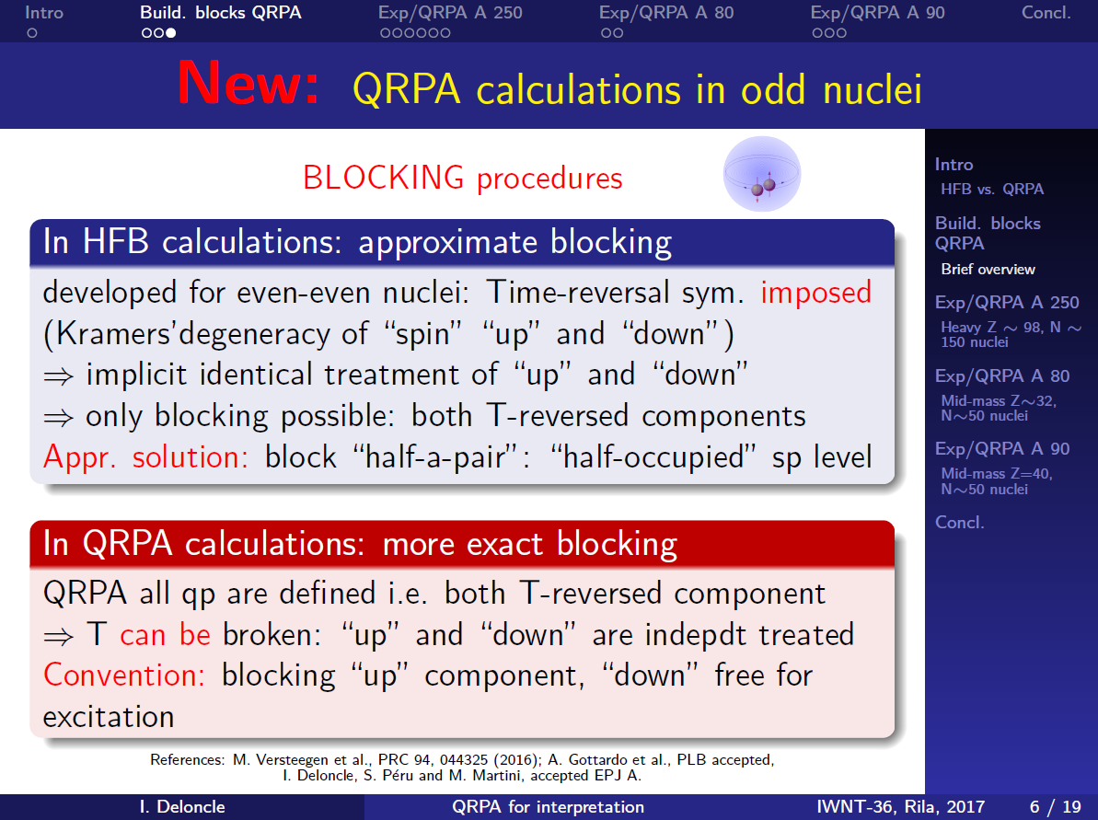
A fully microscopic description
Gogny D1M – QRPA (Bruyères-le-Châtel)
I. Deloncle, Sophie Peru-Desenfants, M. Martini
courtesy Isabelle Deloncle

Slide 32
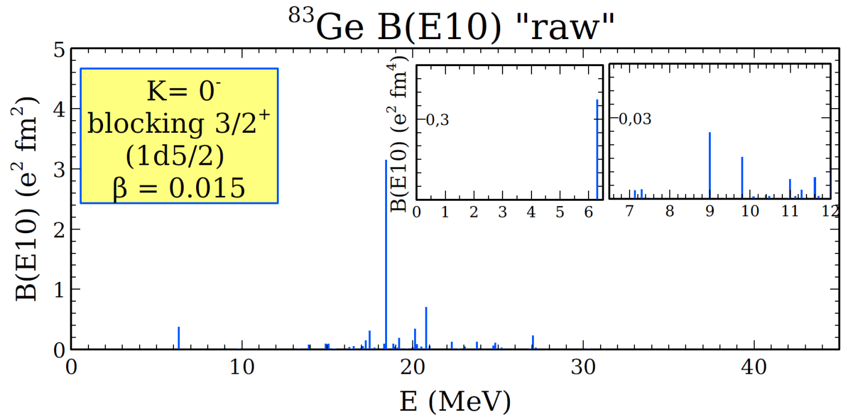
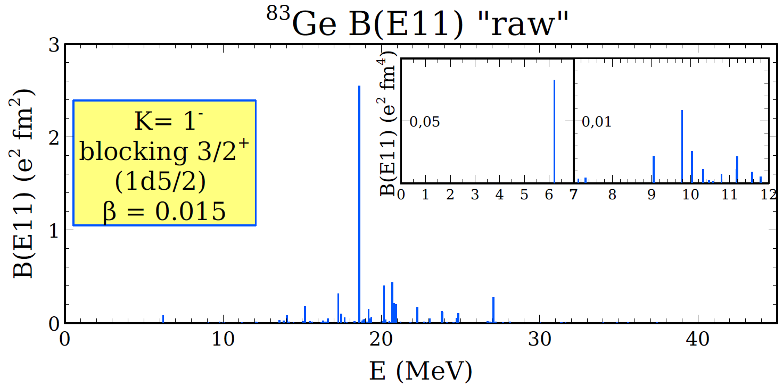
A fully microscopic description
exp Q_{β}
exp Q_{β}

Slide 33
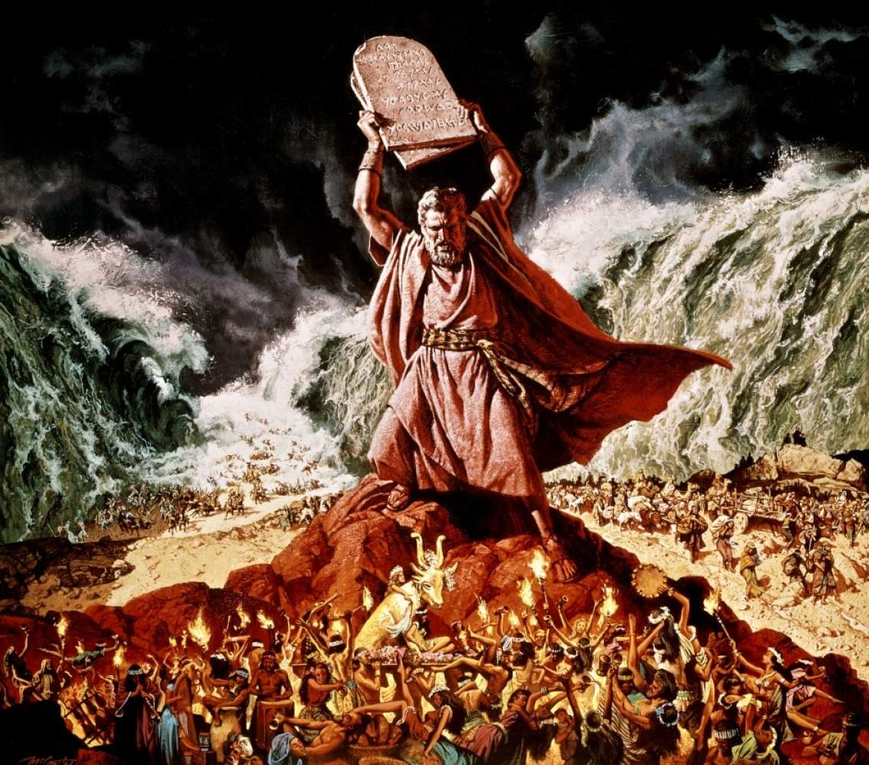
A fully microscopic description
PDR
IV. more than a few % of Thomas-Reiche-Kuhn sum rule should be found in a region of few MeV;
V. transition densities should be non-negligible at the surface (mainly neutron t.d.)
Some definition of “collectivity” may be useful provided it is proven to be basis-independent
I. should be different from threshold effect;
II. should be decoupled from GDR;
III. should NOT be 2-phonon state;
The Kyoto Criteria
courtesy G. Colò

Slide 34

A fully microscopic description
First order of magnitude in 2qp contributions for the phonon excitation at 6.3 MeV in ⁸³Ge
p_{1/2}
n
p_{3/2}
E1
-
h_{11/2}
g_{7/2}
d_{3/2}
s_{1/2}
+
d_{5/2}
g_{9/2}
p_{1/2}
p_{3/2}
f_{5/2}
-
f_{7/2}

Slide 35

A fully microscopic description
First order of magnitude in 2qp contributions for the phonon excitation at 6.3 MeV in ⁸³Ge
p_{1/2}
n
p_{3/2}
E1
-
h_{11/2}
g_{7/2}
d_{3/2}
s_{1/2}
+
d_{5/2}
g_{9/2}
p_{1/2}
p_{3/2}
f_{5/2}
-
f_{7/2}

Slide 36


A fully microscopic description
at higher energies : more complicated neutron states:
interpretable as “tail of the GDR”
conclusion : the “Pygmy GT” seems a doorway to the Pygmy DR
the possible origin of higher energy γ rays remains more mysterious.

Slide 37


A widespread phenomenon ?
can GT connect to PDR states ?
said in other words : can radioactivity trigger global nuclear oscillation ?
close to stability
Schek et al PRL 116, 132501 (2016)
red : common states

Slide 38


Perspectives at ALTO
100 cylindrical BC501A cell of 20 cm x 5 cm.
Intrinsic efficiency (∼50% @ 1MeV)
Energy threshold E_{n} ∼150 keV
Good neutron timing ~1ns
Digital DAQ 14bits & 1 Gsample/s
MOdular Neutron SpectromeTER
(built for FAIR)
International collaboration:
CIEMAT, VECC (India), Univ. de Jyväskylä (Finlandia), IFIC (Valencia), UPC (Barcelona)
TETRA
BEDO
LINO
Ø=20cm x L=5cm

Slide 39



Perspectives at ALTO
PARIS online at ALTO, taking beam, as I speak….
before
after

Slide 40





Perspectives at DESIR
a further (not anticipated in LoIs) excellent physics case for
… but phase 2 is required
  BESTIOL (BEta decay STudies at the SPIRAL2 IsOL facility): Decay spectroscopy setups
  -> β-delayed neutron emission, β-γ, TAS, …
MONSTER
Liquid scintillators
TETRA
BELEN
³He
→ meanwhile : just do our best at ALTO

Slide 41

Conclusions
• rising evidence for structure above the neutron threshold in exotic nuclei (in the ⁷⁸Ni region):
strong Pn Nm +1,2,3 staggering [Verney et al. PRC 95, 054320 (2017) ]
unexpected observation of “ultra”-high-energy γ-rays (8-9 MeV) in the β-delayed emission products of ⁸³Ga [Gottardo et al. PLB 772, 359 (2017)]
• In the ⁷⁸Ni region global decay properties seem to be driven by strong structure effects
questions the long-lived paradigm of first-forbidden decay dominance
Current scenarios in several nuclear applications (decay heat in reactors ?) and astrophysics (r-process) could be substantially affected
• A program to investigate further the question has been launched at ALTO
PARIS and MONSTER campaigns
paves the way for an even more ambitious program at DESIR (within the hypothesis of a Phase 2)
« et si le Ciel était vide ? » (what if heaven was empty ?)
Alain Souchon in ″et si en plus y’a personne″
« what if hell was empty ? »
Thank you for attention

Slide 43



β strength function and the question of ff-transitions in the ⁷⁸Ni region
Because of the structure of the valence space in very N/Z asymmetric nuclei first-forbidden transition are believed to play a major role just after closed neutron shell
consequences for r-process modeling
Marketin et al. PRC 93, 025805 (2016)
at ALTO
(photo)fission of actinides
⁷⁸Ni

Slide 44
A fully microscopic description
Questions on the low-lying (“pygmy”) dipole strength
Conveners: G. Colò and T. Nakatsukasa
Contributors: Y. Kanada-Enyo, M. Matsuo, K. Matsuyanagi, K. Yoshida
→ how recognize a PDR (from a calculation result) ?
The Kyoto Criteria

Slide 45



A widespread phenomenon ?
can GT connect to PDR states ?
said in other words : can radioactivity trigger global nuclear oscillation ?
TAS technique
Tain et al PRL 115, 062502 (2015)
“Enhanced γ-ray emission from neutron unbound states populated in β decay”
^{87,88}Br ; ^{93,94}Rb
enhancement of Γ_{γ} → consequence on (n,γ) cross sections → impact on r-process calculations

