Slide 1


Status of the experiment E676@GANIL:
Lifetime measurements of excited states in neutron-rich C and O isotopes as a test of the three-body forces
M. CiemaŁa, IFJ PAN Krakow
Spokespersons: S. Leoni, B. Fornal, M. Ciemala
Milano – IFJ PAN Krakow
Local Contact: G. DeFrance, M. Ciemala
AGATA@GANIL Collaboration, Coordinators: E. Clement, S. Lenzi
VAMOS Collaboration, Coordinator: M. Rejmund, GANIL, Caen
PARIS Collaboration, Coordinator A. Maj, IFJ PAN, Krakow
NuSpIn 2019
27.06.2019

Slide 2
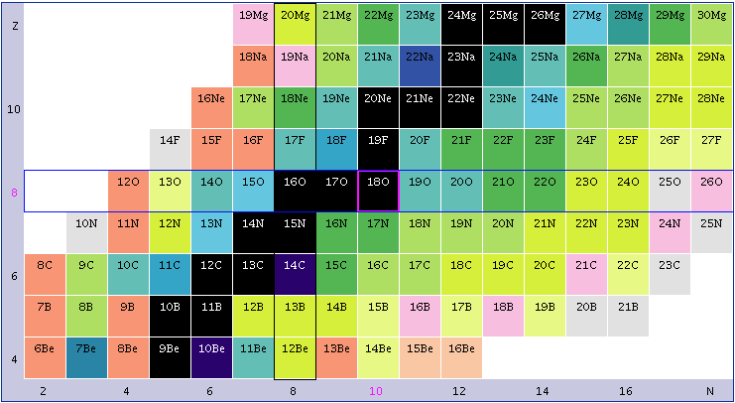
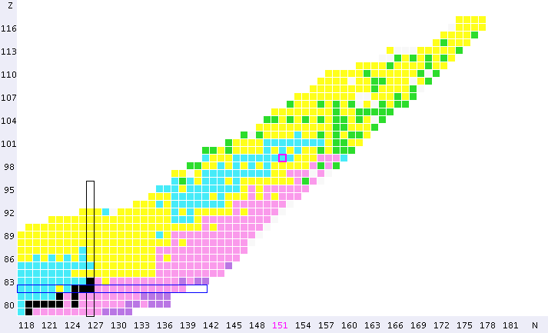
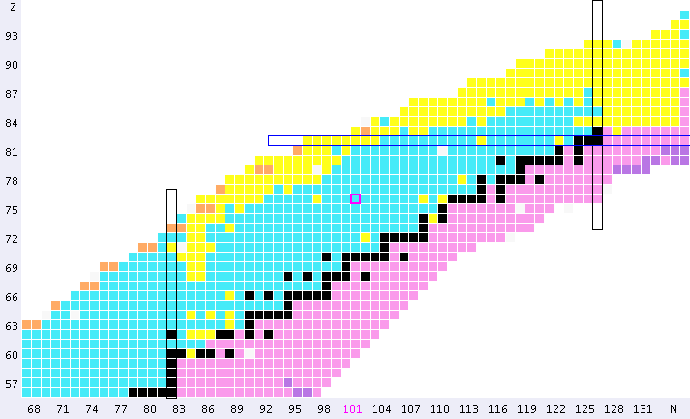
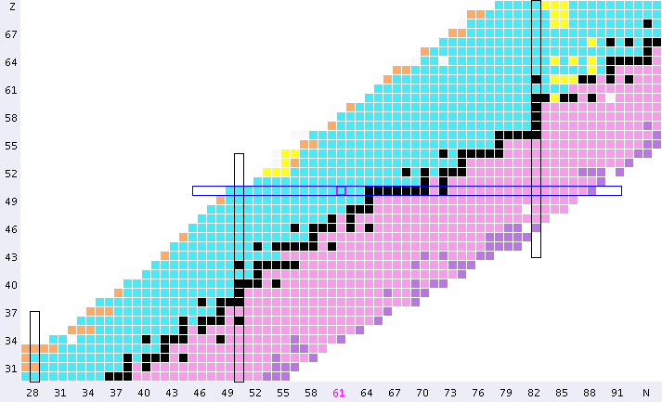
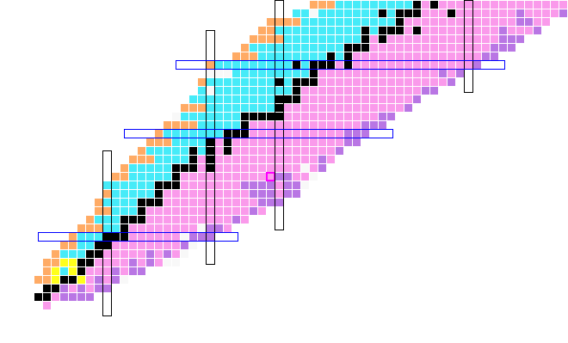
¹⁸O
²⁰O
82
126
Proton number Z
¹⁸O
¹⁶C
50
r-process path
terra incognita
82
28
50
20
8
28
2
20
2
8
Increased sensitivity of some electromagnetic observables to the details of n-n force
Neutron number N

Slide 3
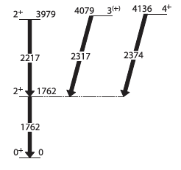
ab initio
Many-Body-Pert. Theory calculations
of the 2⁺₂ lifetimes
Z
NN NNN
0.32 ps 0.20 ps
¹⁸O
²⁰O
¹⁶C
50
N
NN NNN
0.3 ps 0.08 ps
≈ 15 ps
11 ps
ab initio
No-Core-SHELL Model
calculations
¹⁶C
²⁰O
M. Petri et al., Phys. Rev. C 86, 044329 (2012).
M. Wiedeking et al., Phys. Rev. Lett. 94, 132501 (2005).

Slide 4
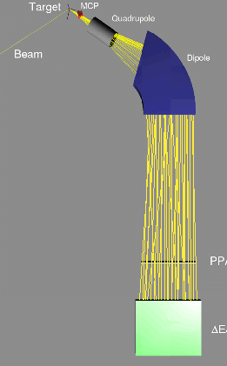

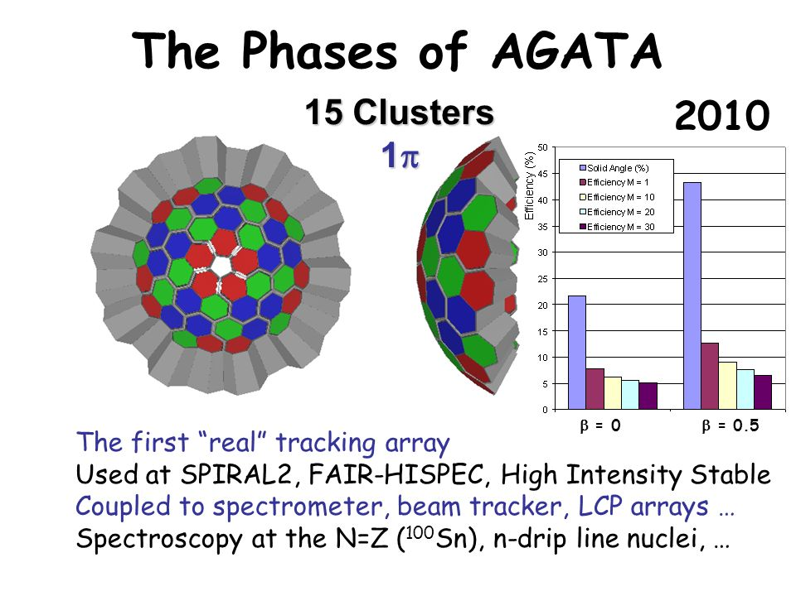

Experimental setup E676@GANIL
¹⁶C + ^{183-xn}Re
¹⁸O + ¹⁸¹Ta →
²⁰O + ^{181-xn}Ta
¹⁶C
²⁰O
PARIS
clusters
target
VAMOS@45 degree
γ
PARIS
clusters
Thick target + degrader
(also plunger)
AGATA
31 detectors
Beam
¹⁸O

Slide 5
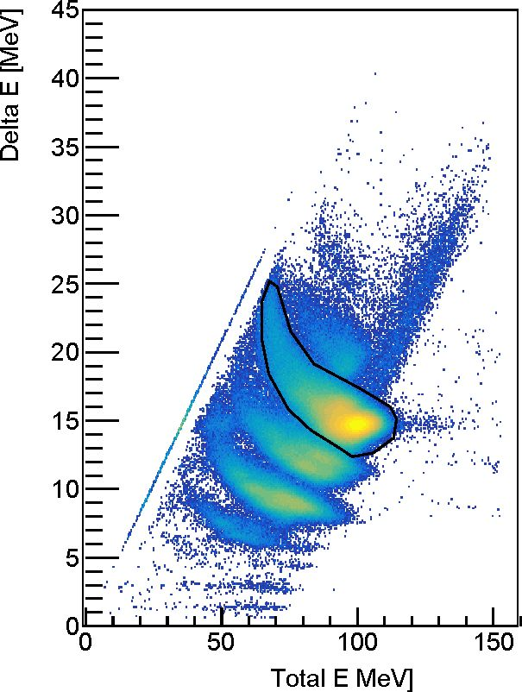
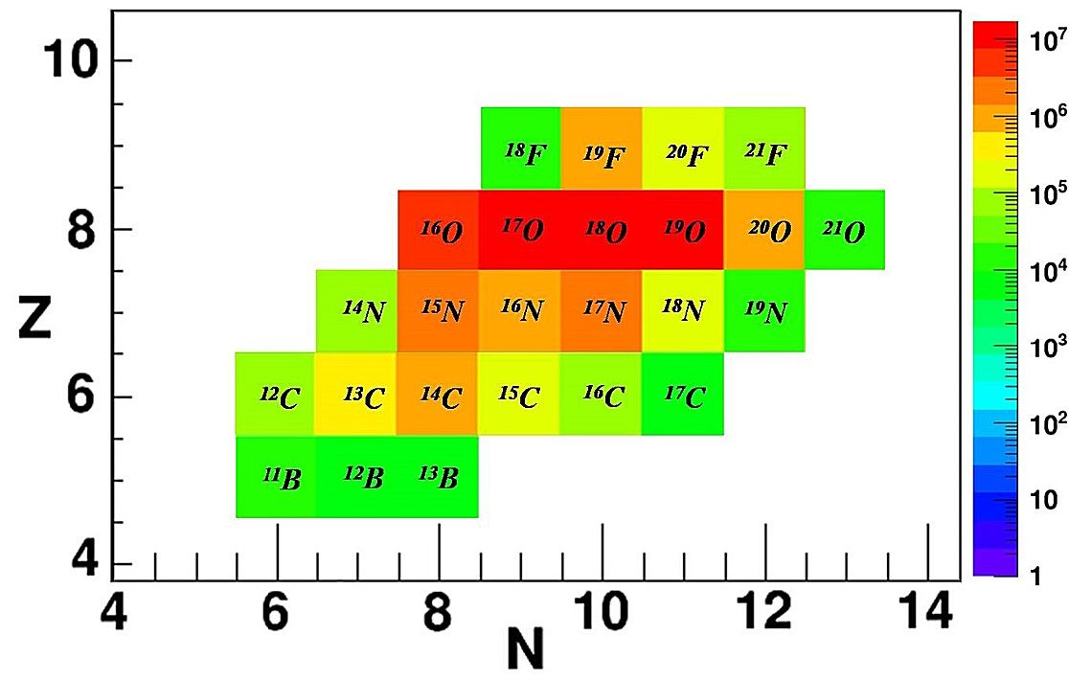
VAMOS A, Z, selection
Z = 8
A gate for Z = 8
Identified isotopes from B to F:
AGATA replay - tuned parameters
S. Ziliani and F. Crespi (U. of Milano)
N isotopes –S. Ziliani talk later today

Slide 6
PARIS timing – correction to velocity
We measure V by path in spectrometer and time between RF and Plastic at the end of focal plane.
¹⁸O MASS reconstruction with RF
Time of experiment
But RF signal is NOT stable in time in respect to beam on target – best observable is Mass (calculated from Brho and V)
We are using PARIS (LaBr part) vs. RF timing to correct RF fluctiations (up to 2 ns, epsecially at the end of exp.)

Slide 7
PARIS timing – correction to velocity
We measure V by: measure path in spectrometer and time between RF and Plastic at the end of focal plane.
¹⁸O MASS reconstruction with RF+PARIS !!!
Time of experiment
Thanks to PARIS timing we recovered good A reconstruction/stability (it means also good V)!
We are using (mean) PARIS vs. RF timing to correct RF fluctiations (up to 2 ns, epsecially at the end of exp.)

Slide 8
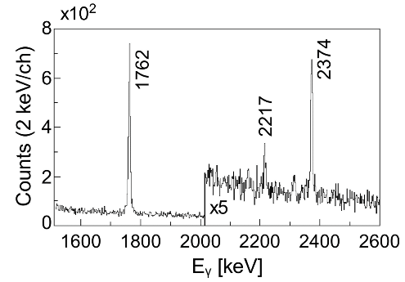
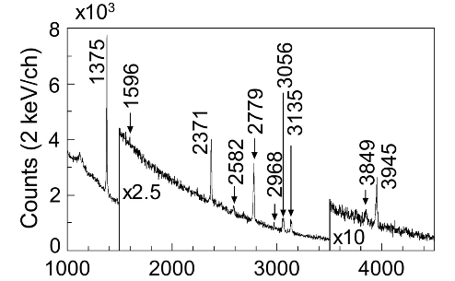
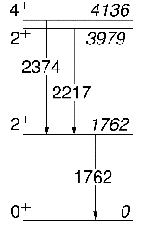
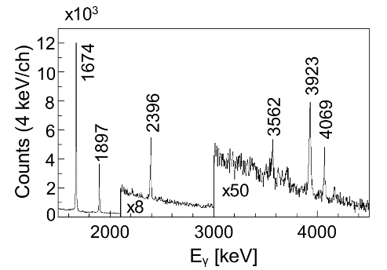
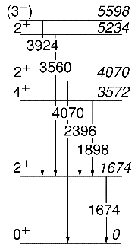
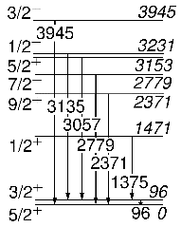
AGATA Spectra –Tracked and Doppler Corrected
¹⁶C
¹⁹O
¹⁶C
¹⁹O
²⁰O
gated by VAMOS
²⁰O

Slide 9
METHOD: Doppler shift dependence on the point of gamma emission
²⁰O velocity
Distribution
Measured
in VAMOS
¹⁸O (7 MeV/A) + ¹⁸¹Ta target (6 mg/cm²)
∿
∿
∿
∿
∿
target
∿
∿
∿
∿
∿
∿
∿
∿
∿
∿
γ
thick
target
Reconstructed
initial ²⁰O velocity distribution
Inside thick target
Beam
Beam
¹⁸O
¹⁸O

Slide 10
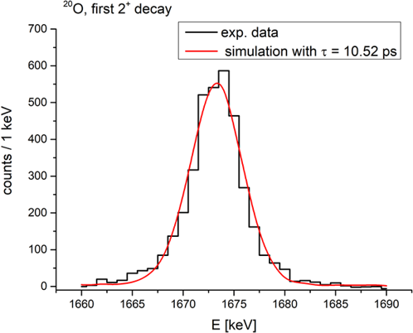
Simulations are needed to extract lifetimes
from γ lineshape
The beam is passing through the target decreasing its energy.
Multi nucleon transfer reactions occur inside the target.
An excited level is let to decay with fixed lifetime.
²⁰O
γ peak
2⁺₁→0+
long
Lifetime
10.5 ps
Simulation (with GEANT4 package) of AGATA response.
AGATA simulated data are tracked (similarly to
experimental data) and Doppler corrected.
Experimental energy resolution of AGATA crystals and differences in counting rates are included in the simulation.
2D chi² maps are used to determine optimum lifetime.

Slide 11
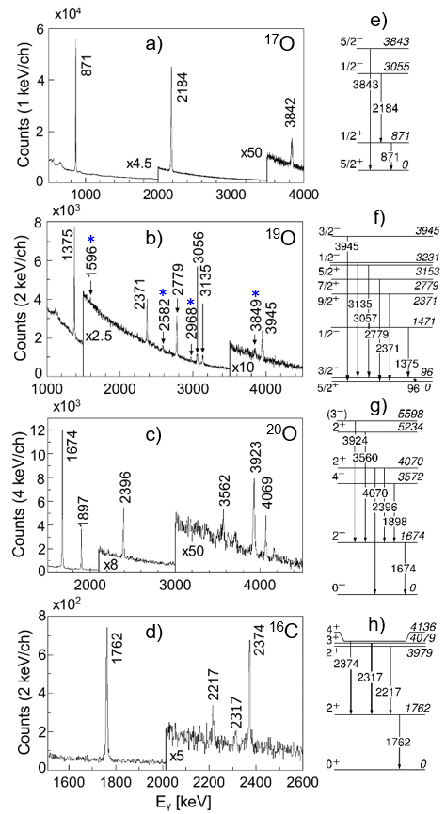
LONG Lifetime test – ²⁰O 2⁺₁→0⁺, 10.5 ps
²⁰O
τ [ps]
1674
E_{γ}

Slide 12
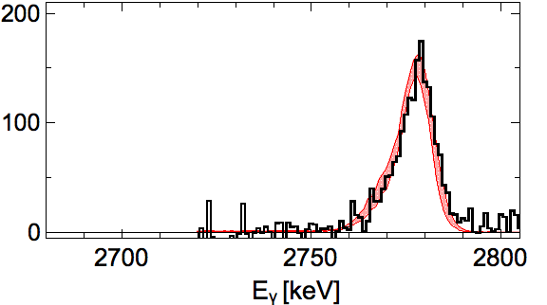
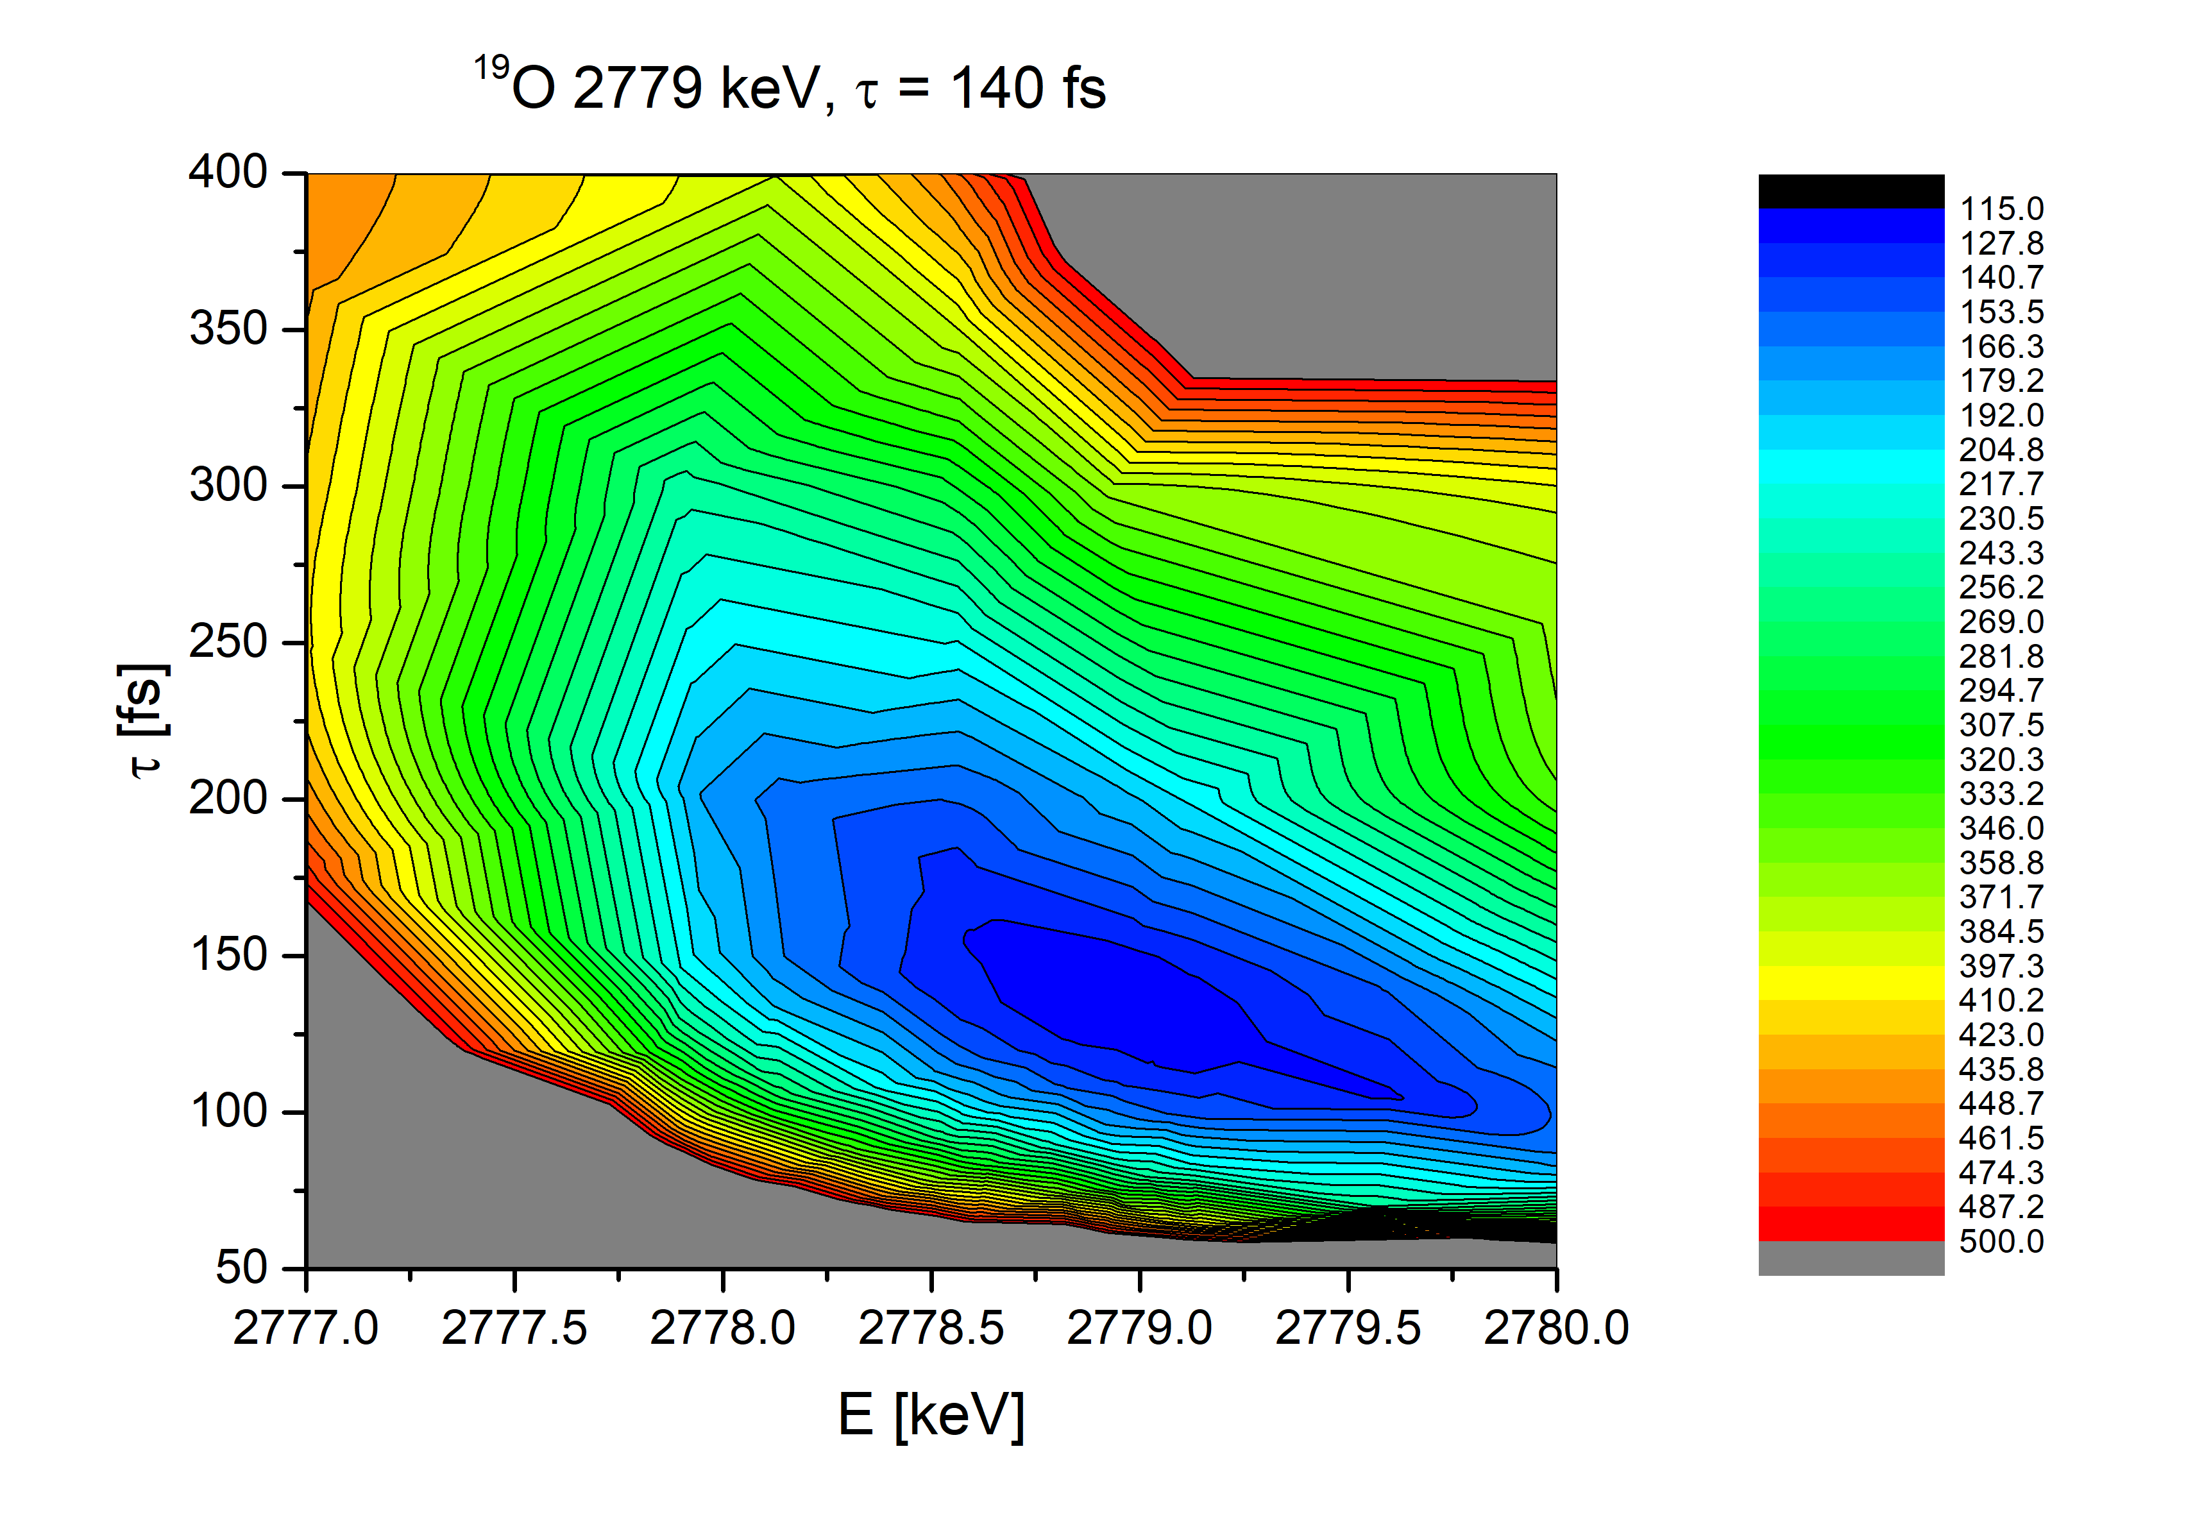
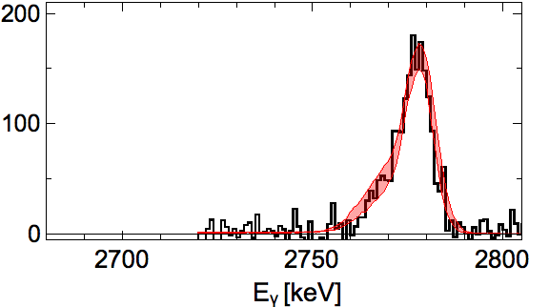
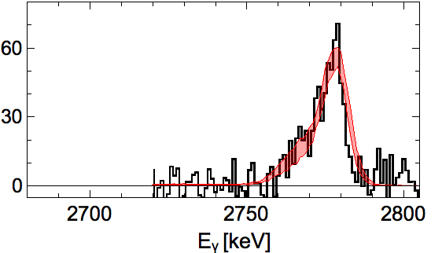
TEST of KNOWN Lifetimes in the 100s femtoseconds region
92(19) fs
¹⁹O
¹⁸O (7 MeV/A) + ¹⁸¹Ta target (6 mg/cm²)
^{130°}
¹⁹O
2779
τ
^{150°}
⁺⁵⁰
τ = 140 fs
₋₄₀
Very old
litterature values (1971)
= 70(26) fs
= 117(26) fs
^{170°}
E_{γ}

Slide 13
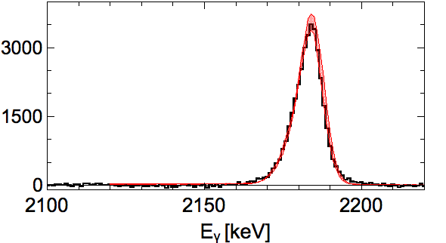
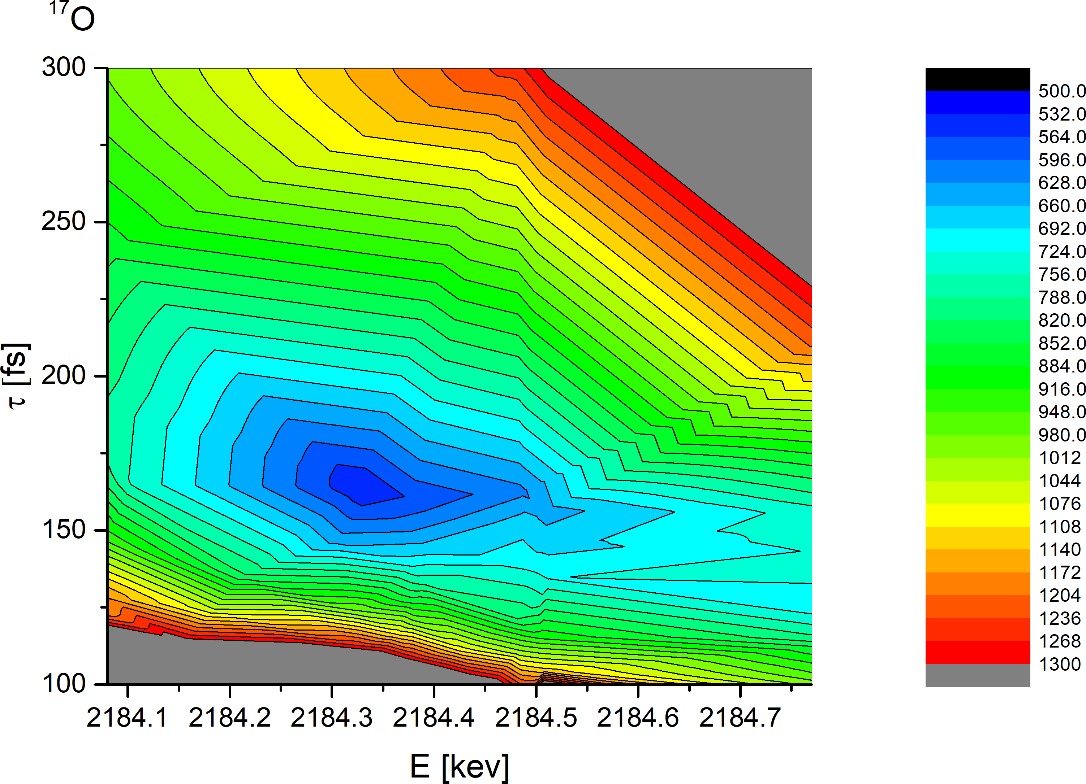
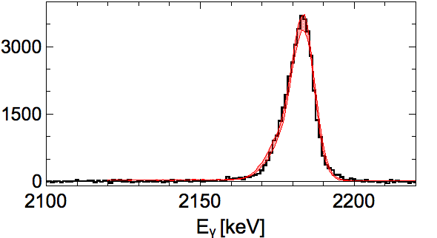
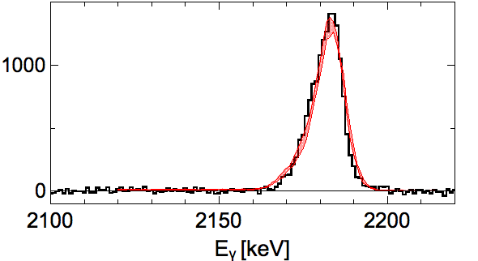
TEST of KNOWN Lifetimes in the 100s femtoseconds region
¹⁷O
115(72) fs
¹⁸O (7 MeV/A) + ¹⁸¹Ta target (6 mg/cm²)
2184
^{130°}
¹⁷O
¹⁷O
τ
^{150°}
⁺⁴⁰
τ = 159 fs
₋₂₀
^{170°}
E_{γ}
Very old
litterature values (1964)
= 120(+80,-60) fs

Slide 14
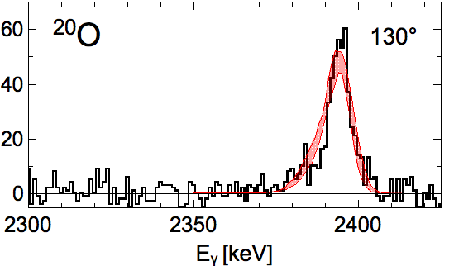
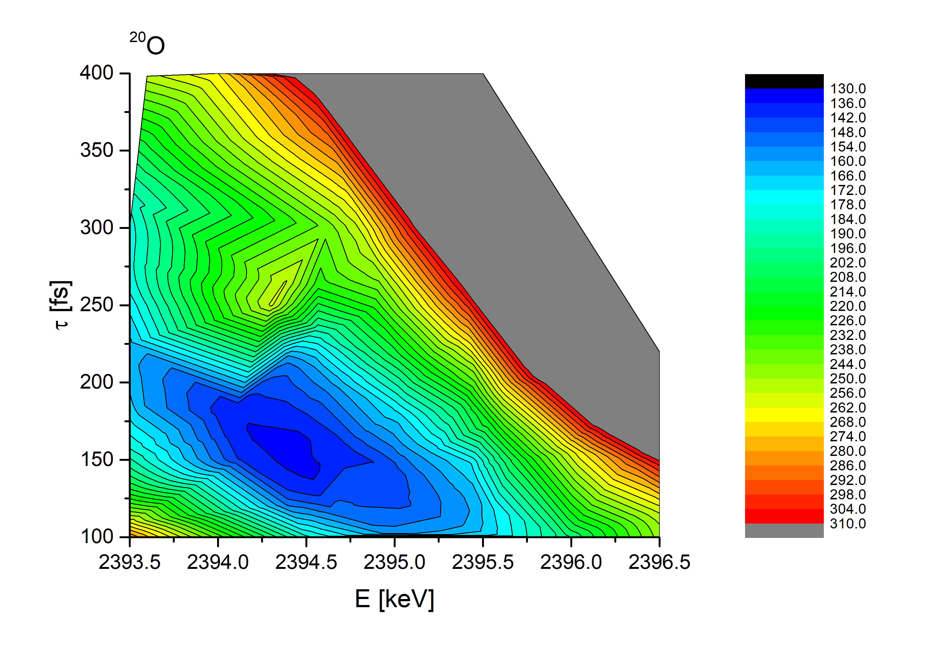
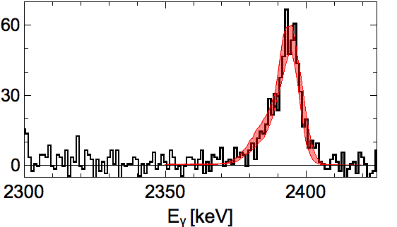
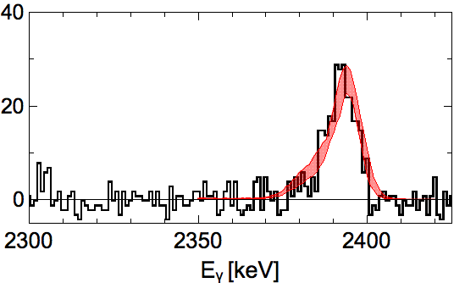
OUR Case of interest – ²⁰O
²⁰O
¹⁸O (7 MeV/A) + ¹⁸¹Ta target (6 mg/cm²)
^{130°}
2396
^{130°}
τ
²⁰O
^{150°}
^{150°}
⁺⁸⁰
τ = 150 fs
₋₃₀
^{170°}
E_{γ}
^{170°}
ab initio predictions
3 body force τ = 200 fs
2 body force τ = 320 fs

Slide 15
Tracking vs. Center of segments
Full tracking
Center of front segments
²⁰O
²⁰O

Slide 16
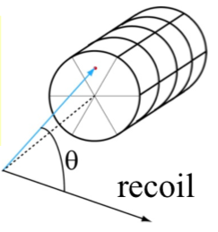

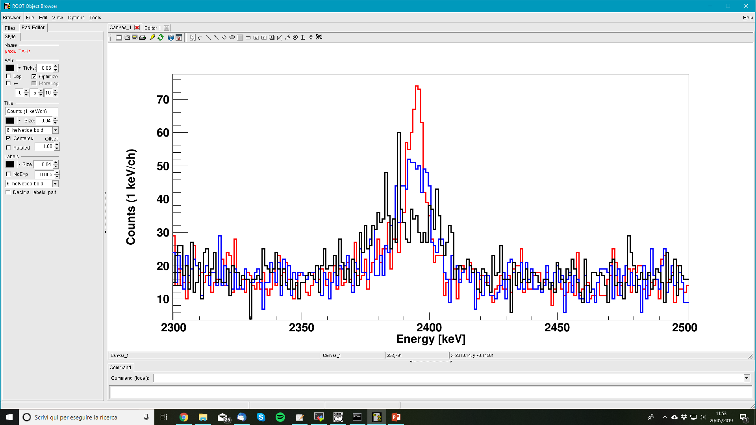
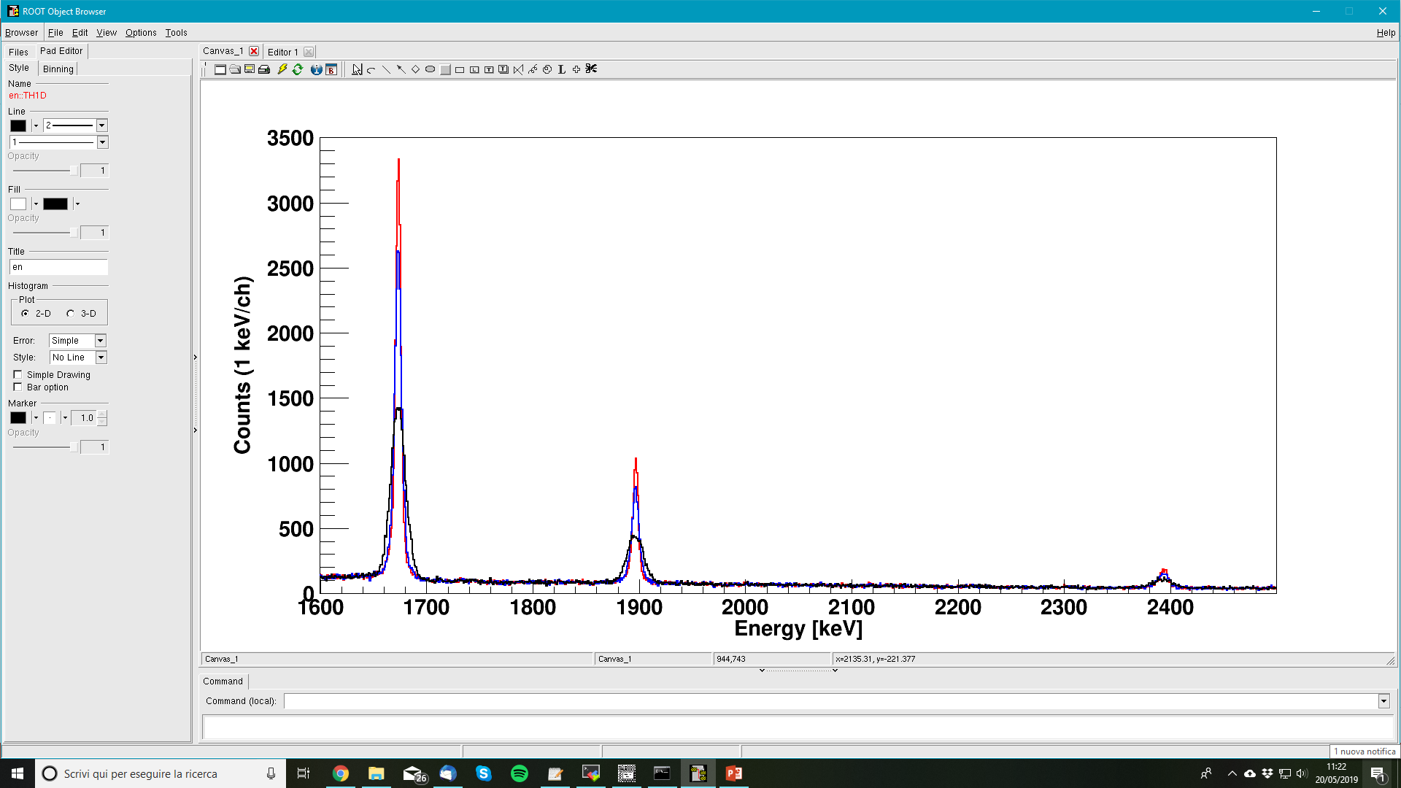
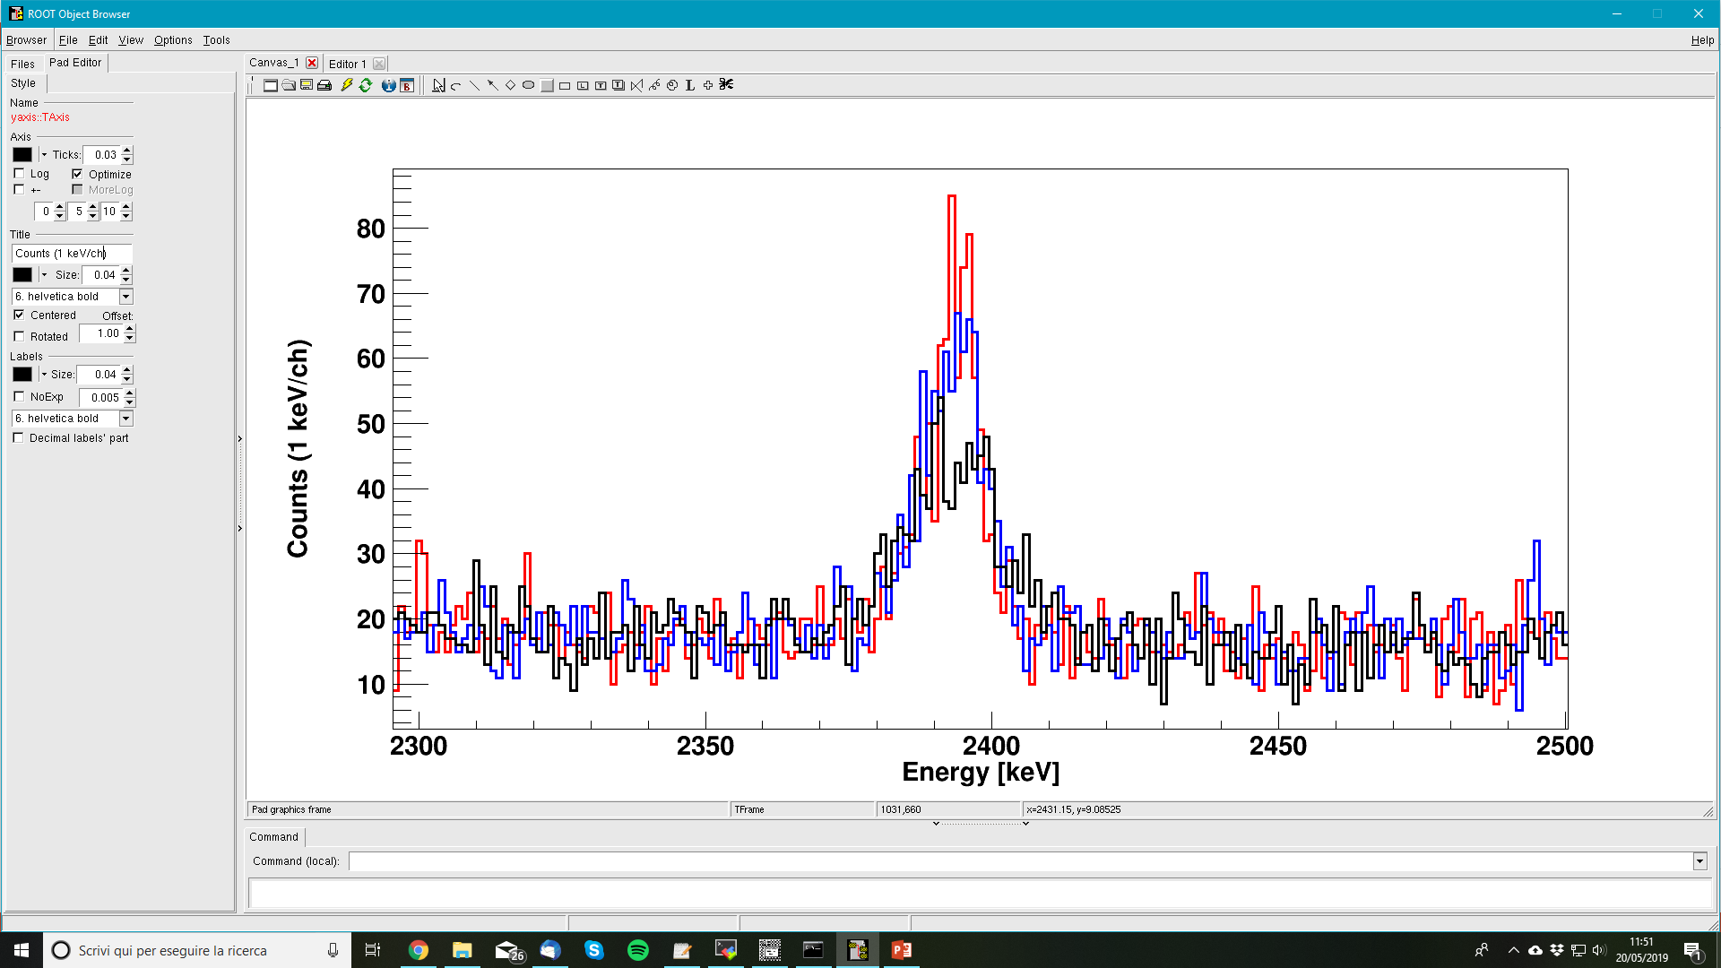
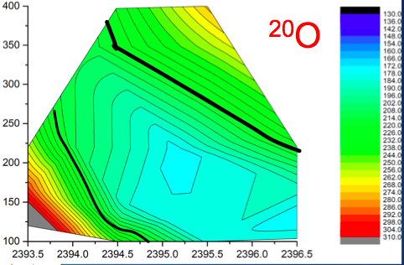
Large improvement with AGATA
²⁰O
FULL Tracking
2⁺₂ → 2⁺₁ (2396 keV)
^{130°}
²⁰O
^{150°}
Center
Front Segment

Slide 17
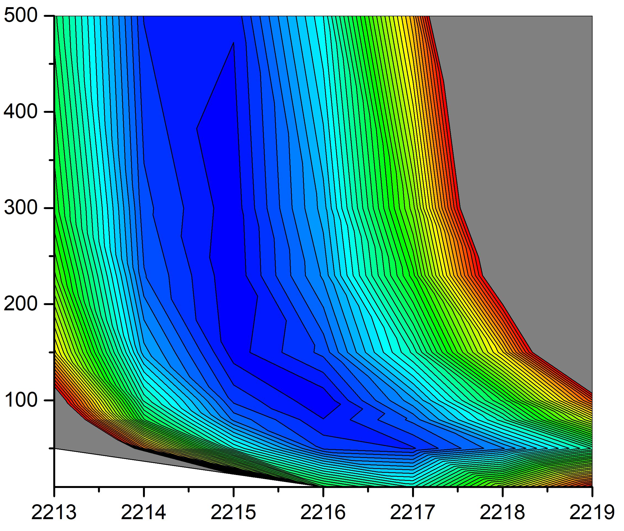
OUR Case of interest – ¹⁶C
¹⁸O (7 MeV/A) + ¹⁸¹Ta target (6 mg/cm²)
τ
¹⁶C
¹⁶C
E_{γ}
ab initio predictions
3 body force τ = 80 fs
2 body force τ = 340 fs

Slide 18
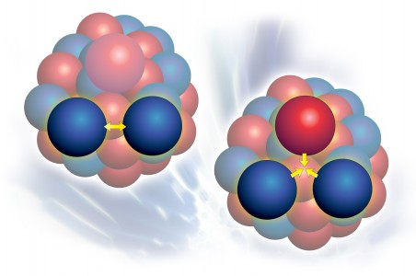
Summary:
Theory vs. exp. results comparison
For ¹⁶C most precise measurement
gives E = 2217(2) keV,
which do not allow
to determine exact lifetime value (for now).
NO sensitivity would be obtained
with conventional HPGe detectors

Slide 19
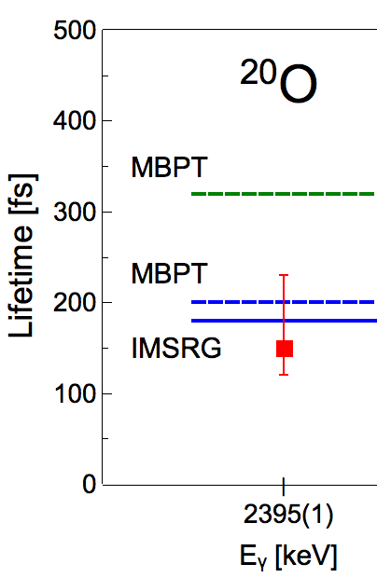
²⁰O
MANY BODY
Pert. THEORY
Clear need for
Three body term
NN
In-Medium
Similarity
Renormalization
Group (IMSRG)
NN
+
NNN
One of most advanced
approaches
(with meson-exchange currents)
NO sensitivity would be obtained
with conventional HPGe detectors

Slide 20

Conclusions
Italian-Polish-French collaboration allows to perform successful experiemnt at GANIL with combined AGATA+VAMOS+PARIS setup.
(Re)-measurement of ¹⁷O (½⁻ state) and ¹⁹O (7/2⁺ state) lifetimes – confirmation that DSAM method for AGATA and simultions works well.
We measured lifetime of second 2⁺ in ²⁰O: 150$\begin{matrix}+80 \\ −30\end{matrix}$ fs, which is consistent with the calculations including three body interactions. AGATA tracking crucial for obtaining results.
Extracted estimates of lifetime in ¹⁶C which depend on non-shifted gamma-ray energy.
Draft of publication send to co-authors.
N isotopes –S. Ziliani talk today.

Slide 21
Acknowledgements
S. Leoni, F. C.L. Crespi, S. Ziliani, G. Benzoni, C. Boiano, S. Bottoni, A. Bracco, S. Brambilla, F. Camera, B. Million, O. Wieland;
Univ. and INFN Milano, Italy
B. Fornal, M. C., A. Maj, P. Bednarczyk, N. Cieplicka-Orynczak , J. Grębosz, L. W. Iskra, M. Krzysiek, M. Kmiecik, K. Mazurek, B. Wasilewska; IFJ PAN Krakow, Poland
E. Clement, G. de France, B. Jacquot, Y. Kim, A. Lemasson, H. Li, C. Michelagnoli, M. Rejmund; GANIL Caen, France
D. Mengoni, F. Recchia, D. Bazzacco, S. Lenzi, S. Lunardi, J. Valiente-Dobon, DeAngelis, D. Napoli; INFN LNL, INFN Padova, Univ. of Padova
A. Dewald, C. Fransen, C. Müller-Gatermann, M. Bast, M. Beckers, T. Braunroth, A. Goldkuhle; Univ. of Koeln
O. Dorvaux, S. Kihel, C. Schmitt; CNRS/IN2P3, Strasbourg, France
I. Matea, I. Stefan; IPN Orsay, France
P. Napiorkowski, M. Matejska-Minda; HIL UW, Warsaw, Poland
M. Harakeh; KVI Univ. Groningen, Netherlands
V. Nanal et al.; Univ. of Calcata, India
M. Kicińska-Habior; Univ.of Warsaw, Poland
M. Stanoiu; IFIN-HH, Bucharest, Romania
A. Karpov; JINR, Dubna, Russia

Slide 22
NNDC,
τ < 26 fs

Slide 23
Comparison with ab initio predictions
²⁰O
MANY BODY
Pert. THEORY
Clear need for
Three body term
NN
In-Medium
Similarity
Renormalization
Group (IMSRG)
NN
+
NNN
One of most advanced
approaches
(with meson-exchange currents)
NO sensitivity would be obtained
with conventional HPGe detectors

