Slide 1
Measurement of isomeric states at the
FRS Ion Catcher
Timo Dickel
GSI Darmstadt, JLU Gießen
How to study the properties of exotic nuclei via mass spectrometry
The FRS Ion Catcher @ GSI
  Setup
  Performance
  Results
Outlook
  Experiments in FAIR phase-0
  The next generation stopping cell for the Super-FRS
Notes:
Introduction

Slide 2
How to study the properties of exotic nuclei via mass spectrometry

Slide 3
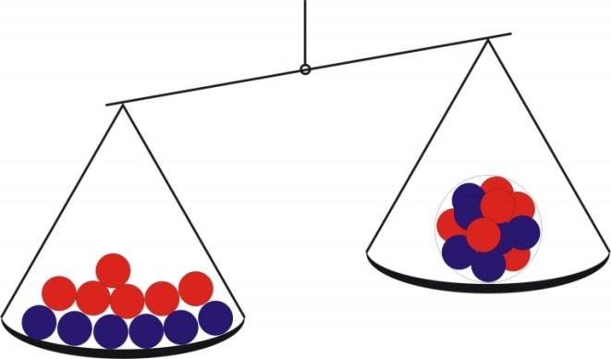
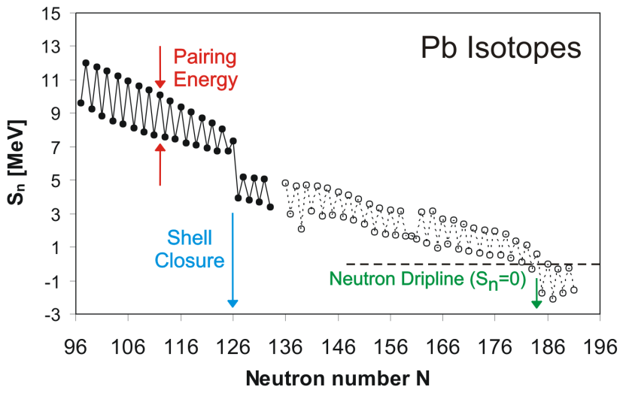
Mass and Binding Energy
The mass of an atomic nucleus reflects its binding energy
and hence its stability and structure
Z Protons (Proton number)
N Neutrons (Neutron number)
A = N + Z (Mass number)
B = Binding energy
E = mc²
Nuclear mass: M(N, Z) = Z·m_{p} + N·m_{n} - B(N, Z)/c²
$$S_{n} =m({}_{Z}^{A−1}{X_{N−1})}+m\left(n\right)−m({}_{Z}^{A}{X_{N})}$$
Structure & Dynamics
of Exotic Nuclei
Precision mass measurements → unambigious identification in A and Z
Notes:
Masses as a window for the information about the BE of the nucleus.

Slide 4
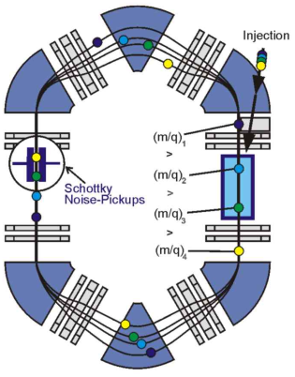
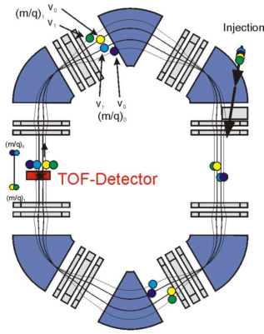
Mass Measurement Techniques for Exotic nuclei
„Standard“ Methods
Storage Rings
Schottky MS
Isochronous MS
t_{meas} ~ 10 s
m/Δm = 10⁶
δm/m ~ 2⋅10⁻⁷
broadband
t_{meas} ~ 100 μs
m/Δm = 2⋅10⁵
δm/m ~ 10⁻⁶
broadband
~500 MeV/u
Penning Trap MS (TOF-ICR-MS)
t_{meas} ~ 1 s
m/Δm = 10⁶-10⁷
δm/m < 10⁻⁷
scanning
1 eV – 10 keV
No Method is highly accurate, sensitive and fast
Notes:
For measuring masses with high accuracy we can use three types of devices: storage rings, PT and MR-TOF-MS.

Slide 5
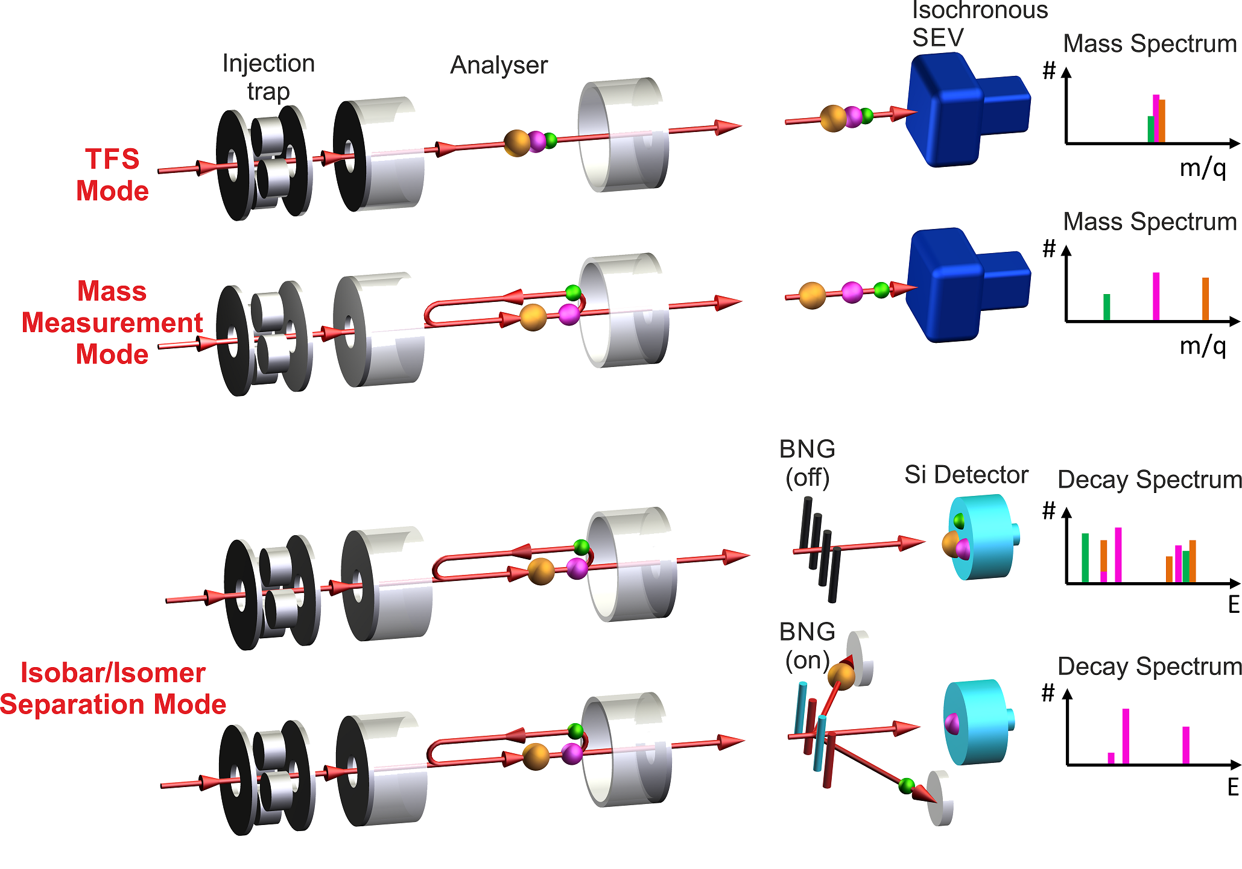
TOF Mass Spectrometry for diagnosis and separation
Enables high performance
Fast → access to very short-lived ions (T_{1/2} ~ ms)
Sensitive, broadband, non-scanning → efficient, access to rare ions
...
To achieve high mass resolving power and accuracy:
Multiple-reflection time-of-flight mass spectrometer (MR-TOF-MS)
H. Wollnik et al., Int. J. Mass Spectrom.
Ion Processes 96 (1990) 267
Applications
Diagnostics measurements: monitor production, separation and low-energy
beam preparation of exotic nuclei
Direct mass measurements of exotic nuclei
High-resolution mass separator
W.R. Plaß et al., Int. J. Mass Spectrom. 394 (2013) 134
C. Scheidenberger et al., Hyperfine Interact. 132 (2001) 531
W.R. Plaß et al., NIM B 266 (2008) 4560
Notes:
What is TOF and MR-TOF MS

Slide 6
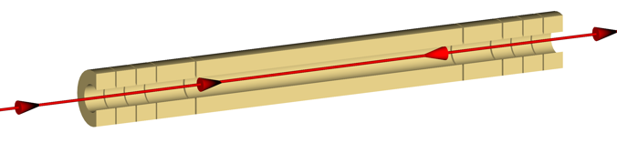
Mass Measurement Techniques
Storage Rings
Schottky MS
Isochronous MS
t_{meas} ~ 10 s
m/Δm = 10⁶
δm/m ~ 2⋅10⁻⁷
broadband
t_{meas} ~ 100 μs
m/Δm = 2⋅10⁵
δm/m ~ 10⁻⁶
broadband
~500 MeV/u
Penning Trap MS (TOF-ICR-MS)
t_{meas} ~ 1 s
m/Δm = 10⁶-10⁷
δm/m < 10⁻⁷
scanning
1 eV – 10 keV
Multiple-Reflection Time-of-Flight MS (MR-TOF-MS)
t_{meas} ~ 10 ms
m/Δm >10⁵
δm/m < 10⁻⁶
Broadband
1 eV – 10 keV
Notes:
For measuring masses with high accuracy we can use three types of devices: storage rings, PT and MR-TOF-MS.

Slide 7

MR-TOF-MS in RIB Facilities
JYFL
EURISOL
TRIUMF
GANIL
GSI/FAIR
Dubna
MSU
ALTO
INFN-LNL
CARIF
HIAF
Berkeley
ANL
Notre Dame
ISOLDE
ELI-NP
CIAE
RIKEN
Oak Ridge
INFN-LNS
IMP-Lanzhou
RISP
FSU
SARAF
HIRA
RCNP
Texas A&M
VECC
RIBRAS
ANU
iThemba
MR-TOF-MS (operational)
MR-TOF-MS (commissioning)
MR-TOF-MS (planned)
Notes:
MR-TOF-MS around the world.

Slide 8
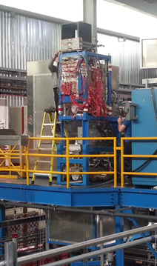
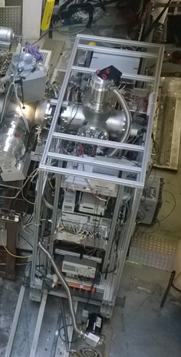
MR-TOF-MS in RIB Facilities
MR-TOF-MS at FRS Ion Catcher (GSI)
MR-TOF-MS Isobar separator
for the TITAN facility (TRIUMF)
JYFL
EURISOL
TRIUMF
GANIL
GSI/FAIR
Dubna
MSU
ALTO
INFN-LNL
CARIF
HIAF
Berkeley
ANL
Notre Dame
ISOLDE
ELI-NP
CIAE
RIKEN
Oak Ridge
INFN-LNS
IMP-Lanzhou
RISP
FSU
SARAF
HIRA
RCNP
Texas A&M
VECC
RIBRAS
ANU
iThemba
MR-TOF-MS (operational)
MR-TOF-MS (commissioning)
MR-TOF-MS (planned)
Notes:
MR-TOF-MS around the world.

Slide 9
FRS Ion catcher @ GSI

Slide 10
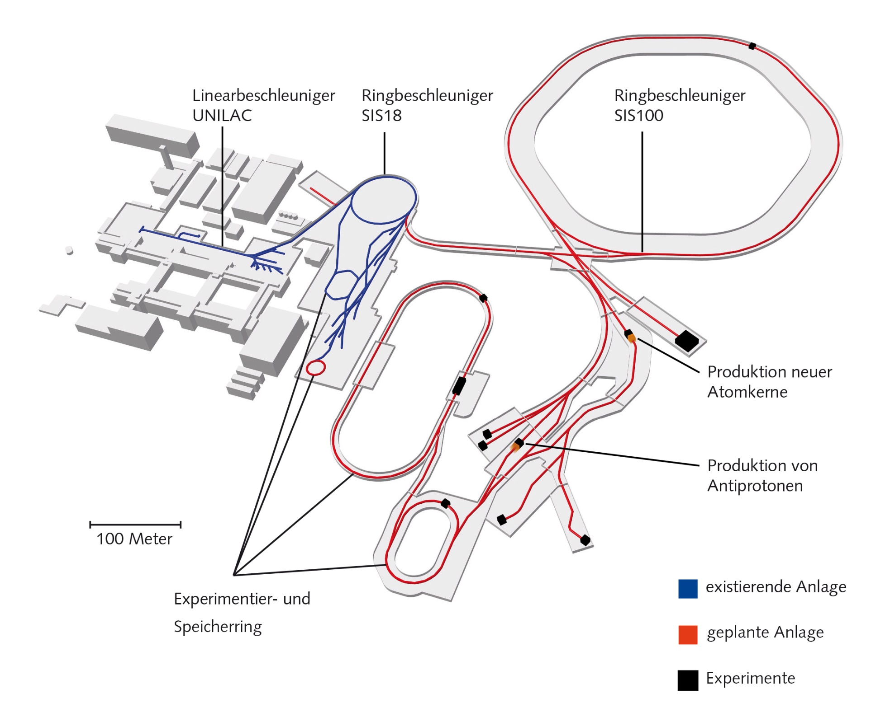
The FRS Ion Catcher at GSI/FAIR
FRS
Super-FRS
7
Notes:
10

Slide 11
Low Energy RIB @ Super-FRS/FRS
High-precision experiments with in-flight separated exotic nuclei almost at rest
universal and fast production
high selectivity
cooled exotic nuclei
100...1500 MeV/u
~ MeV/u
~ eV
~ keV
Target
Fragment
Separator
Buncher /
Degrader
Stopping
Cell
Experiments
(Trap, Laser,..)
Primary
Beam
In-flight
Production
In-flight
Separation
Momentum
Compression
Stopping /
Thermalization
@FRS & LEB:
Super-FRS Experiment Collaboration
(Mass Tagging for PID, New Isotope search, Reaction Studies,…)
MATS (Precision Measurements of very short-lived nuclei
using an Advanced Trapping System for highly charged ions)
LaSpec (Laser Spectroscopy)
J. Äystö et al., NIMB 376 (2016) 111
@LEB:
D. Rodriguez, et a., EPJ 183 (2010) 1

Slide 12
Concept: Cryogenic Stopping Cell (CSC)
RF repelling force
DC Gradient along the cell
high energy beam
(~Mev/u)
DC to Nozzle
high pressure helium
~100mbar
Low energy beam (~eV)
Gas
flow
IGISOL/Stopping cells:
Fast → access to short-lived exotic nuclides (T_{1/2} ~ ms)
Universal → element-independent
Efficient → highest stopping and extraction efficiency
Cryogenic Operation
Clean → ion beams of high cleanliness
M. Wada NIM B 317 (2013) 450
M. Ranjan et al., Europhys. Lett. 96 (2011) 52001
Purushothaman S. et al, EPL 104 (2013) 42001
Notes:
12

Slide 13
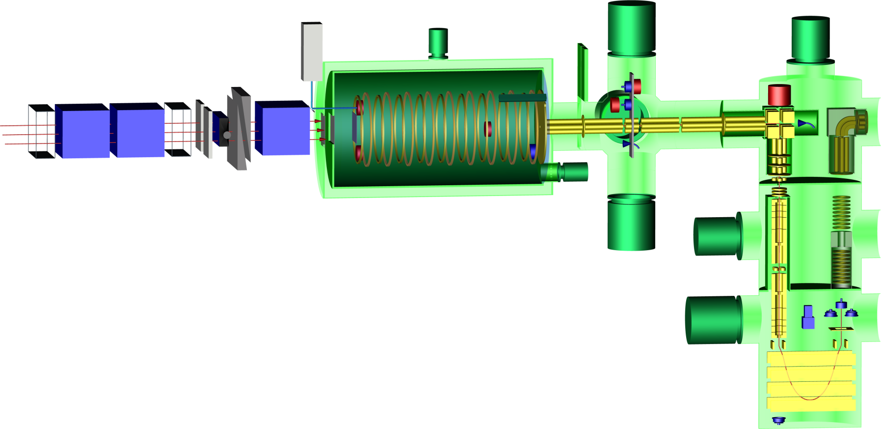
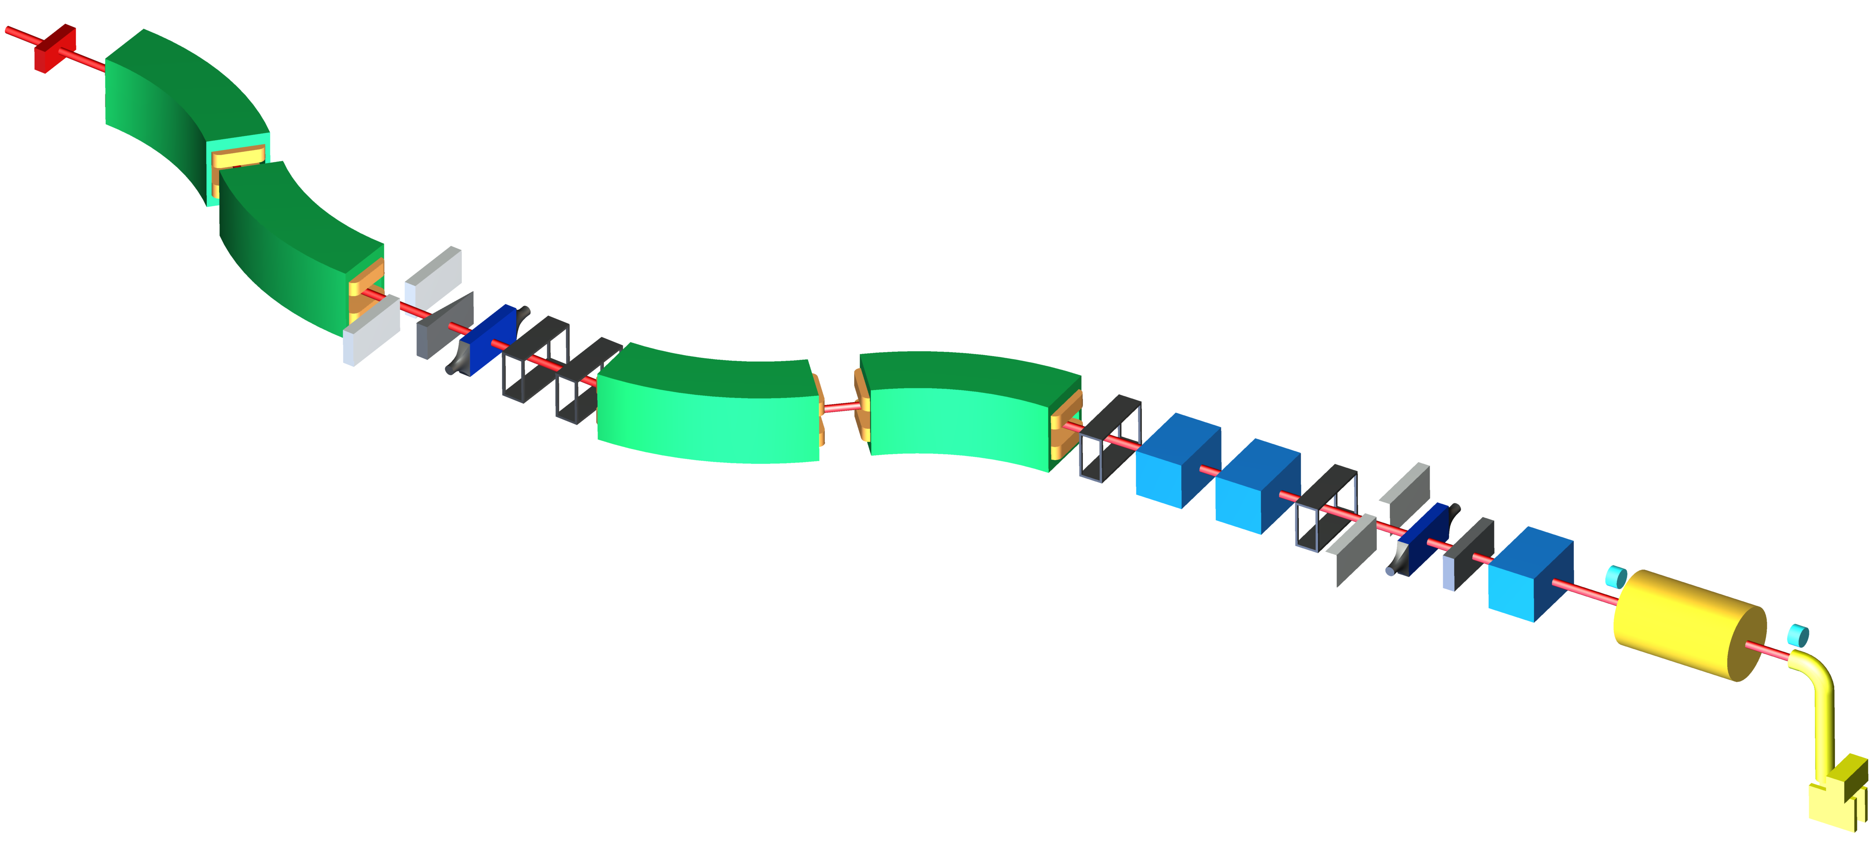
FRS Ion Catcher
~ GeV/u
~ MeV/u
~ eV
~ keV
Multiple-Reflection
Time-of-Flight Mass Spectrometer
Final Focal Plane
²³⁸U @
1000 MeV/u
Injection
Trap System
Homogenous
Degrader
DC Cage
RF Carpet
Cryogenic Stopping Cell
RFQ Beam Line +
Diagnostics Unit
TOF
Analyzer
Slits
~ 500 MeV/u
BNG
Isochronous
SEM
Production Target
1.6 g/cm² Be
+ 0.2 g/cm² Nb
Degrader
PID
FRS
~ MeV/u
PID
~ eV
Slits
CSC
MR-TOF MS
W.R. Plaß et al., NIM B 317 (2013) 457
W.R. Plaß et al, Hypefine Interaction acceppted
Notes:
FRS Ion Catcher Production mechanism, thermalization, extraction and measurement.

Slide 14
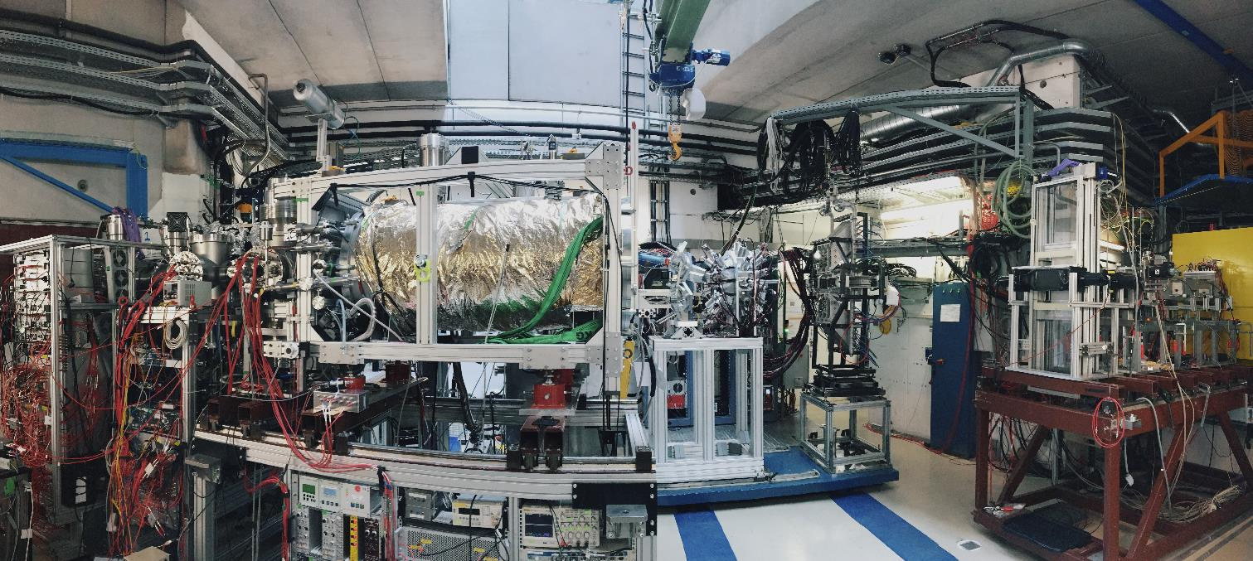
FRS Ion Catcher
Low energy (~eV) beamline
Cryogenic stopping cell
Standard detectors for PID
MR-TOF-MS
DESPEC
W.R. Plaß et al., NIM B 266 (2008) 4560
W.R. Plaß et al., Int. J. Mass Spectrom. 394 (2013) 134
T. Dickel et al., NIM A 777 (2015) 172
S. Purushothaman et al., IJMS 421 (2017) 245
M. Ranjan et al., Europhys. Lett. 96 (2011) 52001
S. Purushothaman et al., EPL 104 (2013) 42001
M. Ranjan et al., NIM A 770 (2015) 87
M.P. Reiter et al., NIM B 376 (2016) 240
F. Greiner et al., NIMB in press
Notes:
More pictures, development in time

Slide 15
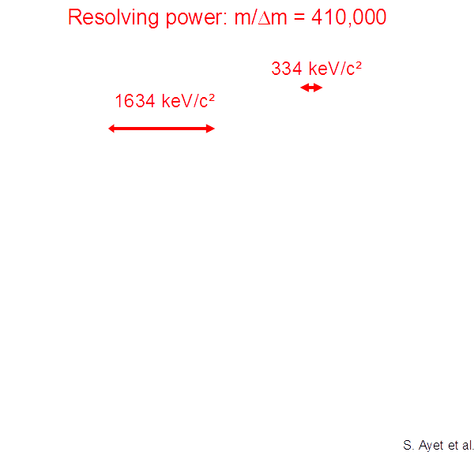
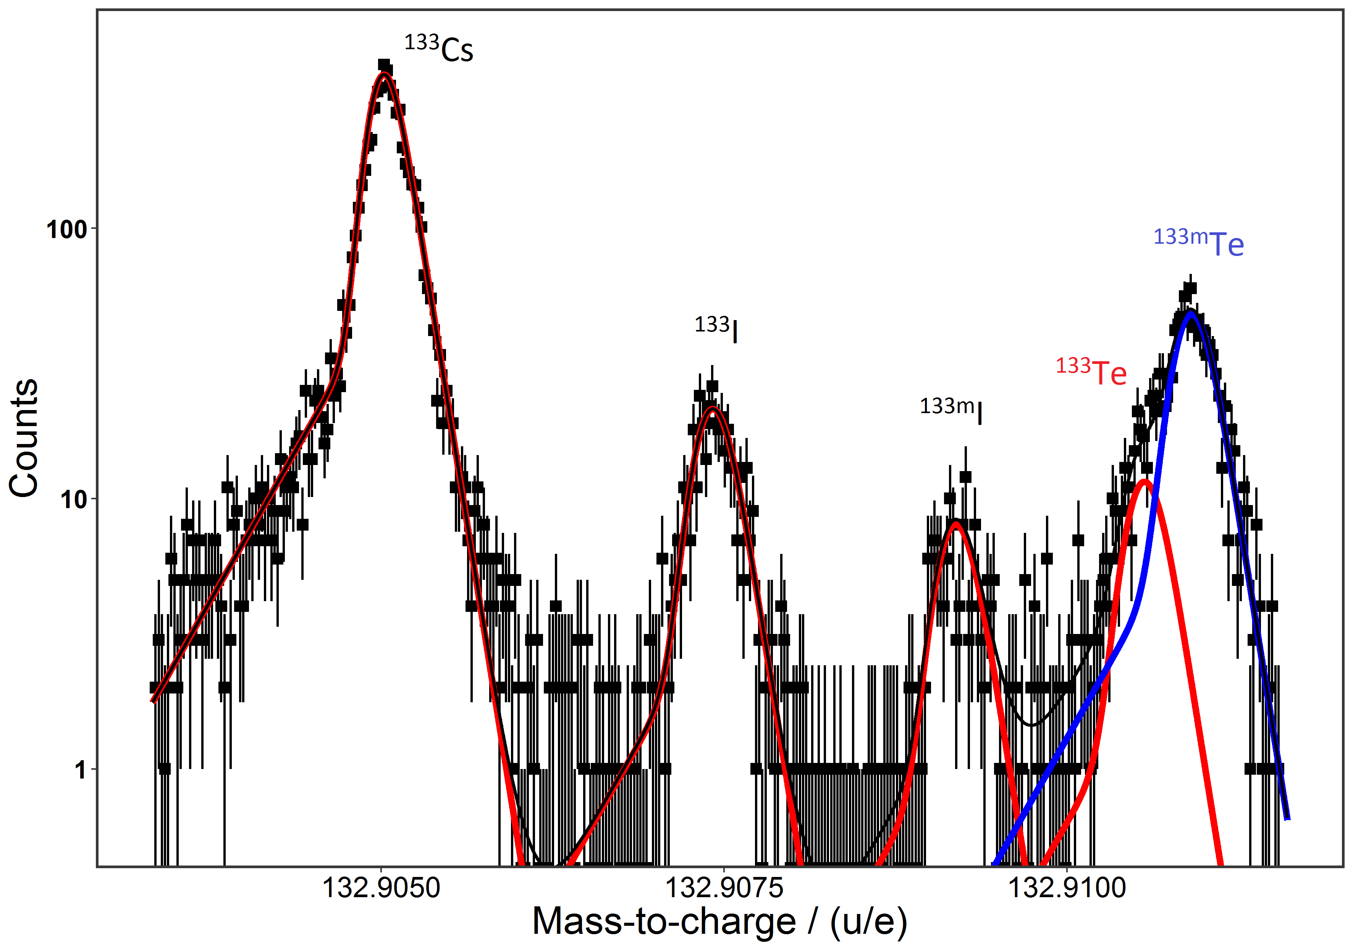
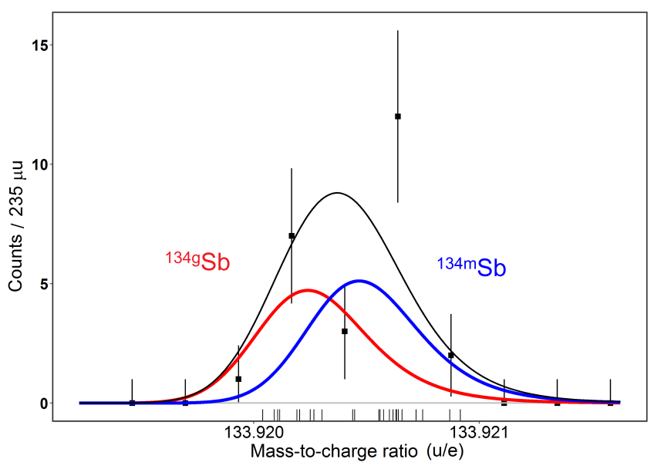
Data-Analysis Procedure
Data-analysis procedure optimzed for sensitivity and accuracy:
  dedicated fit function
  weighted MLE fitting
  accurate handling of overlapping peaks
S. Purushothaman et al, IJMS, 421, 245 (2017)
S. Ayet et al PRC 99, 064313 (2019)
Notes:
U Fission Fragments produced at 1GeV. Thermalized, extracted and measured. Note the gaussian fit for guiding the eye.

Slide 16
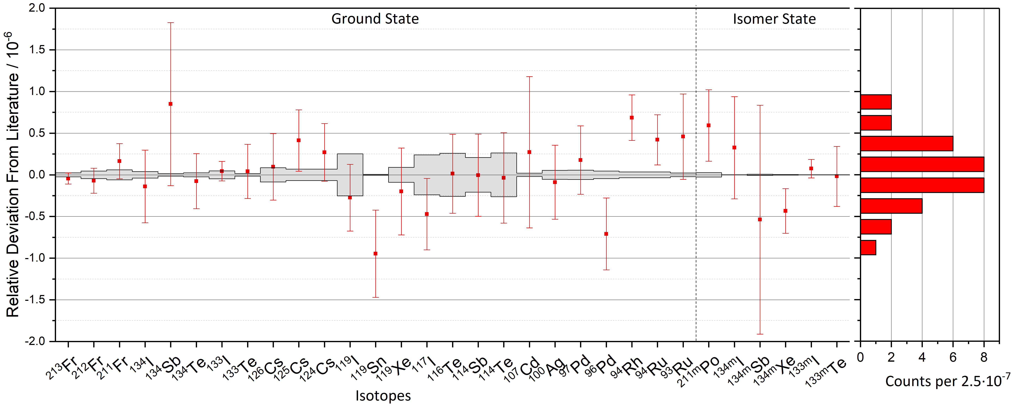
Compilation: Mass Measurement Accuracy
    Mass Accuracy Study
weighted mean:
(4.5 ± 5.3) ·10⁻⁸
Data evaluation developed for low statistics and overlapping peaks
31 masses of 16 different elements including 6 isomeric states:
    Relative deviations down to 6·10⁻⁸
    Excitation energies of isomeric states down to 280 keV
S. Ayet et al PRC 99, 064313 (2019)
Notes:
Compilation of the masses evaluated with the current Hyper EMG functions.

Slide 17
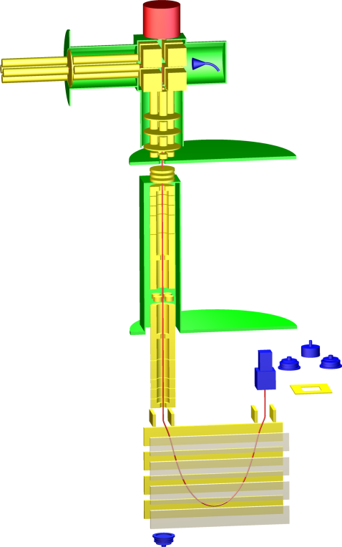
Mass measurement and separation of isomers
MR-TOF-MS enables efficient search and measurement of new isotopes and isomers
m/Δm = 250,000
TOF = 8.7 ms
1472 keV
Measurement using
the TOF detector
Measurement of excitation energy: (1472 ± 120) keV Literature value: (1462 ± 5) keV
T. Dickel et al., Phys. Lett. B 744 (2015) 137
11

Slide 18
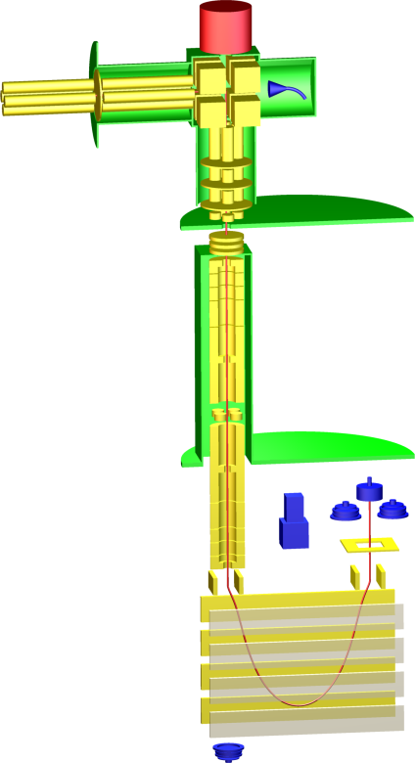
Mass measurement and separation of isomers
First spatial separation of ground state and isomeric state in an MR-TOF-MS
Proof-of-principle: production of isomerically clean beams by MR-TOF-MS
BNG off
BNG on
Separation using the
Bradbury-Nielsen gate,
measurement using
the Si detector
T. Dickel et al., Phys. Lett. B 744 (2015) 137
12

Slide 19
Novel method for t_{1/2} and branching ratios measurements

Slide 20
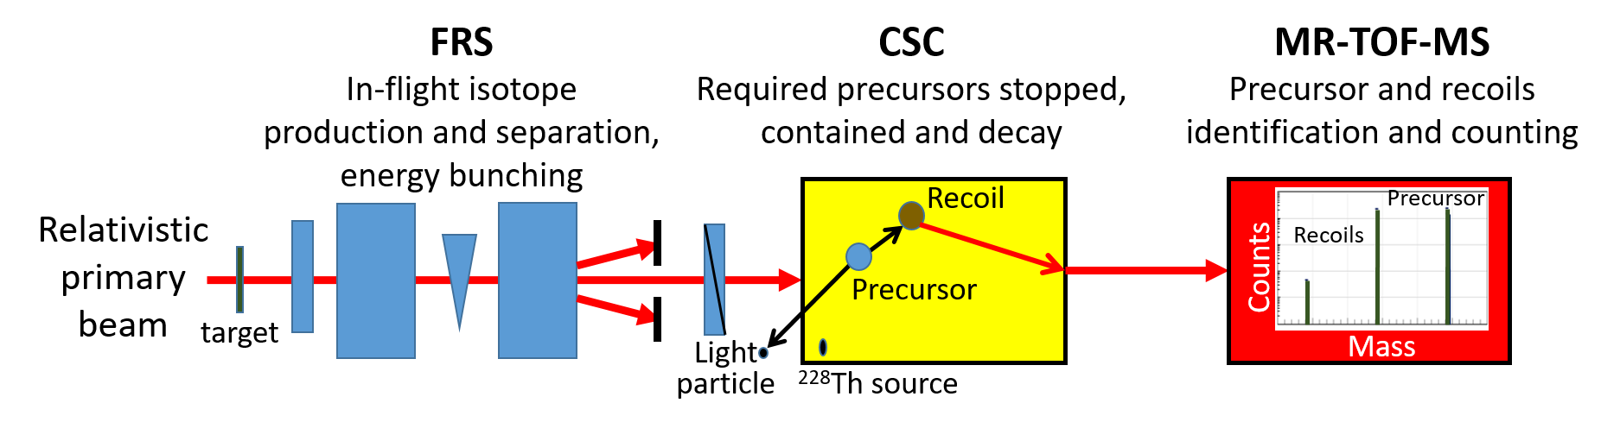
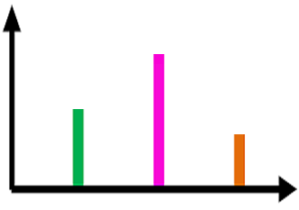
Novel method for t_{1/2} and Branching Ratios
After containment of ~ 2t_{1/2}
Recoil 1
Recoil 2
Precursor
0
I. Miskun et al., submitted to EPJA (arXiv:1902.11195)
31

Slide 21
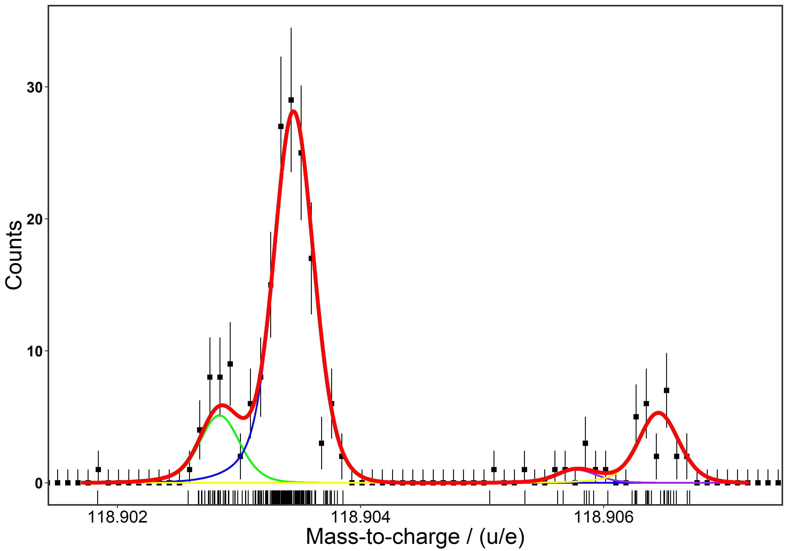
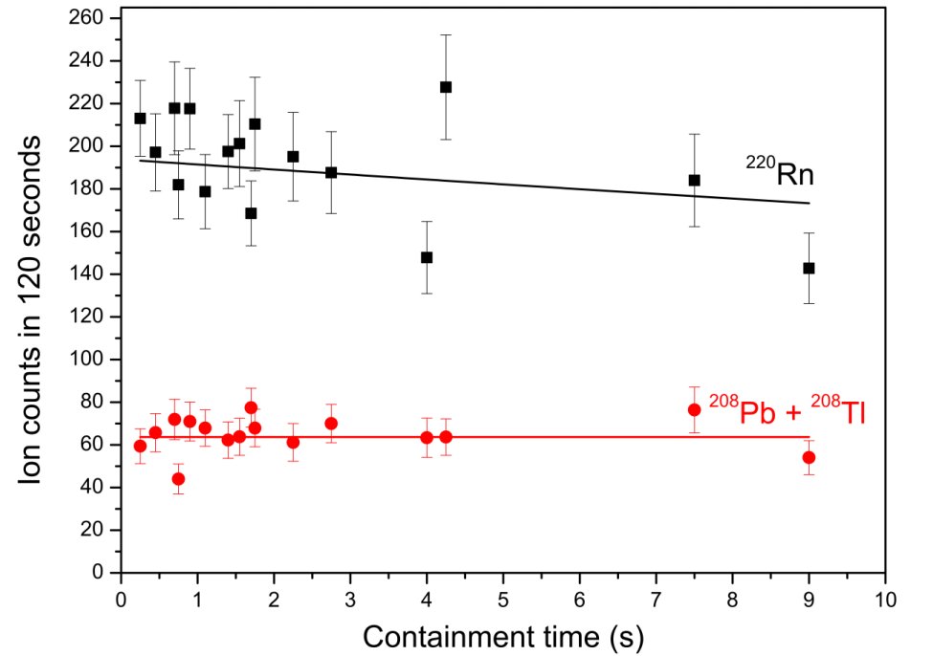
Novel method for t_{1/2} and Branching Ratios
Best fitting instrumentation for the task
MR-TOF-MS
broadband and non-scanning
all recoils are measured at the same time
sensitive
precise determination of abundances
accurate
identification and mass measurement
Cryogenic Stopping Cell
clean
no chemical reactions
fast
ions are extracted within few ms
NEW: CSC as an ion trap
all recoils are stopped in buffer gas
Recoil 2
Recoil 1
Precursor
Recoil 3
I. Miskun et al., submitted to EPJA (arXiv:1902.11195)
32

Slide 22
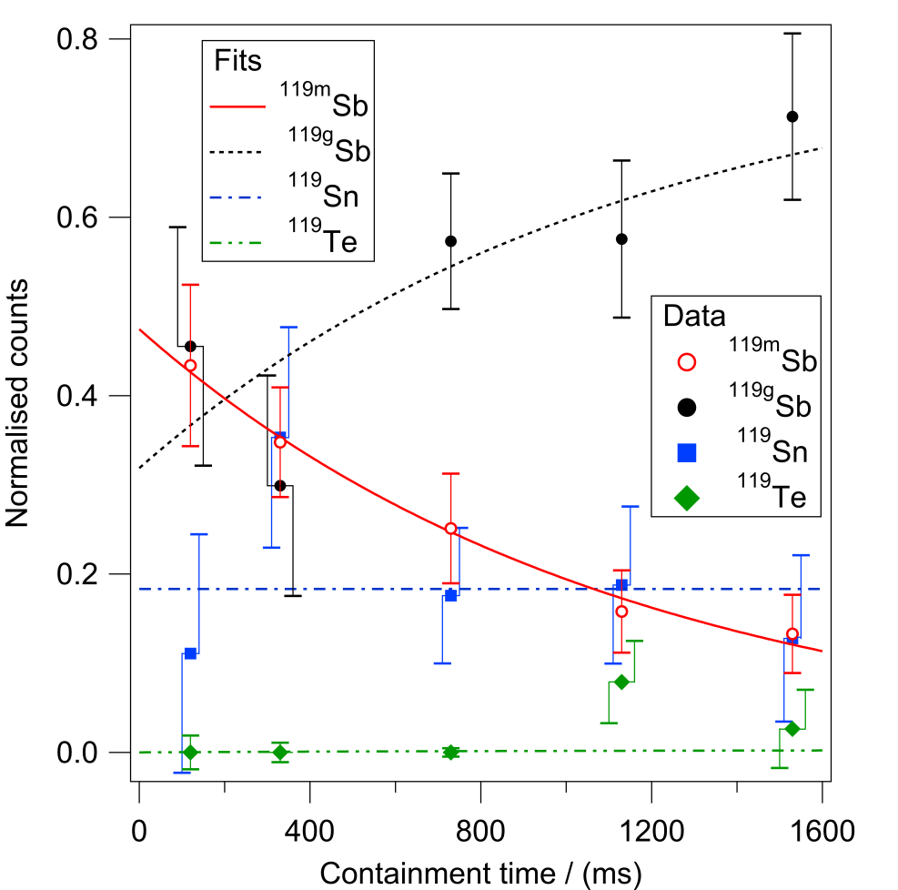
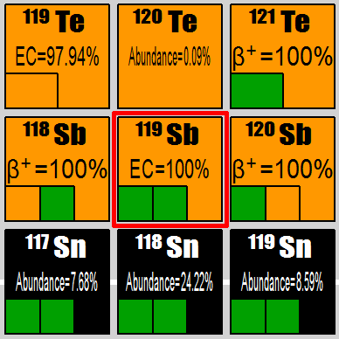
Novel method for t_{1/2} and Branching Ratios
Energetically possible decays
Measured branching ratios
Internal Transition | β- | β+
1 | 0 | 0
Half-life
Measured value | Literature value
776 ± 181 ms | 850 ± 90 ms
I. Miskun et al., submitted to EPJA (arXiv:1902.11195)

Slide 23
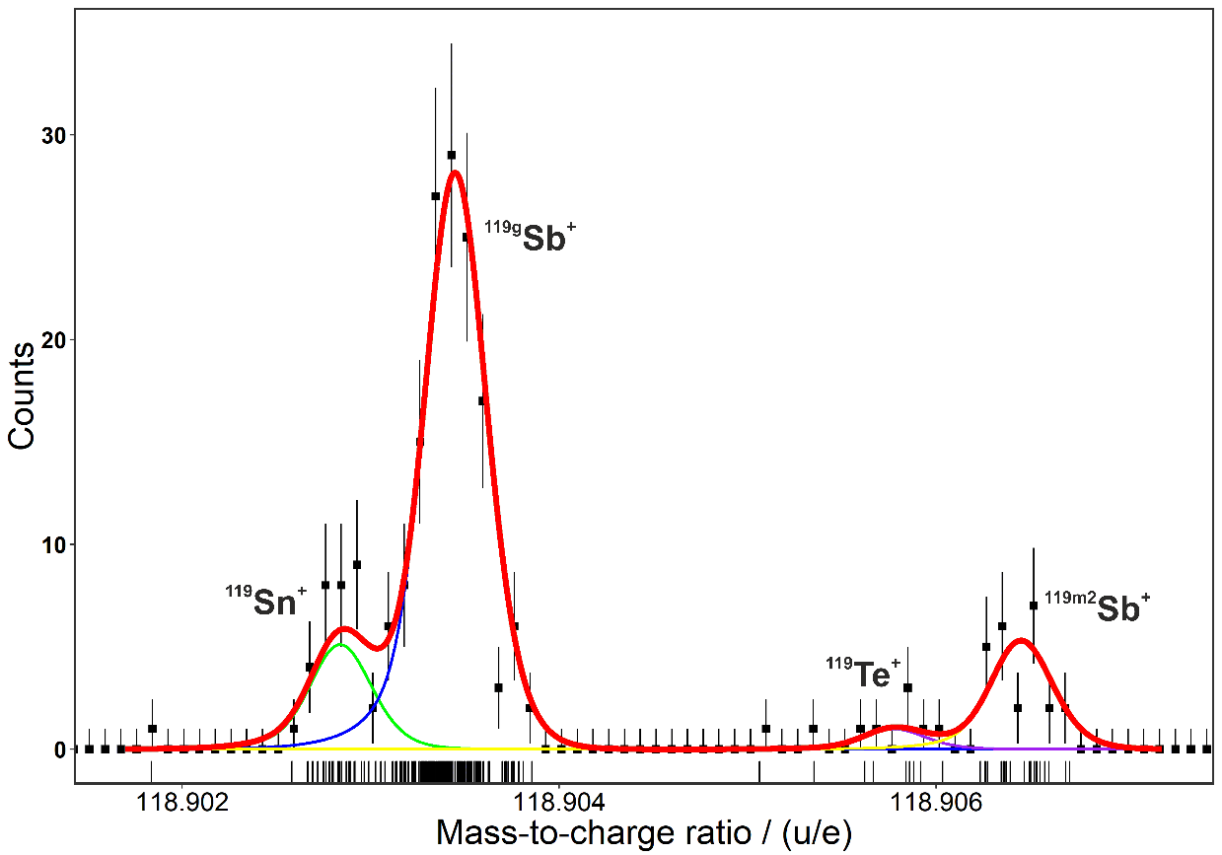
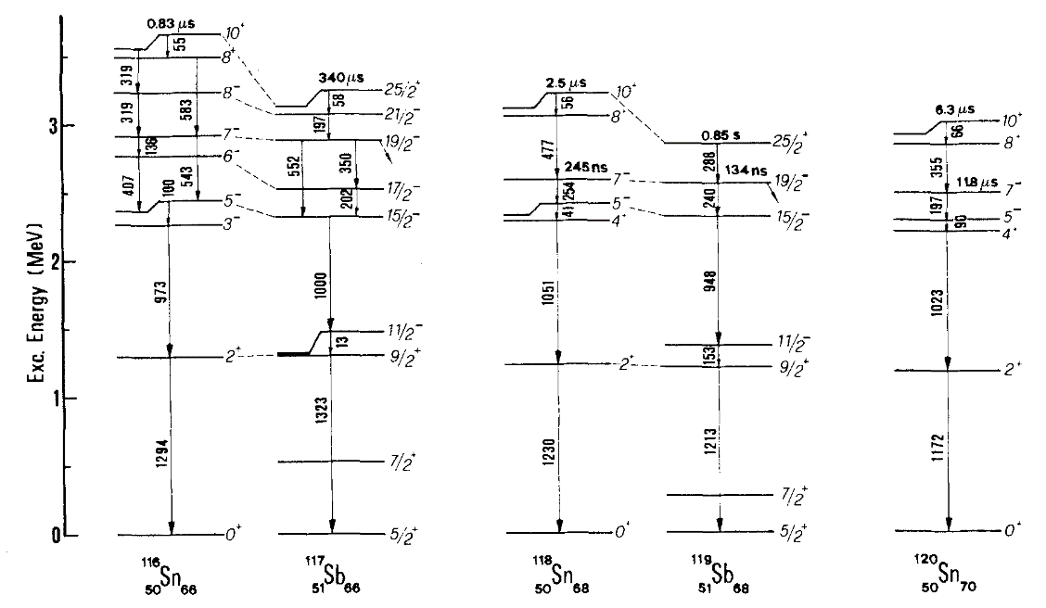
Excitation Energy of ^{119m2}Sb
Ground and isomeric state mass/energy measured directly for the first time
FRS Ion Catcher: (2799 ± 30) keV Lit. (ENSDF): (2841.7 ± 0.4 + x) keV
→ x is consistent with 0, and the 2841.7 keV level is the long-lived isomeric state itself
2799(30) keV
2842
R.E. Shroy, et al., PRC 19, 1324 (1979)
S. Lunardi, et al., Z. Physik A328, 487 (1987)
M.G. Porquet, et al., EPJ A24, 39 (2005)
C.B. Moon, J. Korean Phy. Soc. 569, 1539 (2011)
I. Miskun et al., submitted to EPJ A, arXiv:1902.11195v1

Slide 24
MR-TOF-MS for New Isomers search

Slide 25
Why a new Method to Measure Isomers?
Nubase 2012
MS (SMS, TOF-ICR)
γγ coincidence
Requirements for system for isomere search:
  Fast: ~ms
  Sensitive: Non-Scaning
  High Mass Resolving Power: >>10⁵
  High Dynamic Range: > 10:1

Slide 26
Isomer Measurement with MR-TOF-MS
600MeV/u ¹²⁴Xe on a 1.6g/cm² Be target
m/Δm(FWHM)~450.000
^{109g}In
^{109m1}In
^{109g}In (9/2+)
Preliminary
^{109m2}In
t_{1/2}: 209ms
^{109m2}In (19/2+)
2100 keV
650 keV
x20
^{109m1}In (1/2-)
MS (SMS, TOF-ICR)
MS and isomeric
beams with MR-TOF
γγ coincidence

Slide 27
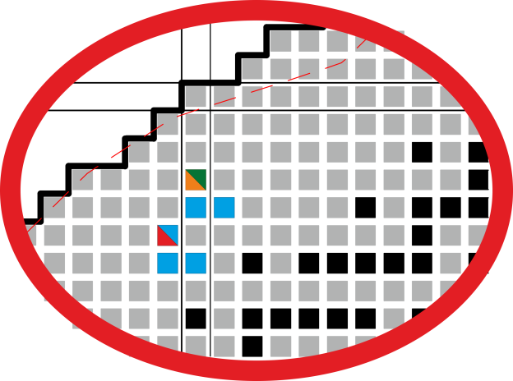
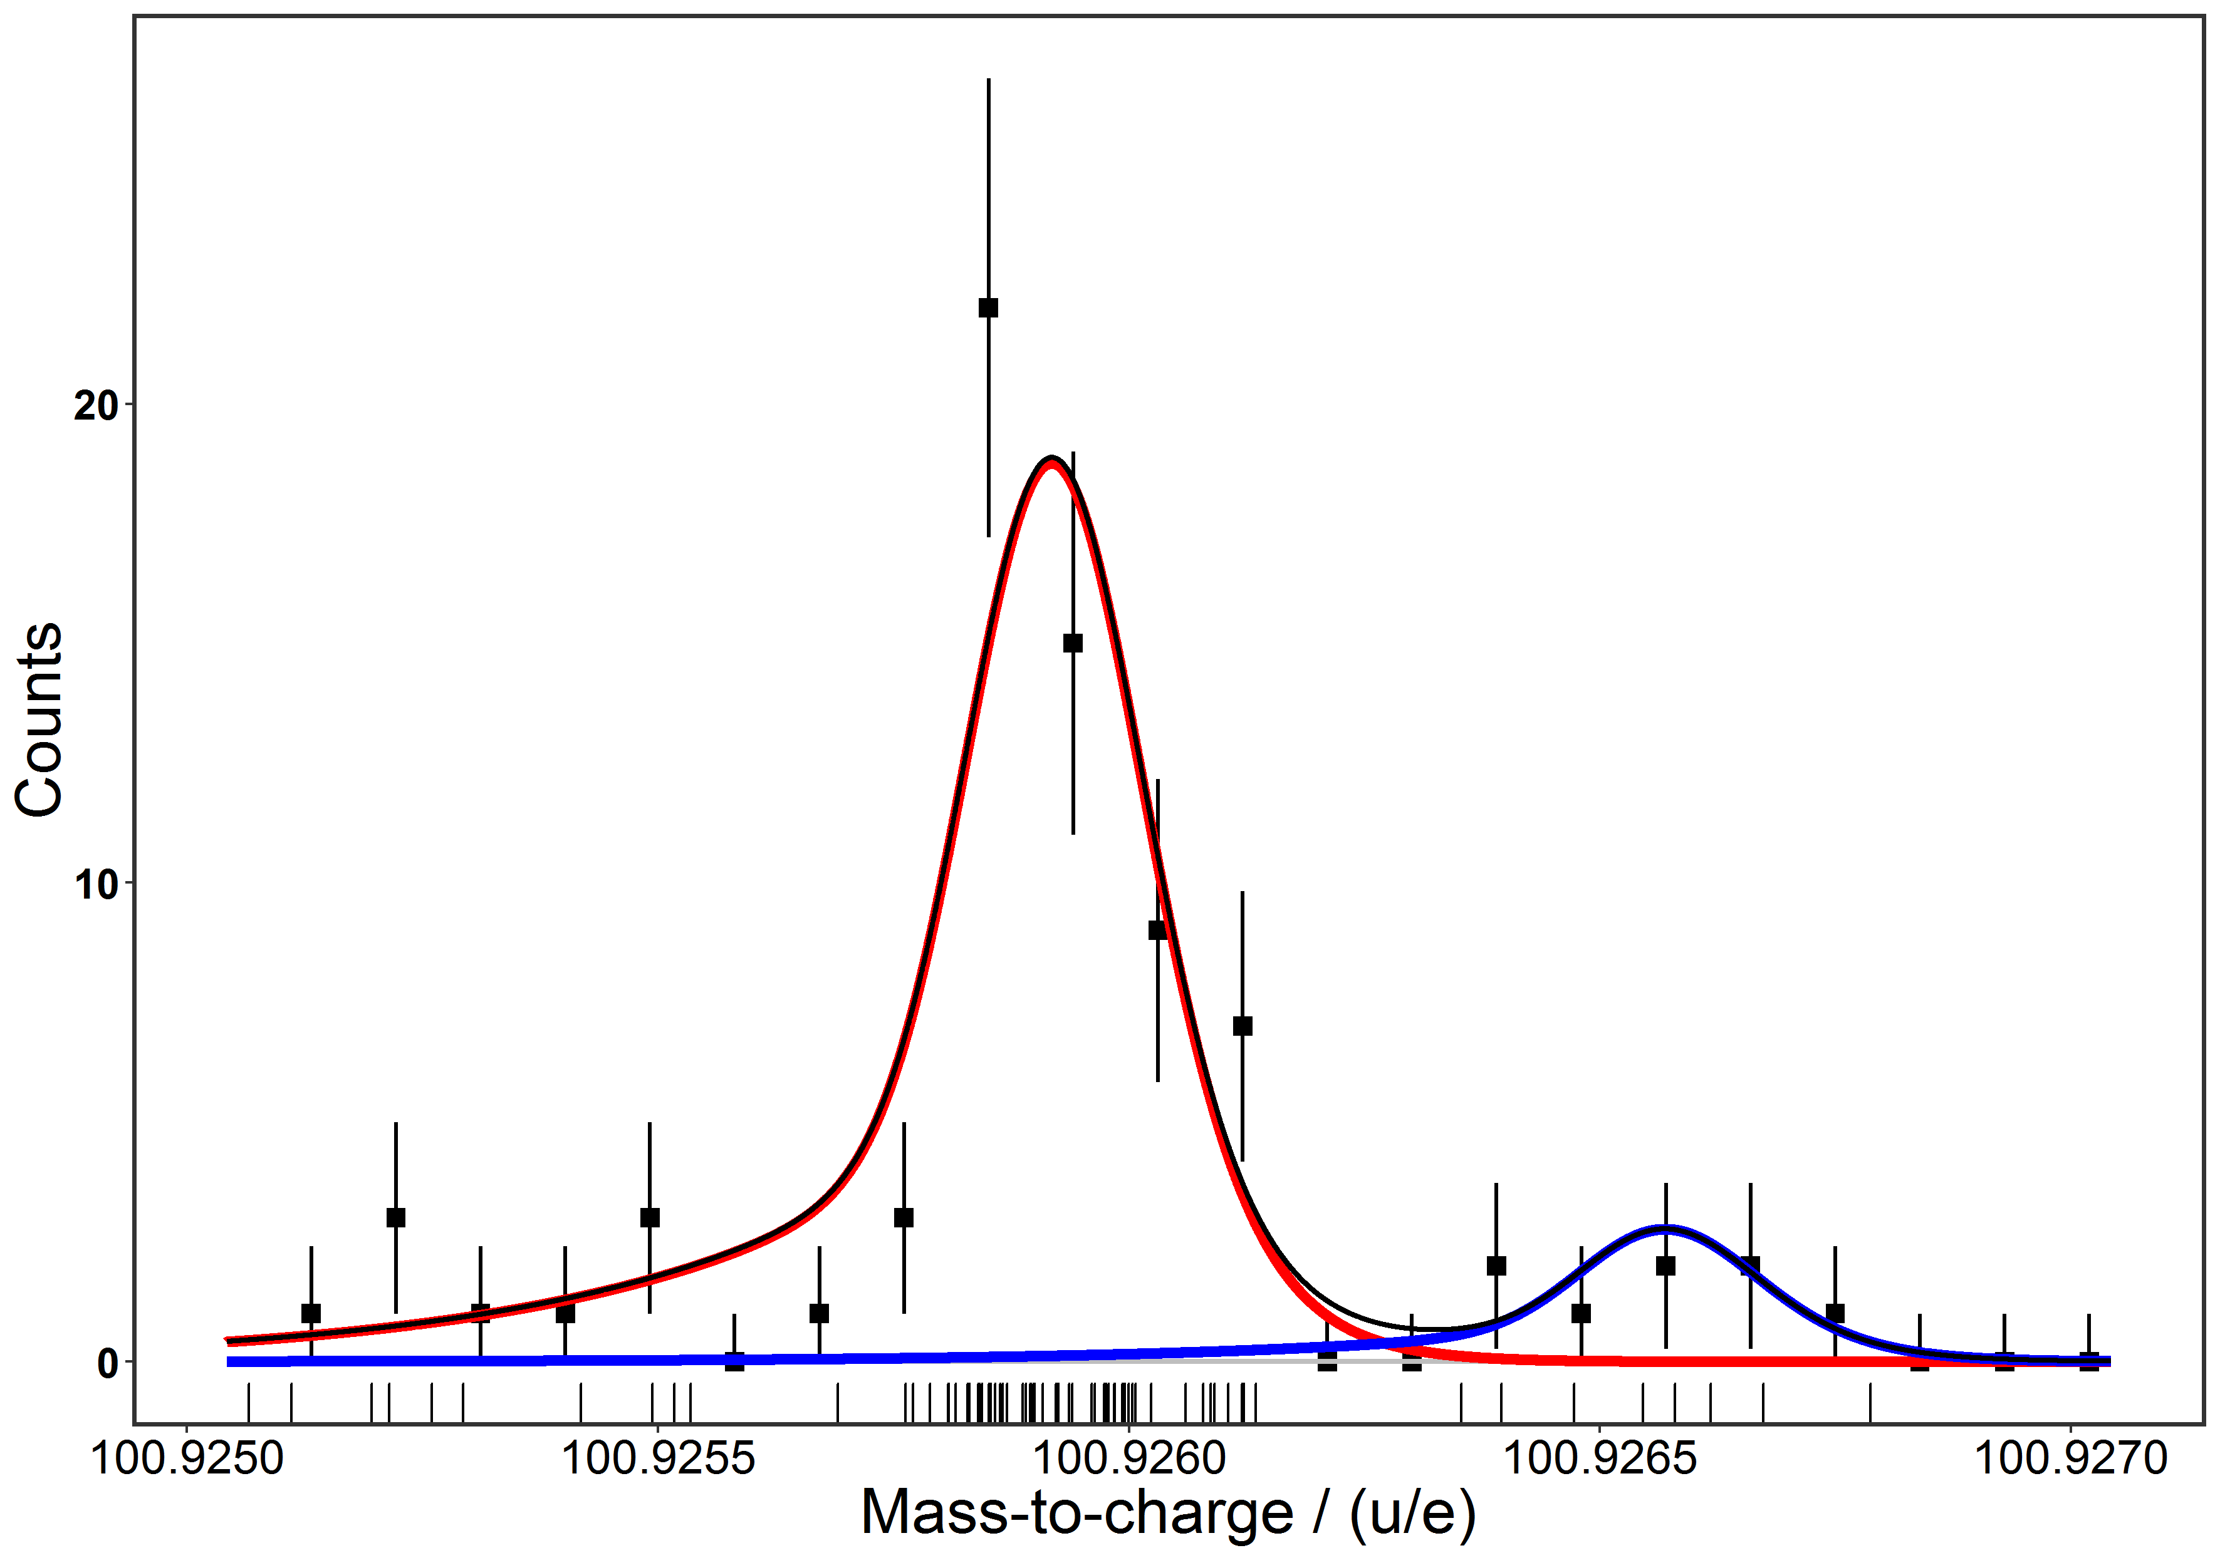
¹²⁴Xe Projectile Fragments: New Isomer Discovered
  Region below ¹⁰⁰Sn
^{101m}In:
Rate ~2 per hour
Cross-Section ~20 nbarn
  ¹⁰¹In
new
mass
FWHM: 230 keV
^{101g}In⁺
new isomeric state
(9 counts)
Preliminary
Due to the high sensitivity and
non-scanning measurement technique, the MR-TOF-MS
is an ideal device for the search
for new isomers
606(52) keV
^{101m}In⁺

Slide 28
Outlook

Slide 29
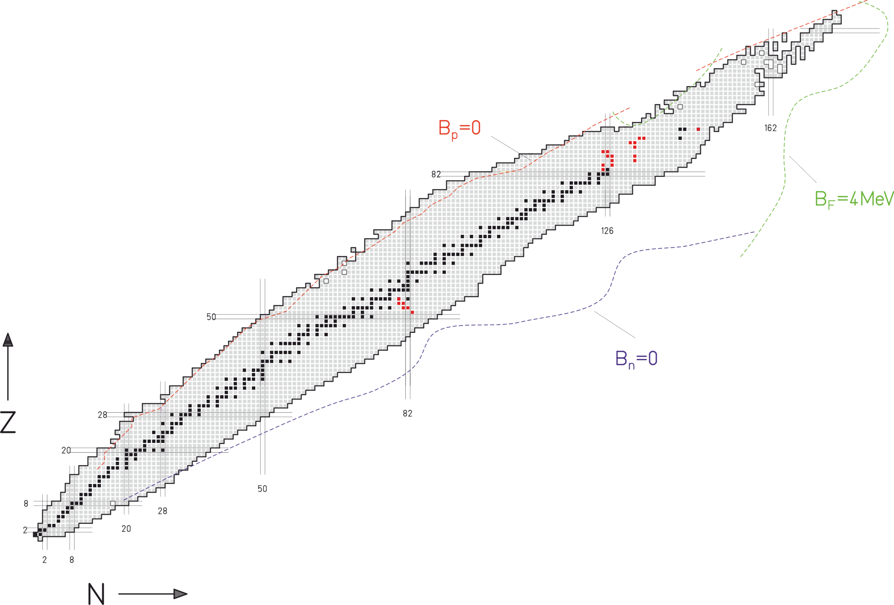
Approved Beam Times for FAIR Phase-0
New isotopes search
(S464 S. Pietri)
N=Z isotopes below ¹⁰⁰Sn
(S474 W. Plaß)
Multi-Nucleon Transfer Reactions
(S475 T. Dickel)
Beta-delayed Neutron Emission
(S472 I. Mardor)
38

Slide 30
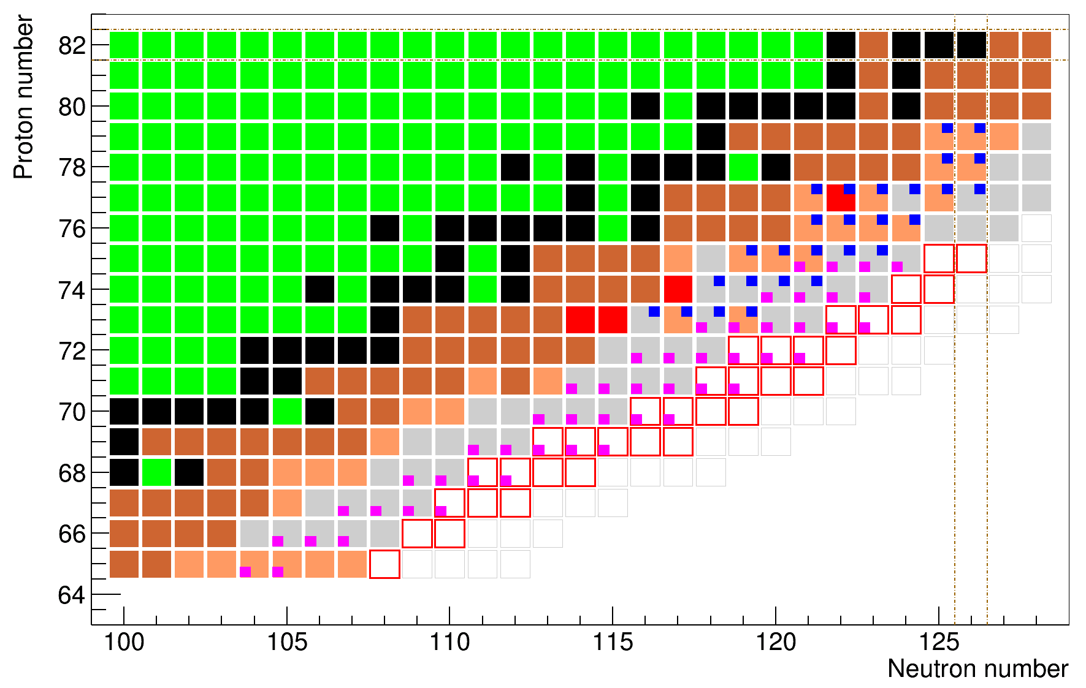
New Isotope Search
²⁰⁸Pb fragmentation to produce neutron rich isotopes from Tb to Re
Identification of new neutron rich isotopes
Measurement of production cross sections and momentum distribution
Mass, half-life and decay spectroscopy measurement after implantation
Goals:
Mapping frontiers of heavy neutron-rich nuclei
Nuclear structure and shells far-off stability
3^{d} r-process abundance peak
New isotope
New mass
New half-life
47 new half lives, 26 new masses and 34 new isotopes
S. Pietri et al.

Slide 31
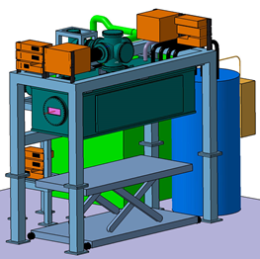
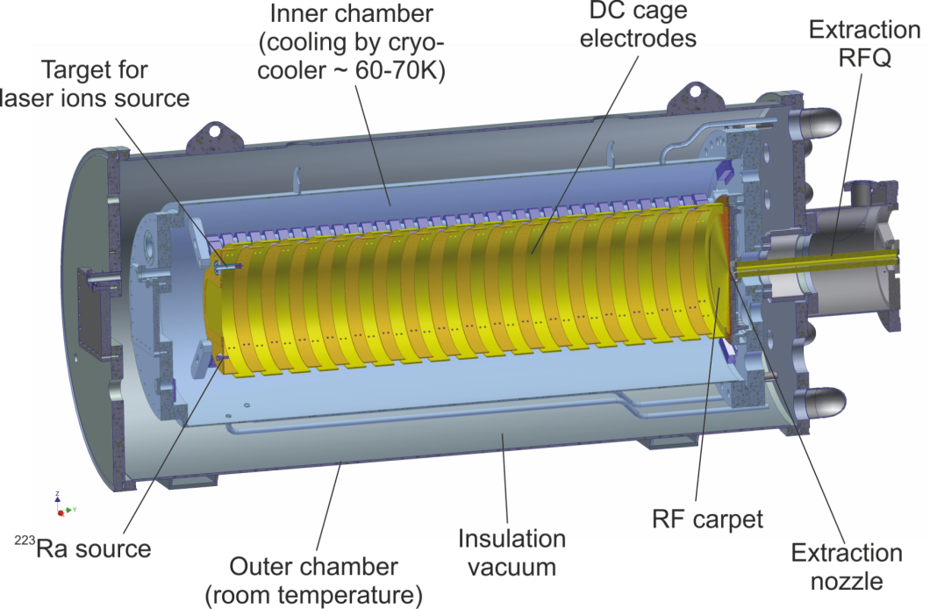
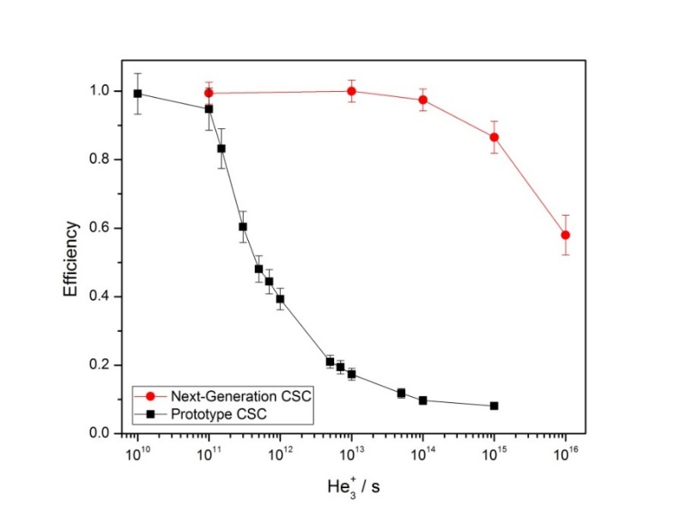
Outlook – Long Term
From FRS-Ion Catcher Stopping cell ... to ... LEB Stopping Cell
70 K)
²²⁸Th Source
 | Prototype CSC | Super-FRS CSC
Areal density (He) | 6 mg/cm² | 20…40 mg/cm²
Extraction time | 25 ms | 5…10 ms
Rate capability | 10⁴/s | 10⁷/s
incl. finnish in-kind: Helium Recovery Unit
Notes:
- Outlook

Slide 32
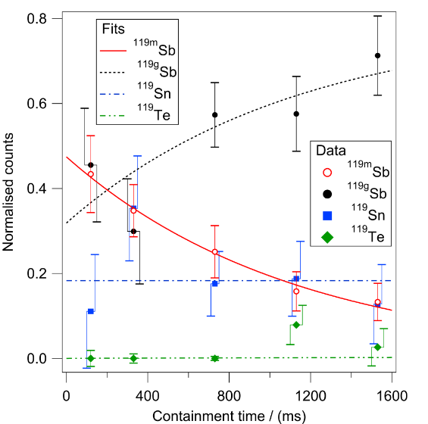
Summary and Outlook
The FRS Ion Catcher
  Unique capabilities:
    Efficient thermalization of relativistic secondary beams
    Broadband measurements with full ID
    High mass accuracy, down to 6*10⁻⁸
    High sensitivity
    Isomer separation
  Novel method to simultaneous measure mass, Q-value, Branching ratio and half-live
  Search for new isomeric states
Outlook:
  Experiments in FAIR Phase-0
  Next generation CSC for the SuperFRS

Slide 33
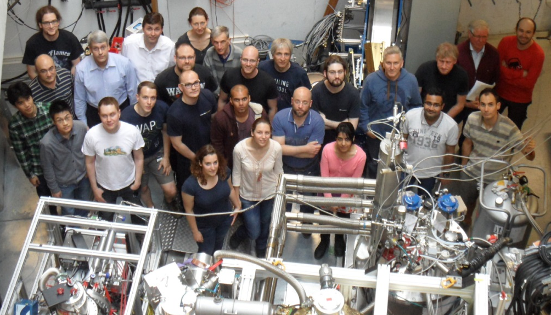












Acknowledgements
FRS Ion Catcher Collaboration
D. Amanbayev¹, S. Ayet^{1,2}, B. Soumya^{2,9}, J. Bergmann¹, P. Constantin⁶, T. Dickel^{1,2}, M. Diwisch¹, J. Ebert¹, A. Finley⁷, H. Geissel^{1,2}, F. Greiner¹, E. Haettner², C.Hornung¹, S. Kaur⁸, R. Knöbel², W.Lippert¹, I. Mardor^{10,11}, B. Mei⁶, I. Miskun¹, I. Moore³, J.-H. Otto¹, Z. Patyk⁴, S. Pietri², A. Pikhtelev⁸, W.R. Plaß^{1,2}, I. Pohjalainen³, A. Prochazka², S. Purushothaman², C. Rappold², M.P. Reiter^{1,7}, A.-K. Rink¹, C. Scheidenberger², M. Takechi², Y. Tanaka², H. Toernquist², H. Weick², J.S. Winfield², X.Xu^{1,2}, M.I. Yavor⁵
¹Justus-Liebig-Universität Gießen, Gießen, Germany;
² GSI, Darmstadt, Germany;
³ University of Jyväskylä, Jyväskylä, Finland;
⁴ National Centre for Nucl. Res., Warszawa, Poland
⁵ Institute for Analytical Instrum., RAS, St. Petersburg, Russia;
⁶ ELI-NP, Bucharest, Romania;
⁷ TRIUMF, Vancouver, Canada;
⁸ Inst. for E. Prob. of Chem. Phys., RAS, Chernogolovka, Russia;
⁹Saint Mary’s University, Halifax, Canada
¹⁰Soreq NRC, Yavne, Israel
¹¹ Tel Aviv University, Tel Aviv, Israel
Funding:
BMBF (05P19RGFN1, 05P16RGFN1), State of Hesse (HMWK) (LOEWE Center HICforFAIR), HGS-HIRe, JLU Giessen and GSI (JLU-GSI strategic Helmholtz partnership agreement), European Union Horizon 2020 (654002 JRA SATNURSE), ELI-NP Phase II (1/07.07.2016, CP, ID 1334)
29

Slide 34
Mass Measurements @ N=126

Slide 35
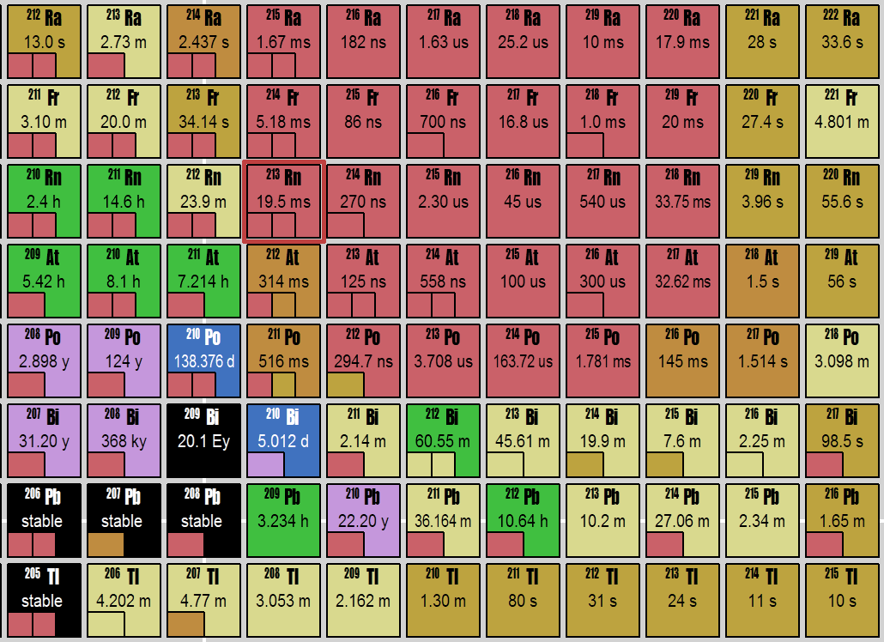
Compilation: Mass Measurement Accuracy
    Mass Measuements at N=126
Z=82
N=126
First direct measurement
Direct measurement
S. Ayet et al., submitted to PRC, arXiv:1901.11278v1
6
Notes:
Compilation of the masses evaluated with the current Hyper EMG functions.

Slide 36
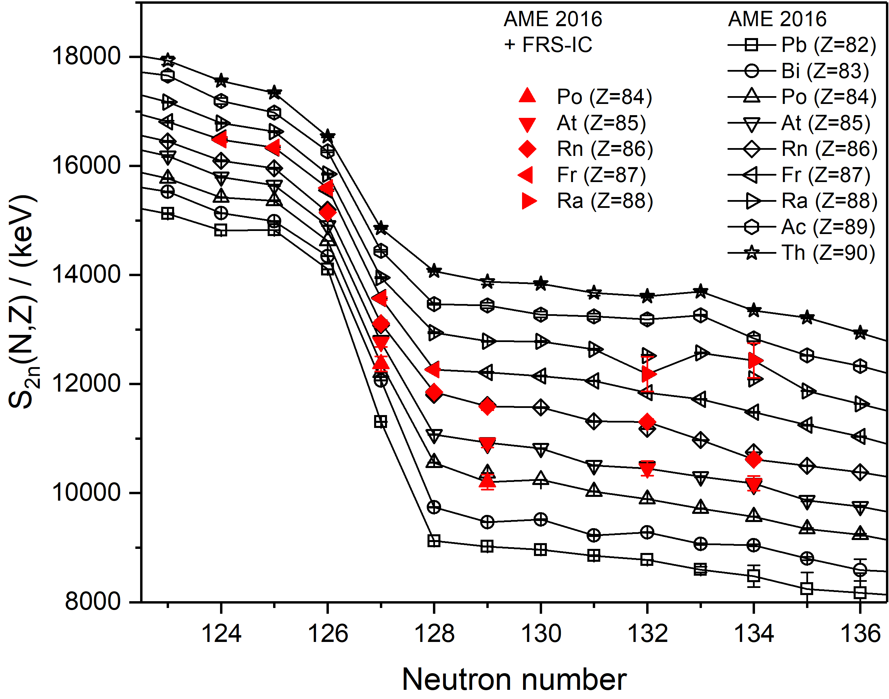
    Mass Measuements at N=126
Investigation of the N=126 neutron shell, above the Z=82 proton shell
7 ground state masses measured for the first time directly
Short-lived isotopes just above the shell
²¹¹Po (512ms), ²¹²At(314ms), ²¹³Rn (19.5ms)
S. Ayet et al., submitted to PRC, arXiv:1901.11278v1
7
Notes:
Compilation of the masses evaluated with the current Hyper EMG functions.

Slide 37
    Mass Measuements at N=126
Investigation of the N=126 neutron shell, above the Z=82 proton shell
Experimental results deviate strongly from the theoretical predictions, especially for N=126 and N=127
A. Sobiczewski and Y. A. Litvinov, PRC 89, 024311 (2014).
W. Myers and W. Swiatecki, NPA 601, 141 (1996).
S. Goriely, N. Chamel, and J. M. Pearson, PRC 88, 024308 2013).
M. Kortelainen et al., PRC 82, 024313 (2010).
S. Ayet et al., submitted to PRC, arXiv:1901.11278v1
7
Notes:
Compilation of the masses evaluated with the current Hyper EMG functions.

Slide 38
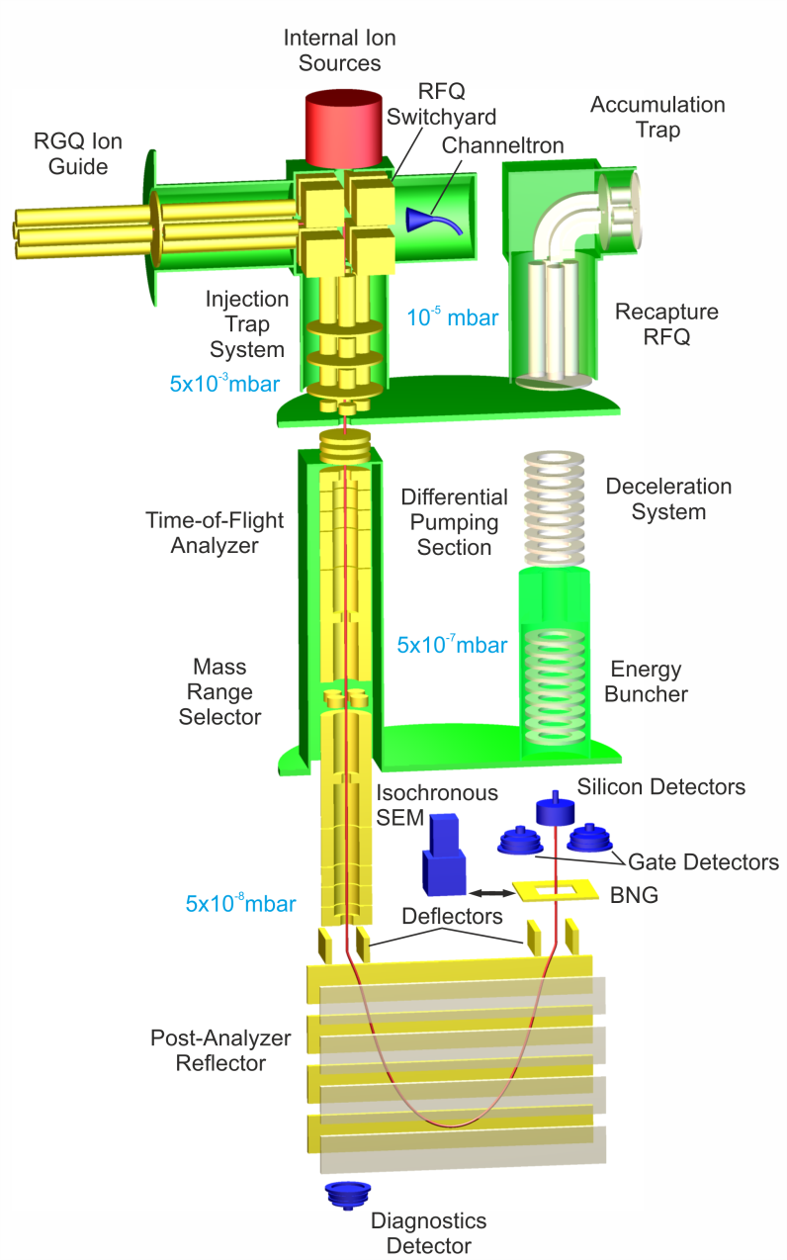
Multiple-Reflection Time-of-Flight Mass Spectrometer
Separated
Ions
Ions
2 m
Kinetic Energy
1.3 keV
Mass Measurement
Accuracy
Transmission efficiency
Isobar separator with
high ion capacity
Sensitivity
Mass
Measurement
~10⁻⁷
>10⁶ ions/s
up to 70%
~10 ions
W.R. Plaß et al., NIM B 266 (2008) 4560
W.R. Plaß et al., Int. J. Mass Spectrom. 394 (2013) 134
T. Dickel et al., NIM A 777 (2015) 172
T. Dickel et al., Phys. Lett. B 744 (2015) 137
World-wide unique combination of
performance characteristics!

Slide 39
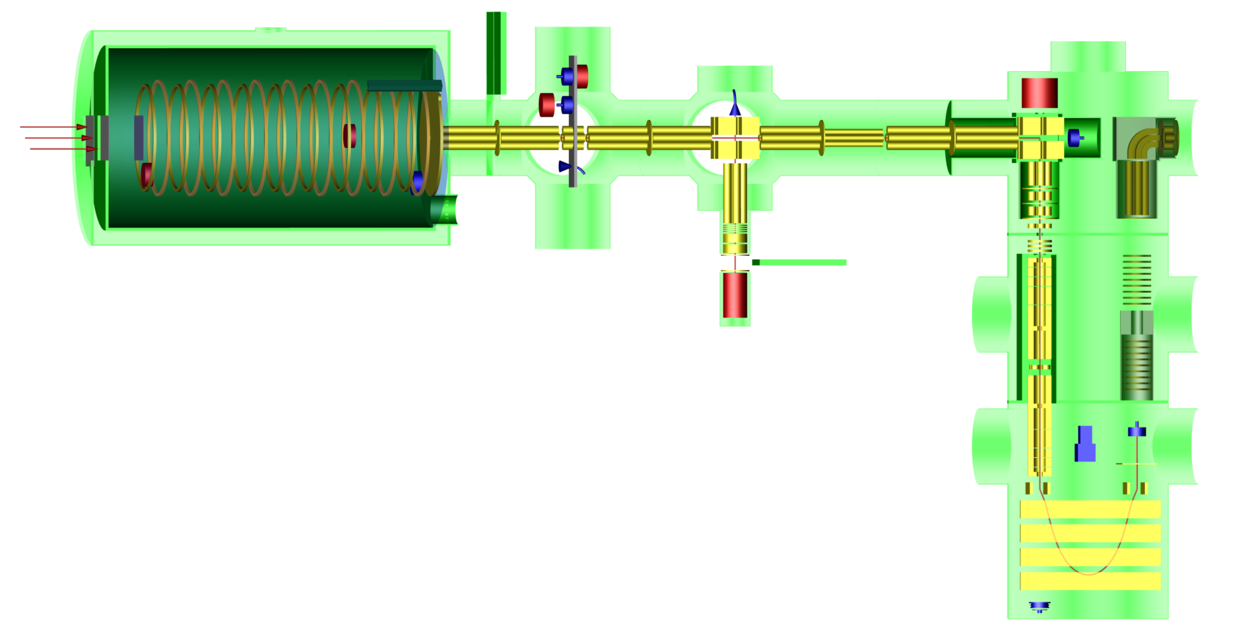
Approved Proposal: Detector Test for the LEB & N=Z
Outlook – Short Term
Improvements:
Higher efficiencies
Faster extraction time
Higher mass resolving power
New sources
Multiple-Reflection
Time-of-Flight
Mass Spectrometer
Cryogenic Stopping Cell
Upgraded Beamline
Laser Ablation Carbon
Cluster Ion Source
Notes:
Higher Efficiencies:
Increase areal density
Optimize transmission
Faster Extraction Times:
Increase DC Fields
Increase MR-TOF-MS Mass Resolving Power:
Stabilization power supplies
Optimization of 25 Hz repetition rate
New Sources:
Cf for characterization of CSC
LACCI for isobar calibration

Slide 40
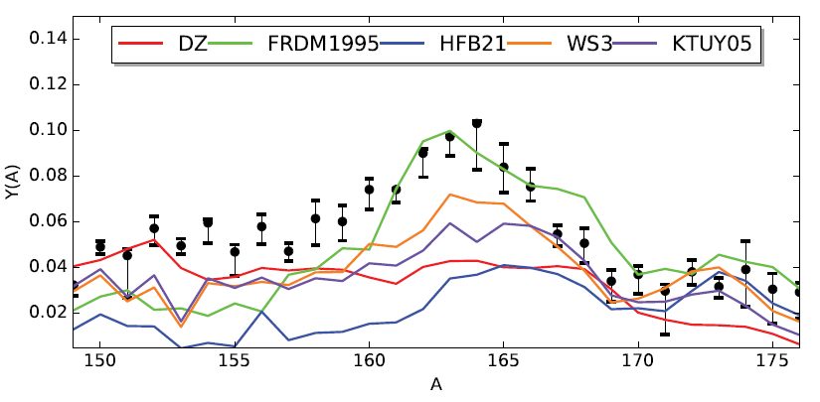
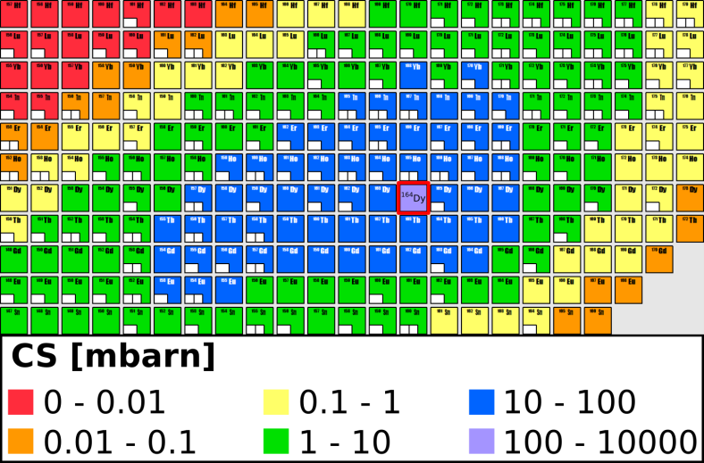
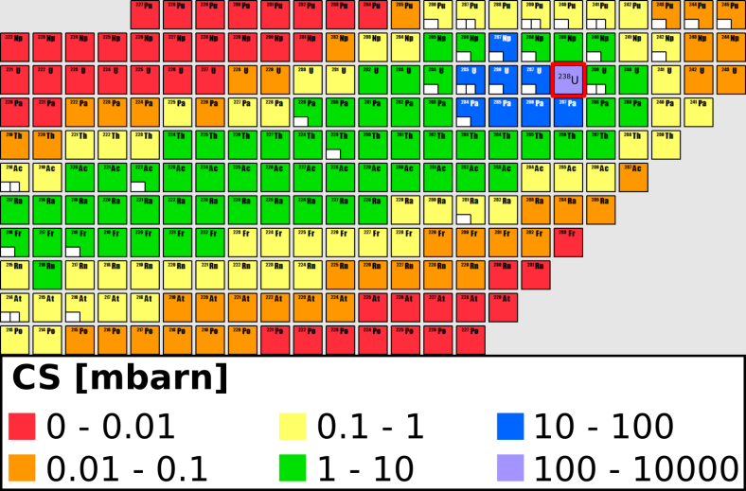
Motivation for ²³⁸U + ¹⁶⁴Dy
Proposal: Reaction studies / MNT (S475)
Rare-earth peak (r-process)
TLF
M. Mumpower et al., J. Phys. G, 44 (2017) 3
SA Guiliani et al., https://arxiv.org/abs/1704.00554
M. Eichler at al., Astrophys. J 808 (2015) 30
„East“ of ²³⁸U
PLF
Results for ²³⁸U on ¹⁶⁴Dy & ⁶⁴Ni:
    Cross Sections: >150
    New masses: ~20
    Discovery of long-lived isomers G.D. Dracoulis et al.,
      Phys. Scr. T152 (2013) 014015
A.V. Karpov, et al PRC 96 (2017) 024618
T. Dickel et al.

Slide 41
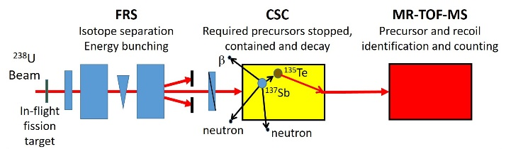
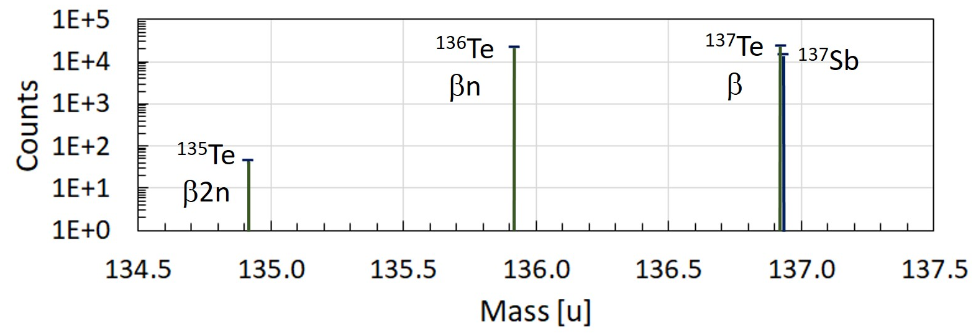
Proposal: beta-delayed neutrons (S472) – Method
We propose to demonstrate and use a novel method for measuring β-delayed single- and multi-neutron emission probabilities (P_{xn}) (and also mass, Q-values and T_{1/2}), in the following way:
I. Mardor et al.

Slide 42
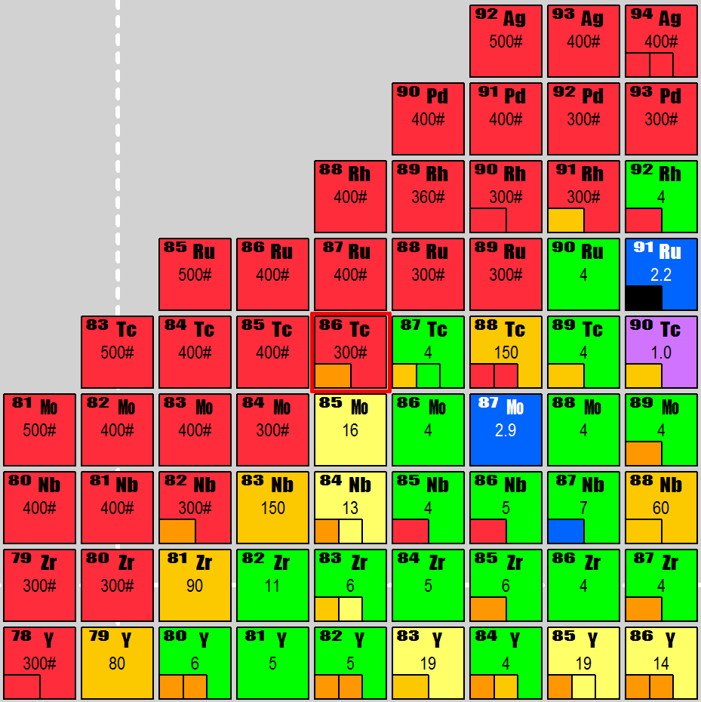
Mass measurements N=Z below ¹⁰⁰Sn
Status and challenges:
Low yields and short lifetimes
Scarce nuclear physics data
Physics Goals
Resolve inconsistencies in the mass surface (shifts > 1 MeV observed)
Wigner energy, e.g. ⁸⁰Zr
rp-process: ⁷⁸Y, ⁸²Nb, ⁹¹Rh
New K-Isomers: e.g. ⁸⁰Zr, ⁸²Zr
High spin isomer in ⁹⁴Ag (⁹³Pd)
1⁺
1⁺
1⁺
1⁺
2⁺
1⁺
2⁺
2⁺
2⁺
  E. Haettner et al., PRL 106 (2011) 122501
  AS Lalleman et al., Hyp. Inter. 132 (2001) 315
  H. Schatz, W.J. Ong, ApJ 844 (2017) 139
  Z.J. Bai et al., Chinese Phys. C 40 (2016) 094102
  I Mukha et al., Nature 439 (2006) 298
A. Kankainen et al., PRL 101, (2008) 142503
W.R. Plaß et al.
Notes:
The vicinity of the N=Z line is of special interest in nuclear structure physics, in nuclear astrophysics and for the basic understanding of nuclear forces and symmetries in nuclei.

Slide 43
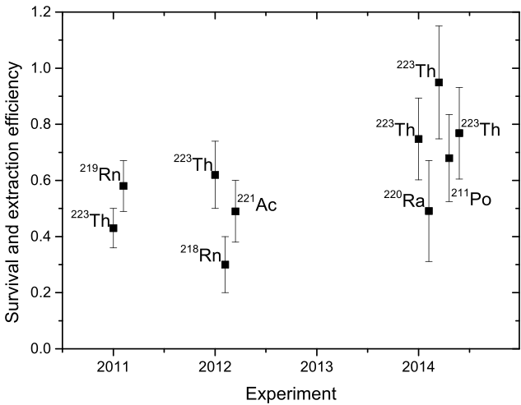
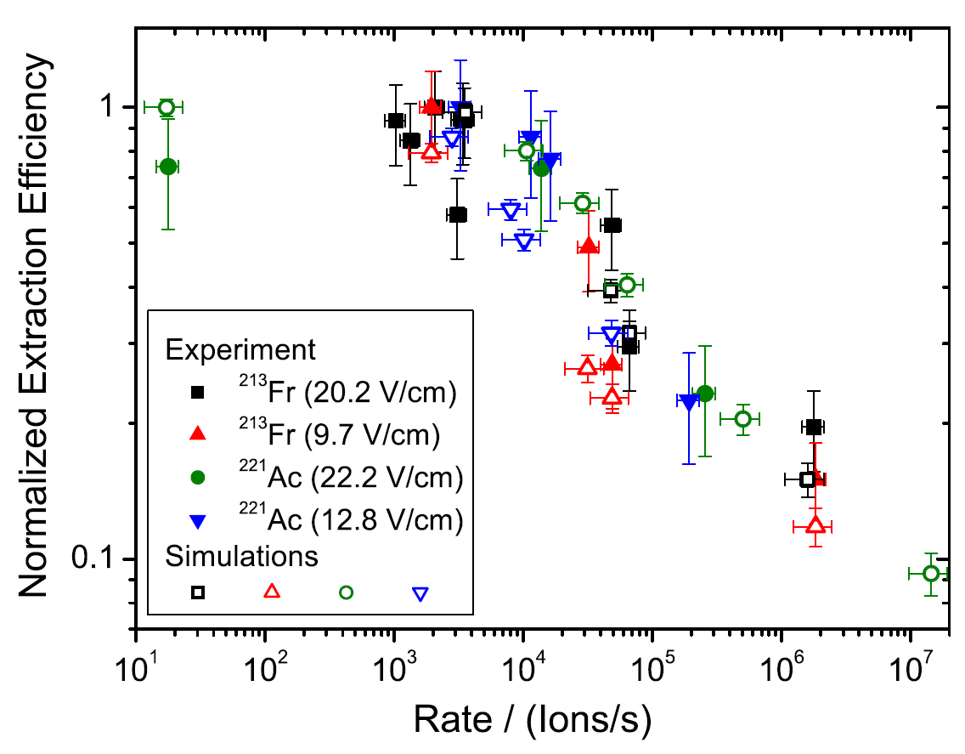
CSC: Performance Characteristics
Performance characteristics for ²³⁸U projectile fragments produced at 1000 MeV/u
Areal density up to 10 mg/cm² (He)
- five times higher gas density compared
to other stopping cells using an RF structure
Ion survival and extraction efficiencies > 60%
- compares favorably to other stopping cells
Total efficiencies up to 30%
- unprecedented for relativistic ions
Extraction times of 25 ms
- access to short-lived nuclei
Rate capability
- full efficiency up to ~10⁴ ions/s
for heavy projectile fragments
> 60%
S. Purushothaman et al., EPL 104 (2013) 42001
M.P. Reiter et al., NIM B 376 (2016) 240
M.P. Reiter PhD Thesis, JLU Giessen, 2015
Notes:
First tests with the CSC done. Able to stop and extract relativistic ions.
Areal Density high to achieve maximum of stopping efficiency
Survival efficiency: ion is not neutralized with some molecule
Extraction efficiency: the ions that are stopped and survive, are transported by the RF carpet and extracted

Slide 44
The Super-FRS CSC
Low-energy
ion beam
0.01 mbar
-5
RF carpets
Nozzle
10 mbar
@ 300 K
@ 300 K
RF
Nozzle
5...10 mbar
@ 70 K
DC
r
High-
o
t
c
m
energy ion
e
2
t
.
beam
e
0
D
~
200...300 mbar
Segmented anode
@ 70 K
~ 2 m
High Areal Density Othrogonal extraction – Cryogenic Stopping Cell
HADO-CSC
T. Dickel et al., NIMB 376 (2015) 216

Slide 45
Advantages of the Novel Design
Orthogonal extraction
  short extraction path → faster extraction, higher rate capability
Higher DC field strengths → faster extraction, higher rate capability
Smaller ratio of RF carpet area to stopping volume compared to stopping cells with an RF body → smaller power dissipation
Scales favorably with an increase in length of the stopping volume;
(no increase in extra. times, no decrease in extra. efficiencies or rate capability)
Segmented anode → electron current indicates the stopping distribution
Installation of targets in the stopping volume
Ion beam does not hit the RF carpet → no desorption of atoms / molecules
Dual-density design → efficient pumping of the CSC
Low-energy
ion beam
0.01 mbar
-5
RF carpets
@ 300 K
Nozzle
10 mbar
@ 300 K
RF
Higher density
Longer stopping volume
Shorter Extraction path
Higher Field strength
Nozzle
5...10 mbar
@70 K
DC
r
High-
o
t
c
m
energy ion
e
2
t
.
beam
e
0
D
~
Segmented anode
200...300 mbar
@70 K
T. Dickel et al., NIMB 376 (2015) 216
~ 2 m

