Slide 1

Direct lifetime measurements of excited states in ¹³⁶Te
V. Vedia*^{, 1}, L. M. Fraile¹, H. Mach^{1, ‡}, J. Benito¹, B. Olaizola^{1,2}, V. Paziy¹,
J. M. Udías¹, P. Spagnoletti³, G. S. Simpson⁴, J.-M. Régis⁵, A. Blanc⁶,
A. M. Bruce⁷, G. de France⁸, M. Jentschel⁶, J. Jolie⁵, W. Korten⁹, U. Köster⁵,
T. Kröll¹⁰, S. Lalkovski¹¹, N. Marginean¹², P. Mutti⁵, P. H. Regan¹³,
N. Saed-Samii⁵, T. Soldner⁶, C. A. Ur¹⁴ and W. Urban¹⁵
¹Grupo de Física Nuclear and IPARCOS, Facultad de CC. Físicas, Universidad Complutense,
CEI Moncloa 28040 Madrid, Spain.
² TRIUMF 4004 Wesbrook Mall Vancouver BC, V6T 2A3 Canada.
³ School of Engineering, University of the West of Scotland, Paisley, PA1 2BE, United Kingdom.
⁴ LPSC, Université Joseph Fourier Grenoble 1, CNRS/IN2P3, Institut National Polytechnique de Grenoble,
F-38026 Grenoble Cedex, France.
⁵ Institut für Kernphysik der Universität zu Köln, Zülpicher Str 77, D-50937 Köln Germany.
⁶ Institut Laue-Langevin, CS 20156, 38042 Grenoble Cedex 9, France.
⁷ SCEM, University of Brighton, Lewes Road, Brighton, BN2 4GJ, United Kingdom.
⁸ Grand Accélérateur National d’Ions Lourds, Caen, France.
⁹ CEA de Saclay, IRFU, 91191 Gif-sur-Yvette, France.
¹⁰ Institut für Kernphysik, TU Darmstadt, Schlossgartenstr. 9, 64289 Darmstadt, Germany.
¹¹ Faculty of Physics, University of Sofia, 1164 Sofia, Bulgaria.
¹² Horia Hulubei NIPNE, 77125 Bucharest, Romania.
¹³ Department of Physics, University of Surrey, Guildford GU2 7XH, United Kingdom.
¹⁴ INFN, via Marzolo 8, 35131 Padova, Italy.
¹⁵ Faculty of Physics, University of Warsaw, ul. Pasteura 5, PL-02-093 Warsaw, Poland.
*mv.vedia@ucm.es

Slide 2
Outline
Introduction and motivation
1: Fast-timing setup and optimization
2: Analysis method and corrections
3: Lifetime measurements in ¹³⁶Te
Conclusions

Slide 3
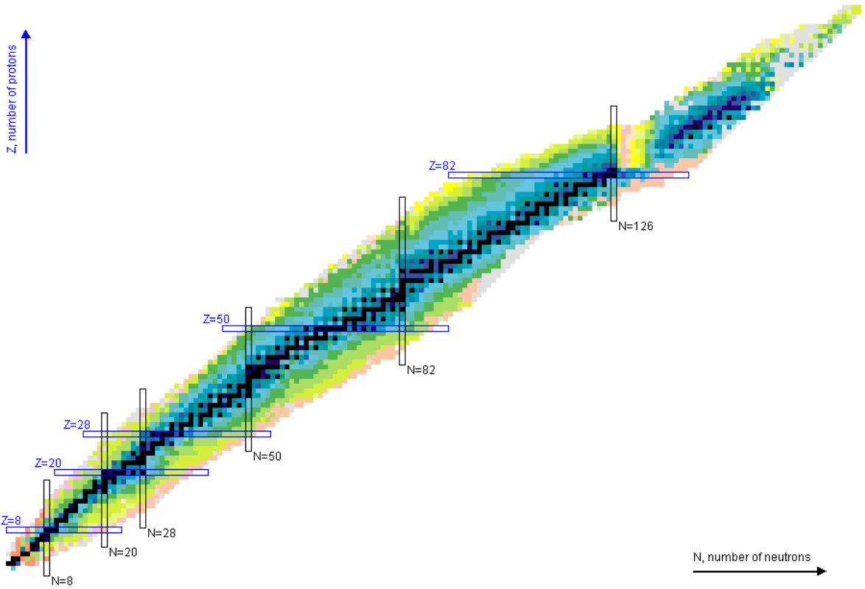
Introduction
Single-particle states
Onset of Collectivity
Nucleon-nucleon effective interaction
Electromagnetic transition operators
Theoretical models put to test
Nuclei around doubly-magic
²⁰⁸Pb
¹³²Sn is the only medium-heavy doubly magic nucleus, which itself and most of its neighbours are experimentally accessible.
¹³²Sn
Unexpected shell structure modifications
Sudden collective behavior
⁷⁸Ni
N=82, Z=50
Notes:
Nuclei with few valence particles outside of a doubly magic core provide valueble information about single particles energies, nucleon-nucleon interaction and give insight into the onset of collectivity. Moreover the allow to put to test the different theoretical models and inform about effective electromagnetic operators
Nuclear models are put to deeper challenge by electromagnetic transitions compared to energy information.

Slide 4

Introduction
Z
N
2f
108 3p1_{/2}
neutron
100 3p_{3/2}
proton
92 2f_{7/2}
¹³²Sn
1h
82
3s
82 2d_{3/2}
70 1h_{11/2}
1d
68 3s_{1/2}
64 2d_{5/2}
58 1g_{7/2}
1g
50
50 1g_{9/2}
2p
40 2p_{1/2}
38 1f_{5/2}
N=84, Z=52
1f
32 2p_{3/2}
28
28 1f_{7/2}
20
¹³⁶Te couples two protons and two neutrons to the doubly-magic core ¹³²Sn.
2s
20 1d_{3/2}
1d
16 2s_{1/2}
14 1d_{5/2}
8
1p
8 1p_{1/2}
6 1p_{3/2}
Doubly-magic ¹³²Sn:
Z=50, N=82
2
1s
2 1s_{1/2}

Slide 5
Introduction
Lifetimes (τ) and EM transition rates
Lifetimes: Time that it takes to a nuclear state to decay to a lower energy one (normally by γ-rays).
Direct and model independent
access
B(Χλ) transitions rates
Transition rates are very sensitive tools to map nuclear properties and unravel surprizing features of nuclei.
γ₁
τ
γ₂
M(Xλ)

Slide 6




Introduction
Lifetimes τ
Fast-Timing Methods
From tens of nanoseconds down to few picoseconds
Range of nuclear lifetimes 45 orders of magnitude
Fast-Timing
Direct electronic measurements
Electronic
CoulEx
Doppler
Range of interest for
¹³⁶Te lifetimes
Resonance
10⁻¹⁸
10⁻¹⁶
10⁻¹⁴
10⁻¹²
10⁻¹⁰
10⁻⁸
10⁻⁶
τ(s)
Fast-Timing: Electronic timing technique that makes use of coincidences between fast scintillators

Slide 7
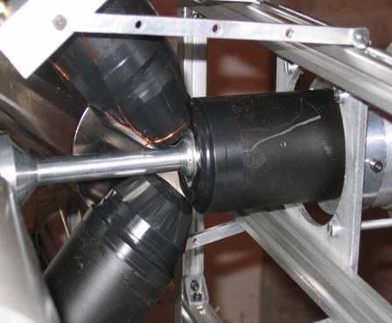

Introduction
The Advanced Time Delayed βγγ(t) method
β
BaF₂
γ₁
start
HPGe
T_{1/2}
β (NE111A)
stop
γ₂
RIB
start
Time difference
stop
LaBr₃(Ce)
HPGe: BRANCH SELECTION
Good energy resolution
Poor time response
Plastic β scintillator: TIMING
Fast response
Efficient start detector
LaBr₃(Ce)/BaF₂: TIMING
Fast response γ-detectors
Stop detectors
βγγ(t)
: β-HPGe-LaBr₃(t)
[H. Mach et al., NPA 523 (1991) 197]

Slide 8

Introduction
Fast-Timing Methods γγγ(t)
HPGe
start
γ₁
Fast scintillators
start
τ
LaBr₃
stop
γ₂
LaBr₃(Ce)
Excellent time resolution
Good E resolution,
thus best peak to background ratio
LaBr₃
stop
γ₃
HPGe
TAC
HPGe: Branch selection
LaBr₃(Ce): Timing
Fast-Timing Methods
γγγ(t)
HPGe-LaBr₃(Ce)-LaBr₃(Ce)(t)
Notes:
Thanks to the use of LaBr3(Ce) detectors it could be possible to apply Fast Timing method to other types of experiments different that beta-decay

Slide 9

Introduction
Fast-Timing Methods-Large Arrays
Standard Setup
Large Fast-timing arrays
HPGe
5
4
6
LaB₃
7
8
9.
LaBr₃
6
10
5
11
12
1
3
7
LaBr₃
4
13
3
14
HPGe
16
15
β−dect
2
1
8
2
1
2 LaBr₃(Ce) detectors --> several LaBr₃(Ce)
  Triple coincidences γγγ:
  GeGeGe and GeLaBr₃LaBr₃(t)
  4-fold coincidences
2 HPGe detectors --> several HPGe-Clovers

Slide 10
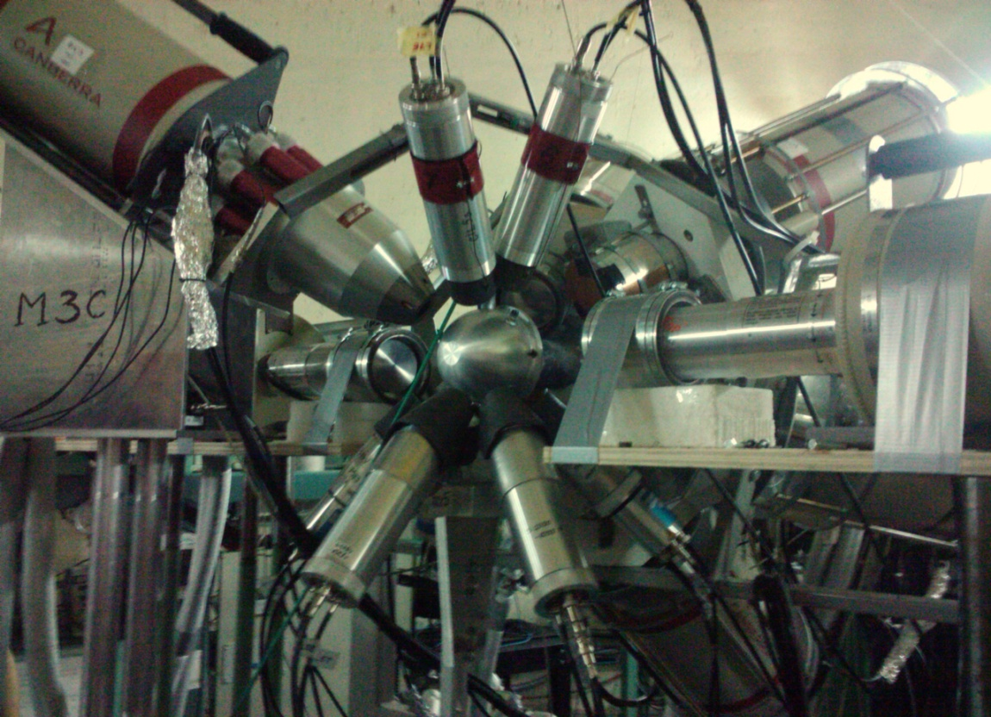
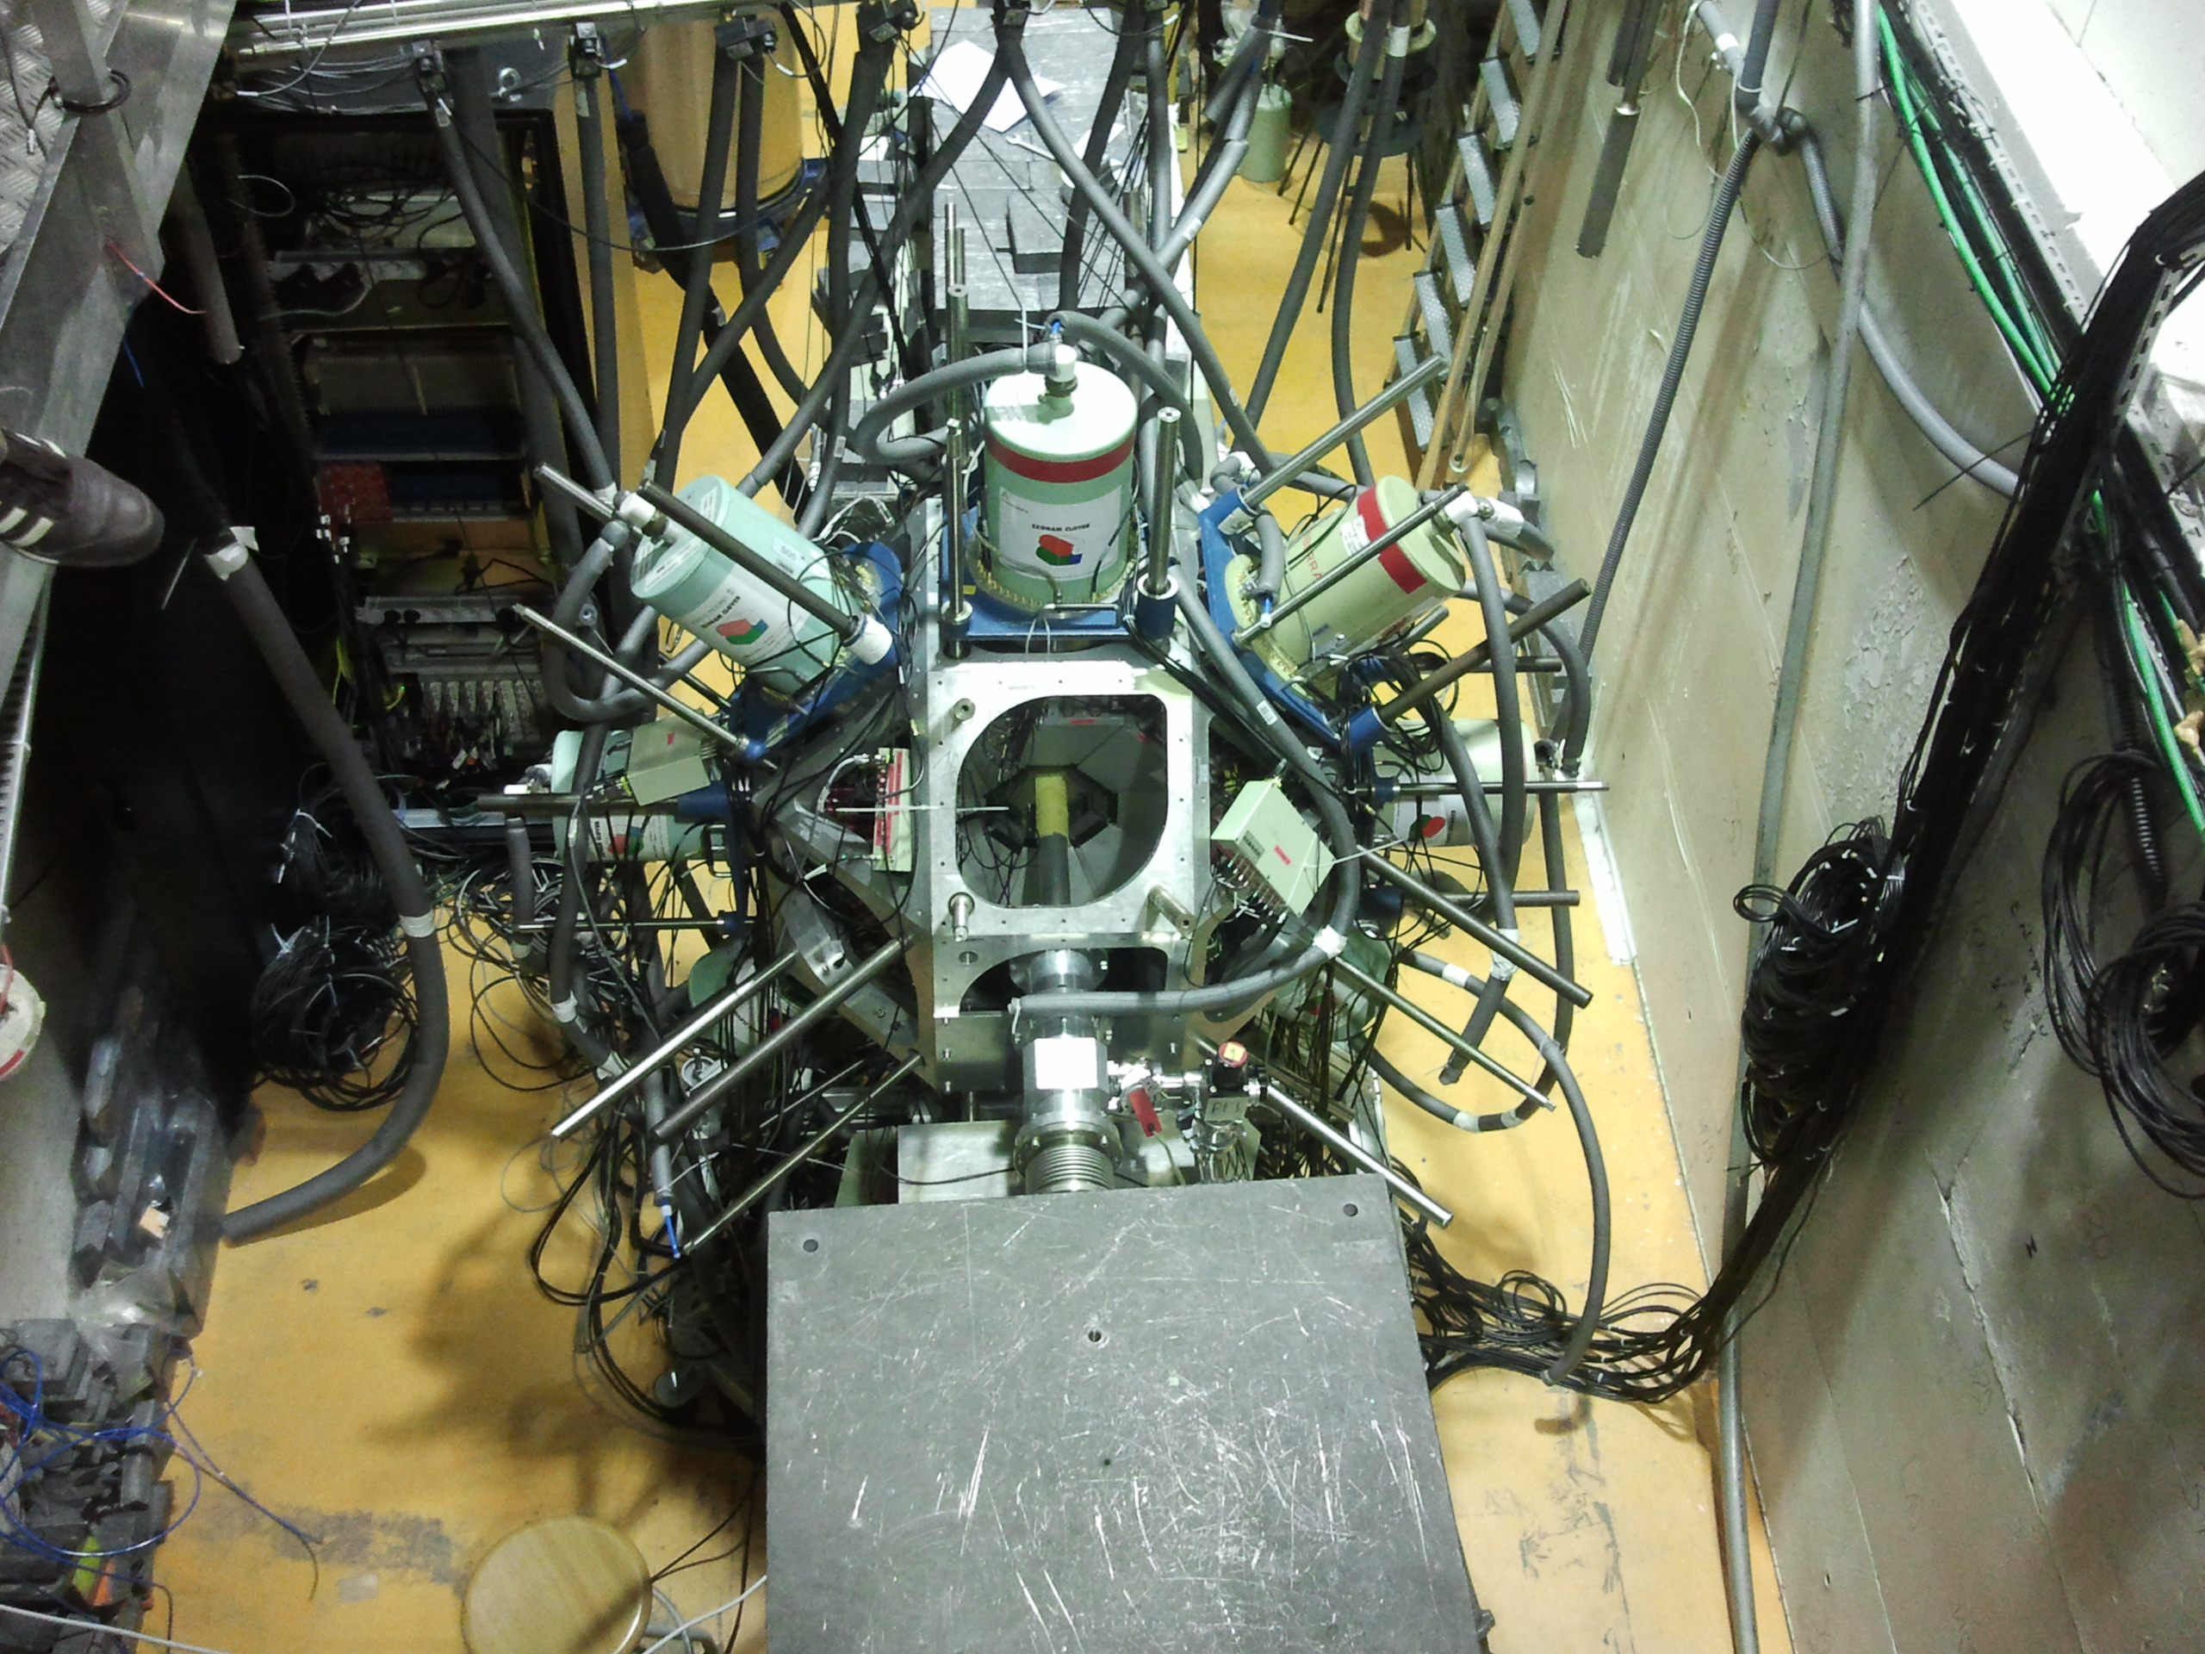
Introduction
Large LaBr₃(Ce) Arrays
ROSPHERE IFIN-HH
EXILL-FATIMA @ILL
Neutron beam
First Hybrid Spectrometer
Large LaBr₃(Ce) array +
HPGe array
Hybrid Spectrometer in induced fission
Large LaBr₃(Ce) array (FATIMA) +
HPGe array (EXOGAM)
D. Bucurescu et al. NIM A 837:1-10, 2016
J.-M. Régis et al. NIM A, 763:210-220,2014
M. Jentschel et al. NIM A Journal of instrumentation 2017

Slide 11
Introduction
Fast-Timing Methods
Powerful tool
Lifetimes measurements
Need for very precise
time calibrations
Their sensibility directly depends on the setup in use
Need for Background/Compton corrections
The better the time resolution
The better the sensitivity

Slide 12
Introduction
Figure of merit for fast timing measurements
Time resolution (FWHM)
energy dependent (walk)
Gaussian response?
Timing corrections (C>1)
Peak to background
Branch / channel selection
E resolution
Number of counts in the time peak
Efficiency / statistics
Ability to select peak: E resolution
Non-linearity
L. M. Fraile et al. NIM B, in press (proceedings EMIS2018)

Slide 13
Introduction
To obtain the best sensitivity
1 : LaBr₃(Ce) detectors and Fast-timing setup optimization
To minimize the background effect
2 : Analysis method and Compton correction procedure
Application to
3 : Lifetimes of ¹³⁶Te.

Slide 14
Outline
Introduction and motivation
1: Fast-timing setup and its optimization
2: Analysis method and corrections
3: Lifetime measurements in ¹³⁶Te and ¹³⁸Te
Conclusions

Slide 15
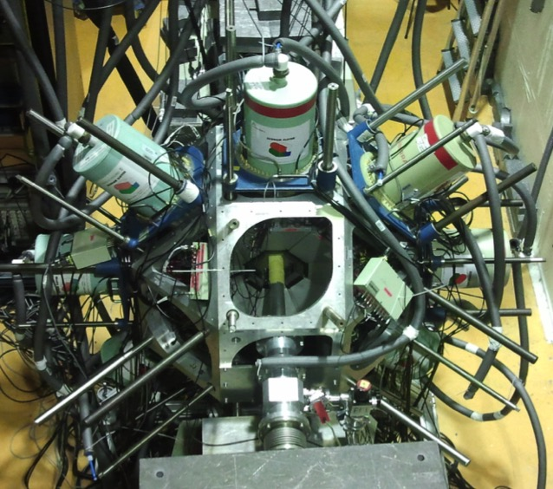
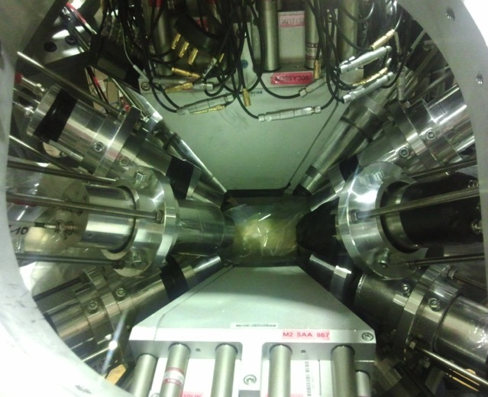
Experimental Set up
THE EXILL-FATIMA CAMPAIGN AND THE HYBRID SPECTROMER 2013
Neutron beam
Characteristics
First experiment on Nuclear Spectroscopy of Prompt Fission Fragments
Targets of ²³⁵U and ²⁴¹Pu . Detectors in close geometry
Cold collimated neutron beam of ∅=1.2 cm flux of about 10⁸ n/(s cm²)
M. Jentschel et al. NIM A Journal of instrumentation 2017
15

Slide 16
Experimental Set up
THE EXILL-FATIMA CAMPAIGN AND THE HYBRID SPECTROMER 2013
5
Detectors
8 Ge-Clovers from EXOGAM
8 BGO for Compton suppression
16 LaBr₃(Ce) detectors in 2 rings
4
8
6
7
9.
10
6
Ge: Good Energy Resolution
Spectroscopy
Branch selection for timing
11
5
Source
12
1
3
7
LaBr₃(Ce): TIMING
Fast response γ-detectors
Start and stop detectors
4
13
3
14
15
Characteristics
Relative E resolution 3.3% @ 662 keV
Absolute FEP efficiency 3.71(7) % @ 662 keV
40 TB of Triggerless data
2
16
8
1
2
1
J.-M. Régis et al. NIM A, 763:210-220,2014
M. Jentschel et al. NIM A Journal of instrumentation 2017
16
Notes:
16 LaBr₃(Ce) 1.5 x 2” y 1.5 x 1.5 “

Slide 17
Fast-timing setup and its optimization
Time resolution optimization
Different Ce doping
5, 8, 10 %
The LaBr₃(Ce)
crystals
Cylindrical
Different Geometries
Truncated Cone
Hybrid-tapered
Photosensor
Hamamatsu R9779 PMT model
CFD external delay
Parameters of electronics
CFD parameters
Zero crossing (Z)
PMT bias Voltage
Technical details
In the manuscript
Notes:
Hamamatsu R9779 PMT model was already chosen as best option for fast timing PMT

Slide 18
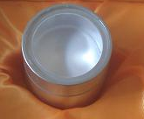
Fast-timing setup and its optimization
Standard LaBr₃(Ce) detectors
1 in. x 1 in. Cylinders
In-depth characterization
Spectroscopic features
Time response
Energy resolution and linearity
γ-ray detection efficiency
Time resolution
Time walk

Slide 19
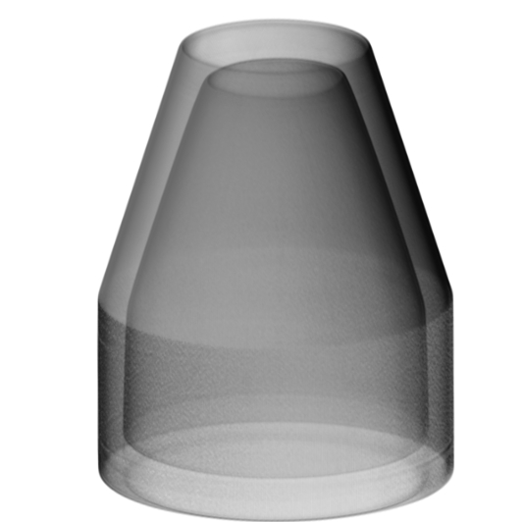
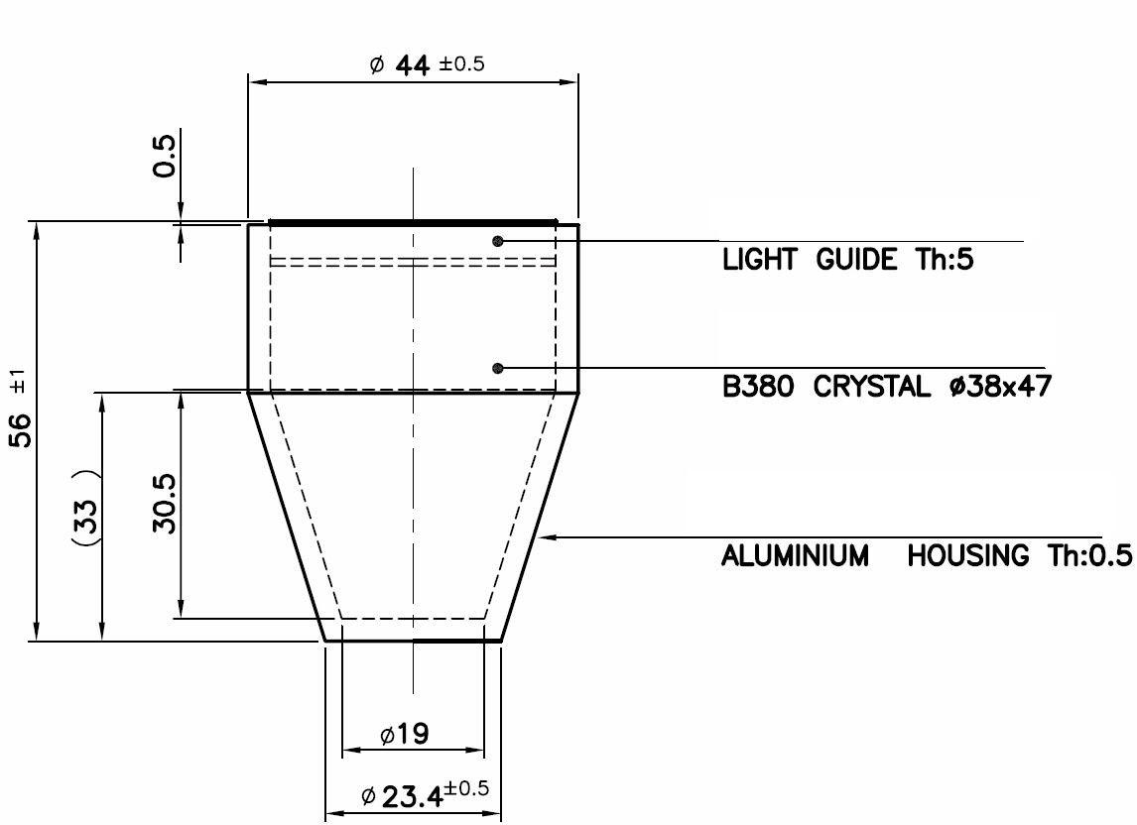
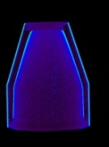
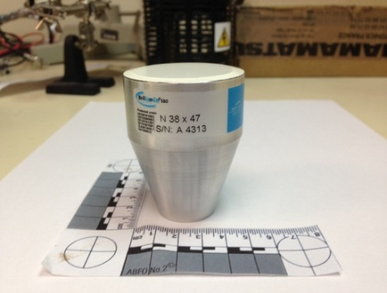
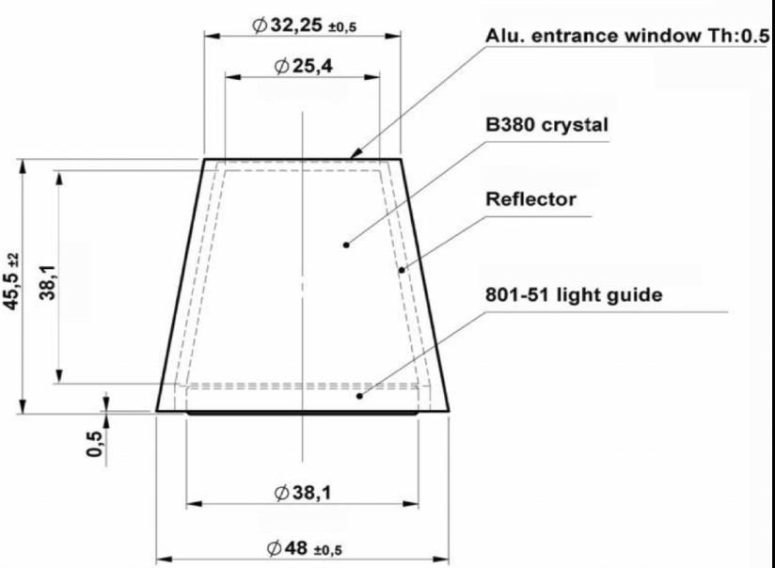
Fast-timing setup and its optimization
Special LaBr₃(Ce) geometries
Hybrid-tapered
Truncated Cone

Slide 20
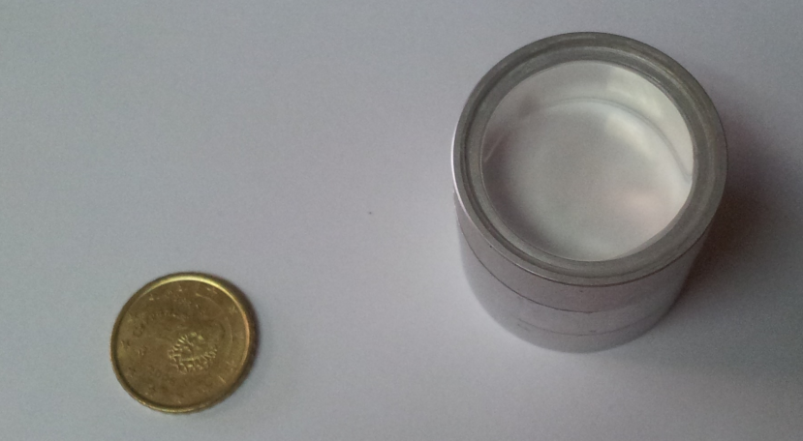
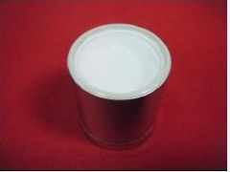
Fast-timing setup and its optimization
Different Ce concentration
Best performing parameters
E. delay= 1.6 ns
HV = –1300 V
Z= 2.0 mV
Crystal A (5%)
Crystal B (8%)
Crystal C (10%)
Time resolution FWHM
Energy resolution
Ce doping | FWHM at ⁶⁰Co energies (ps) | FWHM at 511 keV (²²Na)
5 % | 110 ±3 | 164 ±3
8 % | 98 ±3 | 148 ±3
10 % | 107 ±3 | -
Ce doping (%) | E_{r} (%)
5 % | 3.4
8 % | 3.4
10 % | 4.0

Slide 21
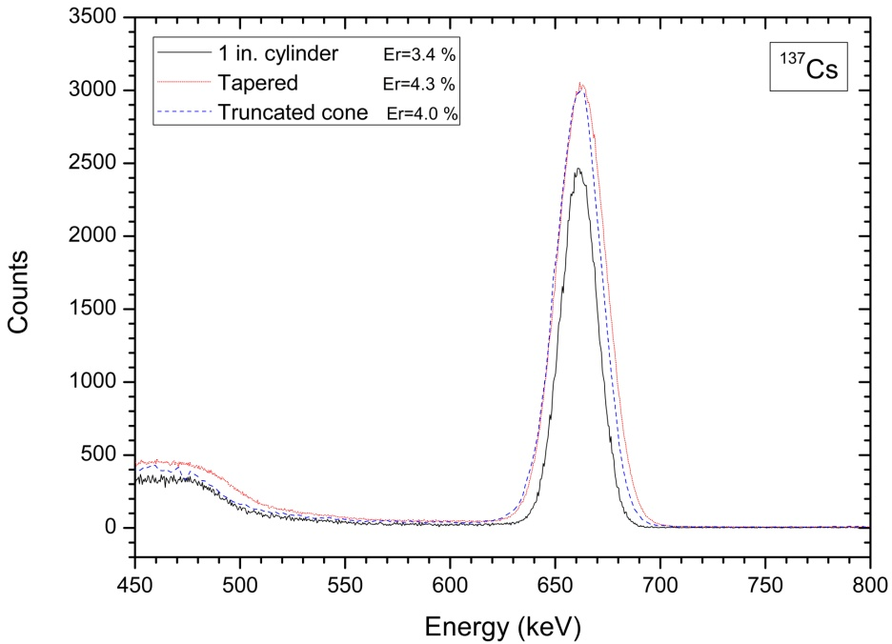
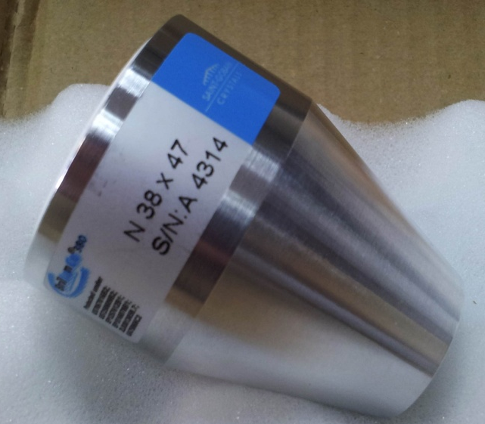
Different LaBr₃(Ce) geometries
E. resolution
Relative Energy Resolution (%)
Crystal | R6231 | R9779
Tapered | 3.8 | 4.3
Truncated cone | 3.3 | 4.0
Cylindrical | 2.8 | 3.4

Slide 22
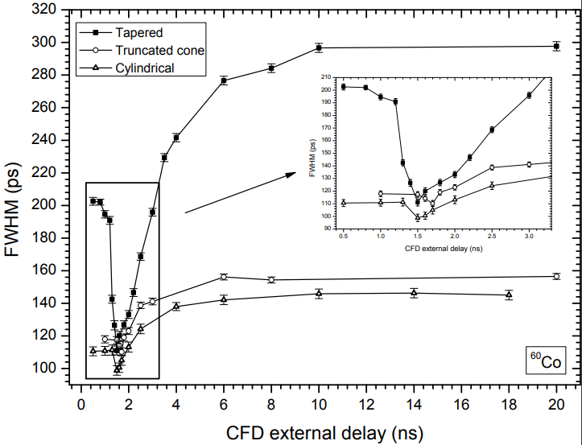
Different LaBr₃(Ce) geometries
Time resolution
Crystal | HV (V) | Ex. Delay ns | FWHM (ps) at ⁶⁰Co | FWHM (ps) at 511 keV
Tapered | -1300 | 1.5 | 111±3 | 160±3
Truncated cone | -1200 | 1.7 | 110±3 | 162±3
Cylindrical | -1300 | 1.5 | 98±3 | 148±3
Notes:
This is the most sensitive parameter for optimization

Slide 23
Fast-timing optimization
Best time resolution to date of fast-timing setups
  Best performing parameters of the analogue electronics
  Best Ce doping concentration (8%)
  LaBr₃(Ce) geometries
Excellent performance of the truncated cone geometry
  Good time response 110(3) ps
  Good spectroscopic features Er 4.0% @662keV
  Versatile geometry for large arrays
The hybrid-tapered geometry presents problems
  Locally good time resolution but sensitive to small electronic variations
  An improvement in the manufacture technique is needed

Slide 24
Outline
Introduction and motivation
1: Fast-timing setup and optimization
2: Analysis method and corrections
3: Lifetime measurements in ¹³⁶Te and ¹³⁸Te
Conclusions

Slide 25
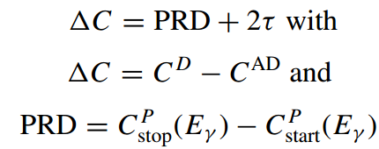
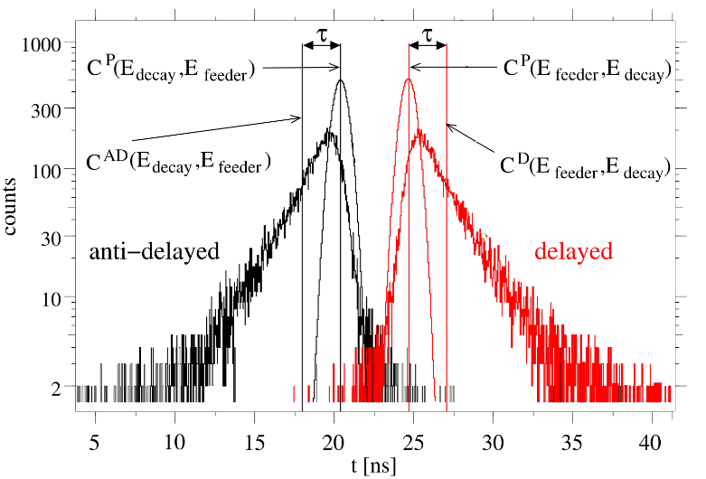
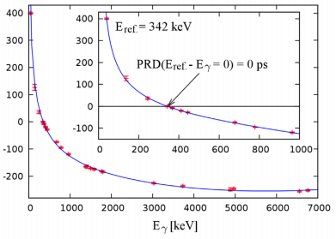
Analysis method and Compton corrections
The Generalized Centroid Difference Method (GCD)
J-M. Régis et al., NIM A726 (2013)
J-M. Régis et al., 6th Workshop on Nuclear Fission on Neutron rich Nuclei. Chamrousse, France
Notes:
PRD: assymetry remaining…

Slide 26

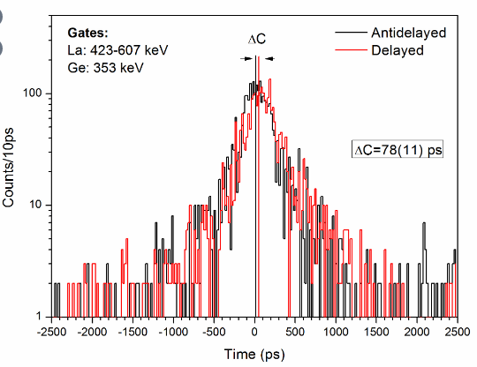




Compton corrections at first order
Analysis method and Compton corrections
We measure
We want
We have to correct
Two γ-rays, feeder and decay
Correction γ _{feeder}
Correction γ _{decay}
CRD _{feeder}
CRD _{decay}
Total correction mean average
V. Vedia, PhD Thesis UCM (2018)

Slide 27
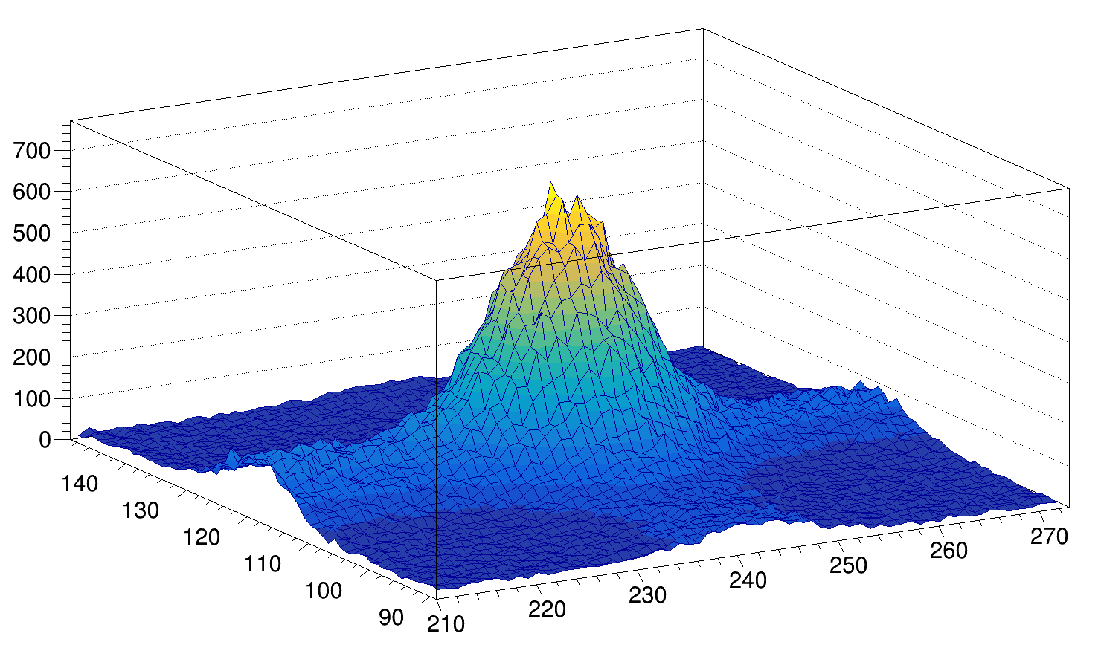
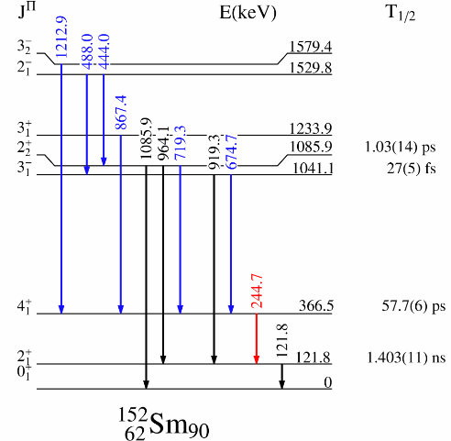
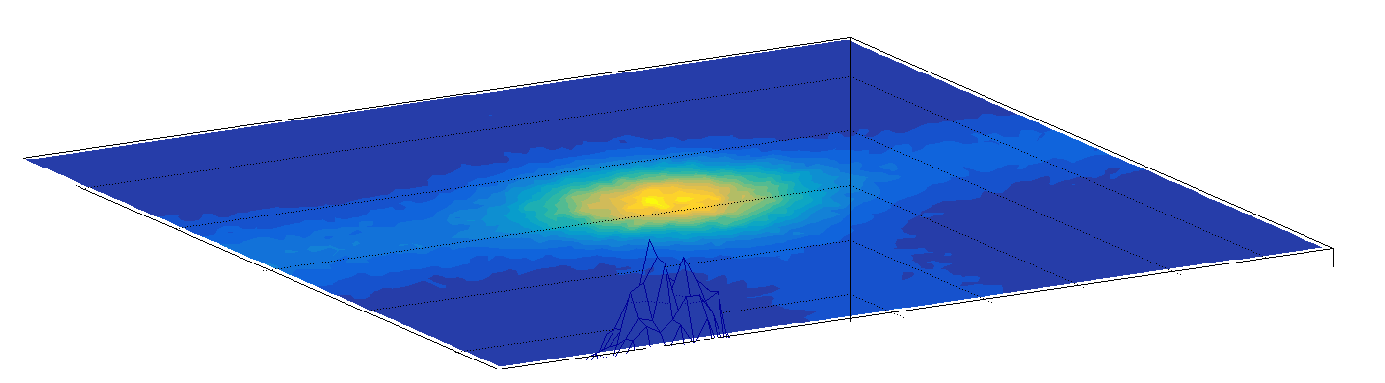

Analysis method and Compton corrections
Compton corrections to second order
Compton-FEP
FEP-FEP
Compton-Compton
FEP-Compton
E_{Stop}
E_{Start}
V. Vedia, PhD Thesis UCM (2018)

Slide 28
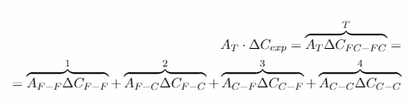

Compton corrections at second order
Analysis method and Compton corrections
As a function of experimental quantities
V. Vedia, PhD Thesis UCM (2018)
Notes:
More detail explanation in the manuscript

Slide 29
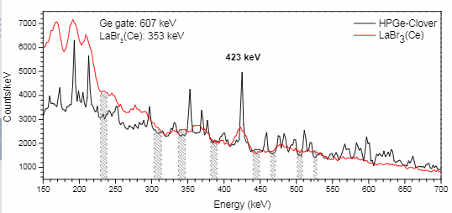
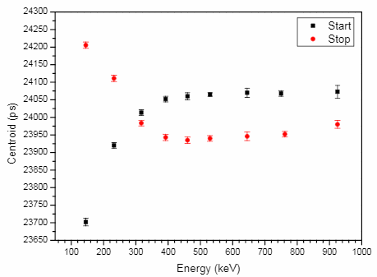
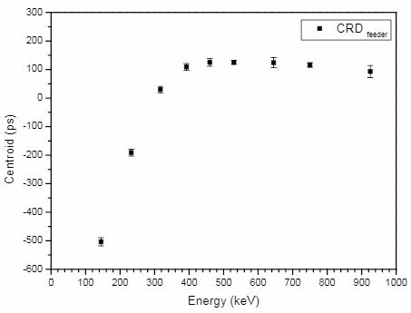
Compton Response Distribution
Analysis method and Compton corrections
V. Vedia, PhD Thesis UCM (2018)

Slide 30
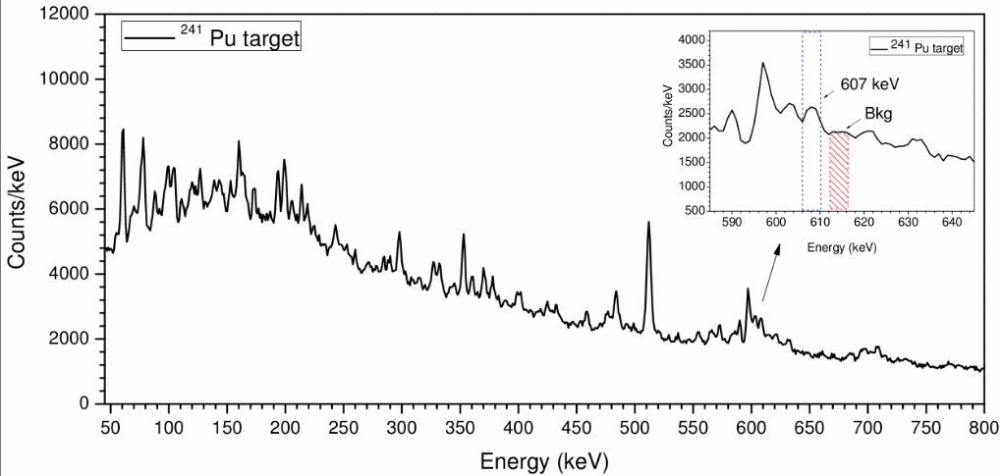
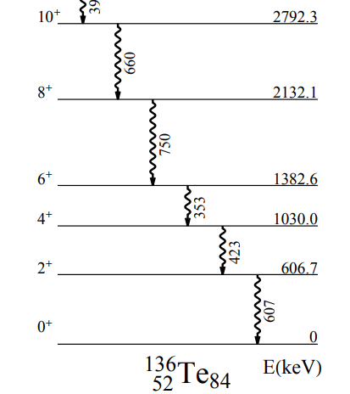
Best background reduction approach
Analysis method and Compton corrections
Very significant problem in fission experiments
Background under FEPs
Bckg subtraction under Ge-gated FEPs
The best performing approach
V. Vedia, PhD Thesis UCM (2018)
Notes:
All explained in the manuscript

Slide 31
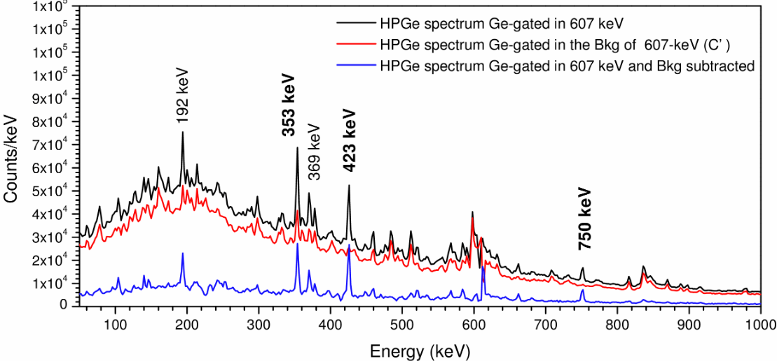
Best background reduction approach
Analysis method and Compton corrections
Effect on the HPGe-Clovers
V. Vedia, PhD Thesis UCM (2018)

Slide 32
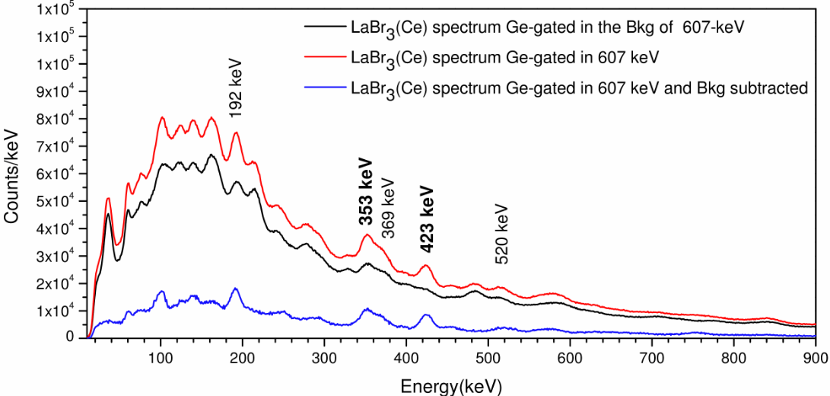
Best background reduction approach
Analysis method and Compton corrections
Effect on the LaBr₃(Ce)
This is the solution implemented in the analysis
V. Vedia, PhD Thesis UCM (2018)

Slide 33
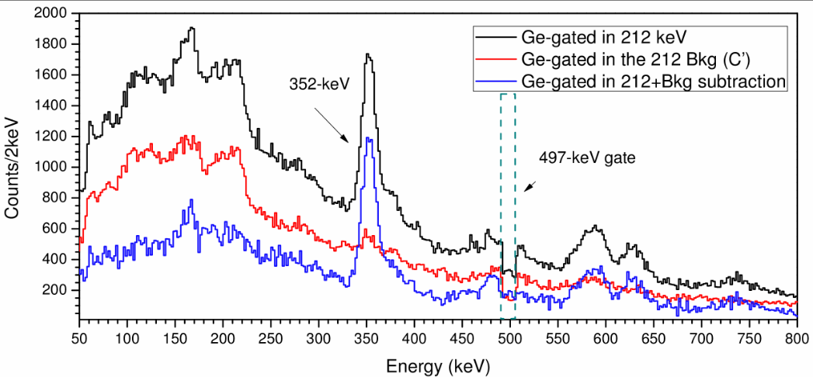
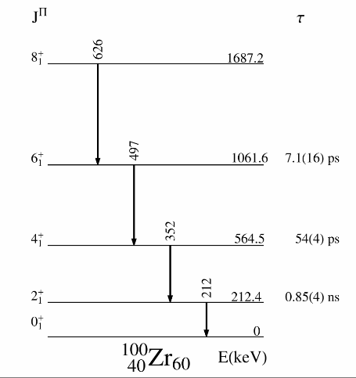
Analysis method and Compton corrections
Validation using ¹⁰⁰Zr
LaBr₃(Ce)-gates
HPGe-gate
The ¹⁰⁰Zr comes as a contaminant with good production yield
Lifetime of the 4⁺ state is a good candidate for testing and validating
      Lifetime in the range of interest
      Previously measured and published
      There is a mismatch between 2 published values
V. Vedia, PhD Thesis UCM (2018)

Slide 34
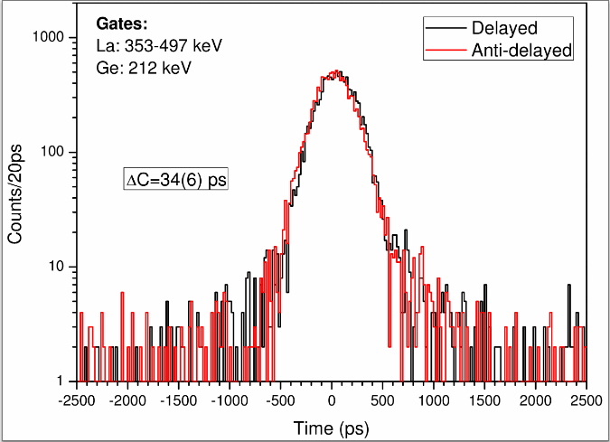
Analysis method and Compton corrections
Validation using ¹⁰⁰Zr
The procedure is validated
Our value is in agreement with S. Ansari et al. [ARJ+17] and at variance with A. G. Smith and coworkers [SWP+02]
The bakground subtraction procedure allowed to measured τ ₄₊ using the ²⁴¹Pu target
Present work (²⁴¹Pu target) |  | EXILL-FATIMA (²³⁵U target) [ARJ17+] | Plunger+²⁵²Cf [SWP02]
τ ₄₊ First order | τ ₄₊ Second order | ₄₊ First order | -
37(7) ps | 31(8) ps | 37(7) ps | 54(4) ps
[ARJ+17] S. Ansari et al., Experimental study of the lifetime and phase transition in neutron rich ^{98,100,102}Zr. Phys. Rev. C, 96:054323, 2017.
[SWP+02] A. G. Smith et al., Lifetimes of yrast rotational states of the fission fragments ¹⁰⁰Zr and ¹⁰⁴Mo measured using a diferential plunger. Journal of Physics G: Nuclear and Particle Physics, 28(8):2307, 2002.

Slide 35
Analysis method and Compton corrections
New Compton correction procedure
  Fully accounts for the Compton contribution
  Validated with ¹⁰⁰Zr
  Applied for the first time in fast-timing methods γγγ(t) in fission-fragments.
Background subtraction procedure. (Ge-Bkg)
  Allows to measure lifetimes with higher accuracy
  Significantly improves the peak-to-background ratio
  Applied for the first time in fission-fragments spectroscopy with large LaBr₃(Ce) arrays

Slide 36
Outline
Introduction and motivation
1: Fast-timing setup and optimization
2: Analysis method and corrections
3: Lifetime measurements in ¹³⁶Te
Conclusions

Slide 37
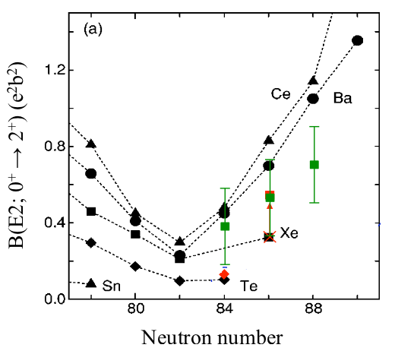
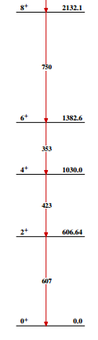
Lifetime measurements in the ¹³⁶Te nucleus
Previous Results for τ₂₊ of ¹³⁶Te
Lifetimes of higher
excited states will
provide clarification
B(E2; 2⁺→0⁺) ¹³²Sn region
CoulEx studies at Oak Ridge. J.M Allmond et al., PRL 118 (2017)
Fast-Timing at ISOLDE
L. M. Fraile et al., Nucl. Phys. A805, 218 (2008)
CoulEx studies from
REX-ISOLDE on ^{138,140,142}Xe
T. Kröll et al.,
Eur. Phys. J 150 (2007)
Exp Technique
CoulEX
β-Decay+ATD
CoulEX
B(E2; 2⁺→0⁺)
208(29) e²fm⁴
245(50) e²fm⁴
362(31) e²fm⁴
Reference
D. Radford et al., PRL 88, 222501 (2002)
L. M. Fraile et al., Nucl. Phys. A805, 218 (2008)
J.M. Allmond et al., PRL 118, 092503 (2017)

Slide 38
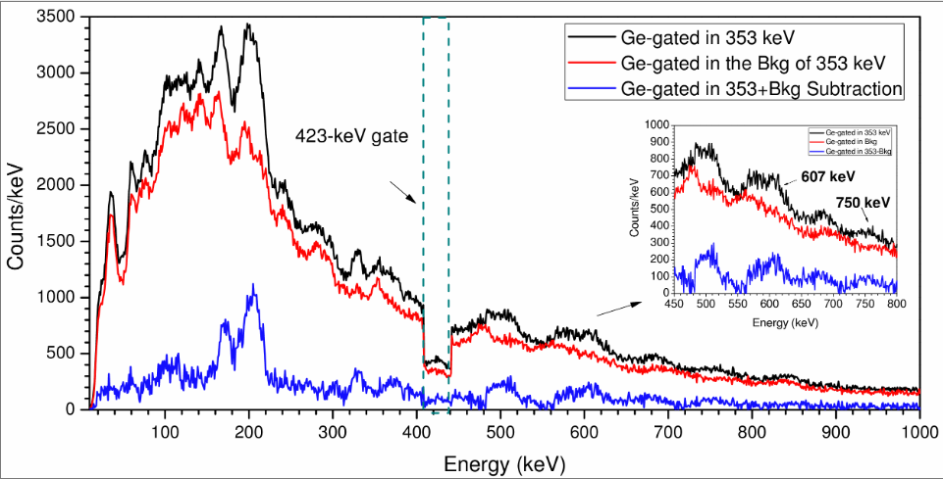
Lifetime measurements in the ¹³⁶Te nucleus
Lifetime value of the 2⁺ state
HPGe-gate
LaBr₃(Ce)-gates

Slide 39
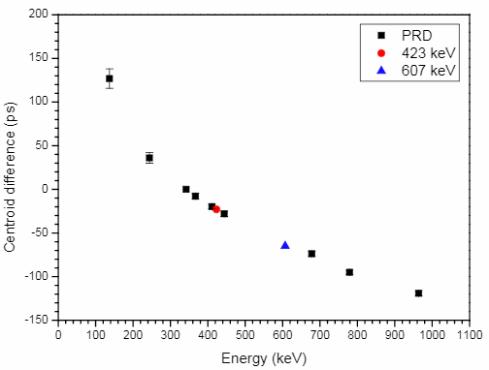
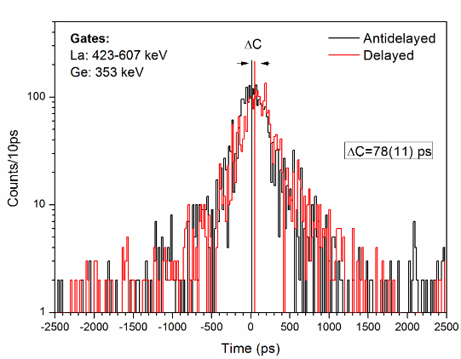

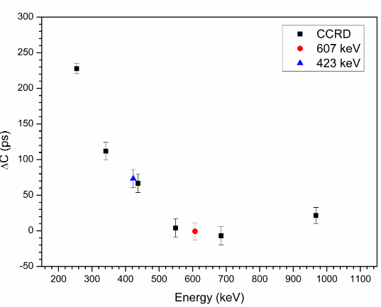

Lifetime measurements in the ¹³⁶Te nucleus
Lifetime value of the 2⁺ state
Prompt Response Distribution
Compton-Compton Resp. Distribution

Slide 40
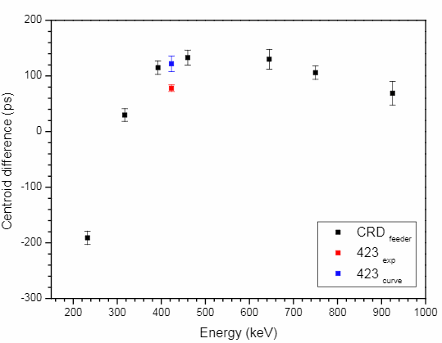
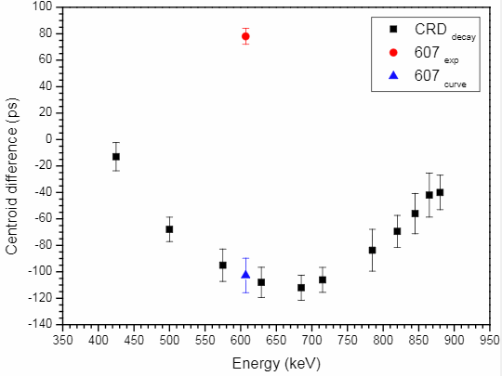
Lifetime measurements in the ¹³⁶Te nucleus
Lifetime value of the 2⁺ state
Compton Response Distribution feeder
Compton Response Distribution decay

Slide 41
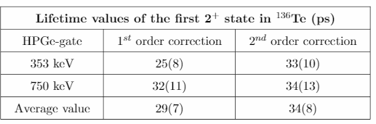
Lifetime measurements in the ¹³⁶Te nucleus
Lifetime value of the 2⁺ state
HPGe-gate
LaBr₃(Ce)-gates

Slide 42
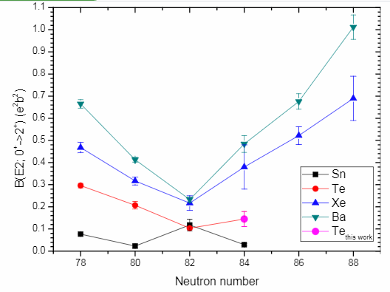
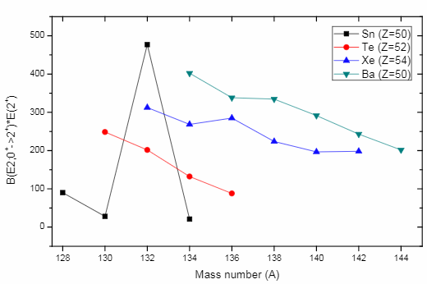
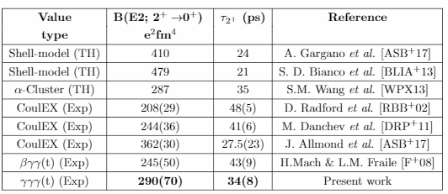
Lifetime measurements in the ¹³⁶Te nucleus
Lifetime value of the 2⁺ state

Slide 43
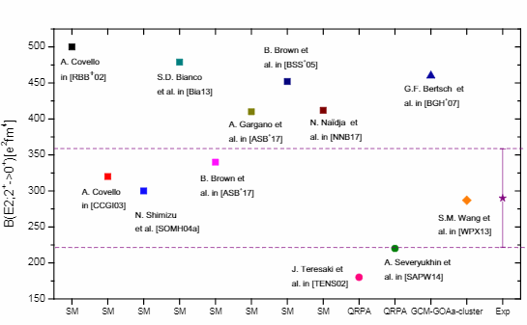
Lifetime measurements in the ¹³⁶Te nucleus
Theoretical calculations B(E2; 2⁺→0⁺)

Slide 44
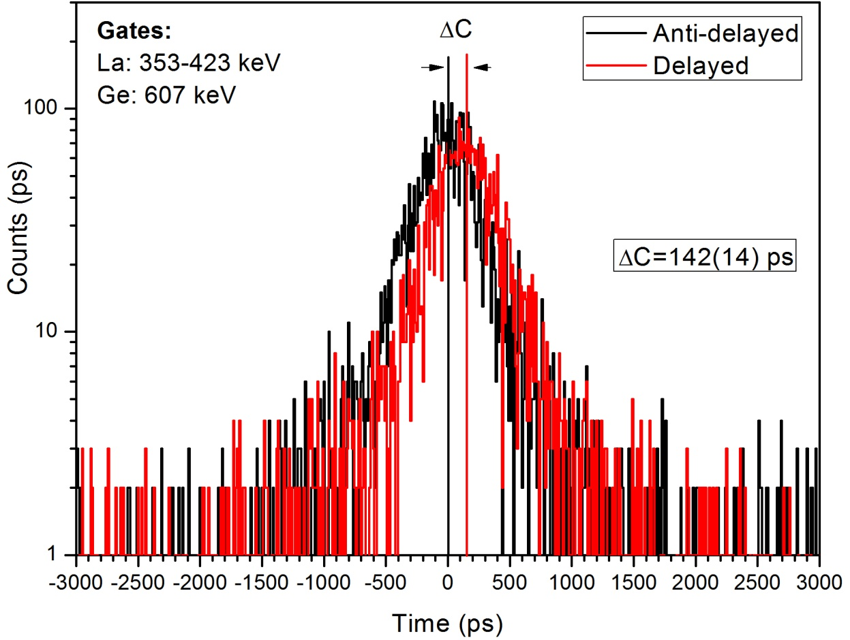
Lifetime value of the 4⁺ state
Preliminary (fist order correction)
τ=95(11) ps
100(15) ps from B(E2), J.M. Allmond et al., PRL 118, 092503 (2017)

Slide 45
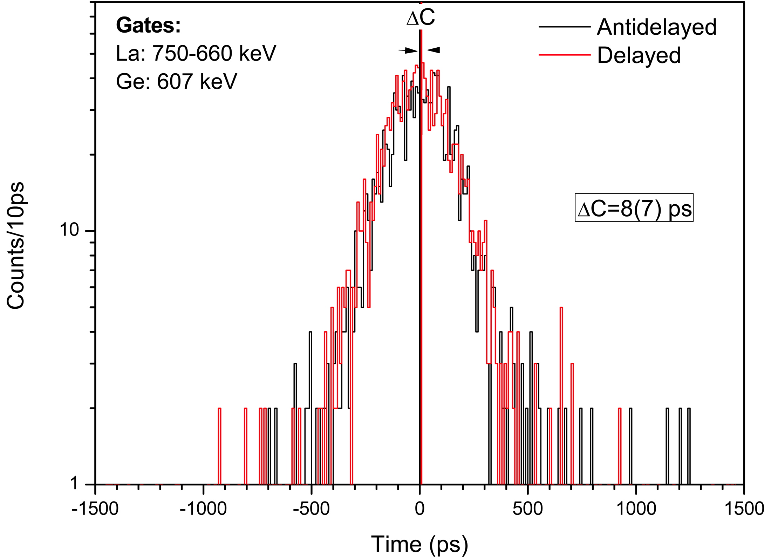

Lifetime measurements in the ¹³⁶Te nucleus
Preliminary (fist order correction)
Τ₆₊>260(22) ps
Τ₈₊<15(11) ps

Slide 46
Lifetime measurements in the ¹³⁶Te nucleus
Complete set of B(E2) values for the g.s rotational band
  The measured lifetime for the 4⁺ state is in agreement with previous measurements J.M. Allmond et al., PRL 118, 092503 (2017)
  First time measured lifetimes of the 6⁺ and 8⁺ states, τ₆₊, τ₈₊
Lifetime of the 2⁺ state
  New experimental direct measurement
  The measured B(E2: 2⁺->0⁺) fits better the systematic of the region, but still indicates certain abnormality.
  Indicates a higher proton contribution the wave function
Theoretical calculations do not simultaneously reproduce
  The depleted B(E2: 2⁺->0⁺) value for the 2⁺ state
  The rest of B(E2) values for the band (4⁺, 6⁺ and 8⁺). A. Gargano et al. private communication

Slide 47
Summary and conclusions
Characterization of LaBr₃(Ce) scintillator detectors
  Best time resolution to date of fast-timing setups
  Excellent performance of the truncated cone geometry
  The hybrid-tapered geometry presents problems
Experimental analysis of EXILL-FATIMA fast-timing data
  Strategy for background subtraction for timing analysis
  Compton corrections implemented
Complete set of B(E2) values for the g.s rotational band in ¹³⁶Te
  New experimental direct measurement. The measured B(E2: 2⁺->0⁺) fits better the systematic of the region, but still indicates certain abnormality.
Notes:
The detailed conclusions for each section have been discussed.

Slide 48
Thank you!
Victoria Vedia
mv.vedia@ucm.es

Slide 49








Acknowledgments
This work has been supported by:
FPA2010-17142, FPA2013-41267 and FPA2015-65035-P projects
BES-2014-068222 FPI
RTC-2015-3772
Consolider-CPAN CSD-2007-00042
EXILL-FATIMA collaborations
ERA-NET NuPNET via PRI-PIMNUP-2011-1338 grant
Fast-timing electronic pool
GFN (Grupo de Física Nuclear)

Slide 50
General Introduction
Lifetimes (τ)
From tens of nanoseconds down to few picoseconds
− βγγ(t)
HPGe-Plastic-LaBr₃(Ce)(t)
Fast-Timing Methods
− γγγ(t)
HPGe-LaBr₃(Ce)-LaBr₃(Ce)(t)
Their sensitivity is directly influenced by the setup resolution
Time resolution
optimization
5
4
start
γ₁
7
8
9.
6
start
τ
6
10
5
11
γ₂
12
1
stop
stop
3
7
4
13
3
14
15
TAC
2
16
γ₃
1
8
HPGe
2
1
Highly performance LaBr₃(Ce) arrays
FATIMA->@ FAIR

Slide 51



Introduction
Fast-Timing Methods
start γ₁
stop γ₂
γ₁
start
γ₂
stop
Problem!
1
Compton under FEPs
Contributes to the
time spectrum
Need of Corrections
Total time spectrum= FEP+Compton

Slide 52

The cold-neutron PF1B guide
Fast-timing setup and its optimization
EXILL
EXILL FATIMA
52
Notes:
Wavelength of 4 to 4.5 Angstrom.

Slide 53



EXILL and EXILL&FATIMA
Fast-timing setup and its optimization
Collimated (12-mm diameter) cold­neutron beam with flux of about 10⁸ n/(s cm²)
EXOGAM Clovers @ ILL (EXILL)
Institut Laue­Langevin Grenoble, France

Slide 54





Introduction
LaBr₃(Ce)
Excellent time response Rise time ~5 ns
Good energy resolution 3.0% @ 662 keV
High detection efficiency ρ = 5.08 g/cm³
High photon yield 63 000 γ per MeV
LaBr₃(Ce) are the current standard in the application of the fast-timing methods.
LaBr₃(Ce) are the option of choice for large high-performance arrays for fast-timing.
Notes:
LaBr3(Ce)-based detectors are the prefered detectors for a wide range of applications. They unite fast response and good energy resolution. They deliver fast pulses with raise time of the order of 5 ns and heir energy resolution is measured to be as good as 3.0% @ 662keV.
2005
Z_eff

Slide 55




Fast-timing setup and its optimization
Fast-timing setup
Test
Test bench
BaF₂+XP2D0
LaBr₃(Ce)+R9779
ORTEC 935 CFD, ORTEC TAC 567
List Mode
Anode pulse
Dynode pulse
Time measurements
Energy measurements
Notes:
ORTEC 935 CFD, ORTEC TAC 567 best analog NIM modules for timing

Slide 56



Optimizing procedure
Block I: LaBr₃(Ce) detectors and Setup optimization
ORTEC 935
CFD External delay
CFD Zero crossing (Z)
PMT bias Voltage
Leading Edge
Constant Fraction

Slide 57

Block I: LaBr₃(Ce) detectors and Setup optimization
Energy resolution
Relative Energy Resolution (%)
Crystal | R6231 | R9779
Tapered | 3.8 | 4.3
Truncated cone | 3.3 | 4.0
Cylindrical | 2.8 | 3.4

Slide 58

Block I: LaBr₃(Ce) detectors and Setup optimization
Absolute γ-ray detection efficiency
¹⁵²Eu at 100 mm from the detector endcap.
Lines represent the Geant4 simulations

Slide 59

PMT-Energy Linearity
Hamatsu R9779
Linear for the entire range
Very linear at 1300 V

Slide 60



Block I: LaBr₃(Ce) detectors and Setup optimization
Time response
Tapered
Truncated cone
Cylindrical
Crystal | FWHM (ps) at ⁶⁰Co | FWHM (ps) at 511 keV
Tapered | 115±3 | 160±2
Truncated cone | 114±3 | 162±2
Cylindrical | 98±3 | 148±2

Slide 61





Block I: LaBr₃(Ce) detectors and Setup optimization
Time response

Slide 62




Block I: LaBr₃(Ce) detectors and Setup optimization
Time response
Time spectra for the conical LaBr₃(Ce) against a reference BaF₂ detector at ⁶⁰Co energies (top) and 511 keV (²²Na) (bottom) [4]. The CRT (Coincidences Resolving Time) of 139 ps is the convolution of the BaF₂ contribution with FWHM= 85(3) ps, yielding 110(3) ps. At 511 keV, the CRT of 197 ps contains the contribution of 120(3) ps of the BaF_{2,} yielding 158(3) ps.
Time Spectra of Conical
Compton time walk of conical and tapered crystals coupled to the Hamamatsu R9779. The energy dependence of the time response of the 1-inch cylinder is also included for comparisons. The relative peak position refers to the shift of the time peak with respect to the position of the 1173-keV full energy peak (zero in the axis).
Compton time walk of the conical LaBr₃(Ce) as a function of the Z parameter, zero crossing of the Constant Fraction Discriminator (CFD). The relative peak position refers to the shift of the time peak with respect to the position of the 1173-keV full energy peak (zero in the axis).

Slide 63


Best time resolution to date of fast-timing setups (below the 100 ps at ⁶⁰Co energies )
FWHM of a 1 in. cylindrical LaBr₃(Ce) (ps)
This work | Typical values
98(3) | ~140
New geometry of LaBr₃(Ce)-truncated Cone is perfectly suited for large arrays
Excellent time resolution of 110(3) ps
Maintains good energy resolution 4.0% (@ 662keV)
High detection efficiency
Versatile geometry for different configurations
FWHM of conical LaBr₃(Ce) at ⁶⁰Co energies (ps)
This work | Crystals of similar size
110(3) | ~240

Slide 64
LaBr₃(Ce) detectors and Setup optimization
Summary
Time resolution vs. Ce concentration: We have investigated the time resolution dependence on the Ce concentration for three cylindrical LaBr₃(Ce) crystals of 1 in. x 1 in. doped with 5%, 8% and 10% of Ce. We believe that it improves with the Ce doping, in spite of the best time resolution is found for the crystal of 8% of Ce, this problem may be attributed to inhomogeneity in the Ce distribution inside of the 10% doped crystal.
The hybrid-tapered LaBr₃(Ce) is not well suited despite its good time resolution: The hybrid-tapered detector is not suited for fast-timing applications despite its good time response since it shows a strong deterioration of the time walk and time resolution with variations in the CFD external delay and present double-peaks in the energy spectra.
Truncated cone LaBr₃(Ce) is an excellent candidate: The truncated cone detector is well suited for the construction of large LaBr₃(Ce) arrays since it has excellent time response good energy resolution and maintains good energy resolution. Its design makes it possible to densely pack them in rings or other arrangement with high efficiency covering large solid angle.
The work is summarized in two publications: The optimization and characterization of different work LaBr₃(Ce) has been published in [VMF+15] and [VCMF+17].
Best value of time resolution to date for the three geometries: best value of time resolution achieved to date for the three detectors: 98(3), 110(3) and 111(3) ps at ⁶⁰Co energies and 144(3),158(3) and 160(3) ps at 511 keV (²²Na) for the cylinder, for the conical and tapered crystals respectively.
[VMF+15] V. Vedia et al.. Enhanced time response of 1-inch LaBr₃(Ce) crystals by leading edge and constant fraction techniques. NIM A: 795:144- 150, 2015.
[VCMF+17] V. Vedia et al.. Performance evaluation of novel LaBr₃(Ce) scintillator geometries for fast-timing applications. NIM A 28(8):2307, 2002.

Slide 65



Block II: Analysis method and Compton corrections
Prompt Response Distribution (PRD)

Slide 66

Block II: Analysis method and Compton corrections
Prompt Response Distribution (PRD)

Slide 67


Experience from earlier campaigns
Block II: Analysis method and Compton corrections
Thermal neutron induced fission of ²³⁵U
>200 nuclei produced
  Around the doubly-magic ⁷⁸Ni and ¹³²Sn
  In the A~100 transitional region
High-medium average spin
High γ­ray multiplicity
Highly segmented array
  Triple γ ­γ ­γ coincidences to select fission product
  Enables Ge­gated γ ­γ fast timing with LaBr₃(Ce) array
Prompt γ­spectrum from neutron­induced fission of ²³⁵U
67
Notes:
Physics cases:
Region close to doubly magic 132Sn and 78Ni → Investigation of nucleon­nucleon interactions, appearance of collectivity
The A~100 mass region → Evolution of collective excitations, Shape transition or coexistence

Slide 68





Introduction
Fast-Timing Methods
De-convolution slope
Time Spectrum
Centroid shift
1
Time Spectrum
Lifetime of the level + system response
τ

Slide 69
Introduction
Fast-Timing Methods
Optimization of the time resolution of the Setup
1
The better time resolution
The better sensitivity

Slide 70
Introduction
Fast-Timing Methods-Large Arrays in Fission
Compton under FEPs
Very significant problem
LaB₃
HPGe
Notes:
Enhanced problem for LaBr3(Ce)

Slide 71


Block II: Analysis method and Compton corrections
The Generalized Centroid Difference Method (GCD)
Superposition of fast­timing data independent of the detector­detector combination ij.
Aligned data using constant “shift_{ij}” in order to improve the statistical timing uncertainty (FWHM)
Raw data of a γ−γ cascade:
The centroid difference is independent of possible timing asymmetries.
The centroid difference is independent of the shift_{ij}.
Notes:
Two distributions: delyaed and antidelayed
Time shifts are constant (corrected by drifts)

Slide 72

Analysis method and Compton corrections
Fast-Timing Methods: GCD
5
γ₁
4
6
start
T_{1/2}
7
8
start
6
γ₂
5
1
stop
3
7
stop
4
3
TAC
2
1
8
2
1
P(t): Prompt Response
System resolution (PRD)
Sub-nanosecond range
Picoseconds sensitive
D(t): Time Distribution
TAC spectrum
Assuming no background
J-M. Régis et al., NIM A726 (2013)

Slide 73
Compton corrections to first order
Block II: Analysis method and Compton corrections
Time calibration
  Prompt Response Differences, PRD curve, for FEPs only
  Compton calibration ignored in the best case, i.e. calibration sources
  Ad hoc Compton calibration using one background condition
Gates on Ge and LaBr₃
  High peak/background
  Gamma-Compton events from spectra
  Large correction
  Ad-hoc averaging or oversubtraction…
⁹⁰Kr
τ₍₂₊₎ = 15(10) ps
J.-M. Régis, J. Jolie et al.,
Phys. Rev. C90 067301 (2014)

Slide 74
Analysis method and Compton corrections
Triple coincidences: 607-keV in HPGe, 423-keV in LaBr₃(Ce)
Notes:
Peak to background
Still needs correction

Slide 75

Lifetime measurements in the ¹³⁶Te nucleus

Slide 76
Lifetime measurements in¹³⁶Te
Conclusions
Lifetime measurements in ¹³⁶Te: We have studied the exotic ¹³⁶Te nucleus through the lifetime measurements of its excited states in its g.s. rotational band.
Theoretical calculations: We have compared our experimental results with state-of-the-art shell model calculations, which helps the interpretation of the structure of ¹³⁶Te.
Lifetime value of the 2⁺₁ state: We report a lifetime value for the 2⁺₁ state τ₂₊= =34(8) ps and the corresponding value of The B(E2; 0⁺->2⁺)= 290(70) e²fm⁴.
Experimental inconsistency of the 2⁺₁ state: The value of τ₂₊= =34(8) ps points towards short lifetimes values in better agreement with 2⁺₁=27.5(23) ps from J. M. Allmond et al. in [ASB+17] than previous measurements from CoulEX experiments [RBB+02, DRP+11] or preliminary fast-timing studies [F+08].
Better agreement of the B(E2; 0⁺->2⁺) in the systematics: The B(E2; 0⁺->2⁺)= 290(70) e²fm⁴ is at variance with the low value of B(E2; 2⁺ ->0⁺)=208(29) e²fm⁴ reported by Radford and coworkers in [RBB+02], and fits better the systematic of the region. However, the new value still points to certain abnormality as it does not follow the Grodzins product rule.
[ASB+17] J. M. Allmond et al.. Electromagnetic moments of radioactive ¹³⁶Te and the emergence of collectivity 2p⊕2n outside of double-magic ¹³²Sn. Phys. Rev. Lett., 118:092503,2017.
[RBB+02] D. C. Radford et al.. Coulomb excitation of radioactive ^{132;134;136}Te beams and the low B(E2) of ¹³⁶Te. Phys. Rev. Lett., 88:222501, 2002.
[DRP+11] M. Danchev et al.. One-phonon isovector 2⁺₁;_{MS} state in the neutron-rich nucleus ¹³²Te. Phys. Rev. C., 84:061306, 2011.
[F+08] L. M. Fraile et al.. INPC 2007 proceedings. Nucl. Phys. A, 805:218, 2008.
[RBB+02] D. C. Radford et al.. Coulomb excitation of radioactive ^{132;134;136}Te beams and the low B(E2) of ¹³⁶Te. Phys. Rev. Lett., 88:222501.

Slide 77
Lifetime measurements in¹³⁶Te
Conclusions
Theoretical calculations for the 2⁺₁ lifetime (τ₂₊): Among the several different theoretical calculations the experimental value of 2⁺₁=34(8) ps is in best agreement with the Shell-model values from by S. D. Bianco and coworkers in [BLIA+13] and N. Shimizu et al. in [SOMH04] and with the α-cluster model from [WPX13]. The higher B(E2) points towards a higher proton contribution of the first 2⁺ in ¹³⁶Te with respect to previous assessment.
Lifetime value of the 4⁺₁ state: We have measured the lifetime of the 4⁺₁ state, τ₄₊= =85(11) ps and it is found in agreement with the previously reported value τ₄₊=100(15) ps from J. Allmond and coworkers [ASB+17].
Lifetimes of the 6⁺₁ and 8⁺₁ states measured for the first time: The lifetimes of the 6⁺ and 8⁺ states were measured here for the first time yielding values of τ₆₊=238(22) ps and τ₈₊≤14 ps, respectively.
Complete set of B(E2) measurements: We provide a complete set of B(E2) measurements for the yrast g.s band from the 2⁺ to the 8⁺.
Theoretical calculations for the entire band: Most of the theoretical calculations have difficulties in simultaneously explaining the depleted B(E2; 0⁺->2⁺) value and the measured B(E2) rates for the other states.
[ASB+17] J. M. Allmond et al.. Electromagnetic moments of radioactive ¹³⁶Te and the emergence of collectivity 2p⊕2n outside of double-magic¹³²Sn. Phys. Rev. Lett., 118:092503,2017.

Slide 78
Analysis method and Compton correction procedure
Conclusions
The best suited conditions for the analysis: We have carefully explored the different analysis conditions and found the best suited ones for the study of ¹³⁶Te. Although both ²³⁵U and ²⁴¹Pu targets abundantly produce ¹³⁶Te in fission, most of the lifetimes reported in this thesis were measured using the ²⁴¹Pu target because of the long-lived Zr isotopes that come as partners in the fission of ²³⁵U and significantly hamper the analysis. It is found that the use of triple γγγ(t) events once the right background reduction procedures are applied, is normally more favorable than the use of quadruple γγγγ(t) events.
Background reduction: We have explored different strategies of background reduction in the data analysis namelly exclusion of detectors combinations. It was found that subtracting to the fast-timing matrices the events that are in coincidences with the background underneath the Ge-gated peaks is crucial being the best approach. The (P/B)=A_{FEP}/A_{bkg} improves by more than a factor 6 and in some cases up to a factor of 18. This strategy prevents from the contribution of contaminants or fission partners whose Compton edge sits underneath the Ge-gated peaks, and appear in coincidences.

Slide 79
Analysis method and Compton correction procedure
Conclusions
Compton correction procedure at second order: We have defined and implemented a new method of timing corrections that fully takes into account the effect of Compton background continuum under full-energy peaks, and explored its impact in timing measurements within the EXILL-FATIMA campaign. We have found that the previous-existing procedure, coined here as Compton correction at first order does not totally correct the Compton contribution, very frequently it yields shorter lifetimes than applying the full correction.
Test and validation using the ¹⁰⁰Zr contaminant: Taking advantage of the ¹⁰⁰Zr nucleus, which comes as a contaminant, the Compton correction procedure developed in this work was tested and validated by measuring the 4⁺₁ state lifetime. We report a value of τ₄₊=31(8) ps, which is in agreement with the published value τ₄₊= =37(4) ps by S. Ansari et al. in [ARJ+17] and at variance with τ₄₊=54(4) ps published by A. G. Smith and coworkers in [SWP+02].
[ARJ+17] S. Ansari et al.. Experimental study of the lifetime and phase transition in neutron rich ^{98,100,102}Zr. Phys. Rev. C, 96:054323, 2017.
[SWP+02] A. G. Smith et al.. Lifetimes of yrast rotational states of the fission fragments ¹⁰⁰Zr and ¹⁰⁴Mo measured using a diferential plunger. Journal of Physics G: Nuclear and Particle Physics, 28(8):2307, 2002.

Slide 80
Conclusions of this thesis
Block I: LaBr₃(Ce) detectors and Setup optimization
Optimization of a standard fast-timing set up finding the best values of PMT bias voltage, the CFD external delay and the zero-crossing (Z), leading to excellent time resolution values.
We have characterized in depth different geometries of LaBr₃(Ce) crystals. A 1 in. x 1in. cylinder, a truncated cone and a hybrid-tapered.
Special geometries of LaBr₃(Ce) crystals:
Best value of time resolution to date for the three geometries : 98(3), 110(3) and 111(3) ps at ⁶⁰Co energies and 144(3),158(3) and 160(3) ps at 511 keV (²²Na) for the cylinder, for the conical and tapered crystals respectively.
We have studied the time resolution of three cylindrical LaBr₃(Ce) vs. the Ce concentration.
The truncated cone LaBr₃(Ce) is an excellent candidate for fast-timing applications.
The hybrid-tapered LaBr₃(Ce) is not well suited despite its good time resolution.
The characterization and optimization work has been summarized in two publications.
Block II: Analysis method and Compton correction procedure
We have studied and found the best suited conditions for the analysis of ¹³⁶Te.
We have investigated different background reduction strategies founding the best one.
We have developed a Compton correction procedure that fully accounts for the Compton.
We have tested and validatied the developed procedure using the ¹⁰⁰Zr contaminant.

Slide 81
Conclusions of this thesis
Block III: Lifetime measurements in¹³⁶Te
We have studied the¹³⁶Te nucleus through the lifetime measurements of its excited states.
We have compared our experimental results with state-of-the-art shell model calculations, which helps the interpretation of the structure of ¹³⁶Te.
The lifetime of τ₂₊= =34(8) ps points towards shorter values in better agreement with τ₂₊=27.5(23) ps from J. M. Allmond et al. in [ASB+17] than previous measurements from CoulEX experiments [RBB+02, DRP+11] or preliminary fast-timing studies [F+08].
The B(E2; 0⁺->2⁺)= 290(70) e²fm⁴ is at variance with the low value of B(E2; 2⁺ ->0⁺)=208(29) e²fm⁴ reported by Radford et al. in [RBB+02], and fits better the systematic of the region. However, it still points to certain abnormality as it does not follow the Grodzins product rule.
The experimental value of 2⁺₁=34(8) ps is in best agreement with the Shell-model values from by S. D. Bianco and coworkers in [BLIA+13] and N. Shimizu et al. in [SOMH04] and with the α-cluster model from [WPX13]. The higher B(E2) points towards a higher proton contribution of the first 2⁺ in ¹³⁶Te with respect to previous assessment.
We have measured the lifetime of the 4⁺₁ state,τ₄₊= =85(11) ps, founding it in agreement with the previously reported value τ₄₊=100(15) ps from J. Allmond and coworkers [ASB+17].
We have measured for the first time the lifetimes of the 6⁺₁ and 8⁺₁, τ₆₊=238(22) ps and τ₈₊≤14 ps, respectively.
We provide a complete set of B(E2) measurements for the g.s band from the 2⁺₁ to the 8⁺₁.
Most of the theoretical calculations available have difficulties in simultaneously explaining the depleted B(E2; 0⁺->2⁺) value and the measured B(E2) rates for the other states.

Slide 82

The Generalized Centroid
Difference Method (GCD)
J-M. Régis et al., NIM A763 (2014)
J-M. Régis et al., NIM A726 (2013)

Slide 83


Time measurements analysis
SORTM.exe by Henryk
1 Gate selection on
1332 keV FEP
2 Gate selection on
1173 keV FEP
ADC 1
Energy spectrum
Proyected energy spectrum
3 Sorting of the time spectrum
+
ADC 2
ADC 3

Slide 84




FAIR TDR
FATIMA, the NUSTAR FAst TIMing Array

Slide 85
Block I: LaBr₃(Ce) detectors and Setup optimization
Detection efficiency
The energy resolution has been tested with two PMTs models: the R9779, which was optimized for timing applications and the R6231, designed for energy measurements.
Crystal | PMT | ΔE/E (%) @ 662 keV
Tapered | R6231 | 3.8
Truncated cone | R6231 | 3.3
Cylindrical | R6231 | 2.8
Tapered | R9779 | 4.3
Truncated cone | R9779 | 4.0
Cylindrical | R9779 | 3.4

Slide 86
Previous Results
B(E2; 2⁺→0⁺) transition rates in ¹³⁶Te
Theoretical calculations
B(E2; 2⁺→0⁺) | Reference | Method
500 e²fm⁴ | A. Covello in PRL 88, (2002) | SM
180 e²fm⁴ | J. Teresaki et al. | QRPA
300 e²fm⁴ | N. Shimizu et al. | MCSM
290 e²fm⁴ | S. M. Wang et al. | α-Cluster
340 e²fm⁴ | B.A. Brown in PRL 118 (2017) | SM
410 e²fm⁴ | A. Gargano in PRL 118 (2017) | SM

Slide 87


Weisskopf estimates
E_{γ} in MeV, λ in s⁻¹
T_{½} in s for E_{γ} in keV

Slide 88



General Introduction
Atomic Nucleus
Neutrons
Electromagnetic
Strong nuclear
Weak nuclear
Nuclei calculated to be bound
Protons
– Stable Nuclei
– β⁺ / EC
Number of Protons, Z
– β⁻
– α
– Fission
300 stable nuclei
>3000 “artificial”
>4000 bound exotic nuclei yet to be discovered up to drip lines
Number of neutrons, N

