Slide 1
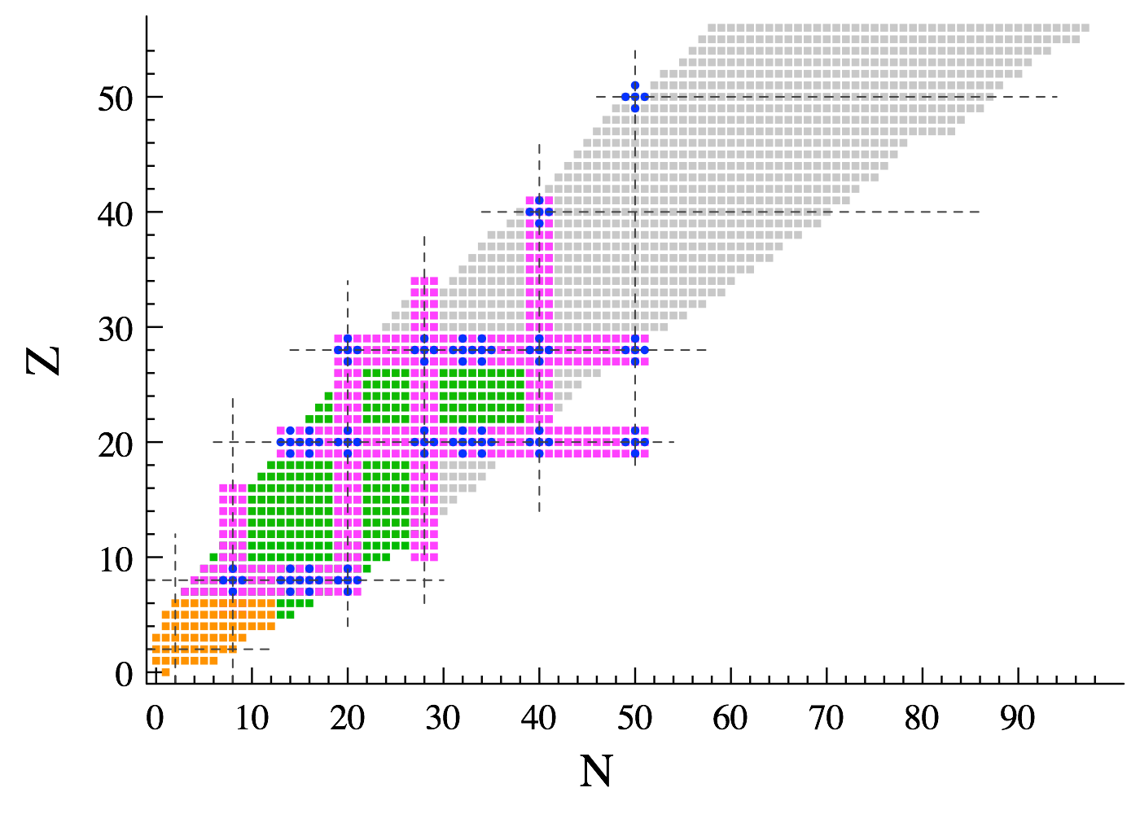



Ab initio calculation of the potential bubble nucleus ³⁴Si
2019
Thomas DUGUET
CEA/SPhN, Saclay, France
IKS, KU Leuven, Belgium
Ab initio methods
T. Duguet, V. Somà, S. Lecluse, C. Barbieri, P. Navrátil, Phys. Rev. C95 (2017) 034319
NUSPIN conference 2019, IPNO, Orsay, June 24-28 2019

Slide 2
Contents
⦿ Introduction
⦿ Theoretical set up
⦿ Results
⦿ Conclusions

Slide 3
Contents
⦿ Introduction
⦿ Theoretical set up
⦿ Results
⦿ Conclusions

Slide 4
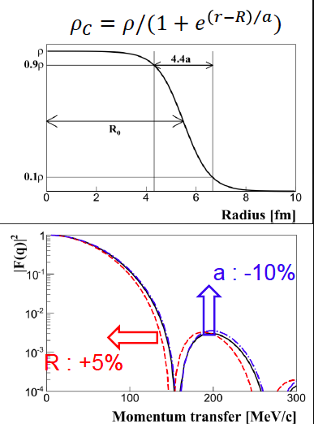
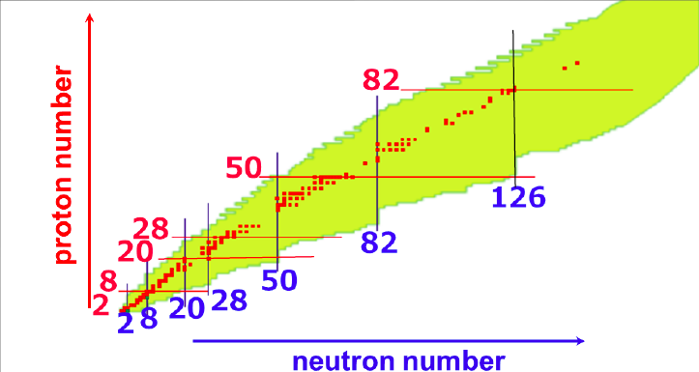
Charge density ρ_{ch}(r)
⦿ Tool to probe several key features of nuclear structure
○ Nuclear saturation, extension, binding and surface tension
○ Oscillations reflect consistent combinations of shell structure and many-body correlations
⦿ Experimental probe via electron scattering
○ Sensitive to charge and spin: EM structure
○ Weak coupling: perturbation theory ok
Ex: elastic scattering between 300 and 700 MeV/c
[Richter & Brown 2003]
with
Mott scattering
Nucleus form factor
PWBA
○ Uniquely stable nuclei
Except few long-lived nuclei (³H,¹⁴C,…)
Few isotopic chains (Kr, Xe,…)
○ Nuclei studied in this way so far
○ Challenge is to study unstable nuclei with enough luminosity (10²⁹ cm⁻²s⁻¹ for 2nd minimum in F(q) for mid A)
SCRIT@RIKEN with 10²⁷ cm⁻²s⁻¹ luminosity
ELISE@FAIR with 10²⁸ cm⁻²s⁻¹ luminosity in next decade? ETIC@X with 10³⁰ cm⁻²s⁻¹ in 20YY?

Slide 5
Motivations to study potential (semi-)bubble nuclei
⦿ Unconventional depletion (“semi-bubble”) in the centre of ρch(r) conjectured for certain nuclei
⦿ Quantum mechanical effect finding intuitive explanation in simple mean-field picture
○ 𝓁 = 0 orbitals display radial distribution peaked at r = 0
○ 𝓁 ≠ 0 orbitals are instead suppressed at small r
○ Vacancy of s states (𝓁 = 0) embedded in larger-𝓁 orbitals might cause central depletion
⦿ Conjectured effect on spin-orbit splitting in simple mean-field picture
From ³⁶S to ³⁴Si
○ Non-zero derivative in the interior
2 proton less « in 1s_{1/2} »
ρch(r)
○ One-body spin-orbit potential of “non-natural” sign
○ Reduction of (energy) splitting of low-𝓁 spin-orbit partners
r
⦿ Marked bubbles predicted for super-/hyper-heavy nuclei
[Dechargé et al. 2003, Bender & Heenen 2013]
[Todd-Rutel et al. 2004, Khan et al. 2008, …]
⦿ In light/medium-mass nuclei most promising candidate is ³⁴Si
0d3/2
Naive proton filling
1s1/2
E₂₊ (³⁴Si)= 3.3MeV
³⁶S
³⁴Si
[Ibbotson et al. 1998]
0d5/2

Slide 6
Contents
⦿ Introduction
⦿ Theoretical set up
⦿ Results
⦿ Conclusions

Slide 7
Ab initio nuclear chart
⦿ Approximate methods for closed-shells
⦿ Approximate methods for open-shells
○ Since 2000’s
○ Since 2010’s
○ MBPT, DSCGF, CC, IMSRG
○ BMBPT, GSCGF, BCC, MR-IMSRG, MCPT
○ Polynomial scaling
○ Polynomial scaling
⦿ Hybrid methods (ab initio shell model)
○ Since 2014
○ Effective interaction via CC/IMSRG
○ Mixed scaling
⦿ “Exact” methods
2019
○ Since 1980’s
○ Monte Carlo, CI, …
○ Exponential scaling

Slide 8
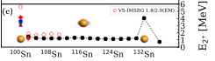
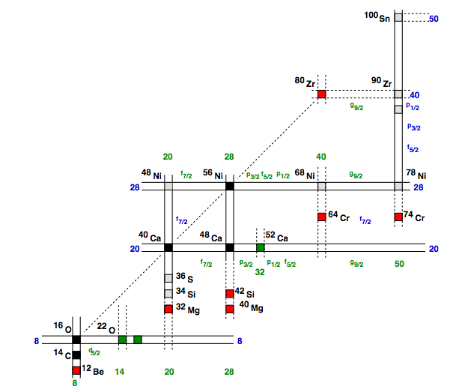
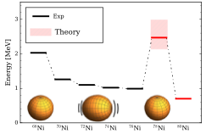
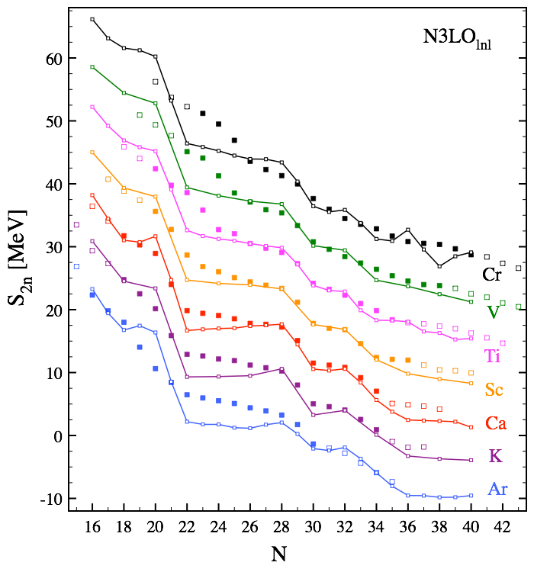
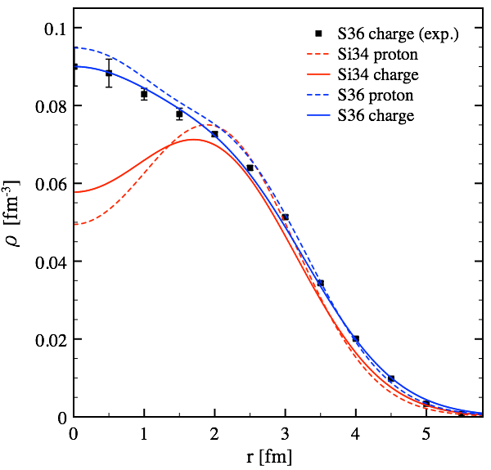
Nuclear structure features addressed ab initio
Collectivity near ¹⁰⁰Sn
Unveils exotic ⁷⁸Ni
Emergence of magic numbers
2019
Spectroscopy in sd shell
Bubble nucleus ³⁴Si

Slide 9
Nuclear structure features addressed ab initio
2019
Bubble nucleus ³⁴Si

Slide 10





Ab initio self-consistent Green’s function approach
[Dickhoff, Barbieri 2004]
⦿ Solve A-body Schrödinger equation by
[Somà, Duguet, Barbieri 2011]
1) Re-express information via 1-, 2-, …. A-body objects G1=G, G2, … GA (Green’s functions)
2) Self-consistent equation for G=G₁: Dyson Equation (DE) G = G⁰ + G⁰Σ[G]G
➟ Self-consistency resums (infinite) subsets of perturbative contributions into G via Σ[G] into DE
…
ADC(1) = HFB
+ these diagrams = ADC(2)
+ these diagrams = ADC(3)
⦿ We employ the Algebraic Diagrammatic Construction (ADC) method
[Schirmer et al. 1983]
○ Systematic, improvable scheme for the one-body Green’s function, truncated at order n = ADC(n)
○ ADC(1) = Hartree-Fock(-Bogoliubov); ADC(∞) = exact solution
○ At present ADC(1), ADC(2) and ADC(3) are implemented and used
⦿ 2N+3N chiral EFT interactions
[Ekström et al. 2015]
➟ N²LO 2N+3N (450 MeV) [NNLOsat]

Slide 11
Contents
⦿ Introduction
⦿ Theoretical set up
⦿ Results
⦿ Conclusions

Slide 12
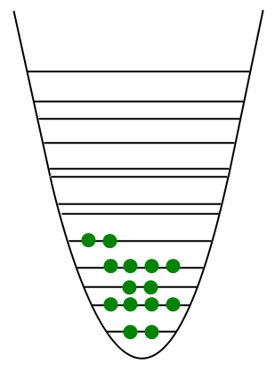
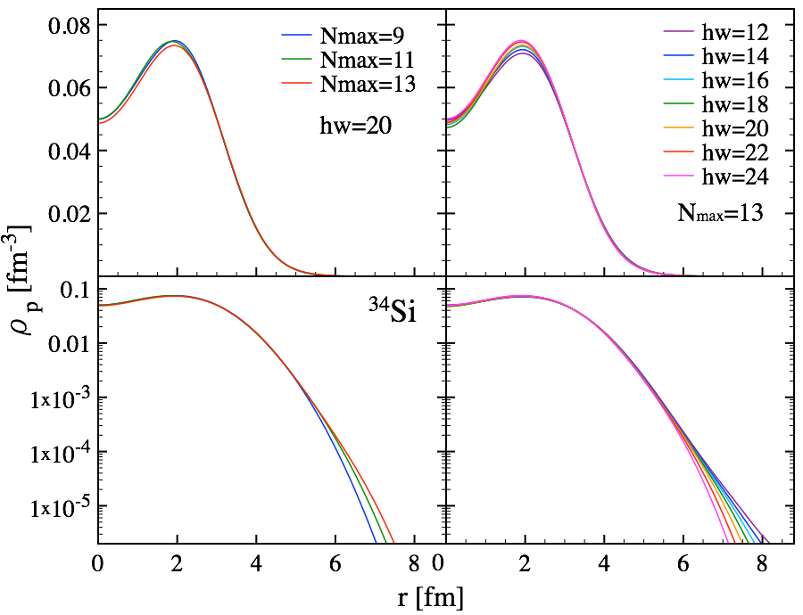
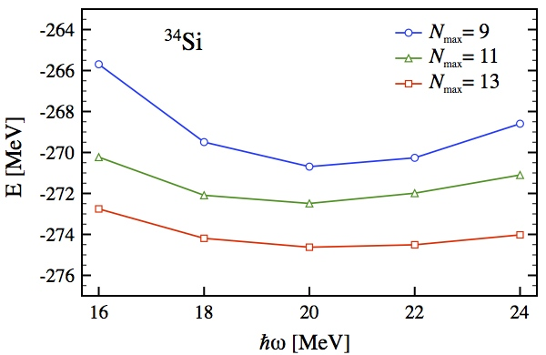
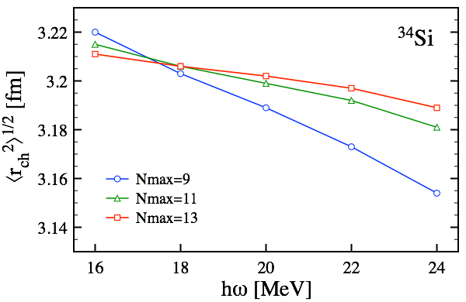
Method & convergence
N_{max}
⦿ Many-body calculation implementation
○ Different sizes (N_{max}, ħω) of harmonic oscillator basis to expand AN interactions
ħω
○ Different many-body truncations [ADC(1) = HF(B), ADC(2), ADC(3)] to solve Schrödinger equation
⦿ Model space convergence
2% variation
⦿ Many-body convergence with NNLO_{sat}
(densities later on)
Binding energies
Charge radii
1%
ADC(3) brings ~5% additional binding
Missing ADC(4) < 1% binding
Radii essentially converged at ADC(2) level
Correlations reduce the charge radii

Slide 13
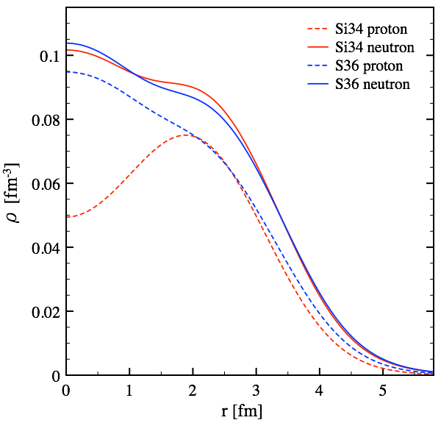
Point-nucleon densities in ³⁴Si and ³⁶S
⦿ Point-nucleon density operator
⦿ Bubble structure can be quantified by the depletion factor
F
Fp (³⁶S) = 0
⦿ Point-proton density of ³⁴Si displays a marked depletion in the center
Fp (³⁴Si) = 0.34
⦿ Point-neutron distributions little affected by removal/addition of two protons
➟ Going from proton density to observable charge density will smear out the depletion

Slide 14
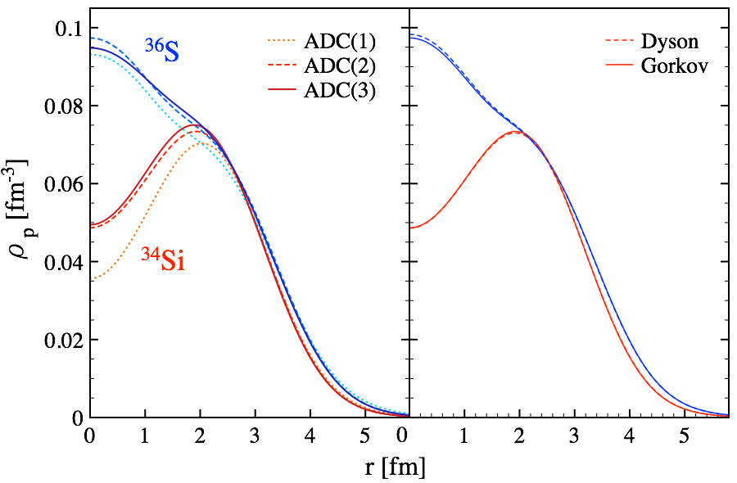
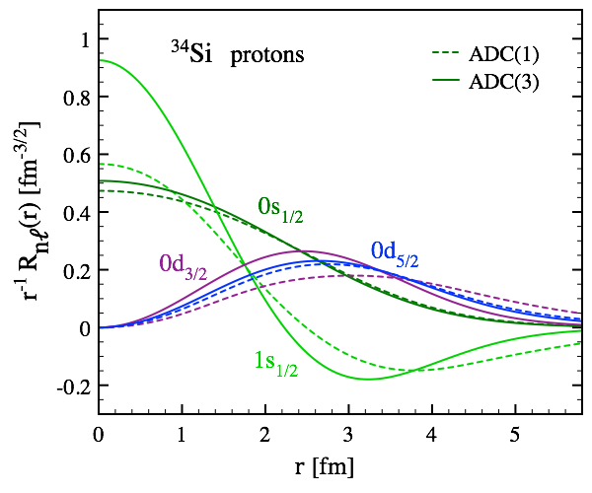
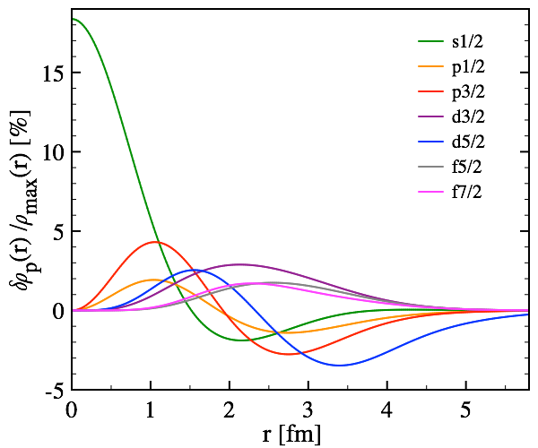
Impact of correlations
⦿ Impact of correlations analysed by comparing different ADC(n) many-body truncation schemes
○ Dynamical correlations cause an erosion of the bubble in ³⁴Si
○ Traces back to two combining effects of correlations
1) Natural 1s_{1/2} orbitals becoming slightly occupied
2) Natural wave functions get contracted ➟ 1s1/2 more peaked at r = 0
○ Including pairing explicitly does not change anything

Slide 15
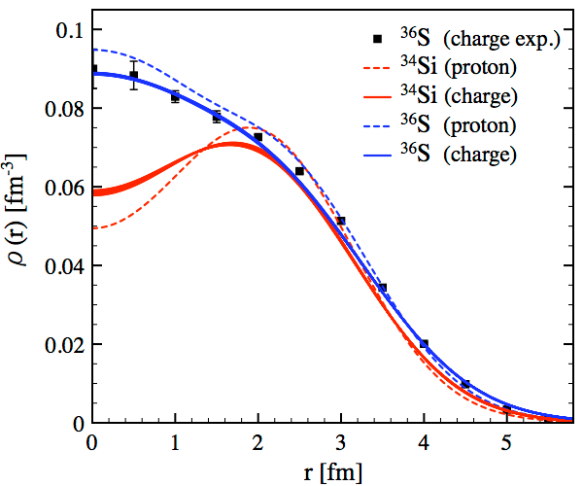
Charge density distribution
⦿ Charge density computed through folding with the finite charge of the proton
no neutron charge distribution
no meson-exchange currents
[Mohr et al. 2012]
[Brown et al. 1979]
Darwin-Foldy correction
Center-of-mass correction
r_{eff} = 0.82 fm
r_{eff} = 0.8 fm
[6] [Grasso et al. 2009]
[7] [Yao et al. 2012]
[8] [Yao et al. 2013]
○ Excellent agreement with experimental charge distribution of ³⁶S
[Rychel et al. 1983]
○ Folding smears out central depletion ➟ depletion factor decreases from 0.34 to 0.15
○ Depletion predicted more pronounced than with MR-EDF (same impact of correlations)

Slide 16
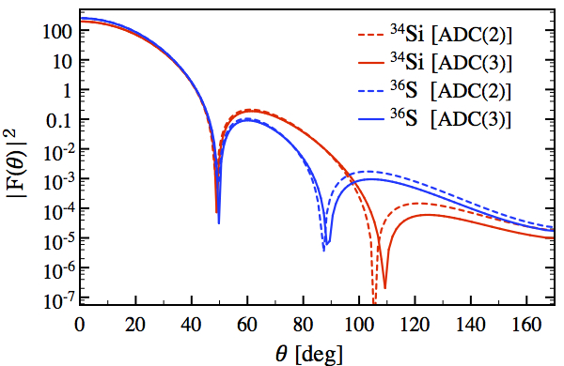
Charge form factor
⦿ Charge form factor measured in (e,e) experiments sensitive to bubble structure?
PWBA
with momentum transfer
E = 300 MeV
○ Central depletion reflects in larger |F(𝜃)|² for angles 60°<𝜃<90° and shifted 2nd minimum by 20°
○ Future electron scattering experiments might see its fingerprints if enough luminosity
○ Need small enough error bars at large angles to perform a safe inversion near the center

Slide 17
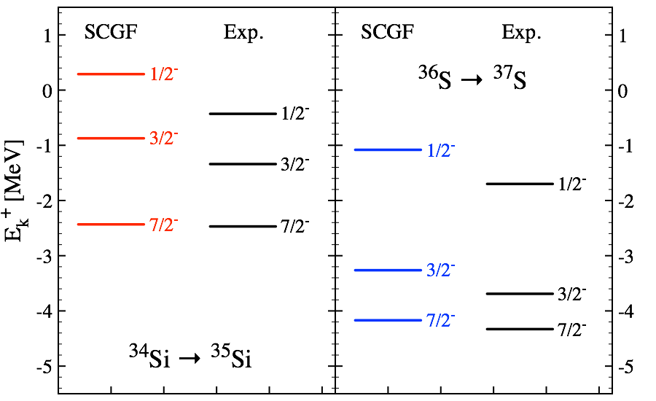
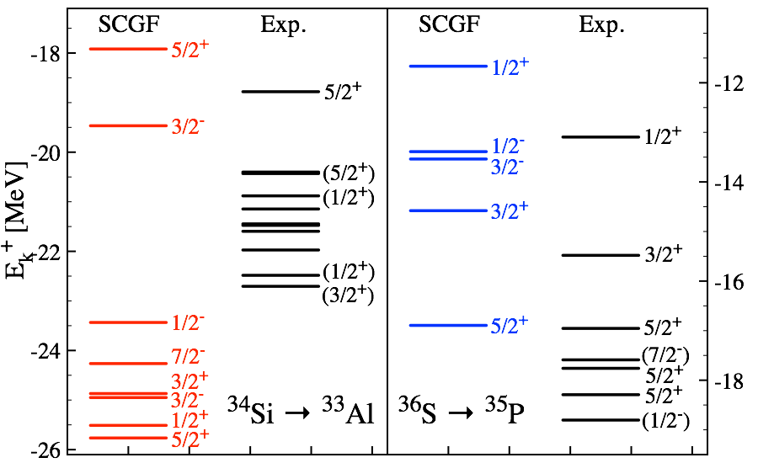
Spectrosocopy in A+/-1 nuclei
⦿ Addition and removal spectra compared to transfer and knock-out reactions
One-neutron addition
Quadrupole moment
[Heylen et al. 2016]
One-proton knock-out
[Thorn et al. 1984]
[Khan et al. 1985]
Exp. data:
[Eckle et al. 1989]
Exp. data:
[Mutschler et al. 2016]
[Burgunder et al. 2014]
[Mutschler et al. 2017]
○ Good agreement for one-neutron addition to ³⁵Si and ³⁷Si (1/2⁻ state in ³⁵Si needs continuum)
○ Much less good for one-proton removal; ³³Al on the edge of island of inversion: challenging!
○ Correct reduction of splitting E1/2⁻ - E3/2⁻ from ³⁷S to ³⁵Si
Such a sudden reduction of 50% is unique
Any correlation with the bubble?!

Slide 18
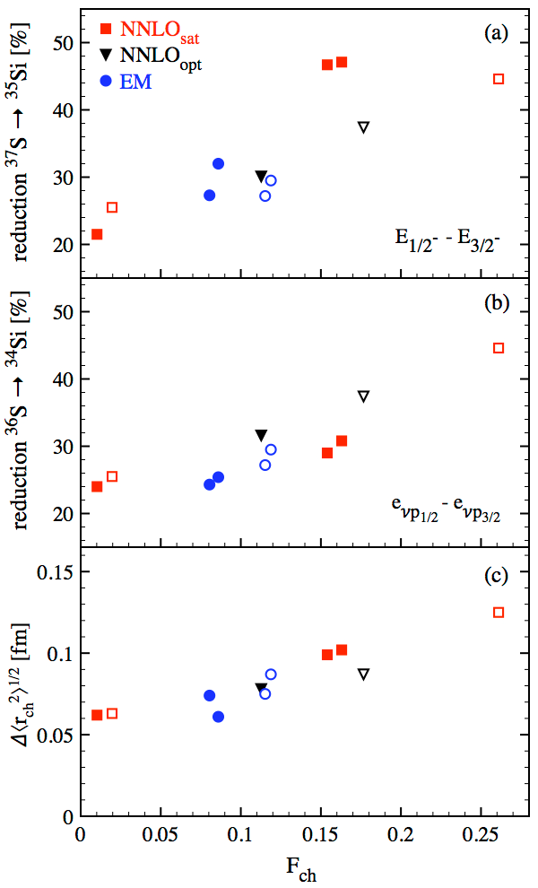
Bubble and spin-orbit splitting
⦿ Correlation between bubble and reduction of spin-orbit splitting?
⦿ Gather set of calculations (various Hamiltonians, various ADC(n) orders)
Many-body separation energies (observable)
○ Calculations support existence of a correlation
Effective single-particle energies (within fixed theoretical scheme)
○ Linear correlation holds for ESPEs in present scheme
○ Accounts for 50% of E_{1/2}⁻ - E_{3/2}⁻ reduction (+fragmentation of 3/2⁻ strength)
Charge radius difference between ³⁶S and ³⁴Si
○ Also correlates with Fch
~0.04fm
Motivation to measure ρ_{ch}(r) in ³⁴Si in (far) future
Valuable to measure Δ<r²>_{ch}^{1/2} in the meantime

Slide 19
Contents
⦿ Introduction
⦿ Theoretical set up
⦿ Results
⦿ Conclusions

Slide 20
Conclusions
► Ab initio Self-consistent Green’s function calculation predicts
■Existence of a significant depletion in ρ_{ch}(r) of ³⁴Si
■Correlation between bubble and weakening of many-body spin-orbit splitting
■Correlation between bubble and Δ<r²>_{ch}^{1/2}
► Next
■Measurement of δ<r²>_{ch}^{1/2} from high-resolution laser spectroscopy@NSCL (R. Garcia-Ruiz)
LOI accepted
■Revise with
▪Future χ-EFT Hamiltonians
▪Meson-exchange currents
■Study other bubble candidates, e.g. in excited states
■Measure ρ_{ch}(r) in ³⁴Si from e⁻ scattering? Maybe heavier bubble candidates first…

Slide 21







Current collaborators on ab initio many-body calculations
J.-P. Ebran
M. Frosini
F. Raimondi
J. Ripoche
V. Somà
A. Tichai
T. M. Henderson
Y. Qiu
G. E. Scuseria
P. Arthuis
C. Barbieri
M. Drissi
P. Navratil
R. Roth
H. Hergert
G. Hagen
T. Papenbrock
P. Demol

Slide 22
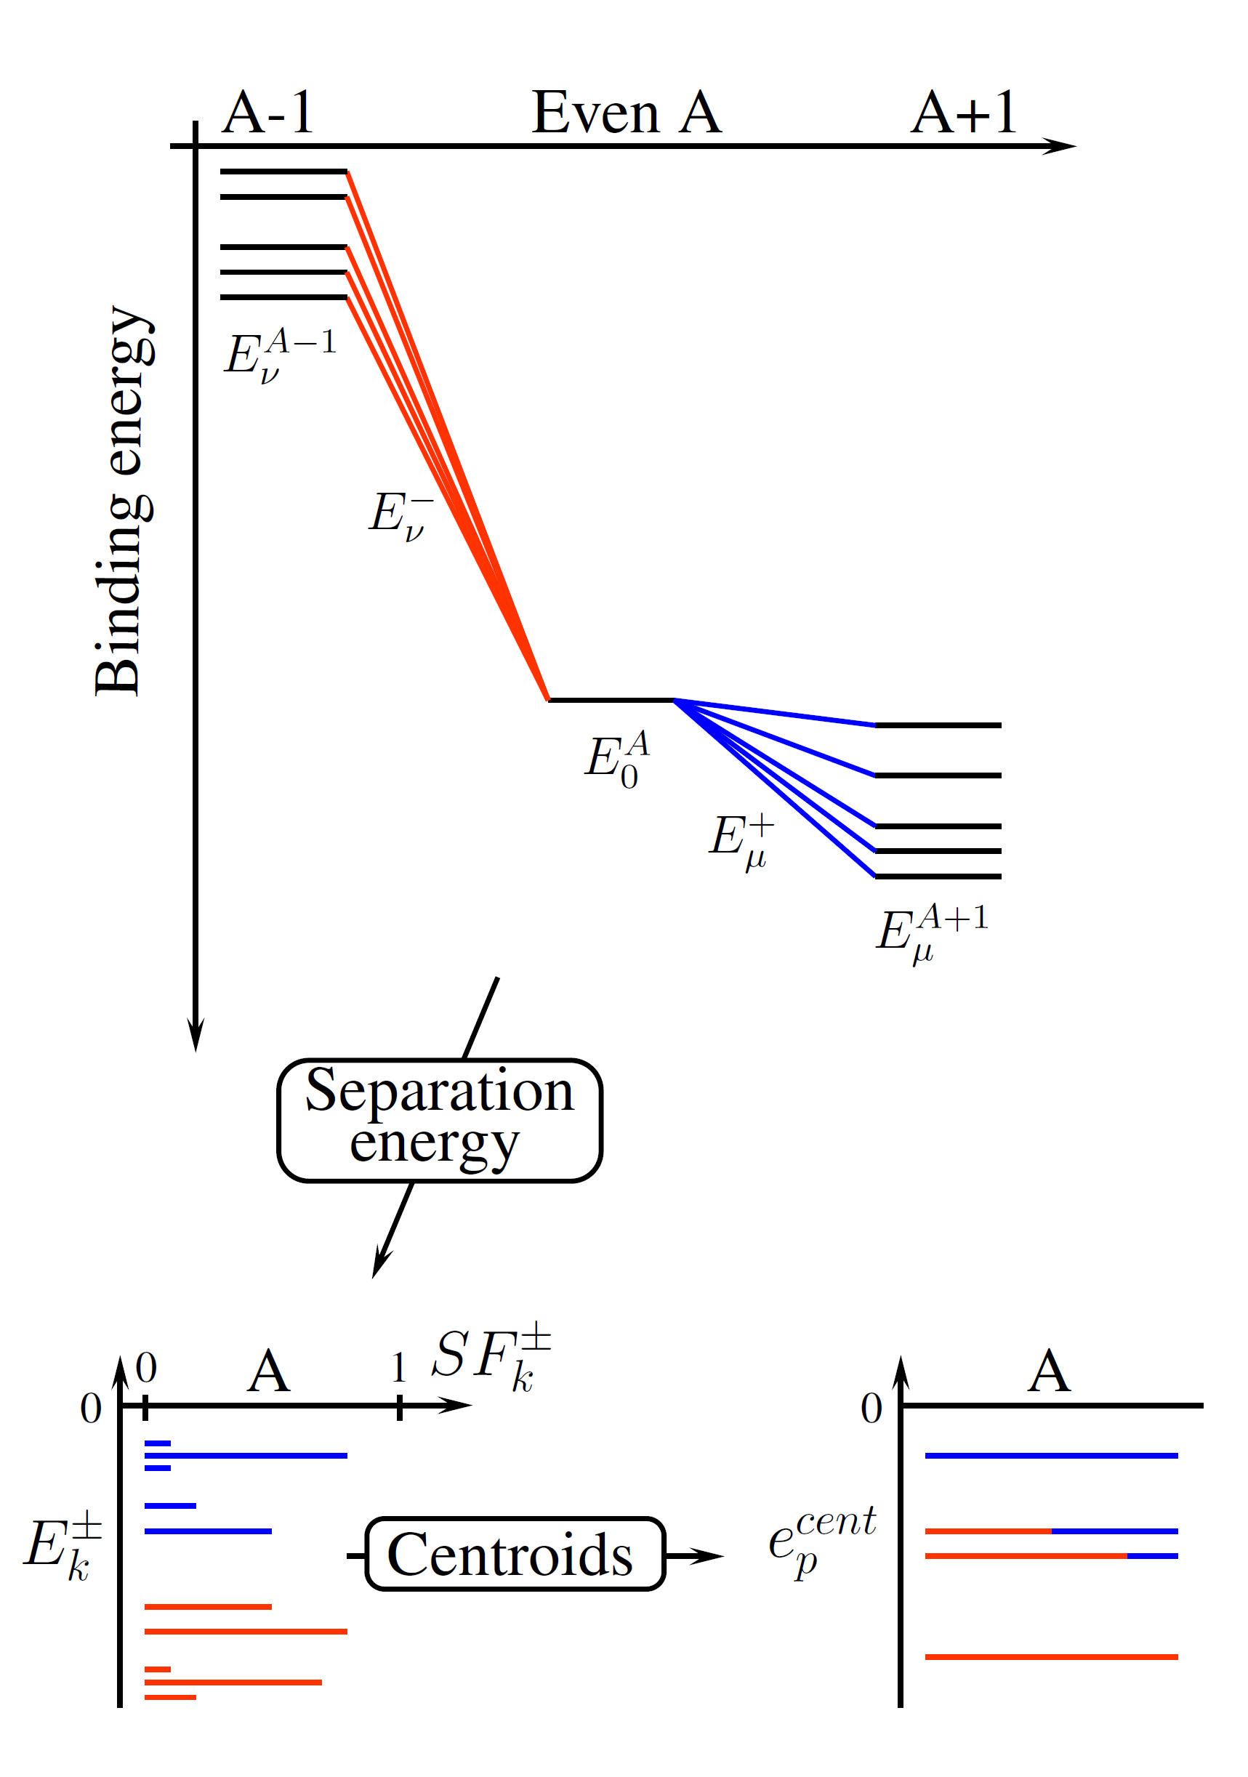


Observables of interest (here)
⦿ Observables: A-body ground-state binding energy, radii, density distributions
⦿ Bonus: one-body Green’s function accesses A±1 energy spectra
⦿ Spectral representation
where
and
⦿ Spectroscopic factors

Slide 23
Calculations set-up
By default in the following calculations
⦿ Two sets of 2N+3N chiral interactions
➟ N²LO 2N+3N (450 MeV) [NNLOsat]
[Ekström et al. 2015]
✓ bare
➟ N³LO 2N (500 MeV) + N²LO 3N (400 MeV) [EM]
✓ SRG-evolved to 1.88-2.0 fm⁻¹
[Entem & Machleidt 2003; Navrátil 2007; Roth et al. 2012]
⦿ Many-body approaches
➟ Self-consistent Green’s functions
By default in the following calculations
○ Closed-shell Dyson scheme [DGF]
○ Open-shell Gorkov scheme [GGF]

Slide 24
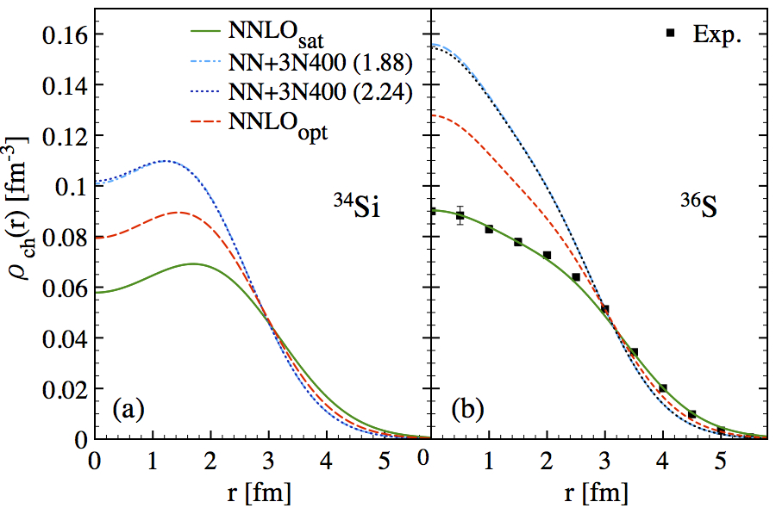
Impact of Hamiltonian (poor man’s way…)
⦿ Rms charge radius
⦿ Charge density distribution
Superior (true for BE as well)
Consistent with charge density in ³⁶S
Empirically = NNLO_{sat} is to be better trusted
Fundamentally = several question marks
Most pronounced bubble
⦿ Consequence on the central depletion in ³⁴Si
⦿ 3N interaction has severe/modest impact for NNLO_{sat}/NN+3N400 = leaves some question marks

Slide 25
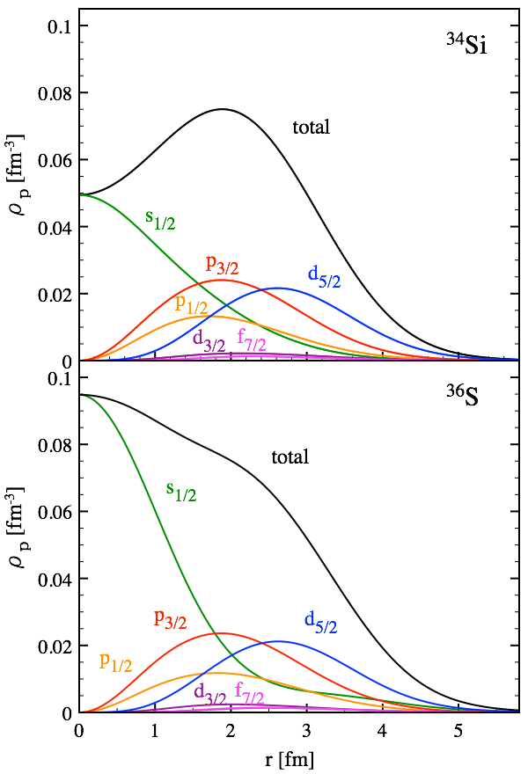
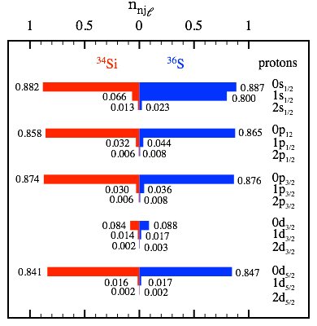
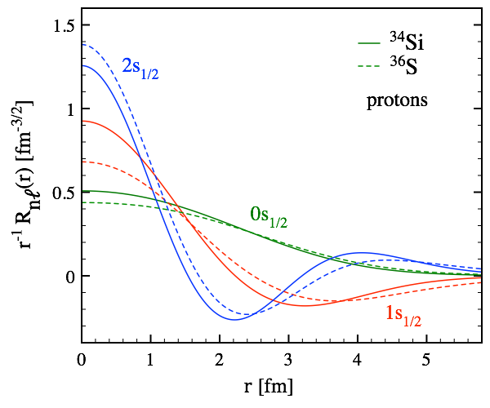
Partial-wave decomposition
⦿ Point-proton distributions can be analysed (internally to the theory) in the natural basis
⦿ Consider different partial-wave (l,j) contributions
○ Independent-particle filling mechanism qualitatively OK
-20%
+8%
○ Quantitatively
Net effect from balance between n=0, 1, 2
Net effect of w.f. polarization and change of occupations
○ Point-neutron contributions & occupations unaffected

Slide 26
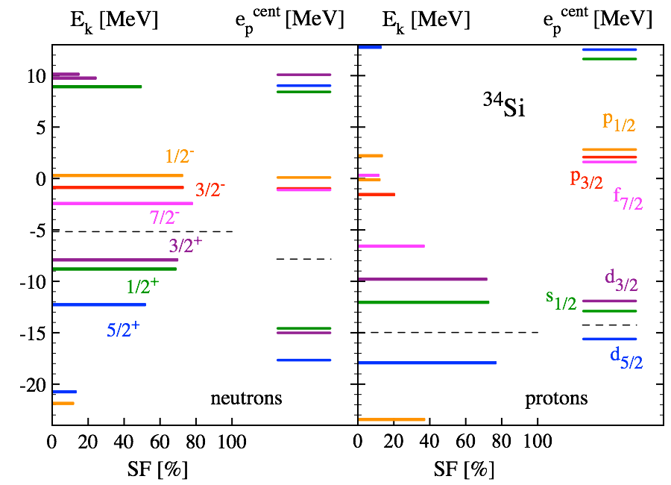
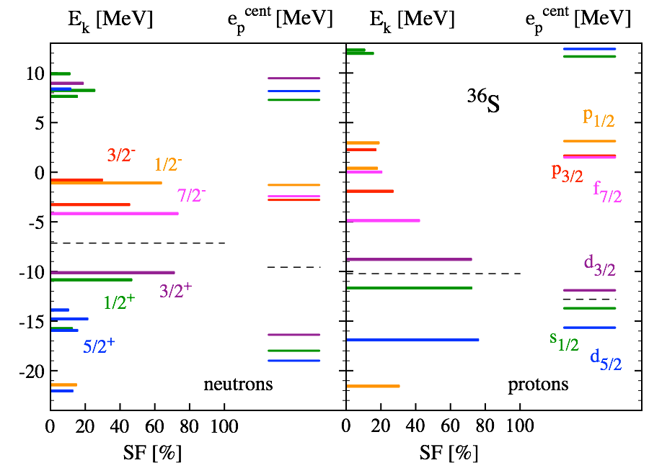
Spectroscopy in A+/-1 nuclei
⦿ Green’s function calculations access one-nucleon addition & removal spectra
One-nucleon separation energies
vs.
Spectroscopic factors
⦿ Effective single-particle energies can be reconstructed for interpretation
[Duguet, Hagen 2012]
[Duguet et al. 2015]

Slide 27
Comparison to data
⦿ Addition and removal spectra can be compared to transfer and knock-out reactions
One-neutron addition
Quadrupole moment
[Heylen et al. 2016]
One-proton knock-out
[Thorn et al. 1984]
[Khan et al. 1985]
Exp. data:
[Eckle et al. 1989]
Exp. data:
[Mutschler et al. 2016]
[Burgunder et al. 2014]
[Mutschler et al. 2017]
○ Good agreement for one-neutron addition to ³⁵Si and ³⁷Si (1/2⁻ state in ³⁵Si needs continuum)
○ Much less good for one-proton removal; ³³Al on the edge of island of inversion: challenging!
○ Correct reduction of splitting E1/2⁻ - E3/2⁻ from ³⁷S to ³⁵Si
Such a sudden reduction of 50% is unique
Any correlation with the bubble?!

