Slide 1



Highlights from the AGATA campaign at GANIL
and future plans
Zsolt Podolyák
University of Surrey

Slide 2
From S. Lenzi

Slide 3
From S. Lenzi

Slide 4
From S. Lenzi

Slide 5
, 2019)
From S. Lenzi

Slide 6
, 2019)
2015-2017
2018
2019-2020
(also plunger, PARIS, FATIMA)
2021?
Modified from S. Lenzi

Slide 7

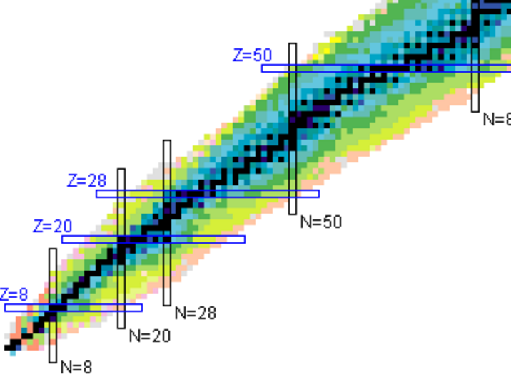
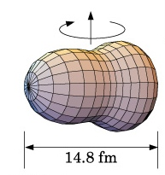
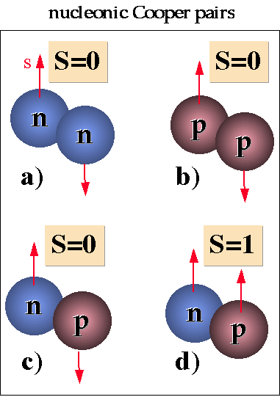
Physics of N~Z nuclei
N=Z
E. Clément/J.J. Valiente-Dobon
Octupoles in ¹¹²Xe
J.. Nyberg
^{102,103}Sn excited levels
B. Cederwall, R Wadsworth, G de France
T=0 pairing ⁸⁸Ru
S. Lenzi, F. Recchia
Iso. Symmetry Breaking A=63
Boso
⁷¹Kr-⁷¹Br – Isospin Symmetry Breaking
Does the Nuclear force identical for proton and neutron ?
New phenomena when proton and neutron occupy the same orbits ?
¹⁰⁰Sn magicity ?
Isospin Symmetry Breaking in the A=63,71 mirror nuclei
Studies of excited states in ^{102,103}Sn
Search for isoscalar pairing in the N=Z nucleus ⁸⁸Ru
Octupole – Quadrupole correlation in ¹¹²Xe

Slide 8
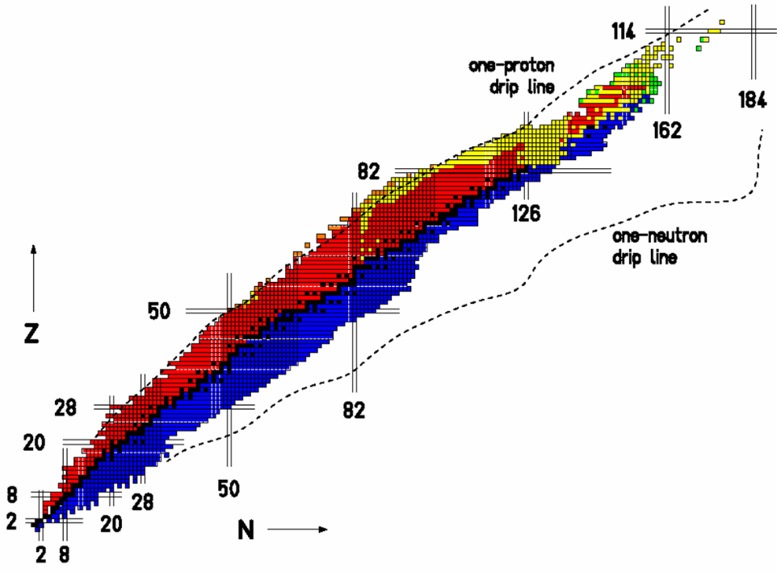
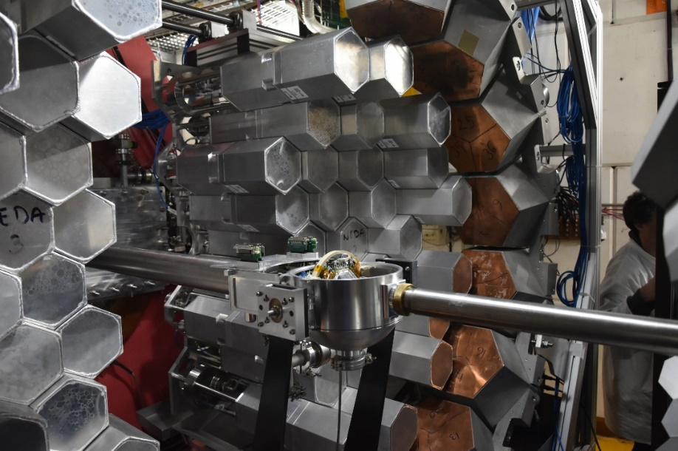
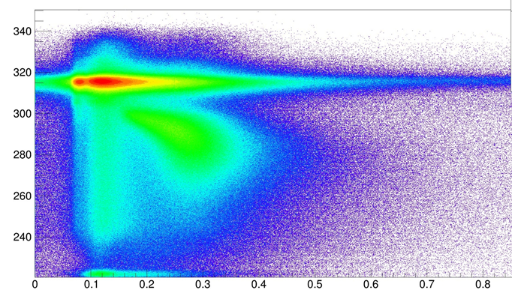
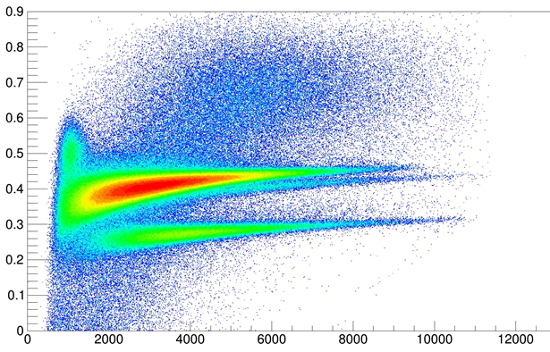
GANIL AGATA-NEDA-DIAMANT
Campaign:
2018: 5 Runs
Quadrupole and Octupoles in ¹¹²Xe
Excited states in ^{102,103}Sn
T=0 pairing ⁸⁸Ru: High Spin
Isospin Symmetry Breaking: ⁷¹Kr-⁷¹Br
Isospin Symmetry Breaking A=63
protons
N=Z
NEDA neutrón Detector Array
ToF vs. NNPSA
CsI PSA
DIAMANT
γ
p
n
α
neutrons
NEDA
Energy
From A. Gadea

Slide 9
AGATA+NEDA+DIAMANT(+plunger)
Individual talks on several of these
Modified from S. Lenzi

Slide 10
2 approved
Modified from S. Lenzi

Slide 11
AGATA in 2019
MUGAST year, 3 experiments
MUGAST commissioning M. Assié ¹⁶O 6UT April 2019
E744 I. Stefan ¹⁴O 16UT April 2019
Proton unbound ¹⁵F (orig. LISE exp.)
E786S A. Gottardo/M. Assié ⁴⁶Ar 24UT June 2019
Is there a problem with protons in N=28 ⁴⁶Ar?
E768S Ch. Diget/N. de Séréville ¹⁵O 36UT July 2019
Determining the α + ¹⁵O radiative capture rate by measurement of the ⁶Li(¹⁵O,d)¹⁹Ne reaction

Slide 12

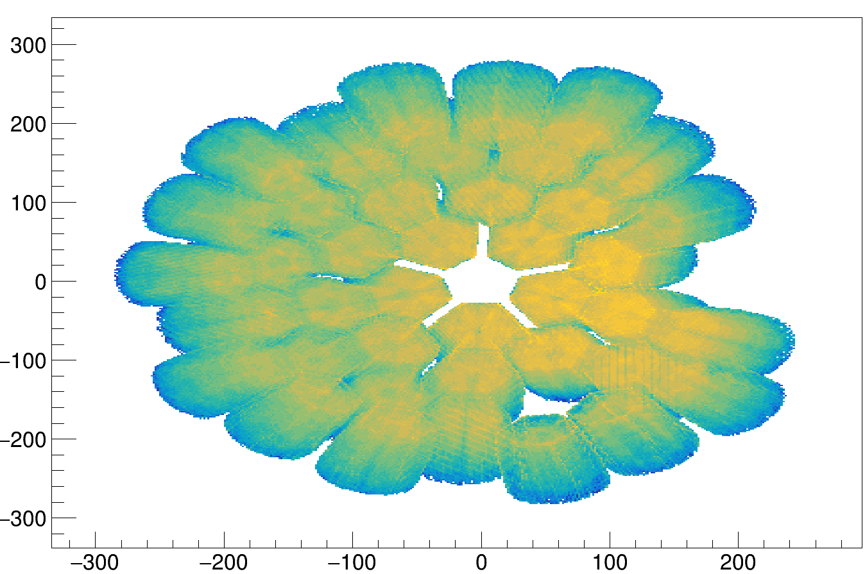
Status of AGATA
Detectors
41 capsules in the system.

Slide 13
performed in April 2019

Slide 14
performed in April 2019

Slide 15




Is there a problem with protons
in N=28 ⁴⁶Ar ?
AGATA-MUGAST-VAMOS Experiment
Andrea Gottardo
Marlène Assié
INFN-LNL, Italy
IPN Orsay, France
⁴⁶Ar(³He,d)⁴⁷K
GANIL PAC 2018 1/9

Slide 16
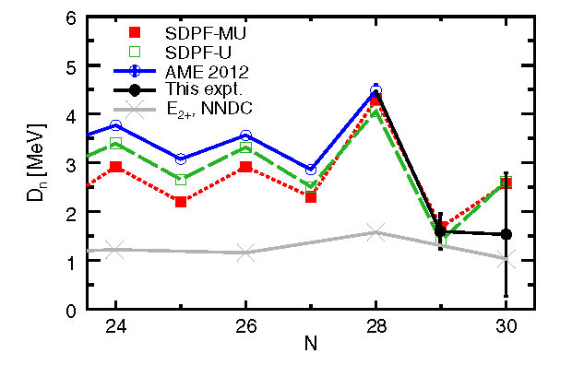
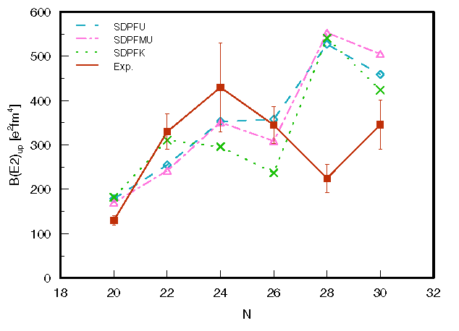
Physics motivation Experiment E786S Andrea Gottardo, Marlène Assié
B(GT) in nuclei The Calcium region Results
Do we understand physics at N=28 ?
Neutron observables understood
Large discrepancy in B(E2)
Excellent theory for neutron-space related quantities:
confirming N=28 shell closure in ⁴⁶Ar
SDPF interaction describes valance-core neutrons interaction very well
Large discrepancy with the measured B(E2) value at N=28:
problem with the proton E2 contribution ?
A. Gade et al., PRC 68, 014302 (2003)
S. Calinescu et al., PRC 93, 044333 (2016)
Z. Meisel et al. PRL 114, 022501 (2015)
⁴⁶Ar(³He,d)⁴⁷K
GANIL PAC 2018 2/9

Slide 17
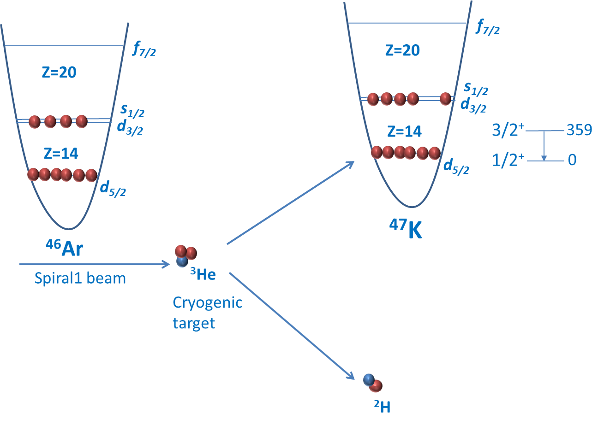
Physics motivation Experiment E786S Andrea Gottardo, Marlène Assié
B(GT) in nuclei The Calcium region Results
⁴⁶Ar(³He,d)⁴⁷K proton pick-up reaction
How sensitive are calculated SF to proton wave function in ⁴⁶Ar ?
Significant dependence of spectroscopic factors from occupation numbers !
⁴⁶Ar(³He,d)⁴⁷K
GANIL PAC 2018 5/9

Slide 18
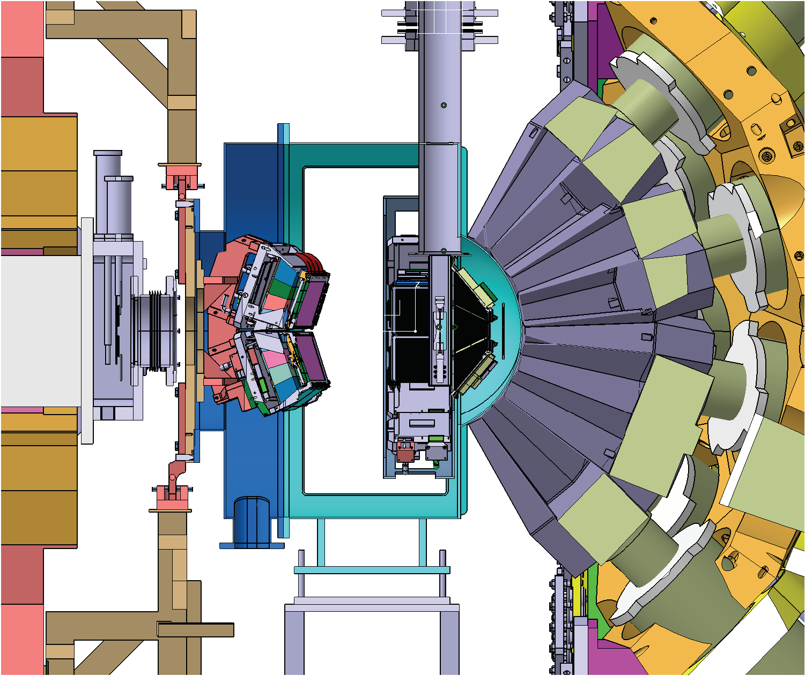
Physics motivation Experiment E786S Andrea Gottardo, Marlène Assié
B(GT) in nuclei The Calcium region Results
Experimental setup
Setup
⁴⁶Ar beam: 2·10⁴ pps @10 MeV/u (SPIRAL 1)
Cryogenic ³He target: 3 mm-thick, T=8 K, P=1 atm (equivalent 1.5 mg/cm²)
MUGAST for deuterons detection
AGATA for γ-ray spectroscopy
VAMOS for helping in identification and spectra cleaning
⁴⁶Ar(³He,d)⁴⁷K
GANIL PAC 2018 8/9

Slide 19
Recent results
(many more in the talks today and tomorrow)

Slide 20
AGATA+VAMOS+EXOGAM
S. Biswas et al., PRC 99, 064302 (2019)
¹²²⁻¹³¹Sb

Slide 21
AGATA+VAMOS+EXOGAM
S. Biswas et al., PRC 99, 064302 (2019)
¹²²⁻¹³¹Sb
SM2: more fragmented
wave functions

Slide 22
AGATA+PRISMA
J. Litzinger et al., PRC 97, 044323 (2018)
DSAM
82Se 6+ -> 4+

Slide 23
C. Delafosse et al., PRL 121, 192502 (2018)
AGATA+VAMOS
Lifetimes in N=52 nuclei
84Ge 4⁺
84Ge 2⁺

Slide 24
C. Delafosse et al., PRL 121, 192502 (2018)
AGATA+VAMOS
Shape coexistence and its microscopic origin

Slide 25
AGATA in 2020?
PRE-PAC in April 2019: 11 new proposals
Setups | proposals | time (UT) | beams
AGATA+MUGAST+VAMOS | 5 or 6 | 129 or 159 | 26Al, 33Cl, 47K, 48Cr, 55Co, 56Ni, 57Ni
AGATA+MUGAST | 2 | 42 | 48Cr, 85Kr
AGATA+VAMOS | 1 or 0 | 30 or 0 | 33Cl
AGATA+VAMOS+plunger | 2 | 55 | 86Kr, (198Pt), 238U
AGATA+NEDA+plunger | 1 | 24 | 40Ca
1 previously approved MUGAST proposal (E. Clément, A. Guasduff)
2 previously approved AGATA+VAMOS proposals (D. Ackermann and Y.H.Kim/N.Alahari)
(and approved AGATA+NEDA proposals, unlikely to run with AGATA;
could run with EXOGAM)

Slide 26
AGATA in 2020?
PAC in 2019
The deadline for submission of the proposals was 30 May 2019.
“During the 2019 run, new SPIRAL1 beams will be tested (48Cr, 49,50Sc, 55Co, 56,57Ni) and the production yields of Al, P and Cl will be also be checked. “
Test had to be cancelled
=> 3 proposals (+2) only
Proposals submitted: ²⁴Ne(d,6Li), ²⁶Al(d,p) and ⁴⁷K(d,p).
+ 2 proposals more with ⁵⁶Ni and ⁴⁸Cr (beams need to be developed)
The next GANIL Program Advisory Committee (PAC): 17-18 October 2019
AGATA+MUGAST campaign continues in 2020 (so far 1 approved exp.)
Total beam-time: 3 months in February-April 2020

Slide 27
AGATA in 2021?
GANIL campaign, probably February-June? 2021
Summer 2021: AGATA moves to Legnaro
for stable beam and (later) SPES beam experiments

Slide 28
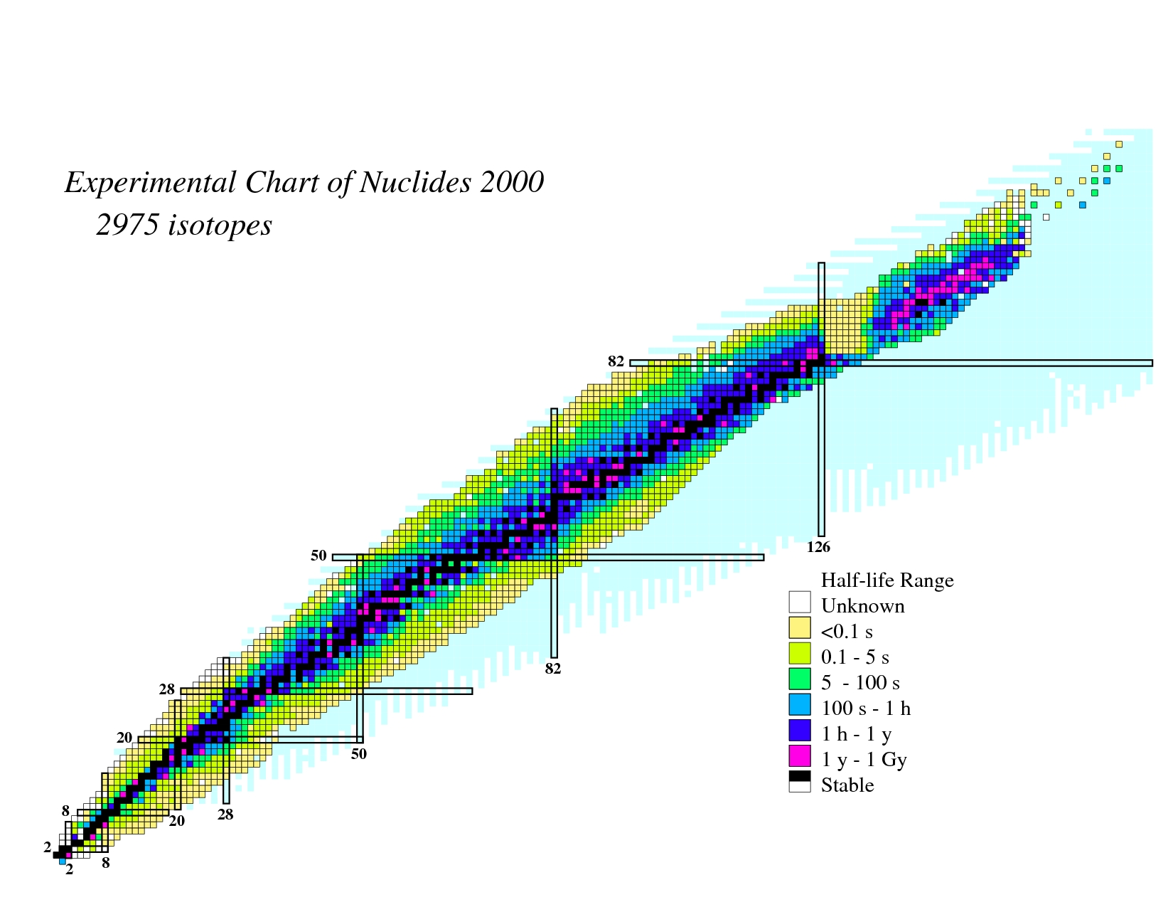
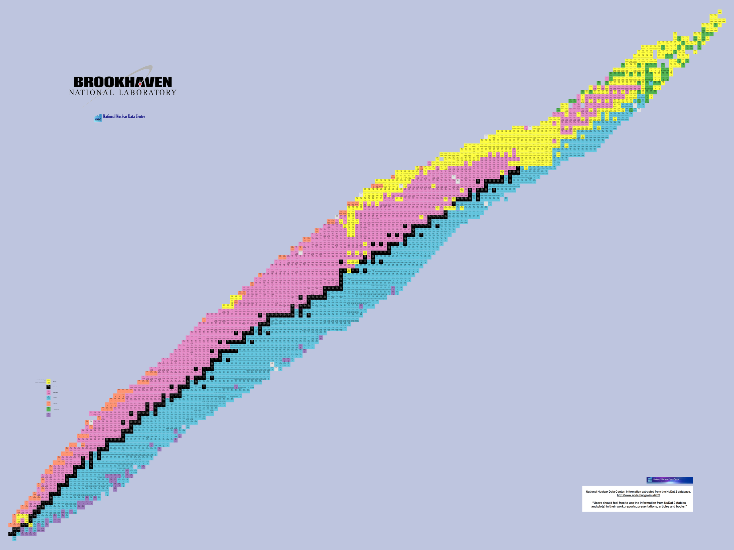
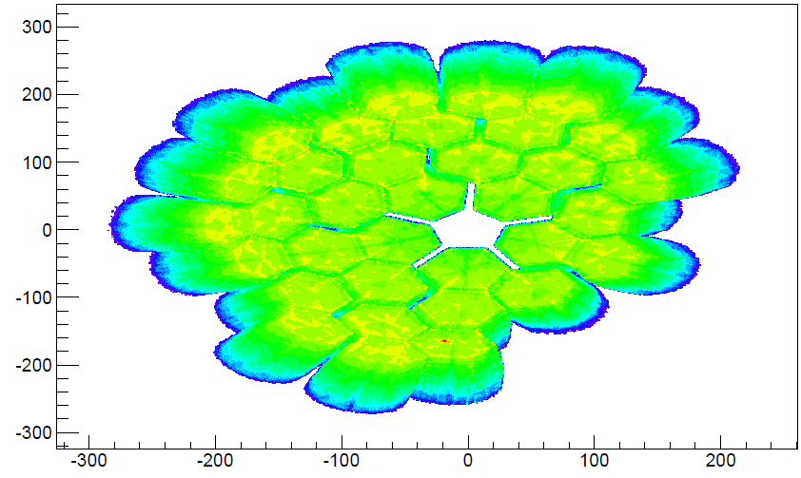
Experiments performed in 2015-2018 at GANIL with AGATA
Search for Double Gamma decay in ¹³⁷Cs source
Reaction mechanism : Fission of Light Hg
Octupole – Quadrupole correlation in ¹¹²Xe
²⁰⁸Pb
Studies of excited states in ^{102,103}Sn
Octupole correlation in ²⁰⁷Pb
Evolution of collectivity around N=50: lifetime measurements ^{104,106}Sn
Exploration of alpha-cluster : the unique case of ²¹²Po (²⁰⁸Pb + α)
Evolution of collectivity around N=50: lifetime measurements ⁹⁴Ru
Shape transition in the neutron-rich W isotopes
Search for isoscalar pairing in the N=Z nucleus ⁸⁸Ru
Transition Quadrupole Moments in ^{166,168}Dy.
¹⁰⁰Sn
i_{13/2} single particle state in ¹³³Sn and high spin in ¹⁰⁸Zr
Isospin Symmetry Breaking in the A=63,71 mirror nuclei
¹³²Sn
Shape evolution in neutron rich fission fragments in the mass A~100 region
⁶⁸Ni
⁷⁸Ni
Shell evolution around N=50: ⁸¹Ga spectroscopy
Evolution of collectivity around N=52: lifetime measurements in ^{83,84}Ge
Evolution of collectivity around N=40: lifetime measurements in ^{73,75}Ga
⁴⁸Ca
Evolution of collectivity around N=40: lifetime measurements in ⁶⁴Fe
Evolution of the shell structure in the region of neutron-rich Ti isotopes
Lifetime measurements of excited states in neutron-rich C and O isotopes
The lifetime of the 7.786 MeV state in ²³Mg as a probe for classical novae models
From A. Gadea

Slide 29
Summary
AGATA at GANIL: 2015-2021
(21 exps. in 2015-2018 +3 in 2019)
VAMOS 2015-2017
NEDA 2018
MUGAST 2019-2020
2021?
Strong physics case (talks today/tomorrow)
SPIRAL1 beams (need to be developed!)
Stable (e.g. ²³⁸U, ²⁰⁸Pb) beams

Slide 30
Summary
AGATA at GANIL: 2015-2021
(22 exps. in 2015-2018 +3 in 2019)
VAMOS 2015-2017
NEDA 2018
MUGAST 2019-2020
2021?
Strong physics case (talks today/tomorrow)
SPIRAL1 beams (need to be developed!)
Stable (e.g. ²³⁸U, ²⁰⁸Pb) beams
Thanks the AGATA collaboration, management,
project manager (E. Clément), former coordinator (S. Lenzi).
Thanks for all the borrowed slides (“Imitation is the sincerest form of flattery”),
and thanks for your attention!

