Slide 1
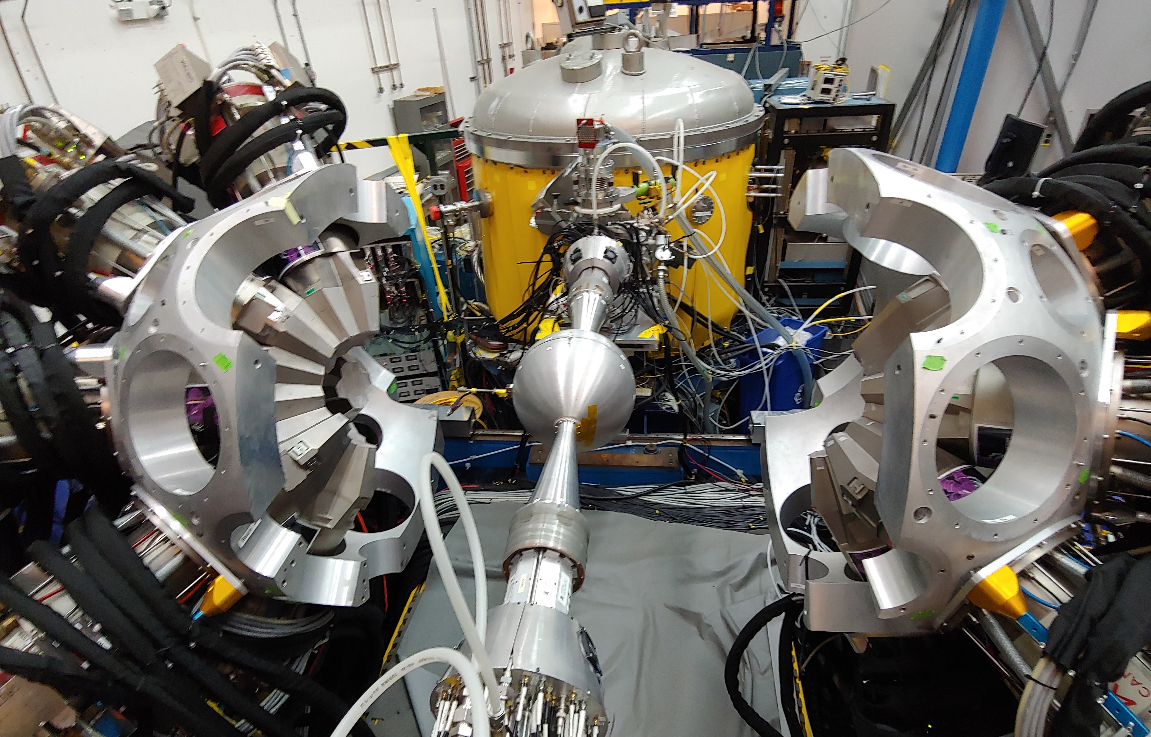

HIGHLIGHTS FROM THE 2nd GRETINA CAMPAIGN AT atlas
2019 NuSpin Workshop
drhgfdjhngngfmhgmghmghjmghfmf
Michael P carpenter
Physics Division
Argonne National Laboratory
June 24, 2019
Orsay, France

Slide 2
Talk Outline
GRETINA
What is GRETINA?
Where has it been used?
Argonne Accelerator Facility
ATLAS
CARIBU
RAISOR
SUMMary of First ATLAS GRETINA CAMPAIGN
Second GRETINA CAMPAIGN at ATLAS
ATLAS and GRETINA upgrades
Coulomb Excitation of stable and CARIBU beams
Experiments with FMA-GRETINA
Experiments with GODDESS-GRETINA

Slide 3
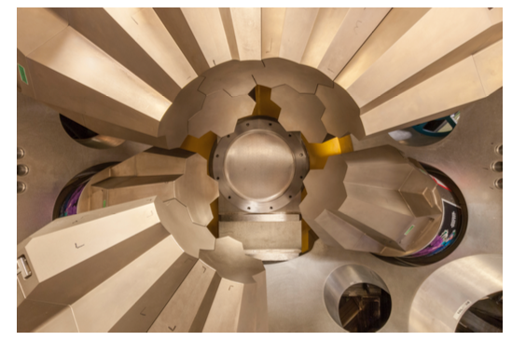
GRETINA
Gamma-Ray Energy Tracking In-Beam Nuclear Array
Constructed 2003-2010: $20M funded by US DOE-Nuclear Physics Office
Optimized for rare isotope science utilizing either fragmented (~100 MeV/A), or (re)accelerated (~5 MeV/A) beams.
Science Campaigns
NSCL: April 2012 – June 2013
7 quad modules at S800 target
ATLAS: July 2013 – June 2015
Up to 8 quad modules
NSCL: July 2015 – June 2017
Up to 10 quad modules
ATLAS: July 2017 – March 2019
Start with 11 modules and add possibly 1 more. Placed at FMA target position.
NSCL: April 2019 – October 2020

Slide 4
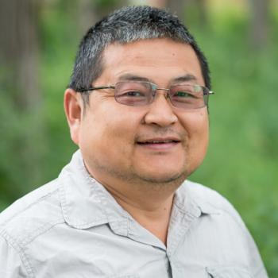

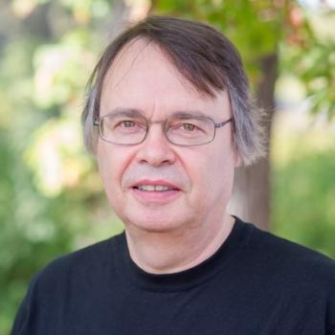

ANL GRETINA AND FMA TEAM
Shaofei Zhu
Darek Seweryniak
Torben Lauritsen
Post Doctoral Fellows:
Kalle Auranen
Jing Li
Sanne Stolz
John Rohrer

Slide 5
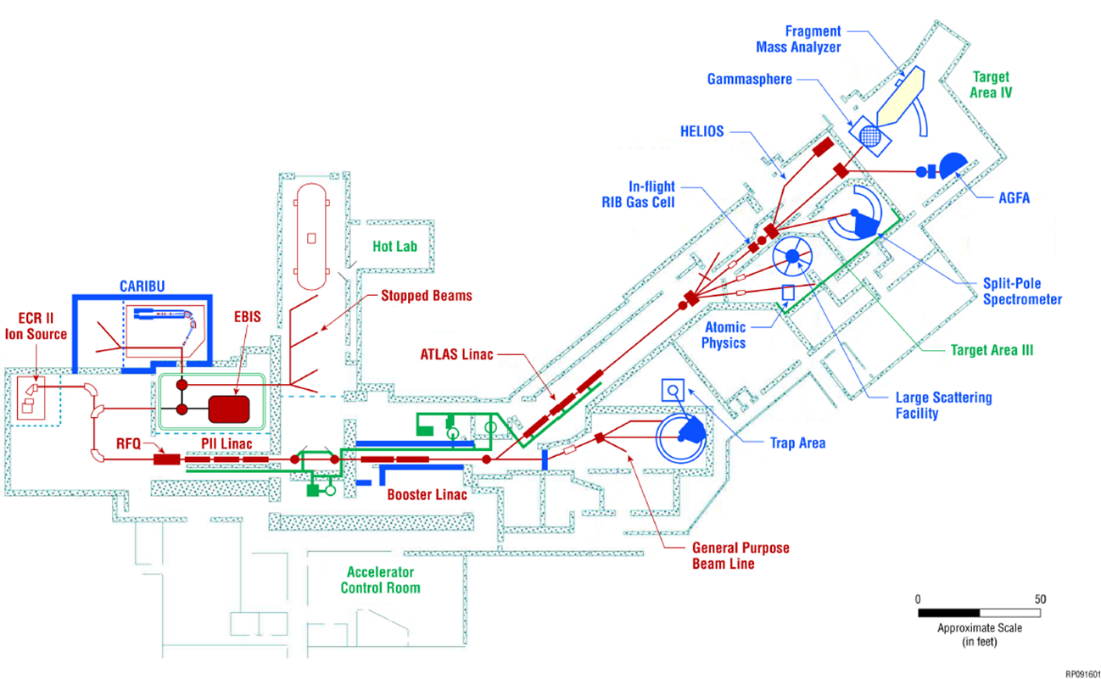
ATLAS/CARIBU facility
Stable beams at high intensity and energy up to 10-20 MeV/u
Light in-flight radioactive beams
  light beams, no chemical limitations, close to stability, acceptable beam properties
CARIBU beams
  heavy n-rich from Cf fission, no chemical limitations, low intensity, ATLAS beam quality, energies up to 15 MeV/u
State-of-the-art instrumentation for Coulomb barrier and low-energy experiments
Operating 5000-6000 hrs/yr (+ 2000 hrs/yr CARIBU stand alone) at about 95% efficiency
  Common PAC for ATLAS and CARIBU
  350-400 users per year performing experiments at ATLAS
Access to n-rich region via fission of the most neutron-rich “available” very heavy nuclei (i.e. ²⁵²Cf)

Slide 6
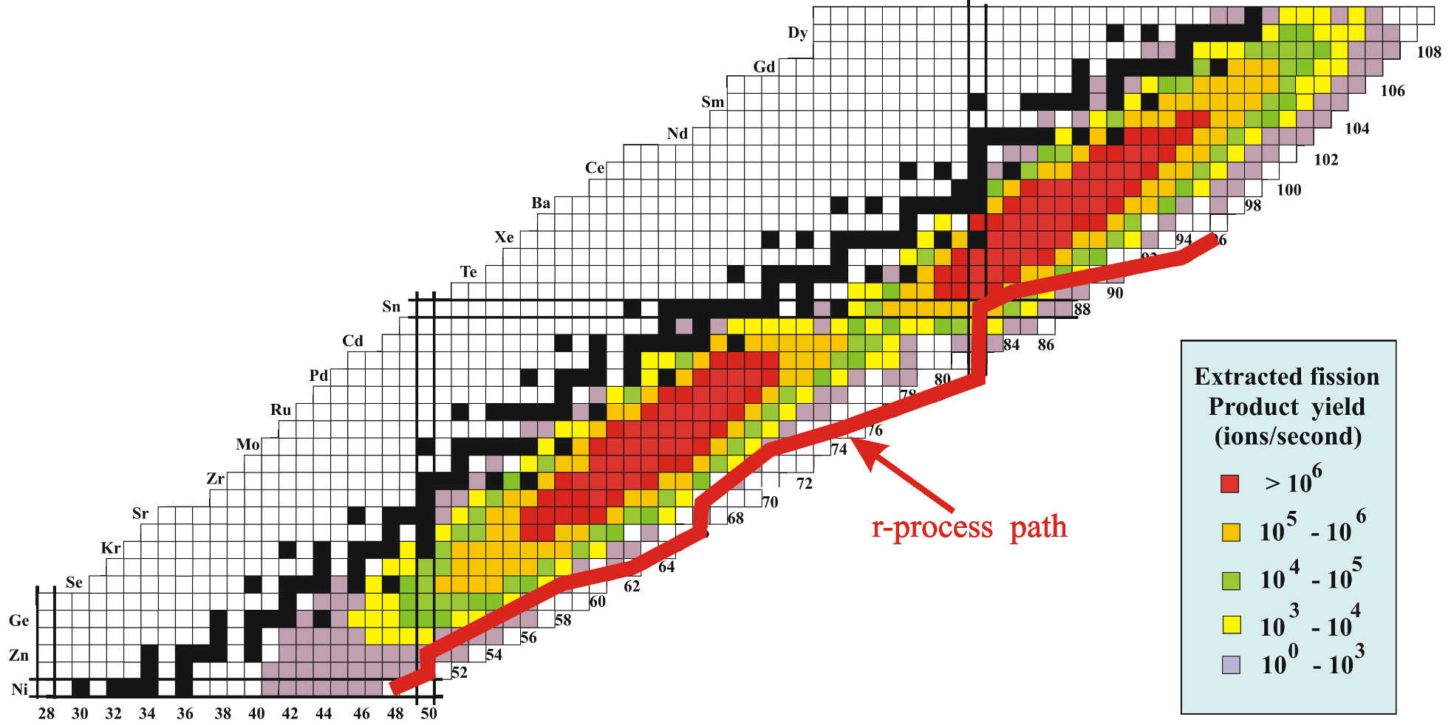
Neutron-rich beam source for ATLAS: CARIBU “front end” layout
Main components of CARIBU
  PRODUCTION: “ion source” is ²⁵²Cf source inside gas catcher
    Thermalizes fission fragments
    Extracts all species quickly
    Forms low emittance beam
  SELECTION: Isobar separator and MR-TOF
    Purifies beam
  DELIVERY: beamlines and preparation
    Switchyard
    Low-energy buncher and beamlines
    Charge breeder to Increase charge state for post-acceleration
    Post-accelerator ATLAS and weak-beam diagnostics
Mass Yields From SF of ²⁵²Cf

Slide 7
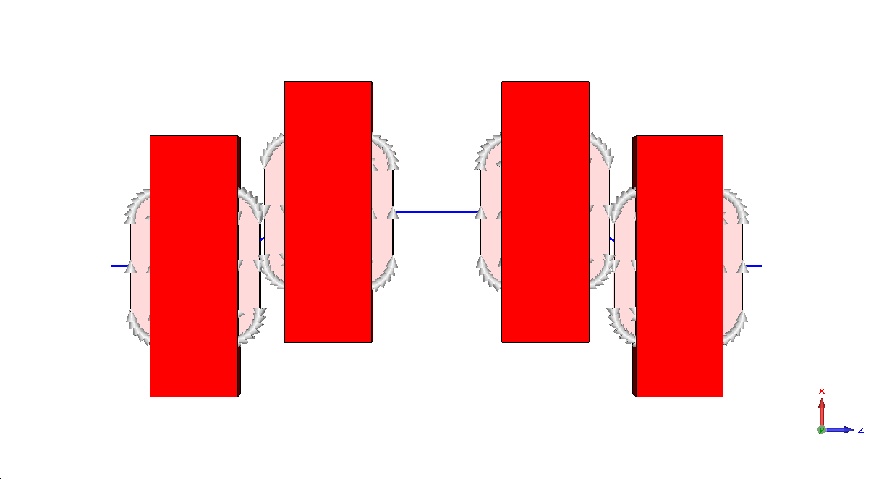
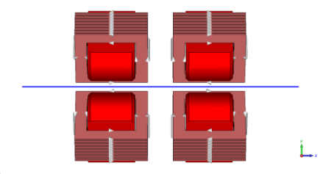
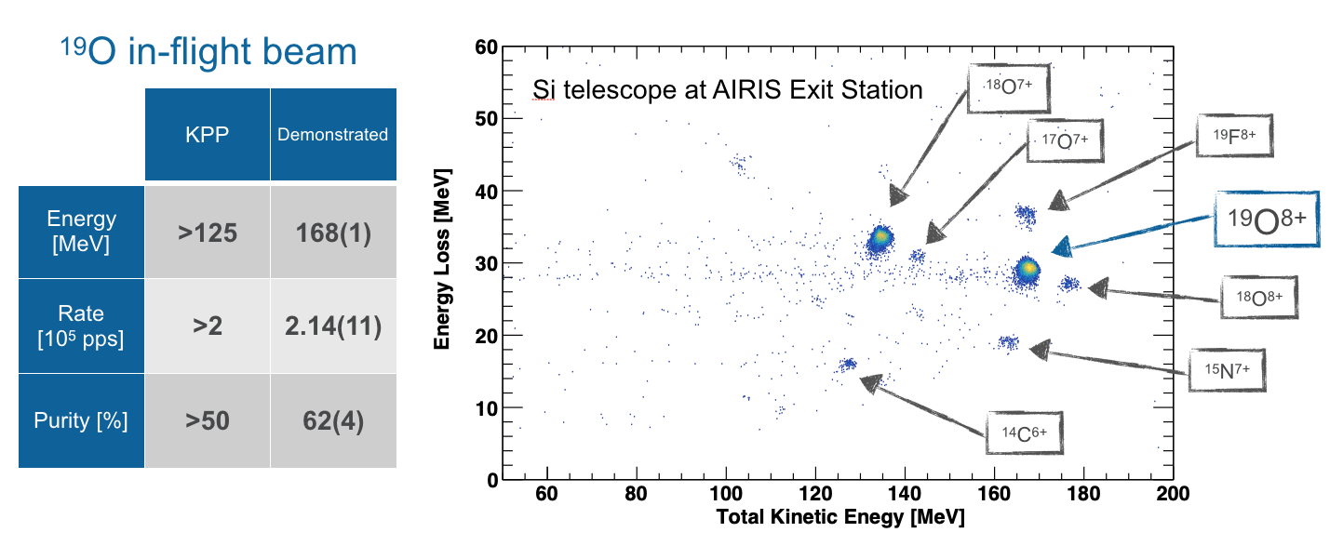
RAISOR – In-Flight RIB production
Zero degree line for stable beams
Q1 Q2
D1 D4
Exit
Plane
Target
D2 D3
Q3 Q4
RAISOR commissioning: ¹⁹O beam
Deflection line for radioactive beam selection
RAISOR serves the experimental areas down stream from the ATLAS section of the linac while maintaining stable beam operations – GRETINA, GAMMASPHERE
For stable beam operations, the dipoles are turned off and the beam follows its normal trajectory.
For radioactive beams, all beams are deflected and the selection is done in the middle plane on the deflection line away from the main line. The selected beam is then deflected back to the main ATLAS line at AIRIS exit
Successful commissioning completed in Summer 2018 & closeout conducted in Fall of 2018
Production of ¹⁹O with specified characteristics
  Production method: ¹⁸O [10 MeV/u] + D
  Measured at both separator exit & at a target station
x2 – x4 improvement in ¹⁹O production & purity over previous facility

Slide 8
First GRETINA CAMPAIGN at ATLAS
Characterizing the operation of GRETINA and its capabilities
Coulomb Excitation of stable and CARIBU beams
In-Beam Gamma-Ray Spectroscopic Studies using Deep-Inelastic and Transfer Reaction

Slide 9
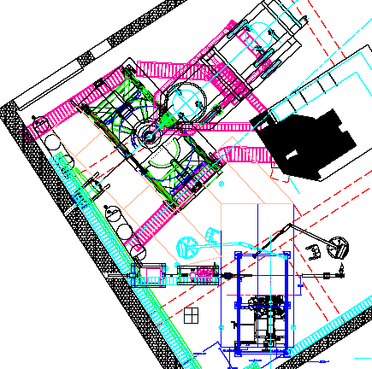
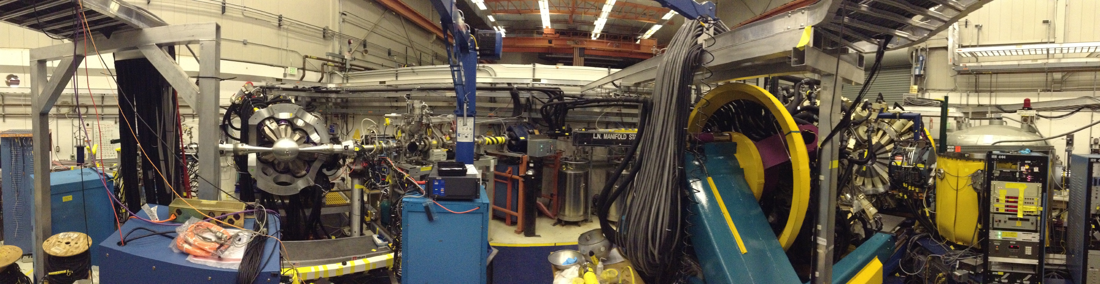
CONFIGURATION OF GAMMASPHERE AND GRETINA (2013-2015)
Gammasphere
FMA
ATLAS Beam
GRETINA

Slide 10
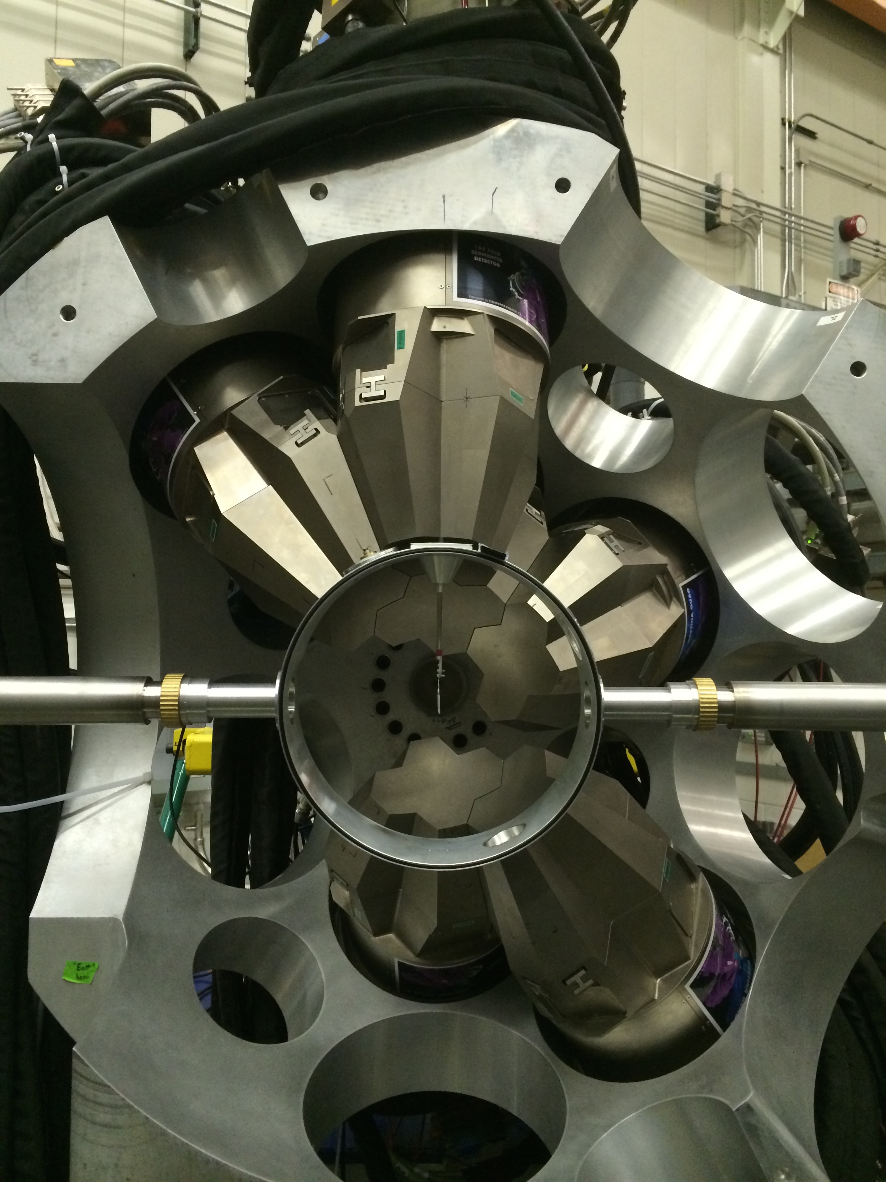
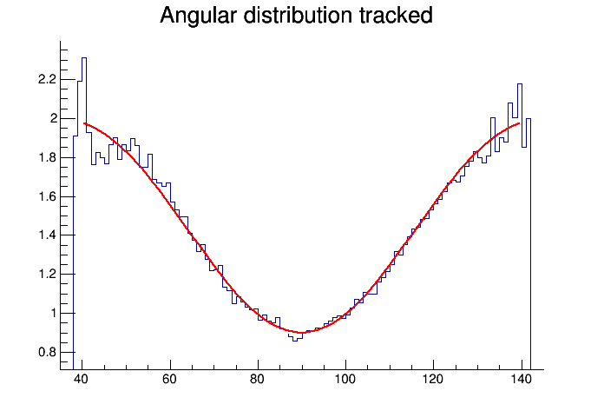
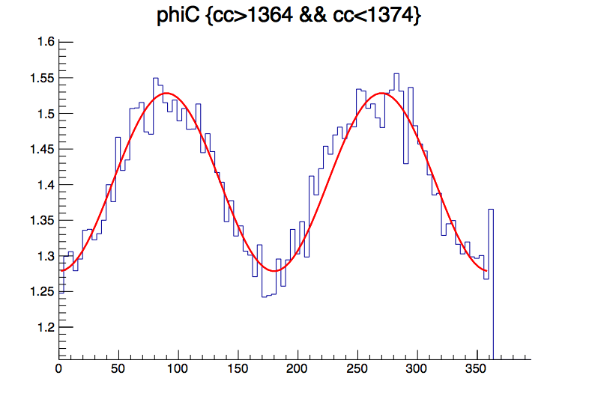

Characterizing the operation of GRETINA and its capabilities
Comparison of the performance of GRETINA and GAMMASPHERE;
P.I. - T. Lauritsen (ANL), A. Korichi (CNSM)
GRETINA Test: High-Energy Gamma-Ray Performance;
P.I. – K. Lister (Lowell)
Commissioning experiment to study the polarization sensitivity of GRETINA;
P.I. - A.O. Macchiavelli, A. Wiens (LBNL)
²⁴Mg(p,p’γ)²⁴Mg E_{p}=2.45 and 6.05 MeV
Anisotropy of angular distribution
Anisotropy in azimuthal Compton scattering angle
Normalized intensity
θ
j

Slide 11
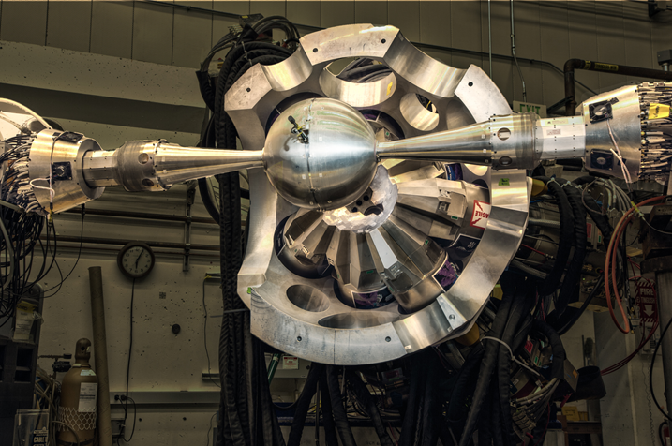
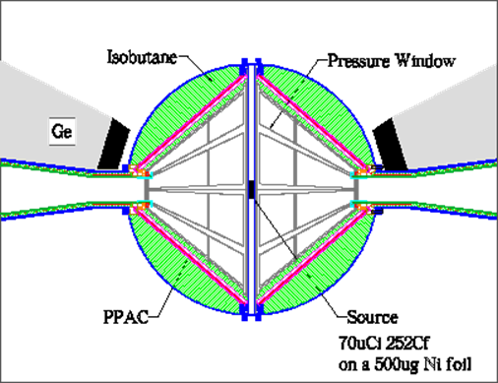
Coulomb Excitation of stable and CARIBU beams with GRETINA
Shape coexistence in the neutron-rich germanium isotopes ⁷²Ge and ⁷⁶Ge
Octupole Strength in Neutron-Rich Nuclei near A~140: Multi-step Coulomb Excitation of ^{144,146}Ba with Reaccelerated CARIBU Beams
Shape coexistence in ¹⁰⁰Zr studied by low-energy Coulomb excitation (CARIBU)
Sub-shell closure, proton-neutron symmetry and shape coexistence in ⁹⁸Zr (CARIBU)
Precision determination of electromagnetic matrix elements in triaxial ¹¹⁰Ru. Triaxial ground state proposed – coulex can confirm. (CARIBU)
Shape Evolution and Coexistence in the Mo-Ru Region, ¹⁰⁶Mo (CARIBU)
Coulomb Excitation of neutron-rich odd-odd nucleus ^{98m}Y (CARIBU)

Slide 12
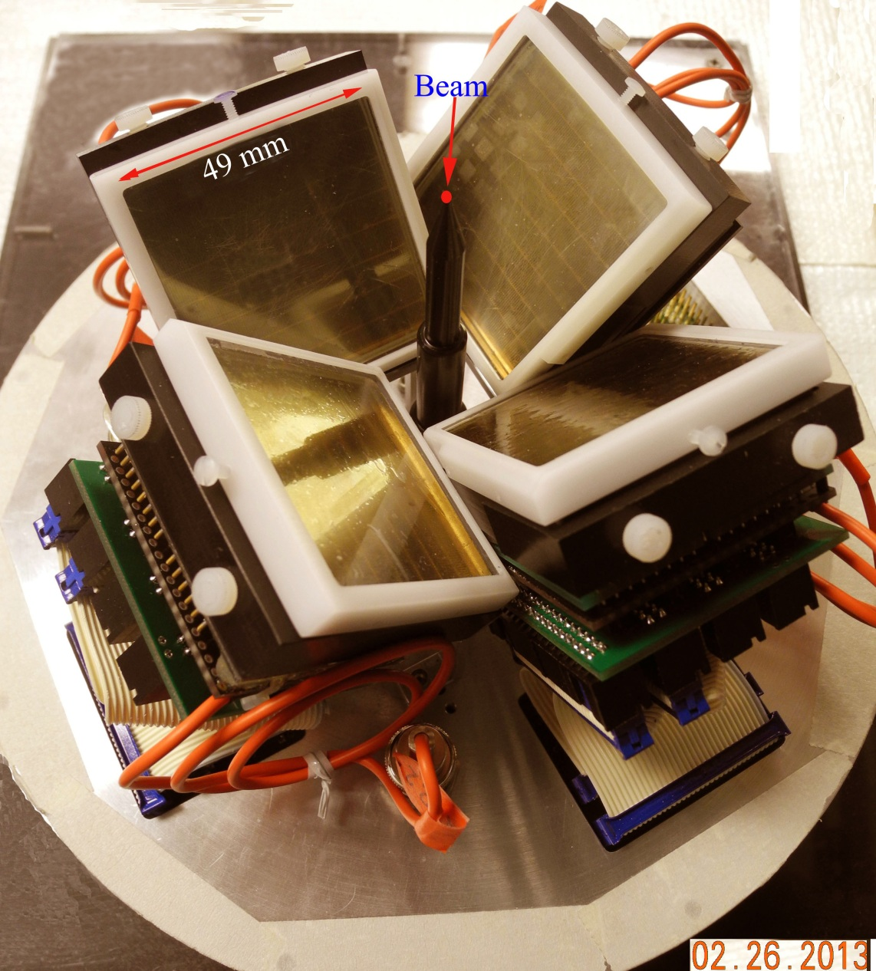
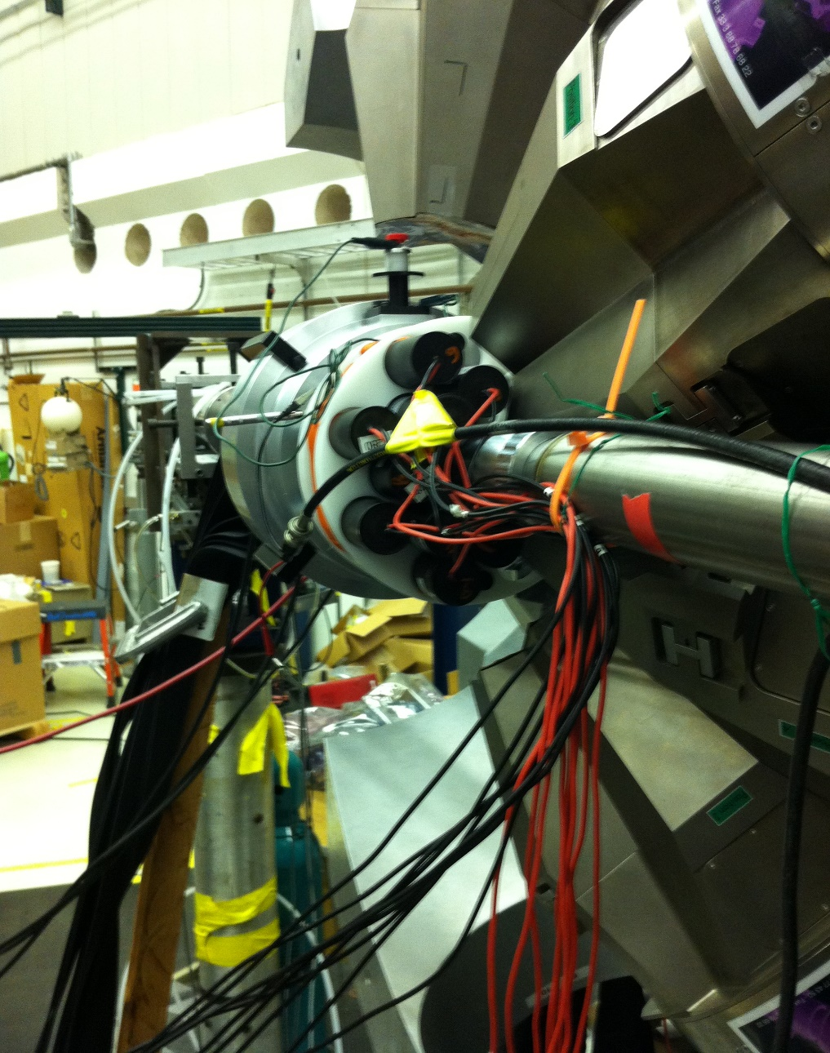
GRETINA + Phoswich Wall Experiments
Multi-Particle-Hole States in neutron rich ³⁴P (S. Tabor FSU)
Understanding the Low-Energy Enhancement of the Photon-Strength Function in Nuclei (A.O. Macchiavelli LBNL)
Fast-timing lifetime measurements in the ¹³C(¹³⁸Ba,¹²C)¹³⁹Ba and ¹³C(¹⁴⁰Ce¹²C)¹⁴¹Ce reactions (W. Reviol WashU)
# Pixels: 256 (4 PMT’s)
Thin fast-plastic + CsI(Tl)
Angle range: 9º ≤ θ ≤ 72º
¹³⁸Ba+¹³C Experiment:
Coupling w/ Gretina and 9 LaBr₃(Ce)’s

Slide 13
HIGHLIGHTS FROM THE SECOND GRETINA CAMPAIGN AT ATLAS
ATLAS and GRETINA upgrades
Coulomb Excitation of stable and CARIBU beams
Experiments with FMA-GRETINA
Experiments with GODDESS-GRETINA

Slide 14

Improvements on CARIBU
Coulomb excitation measurements of CARIBU beams
New Capabilities
MR-TOF:
  >50,000 higher mass resolution;
  2x lower efficiency
EBIS Charge Breeder:
  2-3x higher efficiency
  10x faster in breeding time
  Beam purity substantially enhanced
New ²⁵²Cf source:
  Possibly 2-4x higher yields
≥10 Clusters in GRETINA:
  More than 30% enhancement in γ-ray detection efficiency
~225 isotopes (> 10⁴)
Lower mass peak:
  Rapid shape change, most deformed and stable triaxial deformed ground state.
Higher mass peak:
  One of only a few regions exhibiting enhanced octupole collectivity.
14

Slide 15
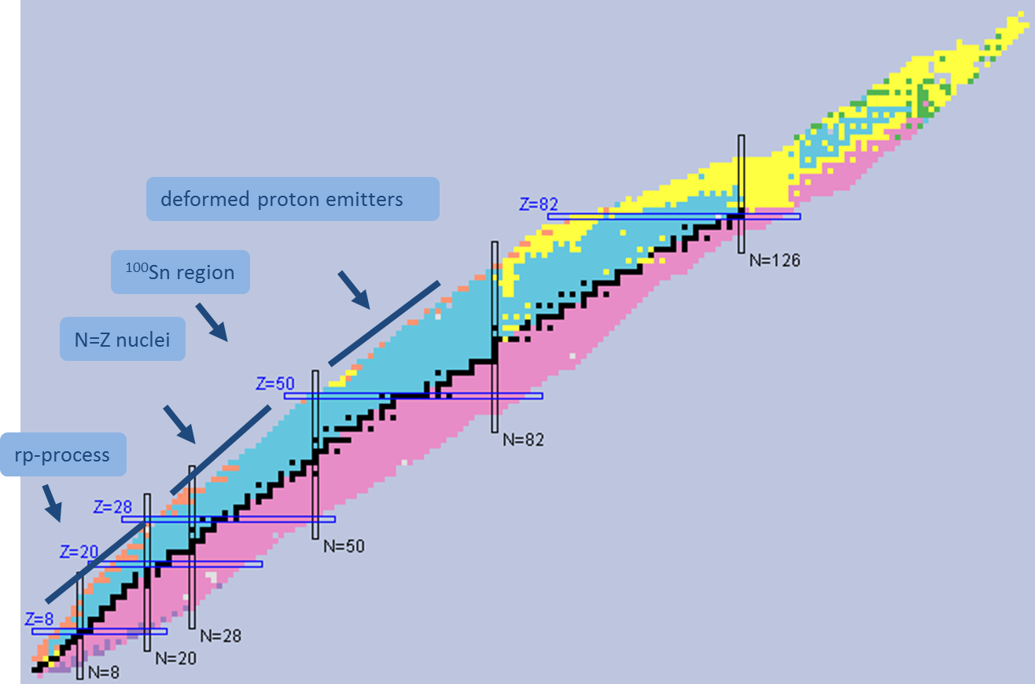
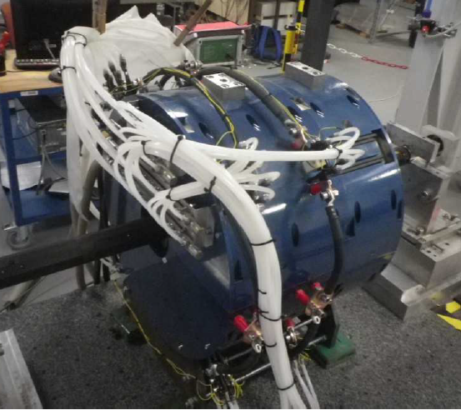
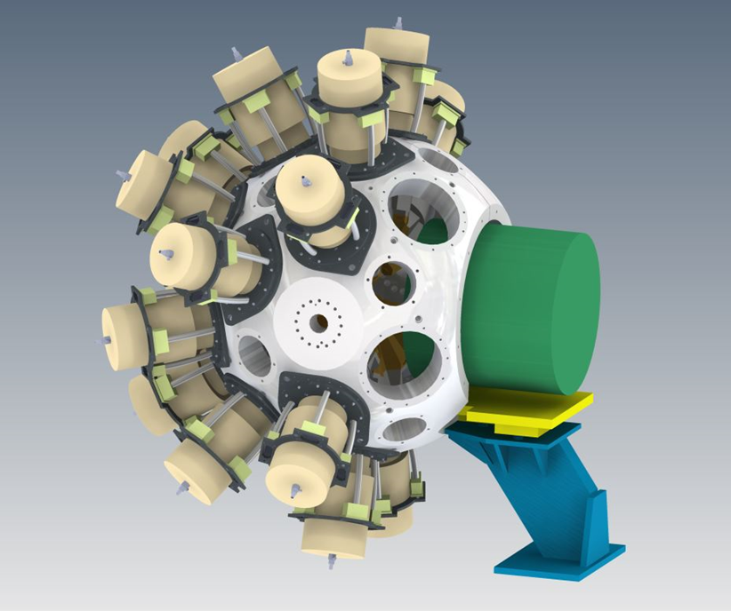
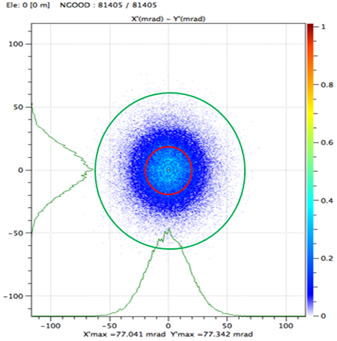
Studies Of Proton-rich Nuclei With GRETINA And FMA
Upcoming GRETINA science campaign at ATLAS
New Capabilities
New FMA quad-magnets
  Closer to target position (inside GRETINA frame);
  Larger acceptance solid angle:
  12 msr (FMA+GS: 2msr)
  Higher γ-ray efficiency;
  Superior Doppler correction;
  γ-ray polarization measurements
Digital FMA DAQ
  Higher counting rate

Slide 16
GRETINA UPGRADE, push rate limits
Goals :
  50kHz /crystal front end rate, acceptable resolution
  >=2 kHz / crystal readout and decomposition rate, acceptable position resolution
Solutions:
  Improved trigger validation window
  Down sampled readout @ 50 MHz
  Decreased Integration time: 2 ms
Results:
  ~45kHz/crystal
  Data Throughput: 2300 events/sec (50MHz)
  Acceptable energy and position resolution
Courtesy by Chris Campbell

Slide 17
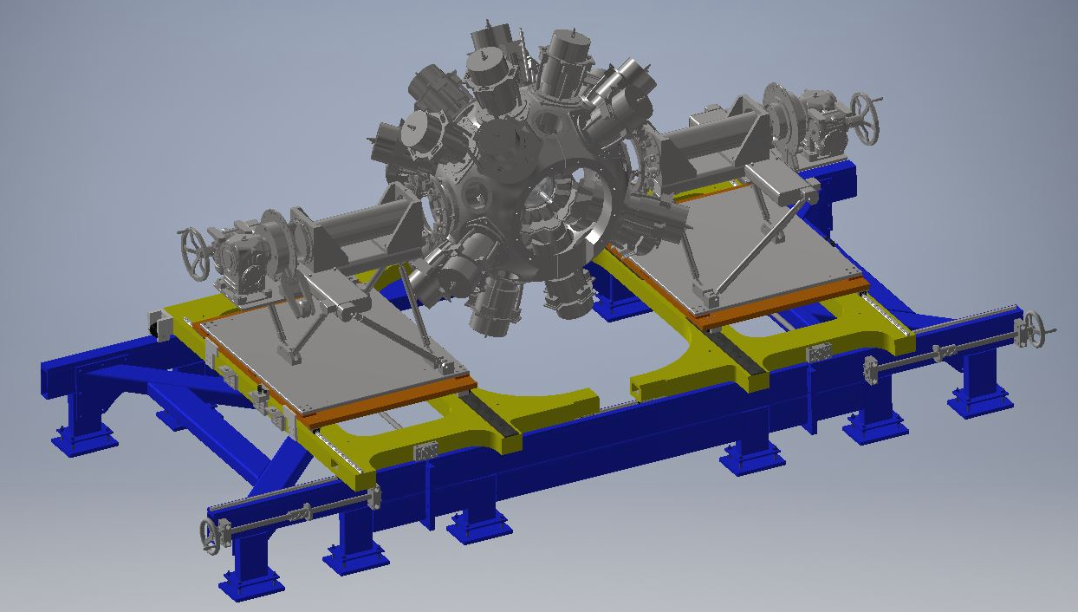
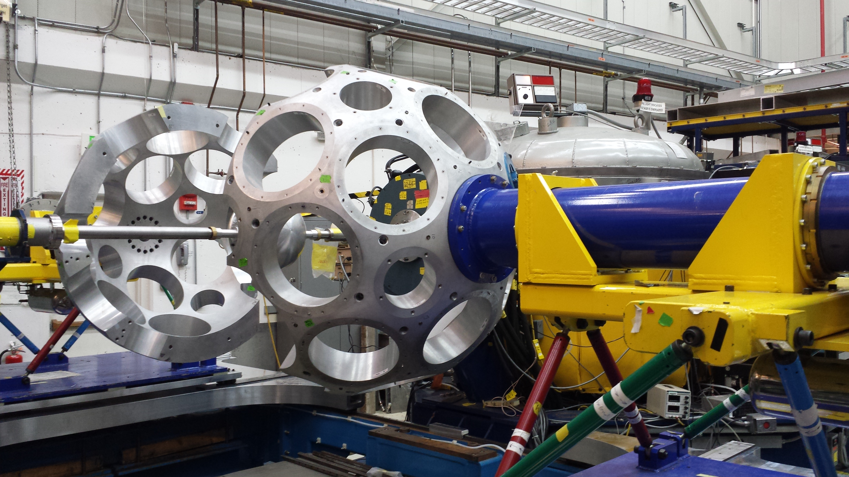
GRETINA (S. Zhu) /FMA (D. Seweryniak) Campaign
New Quad
GRETINA in front of FMA

Slide 18
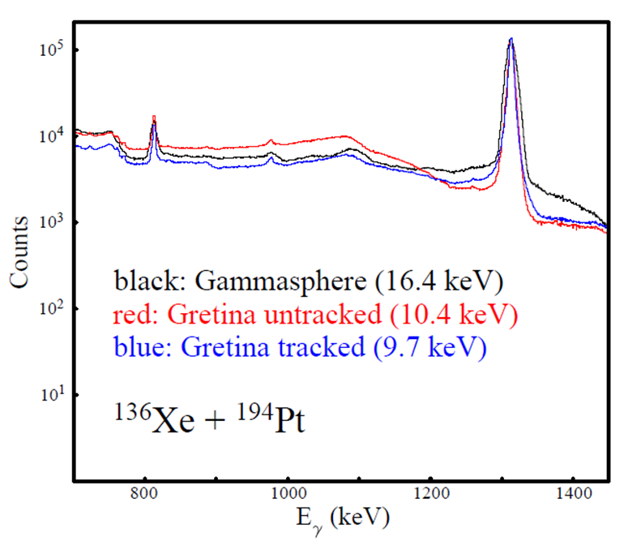
STUDIES with stable and CARIBU beams with GRETINA and CHICO II
  R. V. F. Janssens et. al., Shape coexistence in the neutron-rich germanium isotopes ⁷²Ge and ⁷⁶Ge
  S. Zhu et. al., Angular Distribution Measurements of Target-Like Products of N=126 Neutron-Rich Isotopes
  R. V. F. Janssens et. al., Shape Coexistence in ⁶⁴Ni?
  J. Li et. al., Properties of high-lying 0⁺ states in ⁷⁰Zn
  S. Zhu et. al., Octupole Strength of Condensing Octupole Phonons in ²⁴⁰Pu
  J.M. Allmond et. al., Shape Evolution and Coexistence in the Mo-Ru Region: A Request for Additional Beam Time with the New EBIS
  A. O. Macchiavalli et. al., Octupole Correlations in neutron-rich Ba nuclei: Coulomb Excitation of odd-A ¹⁴³Ba and ¹⁴⁵La
C.Y. Wu and J. Henderson (LLNL)

Slide 19
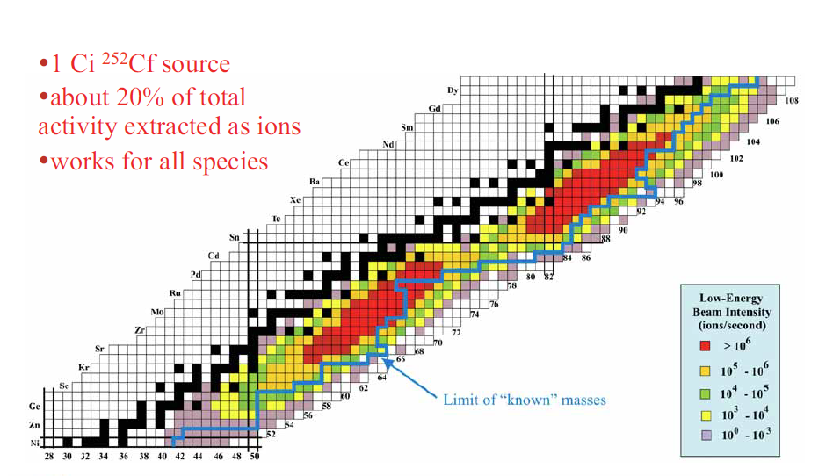
Coulomb Excitation with CARIBU Beams
Mass Yields from SF of ²⁵²Cf
Sr-Zr-Mo region – nuclei with most deformed ground states, triaxility
Xe-Ba-Ce region – one of only a few regions exhibiting enhanced octupole collectivity.
Coulomb excitation experiments performed in first GRETINA campaign at ATLAS include ¹⁴⁵Ba, ¹⁰⁴Mo, ¹⁰⁶Mo, ¹¹⁰Ru … most are only possible at ATLAS

Slide 20
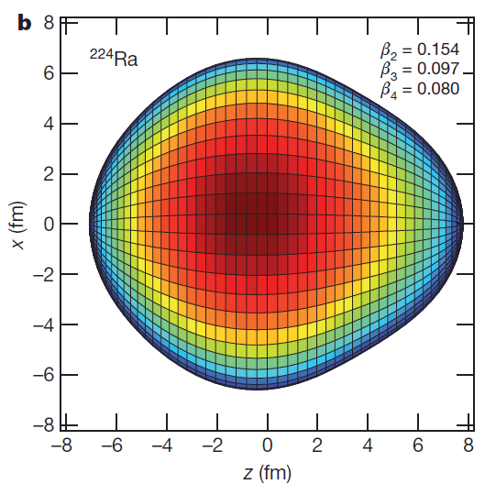
Octupole deformation in atomic nuclei
Long-range interactions between single particle states with Δj = Δl = 3;
}
j_{15/2}
g_{9/2}
~134
126
224Ra
}
i_{13/2}
~88
f_{7/2}
82
144Ba
}
h_{11/2}
d_{5/2}
~56
Previous GRETINA campaign:
¹⁴⁴Ba- ¹⁴⁶Ba CARIBU re-accelerated beam
Coulomb excitation using 3000-10000 ions/sec with CHICO II coupled to GRETINA
Results
¹⁴⁶Ba: B(E3;3-→0+) = 48⁺²¹₋₂₉ W.u.
¹⁴⁴Ba: B(E3;3-→0+) = 48⁺²⁵₋₃₄ W.u.
These results are consistent with stable octupole deformation.
50
g_{9/2}
}
~34
p_{3/2}
28
B. Bucher, S. Zhu et al., Phys. Rev. Lett. 116, 112503 (2016)
B. Bucher, S. Zhu et al., Phys. Rev. Lett. 118, 152504 (2017)

Slide 21
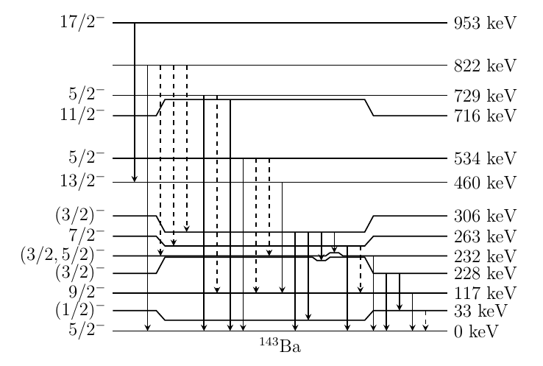
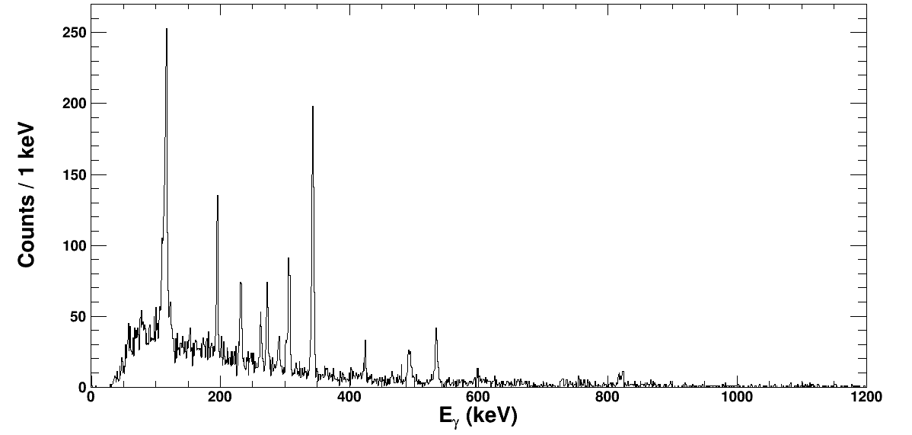
Coulomb Excitation of neutron-rich ¹⁴³Ba
A. O. Macchiavelli et al.,
Single-particle coupling to Quadrupole and Octupole collective modes
Recent IBMF calculations [Nomura et. al. PRC 97, 024317 (2017)] suggest weak collectivity in both degrees of freedom
CHICOII and CARIBU
~3000 pps ¹⁴³Ba at 630 MeV on 2mg/cm² ²⁰⁸Pb
Observed transitions
Doppler-reconstructed GRETINA spectrum
9/2⁻ → 5/2⁻
13/2⁻ → 9/2⁻
*
*
*
17/2⁻ → 13/2⁻
*
*
*
Yrast band states
Unfavored states
Non-yrast states
Bckg ?
*
*
*
*
Notes:
18000pps expected….

Slide 22
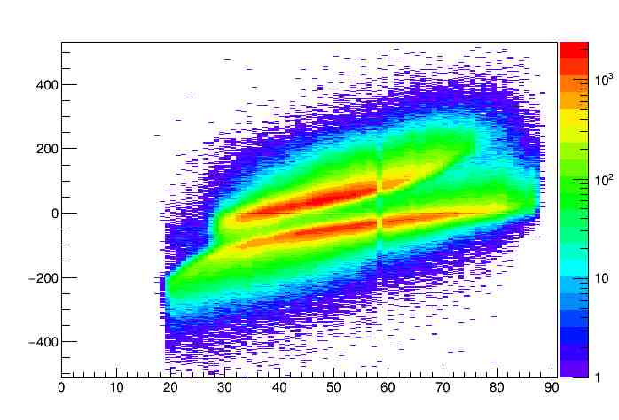
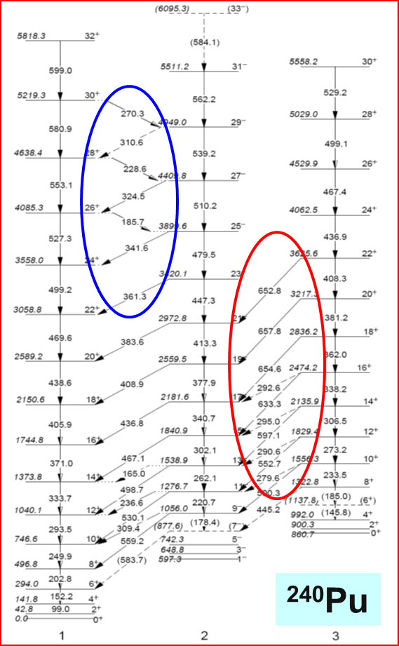
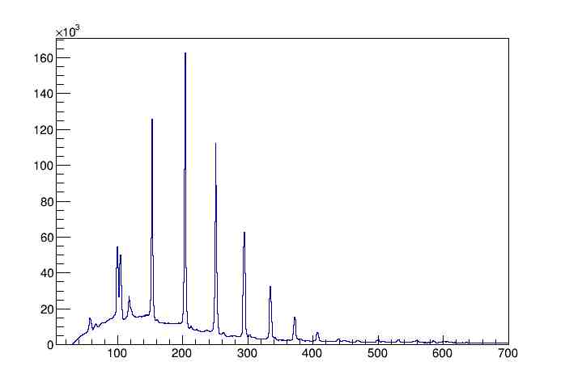
Double-Octupole Phonon bands in ²⁴⁰Pu
S. Zhu et al.
Coulomb Excitation Measurements
²⁴⁰Pu
ΔT (100 ps)
¹³⁶Xe
Scattering Angle (degree)
γ rays in ²⁴⁰Pu
2-phonon
1-phonon
0-phonon
Energy (keV)

Slide 23
Coulomb Excitation of Neutron-rich Ru/Mo
M. Almond, D. Doherty et al.
Coulomb excitation of reaccelerated radioactive refractory isotopes
Present : ¹¹⁰Ru, ^{104,106}Mo
Future : ¹¹²Ru
Are the neutron-rich refractory isotopes triaxially deformed or oblate close to their ground state?

Slide 24
EBIS (2018) vs ECR(2015)
2₁->0₁
4₁->2₁
2₂->0 /
3₁->2₂
2₂->2₁
6₁->4₁
4₂->2₂
8₁->6₁
Factor ~2.5 improvement in statistics from
~60 hours of data
e.g. A(240) ~ 3600

Slide 25
New Information on ¹¹⁰Ru Coulex
8⁺
1945
Observed in previous study
New information from Coulex
New information from beta decay. Branching and mixing ratios
705
4⁺
1084
472
GOISA Re-analysis
Fit to gamma-ray yields and known spectroscopic data
Extended set of matrix elements, with improved precision
M1 matrix elements to be added
Quadrupole Sum Rules yield 𝜸 = 29(6)°,
Previous work: D. T. Doherty, J. M. Allmond et al., Phys. Lett. B766 (2017) 334

Slide 26
New Results on ^{104,106}Ru
¹⁰⁰Mo
¹⁰²Mo
¹⁰⁴Mo
A similar story to the n-rich Ru isotopes (see systematics)
Excellent data obtained with CARIBU beams and EBIS source, see spectrum below (courtesy J. M. Allmond)

Slide 27
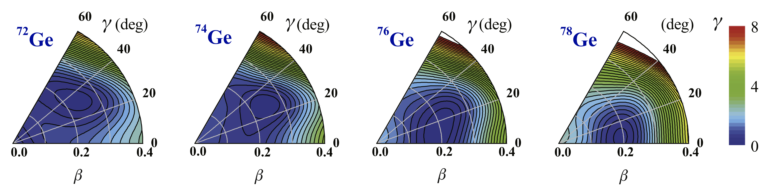

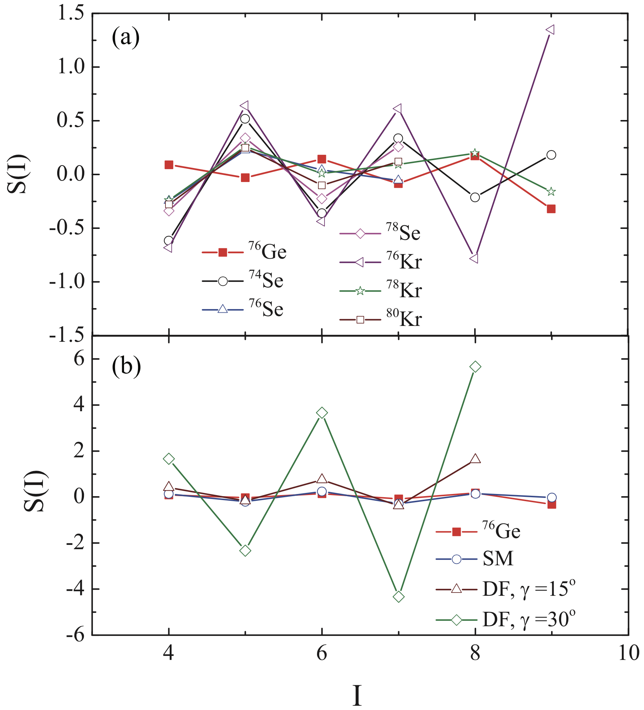
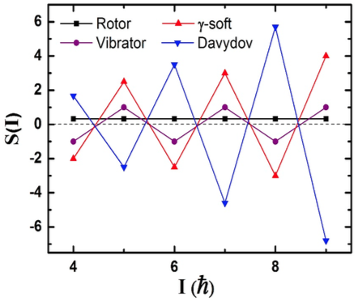
TriaxialITY in Ge isotopes
Triaxiality plays a role in structure of Ge isotopes
J.J. Sun et al. Physics Letters B 734 (2014) 308–313
Energy Staggering for the γ bands provide evidence of triaxiality
Are energies alone sufficient to answer the question of RIGID triaxiality in ⁷⁶Ge?
E. A. McCutchan et al., Phys. Rev. C76 (2007) 024306
Y. Toh et al. Phys. Rev. C87, 041304(R) (2013)

Slide 28
⁷⁶Ge Coulomb excitation GRETINA/CHICO ii
A.D. Ayangaekaa, R.V.F. Janssens et al.

Slide 29
Matrix elements from GOSIA Analysis
⟨cos 3δ⟩
σ⟨cos 3δ⟩
The expectation values of the asymmetry of the intrinsic frame E2 properties of the ground-state band.
Four independent values of ⟨cos 3δ⟩ are shown for each state; one from the third-order (red) and three from the fifth-order invariant.
Statistical fluctuation or variance of the asymmetry deformation for the ground-state band.
Three independent measure of σ⟨cos 3δ⟩ for each state are shown. This provide a test of convergence.
Similar results are obtained for the gamma-band in ⁷⁶Ge
This work has been submitted to Phys. Rev. Lett. – A.D. Ayangeakaa et al.,

Slide 30
FMA – GRETINA Experiments
New FMA entrance quad
  D. Seweryniak et. al., Integration of the digital FMA DAQ with the GRETINA DAQ
  D. Seweryniak et. al., Core excitations and single-neutron states in ¹⁰¹Sn
  D. Seweryniak et. al., Mirror-energy differences in the A=93, T=1/2 mirror pair ⁹³Ag-⁹³Pd
  C. R. Hoffman et. al., First Study of ³⁸S at High Excitation via Fusion Evaporation
  G. Lotay et. al., The importance of the ³³Cl(p,γ)³⁴Ar reaction in explosive binary systems : Spectroscopy of ³⁴Ar with GRETINA (see talk this workshop)
  M. Petri et. al., Electromagnetic transition rates in ²²O and ²³F (did not run due to ¹⁴C beam)
Measured acceptance
Gammasphere target position 90 cm from 1st quad (2msr)
GRETINA target position 30 cm from 1st quad (12msr)

Slide 31
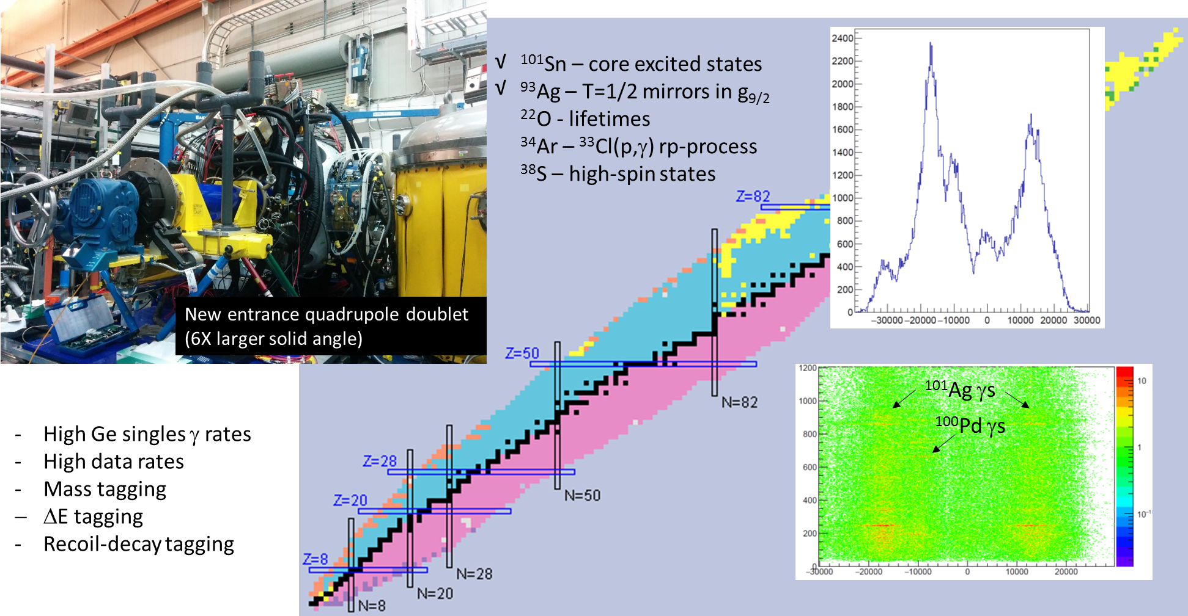
GRETINA/FMA experiments
¹⁰¹Sn : core excitations
⁹³Ag : T=1/2 mirrors in g_{9/2}
³⁴Ar : ³³Cl(p,γ) rp-process
³⁸S : high-spin states
²²O : Lifetimes
Courtesy by D. Seweryniak

Slide 32
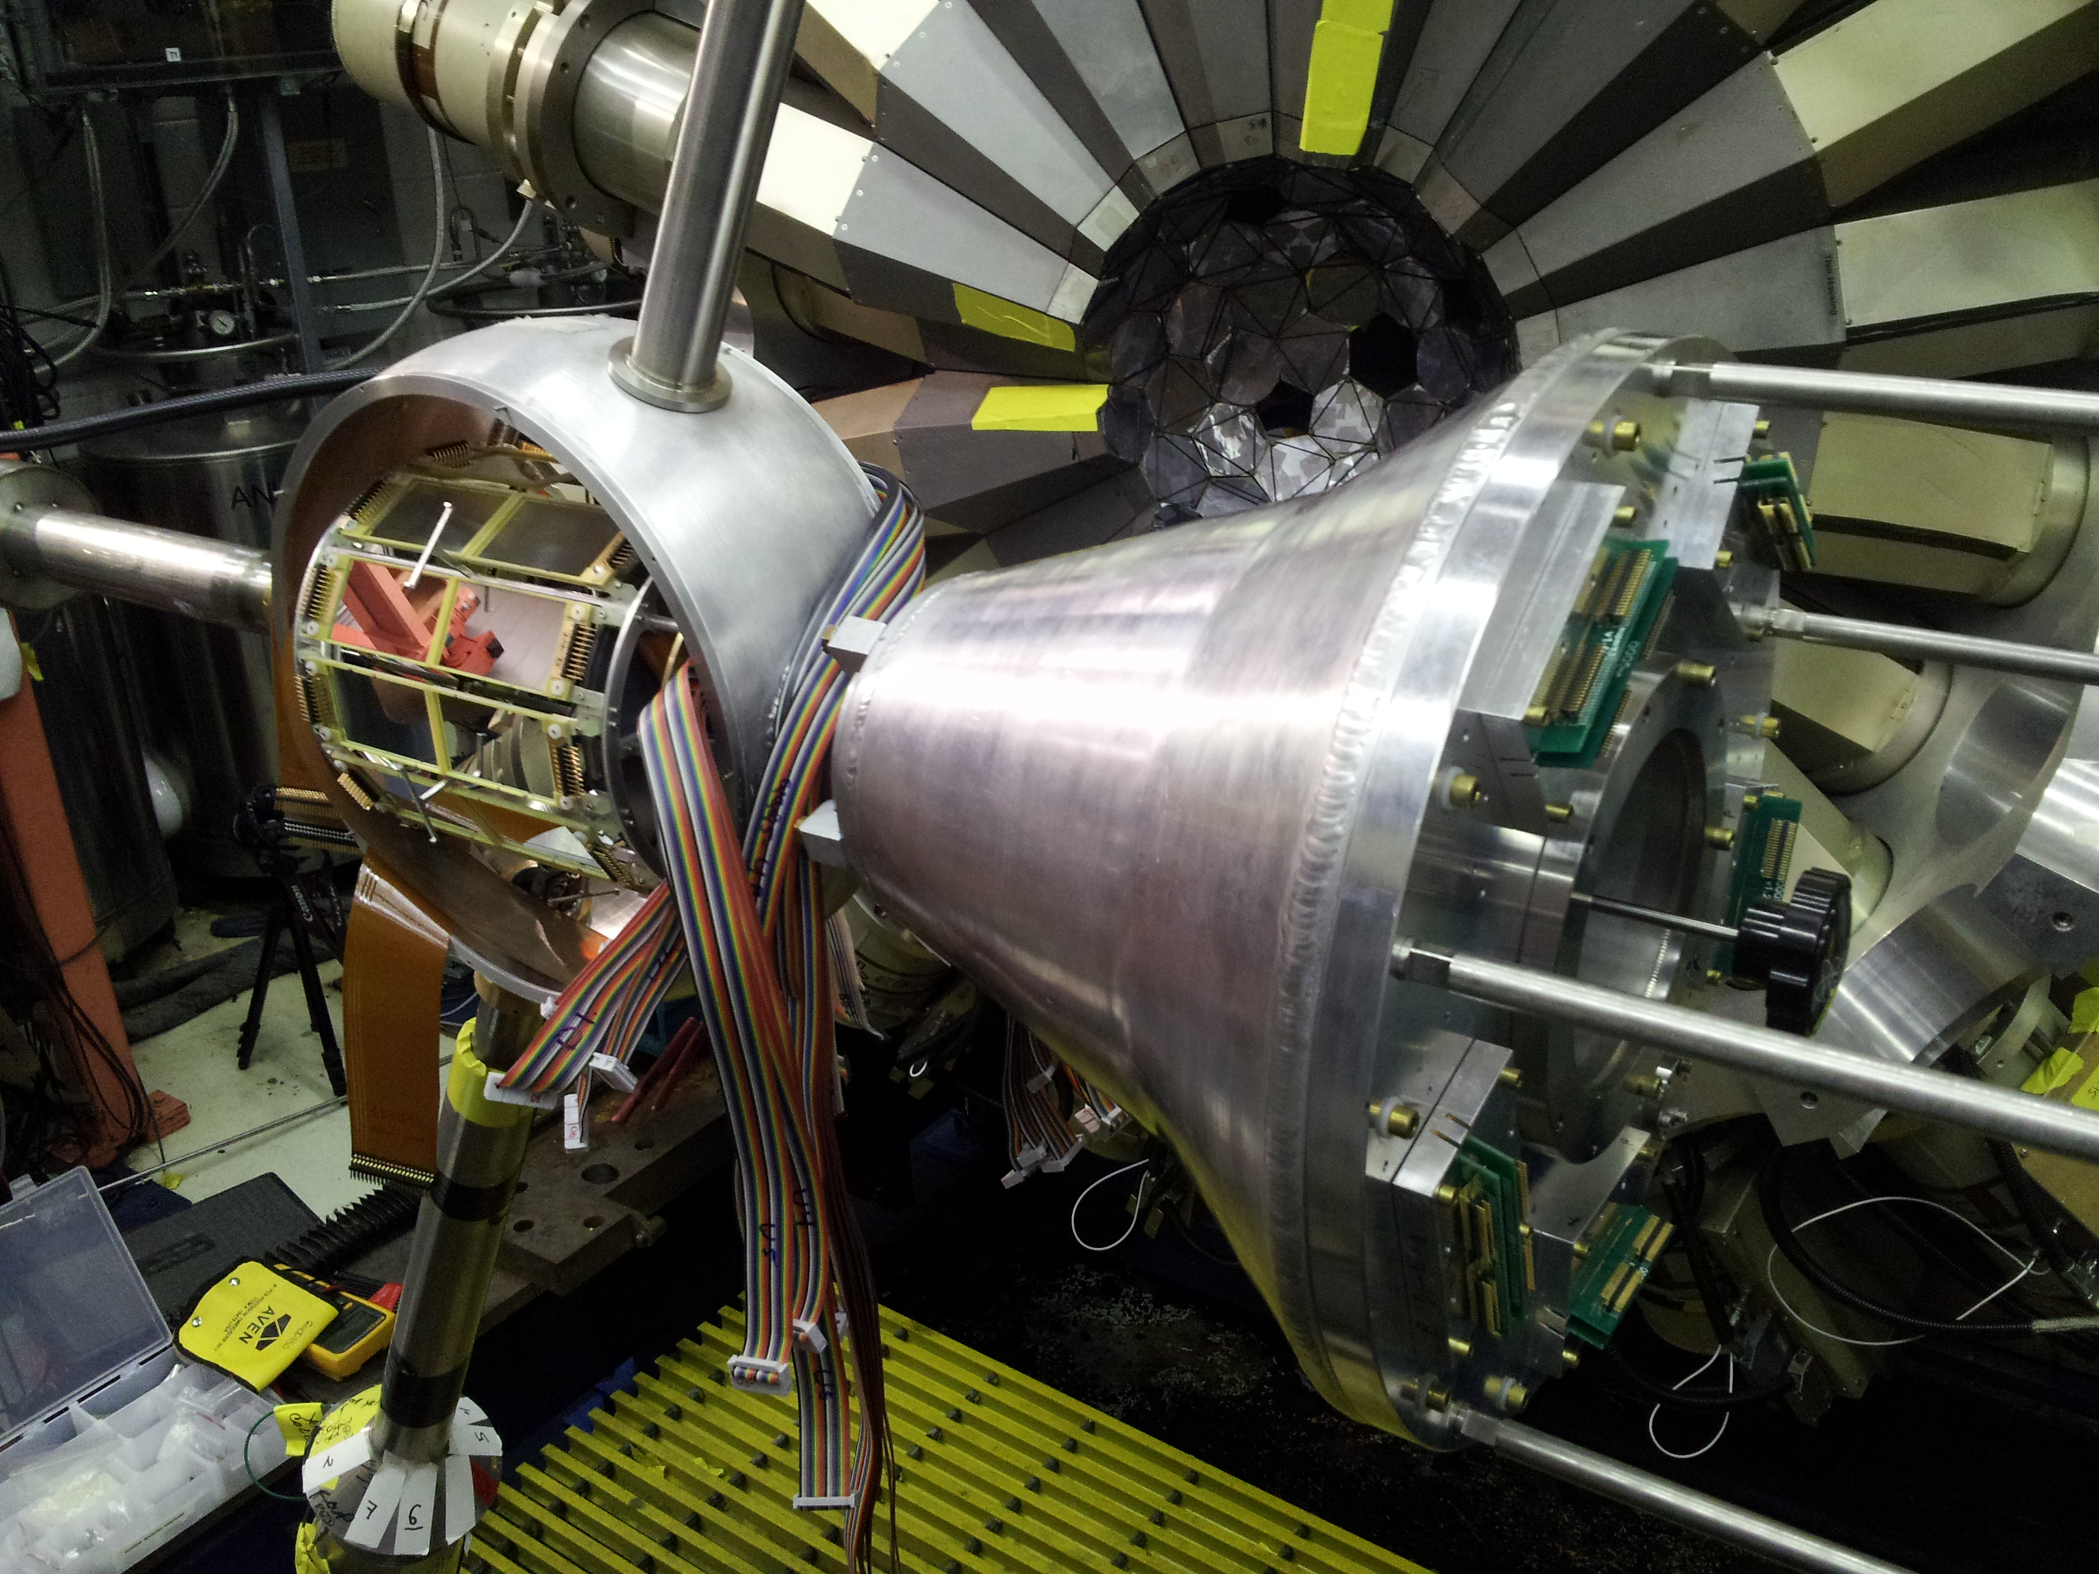
GRETINA – GODDESS Experiments
  S. Pain et. al., Measurements of (d,pγ) on neutron-rich Xe and Te with CARIBU beams (CARIBU)
  S. Pain et. al., Constraining the ³⁰P(p,γ)³¹S reaction using ³⁰P(d,pγ)³¹P with GODDESS (In-flight-RAISOR)
  M. D. Jones et. al., Determining the E1/M1 polarization of the Low-energy Enhancement in the gamma-ray Strength Function of ⁵⁶Fe
  J. Cizewski et. al., Deducing the ¹⁴³Ba(n,γ) cross section via surrogate (d,pγ) with GODDESS (CARIBU) Did Not Run
GODDESS is a coupling of ORRUBA with forward and backward annular strip detectors for reaction studies with γ-rays. G-rays provide resolution when used with reactions in inverse kinematics.
~700 channels – DAQ synched with GRETINA resulting in synchronized timestamps.
3 experiments were during the current installation with GRETINA
S. Pain (ORNL), J. Cizewski (Rutgers) and A. Ratkiewicz (LLNL)

Slide 33
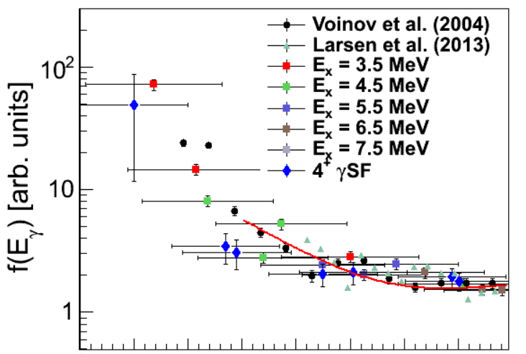

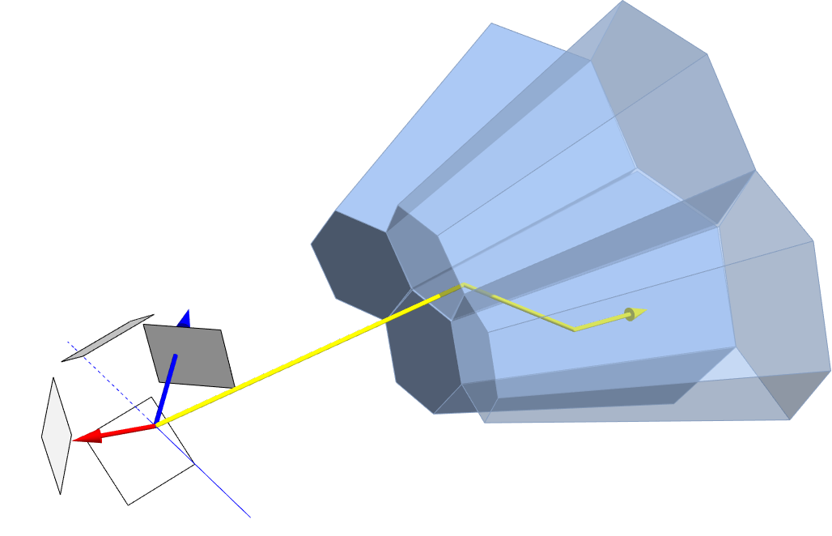
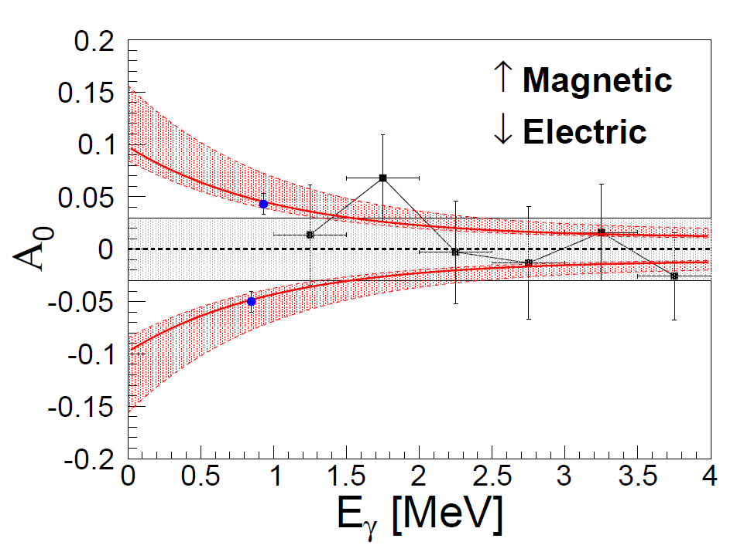
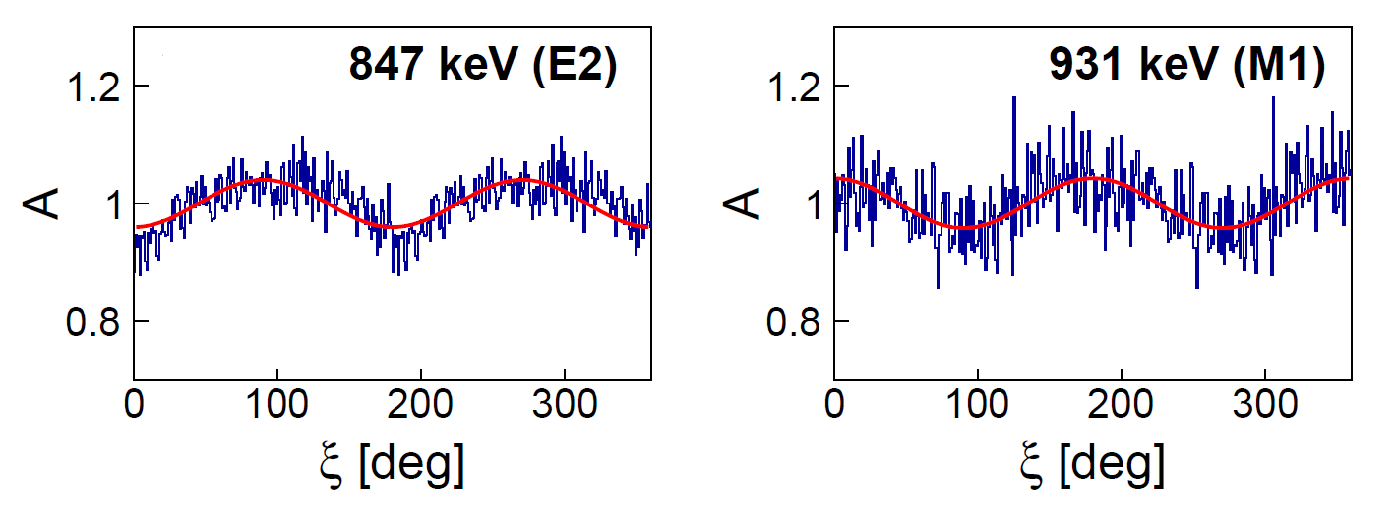
low-energy enhancement in the γSF in ⁵⁶Fe
Extract γSF using a model independent method
M. Wiedeking et al. PRL 108, 162503 (2012)
????
Determine M1/E1 character of the “up-bend”
using GRETINA polarization sensitivity
M. D. Jones et al. PRC 97, 024327 (2018) GRETINA @ ATLAS I
⁵⁶Fe(p,p’)
γ₁
γ₂
p’
p
Improved experiment with GODDESS will provide a definite answer(~ x10 statistics). Analysis on-going

Slide 34
Summary
GRETINA has been successfully installed att ATLAS for a 2nd campaign and running a program to maximize its physics reach using both stable and radioactive ions beams
Total of 16 PAC-approved experiments were performed with most of the final results still pending.
Lots of Collaborators: More than 100 scientists from more than 15 institutes.
ATLAS has requested to host GRETINA between the time NSCL ceases operations, October 2020 and availability of FRIB beams for day 1 experiments sometime in FY22.
GRETINA will operate until ~2023 with current electronics and support frame – at which point detectors will become part of GRETA with new electronics and support structure.
Thanks to S. Zhu, R.V.F. Janssens, A.O. Macchiavelli, D.T. Doherty, D. Seweryniak, and A.D. Ayangeakaa for allowing me use of their slides and presentation of their data.

Slide 35
GRETINA TEAM
ANL: S. Zhu, J. Li, S. Stolz, J. Anderson, K. Auranen, M.P. Carpenter, R.V.F. Janssens, T. Lauritsen, D. Potterveld, J. Rohrer, G. Savard, D. Seweryniak, B. Zabransky
LBNL: C.M. Campbell, H. Crawford, M. Cromaz, P. Fallon, A.O. Macchiavelli
NSCL: D. Weisshaar
ORNL: J. M. Allmond
CHICO-II: C-Y. Wu, J. Henderson, D. Cline
LLNL and U. of Rochester
GODDESS: S. Pain, K. Chipps, A. Ratkiewicz, J. Cizewski, and many others.
ORNL, LLNL, Rutgers, Univ. TN, Univ. Notre Dame
Supported by the DOE Office of Science

Slide 36
Thanks for your Attention!

