Slide 1






NuSpIn 2019 & Annual AGATA collaboration meeting
24th – 28th June 2019, Orsay
Spectroscopy of C, N, O, F neutron-rich nuclei
with AGATA+PARIS+VAMOS
Sara Ziliani
E676 experiment
Spokepersons: S. Leoni, B. Fornal, M. Ciemała

Slide 2
Outline
Experiment and physics case
  Experimental setup
    Reaction products
      High-precision spectroscopy of the reaction products:
        ²⁰O
        Focus on ¹⁷N - ¹⁸N - ¹⁹N

Slide 3
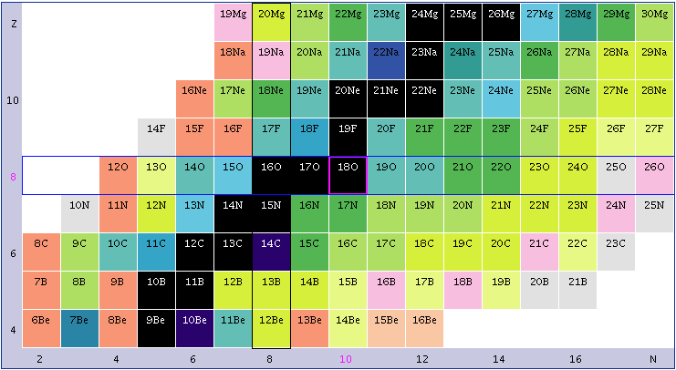
Experiment and physics case
Lifetime measurements of the second 2⁺ state in ¹⁶C and ²⁰O: a stringent
test of the three body forces with the AGATA+PARIS+VAMOS setup
Experiment Performed in July 2017
13 days
See M. Ciemała's talk
¹⁸O (7 MeV/A) on ¹⁸¹Ta (6 mg/cm²)
Spectroscopy of n-rich B, C, O, N, F nuclei by deep-inelastic reactions
Limited spectroscopic information in this region of mass
Importance of these nuclei in astrophysics processes, especially in nucleosynthesis
¹⁸O

Slide 4
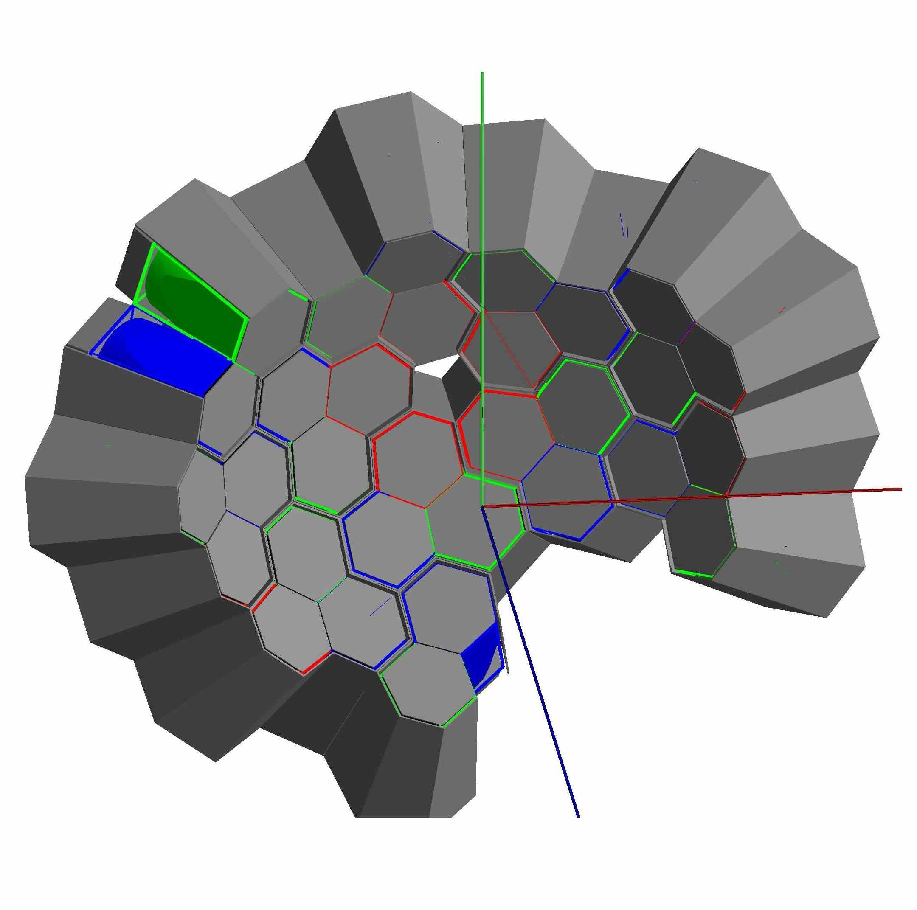
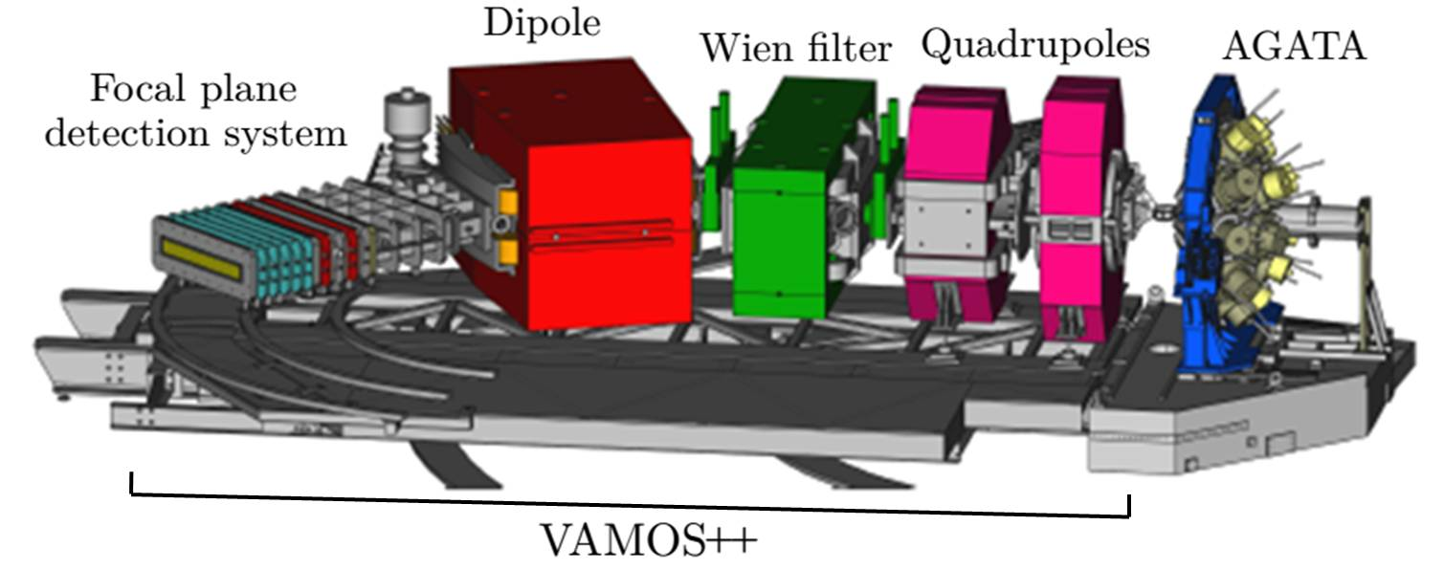

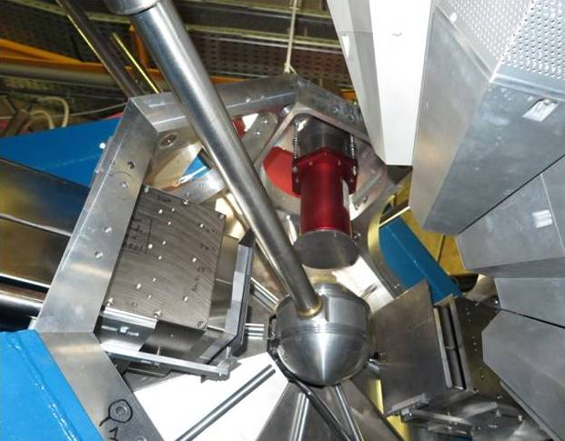
Experimental setup
¹⁸O (7 MeV/A) on ¹⁸¹Ta (6 mg/cm²)
AGATA (10 TC+ 1 DC=32 crystals)
31 crystals working
PARIS-Demonstrator @ 23 cm
2 Clusters + 2 Large volume LaBr₃
VAMOS++ @ 45°

Slide 5
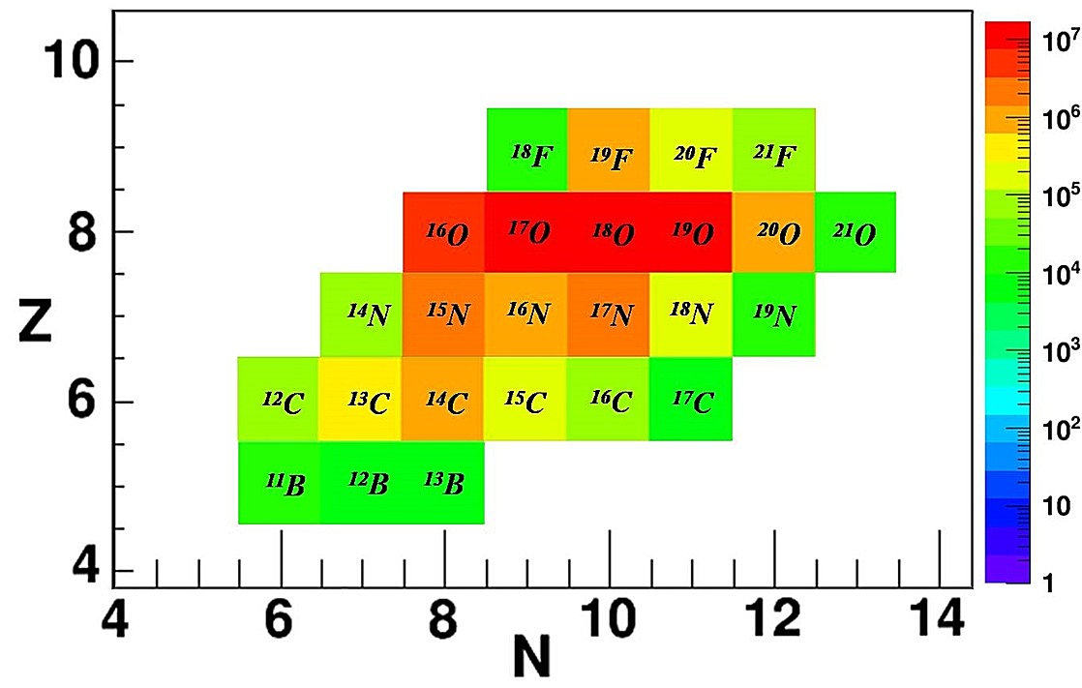
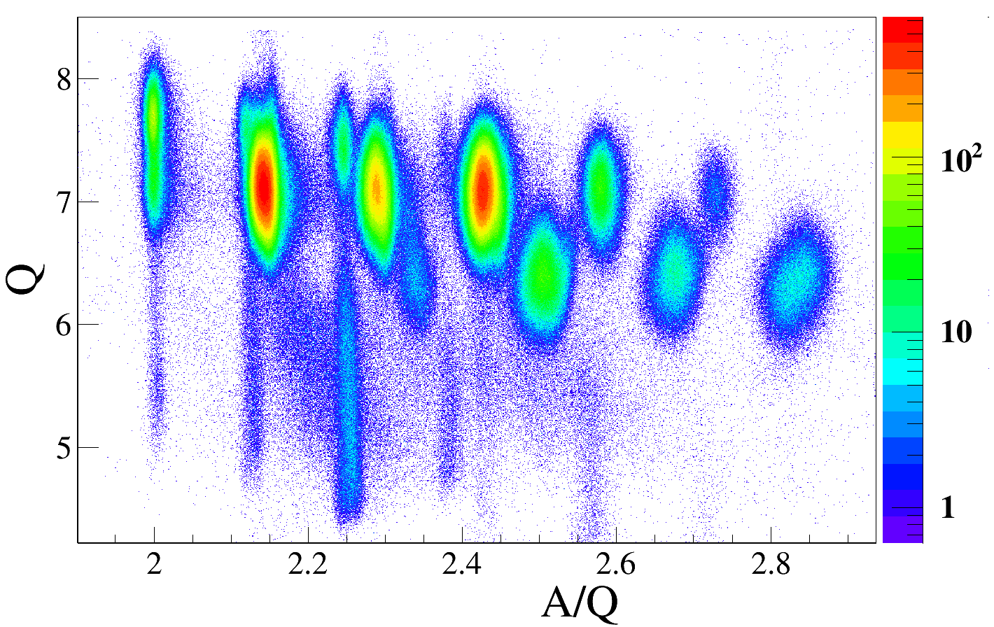
Reaction products
¹⁸O (7 MeV/A) on ¹⁸¹Ta (6 mg/cm²)
Reaction products (deep-inelastic reaction): main focus on ^{17,18,19}N isotopes
¹⁴N
¹⁵N
¹⁶N
¹⁷N
¹⁸N
¹⁹N
Other charge states
Need for high-precision spectroscopy to verify and extend very old information quoted in the database

Slide 6
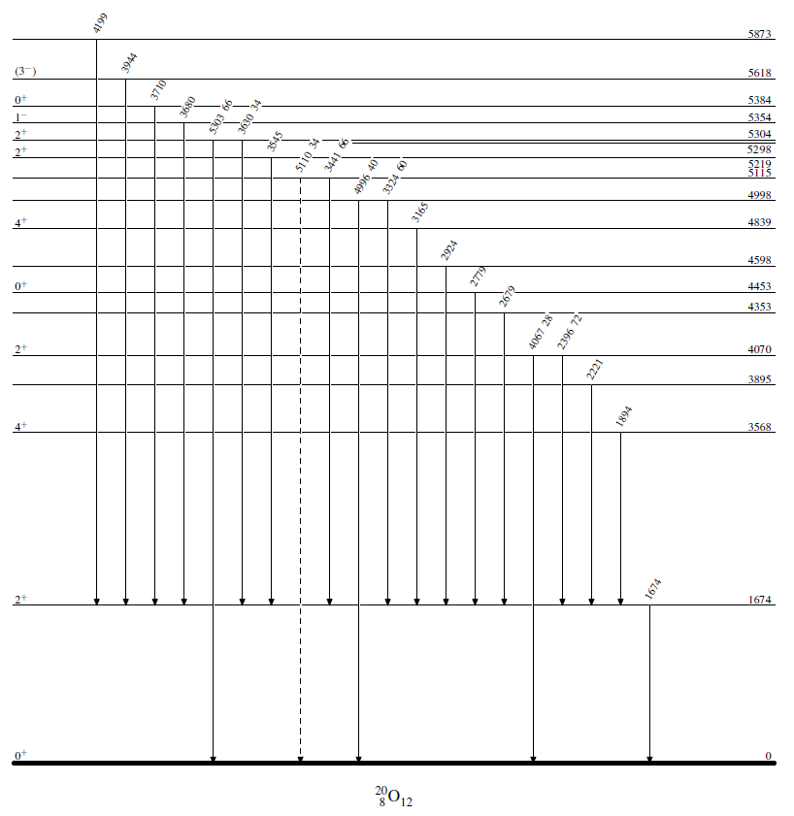
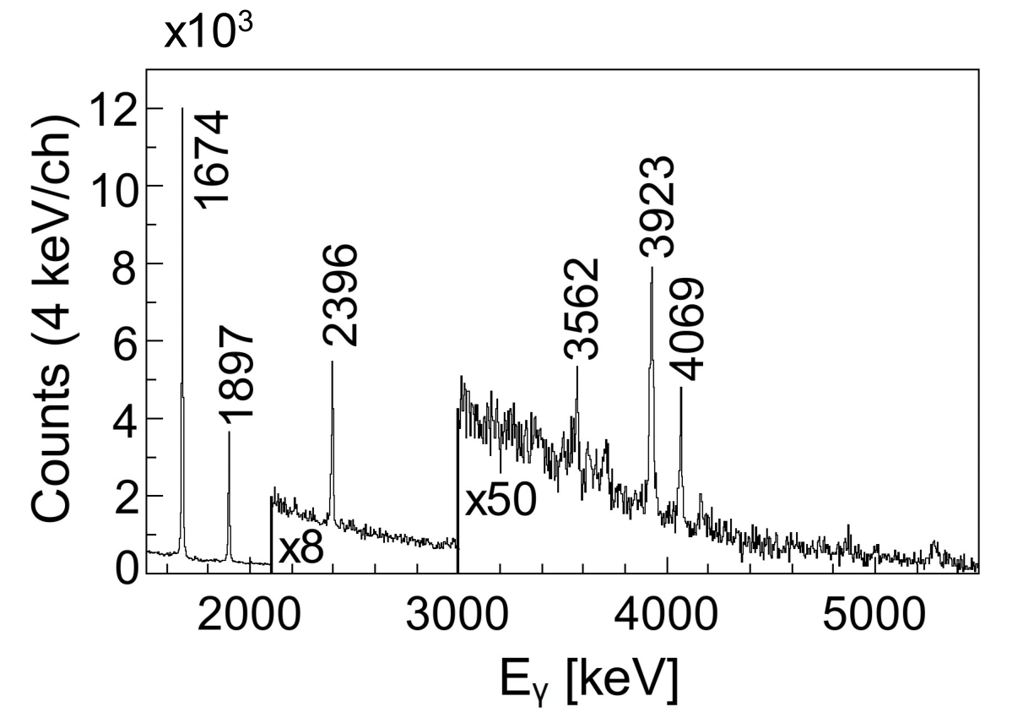
²⁰O
5572 (3)
3710
5288 (3)
5004
4865 (5)
3625
3568
4165
4865
5288
4165 (2)
Previously observed γ rays
New γ rays
* Wiedeking et al.,Phys. Rev. Lett. 94, 132501 (2005)
*

Slide 7
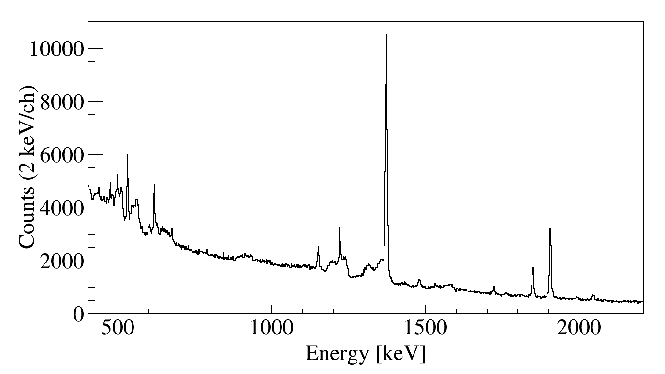
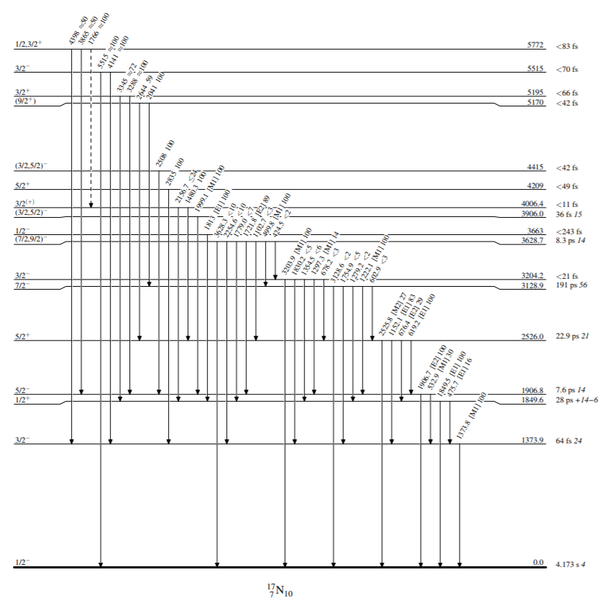
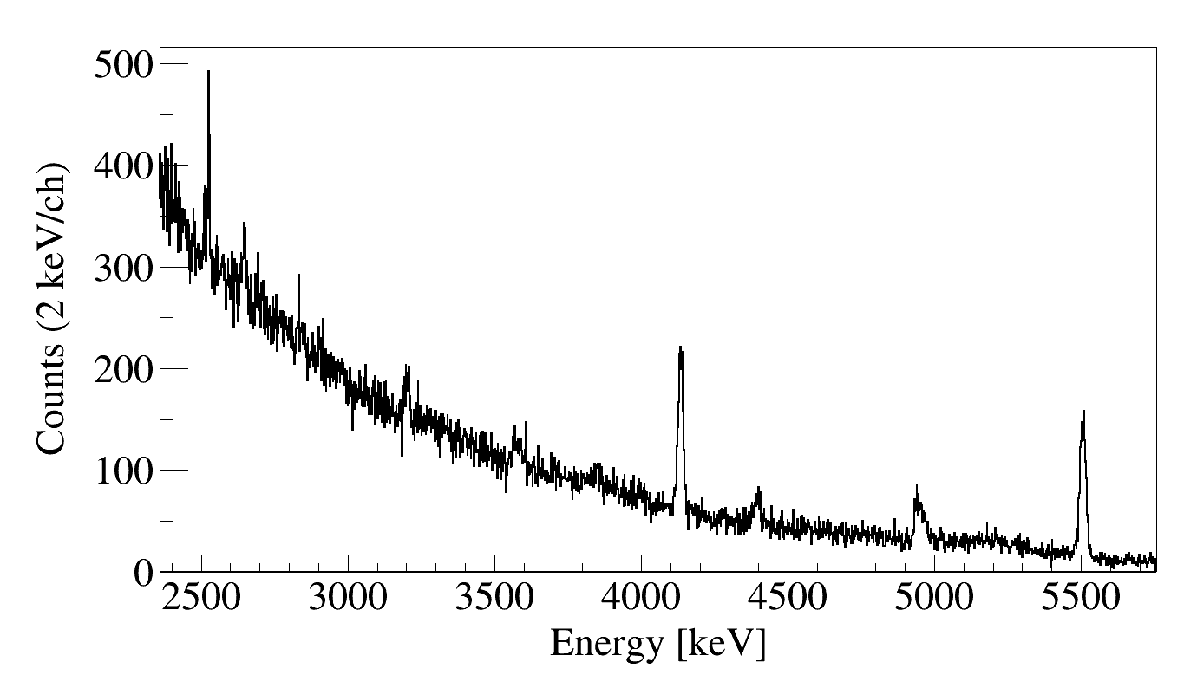
¹⁷N
T_{1/2}
532.62(6)
1373.92(2)
1906.64(4)
499.6(2)
1999,1(20)
619.74(8)
< 42 fs
1222.6(2)
1152.14(13)
1480.6(5)
1850.18(8)
< 42 fs
1722.6(3)
2045.1(3)
< 11 fs
2510.9(8)
2646.9(11)
2526.6(3)
3203.3(12)
4141(3)
5515(3)
3865(3)
4398(3)
‡
‡ NNDC www.nndc.bnl.gov/nudat2/

Slide 8
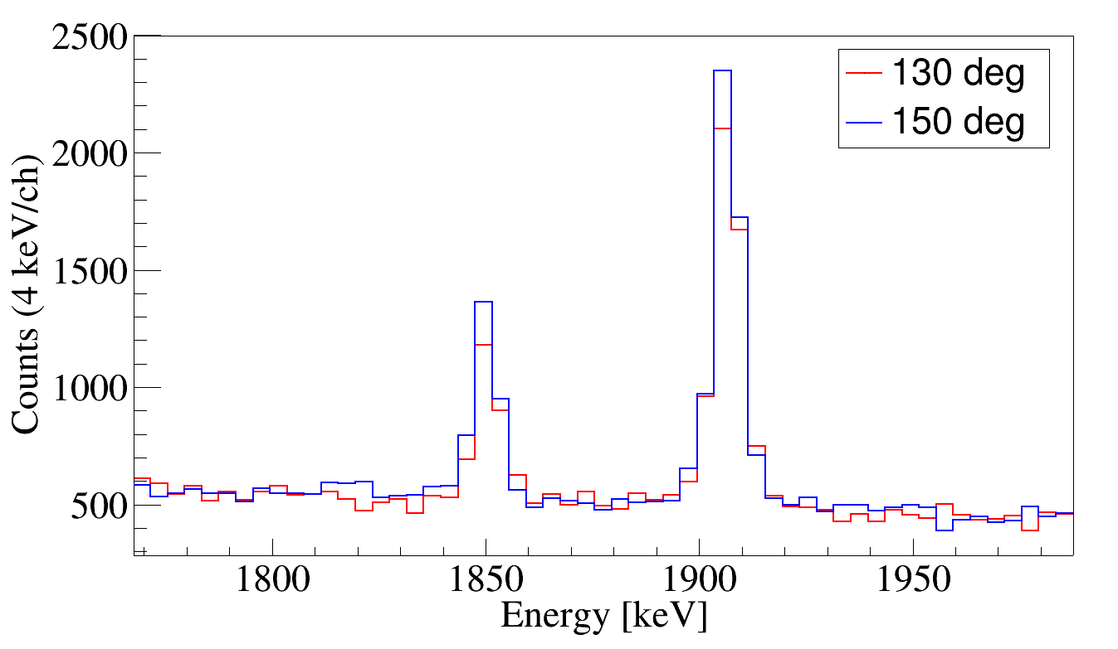
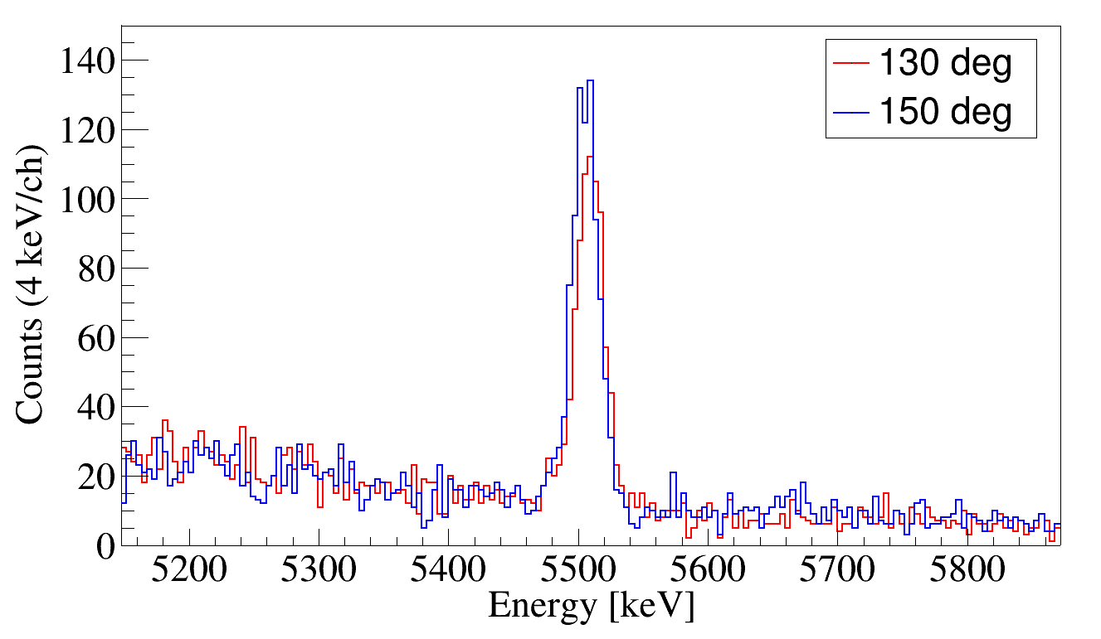
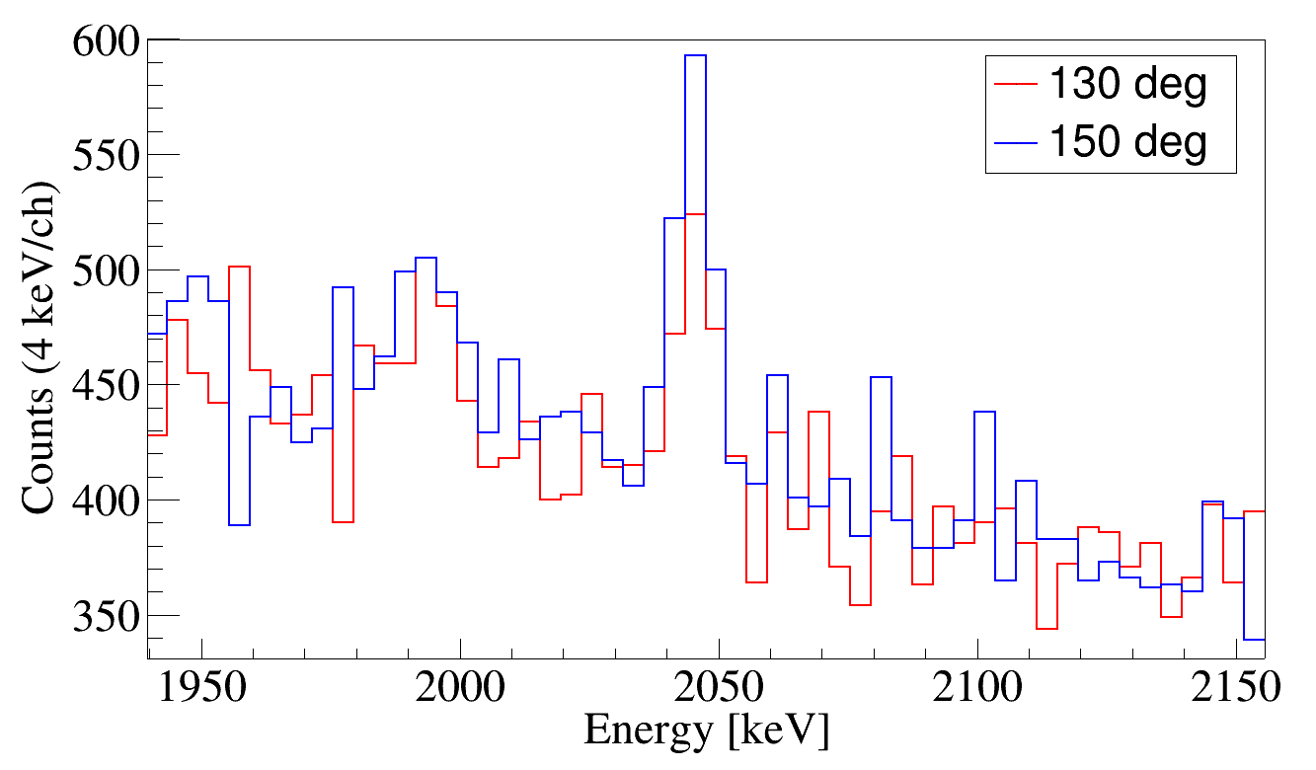
¹⁷N: lifetimes
Long lifetime
No shift observed
Short lifetime
Shift observed
T_{1/2} = 7.6 ps
T_{1/2}<70 fs
T_{1/2} = 28 ps
5/2⁻ → g.s.
3/2₄⁻→ g.s.
1/2⁺ → g.s.
Experimentally measured lifetime with Fractional DSAM (Rogers,1974):
T_{1/2} < 42 fs
9/2⁺→ 7/2⁻
No shift is visible!
Lifetime should be long!

Slide 9
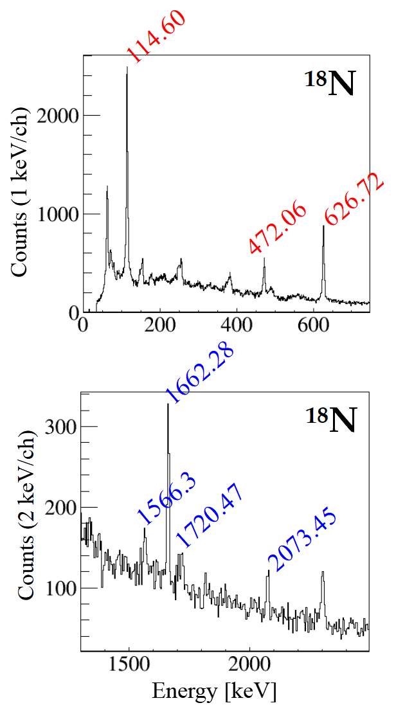
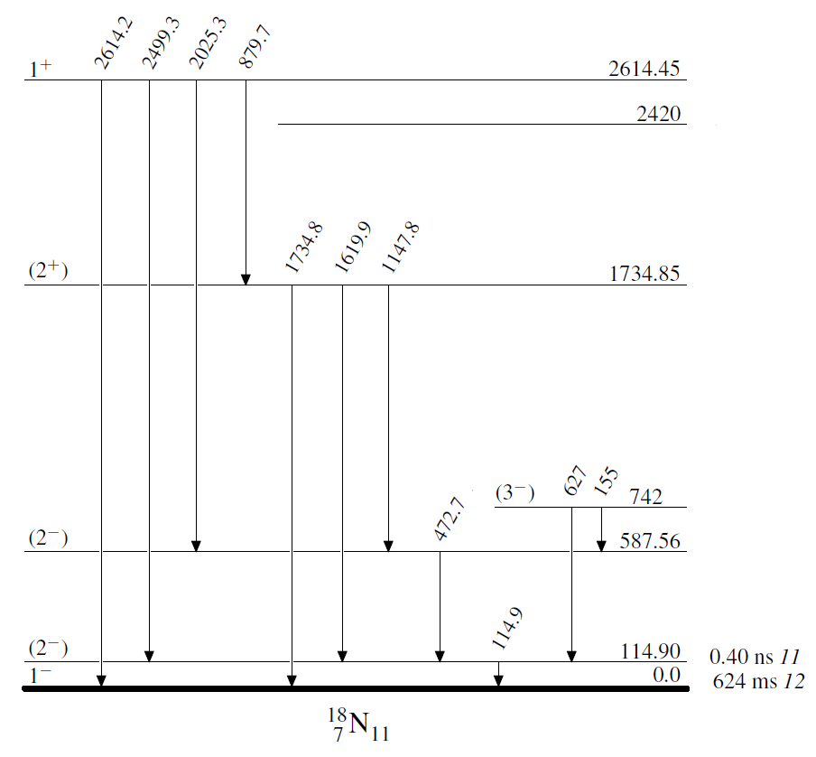
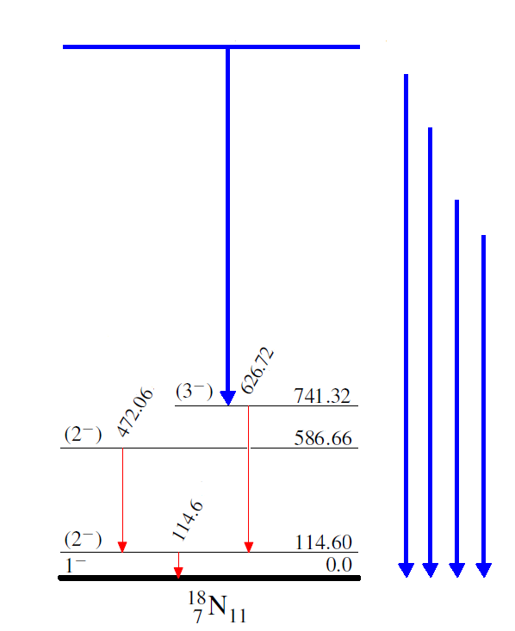
¹⁸N
Previously observed γ rays
New γ rays
Unknown collocation
1662.28
2403.60
2300.94
2073.45
1720.47
1566.3
2300.94
‡
Possibility to use AGATA-PARIS γ-γ matrices to improve statistics
‡ NNDC www.nndc.bnl.gov/nudat2/

Slide 10
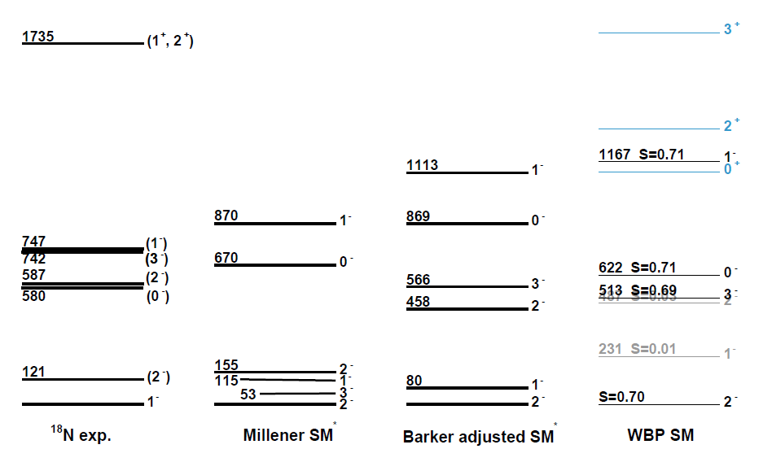
¹⁸N: comparison with theory
A challenge for theoretical predictions
1662.28
2300.94
2403.60
2073.45
1720.47
1566.3
A. Matta et al., ISOLDE proposal (2013)

Slide 11
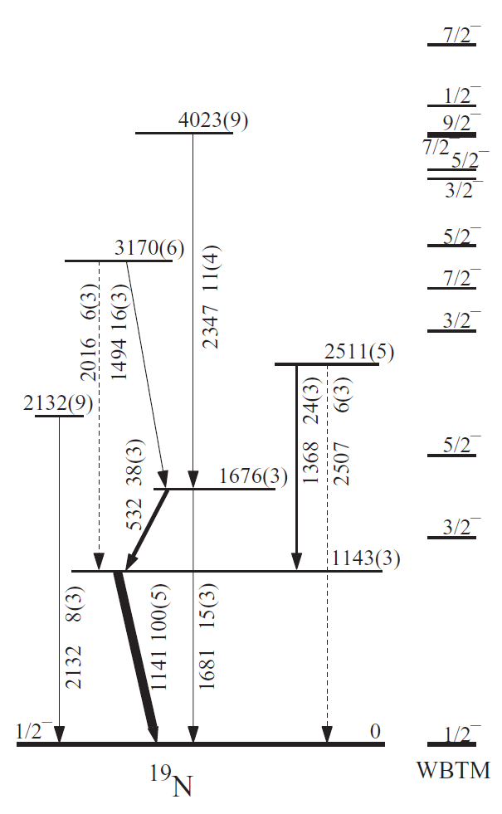
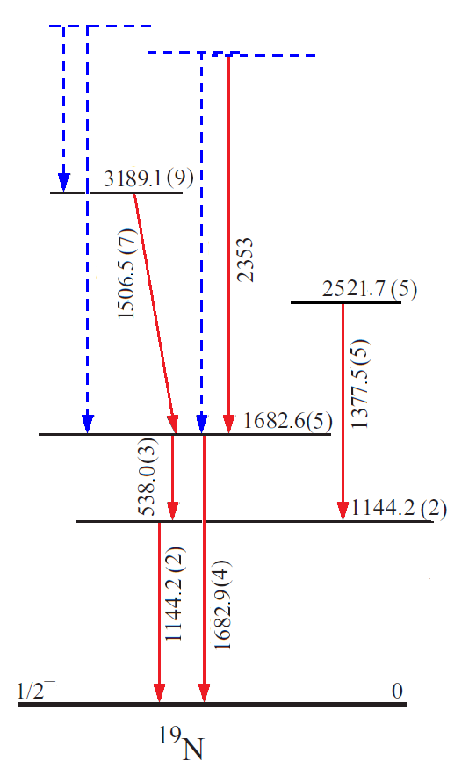
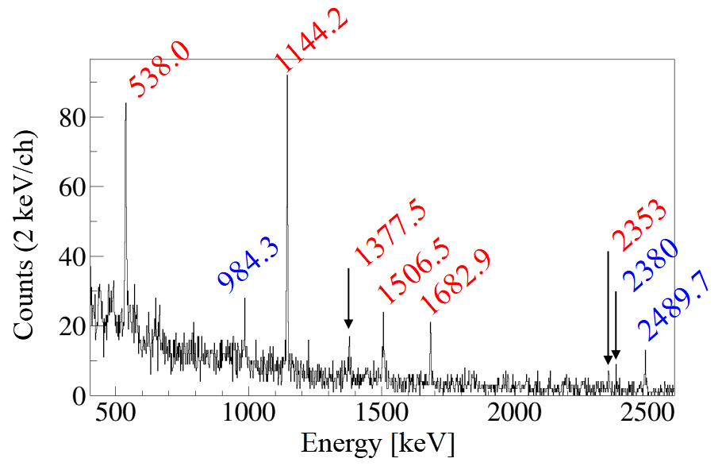
¹⁹N
Tentative collocation
4172
4063
4036
984.3 (4)
2380
Theoretical model
2489.7 (8)
Previously observed γ rays
New γ rays
**
**
** D. Sohler, Phys. Rev. C 77, 044303 (2008)

Slide 12
Conclusions
Many light n-rich isotopes produced with deep-inelastic reactions
Useful information extracted in ²⁰O and C isotopes
Focus on N isotopes:
    ¹⁷N: discrepancies with the tabulated values of the lifetimes
    ¹⁸N: new gamma rays, need for predictive theoretical models
    ¹⁹N: new gamma rays, placed in the level scheme following theory
To do:
      AGATA-PARIS coincidence matrices for the reconstruction of the level schemes
      Theoretical models for the comparison with experiment
      Estimate of lifetimes in the cases with discrepancies with the database

Slide 13
Acknowledgements
S. Leoni, S. Ziliani, F.C.L. Crespi, G. Benzoni, A. Bracco, C. Boiano, S. Bottoni, S. Brambilla, F. Camera, S. Coelli, B. Million, O. Wieland University and INFN Milano, Italy
B. Fornal, M. Ciemała, A. Maj, P. Bednarczyk, Ł.W. Iskra, N. Cieplicka-Oryńczak, J. Grebosz, M. Kmiecik, K. Mazurek, B. Wasilewska Institute of Nuclear Physics, PAN, Poland
M. Bast, M. Beckers, T. Braunroth, C. Fransen, A. Goldkuhle, C. Muller-Gatermann - IKP Cologne, Germany
E. Clément, G. De France, B. Jacquot, Y. Kim, A. Lemasson, M. Lewitowicz, H. Li, M. Rejmund - GANIL, CEA/DSAM and CNRS/IN2P3, France
O. Dorvaux, Ch. Schmitt - CNRS/IN2P3, IPHC UMR 7178, France
S. Erturk - Nigde University, Turkey
M.N. Harakeh - KVI - Center for Advanced Radiation Technology, Groningen, Netherlands
A. Karpov - JINR, Dubna, Russia
M. Kicińska-Habior - Faculty of Physics, Warsaw University, Poland
S. Lenzi, D. Mengoni - Padova University and INFN, Italy
I. Matea, I. Stefan - IPN Orsay Laboratory, Orsay, France
C. Michelagnoli - Institut Laue-Langevin (ILL), Grenoble, France
M. Matejska-Minda, P. Napiorkowski - Heavy Ion Laboratory, University of Warsaw, Poland
V. Nanal, R. Palit - Tata Institute of Fundamental Research, Mumbai, India
D.R. Napoli - INFN Laboratori Nazionali di Legnaro, Italy
M. Stanoiu - IFIN-HH, Bucharest, Romania
E. Vardaci - Università degli Studi di Napoli and INFN sez. Napoli, Italy
M. Zielińska - IRFU, CEA/DRF, Centre CEA de Saclay, F-91191 Gif-sur-Yvette Cedex, France
J. Holt - TRIUMF, Vancouver , Canada
J. Menendez - Center for Nuclear Study, University of Tokyo, Japan
A. Schwenk - TU Darmstadt, ExtreMe Matter Institute EMMI, GSI, Darmstadt and Max-Planck-Institut fr Kernphysik, Heidelberg, Germany
J. Simonis - Institut fur Kernphysik and PRISMA Cluster of Excellence, Mainz University, Germany
R.S. Stroberg - Department of Physics, University of Washington, Seattle WA, USA
VAMOS+AGATA+PARIS collaboration
E676 experiment @GANIL

Slide 14
NuSpIn 2019 & Annual AGATA collaboration meeting
24th – 28th June 2019, Orsay
THANK YOU FOR YOUR ATTENTION

Slide 15
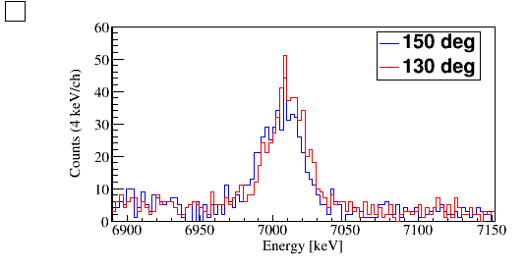
¹⁴C: 2⁺ state lifetime
7010 keV (literature)

Slide 16
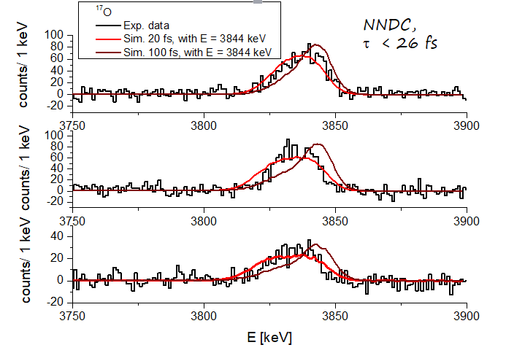
Short lifetimes sensitivity

Slide 17
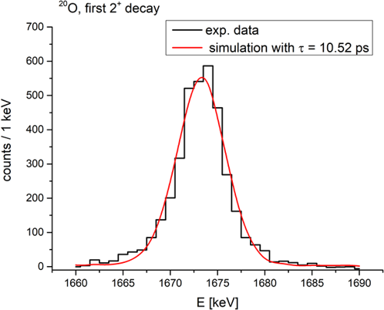
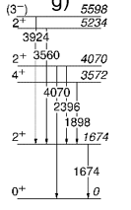
Long lifetimes sensitivity
²⁰O
1674

