Slide 1
Multi-nucleon transfer reactions for studies of heavy neutron-rich nuclei
Julia Even
University of Groningen
Starting grant 2018

Slide 2
Outline
Motivation
Status of the field
What comes NEXT

Slide 3
The nuclear chart

Slide 4
Why now?
Observation of the smoking gun of the rapid neutron capture (r)-process, the exact path and the upper end of the r-process remains unknown
Currently, no facility provides access to the neutron-rich heavy isotopes
Rapid neutron
capture process
Need:
New path to the neutron-rich side – different reaction mechanism
Benchmark data: masses, half-lives and fission properties

Slide 5
The heaviest nuclei
120
Z
Og
Tn
Lv
Fl
Mc
114
Nh
Cn
Rg
Ds
Mt
108
Hs
Bh
Sg
Db
SF
Rf
184
α
100
β⁺ EC
N
152
162
172

Slide 6
What are the limitations

Slide 7

Two options
Radioactive ion beams
- required beam intensity: $\sim {10}^{8}$ ions/s
Multi-nucleon transfer
W.D. Loveland, The Synthesis of New Neutron-Rich Heavy Nuclei, Front. Phys. 7 (2019) 1–8. doi:10.3389/fphy.2019.00023.

Slide 8
Multi-nucleon transfer reactions
⁴⁸Ca,⁸⁴Kr,
Xe,⁵⁶Ni, ²³⁸U
+Actinides
¹³⁶Xe+²⁰⁸Pb
¹³⁶Xe+¹⁹⁸Pt

Slide 9
The heaviest nuclei
120
Z
Og
Tn
Lv
Fl
Mc
114
Nh
Cn
Rg
Ds
Mt
108
Hs
Bh
Sg
Db
SF
Rf
184
α
100
β⁺ EC
N
152
162
172

Slide 10
Symmetrizing vs. inverse quasi-fission
V.I. Zagrebaev, W. Greiner / Nuclear Physics A 944 (2015) 257–307

Slide 11
Cross section U+Cm
V.I. Zagrebaev, W. Greiner / Nuclear Physics A 944 (2015) 257–307

Slide 12
Multi-nucleon transfer reactions
⁴⁸Ca,⁸⁴Kr, Xe,⁵⁶Ni
+Actinides
10⁻¹
¹³⁶Xe+²⁰⁸Pb
¹³⁶Xe+¹⁹⁸Pt
²⁵⁹Md
²⁴⁵Cm+⁴⁸Ca
²⁴⁶Cm+⁴⁸Ca
²⁴⁸Cm+⁴⁸Ca
10⁻²
¹³⁶Xe+²⁰⁸Pb
²⁰⁷Tl
Cross section (μb)
²⁶⁰Md
²⁰⁶Hg
10⁻³
²⁶¹Md
²⁰⁵Au
²⁶³Md
²⁶²Md
²⁰⁴Pt
10⁻⁴
²⁰³Ir
198
200
202
204
206
E_{CM} (MeV)
V. Zagrebarev, W. Greiner
J. Phys. G: Nucl. Part. Phys. 35
(2008) 125103
²⁰²Os
M.H. Mun et al.
Eur. Phys. J. A 52 (2016) 363

Slide 13
MNT – existing approaches
ISOL type approach (KISS)
Gas-catcher approach (N=126 factory)
Radiochemical separations
Electromagnetic separators (e.g. PRISMA, VAMOS, SHIP)

Slide 14
Radiochemical studies
⁴⁸Ca+²⁴⁸Cm
Fm: B2
Es, Bk, Cf: B3
M. Götz et al., Nucl. Phys. A. 961 (2017) 1–21.

Slide 15
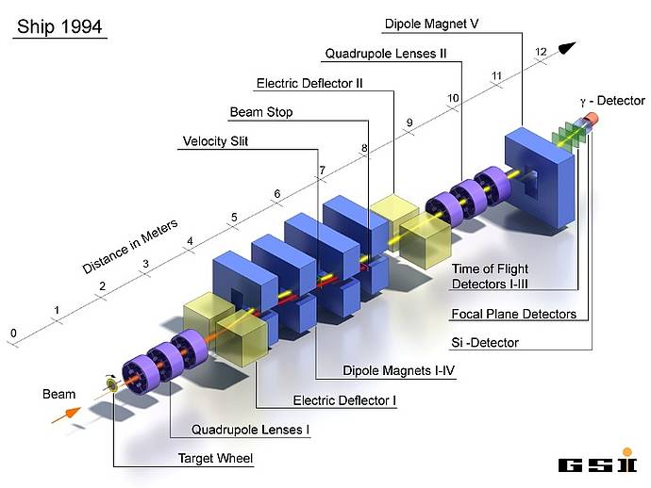
Studies at SHIP
⁴⁸Ca+²⁴⁸Cm

Slide 16

⁴⁸Ca+²⁴⁸Cm @ SHIP
Cross sections: $\sim μb$
H.M. Devaraja et al., Eur. Phys. J. A. 55 (2019).

Slide 17
The challenges
Wide angular distribution
Half-lives
Isotope separation and identification
Need:
Spectrometer with a large angular acceptance, and good back-ground separation independent from the chemical and atomic properties

Slide 18
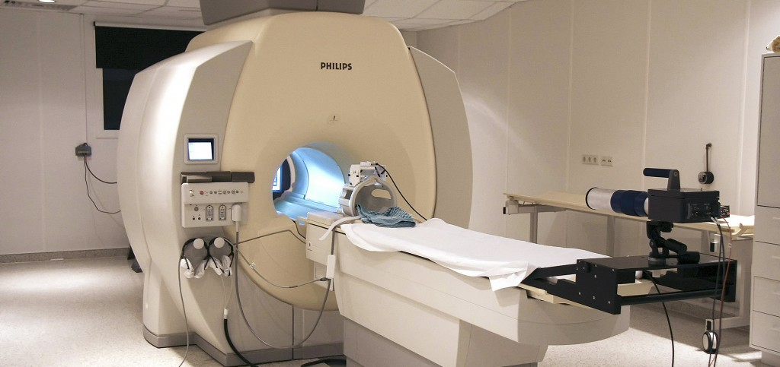
Dedicated setup for MNT reactions
J. Dvorak et al. NIM A 652, 687-691 (2011)

Slide 19
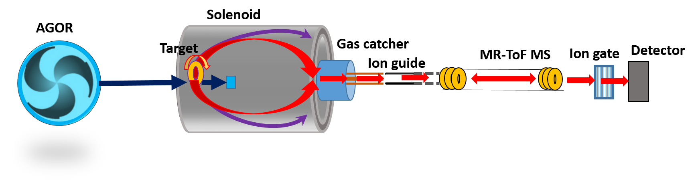
NEXT
Neutron-rich EXotic nuclei produced in multi-nucleon Transfer reactions
Starting grant 2018
Start of the project: September 2019

Slide 20
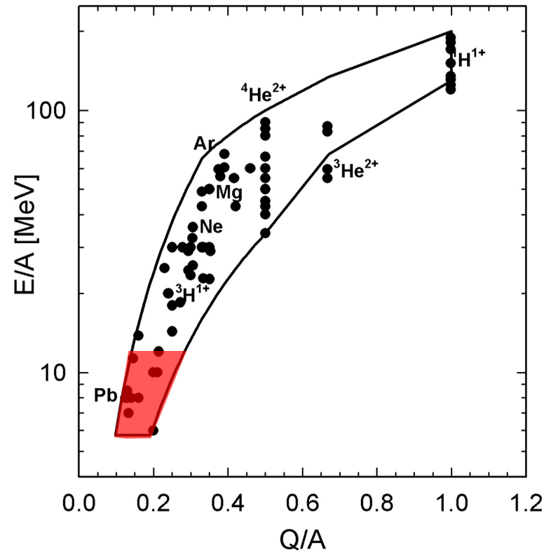
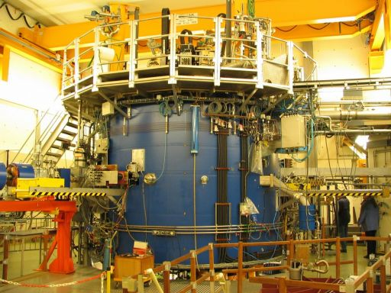
The AGOR facility

Slide 21
Separation & focusing in a solenoid magnet
⁴⁸Ca+²⁴⁸Cm
E_{lab} = 240 MeV
²⁶¹Md
³⁵P
Bachelor thesis, Lisa van der Werff,
University of Groningen, 2018

Slide 22
Multi-reflection ToF mass spectrometer
Mass resolving power: 10⁴ – 10⁶
Measurement cycle: ≈30 ms
Collaboration with L. Schweighard, University of Greifswald,
R.N. Wolf et al.; Int. J. Mass Spec. 349– 350 (2013) 123– 133
F. Wienholtz et al.; Nature 498 (2013) 346-349

Slide 23
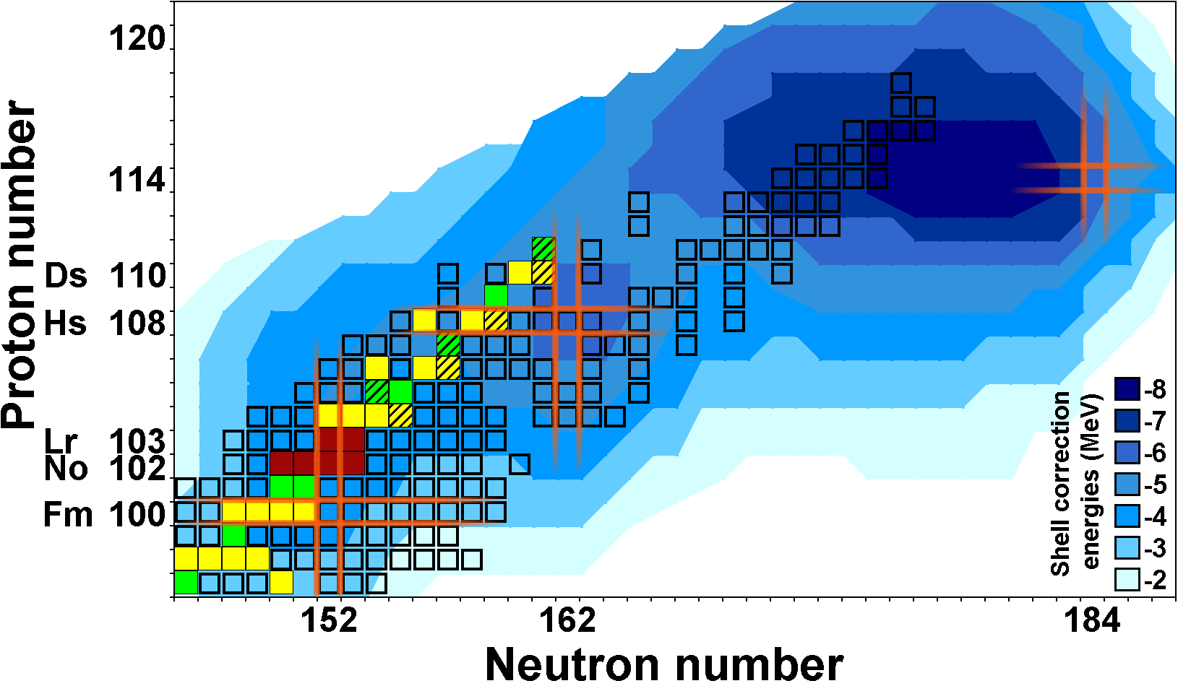
Nuclear masses
M. Block et al., Nature 463, 785 (2010),
E. Minaya Ramirez et al., Science 337, 1183 (2012)
Y. Ito et al., Phys. Rev. Lett. 120, 152501 (2018)

Slide 24
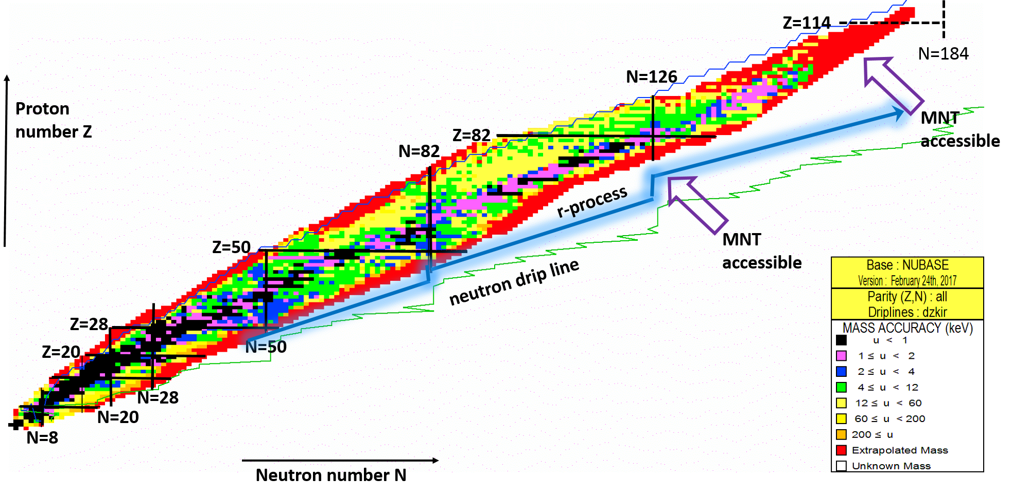
Nuclear masses
*
*Chin. Phys. C 41, (2017) 030002

Slide 25
Fulfilling the needs
Reaction path to the neutron-rich side
The NEXT setup: Unique access to neutron-rich nuclei
Multi-nucleon transfer reaction studies: Discovery of new isotopes along the closed neutron subshell N=162
Benchmark data for nuclear(astro)physics
Mass measurements along the N=126 shell: the 3rd waiting point of the astrophysical r-process
Mass measurements in the neutron-rich transfermium region: Access to isotopes from the closed neutron subshells N=152 to N=162
Fission half-lives of transfermium isotopes from N=152 to the N=162 and beyond: Information on the evolution of the fission barriers

Slide 26
Summary
Need: an alternative route to the north-east of the nuclear chart
Two options: RIB or MNT
Challenges of MNT: wide angular distribution, half-lives, isotope identification

Slide 27
What comes NEXT?
Unique access to neutron-rich, heavy isotopes and their properties

Slide 28

I am currently looking for….
Enthusiastic Postdoc & PhD student
Collaborators are welcome!
Contact:
j.even@rug.nl

Slide 29
Thank you for your attention!

