Slide 1

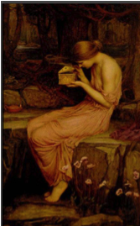
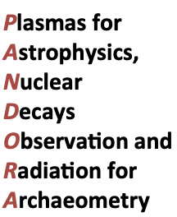
PANDORA: an experiment to measure nuclear beta decays of astrophysical interest in Magnetized Plasmas
INFN-LNL
INFN-Bo
INFN-Pg
Laboratori Nazionali del Sud
Catania
Domenico Santonocito, 26- june-2019, Orsay

Slide 2
PANDORA concept
Build a plasma trap where ion species are confined in magnetic field and a plasma is created with:
Electron dens: 10¹²-10¹⁴ cm⁻³
Electron Temperature: 0.01-100 keV
ion dens. 10¹¹ cm⁻³
Ion Temperature : ≈ 1 eV
Plasma is well characterized in terms of density, temperature and ion charge states using advanced diagnostics
Investigate possible modifications of β-decaying radio-isotopes lifetimes , a phenomenon predicted by models in strongly ionised atoms !
Variations in lifetimes would have important implications in S and R-processes branching points depend on the “competitive” rates of neutron capture vs. β-decay

Slide 3
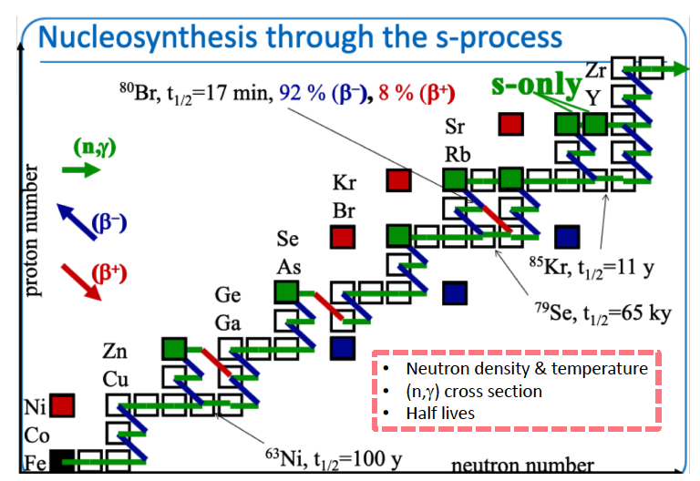
Courtesy of S. Palmerini and M. Busso

Slide 4
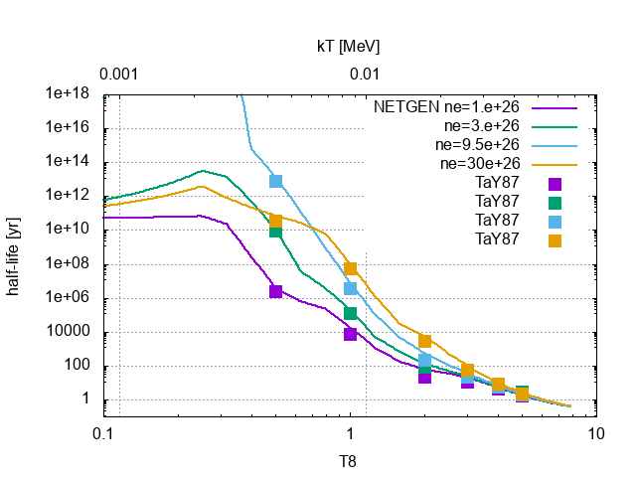
Lifetime variation vs T
Re187(𝛽⁻)
(10⁸ Kelvin)
Courtesy of A. Mengoni

Slide 5





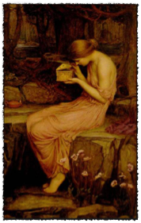
PANDORA
Ion Beams Production
Study of nuclear β-decay in plasma
A plasma-based facility for interdisciplinary research
In-plasma optical emission measurements of astrophysical interest

Slide 6
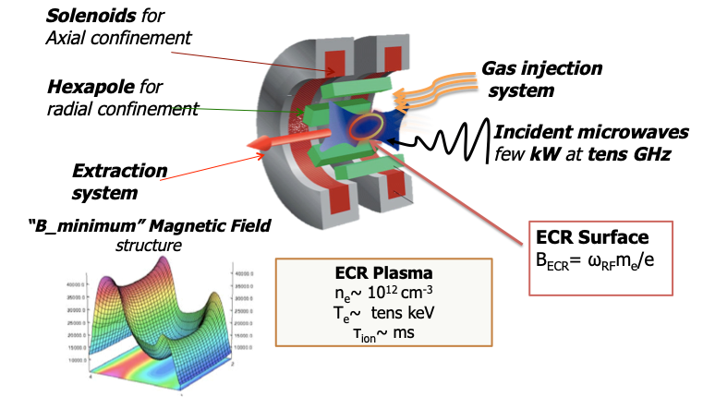
PANDORA TRAP DESIGN
The B-min configuration
suitable for multiply charged ions production
Trap Design
The biggest B-minimum Trap ever designed (and hopefully built!) ->This maximizes trapping efficiency
Requirements from physics cases impose operative ECR frequency @ 18 GHz ->This fixes max-B up to 2.4 Tesla
Fix a Maximum B-field (the maximum charge state depends on it)
Coils in SC magnets – exapole in Cu!
Accesses for plasma diagnostics!!
Accesses for decay-product detection!!
el. dens. 10¹²-10¹⁴ cm⁻³
el. temperature 0.01-100 keV

Slide 7
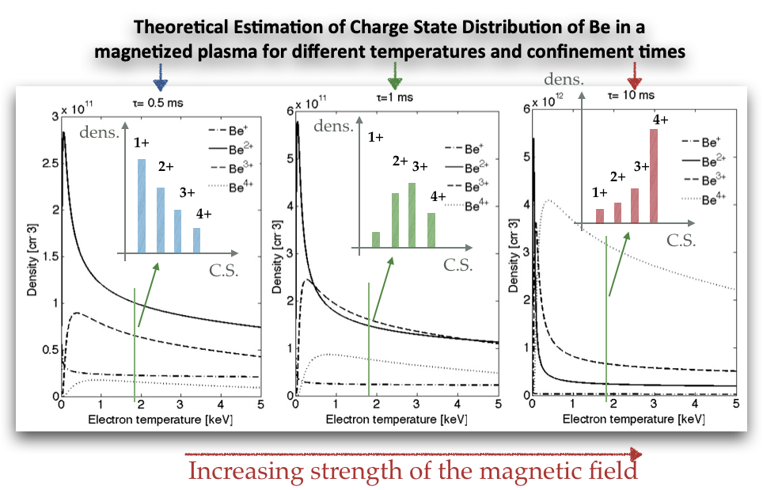
Charge State distribution of the ions in the plasma
It can be modulated by changing the density, the temperature and the “confinement strength” provided by the magnetic field (e thus fixing the ions lifetime)

Slide 8
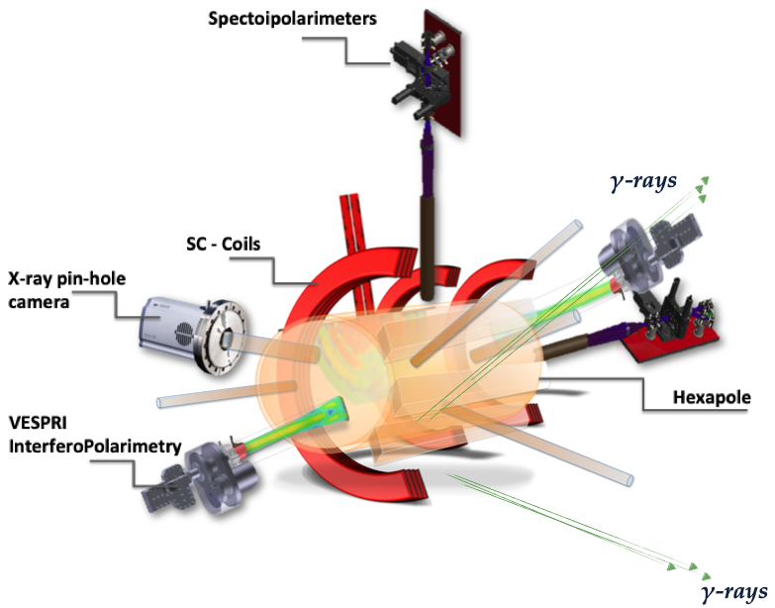
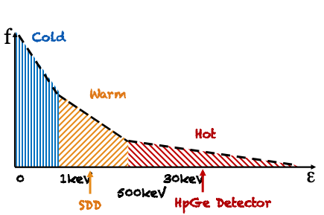
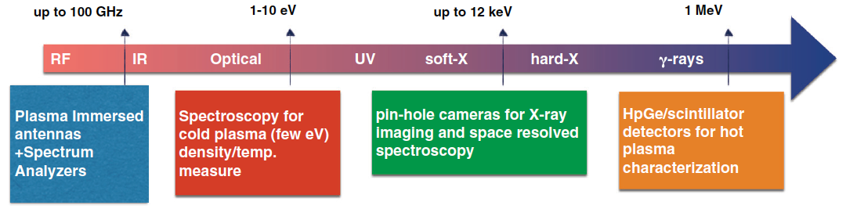
PANDORA Conceptual Design

Slide 9
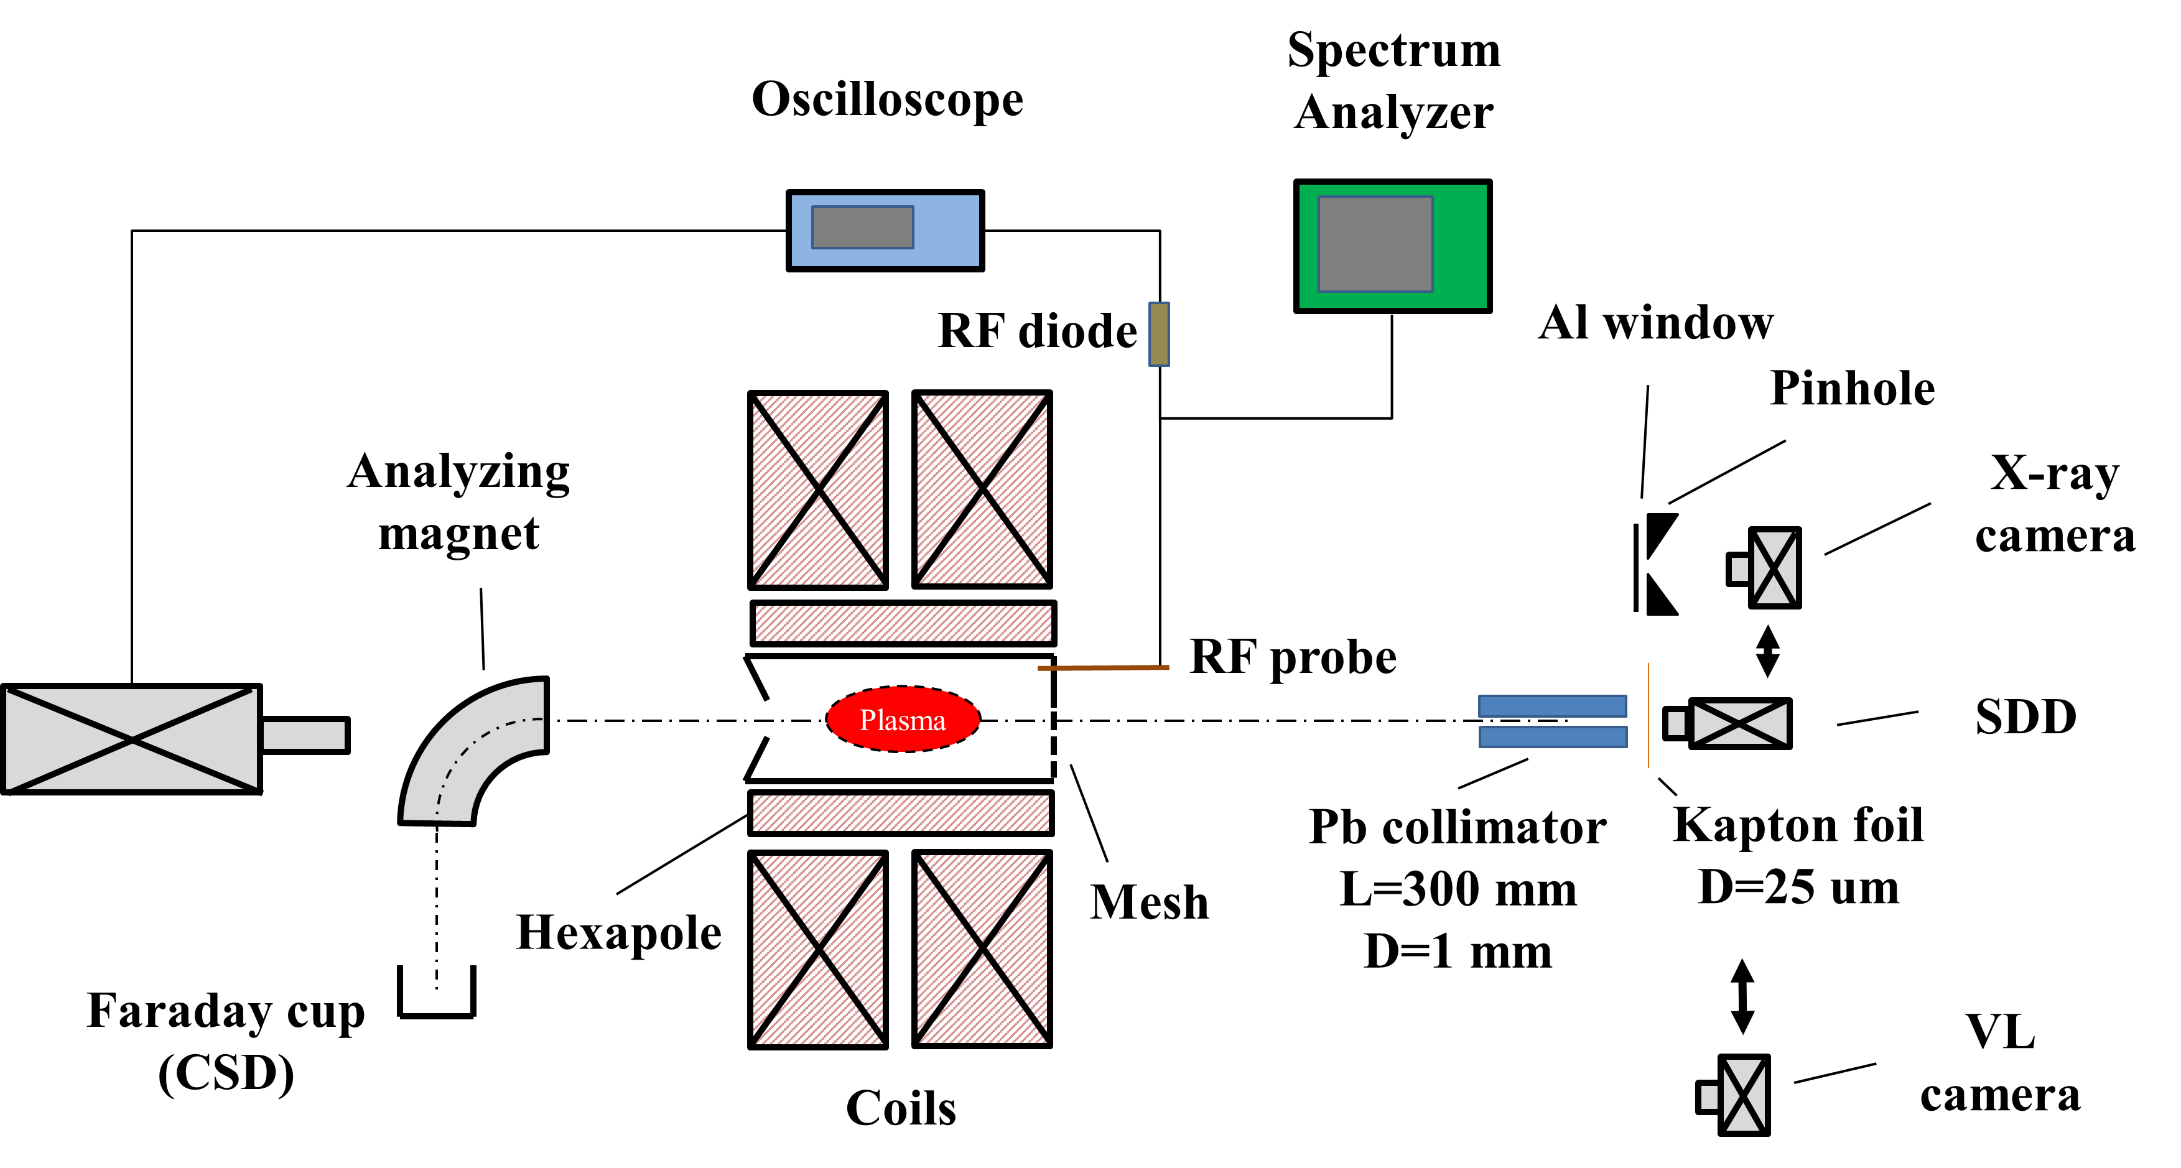
Multi-diagnostics Setup
Mass spectrometry: evaluation of CSD
SDD: probing volumetric soft X-radiation in the 2 – 20 keV domain
HPGe: providing time integrated X-ray spectra in the 30 - 300 keV domain
VL camera: probing volumetric optical radiation in the 1 – 12 eV domain
Pinhole camera: providing plasma structural in the range 2 - 20 keV
RF probe + Spectrum analyzer: plasma radio-emission analysis
  Time resolved spectra with 6 ms resolution if triggered by RF probe (useful for instabilities)
trigger signal
HpGe detector

Slide 10
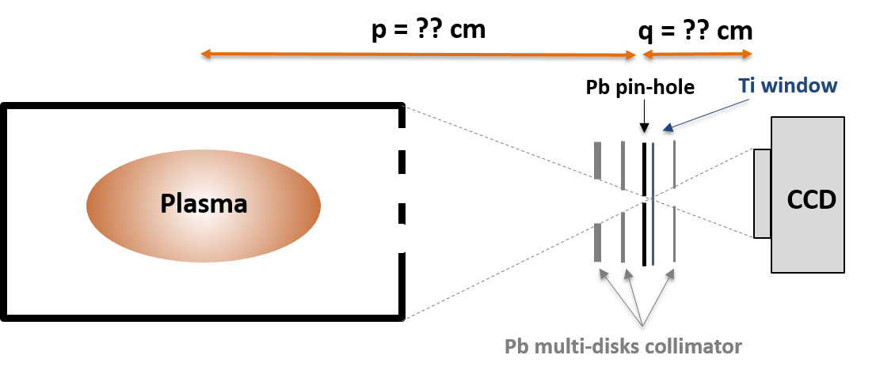
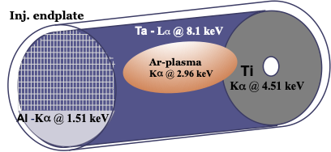
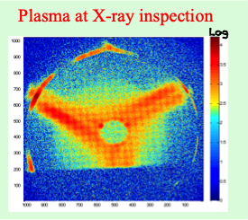
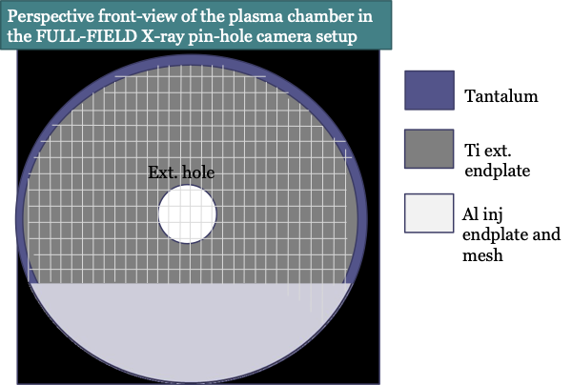
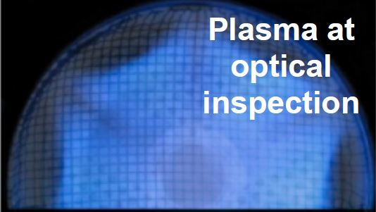
Space resolved X-ray analysis
Q.E. ~ 2 ÷ 15 keV
Sensor Size: 26.6 mm x 26.6 mm
(1024 x 1024 Pixels)
Max Energy Resolution ~ 150 eV
Lead Pin-hole (diameters 400 μm)

Slide 11
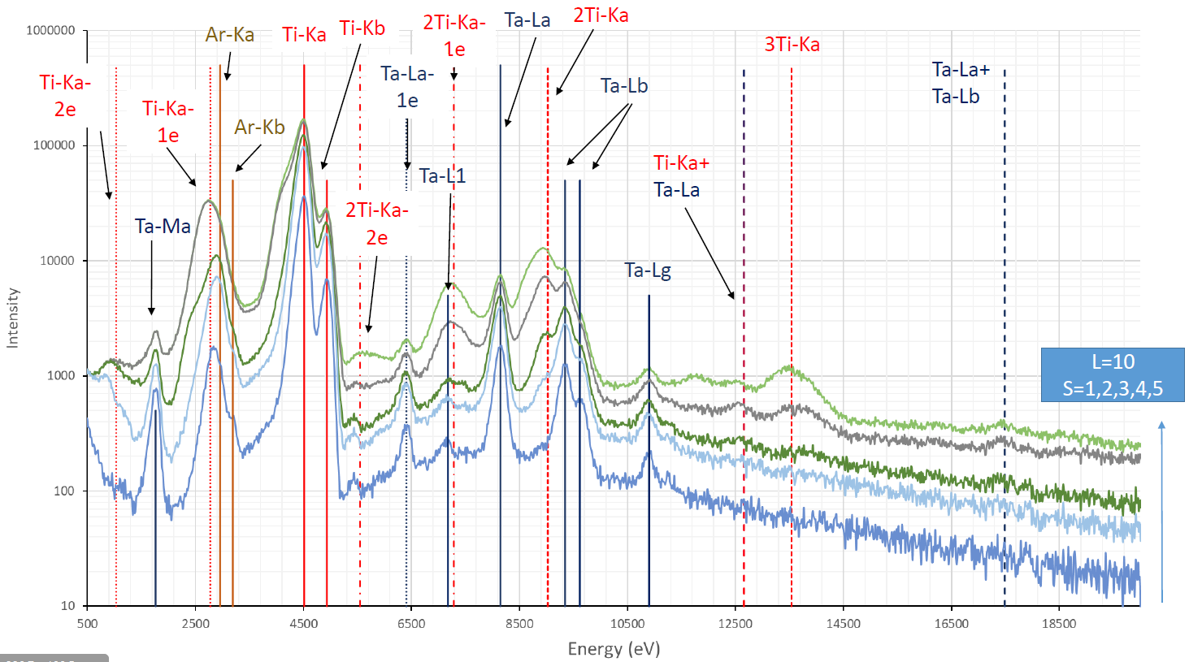
Space resolved X-ray analysis
Escape Peak
Dimer Peak
Ar
Ti
Ta
Energy Resolution ~ 230 eV at 8.1 keV (Ta-Lα fluorescence line)

Slide 12
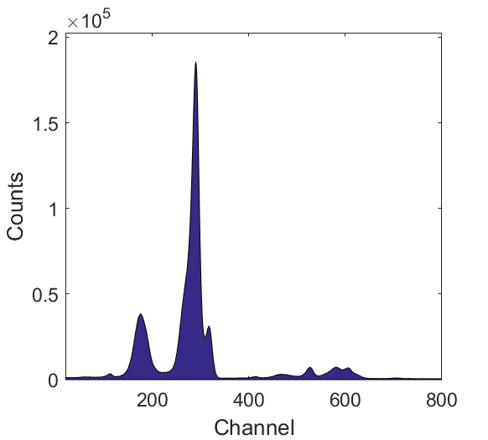

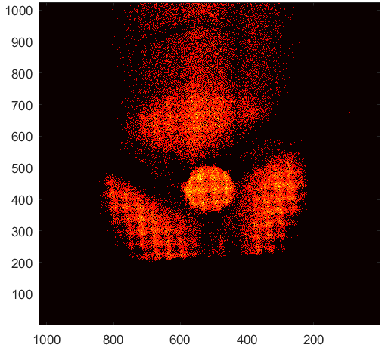
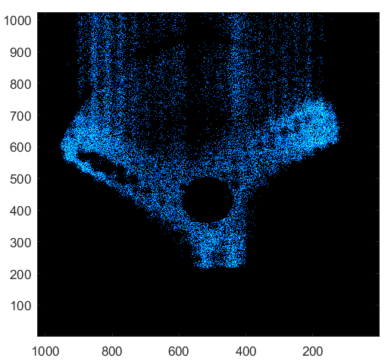

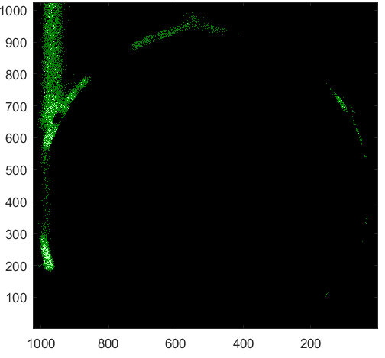

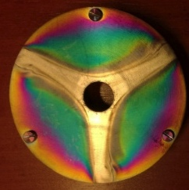
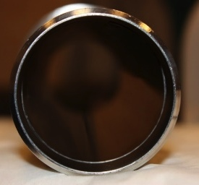
Plasma structure inspection
Ti
L=10
S=5
Info on:
Plasma density
Intensity of losses in
plasma
Ar
Ta
Argon
Titanium
Tantalum
Titanium
Tantalum

Slide 13
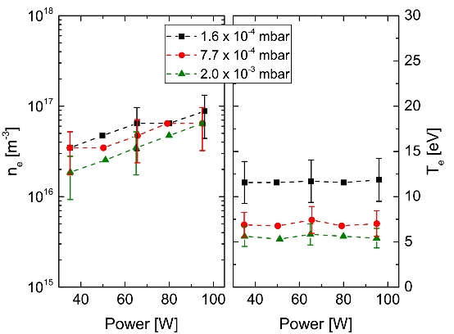
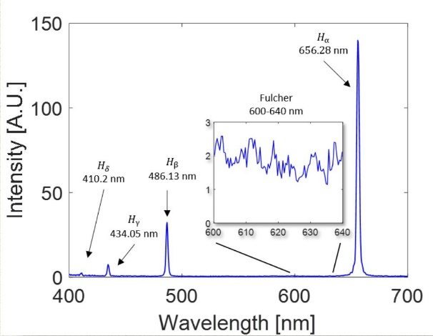
Optical emission spectroscopy at INFN-LNS
2017
Δλ = 1nm
R = 500
H
CR model
2018
Δλ = 0.04nm
R=12500nm
H, Ar
CR model
2016
Δλ = 2nm
R = 250
H, Ar
CR model
2018
Δλ = 0.17nm
R=3000
H, Ar
CR model
2019
YACORA
Collisional Radiative (CR) model is used to evaluate density and temperature from line ratios
We started to measure in H2 plasmas
In collaboration with Max Plank Institute Institute of Plasma Physics (Germany)
H spectrum

Slide 14



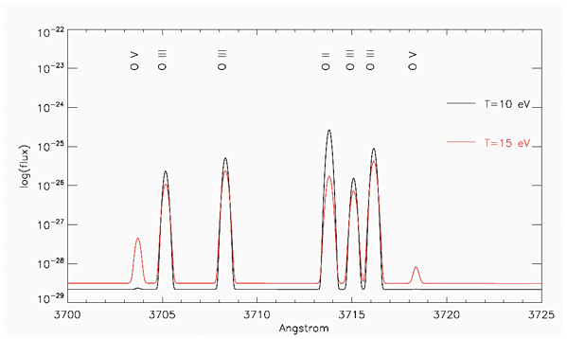
Optical emission spectroscopy at INFN-LNS
2017
Δλ = 1nm
R = 500
H
CR model
2018
Δλ = 0.04nm
R=12500nm
H, Ar
CR model
2016
Δλ = 2nm
R = 250
H, Ar
CR model
2018
Δλ = 0.17nm
R=3000
H, Ar
CR model
2019
Δλ = 0.003nm
R=164000
any
At higher and higher resolutions, it is possibile to see the shift of emission lines due to multi-ionization
CHIANTI
Astrophysical database to ECR plasmas
In collaboration with
University of Michigan
and Cambridge University
The powerful spectropolarimeter SARG (Spettrografo Alta Risoluzione Galileo, moved from TNG – Canary Islands to INFN-LNS), operating at R=164000, will allow in-plasma on-line charge state distribution discrimination.

Slide 15
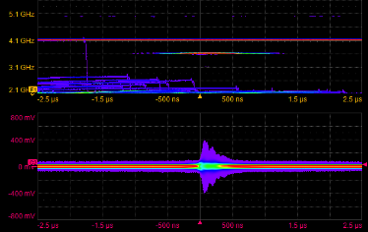
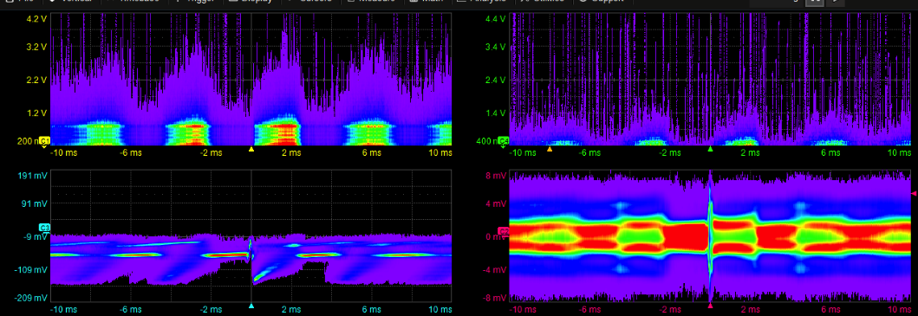
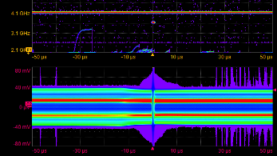
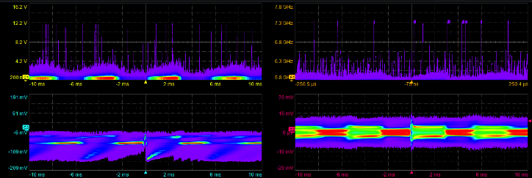
TIME-Resolved RF + Soft/Hard X ray Spectroscopy
When modifying the axial magnetic field profile, the X-ray emission “jumps” and becomes pulsed instead of CW
Axial and radial X-ray measurements → X-ray burst
Spectrogram → microwave plasma-self emission
RF burst → trigger signal
Axial X-ray
Radial X-ray
RF emission
Plasma-self emission:
Sub-harmonics
Main RF frequency
of plasma heating
X-ray burst RF burst: trigger signal
Axial X-ray
Radial X-ray
RF emission

Slide 16
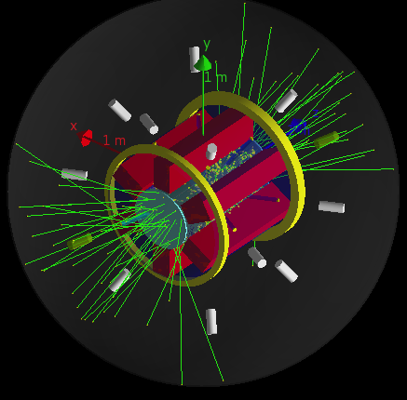
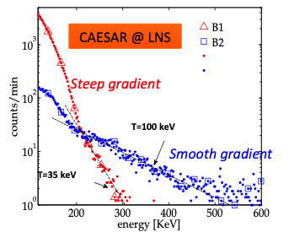
Measurement of β-decays in a plasma trap
A “buffer plasma” is created by He, O or Ar up to densities of 10¹³ cm⁻³
The isotope is then directly fluxed (if gaseuous) or vaporized inside the chamber
Relative abundances of buffer vs. isotope densities range from 100:1 (if the isotope is in metal state) to 3:1 (in case of gaseous elements
The decay-products can be tagged by the emitted γ-rays using an array of GE detectors or scintillators (ex. LaBr3)
Plasma self-emission must be taken into account
  For PANDORA’s trap, expected up to 1 MeV (<1 counts/sec)
Simulations of efficiencies, signal/noise ratio

Slide 17
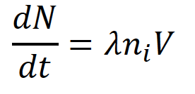
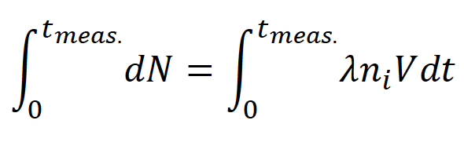
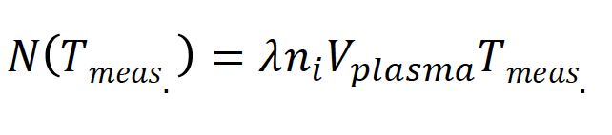
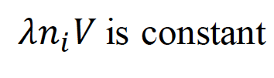
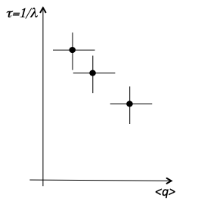
Measurement of β-decays in a plasma trap
Number of decays
As a consequence of dynamical equilibrium
Total decays depend linearly on meas. Time !!
Plasma volume (const.)
Isotope activity
Density of the isotope in the plasma (const.)
Monitoring of plasma density, temperature and CSD becomes crucial!!

Slide 18
Scientific cases under investigations
Measurement of half-lives of radioactive nuclei sited at possible branching ratios along the n-capture path
Feasibility -> tagging using gamma-ray emission
-> lifetime in a measurable range
-> easy access to the samples
t_{1/2} (yr) E_{γ}(KeV)
¹³⁴Cs 2.06 > 600
⁹⁴Nb 2.03x10⁴ > 700
⁸¹Kr 2.29x10⁵ 276
¹⁷⁶Lu 3.78x10¹⁰ 88-400
In-plasma isotope concentration = 10¹¹ cm⁻³
Plasma volume=1000 cm³
Assuming dynamical equilibrium, the total number of γ emitted over the entire solid angle can be estimated
Geant-4 simulations have been carried our right for determining geometrical and photo-peak efficiency, including branching of γ-lines for each of the selected physics cases
¹³⁴Cs
⁹⁴Nb
¹⁸⁷Re ¹⁷⁶Lu

Slide 19
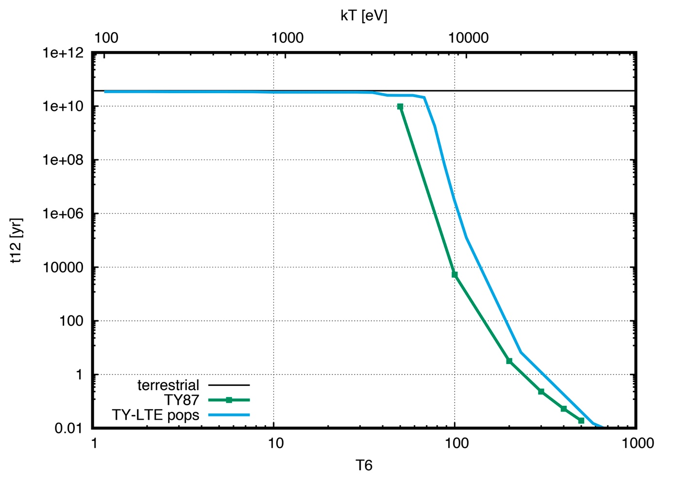
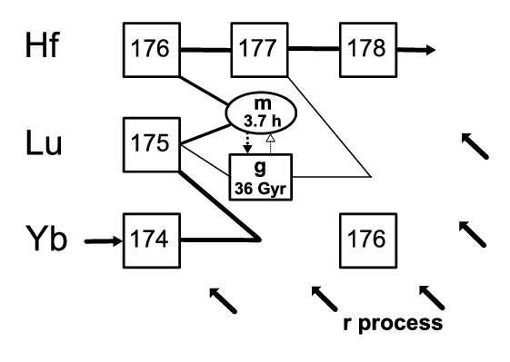
¹⁷⁶Lu - cosmochronometer
¹⁷⁶Lu T_{1/2} = 3.78 x 10¹⁰ yr
Lifetime variation vs Temperature
N_{e} =10²⁶
N_{e} = 10¹⁸
Calculation by A. Mengoni

Slide 20
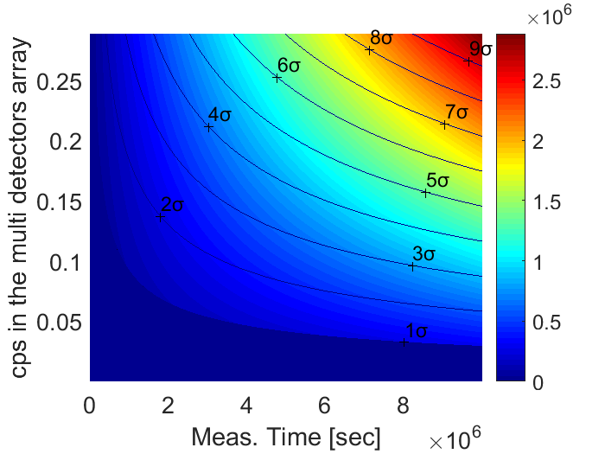
¹⁷⁶Lu - cosmochronometer
¹⁷⁶Lu T_{1/2}= 3.78 x 10¹⁰
1.6 10⁵
100
2.0 10⁵
80
2.6 10⁵
60
Lifetime [years]
Effective activity in plasma (cps)
4.0 10⁵
40
8 10⁵
20
2 10⁶
10
10⁷
1
10 20 40 60 80 days

Slide 21
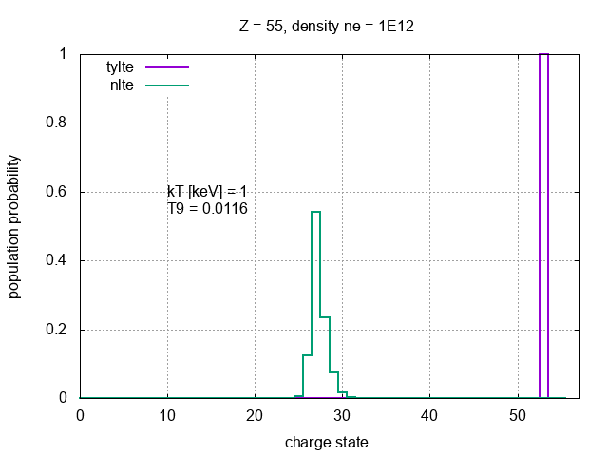
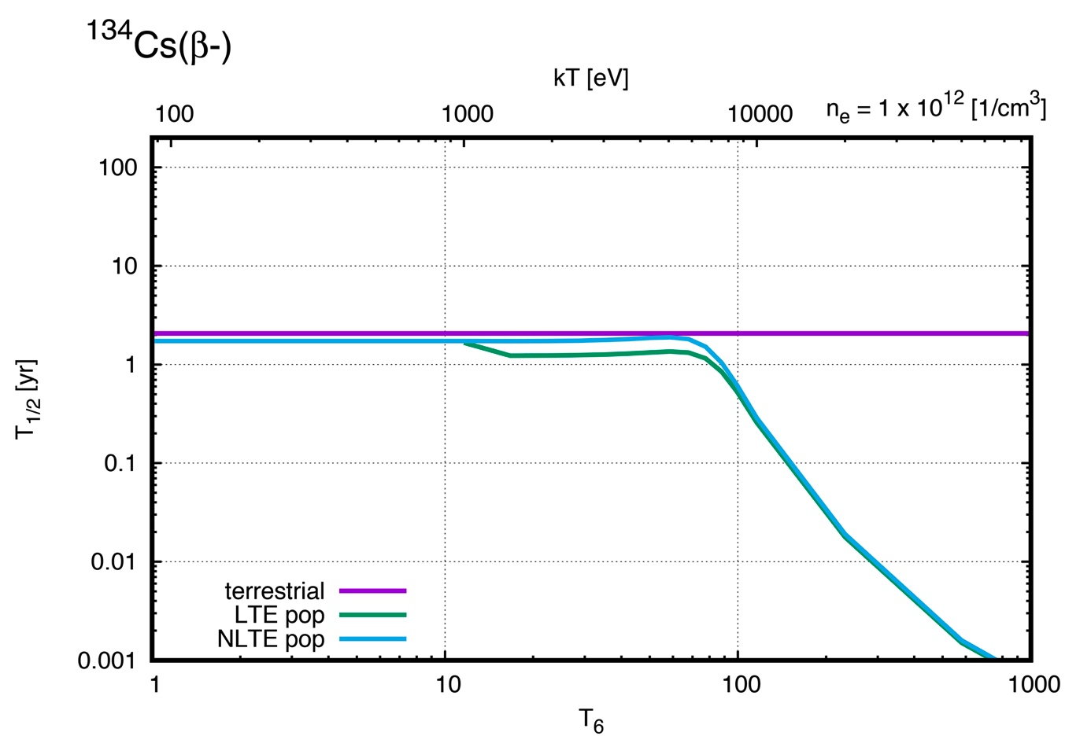
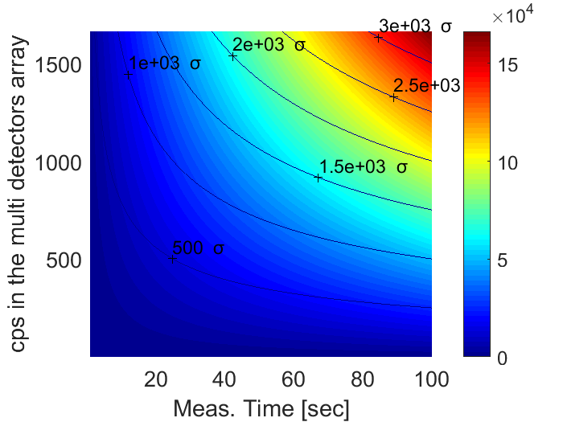
¹³⁴Cs nucleus
¹³⁴Cs (β-) → ¹³⁴Ba
T_{1/2} = 2.06 yr
Lifetime variation vs Temperature
Calculation by A. Mengoni

Slide 22
Cost estimations of the PANDORA setup
Item | Cost [k€] | Description
Coil 1 | 150 | SC technology
Coil 2 | 150 | SC technology
Coil 3 | 150 | SC technology
Lhe Cryostats (3) | 60 | SC coils cooling
Iron | 50 | monocoil hexapole technology
Hexapole in Copper | 250 | monocoil hexapole technology
SUBTOTAL | 810
Germanium Detectors | 1120 | 14 HpGe detectors including cooling and electronics
SUBTOTAL | 1120
Vaporization system | 30 | high-temp. Oven
Sputtering system | 15 | movable sputtering system
Isotopes procurement | 100 | Rare isotopes purchase
SUBTOTAL | 145
Pumping | 50 | vacuum system
Controls | 50 | remote control of the Trap
Ancillaries&Cons. | 50 | microwave connections, mechanics etc.
SUBTOTAL | 150
Plasma Diagnostics Upgrade | 100 | Construction
SUBTOTAL | 100
TOTAL | 2325
Total: 2.3 - 2.5 MEuro

Slide 23
Conclusions
New approach to Astrophysics and Nuclear Astrophysics using a plasma trap to investigate possible modifications of β-decaying radio-isotopes lifetimes
Developed complex diagnostic systems to extract plasma parameters (density, Temperature, charge states)
Experimental setup based on Ge detectors to tag the gamma decay following beta emission
Selected few physics case as test case to investigate the quality of this new approach.

Slide 25

Injection of rare isotopes in the magnetoplasma
Short lifetime
(e.g. ⁷Be, ¹³N, ¹⁵O)
Long lifetime
(e.g. ¹⁷⁶Lu, ⁸¹Kr)
Charge Breeding
(in-flight-in-plasma capture)
Classical evaporation systems
(resistive/inductive ovens)
This is more feasible as a first step!!

Slide 26
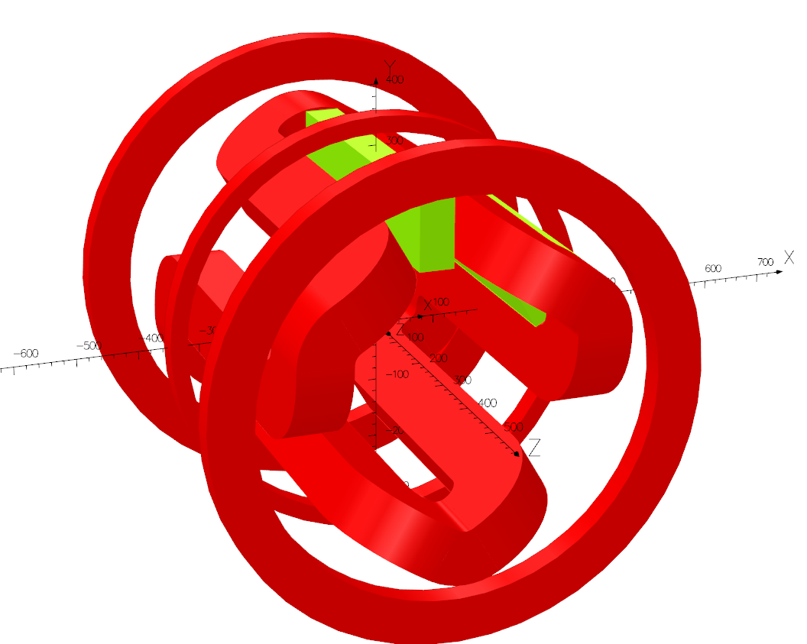
PANDORA TRAP DESIGN
The biggest B-minimum Trap never designed (and hopefully built!);
  This maximizes trapping efficiency
Requirements from physics cases impose operative ECR frequency @ 18 GHz
  This fixes max-B up to 2.4 Tesla
To maximize space availability for diagnostics and γ-detection, we opted for HYBRID solution
  → Coils NbTi, mono-coil-hexapole in Copper… BUT… we need feedbacks from manufacturers
80 cm
plasma
35 cm

